Slide 1


Time Series Analysis I: Models & Forecasting
Prepared by Dr. Sumaya Alkubaisi
FNT633
Machine Learning in Finance
Lecture 9

Slide 2

Chapter
Learning Goals
9
By the end of this lecture, you will be able to:
Understand time series components
Learn AR, MA, ARMA, ARIMA, SARIMA models
Apply preprocessing techniques
Use forecasting metrics (MAE, RMSE, MAPE)
Analyze a synthetic stock price example
www.midocean.ae

Slide 3
Chapter
Time Series
9
A time series is a sequence of data points (observations) collected and recorded (measured ) over time in order.
Financial Examples:
S&P 500 daily returns: Measures how the stock market index changes each day.
EUR/USD exchange rate: Shows how the value of the euro changes against the dollar over time.
Bitcoin price: Tracks Bitcoin’s price movements daily or hourly.
Monthly CPI: Measures inflation by tracking changes in consumer prices every month.
Quarterly GDP: Shows the economic growth of a country every three months.
www.midocean.ae

Slide 4
Chapter
Components of a Time Series
9
Trend: The long-term direction of the data (upward, downward, or flat).
Example
A company’s revenue increases gradually every year; long-term upward trend.
Seasonality: Patterns that repeat at regular intervals (daily, monthly, yearly).
Example
Ice-cream sales go up every summer and drop every winter; repeating seasonal pattern.
Cyclic: Longer, irregular cycles caused by economic or market conditions.
Example
Housing prices rise and fall over several years due to economic cycles; irregular ups/downs.
Noise: Random fluctuations that cannot be explained by any pattern.
Example
Sudden spikes in stock prices caused by unexpected news; random movements with no pattern.
www.midocean.ae

Slide 5
Chapter
Stationarity (Concept)
9
A time series is stationary when its statistical properties do not change over time.
This means:
The mean stays constant
The variance stays constant
No long-term trend
No seasonal patterns
Stationary data is easier to model and is required for many forecasting methods.
Stationarity importance:
Models like AR, MA, ARMA, and ARIMA work only when the data is stationary.
When the series is stationary, the model’s patterns stay stable, which makes forecasting more accurate and reliable.
www.midocean.ae

Slide 6
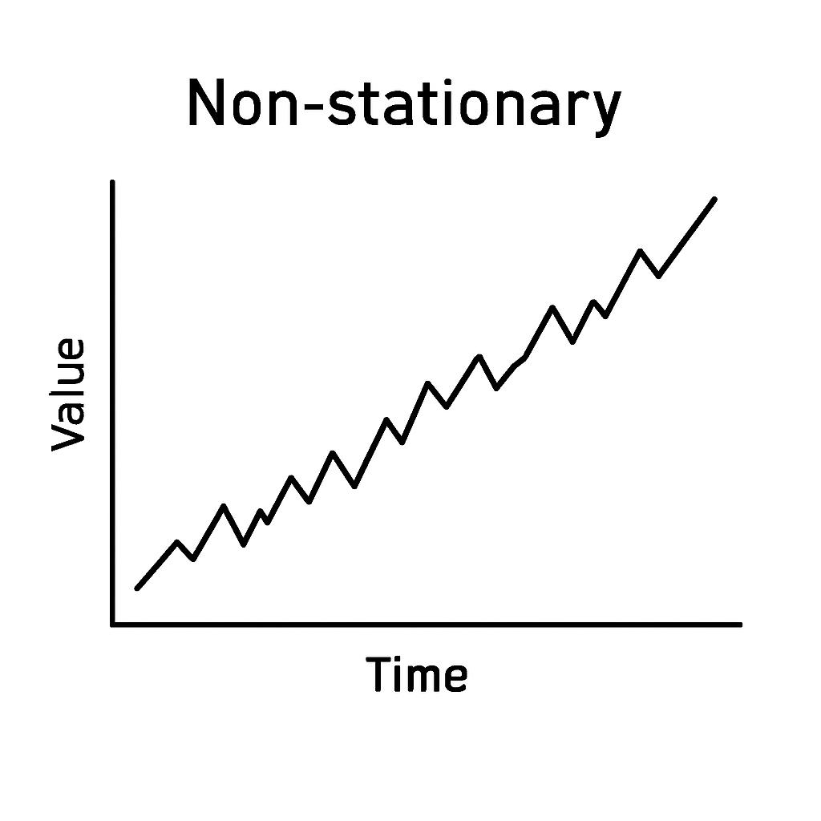
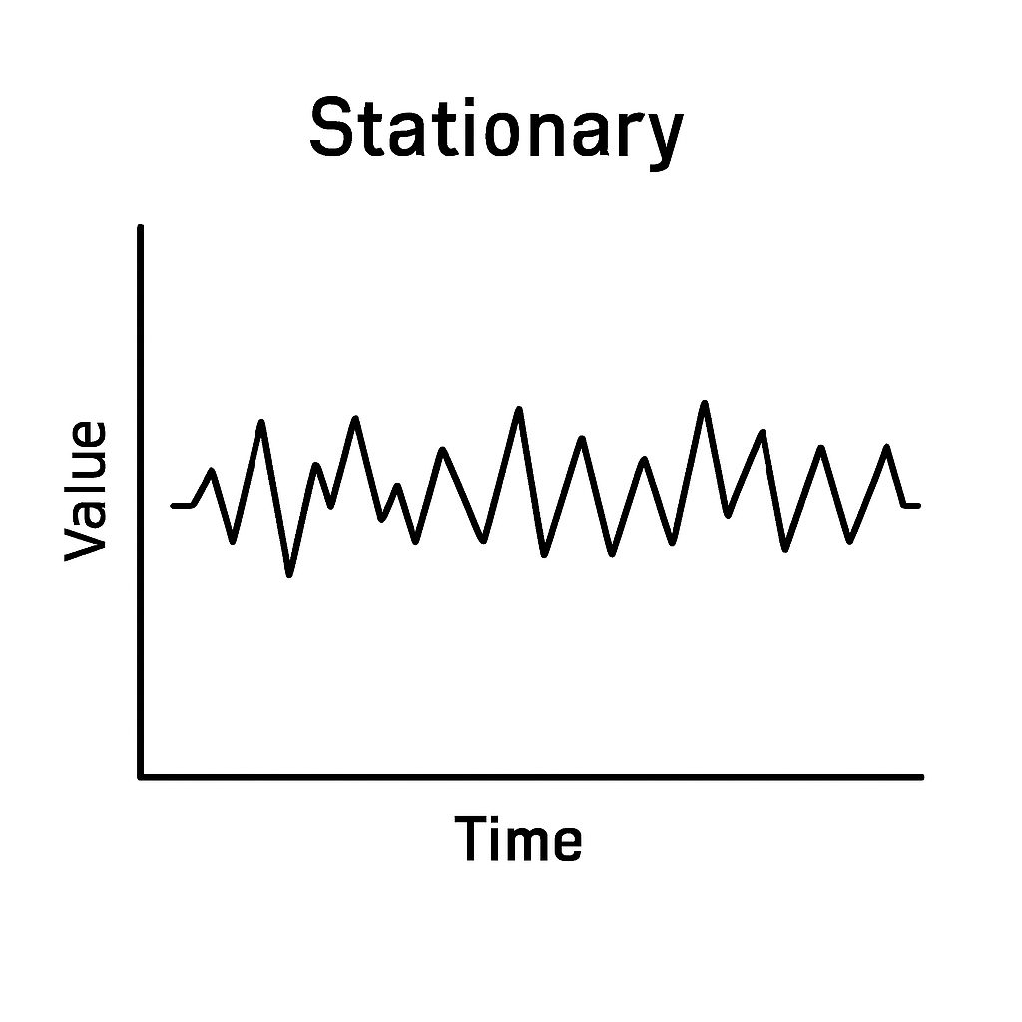
Chapter
Visual Intuition
9
Non-stationary: The line keeps going up or down over time: has a trend.
Stationary: The line moves up and down around a flat average: no trend, stable behavior.
www.midocean.ae

Slide 7
Chapter
Forecasting Foundations
9
Forecasting means using past/historical data to predict what will happen in the future.
Example: using last year's stock prices to predict tomorrow’s price.
One-Step & Multi-Step Forecasting
One-step ahead:
You predict only the next point (t+1).
Most accurate because it's close to the known data.
Multi-step ahead:
You predict several future points (t+1, t+2, … t+n).
The further you try to predict, the more uncertainty and error you get.
www.midocean.ae

Slide 8
Chapter
Rolling & Expanding Window
9
Rolling window:
We use a fixed-size window of recent data (e.g., last 30 days).
As time moves forward, the window slides forward.
Always same size.
Expanding window:
We start with a small window, and it keeps growing as more data arrives.
Uses all past data up to the current point.
www.midocean.ae

Slide 9
Chapter
Forecasting Workflow in Finance
9
Collect data
Get historical financial data (prices, returns, rates).
Clean & preprocess
Handle missing values, remove outliers, format correctly.
Test stationarity
Check if the series is stable (ADF test, visualization).
Fit model
Apply models like AR, MA, ARIMA, SARIMA.
Forecast
Predict future values (one-step or multi-step).
Evaluate errors
Compare predictions to actual values using metrics (MSE, RMSE, MAE).
www.midocean.ae

Slide 10
Chapter
Preprocessing Time Series
9
Handling Missing Values:
Fill gaps using previous values (forward fill),
interpolate between points,
or remove them if there are very few.
Interpolation in time series means estimating missing values by looking at surrounding data points.
  Linear interpolation: Connects the points with a straight line and fills missing values along it.
  Other types: Can use polynomial, spline, or more advanced methods depending on the pattern.
www.midocean.ae

Slide 11
Chapter
Preprocessing Time Series
9
Smoothing & Moving Averages:
  Reduce short-term fluctuations in the data to make trends easier to see
  Use simple or exponential moving averages to reduce noise and highlight trends.
Differencing: Subtract previous value from current (Δy = y(t) – y(t–1)) to remove trends and stabilize the series.
Scaling & Normalization: Apply z-score or min–max scaling to adjust value ranges, which some models require.
ADF Test: Checks stationarity. If p-value < 0.05, the series is stationary; if > 0.05, it’s non-stationary.
www.midocean.ae

Slide 12
Classical Time Series Models - Autoregressive (AR) Model
Chapter
9
Predicts future value using past values.
Formula: y(t) = c + φ₁y(t–1) + ... + φpy(t–p) + ε(t)
p = number of past observations considered.
So AR compute Next value = starting point + effect of past values + tiny unpredictable changes
Example: AR(2) uses the previous two values, y(t–1) and y(t–2), to predict y(t).
Visual Understanding/Intuition: Past values (Lagged) strongly influence the next value.
www.midocean.ae

Slide 13
Classical Time Series Models - Moving Average (MA) Model
Chapter
9
Predicts the next value based on past errors (residuals), not the values themselves.
Formula: y(t) = μ + θ₁ε(t–1) + ... + θqε(t–q)
q = number of past error terms used.
So MA prediction depends on the baseline level + the last two mistakes the model made.
Example: MA(2) uses the previous two error terms, ε(t–1) and ε(t–2), to predict y(t).
Visual Understanding/Intuition: Large errors today affect future predictions.
In conclusion: AR looks at past values, MA looks at past errors.
www.midocean.ae

Slide 14
Classical Time Series Models –
ARMA Model
Chapter
9
ARMA combines both AR and MA:
AR part: uses past values.
MA part: uses past errors.
It can model more complex patterns, but it requires the data to be stationary.
ARMA(p, q) Use Cases
ARMA(p, q) is commonly used for:
Financial returns
Volatility patterns
Short-term fluctuations in stationary time series
It works well when the series has no clear trend but has some autocorrelation structure.
Where: p = number of past values used (from the AR part) and q = number of past errors used (from the MA part)
www.midocean.ae

Slide 15
Chapter
Strengths & Limitations
9
Strengths
Simple to use: The formulas and concepts are straightforward.
Easy to interpret: You can clearly see how past values (AR) or past errors (MA) affect predictions.
Good for short-term forecasting: They work well when the data has short memory and stable patterns.
Limitations
Require stationarity: AR, MA, and ARMA only work well if the data has no trend and stable variance.
Not suitable for long-term trends: They cannot capture long-term growth or downward movement.
Limited complexity: They cannot model seasonal patterns or non-linear behavior unless extended.
www.midocean.ae

Slide 16
Advanced Time Series Models -
ARIMA Model
Chapter
9
ARIMA(p, d, q) combines three parts:
  p: number of AR terms (past values)
  d: number of differencing steps to make the data stationary
  q: number of MA terms (past errors)
It extends ARMA by adding differencing.
What “I” Means (Integrated)
  The “I” in ARIMA stands for Integrated, which simply means: you apply differencing to remove trends and make the series stationary.
www.midocean.ae

Slide 17
Advanced Time Series Models -
ARIMA Model
Chapter
9
ARIMA Workflow
Check stationarity of the series
Apply differencing until it becomes stationary (this gives you d)
Select p, d, q using tools like ACF/PACF
Fit the model to the data
Evaluate the forecast accuracy
www.midocean.ae

Slide 18
Advanced Time Series Models -
SARIMA (Seasonal ARIMA)
Chapter
9
SARIMA adds seasonal terms to ARIMA.
SARIMA(p, d, q)(P, D, Q)_s: adds AR, MA, and differencing for both regular patterns and repeating seasonal patterns.
SARIMA(p, d, q) (P, D, Q)ₛ has two parts:
1.The first part (p, d, q)
These are the normal ARIMA terms
www.midocean.ae

Slide 19
Advanced Time Series Models -
SARIMA (Seasonal ARIMA)
Chapter
9
SARIMA(p, d, q) (P, D, Q)ₛ has two parts:
2. The seasonal part (P, D, Q)
These do the same thing, but for seasonal patterns:
P: seasonal AR: uses past values from one season ago
(e.g., last year’s same month)
D: seasonal differencing: removes seasonal trends
(e.g., y(t) – y(t–12))
Q: seasonal MA: uses past seasonal errors
(e.g., error from one year ago)
s: the length of the season
12: monthly data with yearly seasonality
7: daily data with weekly seasonality
4: quarterly data
www.midocean.ae

Slide 20
Chapter
When to use ARIMA vs SARIMA
9
ARIMA
Use ARIMA when the data does NOT have seasonality (non-seasonal data).
It handles trends and short-term patterns, but not repeating cycles.
SARIMA
Use SARIMA when the data HAS clear seasonal patterns, like
  monthly patterns (s = 12)
  weekly patterns (s = 7)
  quarterly patterns (s = 4)
www.midocean.ae

Slide 21
Chapter
Evaluation Metrics
9
MAE – Mean Absolute Error
MAE measures the average size of the errors without considering direction.
It tells you, on average, how far your predictions are from the actual values.
RMSE – Root Mean Square Error
RMSE also measures error size, but it penalizes large errors more because it squares the errors first.
Useful when big mistakes are especially bad.
MAPE – Mean Absolute Percentage Error
MAPE measures the error as a percentage.
It is good for data where the scale matters, like stock prices or sales, because it shows how big the error is relative to the value.
www.midocean.ae

Slide 22
Chapter
Evaluation Metrics
9
Which Metric for Finance?
Stock prices: RMSE (big errors matter more)
Returns: MAE (simple, stable, no percentage issues)
Percentage-based forecasts: MAPE (shows error relative to value)
www.midocean.ae

Slide 23
Case Study: Synthetic Daily Stock Price Dataset
Chapter
9
Dataset Description
Synthetic daily stock prices for ~2 years (500 days)
Generated with a linear upward trend + added random noise
Creates realistic movement similar to real stocks:
gradual growth
small daily fluctuations
Time Series Forecasting using (ARIMA)
Predict future values of a time series by modeling trends and past patterns using ARIMA
www.midocean.ae

Slide 24
Case Study: Synthetic Daily Stock Price Dataset
Chapter
9
Libraries used:
pandas
numpy
matplotlib
seaborn
statsmodels: A Python library for statistical modeling, including time series analysis (ARIMA, SARIMA, ADF test, etc.). It allows fitting classical econometric models.
www.midocean.ae

Slide 25

Python Lab: Time Series Forecasting (ARIMA)
#Create a Synthetic Daily Stock Price Dataset
import numpy as np
import pandas as pd
import matplotlib.pyplot as plt
import seaborn as sns
np.random.seed(42)
# Generate 500 days of synthetic stock prices
days = 500
time_index = pd.date_range(start="2020-01-01", periods=days)
# Create trend + noise
trend = np.linspace(100, 150, days)
noise = np.random.normal(0, 2, days)
prices = trend + noise
df = pd.DataFrame({"Date": time_index, "Price": prices})
df.set_index("Date", inplace=True)
df.head()
www.midocean.ae

Slide 26
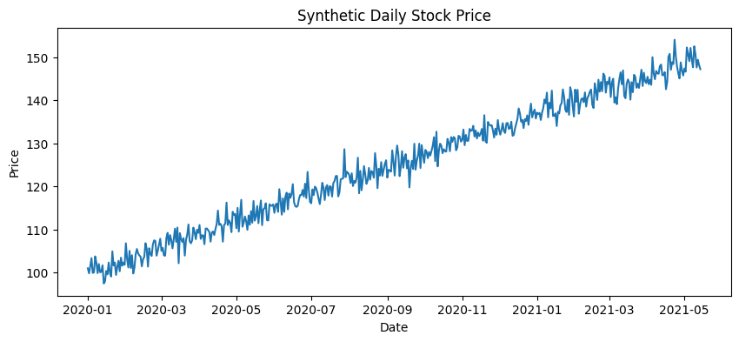
Python Lab: Time Series Forecasting (ARIMA)
#Plot the Time Series
plt.figure(figsize=(10,4))
plt.plot(df["Price"])
plt.title("Synthetic Daily Stock Price")
plt.xlabel("Date")
plt.ylabel("Price")
plt.show()
The series shows a clear upward trend
overtime, so its mean is not constant.
Because a stationary series must have
a constant mean, this strong trend indicates
that the data is non-stationary.
www.midocean.ae

Slide 27
Python Lab: Time Series Forecasting (ARIMA)
#ADF Test (Stationarity Check)
from statsmodels.tsa.stattools import adfuller
result = adfuller(df["Price"])
print("ADF Statistic:", result[0])
print("p-value:", result[1])
p-value = 0.903: much greater than 0.05. (expected because of trend)
The series is non-stationary. It has a trend or changing mean, so you would need to difference it before using ARIMA.
www.midocean.ae

Slide 28
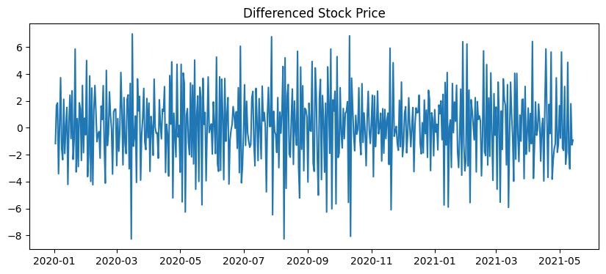
Python Lab: Time Series Forecasting (ARIMA)
#Differencing (to Make it Stationary)
df["Price_diff"] = df["Price"].diff()
plt.figure(figsize=(10,4))
plt.plot(df["Price_diff"])
plt.title("Differenced Stock Price")
plt.show()
After differencing the original series, the values fluctuate around a constant mean of zero with stable variance.
This transformation makes the series visually stationary and suitable for time series modeling.
www.midocean.ae

Slide 29
Python Lab: Time Series Forecasting (ARIMA)
#Fit ARIMA Model - We use ARIMA(1,1,1)
#Understand and fit ARIMA on full data (teaching purposes).
from statsmodels.tsa.arima.model import ARIMA
# Remove NaN after differencing
ts_data = df["Price"].dropna()
model = ARIMA(ts_data, order=(1,1,1))
model_fit = model.fit()
print(model_fit.summary())
In ARIMA(1,1,1):
p = 1: Uses 1 past value (AR term)
d = 1: 1 differencing step to make the series stationary
q = 1: Uses 1 past error (MA term)
www.midocean.ae

Slide 30
Python Lab: Time Series Forecasting (ARIMA)
#Forecast Next 30 Days
forecast_steps = 30
forecast = model_fit.forecast(steps=forecast_steps)
plt.figure(figsize=(10,4))
plt.plot(df["Price"], label="Historical")
# Generate forecast dates
forecast_dates = pd.date_range(start=df.index[-1] + pd.Timedelta(days=1), periods=forecast_steps)
plt.plot(forecast_dates, forecast, label="Forecast")
plt.title("ARIMA Forecast (30 Days)")
plt.xlabel("Date")
plt.ylabel("Price")
plt.legend()
plt.show()
www.midocean.ae

Slide 31
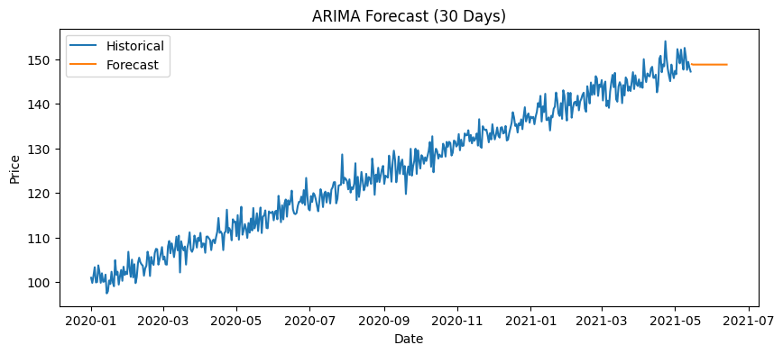
Python Lab: Time Series Forecasting (ARIMA)
#Forecast Next 30 Days - Output
Historical data shows a strong upward trend (~100 → ~150).
30-day forecast is flat (~149.5), not continuing
the trend.
Flat forecast occurs because ARIMA models
the stationary series, removing trends.
Implication: Model captures short-term
fluctuations but doesn’t extrapolate strong trends.
Visual check is helpful, but evaluation metrics are
still needed to quantify accuracy.
www.midocean.ae

Slide 32
Python Lab: Time Series Forecasting (ARIMA)
#Train/Test Split + Forecasting Accuracy
#Split data: forecast on unseen data, evaluate (validation & tuning)
# 80% training, 20% testing
train_size = int(len(df) * 0.8)
train, test = df["Price"][:train_size], df["Price"][train_size:]
# Fit on training only
model = ARIMA(train, order=(1,1,1))
model_fit = model.fit()
# Forecast length = test set length (Purpose: Compare predicted values with actual test data to measure #accuracy using metrics like MAE, RMSE, or MAPE.)
predictions = model_fit.forecast(steps=len(test))
www.midocean.ae

Slide 33
Python Lab: Time Series Forecasting (ARIMA)
#Evaluation Metrics
from sklearn.metrics import mean_absolute_error, mean_squared_error
import numpy as np
mae = mean_absolute_error(test, predictions)
rmse = np.sqrt(mean_squared_error(test, predictions))
print("MAE:", mae)
print("RMSE:", rmse)
www.midocean.ae

Slide 34
Python Lab: Time Series Forecasting (ARIMA)
#Evaluation Metrics - Output
Forecast Accuracy
MAE ≈ 4.9: Predictions are on average ~5 units off
RMSE ≈ 5.85: Larger deviations slightly increase the error
Interpretation: Errors are small relative to stock prices (~100–150) → short-term forecasts are reasonably accurate
Key Idea:
Smaller values = better predictions
Compare errors to the scale of the data to see if they are acceptable
Example: Stock prices ~100–150 → MAE ~5 is reasonably accurate
www.midocean.ae

Slide 35
Python Lab: Time Series Forecasting (ARIMA)
#Plot Forecast vs Actual
plt.figure(figsize=(10,4))
plt.plot(test.index, test, label="Actual")
plt.plot(test.index, predictions, label="Predicted")
plt.title("Forecast vs Actual (Test Data)")
plt.xlabel("Date")
plt.ylabel("Price")
plt.legend()
plt.show()
www.midocean.ae

Slide 36
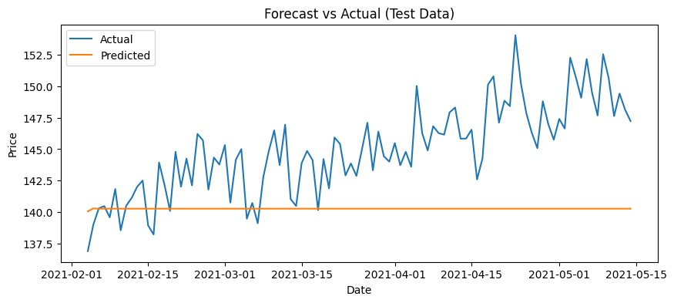
Python Lab: Time Series Forecasting (ARIMA)
#Plot Forecast vs Actual - Output
Actual Data (Blue): Feb → May 2021, prices rise ~137.5 → 152.5 with daily fluctuations.
Predicted Data (Orange): Flat line near 140, failing to capture trend or volatility.
Model Performance:
  Does not capture upward trend
  Ignores daily fluctuations → high errors
  Forecast is inadequate for this strongly trending,
  volatile series
In conclusion: Visual comparison shows the model
underperforms when trends and volatility are strong.
Forecast vs Actual – Model Suitability
Observation: ARIMA(1,1,1) produces a flat forecast:
fails to capture trend and volatility.
Conclusion: Model is not suitable for strongly trending, volatile stock prices.
Recommendation:
Use trend-aware or more advanced models for better predictions.
www.midocean.ae

Slide 37
Lecture
Recap
9
Introduced time series data and its components: trend, seasonality, cycles, noise.
Explained why forecasting is important in finance (stocks, volatility, demand, returns).
Covered stationarity, how to check it, and why models need it.
Applied transformations like log scaling and differencing to achieve stationarity.
Reviewed AR, MA, and ARIMA models and when each is useful in financial forecasting.
Evaluated forecasts using a proper train/test split and metrics (MAE, RMSE, MAPE).
Lab demo: created synthetic stock data, made it stationary, fitted ARIMA, forecasted, and compared predictions to actual values.
www.midocean.ae

Slide 38
Chapter
References
9
López de Prado, M. Advances in Financial Machine Learning. Wiley.
Klaas, J. Machine Learning for Finance: Principles and Practice for Financial Insiders. Packt Publishing.
Coursera – Machine Learning & Time Series Courses
(Used for structure, pedagogical flow, and conceptual clarity.)
Hyndman, R.J. & Athanasopoulos, G. Forecasting: Principles and Practice. OTexts.
Box, G.E.P, Jenkins, G.M., & Reinsel, G.C. Time Series Analysis: Forecasting and Control.
Brownlee, J. Introduction to Time Series Forecasting. Machine Learning Mastery.
www.midocean.ae

