Slide 1
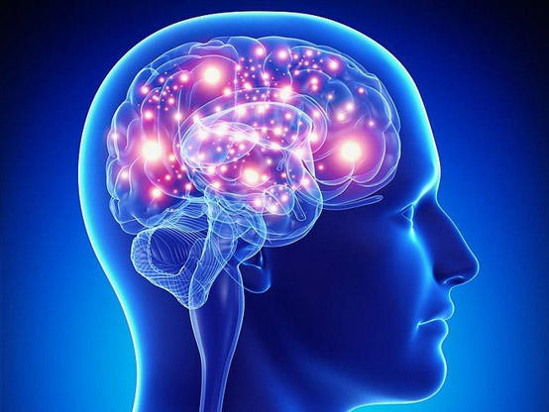
AI System For Detecting Brain Tumor

Slide 2
Contant
1- Introduction
2- objective
3- Dataset
4-Methodology & Proposed Approach
5- Experimental Results
6- conclusion
7- Future Work

Slide 3
Introduction
The brain is the main control center for all bodily functions. It is responsible for issuing commands and regulating vital functions that ensure the continuation of life. Any damage to the brain can directly affect a person's physical and cognitive abilities. Brain tumors are defined as abnormal growths in brain cells that form masses which may be benign or malignant. Early detection is a crucial step in improving treatment outcomes and reducing complications.
In light of the rapid technological advancements we are witnessing, and the integration of artificial intelligence into many aspects of our daily lives and across various fields, it has become possible to harness it in the medical field. Detecting brain tumors is one of the most difficult challenges due to their diversity and the difficulty in differentiating between them using traditional methods.

Slide 4
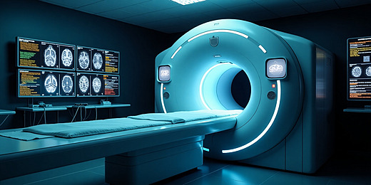
objective
I chose this project because it combines artificial intelligence and medicine, helping doctors make highly accurate diagnoses using algorithms that classify different images (MRI scans) and detect various tumors with exceptional precision. This allows doctors to analyze thousands of images in minutes, significantly reducing human error during diagnosis, contributing to faster decision-making and the selection of the most appropriate treatment, thus increasing the patient's chances of recovery, God willing. This is our goal.

Slide 5
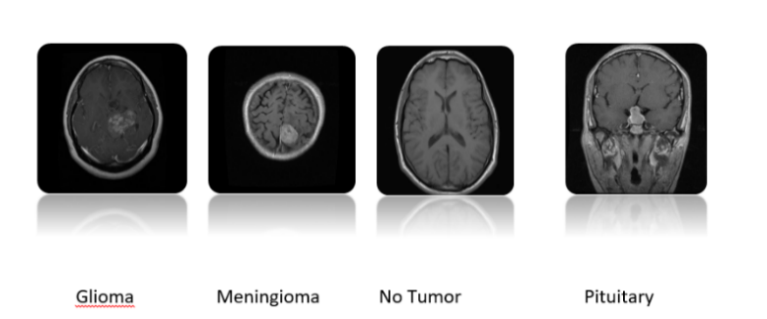
Dataset
First dataset
Second dataset
A dataset titled "Brain Tumor Classification (MRI)" was downloaded from Kaggle. It consists of 2,656 JPG images, divided into two categories: training (80%) and testing (20%). Each category is further divided into four subcategories: pituitary tumor, glioma, no tumor, and meningioma.
Another dataset, "Brain Tumor Dataset," was downloaded from Kaggle. It contains 10,560 images, also divided into four subcategories, in both JPG and PNG formats.

Slide 6
Methodology & Proposed Approach
Data collection
Data Preprocessing
Pre-trained CNNs models
Evaluation Mode
Collection of images MRI
1-2,656 JPG images.
2-10,560 JPG and PNG images
1-Image Normalization.
2-Data Augmentation.
3-Oversampling.
1-MobileNetV2 .
2-EfficientNetB0.
3- Inception v3 .
1-Accuracy.
2-Precision .
3-Recall.
4- F1 Scale .
Prediction images

Slide 7
Experimental Results
MobileNetV2
EfficientNetB0
Inception v3
1- Accuracy : 82%
2- Precision : 81%
3- Recall : 79%
4- F1-score :79%
1- Accuracy : 68%
2- Precision : 14%
3- Recall : 21%
4- F1-score :15%
1- Accuracy : 68%
2- Precision : 69%
3- Recall : 70%
4- F1-score :68%

Slide 8
Conclusion
The results of this study highlight the importance of early detection of brain tumors and its role in improving treatment outcomes and reducing mortality. The models used showed varying performance, with MobileNetV2 achieving the best accuracy and generalization, while EfficientNetB0 and InceptionV3 scored lower. Data augmentation techniques also contributed to improving the performance of all models and overcoming the data imbalance. These results confirm the effectiveness of using artificial intelligence to support medical diagnosis, especially given the increasing need for accurate and rapid tools for detecting brain tumors.

Slide 9
Future Work
Future research should focus on improving the performance of EfficientNetB0 and InceptionV3 by fine-tuning hyperparameters, scaling up data, and increasing data volume to fully leverage their architecture's advantages and optimize tumor types. It should also include testing and comparing other models to determine the most suitable one, as well as conducting clinical trials with appropriate specificity considerations. Such studies can greatly benefit low-income healthcare facilities and remote areas, reducing the workload on healthcare practitioners and improving the speed and accuracy of outcomes.

Slide 10
Thank you

