Slide 1


DIGITAL MEDIA ETHICS
DGM 723
Prepared by:
Dr. Sherihan Mohamed
Lecture 1

Slide 2



DMG 723
DIGITAL MEDIA ETHICS
Chapter 1
Central Issues in the Ethics of Digital Media
Prepared by:
Dr. Sherihan Mohamed

Slide 3

Lecture 1
OUTLINES:
** Introduction.
** (Ethical) life in the (post-)digital age:
1. Digital media, analog media: convergence and Ubiquity.
2. Digital media and “greased information”.
3. Digital media as communication media: fluidity, ubiquity, global scope, and selfhood/identity.

Slide 4

Lecture 1
INTRODUCTION

Slide 5
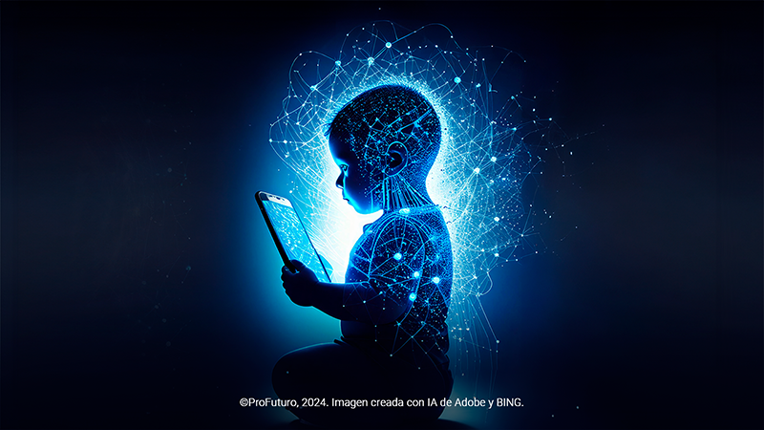
INTRODUCTION
Lecture 1
Most certainly, in the industrialized world, our lives are inextricably interwoven with what are sometimes called “New Media” or digital media.
Current generations are sometimes referred to as “digital natives”, indicating that they have been born into and grown up in a world saturated with these technologies.

Slide 6
an influential European Commission “Digital Futures” project used in its title the term “On-life,” as developed by information philosopher Luciano Floridi (2015) to highlight how the once distinct domains of “life online” and “life offline” are now (more or less) seamlessly interwoven in an “On-life”.

Slide 7
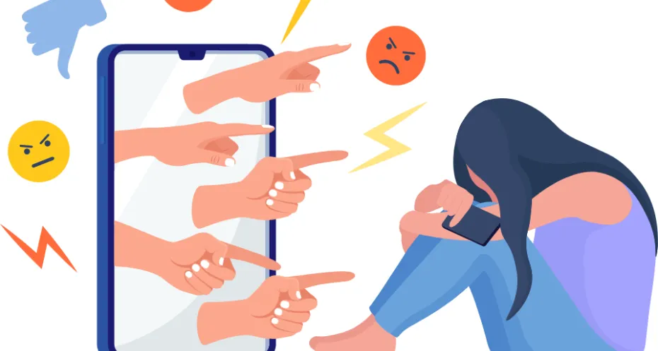
INTRODUCTION
Lecture 1
Contemporary media coverage of digital media frequently highlights important, often frightening, ethical issues these entanglements entail. Beyond our opening examples of cyberbullying and “trial by Internet,” it is easy to find stories highlighting how violence in games appears to lead to horrific, real-world violence.

Slide 8
The link between violence in video games and real-world violence has been a subject of intense debate among researchers, policymakers, and the public. Some argue that violent games desensitize individuals to aggression, while others emphasize that there is no conclusive evidence to support the idea that violent games directly cause real-world violence.

Slide 9

INTRODUCTION
Lecture 1
These are certainly critical ethical issues, ones that will only become more complex and pressing as our digital environment continues to expand and evolve – most obviously, through ever greater collection and analysis of our personal data in so-called Big Data approaches that will be fed ever more data about us in the emerging Internet of Things.

Slide 10
Thus, we begin to present and analyze the important features and characteristics of digital media, analyze the issues and ethical problems they raise, with a view to raising awareness of such issues and trying to formulate solutions to them.

Slide 11
Lecture 1
(Ethical) life in the (post-)digital age
Central Issues in the Ethics of Digital Media

Slide 12
(Ethical) life in the (post-)digital age:
Digital media, analouge media: convergence and Ubiquity.
Digital media and “greased information”.
Digital media as communication media: fluidity, ubiquity, global scope, and selfhood/identity.

Slide 13

Lecture 1
(Ethical) life in the (post-)digital age

Slide 14

(Ethical) life in the (post-)digital age
Lecture 1
A largely optimistic assumption that new technologies would make our lives better in many ways – whether as consumers satisfied with the latest convenience of, say, a voice activated digital assistant or smart home, and/or as citizens in a world of increasing individual and collective freedom, democracy, is increasingly overshadowed by darker developments.

Slide 15
To be clear: “post-digital” DOES NOT MEAN “anti digital”.
It signals, rather, a broader shift from an exclusive focus on “the digital” – to the exclusion of “the analogue” – to a more nuanced balance and recognition of the roles and importance of each in our lives.

Slide 16
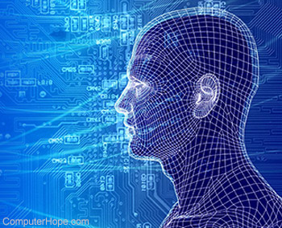
(Ethical) life in the (post-)digital age
Lecture 1
Namely, Do digital media present us with radically new kinds of ethical problems that thereby require absolutely new ethical approaches?
Such questions are often driven by emphasizing instead important differences between earlier media and digital media.

Slide 17
Such an emphasis, however, also drives the either/or approach underlying much popular media reporting. In any event, these differences often are part of why new ethical issues come up in conjunction with digital media. Exploring these differences at the outset is hence a good starting point.

Slide 18

(Ethical) life in the (post-)digital age
Lecture 1
Three especially relevant characteristics of digital media are:
* How digital media foster convergence;
* Digital information as “greased”;
* Digital media as ubiquitous and global communication media.

Slide 19
Lecture 1
Digital media, analogue media

Slide 20
Digital media, analogue media
Lecture 1
1. Digital media, analogue media: convergence and ubiquity:
To begin with, digital media work by transforming extant into the basic informational elements of electronic computers and networks, using binary code (1s and 0s – bits on and off). By contrast, analogue media, such as increasingly popular vinyl records, capture, store, and make information accessible by producing specific material artifacts that are like (analogous to) the original.

Slide 21

One of the reasons digital media are so attractive is that analogue media, by contrast, always involve some LOSS of information across the various processes of collecting, recording, and storing it.

Slide 22
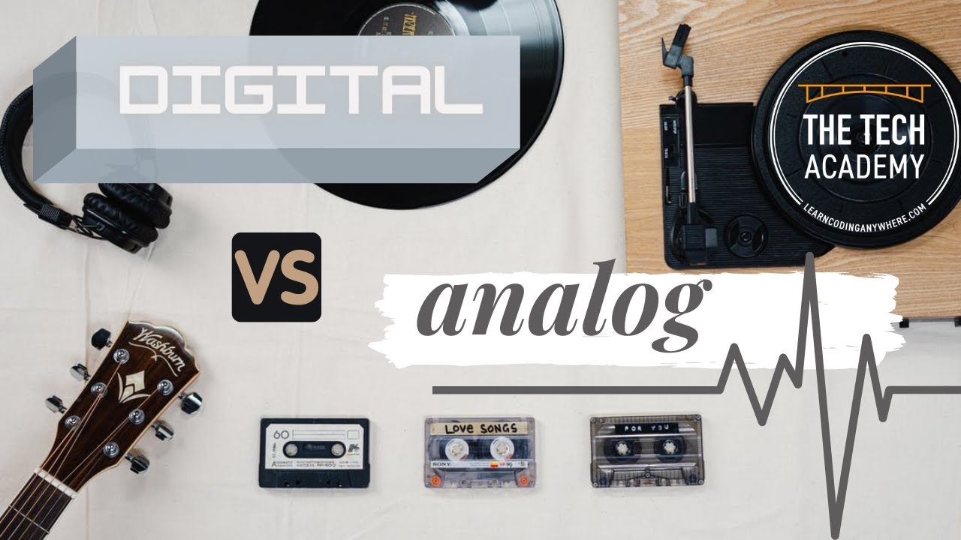
Digital media, analogue media
Lecture 1
This means – and this is particularly critical to the ethical discussions of copying – that each analogue copy of an original is ALWAYS LESS TRUE to the original; and the more copies that are made – e.g., a tape copy of a record as a copy of a tape of an original performance – the less faithful (and satisfying) the resulting copy will be.

Slide 23
To be sure, these distinctions between analogue and digital media are only one side of the coin.
As advocates of the post-digital remind us, however much our media technologies have changed in recent decades, the human eyes, ears, and voices have not.

Slide 24
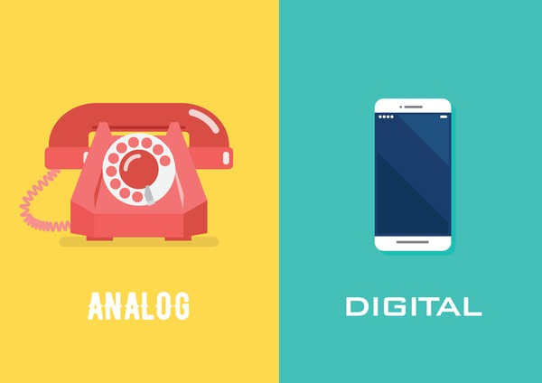
Digital media, analogue media
Lecture 1
We as embodied beings still generate and receive information in resolutely analogue form. The digital codes, for example, that pass between two computers or smartphones, whether in the form of a Skype call, Facebook update, or phone call, begin and end for their human users as analogue information.

Slide 25
The ethical experiences and challenges of digital media are so strikingly new that they require entirely new frameworks. But these continuities with our experiences as analogue and embodied beings argue that the emergence of digital media does not require us to throw out all previous ethical reflections and views and somehow try to start de novo – from the beginning.

Slide 26

Digital media, analogue media
Lecture 1
On the contrary, we will see several examples of how older forms of ethical reflection (perhaps, most notably, virtue ethics) – however transformed through their applications within digital media – are often key in helping us analyze and successfully resolve contemporary ethical dilemmas.

Slide 27
Lecture 1
Digital media and “greased information”

Slide 28
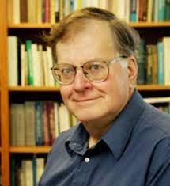
Digital media and “greased information”
Lecture 1
A second characteristic of digital media is that digital information is “greased”. That is, as James Moor (1997) has observed, “When information is computerized, it is greased to slide easily and quickly to many ports of call”.

Slide 29
"Greased information" is a term often used to describe the rapid and sometimes unfiltered spread of information through digital media. This can include both accurate and inaccurate information, leading to the phenomenon of misinformation and disinformation. The ease of sharing content online means that false or misleading information can quickly go viral, influencing public opinion and behavior.

Slide 30
Digital media and “greased information”
Lecture 1
Accessibility and Speed: Digital media allows for instant access to information and the ability to share content globally within seconds.
Volume of Information: The sheer amount of content available online can make it difficult for users to discern credible information from false or misleading content.
Social Media Influence: Platforms like Facebook, Twitter, and Instagram play a significant role in the dissemination of information, both true and false.

Slide 31
Misinformation and Disinformation: The spread of false information (misinformation) and deliberately deceptive information (disinformation) can have serious consequences, such as influencing elections, public health responses, and social unrest.
Digital Literacy: The ability to critically evaluate and verify information online is crucial in navigating the digital landscape and avoiding the pitfalls of greased information

Slide 32
Digital media and “greased information”
Lecture 1
As anyone who has hit the “post” button on a status update too quickly knows all too well, information in digital form can spread more or less instantaneously and globally, whether we always want it to or not.
As the example of uploading embarrassing photos or videos from a smartphone suggests, the near-instantaneous and potentially global distribution of digital information raises especially serious ethical issues surrounding privacy.

Slide 33
Digital media has the potential to be a powerful tool for good, but it Also requires careful management to prevent the negative impacts of greased information.
Strategies to Combat Greased Information:
Media Literacy Education: Teaching individuals, especially children and young adults, how to critically assess the credibility of online content.
Fact-Checking: Encouraging the use of fact-checking websites and tools to verify information before sharing it.

Slide 34

Digital media and “greased information”
Lecture 1
Regulation and Policies: Implementing policies that hold digital platforms accountable for the spread of misinformation and disinformation.
Public Awareness Campaigns: Raising awareness about the dangers of misinformation and promoting responsible sharing of information.

Slide 35
Lecture 1
Digital media as communication media

Slide 36
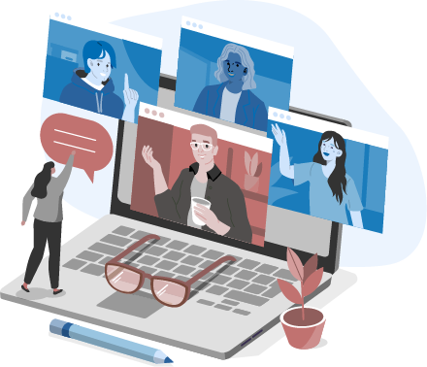
Digital media as communication media
Lecture 1
Digital media as communication media refers to the various platforms and tools used for sharing information, ideas, and messages through digital means.
This encompasses a wide range of technologies and services that facilitate communication and interaction among individuals and groups across the globe. Here's an overview of its key aspects:

Slide 37

Benefits of Digital Media as Communication Media:
* Instant Communication.
* Global Reach.
* Interactivity
* Cost-Effective
* Customization.

Slide 38
Digital media as communication media
Lecture 1
Challenges of Digital Media as Communication Media:
Misinformation: The rapid spread of false information can lead to confusion and harm.
Privacy Concerns: The potential for data breaches and misuse of personal information.
Digital Divide: Inequality in access to digital technologies and the internet.
Addiction and Overuse: Excessive use of digital media can negatively impact mental and physical health.

Slide 39
So the internet and the Web now make possible cross-cultural encounters online at a scope, speed, and scale unimaginable even just a few decades ago.
Along these lines, two additional features of digital media become CRUCIAL. To begin with, digital media enjoy what has characterized as a kind of fluidity: specifically.

Slide 40

Digital media as communication media
Lecture 1
Secondly, the diffusion of internet and Web-based connectivity by way of smartphones and other digital devices makes increasingly real for us the ubiquity of digital media.
We are increasingly surrounded by an envelope of interacting digital devices – meaning first of all that we are “ALWAYS ON”, always connected.

Slide 41
The ubiquity of our interactive devices means that we are increasingly both the subjects and the objects of what Anders Albrechtslund (2008) early on identified as “Voluntary Surveillance”.
Voluntary Surveillance on social media refers to the phenomenon where users willingly share personal information, activities, and preferences on social media platforms, often without fully understanding the implications or potential risks. This voluntary sharing can be seen as a form of self-surveillance, where individuals monitor and present themselves to others.

Slide 42

Digital media as communication media
Lecture 1
At the same time, however, the mobile or smartphones we carry with us into more or less every corner of our lives – including the (once) most intimate spaces – open up our lives in those spaces to new possibilities of tracking and recording in exquisite detail.

Slide 43
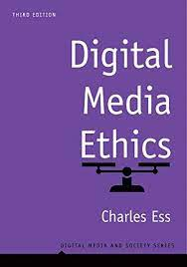

Digital Media Ethics (Digital Media and Society Series), 3rd Edition, by Charles Ess
Intro
Recommended Reference

Slide 44
Lecture 1
REMEMBER:
** Introduction.
** (Ethical) life in the (post-)digital age:
1. Digital media, analog media: convergence and Ubiquity.
2. Digital media and “greased information”.
3. Digital media as communication media: fluidity, ubiquity, global scope, and selfhood/identity.

Slide 45



Thank You

Slide 46
DIGITAL MEDIA ETHICS
Lecture 1
DMG 723
Prepared by:
Dr. Sherihan Mohamed

