Slide 1



Project Planning
Lecture 9
PMG202
Monitoring & Controlling
Prepared by
Lec. Dina ElWakkad
www.midocean.ae

Slide 2


Slide 3
In this lesson, we’ll:
Learn the steps, methodology, and processes that lead to successful Project Monitoring and Controlling Phase.
Find Project Monitoring and Controlling Steps and Processes, the helpful tools to support your Project’s next success, and the importance of both Monitoring and Controlling along all the phases of the Project Life Cycle .

Slide 4
1) The Project Monitoring

Slide 5
It is normally impossible to judge if work is going in the right direction without effective Project Monitoring
Project Monitoring is defined as a process that is performed to track the progress of Project Execution so that potential problems can be identified well in time for the taking of corrective actions for the purpose of controlling the execution of the Project.
It focuses on reviewing progress against achieving Goals

Slide 6
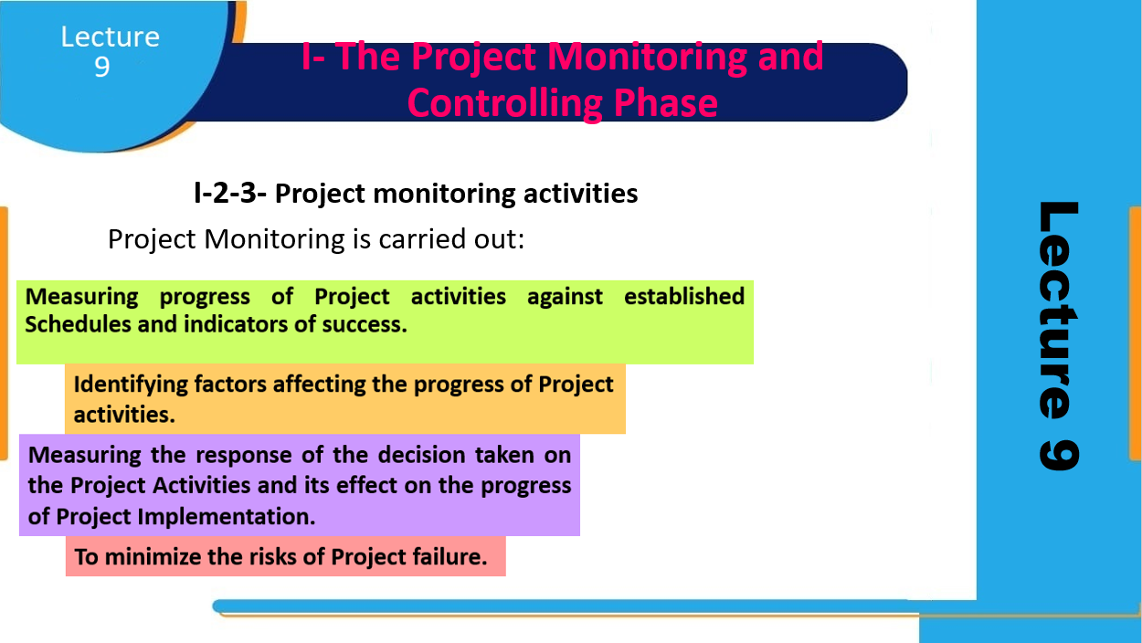
The Project Execution definition
Project Monitoring Activities

Slide 7
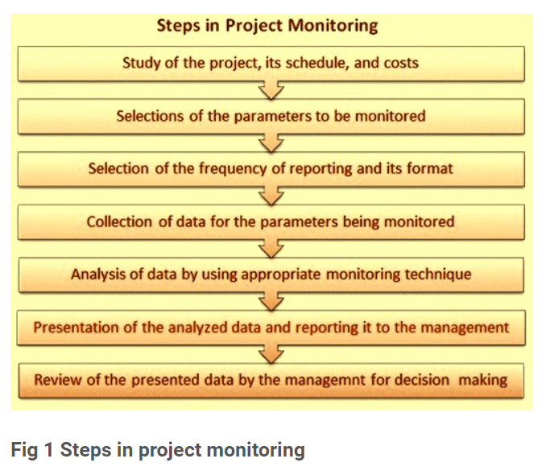
Steps of Project Monitoring

Slide 8
2) The Project Control

Slide 9
Project Control is a process that encompasses the Resources, Procedures, and Tools for the Planning, Monitoring, and Controlling of all phases of the capital Project Lifecycle.
  It includes estimating cost and Schedule Management, Risk Management, Change Management, Earned Value progressing, and forecasting
  Developing a Risk Management Plan and Optimizing Project Strategies to enable better outcomes in the future

Slide 10
3) Project Monitoring and Control Process

Slide 11
The monitoring and control process tracks performance metrics to keep a project on schedule, on budget, and within scope.
The process helps project teams discover problems before they occur.
The Project Monitoring and Control Process aims at tracking and reviewing the Project and is undertaken From the Initiation of the Project to its Closure

Slide 12
Monitor Key Performance Indicators (KPIs): Monitoring KPIs keeps project deliverables on track and performance up to date. Project managers use data on timelines, budgets, and quality to enable better decisions, make changes to avoid problems, and capitalize on opportunities.

Slide 13
Monitor Change Requests: Measuring project performance data helps reveal whether the project is on track or if changes are necessary. If the project is off course, then a change request will be submitted and implemented to make a course correction.

Slide 14
Monitor Project Scope: This step helps ensure that any changes to the project scope are verified and documented. You’ll need to update any relevant documents, such as a project scope statement and work breakdown structure. You’ll also want to determine any Schedule and cost adjustments that are relative to a scope increase that can cause a shift in strategy.

Slide 15
Identify Risks: Ideally, risk identification should occur throughout a project; when risks arise, you have the relevant information available to make the right decision.
Communicate with Team Members, Stakeholders, and Clients: Maintaining regular communication keeps projects on track and helps avoid misunderstandings that cost time and money. It’s vital that stakeholders and team members receive all relevant information in a timely manner.

Slide 16
4) How to Create a Project Monitoring and Control Plan

Slide 17
A project monitoring and control plan is developed during the project lifecycle’s planning phase.
Outline the project.
Establish scope, schedule, and budget baselines for benchmarking according to the project plan. The plan defines project goals, resources, and milestones.
Break down the project into subtasks or units of work.
A work breakdown structure is a useful tool that project managers can use to create subtasks and manage work. This visualization helps project managers track and simplify performance and deliverables.
Execute the project plan, and report and analyze to identify variances.
Determine if variances are acceptable and continue to monitor them.
Find the cause of unacceptable variances and make adjustments.

Slide 18
5) How to Implement Project Monitoring and Control

Slide 19
Monitor Project Parameters: The project plan will include the scope of the project and measurements for success. Project managers use KPIs to track schedule, effort, and cost and to ensure they align with the project plan.
Monitor Stakeholder Involvement: By positioning and communicating with the project team, management, and clients, you keep everyone engaged and on task.
Monitor Risk: When you complete risk assessments throughout the life of the project, you avoid issues and enable mitigating negative impacts on the project timeline and budget.

Slide 20
Take Corrective Action to Control Progress: Project managers use the project plan as a baseline to control progress and track changes until resolution or the project enters the closure phase.
Monitor and Manage Data Documentation: Documenting performance and changes in the project keeps stakeholders involved, mitigates issues, and informs future projects

Slide 21
6) Project Monitoring and Control Best Practices

Slide 22
Define Project Management Team Roles: Make sure that team members know the expectations and the timelines to meet.
Identify a Point of Contact: When problems arise, there should be a dedicated person who is responsible for tracking, documenting, and monitoring any issues.
Determine the Frequency of KPI Reporting: When developing the project plan, decide how often you’ll conduct KPI reporting and stick to that schedule. This data is essential for monitoring and control performance.

Slide 23
Define Variance Thresholds for Schedule, Budget, and Cost: Decide what percentage of change is acceptable and the variance threshold figure that requires change.
Determine if Variance Cause Is Common or Unique:
  Work continues without change under expected and acceptable variance.
  If the variance is caused by the unexpected, identify and implement the proper change.

Slide 24
Scrutinize Change Orders: Review documented change requests with the project team to approve or reject them.
Monitor and Control Scope Creep: Mitigate scope creep to maintain project parameters and recognize that project change may impact outcomes.
Conduct a Rigorous Approval Process at Completion: Make sure to document and file all approvals appropriately.

Slide 25
7) Project Monitoring and Control Techniques

Slide 26
Project Plan Monitoring → critical path method (CPM).
Project Budget Monitoring → earned value management (EVM).
Project Status Monitoring → Project Status Reports

Slide 27
Project monitoring and control techniques address three areas in project management:
Project Plan Monitoring:
Use the critical path method (CPM) to identify essential project milestones and keep deliverables on schedule.
  The critical path method (CPM) is a technique where you identify tasks that are necessary for project completion and determine scheduling flexibilities.

Slide 28
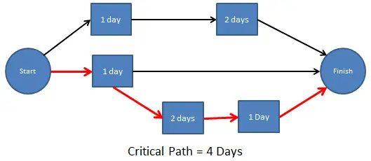
Project Plan Monitoring:
  The critical path method (CPM)

Slide 29
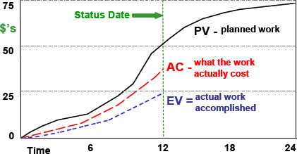
Project monitoring and control techniques address three areas in project management:
Project Budget Monitoring: Use earned value management (EVM) to assign project tasks according to their cost.
  Earned Value Analysis (EVA) is a method that allows the project manager to measure the amount of work actually performed on a project beyond the basic review of cost and schedule reports.

Slide 30
Project monitoring and control techniques address three areas in project management:
Project Status Monitoring: Use project status reports to standardize the reporting process and identify completed tasks, key takeaways, risks, and real-time progress.

Slide 31

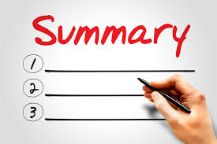


Slide 32
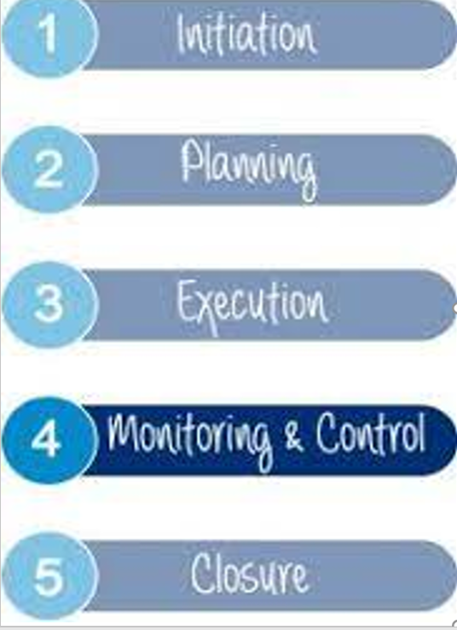

Slide 33
The Project Monitoring: definition, activities, steps
The Project Control
Project Monitoring and Control Process
How to Create a Project Monitoring and Control Plan
How to Implement Project Monitoring and Control
Project Monitoring and Control Best Practices
Project Monitoring and Control Techniques

Slide 34
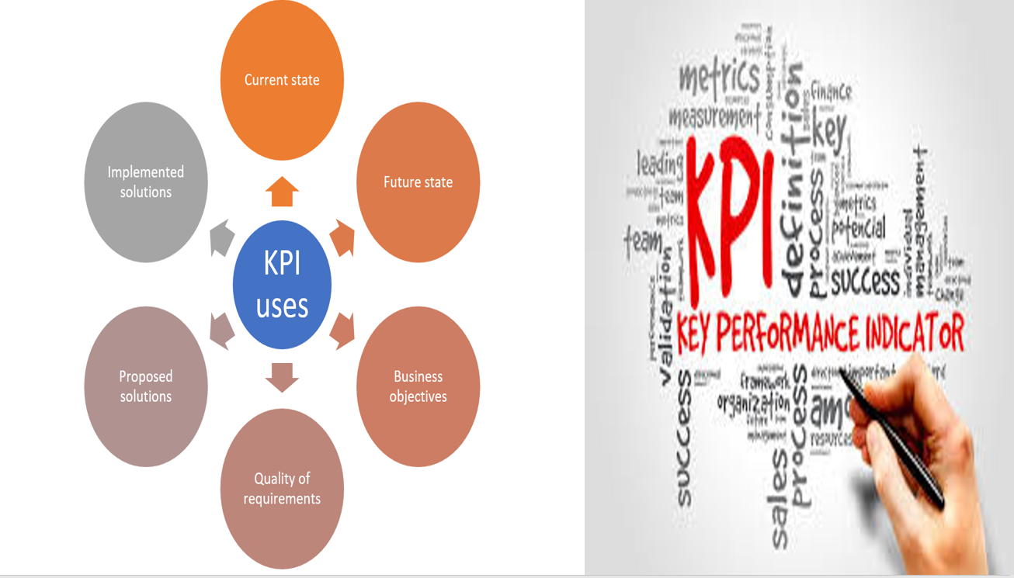

Slide 35


Slide 36
Questions
Without effective ....it is normally impossible to judge if work is going in the right direction. Monitoring Controlling Planning Execution
----- includes estimating cost and Schedule Management, Risk Management, Change Management, Earned Value progressing, and forecasting. Controlling Monitoring Planning Execution

Slide 37
Questions
Developing a Risk Management Plan and Optimizing Project Strategies to enable better outcomes in the future are ..... activities. Controlling Monitoring Planning Execution
The KPIs are the: Key Performance Indicators Key Planning Interests Key Programming Indicators Key Performance Interests

Slide 38
Questions
The Project Monitoring and Control Process aims at tracking and reviewing the Project and is undertaken. from: the Initiation of the Project to its Closure. the Planning of the Project to its Closure. the Initiating of the Project to its Execution. the Planning of the Project to its Execution.
Which element ISN’T included in the Performance measurement Baseline? The Requirements The Budget The Schedule The Targets of the Project

Slide 39
Questions
---------- defined as a process that is performed to track the progress of Project Execution so that potential problems can be identified well in time for the taking of corrective actions for the purpose of controlling the execution of the Project Project Monitoring Project Control Project Planning Project Execution
Which statement DOESN’T describe the role of the Project Manager? Project Manager must bring funds for the Project. Project Manager manages the Project Team and Stakeholders to meet these Targets by the end of the Project. The Project Manager is accountable for meeting the Performance Measurement Baseline. The Project Manager takes actions to correct any variances.

Slide 40
Questions
For Project Plan Monitoring, ----- used to identify essential project milestones and keep deliverables on schedule. critical path method Earned value management Project Status Reports All answers are incorrect
For Project Budget Monitoring, ----- used to assign project tasks according to their cost. Earned value management critical path method Project Status Reports All answers are incorrect

Slide 41
Questions
For Project Status Monitoring, ----- used to standardize the reporting process and identify completed tasks, key takeaways, risks, and real-time progress. Project Status Reports Earned value management critical path method All answers are incorrect
Which of the following is/ are Project Monitoring and Control Techniques: Project Status Reports Earned value management critical path method All Answers are correct.

Slide 42
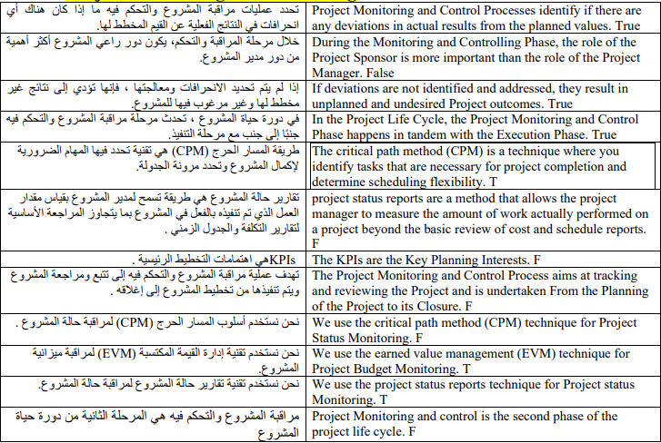

Slide 43


Slide 44



Thank You

