Slide 1

Strategic and Operational Risk Management
Prepared by Dr. Nael Zabel
Lecture 2
PMG 630
the risk management
Process

Slide 2

Lecture 2
Risk Management Processes
There are many risk management processes used in various industries, disciplines, and professions. These risk management processes differ primarily in the details of how the risk management process is undertaken. These variations mainly stem from differences in the specific systems, conditions, and environments that are unique to a particular industry or discipline.

Slide 3
It is necessary to describe the system of interest as well as its boundaries to focus the efforts of the risk management process. Risk management can be and should be applied to the total system as a whole. However, when necessary, risk studies and analysis can focus on certain subsystems, processes, or components of concern. The scope can range from large complex systems such as production facilities to small subsystems or components of a product.

Slide 4
3-Pillar Structure

Slide 5
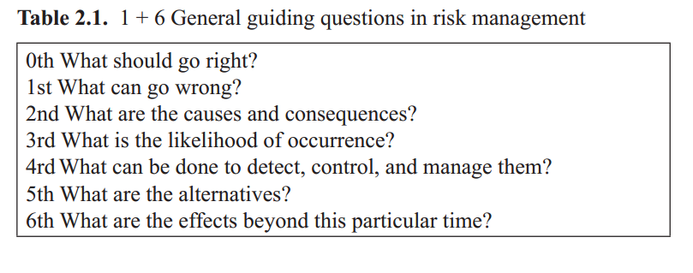
General Guiding Questions In risk Management:

Slide 6
what should go right?
Once the system of interest is defined, its primary goals and related constraints need to be identified. Consider the examples provided in Chapter 1 for a production system in which the following are some of the possible goals:

Slide 7
• Produce the right quantity and quality products.
• Minimize shortages in raw materials, machine resources, and needed personnel.
• Minimize total cost of production.
• Minimize disruption in delivery of finished products.
• Minimize the number of defective products.
• Maximize return on invested resources (e.g., profit).

Slide 8
what can go wrong?
Once the system of interest is defined, identifying the hazards, risks, and accidents that may happen in the operation of a system is the next step in managing risk. It will not be a stretch of analysis to deduce some undesirable events based on the objectives, for example:
• Failure to produce the right quantity and quality products.
• Excessive shortages of raw materials, machine resources, and needed personnel.
• Unacceptable total cost of production.

Slide 9
There are also several ways to find information on a particular risk,
hazard, or accident described as follows.
1. Using Historical Information
The simplest way to identify risk that may happen in the future is by looking back at the past. This is particularly applicable for systems that are currently operating or systems that have operated or existed in some form in the past.

Slide 10
Histories of risk events (both accidents and no accidents) that have happened are usually documented in various forms: written, electronic, or tacit. Companies that are diligent in their risk management practices, usually keep detailed information surrounding these events in the form of a risk register, a risk log, or hazard log.
As an example, consider the event of a power supply interruption in a chemical processing plant. The following information is commonly found in risk registers related to this risk event:

Slide 11
• Brief description of risk event—for example, power supply interruption during time of operation of chemical processing;
• Known causes—for example, power outage at local electrical grid supply, accidental switch off of power switch into the facility, localized natural events such as lightning strikes, localized accidents such as fire, and others;
• Known consequences—for example, interruption in the affected facility and all ongoing chemical processes, downtime, production delays, product defects, and others;
• Risk management strategies in place—for example, uninterrupted power supply by backup generator.

Slide 12
2 . Using Comparative Analysis
There are instances in which identifying risk from historical information may not be sufficient or even possible, as is the case with a system not yet built or still being developed. In these cases, there are no past records of risk events. Another instance is when a system is undergoing significant change. For example, an existing production system that is adding a new product line may have significant changes in personnel, equipment, and process, or the environment such as prevailing economic conditions or newly enacted laws and regulations may change.

Slide 13
3 . Using Predefined List of Risk Events
Data banks of risk registers or hazard logs provide a wealth of information on risk events. Risk registers are again particularly useful in extracting risk events that may not have occurred in a given system but have been observed in other similar systems. This type of list is commonly published by federal agencies as well as professional and industry groups based on a compilation of risk registers from systems under their purview.

Slide 14
4 .Team-Based Elicitation
Brainstorming is particularly useful when hazards have to be conceived (abstractly imagined) and predicted (foreseen). A multidisciplinary cross-functional team with specific knowledge on the system can help identify many potential risks. This method capitalizes on the wide range of knowledge and experience of team members, especially tacit knowledge.

Slide 15
5 . Modeling
Models are also used to identify potential risk events. Models include analytical, mathematical, physical, mental, and other types, which may be used to represent a new system, the changes within the existing system, and the system’s external environment. Many models of these types often include computer simulations. Consider as an example the prototype modeling of cars and airplanes to identify which components will most likely fail after extensive use under various scenarios.

Slide 16
WHAT ARE THE CAUSES AND CONSEQUENCES?
Once risk events are identified, the next phase is to describe these events for the purpose of extending understanding and knowledge about the event. This involves establishing causality, identifying root cause sand their likelihood, as well as characterizing consequences and impact. This helps in developing more appropriate and effective decisions or actions related to the management of risk.

Slide 17
Invoking the notion of the systems approach has proven to be effective toward describing a particular risk. Establishing what causes accidents, risk events, or any type of events in general can be termed as establishing the causal chain of events. The use of the notion of a chains a metaphor for how events form distinct links that together form a continuous span. As an example, Figure 2.1 illustrates how the knowledge of interaction between elements of a system and the mechanics of fire help in establishing a causal chain of events.

Slide 18
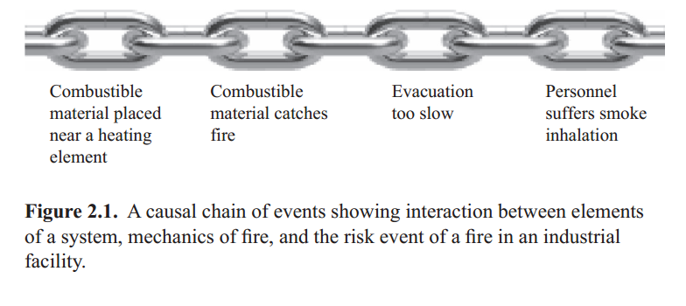

Slide 19
Based on the same notion of causal chain events as described earlier, the direct and indirect consequences of a particular risk event are identified. The distinction between direct and indirect consequences is usually based on temporal separation, system boundary, and direct causal attribution. From a systems perspective, consequences of some risk events may propagate beyond the system of interests and hence be considered as indirect consequences.

Slide 20
As an example, a production system that fails to pro-duce the right quality product (contrary to its objective) may be directly affected in terms of reduced profit. Nonetheless, failure to produce the right quality product may also affect the morale of the production personnel, indirectly due to stagnant salary. Consequences are often predicted and estimated by looking at how other events may occur (unintended con-sequences) as a result of the occurrence of the risk event and their impact on the various elements of the system and the achievement of the system’s overall objective.

Slide 21
Often the severity of consequences is evaluated through a rating scale such as that shown in Table 2.2. In the table, effects are rated from 1 to 5, where 1 is negligible and 5 is catastrophic. There may be risks that have more than one consequence. In this case, it is typical that focus is placed on the consequence with the highest severity rating. This avoids the complication of dealing with too many effects with low ratings, enabling the focus to be placed more on the highest rated ones first.

Slide 22
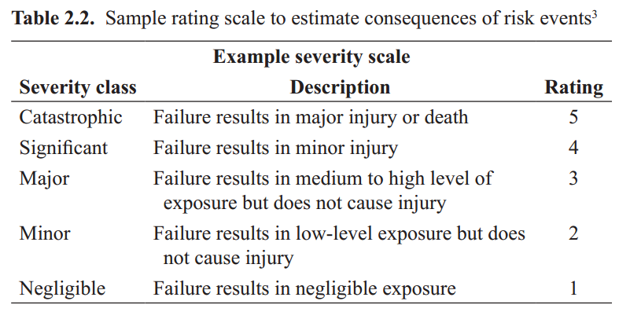

Slide 23
WHAT ARE THE CHANCES OF OCCURRENCE?
Sequences of events that lead to a particular risk event, that is, the causal chain of events, need to be described in terms of their respective chances of occurrence. The frequency or chance of occurrence of a risk event pertains to the quantitative or qualitative description of how often or how soon a particular risk event may occur. This is often derived from historical information or records of the risk event. This can also be derived from team-based elicitation.

Slide 24
Likelihoods are also evaluated through a rating scale such as that shown in Table 2.3. In the table, likelihoods are rated from 1 to 5, where 1 is extremely unlikely and 5 is frequent. A well-rounded team proves valuable with ratings, as they can be highly subjective and should be provided by people who have direct knowledge and experience with the system and the risk being evaluated.

Slide 25
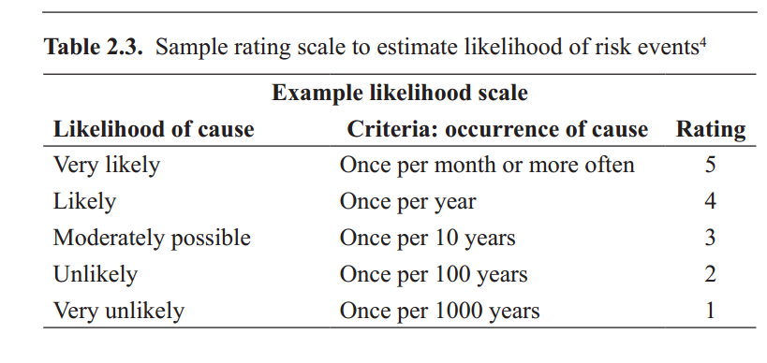

Slide 26
WHAT CAN BE DONE TO DETECT, CONTROL, AND MANAGE THEM?
Ranking and scoring is conducted to evaluate criticality and determine relative importance. What may be critical is contextual. However, com-mon critical risks are those whose consequences are related to health and safety, compliance to regulatory requirements, or those that affect core business practices. Criticality may be assessed using a risk matrix similar to that shown in Table 2.4. The risk matrix in Table 2.4 highlights risk events with high severity ratings such as those risks that fall under the catastrophic category of consequences or risks that fall under the very likely category of likelihood of occurrence.

Slide 27
However, particular attention should be given to those risks in which consequences are catastrophic and the likelihood of occurring is very likely or eminent. In Table 2.4, these are the risk events that fall in the darker boxes. Risk events that fall in the darkest boxes should be addressed immediately. Risk matrix tables are useful for categorizing and prioritizing identified risks.

Slide 28
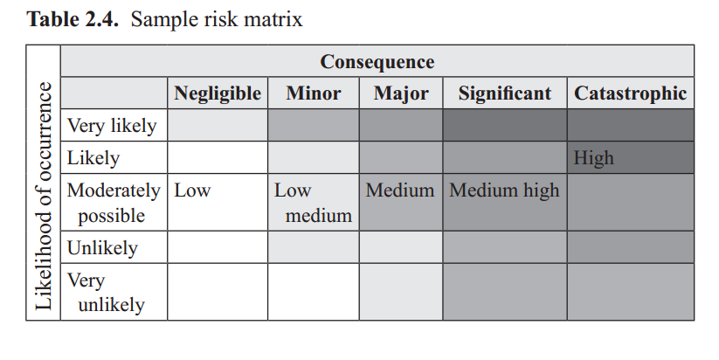

Slide 29
Table 2.2) and a very likelihood of occurrence (rated as 5 in Table 2.3) will have a risk score of 25 (5 ×5). Many times current capabilities to address those risks are also incorporated in the score. This method is shown in Chapter 3’s section on FMEA: Failure Modes and Effects Analysis. The risk score can provide guidance for ranking potential risks in the order they should be addressed. The purpose is to concentrate resources, time, and effort to the risks that are most significant.

Slide 30
After the more significant (high priority risk) events are identified, the strategies to treat these risk events are generated based on the information known from its causal chain of events. This stage of the risk management process is also known as risk treatment and is discussed in more detail in Chapter 4. However, it will suffice to think of the following guiding questions when trying to detect, control, and manage risk events.

Slide 31
• Which segments in the causal chain of events can be detected? Certain segments in the causal chain of events may be more amenable to detection than other segments based on the mechanics of the phenomena, available technology for detections, and other factors (e.g., ethical and legal factors). Also, how early the start of a risk event can be detected gives you time to address it. Early detection is desired.

Slide 32
• Which causal chain of events and target risk events can be controlled and how can they be controlled? In the same way that segments in the causal chain of events may be more amenable to detection, some of these segments may be more amenable to control than others.

Slide 33
• If the risk event happens, how can the system recover quickly? Important functions in the operation of the system are identified for the purpose of analyzing what can be done to prevent or reduce the
consequences.

Slide 34
WHAT ARE THE ALTERNATIVES?
Which risk treatment strategies will work well together, given the causal chain of events? Risk treatment strategies are not mutually exclusive, and effective action plans are usually made up of combination of strategies, albeit in various degrees. Consider the causal chain of events illustrated in Figure 2.1 of a system and mechanics of fire. Based on common experience, we can identify particular risk strategies to address the various segments in this chain,

Slide 35
for example, regular housekeeping to prevent the accumulation of combustible materials near a heating element, installing and maintaining smoke detectors near equipment with heating elements, having an evacuation plan and conducting regular drills, training to prevent smoke inhalation, and others. However, all these strategies can be in various degrees and combinations; the appropriateness may depend on the particulars of the specific system.

Slide 36
WHAT ARE THE EFFECTS BEYOND THIS PARTICULAR TIME?
From a system’s perspective, it is important to evaluate the effects of the risk treatment alternatives to other elements of the system. Risk treatment alternatives may be analyzed according to their effects to functionalities of elements of the system, the manner by which they alter interaction among elements, and their potential to affect future decisions.

Slide 37
This is also the point where the acceptable level of risk is determined by comparing the costs and benefits of each mitigation alternative. The concept of As Low as Reasonably Practicable, a fundamental approach that sets the risk to the tolerable, reasonable, and practical level, will be further discussed in Chapter 3.

Slide 38
Resources:
Operational Risk Management
C. Ariel Pinto
Luna Mylene Magpili
Raed M. Jaradat
Chapter 2

