Slide 1

Lecture 2
Impact of risk on organizations
Prepared by Eng. Mosaab Hamed
MGM510
Risk Management

Slide 2

Level of risk

Slide 3
Level of risk
By taking a proactive approach to risk and risk management, organizations will be able to achieve the following four areas of improvement:
  Strategy, because the risks associated with different strategic options will be fully analysed and better strategic decisions will be reached.
  Tactics, because consideration will have been given to selection of the tactics and the risks involved in the alternatives that may be available.
  Operations, because events that can cause disruption will be identified in advance and actions taken to reduce the likelihood of these events occurring, limit the damage caused by these events and contain the cost of the events.
  Compliance will be enhanced because the risks associated with failure to achieve compliance with statutory and customer obligations will be recognized.

Slide 4
Level of risk
The term ‘magnitude’ is used to indicate the size of the event that has occurred or might occur. The term ‘impact’ is used to define how the event affects the finances, infrastructure, reputation and/or marketplace (FIRM) of the organization.

Slide 5
Impact of hazard risks
Hazard risk management is concerned with issues such as health and safety at work, fire prevention, avoiding damage to property and the consequences of defective products.
Hazard risks can cause disruption to normal operations, as well as resulting in increased costs and poor publicity associated with disruptive events.

Slide 6
Impact of hazard risks
the standard approach is to attach risks to corporate objectives.

Slide 7
Risk and reward
Another feature of risk and risk management is that many risks are taken by organizations in order to achieve a reward.
A business will launch a new product because it believes that greater profit is available from the successful marketing of that product. In launching a new product, the organization will put resources at risk because it has decided that a certain amount of risk taking is appropriate.

Slide 8
Risk and reward
When an organization puts value at risk in this way, it should do so with the full knowledge of the risk exposure and it should be satisfied that the risk exposure is within the appetite of the organization. Even more important, it should ensure that it has sufficient resources to cover the risk exposure. In other words, the risk exposure should be quantified, the appetite to take that level of risk should be confirmed, and the capacity of the organization to withstand any foreseeable adverse consequences should be clearly established.

Slide 9
Risk and reward
Start-up operations are usually high risk and the initial expected return may be low. The figure below demonstrates the probable risk versus reward development for a new organization or a new product. The activity will commence in the bottom right-hand corner as a start-up operation, which is high risk and low return. As the business develops, it is likely to move to a higher return for the same level of risk. This is the growth phase for the business or product. As the investment matures, the reward may remain high, but the risks should reduce. Eventually, an organization will become fully mature and move towards the low-risk and low-return quadrant. The normal expectation in very mature markets is that the organization or product will be in decline.

Slide 10
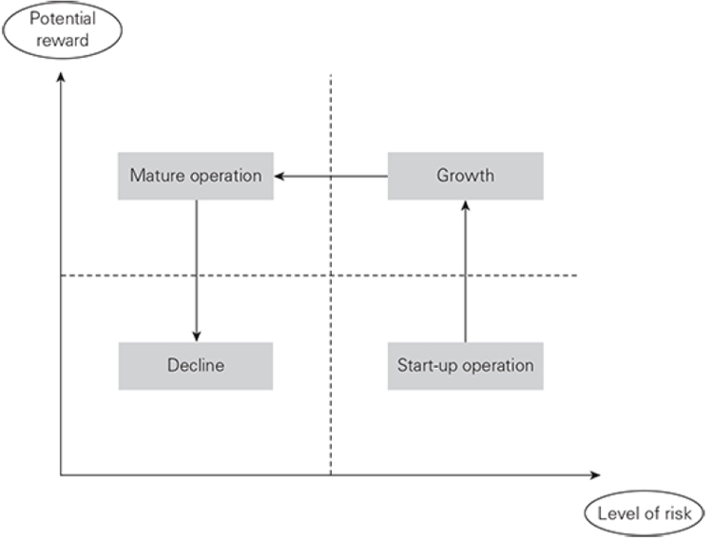
Risk and reward

Slide 11
Risk and reward
It must always be the case that risk management effort produces rewards. In the case of hazard risks, it is likely that the reward for increased risk management effort will be fewer disruptive events. In the case of project risks, the reward for increased risk management effort will be that the project is more likely to be delivered on time, within budget and to specification/quality.
For opportunity risks, the risk versus reward analysis should result in fewer unsuccessful new products and a higher level of profit or (at worst) a lower level of loss for all new activities or new products.

Slide 12
Attitudes to risk
Different organizations will have different attitudes to risk. Some organizations may be considered to be risk averse, whilst others will be risk aggressive. the attitude of the organization to risk will depend on the sector and the nature and maturity of the marketplace within which it operates, as well as the attitude of the individual board members.

Slide 13
Attitudes to risk
Attitude to risk is a complex subject and is closely related to the risk appetite of the organization, but they are not the same. Risk attitude indicates the long-term view of the organization to risk and risk appetite indicates the short-term willingness to take risk.

Slide 14
Attitudes to risk
Other key factors that will determine the attitude of the organization to risk include the stage in the maturity cycle, as shown in the figure above, for an organization that is in the start-up phase, a more aggressive attitude to risk is required than for an organization that is enjoying growth or one that is a mature organization in a mature marketplace. Where an organization is operating in a mature marketplace and is suffering from decline, the attitude to risk will be much more risk averse.

Slide 15
Risk and triggers
Risk is sometimes defined as uncertainty of outcomes. This definition is particularly applicable to the management of control risks.
Control risks are the most difficult to identify and define, but are often associated with projects.
The overall intention of a project is to deliver the desired outcomes on time, within budget and to specification, quality or performance.

Slide 16
Risk and triggers
For example, when a building is being constructed, the nature of the ground conditions may not always be known in detail. As the construction work proceeds, more information will be available about the nature of the conditions. This information may be positive news that the ground is stronger than expected and less foundation work is required. Alternatively, it may be discovered that the ground is contaminated or is weaker than expected or that there are other potentially adverse circumstances, such as archaeological remains being discovered.

Slide 17
Risk and triggers
One of the tools for representing risk management activities that has recently been developed is the bow-tie.
The figure below shows a simple representation of the bow-tie applicable to events that can cause disruption to normal efficient operations.

Slide 18
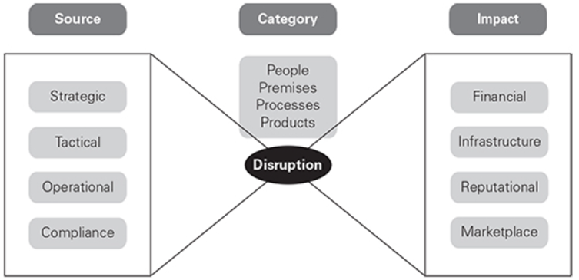
Risk and triggers

Slide 19
Risk and triggers
A bow-tie is a simple way of analyzing a risk to gain a greater understanding. The first stage is to put the risk description into the middle box. The causes of the risk then need to be recorded along with the preventive controls to stop the risk occurring. The impact of the risk is also considered. This enables the identification of response controls to lessen the impact of the risk should it occur.

Slide 20
Risk and triggers
Example: The figure below shows a practical application of the bow-tie to the identification of preventive and response controls related to a fire in the kitchen of a residential home.

Slide 21
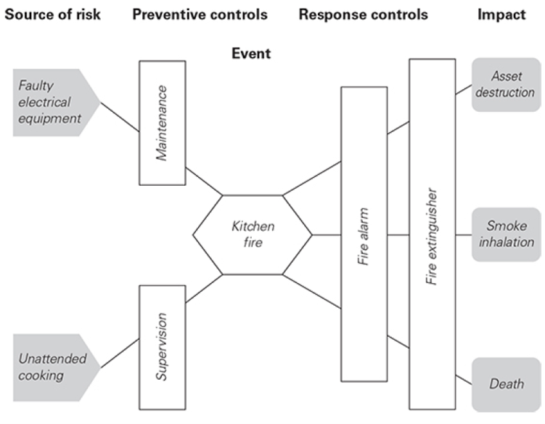
Risk and triggers

