Slide 1

PMG 611
Enterprise Risk Management
Prepared by Dr. Abdullah Jameel Halawany
Lecture 3
Importance of Effective GRC Practices and Principles

Slide 2

Session Outline
Session Outline
Road to Effective GRC Principles
Importance of GRC Governance
Risk Management Component of GRC
GRC and Enterprise Compliance
Importance of Effective GRC Practices and Principles
Introduction

Slide 3
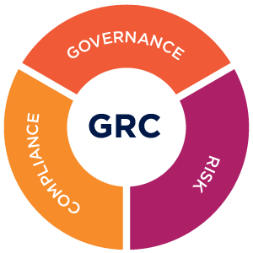
Introduction

Slide 4
Introduction
Enterprise organizations and corporations have faced governance issues since their earliest days.
In past eras, setting the rules for employees and other stakeholders to follow worked with small single proprietorships or in the tightly centralized corporations.
Today’s larger and often multiunit enterprises need broad-based units or functions for setting rules and procedures—they need efficient and effective governance processes.

Slide 5
Introduction
Life would be easier for enterprises if they just had to rely on a central leadership to set those governance rules.
Enterprises today of any location or size are faced with ever increasing sets of rules and procedures
  Local Police
  Public Safety Ordinances
  National and International Laws
  Broad professional rules and standards

Slide 6
Introduction
On a whole series of levels, an enterprise must comply with these laws and regulations.
Failure to do so can result in a variety of penalties.
Enterprise needs processes to ensure that they are operating incompliance with the appropriate laws and regulations.
An enterprise always faces risks that it will be found in violation of one or another of these multiple laws and regulations.

Slide 7
Introduction
There are also risks that their own established governance rules will
  not achieve their desired results or
  may face some outside event beyond their control, such as a major weather event or a fire
There is a need to manage these risks at an overall enterprise level.
ERM has brought all three of these governance, risk, and compliance concerns together into what has been called GRC principles.

Slide 8
Road to Effective GRC Principles

Slide 9
Road to Effective GRC Principles
Business professionals did not even hear about the now increasingly familiar acronym GRC until a few years after SOx.
The Sarbanes-Oxley Act of 2002, often simply called SOX or Sarbox, is U.S. law meant to protect investors from fraudulent accounting activities by corporations.
Sarbanes-Oxley was enacted after several major accounting scandals in the early 2000’s perpetrated by companies such as Enron, Tyco, and WorldCom.

Slide 10
What is SOX Law?
The law mandates strict reforms to improve financial disclosures from corporations and prevent accounting fraud.
It also covers issues such as auditor independence, corporate governance, internal control assessment, and enhanced financial disclosure.
The law is named for the two congressmen who drafted it, Paul Sarbanes and Michael Oxley.
The U.S. Securities and Exchange Commission (SEC) administers the act.

Slide 11
G for Governance.
It means taking care of business, making sure that things are done according to
  Enterprise’s Standards,
  Enterprise’s Regulations,
  Enterprise’s Board of Directors’ Decisions.
It also means setting forth clear stakeholder expectations of what should be done so that everyone is on the same page with regard to how the enterprise is run.

Slide 12
R for Risk
It’s pretty clear that certain risks are just not to be taken.
When it comes to business, however, risk becomes a way to help both
  Protect existing asset value
  Create value by strategically expanding an enterprise or adding new products and services.
The concept of risk is even more important than just the ERM. (Lecture 2)

Slide 13
C for Compliance
Represents compliance with the many laws and rules affecting businesses and citizens today.
Sometimes, people will also extend that C to include controls.
For example, it means monitoring a factory’s emissions or ensuring that its import and export papers are in order. Or it might just mean establishing effective Internal Accounting Controls.
Notes:
Sometimes, people will also extend that C to include controls, meaning that it is important to put certain controls in place to ensure that compliance is happening.

Slide 14
GRC Concepts
All enterprises, and corporations, historically do not think of GRC as a combined set of principles.
GRC is an increasingly recognized term that reflects a new way in which enterprises today are adopting an integrated approach to these aspects of their businesses.
GRC represent core disciplines of governance, risk management, and compliance.
Each of the disciplines consists of the four basic GRC components: strategy, processes, technology, and people.

Slide 15
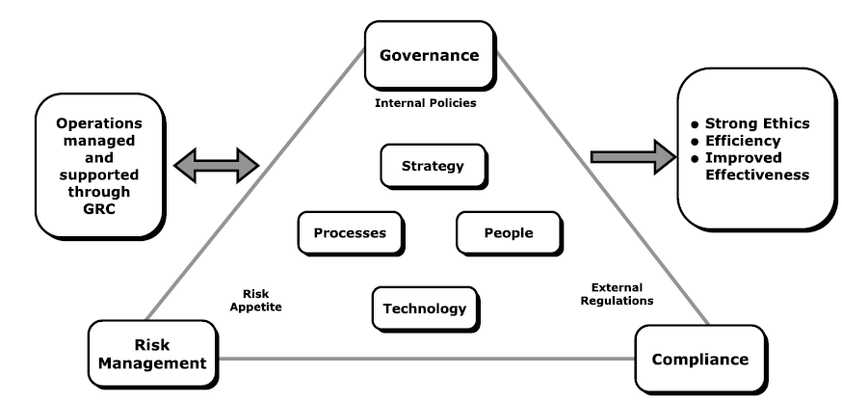
GRC Concepts

Slide 16
GRC Concepts
Internal policies are the key factors supporting governance.
External regulations drive compliance principles.
Enterprise’s risk appetite is a key element of risk management.
Requires management attention and support,
Result in correct ethical behavior, organizational efficiency, and improved effectiveness

Slide 17
GRC Concepts
The three GRC principles should be thought of in terms of one continuous and interconnecting flow of concepts.
Neither G, R, or C more important or significant than the others.

Slide 18
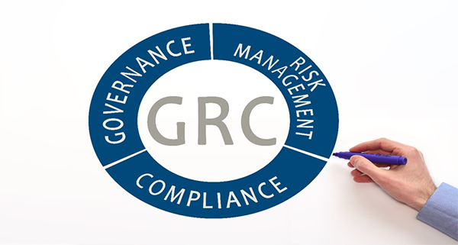
Importance of GRC Governance

Slide 19
Importance of GRC Governance
Corporate or enterprise governance is a term that refers broadly to the rules, processes, or laws by which businesses are operated, regulated, and controlled.
The term can refer to
  Internal factors defined by the officers, stockholders, or the charter and basic objectives of a corporation.
  External forces such as consumer groups, clients, and government regulations.

Slide 20
Importance of GRC Governance
At enterprise operations level, we can define enterprise governance as
The responsibilities and practices exercised by the board, executive management, and all levels of functional management with the goals of
  Providing strategic direction.
  Ensuring that objectives are achieved.
  Ascertaining that risks are managed appropriately.
  Verifying that the enterprise’s resources are used responsibly.

Slide 21
Importance of GRC Governance
Governance really refers to the process of
  Establishing rules and procedures within all levels of an enterprise
  Communicating those rules to appropriate levels of stakeholders
  Monitoring performance against those rules
  Administering rewards and punishments based on the relative performance or compliance with those rules

Slide 22
Importance of GRC Governance
A well-defined and enforced set of corporate governance principles provides a structure that works for the benefit of everyone concerned by ensuring that the enterprise adheres to accepted ethical standards and best practices as well as to formal laws.

Slide 23
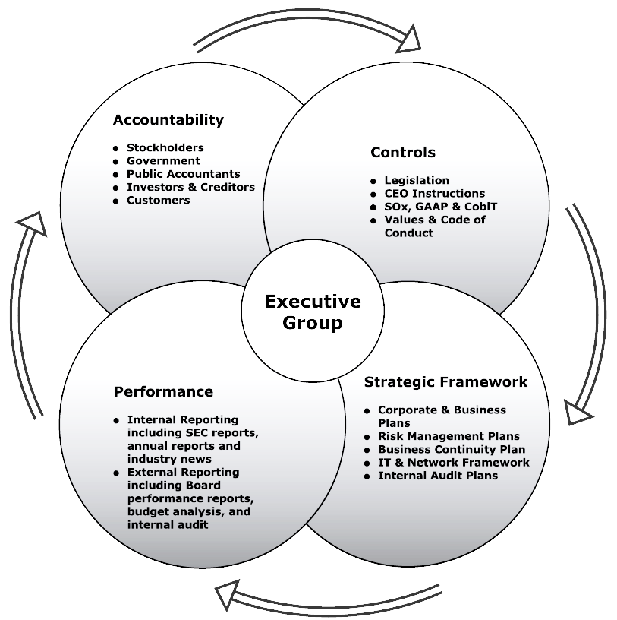
GRC Governance Concepts

Slide 24

Risk Management Component of GRC

Slide 25
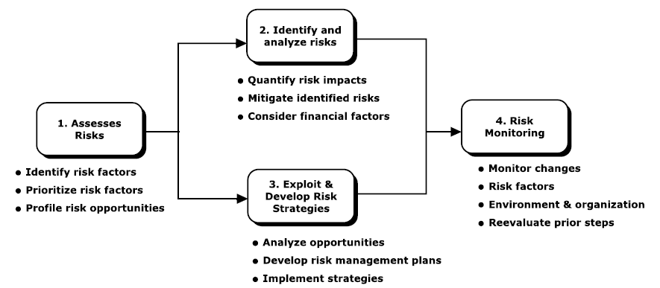
Risk Management Component of GRC
Risk Management should be part of the overall enterprise culture from the board of directors and very senior officers down through the enterprise.

Slide 26
Risk Management Component of GRC
1- Risk assessment and planning.
  An enterprise faces all levels of risks, whether global issues based on weather or currency threats to weather-related threats at local operations.
  We cannot plan or identify every type of risk that might impact an enterprise, but there should be an ongoing analysis of these various potential risks that may face an enterprise.

Slide 27
Risk Management Component of GRC
2- Risk identification and analysis
  There is a need for a more detailed analysis on the likelihood of these risks coming to fruition as well as their potential impacts.
  There is a need to quantify the impacts of the identified risks and to determine mitigation strategies in the event the risk event occurs.
  Mitigation refers to assessing the best way to manage or eliminate an identified risk.

Slide 28
Risk Management Component of GRC
3- Exploit and develop risk response strategies.
  Essentially a concept that should be considered in parallel with risk identification, an enterprise should develop plans and strategies to return to normal operations and then recover from the risk event.
  This may include an analysis of risk-related opportunities.

Slide 29
Risk Management Component of GRC
4- Risk monitoring.
  Tools and facilities should be in place to monitor for the identified risks possibly occurring.
  Most risk-related monitoring requires a wide series of special reports, established and measurable standards, and a diligent human resources function.
  The idea is to keep ahead and to reenter these prior risk management steps as necessary.

Slide 30
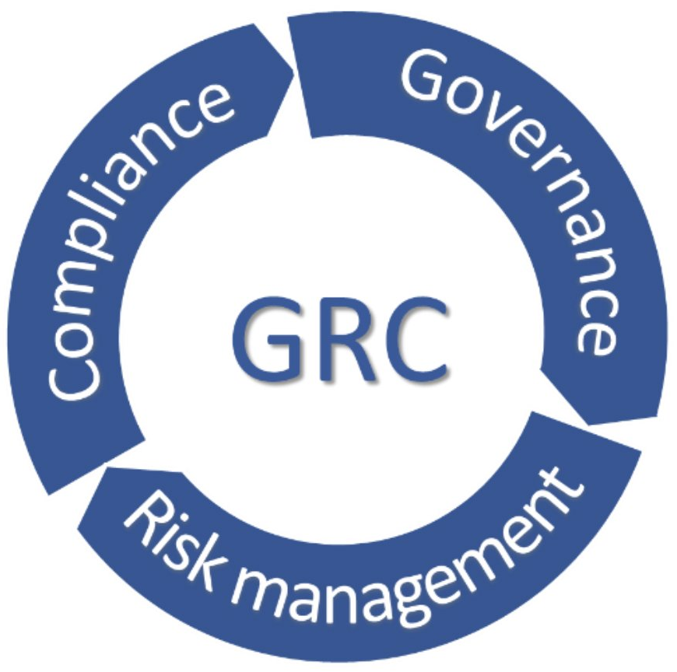
GRC and Enterprise Compliance

Slide 31
GRC and Enterprise Compliance
Compliance is the process of adhering to a set of guidelines or rules established by government agencies, standards groups, or internal corporate policies.
Adhering to these compliance-related requirements is a challenge

Slide 32
GRC and Enterprise Compliance
Adhering to these compliance-related requirements is a challenge because of
  The frequent introduction of new regulations.
  Vaguely written regulations that require interpretation.
  No consensus on best practices used for compliance.
  Multiple regulations often overlap.
  Constantly changing regulations.

Slide 33
GRC and Enterprise Compliance
The Frequent Introduction Of New Regulations
Regulation is a fundamental tool for managing the risks present in society and the economy and can help to reduce the incidence of hazardous events and their severity.
  Examples (New studies, Privacy issues, etc..)
Companies have a challenge to monitor these rules and determine which apply to them.

Slide 34
GRC and Enterprise Compliance
Vaguely Written Regulations That Require Interpretation
Some regulations was printed on many thousands of pages, covering issues and rules that the legislators who passed the bill never even read, let alone understood.
Even today, we are still looking at these rules and interpreting what they mean.
Compliance with those types of rules can be difficult.

Slide 35
GRC and Enterprise Compliance
No Consensus On Best Practices Used For Compliance
Rules are filled with regulations stating such things as ‘‘All transactions must be supported by a receipt.’’
Does such a rule require receipts for transactions less than $1.00, less than $25.00, or some other value?
There are often no guidelines here and everyone seems to have their own interpretations.

Slide 36
GRC and Enterprise Compliance
Multiple Regulations Often Overlap
Governmental units from different geographies may issue rules that cover similar areas but may have different requirements.
Compliance until matters are resolved can be a challenge.

Slide 37
GRC and Enterprise Compliance
Constantly Changing Regulations
Regulatory agencies in particular are often constantly changing or reinterpreting their rules, making strict compliance a challenge.
Examples (Ex post evaluation of past approaches)

Slide 38
GRC and Enterprise Compliance
Compliance becomes a continuous process, not a one-time project.
Continues to drive business agendas as organizations are being held accountable for meeting the myriad of mandates specific to their markets.
Enterprises might also be required to address cross-industry legislation.

Slide 39
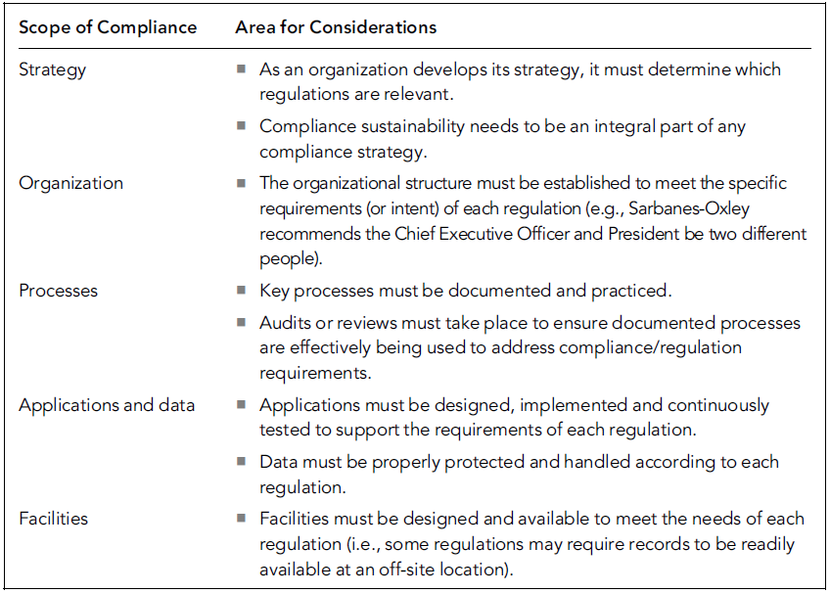
Scope of Compliance Architectures Considerations
The scope of compliance also permeates other aspects of an enterprise.

Slide 40
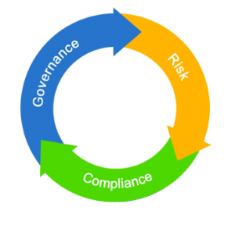
Importance of Effective GRC Practices and Principles

Slide 41
Importance of Effective GRC Practices and Principles
Corporate Governance has received increased attention because of high-profile scandals involving abuse of corporate power and, in some cases, alleged criminal activity by corporate officers.
An integral part of an effective corporate governance regime includes provisions for civil or criminal prosecution of individuals who conduct unethical or illegal acts in the name of the enterprise.

Slide 42
Importance of Effective GRC Practices and Principles
Risk management should create value and be an integral part of organizational processes.
It should be part of decision-making processes and be tailored in a systematic and structured manner to explicitly address the uncertainties an enterprise faces based on the best available information.
In addition, risk management processes should be dynamic, iterative, and responsive to change with the capabilities of continual improvements and enhancements.

Slide 43
Importance of Effective GRC Practices and Principles
A consistent approach on the use of compliance driven capabilities and supporting technologies across an enterprise can provide these potential benefits:
  Reduced total cost of ownership.
  Flexibility.
  Competitive advantage.

Slide 44
Importance of Effective GRC Practices and Principles
Reduced total cost of ownership.
  For example, many regulations specify document retention requirements, which can be met by a single investment in a content and records management system.
Flexibility.
  By centrally managing compliance initiatives via organization-wide compliance architecture, an enterprise can quickly adapt to these changes.
Competitive advantage.
  better understand and control their business processes, which allows them to respond more quickly and accurately to external or internal pressures.

Slide 45
Summary

Slide 46
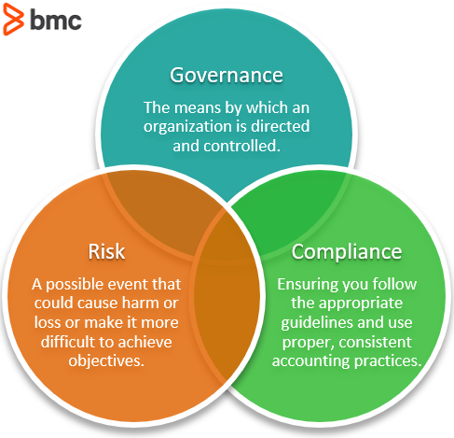

Slide 47
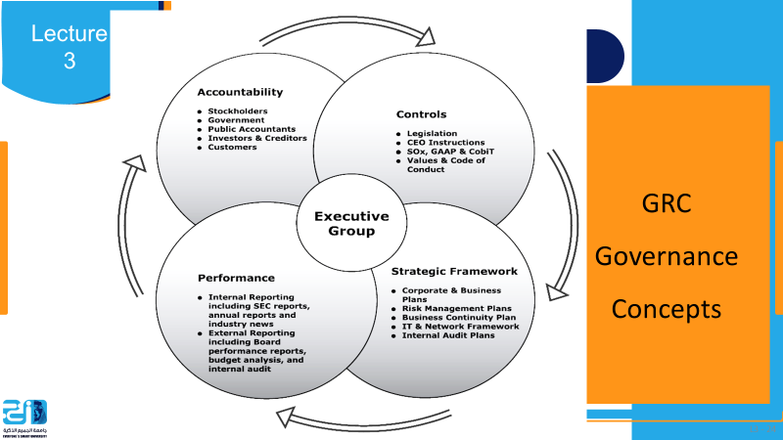
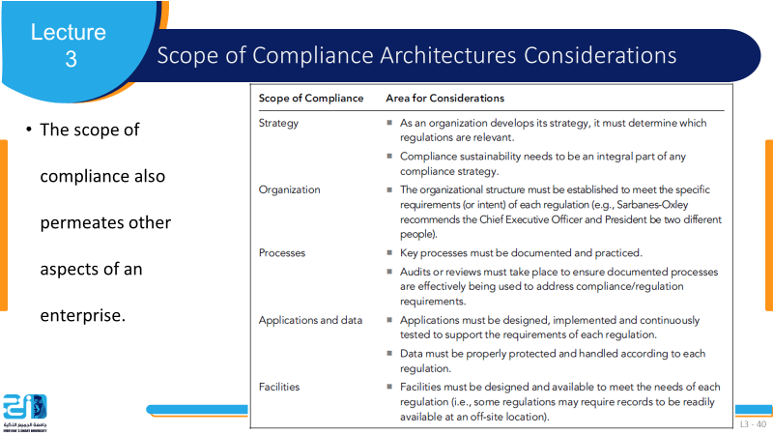
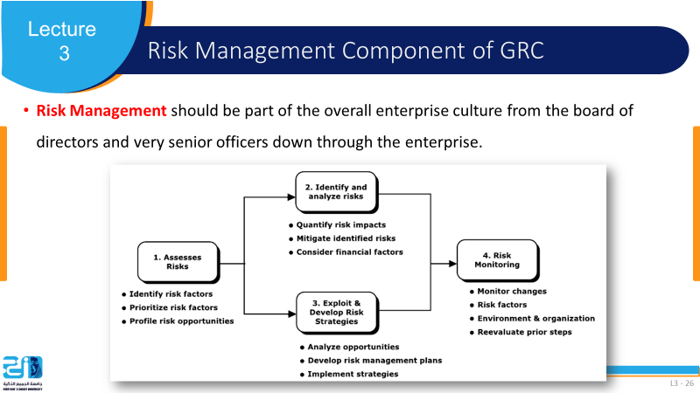

Slide 48
References
COSO Enterprise Risk Management: Establishing Effective Governance, Risk, and Compliance Processes. Robert R. Moeller.

