Slide 1


Slide 2


Slide 3
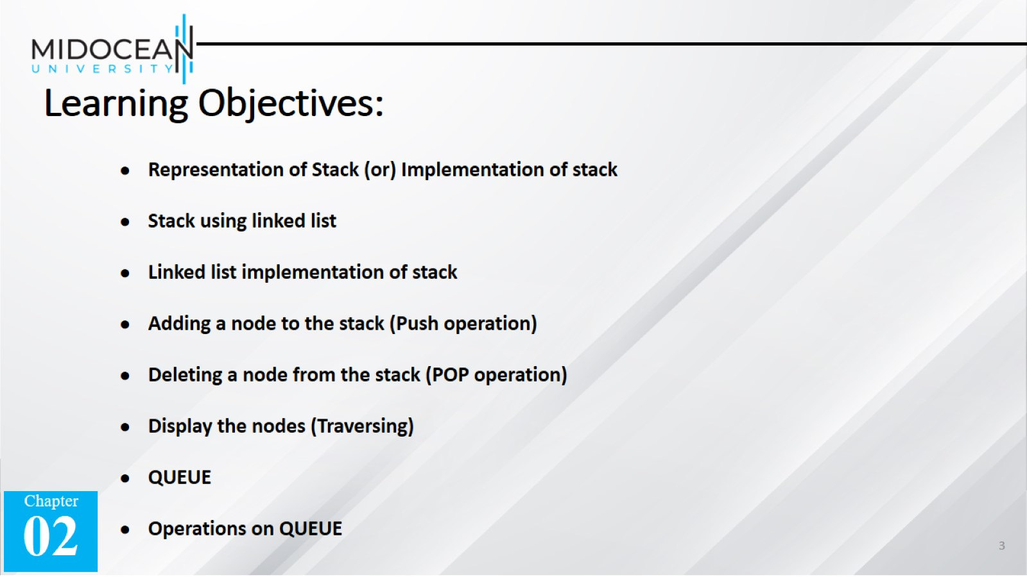
Learning Objectives:

Slide 4
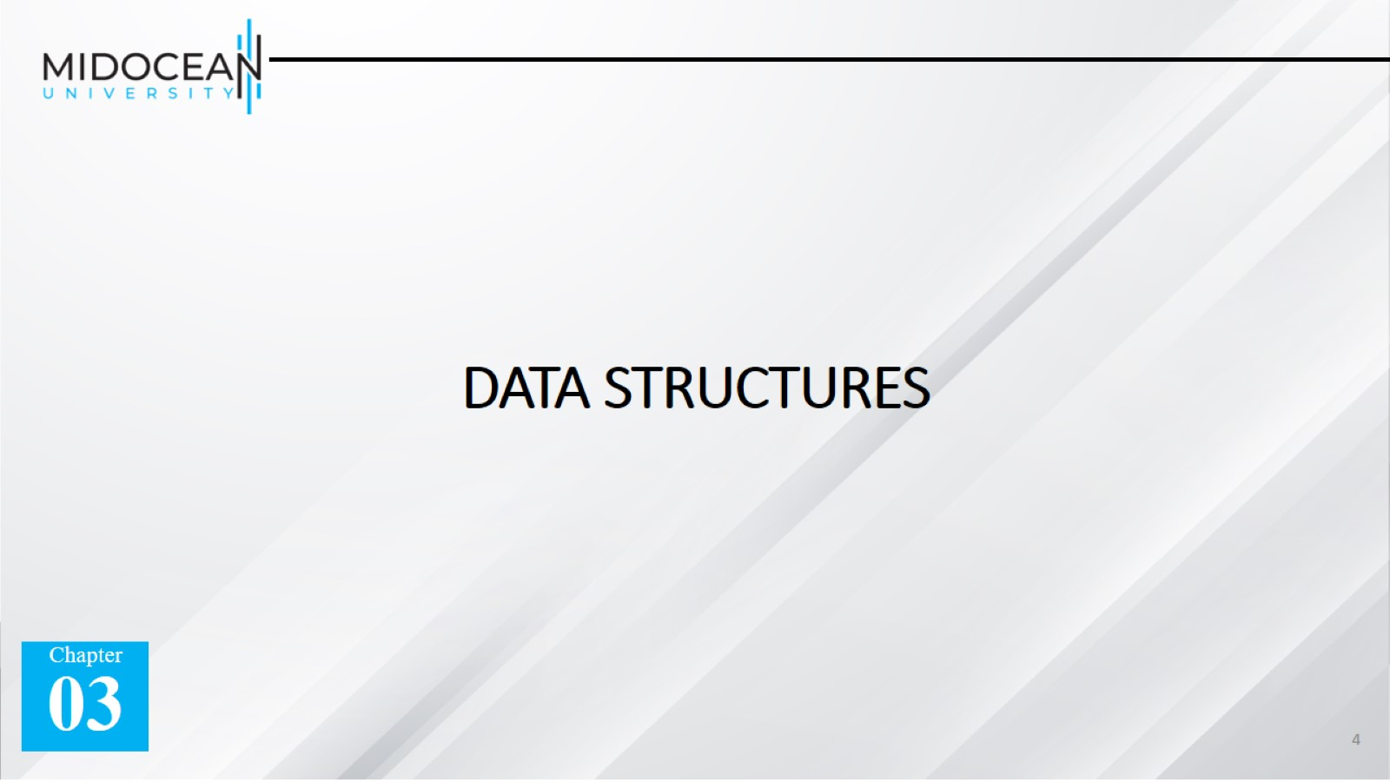
DATA STRUCTURES

Slide 5
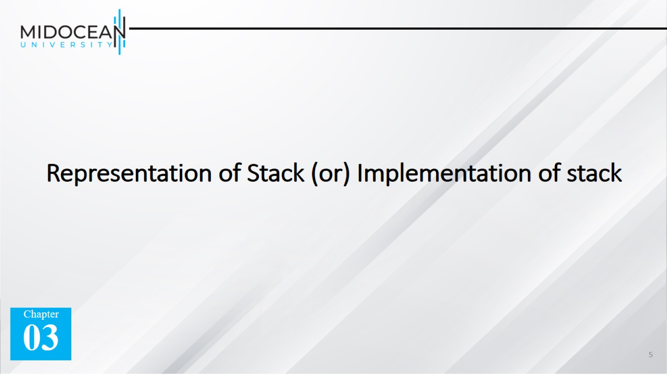
Representation of Stack (or) Implementation of stack

Slide 6
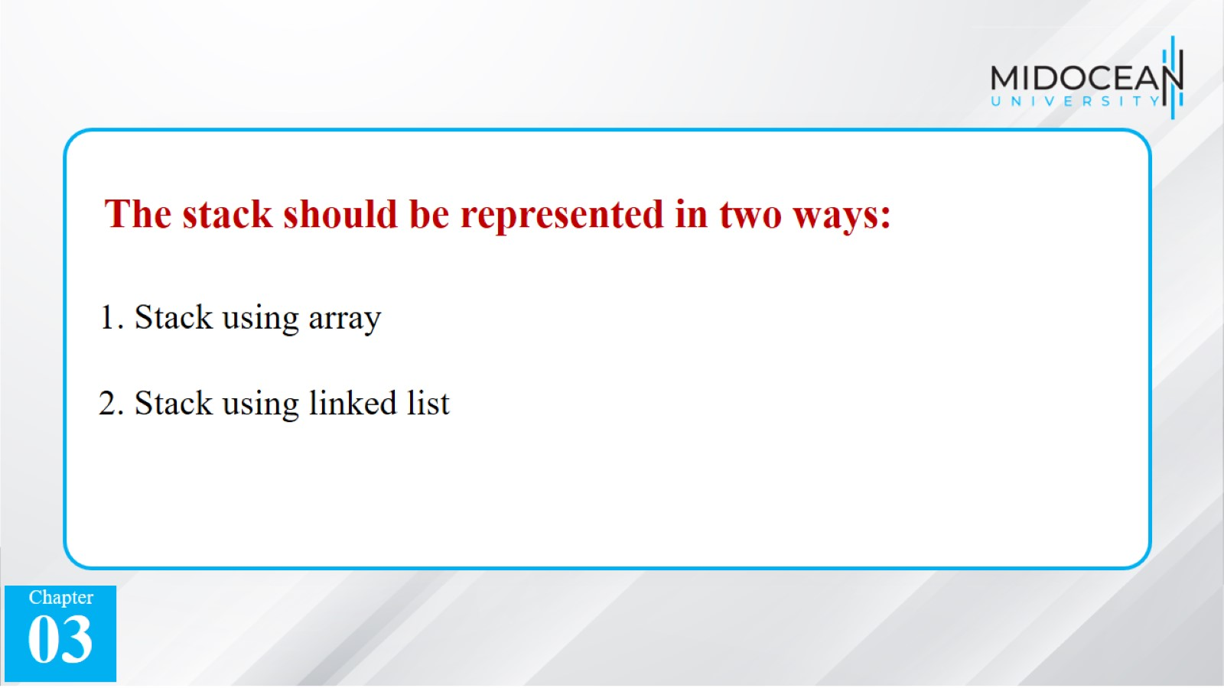

Slide 7
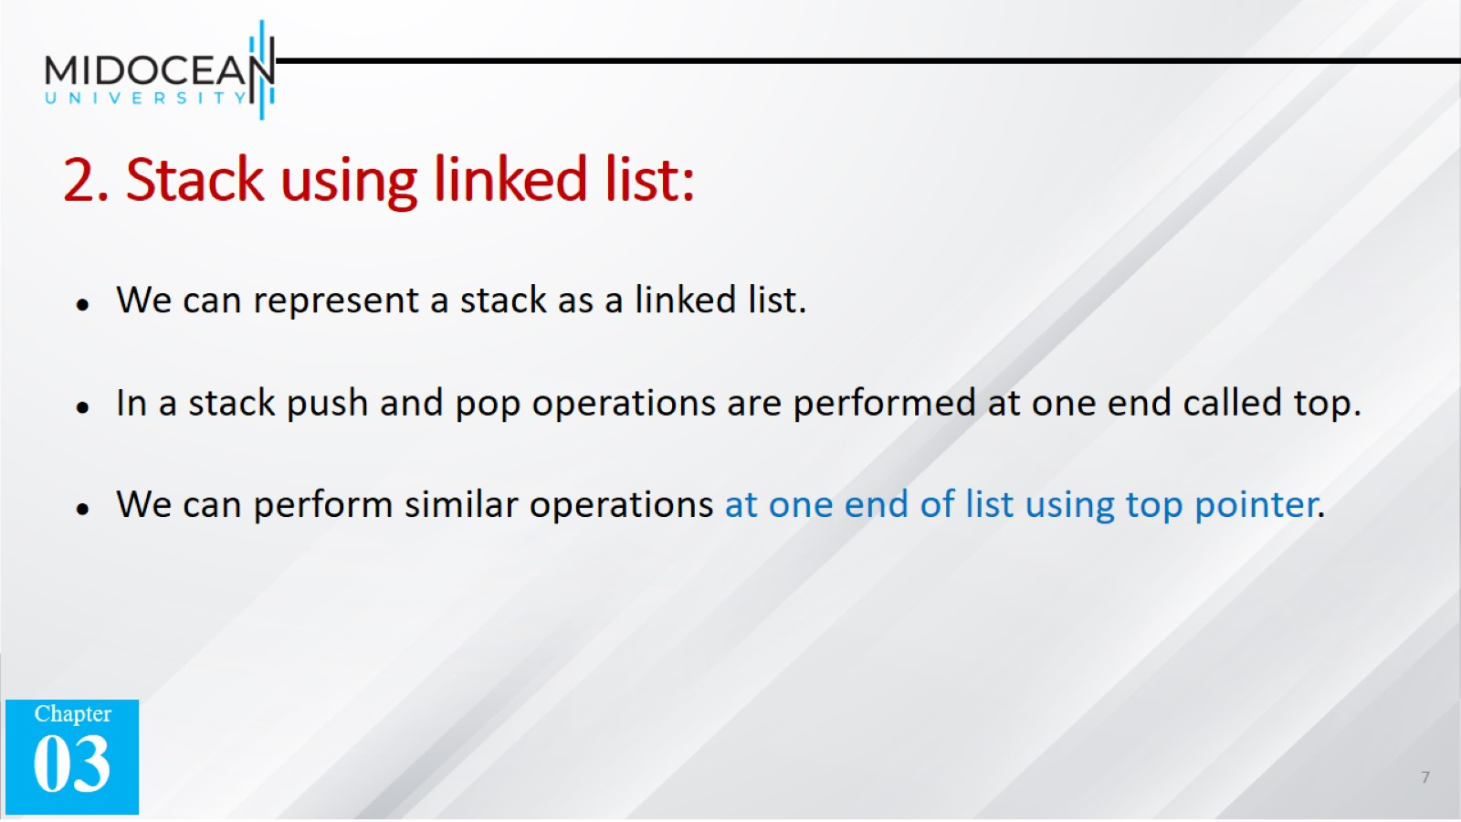
2. Stack using linked list:

Slide 8
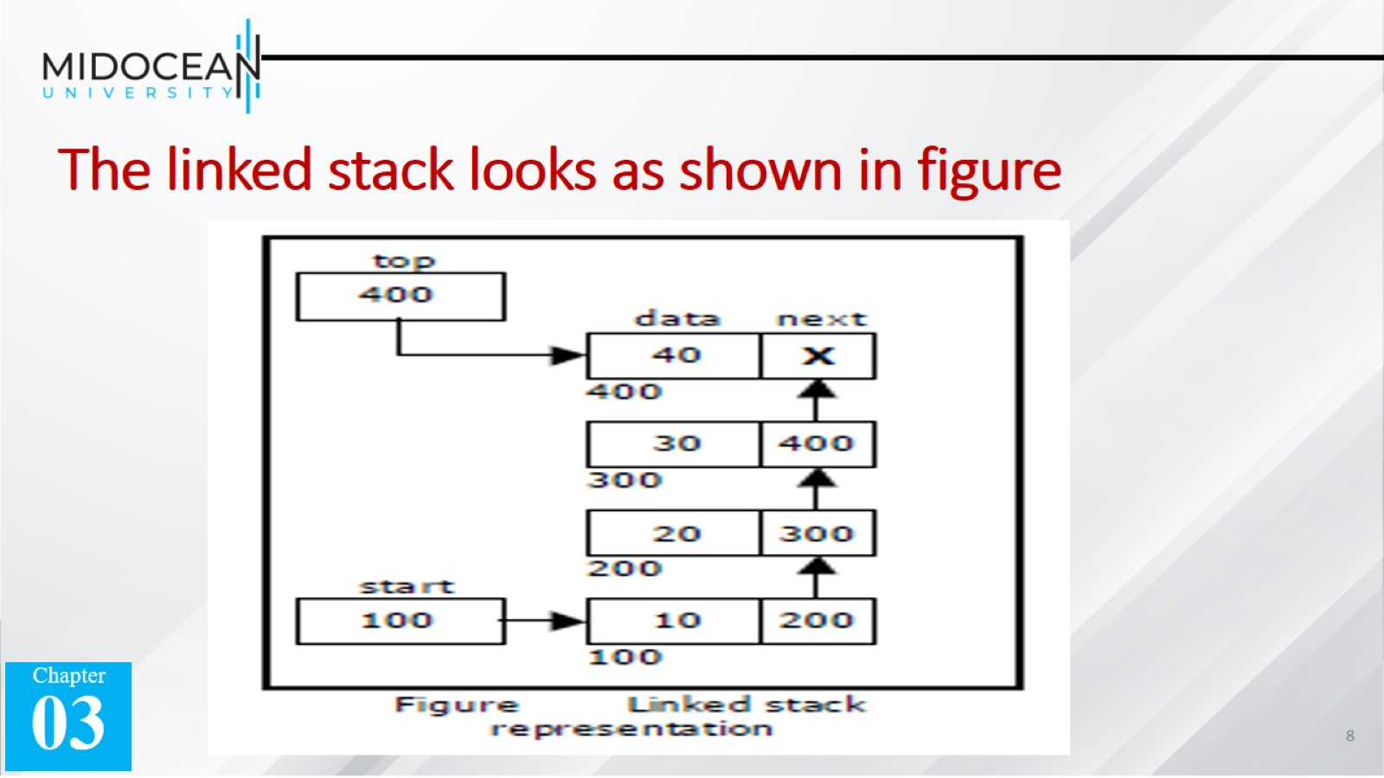
The linked stack looks as shown in figure

Slide 9


Slide 10
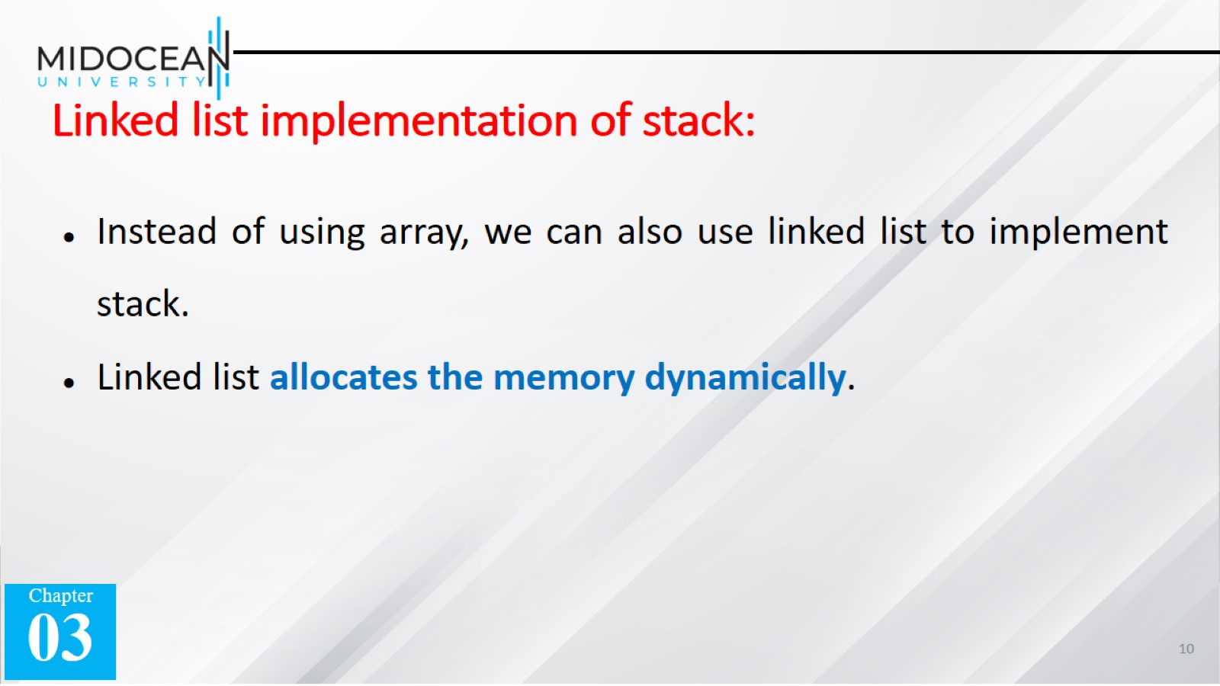
Linked list implementation of stack:

Slide 11
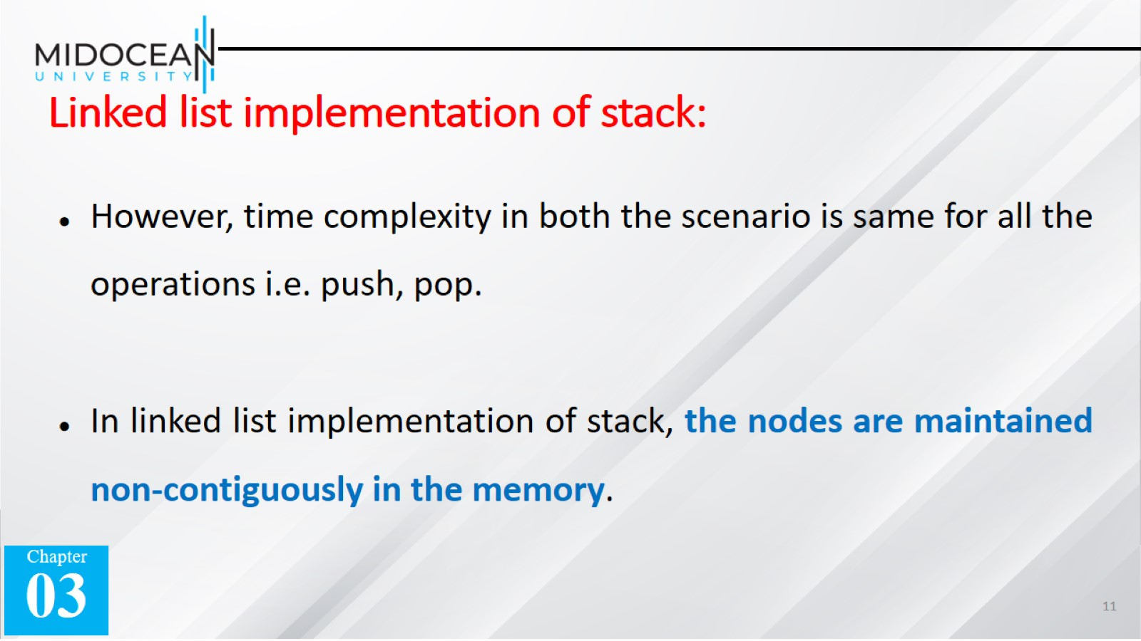
Linked list implementation of stack:

Slide 12
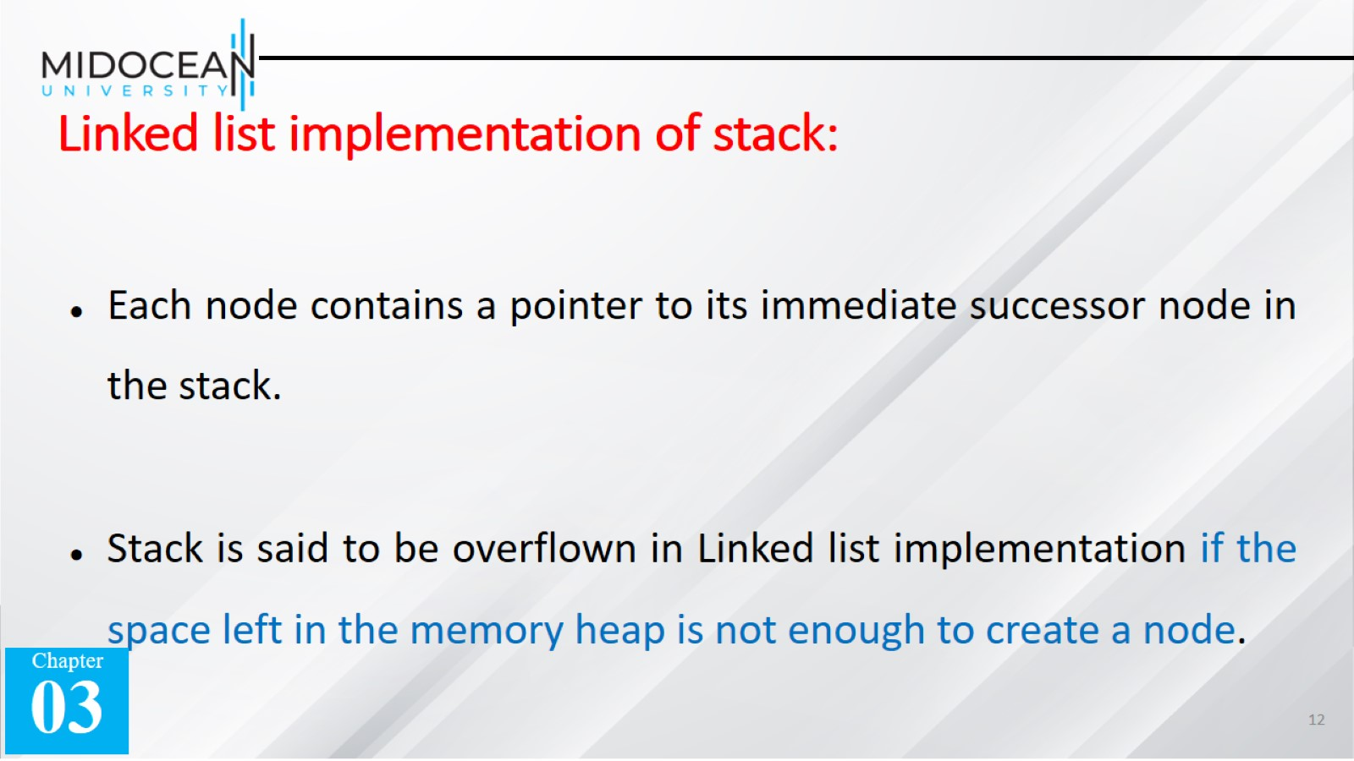
Linked list implementation of stack:

Slide 13
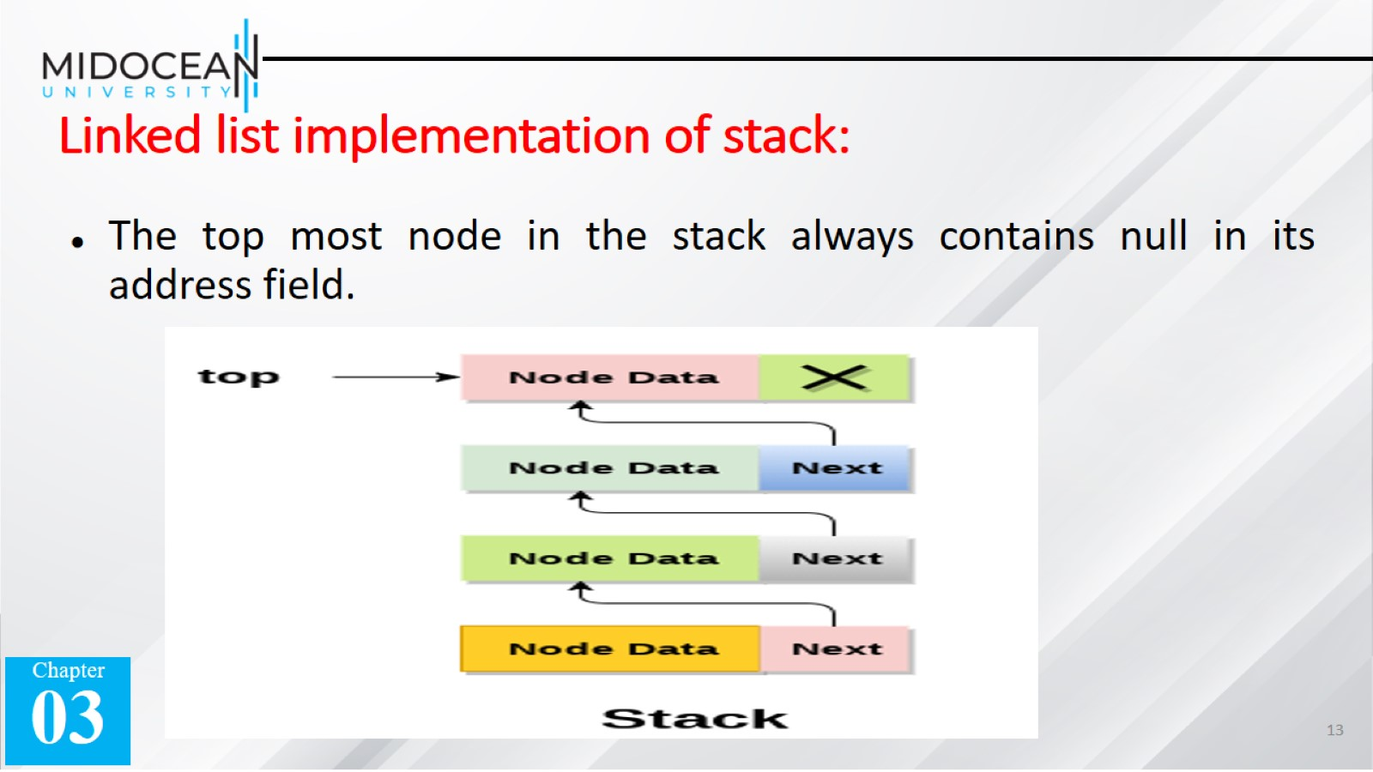
Linked list implementation of stack:

Slide 14

The linked stack looks as shown in figure

Slide 15
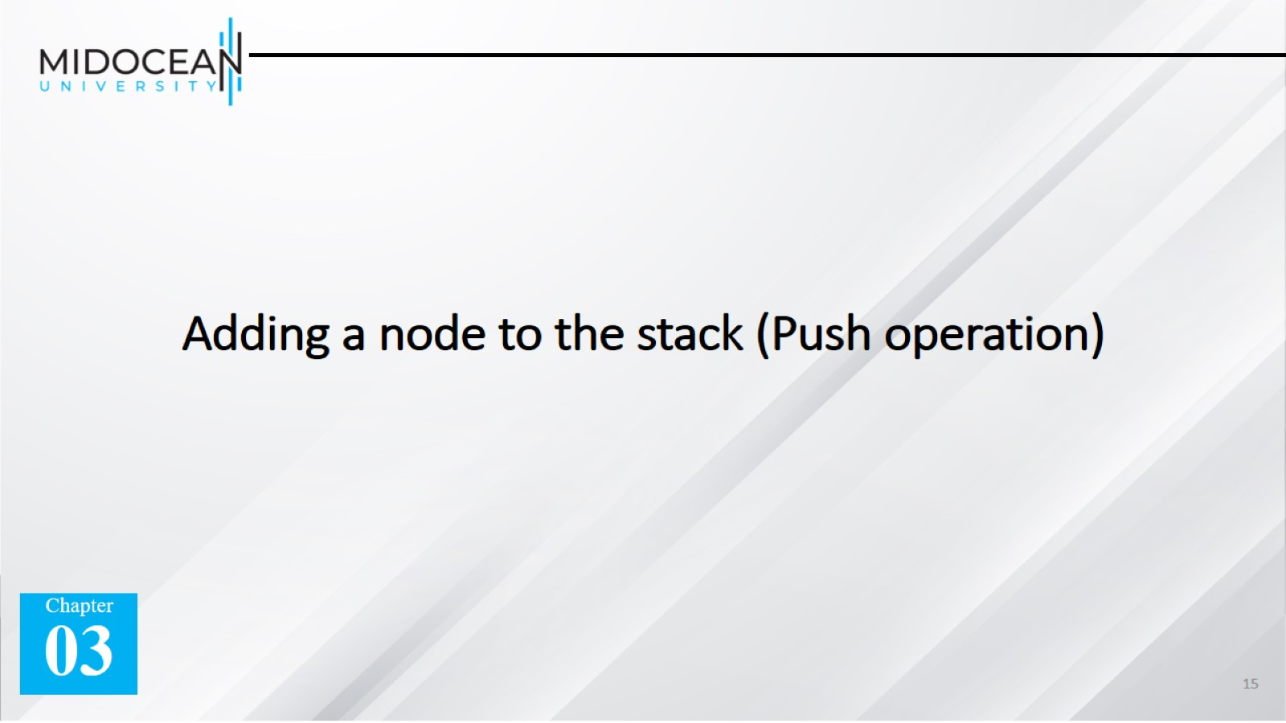
Adding a node to the stack (Push operation)

Slide 16
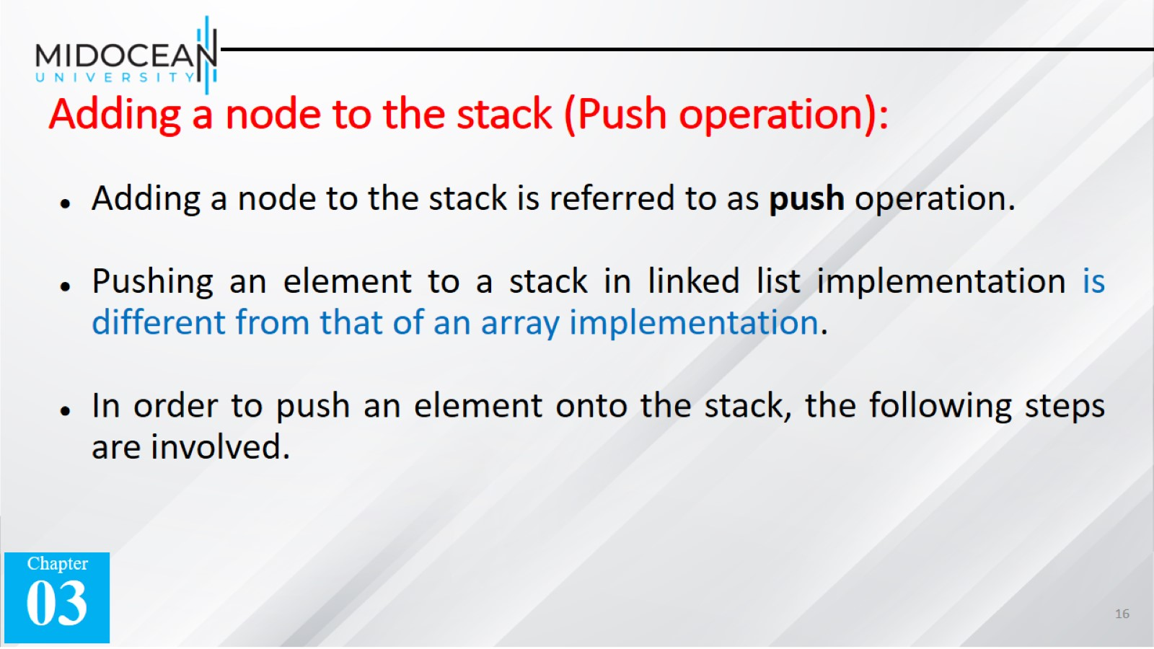
Adding a node to the stack (Push operation):

Slide 17
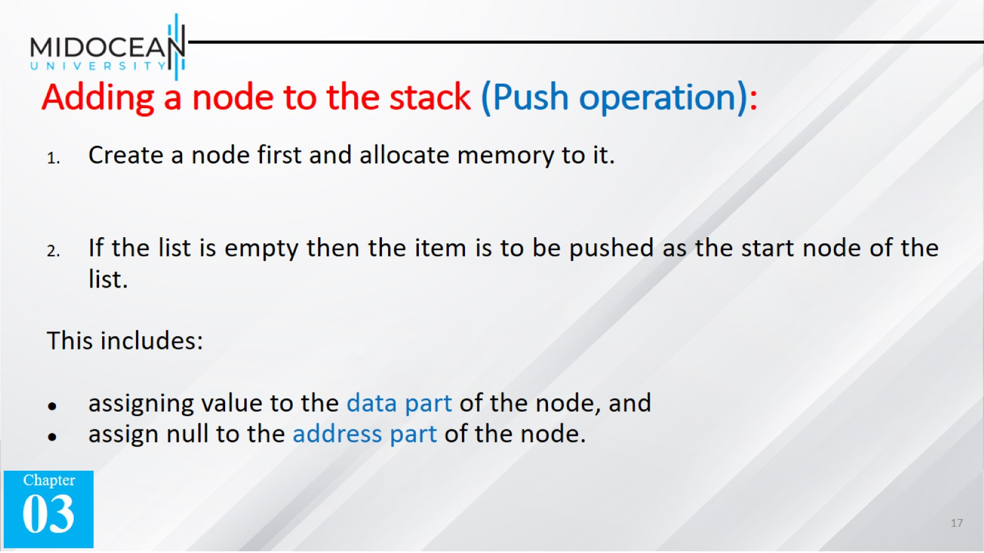
Adding a node to the stack (Push operation):

Slide 18
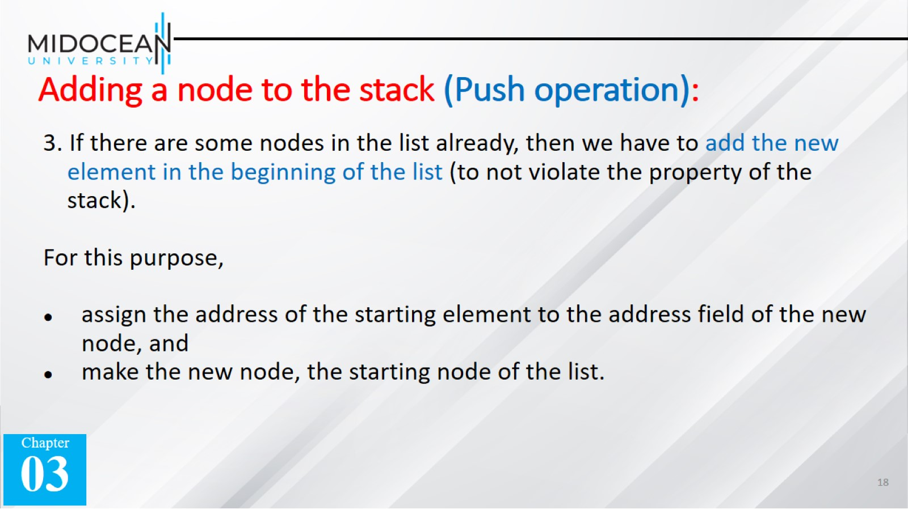
Adding a node to the stack (Push operation):

Slide 19
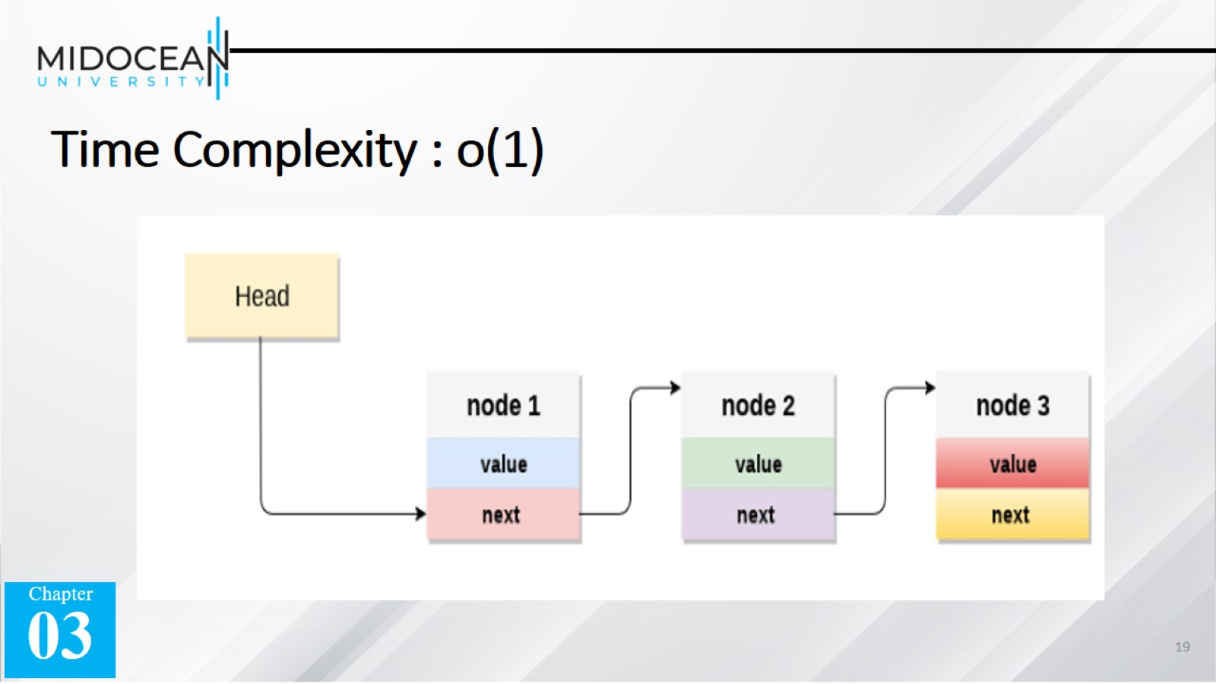
Time Complexity : o(1)

Slide 20

Deleting a node from the stack (POP operation)

Slide 21
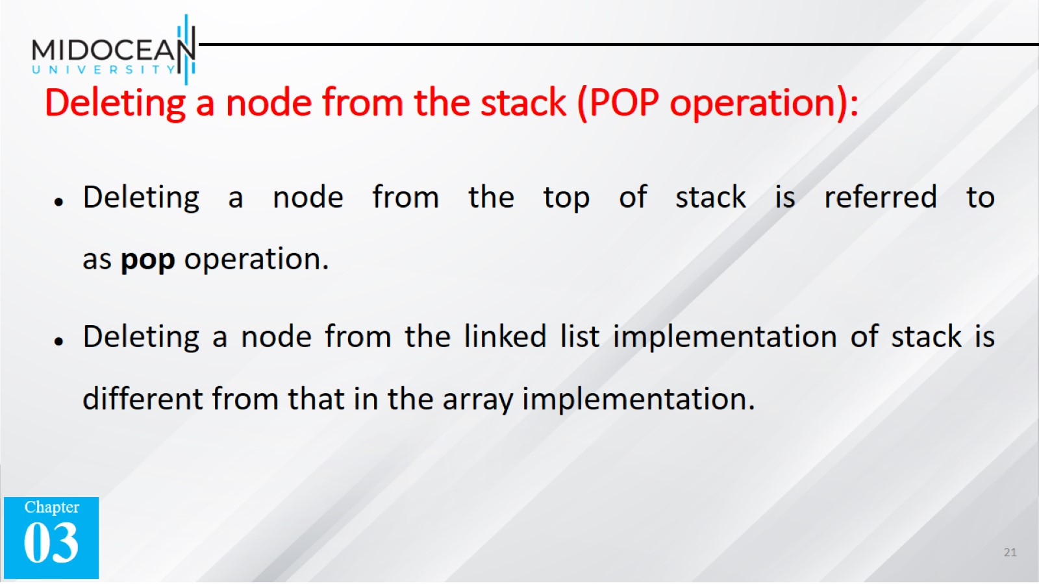
Deleting a node from the stack (POP operation):

Slide 22
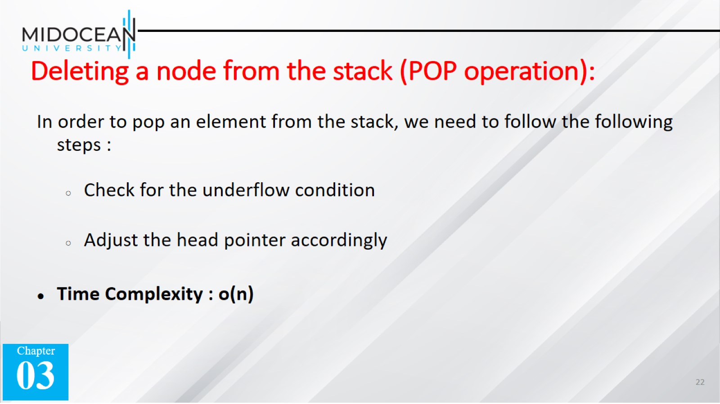
Deleting a node from the stack (POP operation):

Slide 23
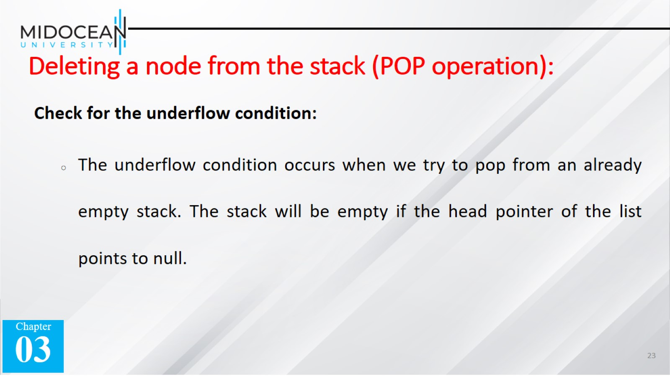
Deleting a node from the stack (POP operation):

Slide 24
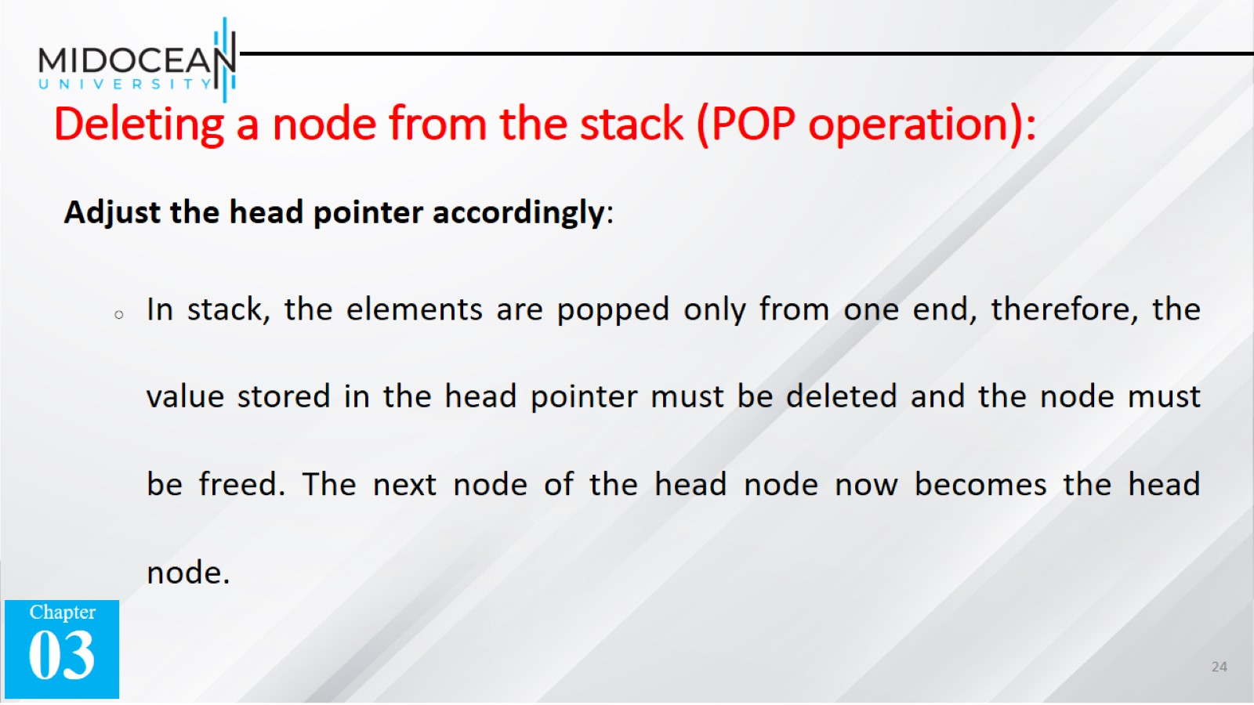
Deleting a node from the stack (POP operation):

Slide 25
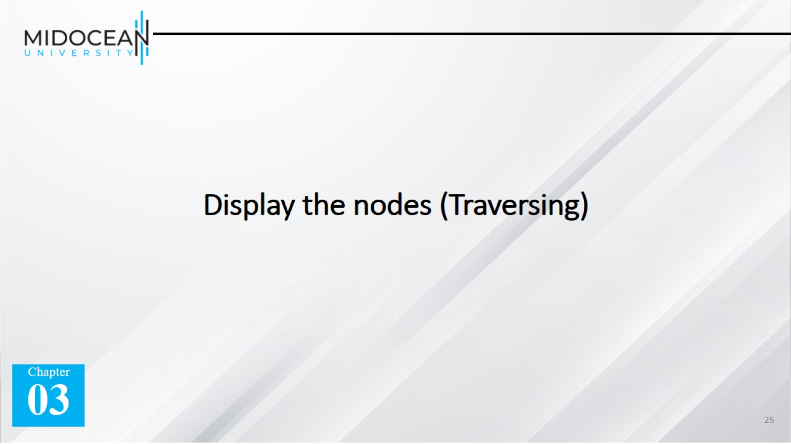
Display the nodes (Traversing)

Slide 26
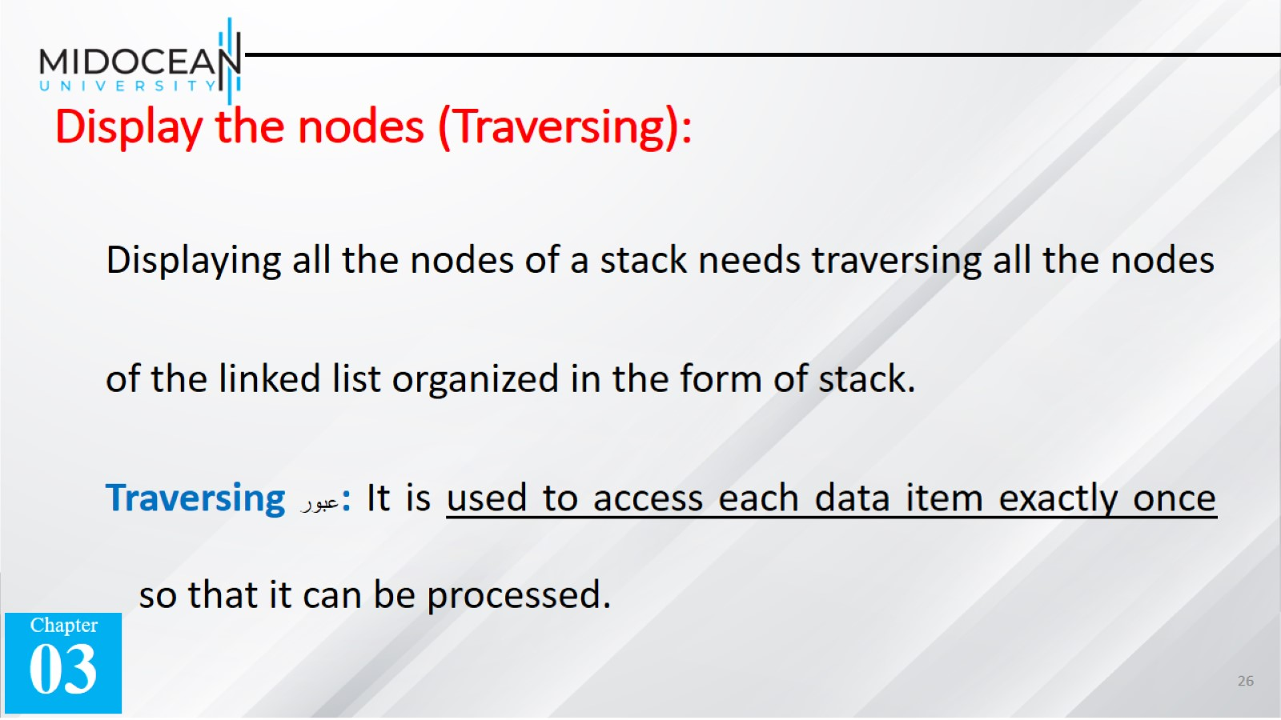
Display the nodes (Traversing):

Slide 27
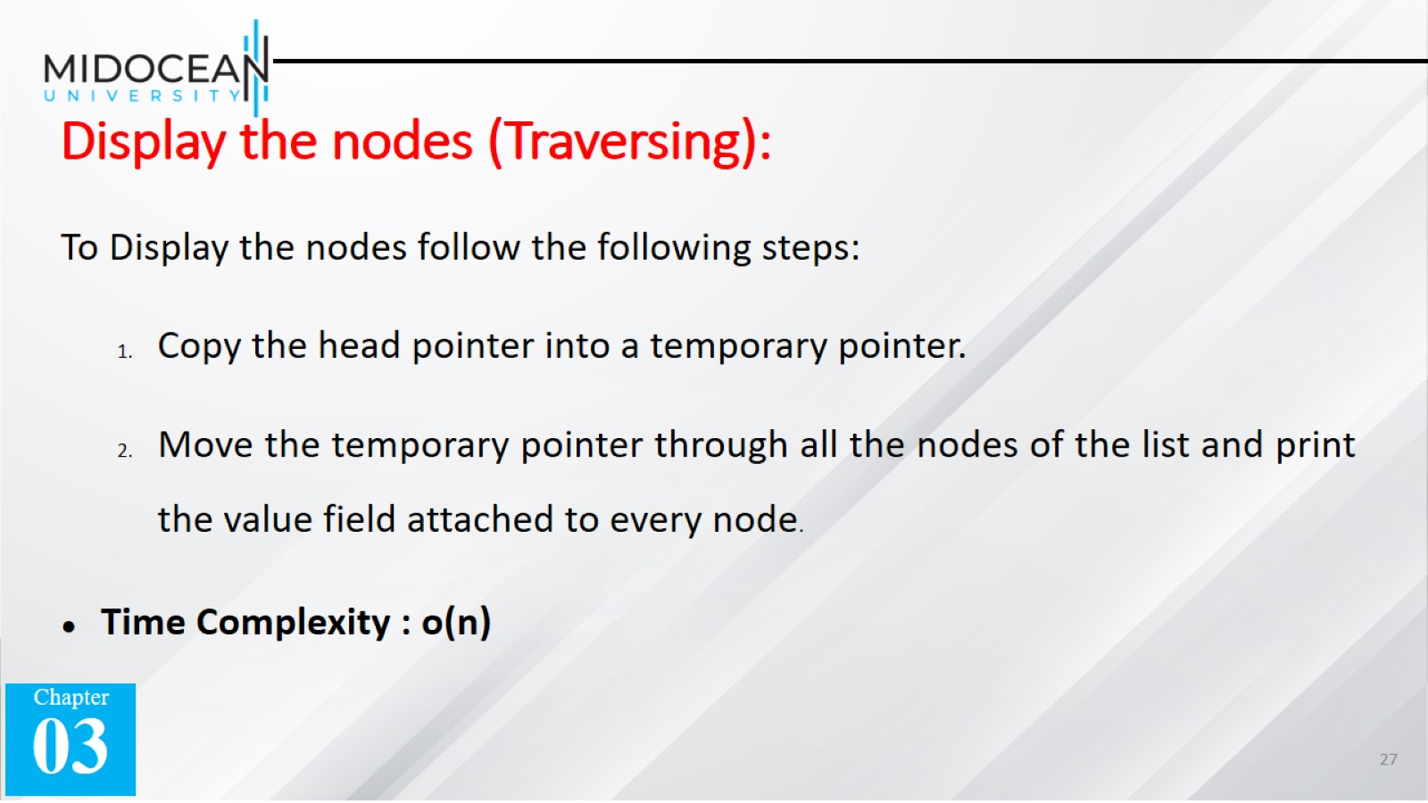
Display the nodes (Traversing):

Slide 28


Slide 29
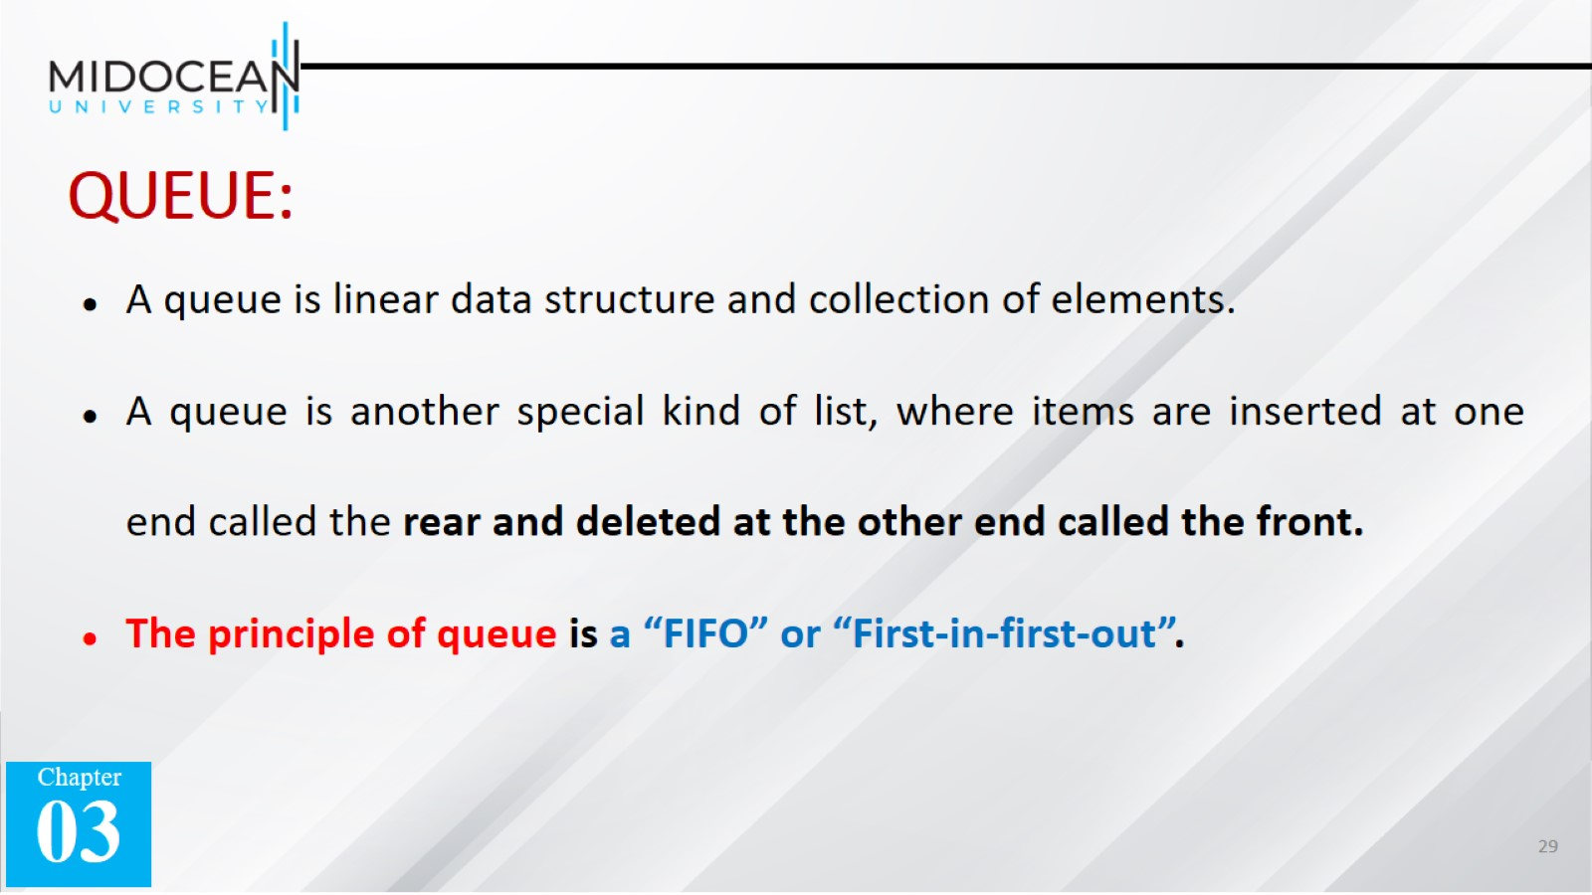
QUEUE:

Slide 30
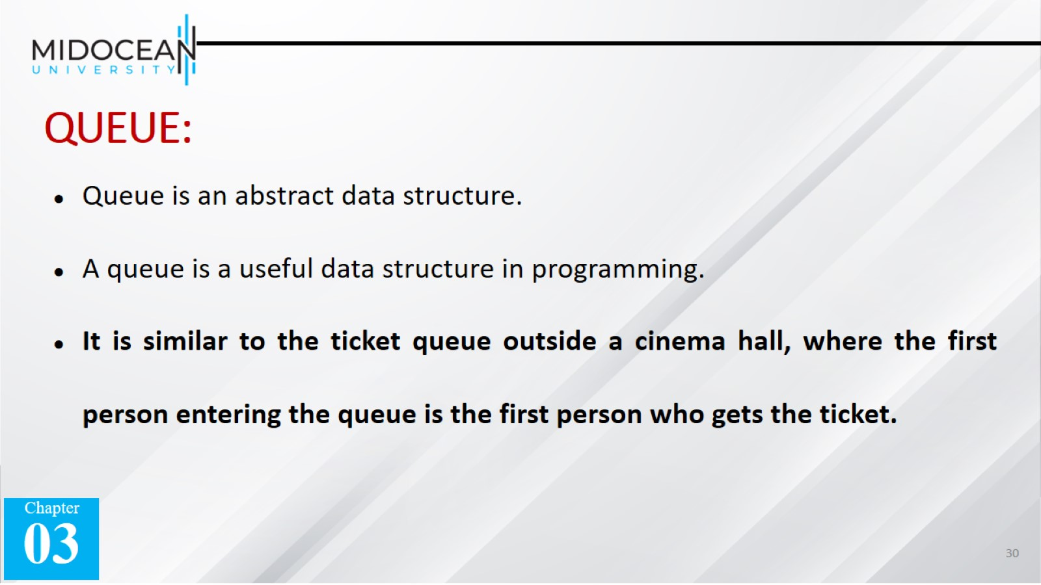
QUEUE:

Slide 31

Real-world examples of queue

Slide 32
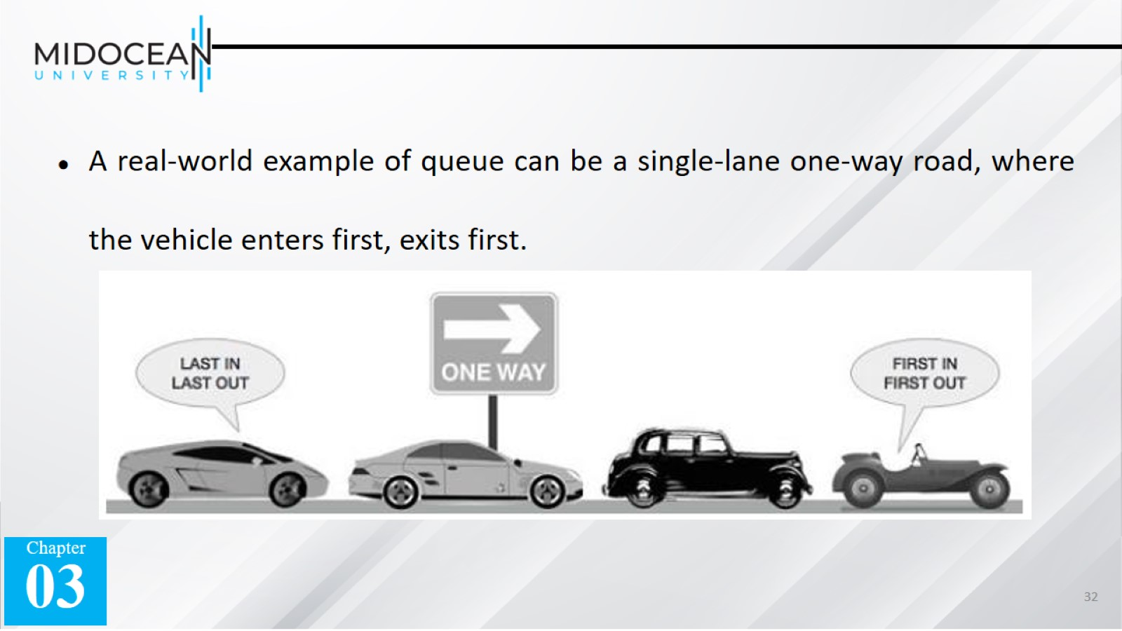
A real-world example of queue can be a single-lane one-way road, where the vehicle enters first, exits first.

Slide 33
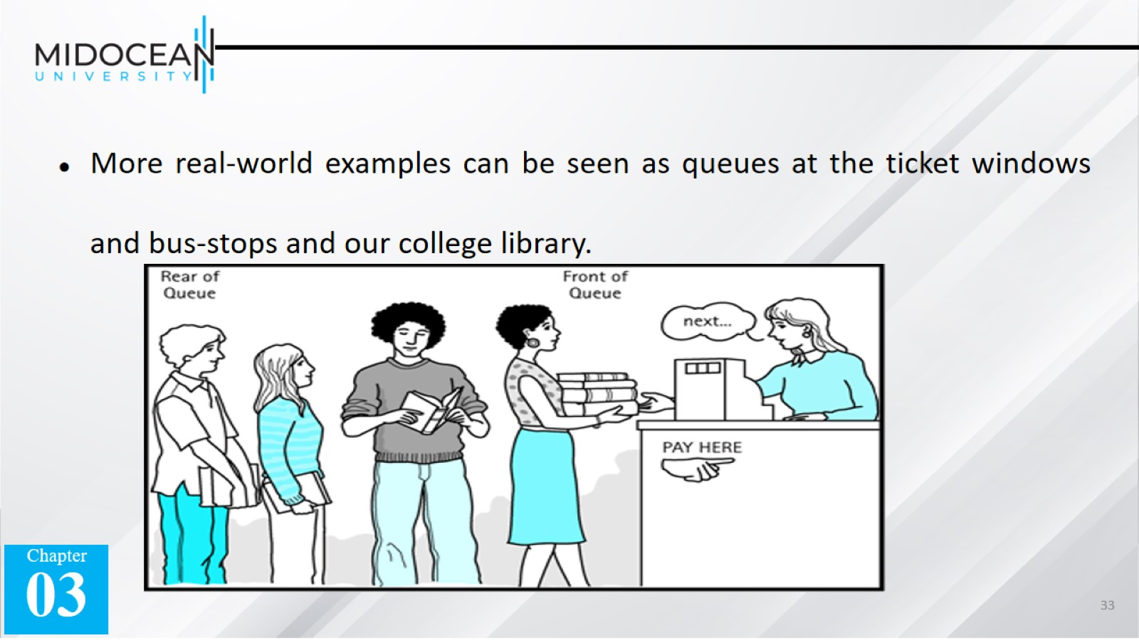
More real-world examples can be seen as queues at the ticket windows and bus-stops and our college library.

Slide 34


Slide 35
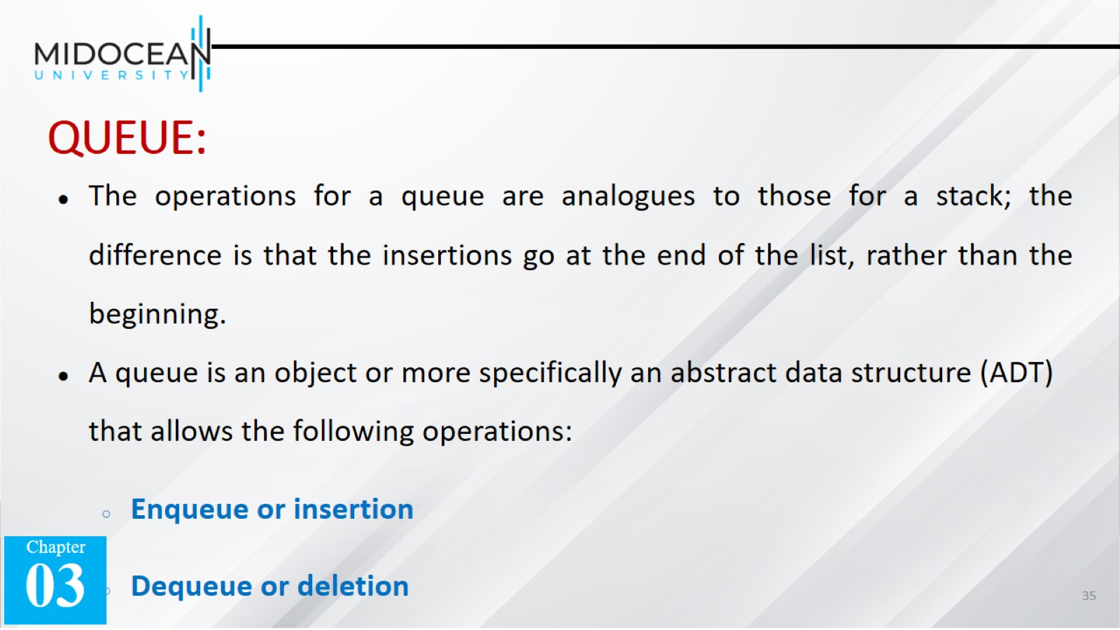
QUEUE:

Slide 36
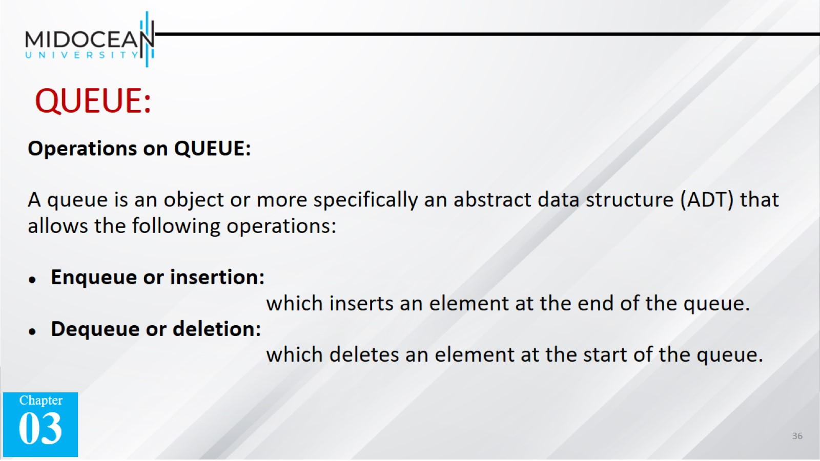
QUEUE:

Slide 37
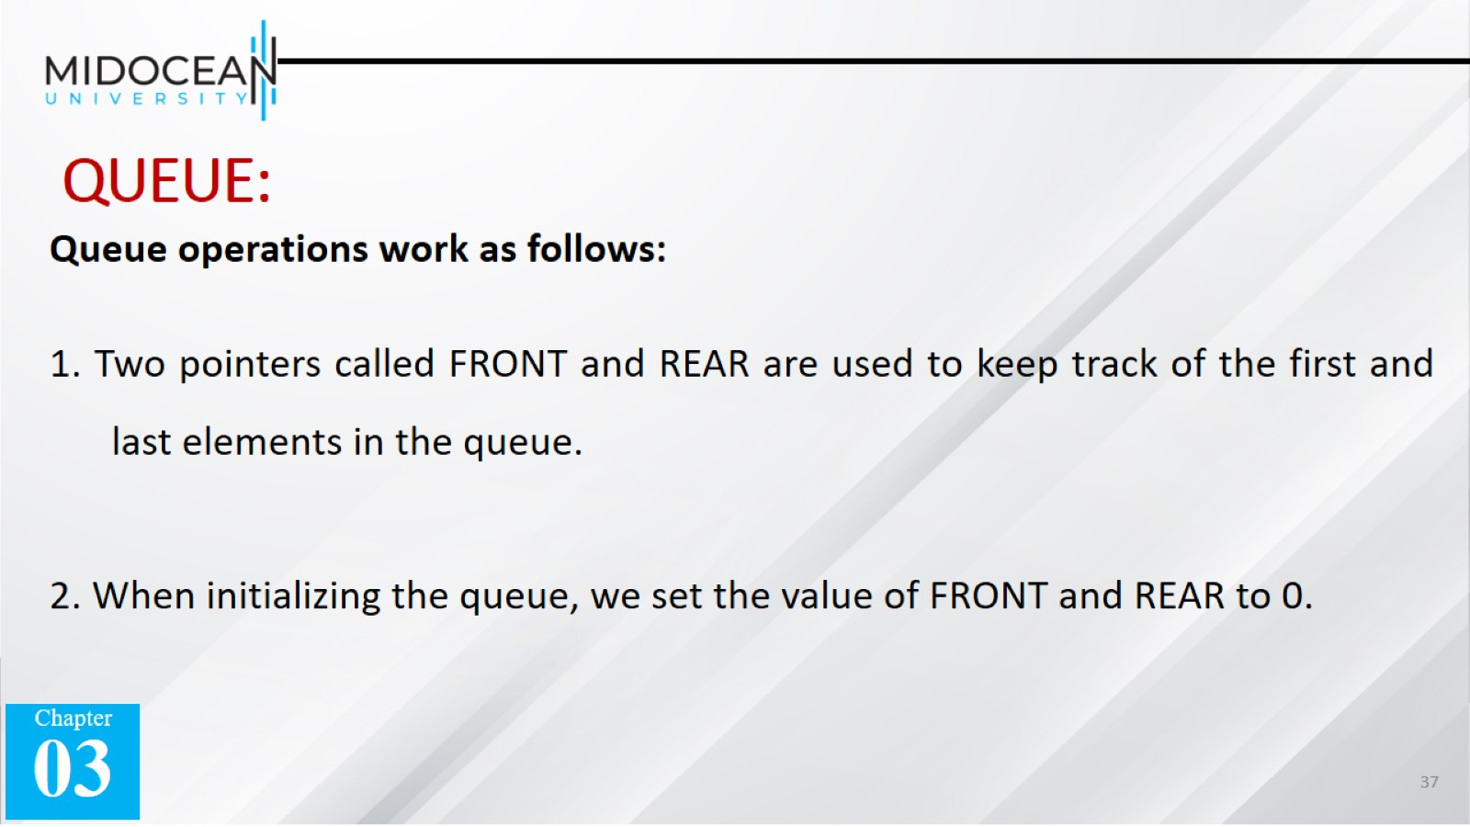
QUEUE:

Slide 38
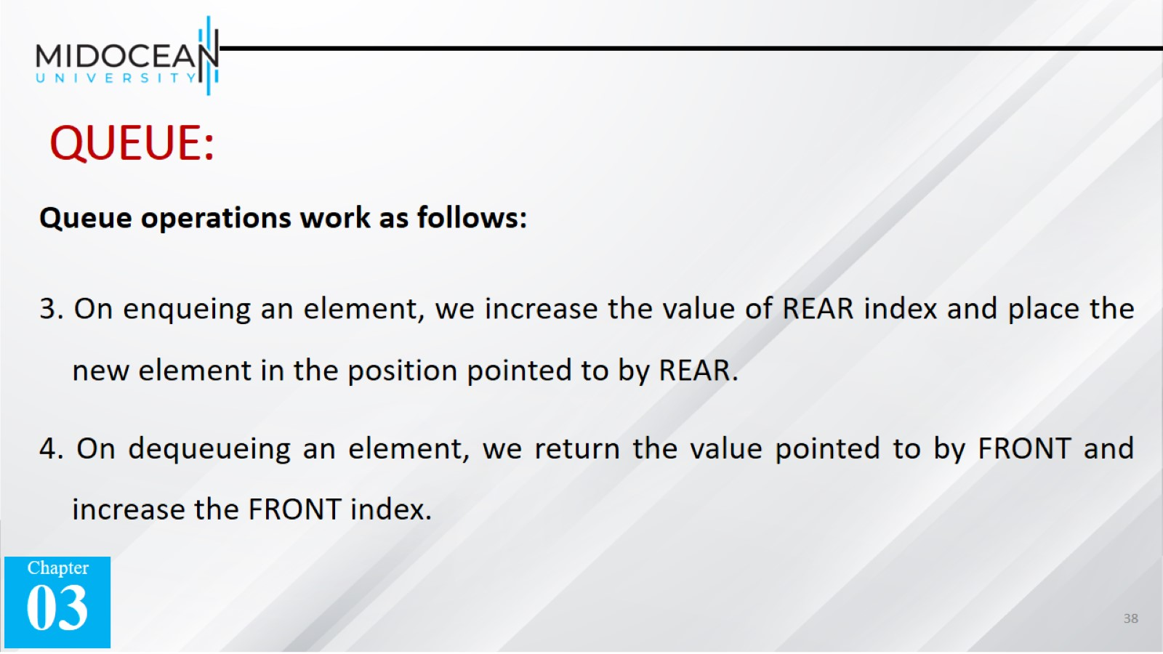
QUEUE:

Slide 39
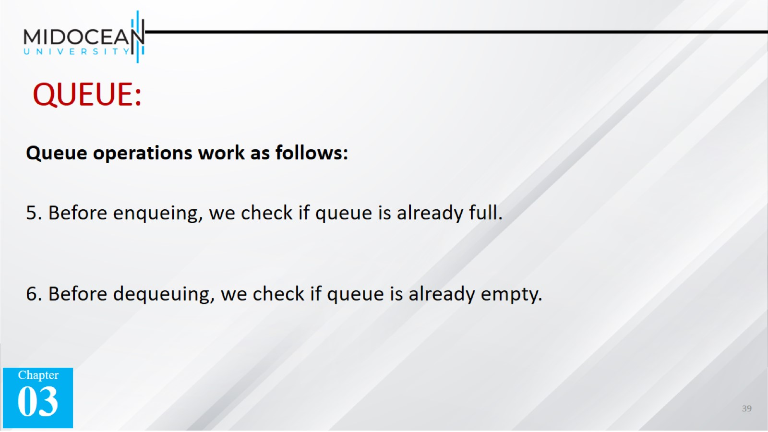
QUEUE:

Slide 40
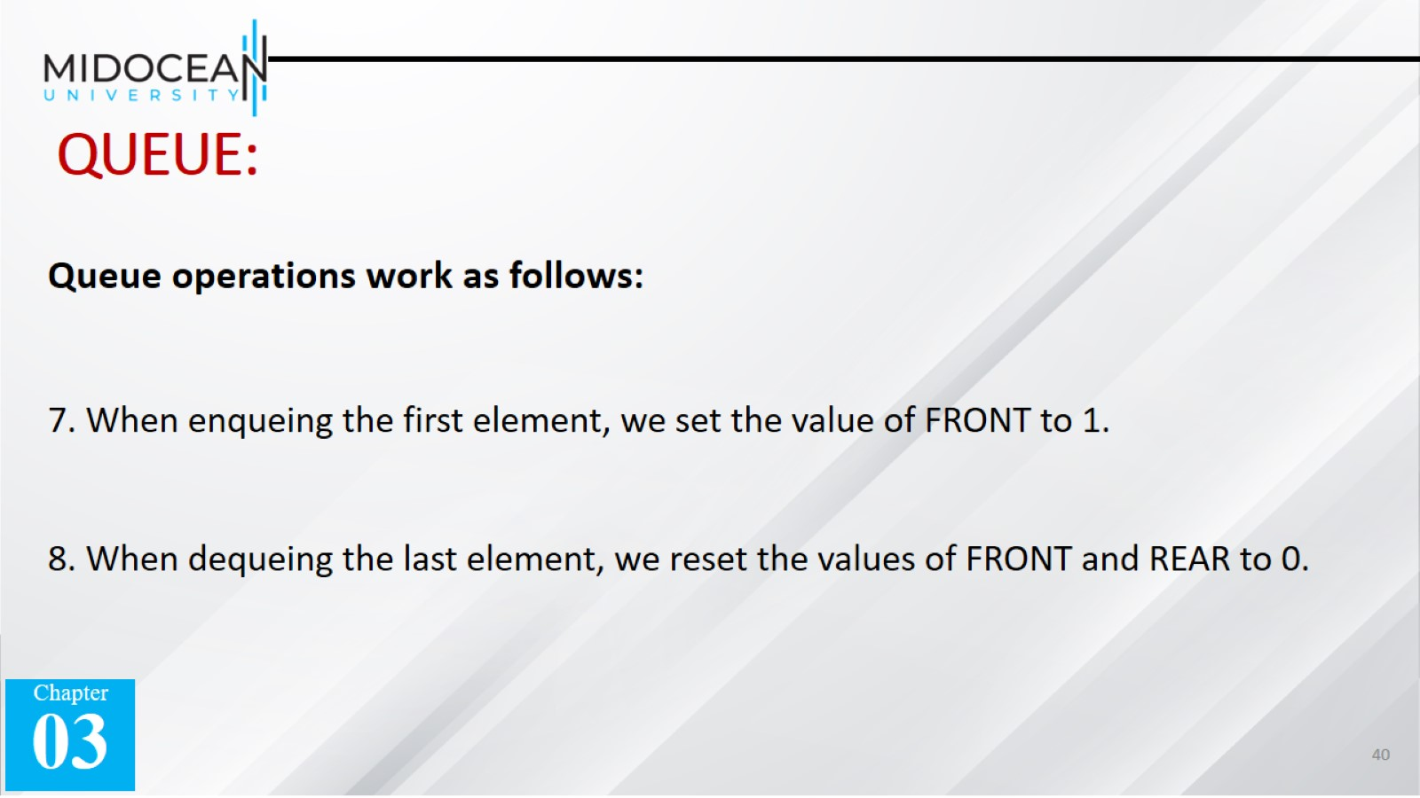
QUEUE:

Slide 41


