Slide 1


Chapter 11: File-System Interface
CYB 510 OPERATING SYSTEMS
Prepared by Prof. Dr. Lamiaa Fattouh
Lecture 10
Chapter 7: Deadlocks
Chapter 10: Virtual Memory
CYB 510
File Systems Interface and Security Security
1

Slide 2
Outline
File Concept
Access Methods
Disk and Directory Structure
Protection
Memory-Mapped Files

Slide 3
Objectives
To explain the function of file systems
To describe the interfaces to file systems
To discuss file-system design tradeoffs, including access methods, file sharing, file locking, and directory structures
To explore file-system protection

Slide 4
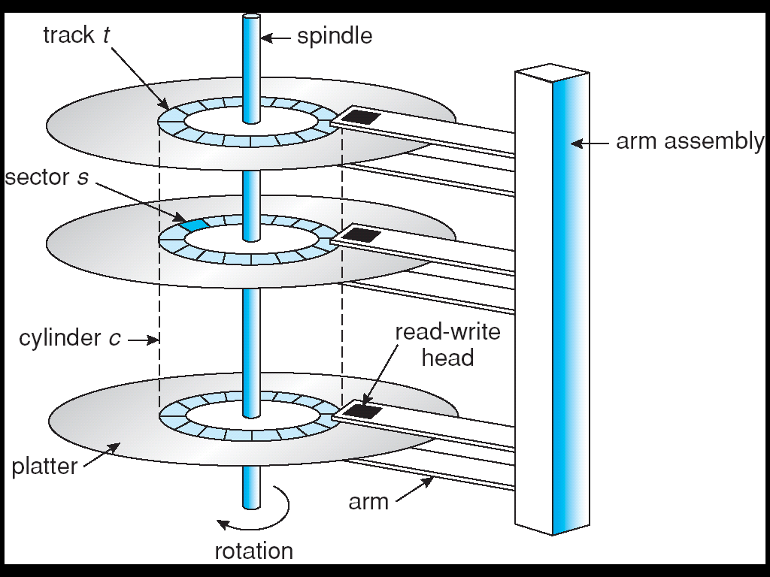
Magnetic Media (Disk)
Disks have multiple platters
  Each platter has a head
  The different heads are attached to a single arm
  The different heads can access data in parallel
Each platter has multiple concentric tracks
  A cylinder is same track across different platters
Each track has multiple sectors
  A sector typically has preamble, data and ECC

Slide 5
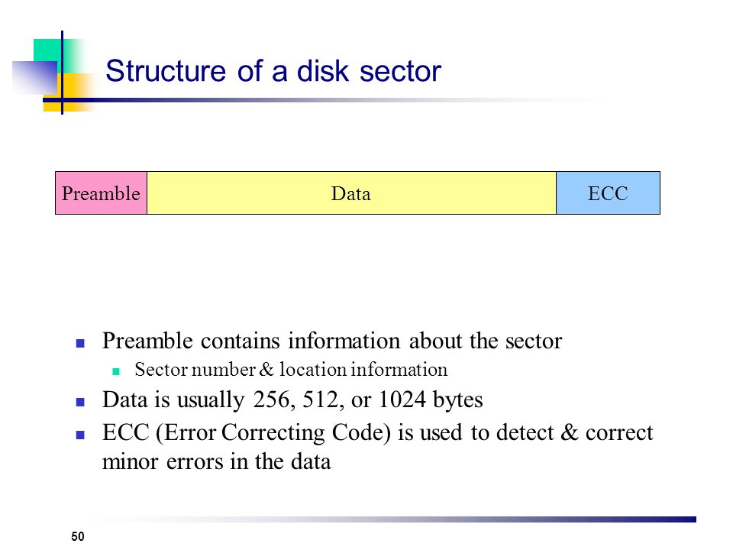
Magnetic Disk (Cont.)

Slide 6
Magnetic Disk (Cont.)
Disks are accessed at the granularity of sectors Typically, 512 bytes
A file system allocates data in chunks called blocks
  A block contains 2^{n} contiguous sectors
  Reduces overhead of managing individual bytes
  Large blocks improve throughput but increase internal fragmentation
File systems view the disk as an array of blocks
Disks can process I/O requests in parallel
Many I/O requests for blocks can be pending at a given time
Disks are slow!
  ~10 ms latency to access a block1
  Versus 0.0002 ms to access to memory
  Versus 0.000001ms to access to register

Slide 7
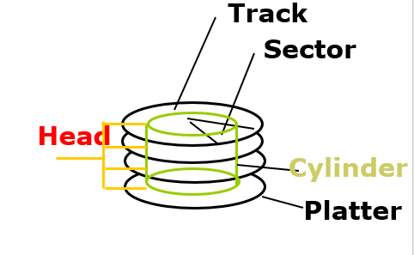
Magnetic Disk (Cont.)
Cylinder: all the tracks under the heads at a given point on all surface
Software
Queue
(Device Driver)
Hardware
Controller
Media Time
(Seek+Rot+Xfer)
Request
Result
Notes:
To read write information into a sector, a movable arm containing a read/write head is located over each surface.
The term cylinder is used to refer to all the tracks under the read/write head at a given point on all surfaces.
To access data, the operating system must direct the disk through a 3-stage process.
(a) The first step is to position the arm over the proper track. This is the seek operation and
the time to complete this operation is called the seek time.
(b) Once the head has reached the correct track, we must wait for the desired sector to
rotate under the read/write head. This is referred to as the rotational latency.
(c) Finally, once the desired sector is under the read/write head, the data transfer can begin.
The average seek time as reported by the manufacturer is in the range of 12 ms to 20ms and is calculated as the sum of the time for all possible seeks divided by the number of possible seeks.
This number is usually on the pessimistic side because due to locality of disk reference, the actual average seek time may only be 25 to 33% of the number published.
+2 = 34 min. (Y:14)

Slide 8
Magnetic Disk (Cont.)
Read/write data is a three-stage
process:
  Seek time: position the head/arm over the proper track (into proper cylinder) =>arm motion (say forth and back motion)
  Rotational latency: wait for the desired sector to rotate under the read/write head ( rotation motion)
  Transfer time: transfer a block of bits (sector)
  under the read-write head
Disk Latency = Queuing Time + Controller time +
Seek Time + Rotation Time + Xfer Time
Highest Bandwidth:
  transfer large group of blocks sequentially from one track
Notes:
To read write information into a sector, a movable arm containing a read/write head is located over each surface.
The term cylinder is used to refer to all the tracks under the read/write head at a given point on all surfaces.
To access data, the operating system must direct the disk through a 3-stage process.
(a) The first step is to position the arm over the proper track. This is the seek operation and
the time to complete this operation is called the seek time.
(b) Once the head has reached the correct track, we must wait for the desired sector to
rotate under the read/write head. This is referred to as the rotational latency.
(c) Finally, once the desired sector is under the read/write head, the data transfer can begin.
The average seek time as reported by the manufacturer is in the range of 12 ms to 20ms and is calculated as the sum of the time for all possible seeks divided by the number of possible seeks.
This number is usually on the pessimistic side because due to locality of disk reference, the actual average seek time may only be 25 to 33% of the number published.
+2 = 34 min. (Y:14)

Slide 9
To read write information into a sector, a movable arm containing a read/write head is located over each surface.
The term cylinder is used to refer to all the tracks under the read/write head at a given point on all surfaces.
To access data, the operating system must direct the disk through a 3-stage process.
(a) The first step is to position the arm over the proper track. This is the seek operation and the time to complete this operation is called the seek time.
(b) Once the head has reached the correct track, we must wait for the desired sector to rotate under the read/write head. This is referred to as the rotational latency.
(c) Finally, once the desired sector is under the read/write head, the data transfer can begin.

Slide 10
Magnetic Disk (Cont.)
Disks: Not just slow, Complex
  Seeks between cylinders are expensive
    Random vs. sequential access
Sequential access – platter rotation
  80 MB/s bandwidth
  0.16 ms latency
Random access – head seeks
  0.5 MB/s bandwidth
  10 ms latency

Slide 11
File Systems
3 criteria for long-term information storage:
  Should be able to store very large amount of information
  Information must persist the processes using it
  Should provide concurrent access to multiple processes
Solution:
  Store information on disks in units called files
  Files are persistent, and only owner can explicitly delete it
  Files are managed by the OS
File Systems: How the OS manages files!
File systems have different types
  File system partitions have types
    e.g., swap space, EXT3, FAT32, NTFS

Slide 12
File System (Cont.)
File System: Layer of OS that transforms block interface of disks (or other block devices) into Files, Directories, etc.
File System Components
  Disk Management: collecting disk blocks into files
  Naming: Interface to find files by name, not by blocks
  Protection: Layers to keep data secure
  Reliability/Durability: Keeping of files durable despite crashes, media failures, attacks, etc.

Slide 13
File System (Cont.)
User vs. System View of a File
  User’s view:
    Durable Data Structures: directories and files.
  System’s view (system call interface):
    Collection of Bytes (UNIX)
    Doesn’t matter to system what kind of data structures you want to store on disk!
  System’s view (inside OS):
    Collection of blocks (a block is a logical transfer unit, while a sector is the physical transfer unit)
    Block size ≥ sector size; in UNIX, block size is 4KB

Slide 14
Translating from User to System View
File
System
What happens if user says: give me bytes 2—12?
  Fetch block corresponding to those bytes
  Return just the correct portion of the block
What about: write bytes 2—12?
  Fetch block
  Modify portion
  Write out Block
Everything inside File System is in whole size blocks
  file is a collection of blocks (i.e. systems view inside OS)

Slide 15
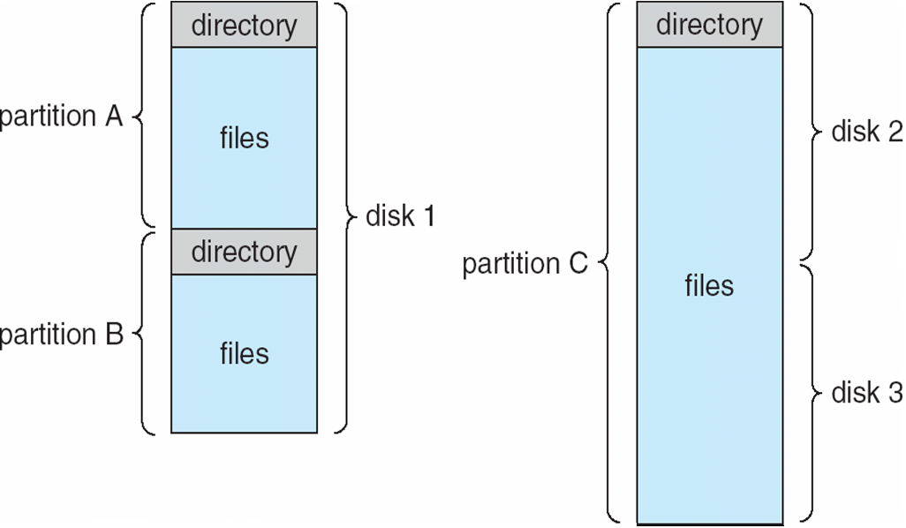
File Systems (Cont.)
A file system provides an abstraction for storing, organizing and accessing persistent data. It is a Layer of OS that transforms block interface of disks (or other block devices) into Files, Directories, etc.
  File-system data is organized as logical files
    Accessed via system calls
    Files have names and are organized as directories
  Directory structure maintains info of all files in the volume
    Name, location, size, type, …
    The list of blocks containing the data
    Other information such as access control list or permissions, owner, time of access, etc?

Slide 16
What is a File?
A file is a sequence of bytes contained in multiple, ordered, sectors (blocks) on non-volatile devices such as disks
  Disk space is always allocated in blocks
A sector is a fixed size block of data
  E.g., 512 bytes
Example
  With a 512 byte sector size, a 64 MB file (MB = 1024* 1024 bytes) would have how many sectors?
  Remember Block size ≥ sector size

Slide 17
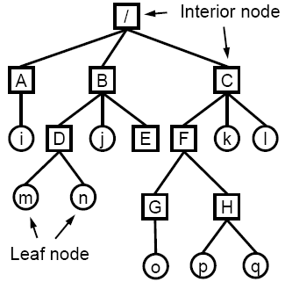
Directories
A Directory Store a list of directory entries
that point to files or subdirectory. Method for naming and locating a file
  Efficiently locate and identify files
  Allow intuitive grouping of objects
  like files together
  Useful for both OS and users
Modern systems use hierarchical directories
  A directory contains files or sub-directories
  E.g., B contains entries for D, j and E
Files are accessed with pathnames
  Absolute pathname. path of file from the root directory e.g. cat /B/D/n
  Relative pathname path from the current working directory e.g. cd B/D; cat n
  two special entries in each directory:
  “.” for current directory and “..” for parent

Slide 18
Operations Performed on Directory
  1- Search for a file
  2- Create a file
  3- Delete a file
  4- Truncate a file
  5- List a directory
  6- Rename a file
7- Traverse file system

Slide 19
File Structure and Attributes
The OS typically treats files as an unstructured sequence of bytes
Programs create files and they can impose any format on files
  E.g., application programs may look for specific file extension to indicate the file’s type
However, OS needs to understand the format of executable files to execute programs(text, data, heap, stack sections)
Files have various attributes associated with them. These attributes are called file metadata or File Control Block (FCB) or I-node and is maintained in file system data structures for each file. They vary a lot across different operating systems. Examples:
  Name – only information kept in human-readable form
  Identifier – unique tag (number) identifies file within file system
  Type – needed for systems that support different types
  Location – pointer to file location on device
  Size – current file size
  Protection – controls who can do (reading, writing, executing)
  Time, date, and user identification – data for protection, security, and usage monitoring

Slide 20
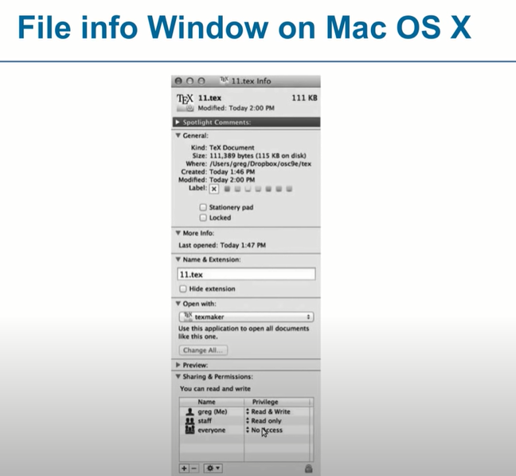

Slide 21
File Operations
1- Create a file: create new file in a directory
  Find space in the file system, add directory entry.
2- Open file: fetch existing file attributes and disk addresses in memory
  System call specifying name of file.
  system searches directory structure to find file.
  System keeps current file position pointer to the location where next write/read occurs
  System call returns file descriptor (a handle) to user process
3- Write in file: write content of buffer in memory into disk blocks- Increase size
  System call specifying file descriptor and information to be written
  Writes information at location pointed by the files current pointer
4- Read from a file: read disk blocks into buffer in memory
  System call specifying file descriptor and number of bytes to read (and possibly where in memory to stick contents).
5- Repositioning within a file: move to specific block
  System call specifying file descriptor and new location of current pointer. Also called a file seek even though does not interact with disk

Slide 22
File Operations (Cont.)
6- Sharing a file:
  Sharing may be done through a protection scheme
  Some systems provide file sharing by maintaining a single copy of a file; other systems maintain several copies, one for each of the users
    With a single copy, several concurrent updates to a file may result in user obtaining incorrect information, and the file being left in an incorrect state.
    With multiple copies, there is storage waste and the various copies may not be consistent with respect to each other.
7- Delete (unlink) a file: remove directory entry, free up space
8- Truncate a file: free up space, set file length to zero
9- Closing a file: entry removed from open file table
  System call specifying file descriptor
  Call removes current file position pointer and file descriptor associated with process and file

Slide 23
Multiple users of a file
Several pieces of data are needed to manage open files:
  File pointer: pointer to last read/write location, per process that has the file open
  File-open count: counter of number of times a file is open – to allow removal of data from open-file table (in memory) when last processes closes it
  Disk location of the file: cache of data access information
  Access rights: per-process access mode information
OS typically keeps the above information in two levels of internal tables:
Per-process table
  Information about the use of the file by the user (e.g. current file position pointer).
System wide table
  Gets created by first process which opens the file
  Location of file on disk
  Access dates
  File size
  Count of how many processes have the file open (used for deletion)

Slide 24
Access Methods
Sequential Access
Direct Access

Slide 25
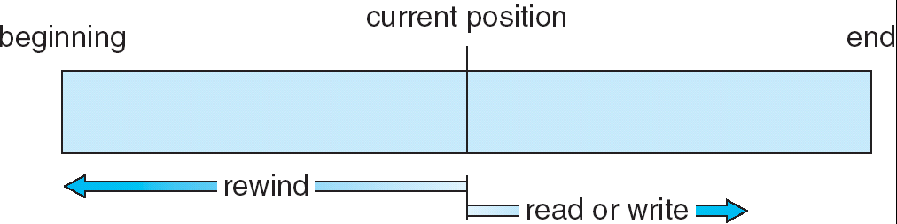
Sequential-access File

Slide 26
Directory Structure
A collection of nodes containing information about all files
Directory
Files
F 1
F 2
F 3
F 4
F n
Both the directory structure and the files reside on disk
Backups of these two structures are kept on tapes

Slide 27
Organize the Directory (Logically) to Obtain
Efficiency – locating a file quickly
Naming – convenient to users
  Two users can have same name for different files
  The same file can have several different names
Grouping – logical grouping of files by properties, (e.g., all Java programs, all games, …)

Slide 28
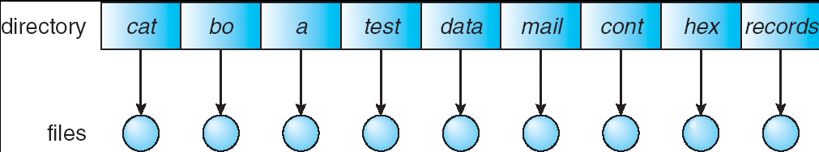
Single-Level Directory
A single directory for all users
Naming problem
Grouping problem

Slide 29
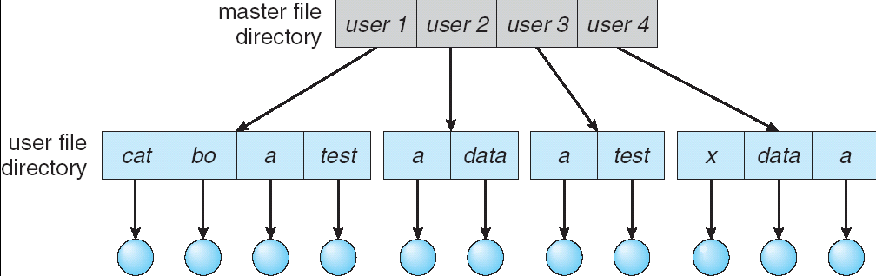
Two-Level Directory
Separate directory for each user
Path name
Can have the same file name for different user
Efficient searching
No grouping capability

Slide 30
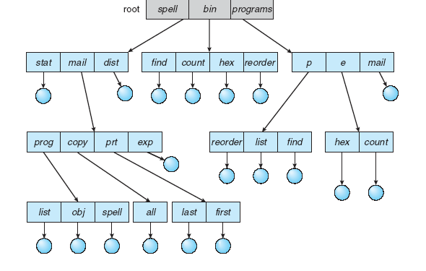
Tree-Structured Directories

Slide 31
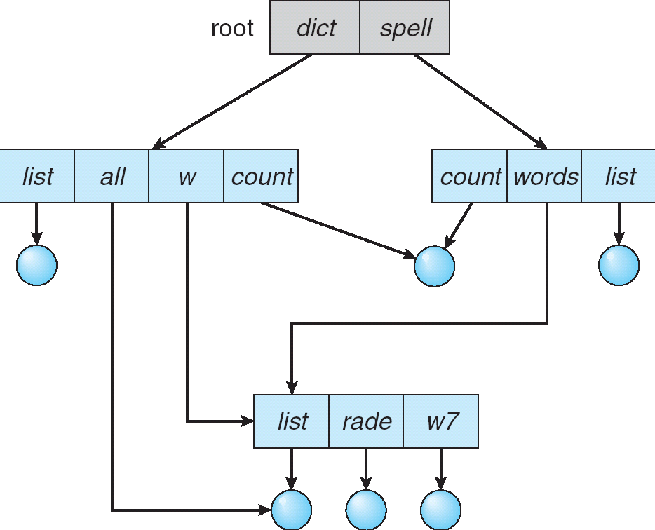
Acyclic-Graph Directories
Have shared subdirectories and files

Slide 32
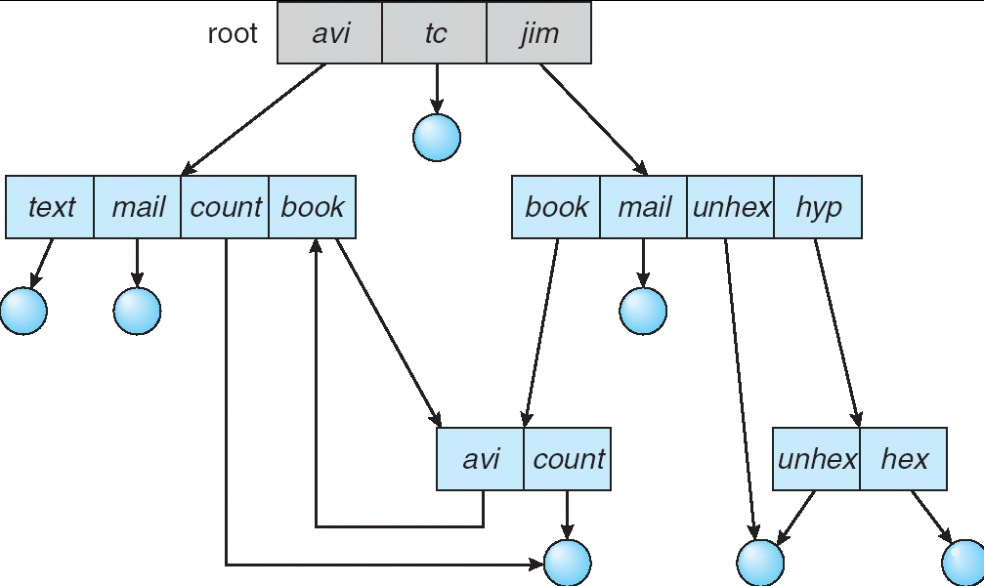
General Graph Directory

Slide 33
File Protection(Cont.)
Linux Access Rights (chmod, uid, grpid….)
Mode of access: read, write, execute
Three classes of users RWX
a) owner access 7 ⇒ 1 1 1
RWX
b) group access 6 ⇒ 1 1 0
RWX
c) other access 1 ⇒ 0 0 1
For a particular file (say game) or subdirectory, define an appropriate access.
owner
group
public
761
game

Slide 34
Chapter 16: Security

Slide 35
The Security Problem
System secure if resources used and accessed as intended under all circumstances
  Unachievable
Intruders (crackers) attempt to breach security
Threat is potential security violation
Attack is attempted to breach security
Attack can be accidental or malicious
Easier to protect against accidental than malicious misuse

Slide 36
Security Violation Categories
Breach of confidentiality
This type of violation involves unauthorized reading of data (or theft of information). Typically, a breach of confidentiality is the goal of an intruder. Capturing secret data from a system or a data stream, such as credit-card information or identity information for identity theft, or unreleased movies or scripts, can result directly in money for the intruder and embarrassment for the hacked institution.

Slide 37
Breach of integrity
This violation involves unauthorized modification of data. Such attacks can, for example, result in passing of liability to
an innocent party or modification of the source code of an important
commercial or open-source application.

Slide 38
Breach of availability
This violation involves unauthorized destruction of data. Some attackers would rather wreak havoc and get status or bragging rights than gain financially. Website defacement is a common example of this type of security breach.

Slide 39
Theft of service
This violation involves unauthorized use of resources. For example, an intruder (or intrusion program) may install a daemon on
a system that acts as a file server.
Denial of service (DOS)
This violation involves preventing legitimate use of the system. Denial-of-service (DOS) attacks are sometimes accidental. The
original Internet worm turned into a DOS attack when a bug failed to delay its rapid spread.

Slide 40
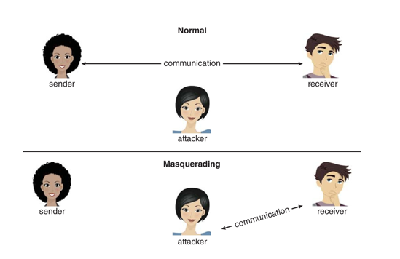
Security Violation Methods
Masquerading (breach authentication)
  Pretending to be an authorized user to escalate privileges

Slide 41
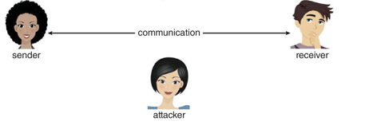


Replay attack
  As is or with message modification
Receiver 1
Receiver 2

Slide 42
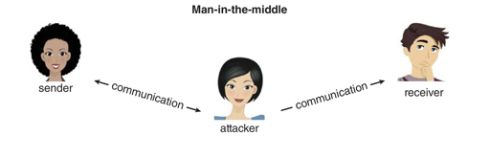
Man-in-the-middle attack
  Intruder sits in data flow, masquerading as sender to receiver and vice versa
Session hijacking
  Intercept an already-established session to bypass authentication
Privilege escalation
  Common attack type with access beyond what a user or resource is supposed to have

Slide 43
Security Measure Levels
Impossible to have absolute security, but make cost to perpetrator sufficiently high to deter most intruders
Security must occur at four levels to be effective:
  Physical
    Data centers, servers, connected terminals
  Application
    Benign or malicious apps can cause security problems
  Operating System
    Protection mechanisms, debugging
  Network
    Intercepted communications, interruption, DOS
Security is as weak as the weakest link in the chain
Humans a risk too via phishing and social-engineering attacks
But can too much security be a problem?

Slide 44
End of Lecture 10

