Slide 1

Forecasting
Prepared by Dr. Mohamed Sleem
Subject code : FNT 631
Data Analysis
Lecture 7

Slide 2



Forecasting
Lecture 7
Subject code : FNT 631
Data Analysis
Prepared by
Dr. Mohamed Sleem

Slide 3
Answer Review Questions
What is the purpose of regression analysis?
- Regression analysis examines relationships between dependent and independent variables.
What is the difference between simple regression and multiple regression?
- Simple regression uses one independent variable, while multiple regression uses multiple independent variables.
What are some common applications of regression analysis?
- Forecasting outcomes, solving business problems, and supporting strategic decision-making.

Slide 4
Forecasting Techniques
Qualitative and judgmental
Statistical time series models
Explanatory/causal models

Slide 5
Qualitative and Judgmental Methods
Historical analogy – comparative analysis with a previous situation
Delphi Method – response to a sequence of questionnaires by a panel of experts

Slide 6
Indicators and Indexes
Indicators – measures believed to influence the behavior of a variable we wish to forecast
  Leading indicators
  Lagging indicators
Index – a weighted combination of indicators
Indicators and indexes are often used in economic forecasting

Slide 7
Example Dept. of Commerce Index of Leading Indicators
• Average weekly hours, manufacturing
• Average weekly initial claims, unemployment insurance
• New orders, consumer goods and materials
• Vendor performance—slower deliveries
• New orders, nondefense capital goods
• Building permits, private housing
• Stock prices, 500 common stocks (Standard & Poor)
• Money supply
• Interest rate spread
• Index of consumer expectations (University of Michigan)

Slide 8
Time Series
A time series is a stream of historical data
Components of time series
  Trend
  Short-term seasonal effects
  Longer-term cyclical effects

Slide 9
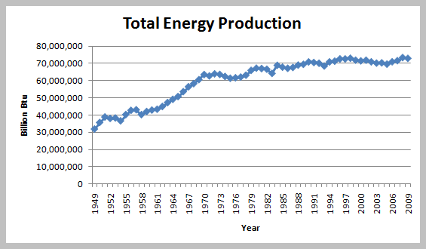
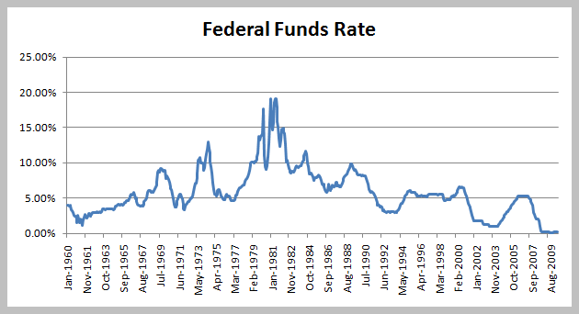
Examples of Time Series

Slide 10
Statistical Forecasting Methods
Moving average
Exponential smoothing
Regression analysis

Slide 11
Simple Moving Average
Average random fluctuations in a time series to infer short-term changes in direction
Assumption: future observations will be similar to recent past
Moving average for next period = average of most recent k observations

Slide 12
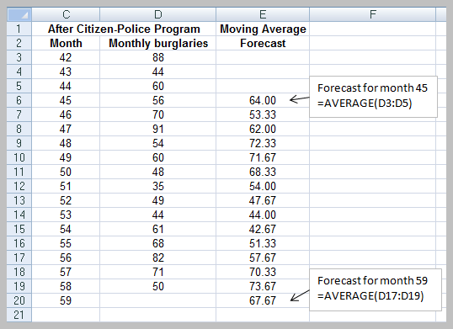
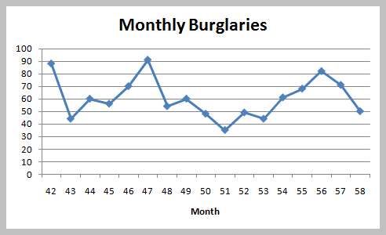
Example: Moving Average Forecast With k = 3

Slide 13
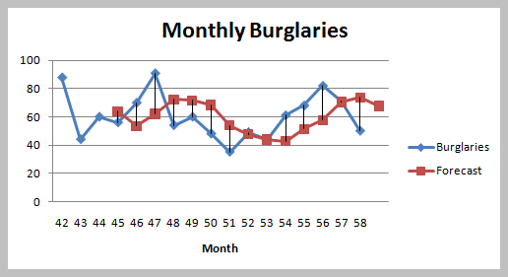
Time Series Data and Moving Averages

Slide 14
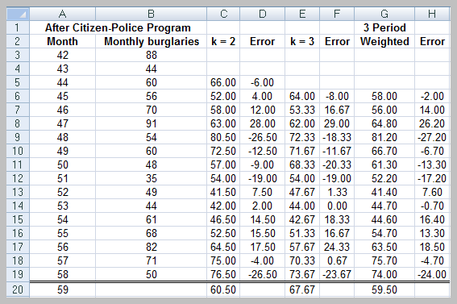
Alternative Moving Average Models

Slide 15
Error Metrics and Forecast Accuracy
Mean absolute deviation (MAD)
Mean square error (MSE)
Mean absolute percentage error (MAPE)

Slide 16
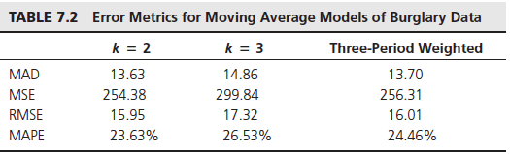
Summary of Error Metrics for Burglary Data

Slide 17
Exponential Smoothing
Exponential smoothing model:
F_{t+1} = (1 – α )F_{t} + αA_{t}
= F_{t} + α (A_{t} – F_{t} )
F_{t+1} is the forecast for time period t+1,
F_{t} is the forecast for period t,
A_{t} is the observed value in period t, and
α is a constant between 0 and 1, called the smoothing constant.

Slide 18
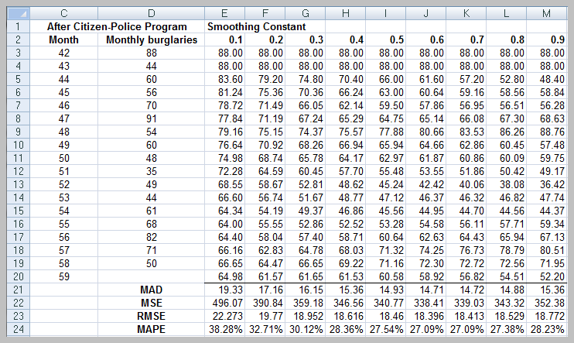
Exponential Smoothing Example

Slide 19
Forecasting Models With Linear Trends
Double Moving Average
Double Exponential Smoothing
Based on the linear trend equation

Slide 20
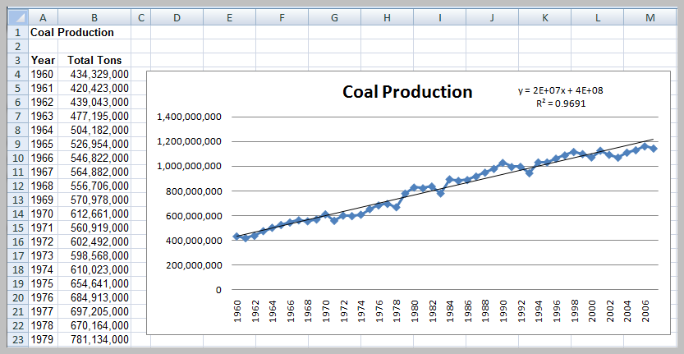
Regression-Based Forecasting
A forecast for 2008 would be:
Tons = 416,896,322.7 + 16,685,398.57 * (49) = 1,234,480,853

Slide 21
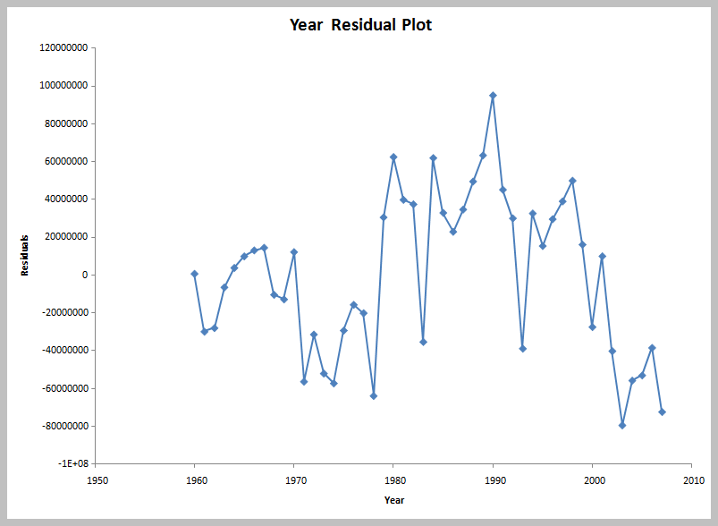
Autocorrelated Data

Slide 22
Autoregressive Models
First-order autoregressive model
  Y_{i} = a₀ + a₁Y_{i-1} + δ_{i}
Second-order autoregressive model
  Y_{i} = a₀ + a₁Y_{i-1} + a₂Y_{i-2} + δ_{i}

Slide 23
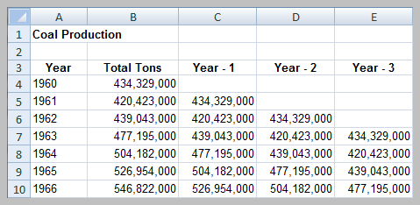
Portion of Coal Production File for Autoregressive Modeling

Slide 24
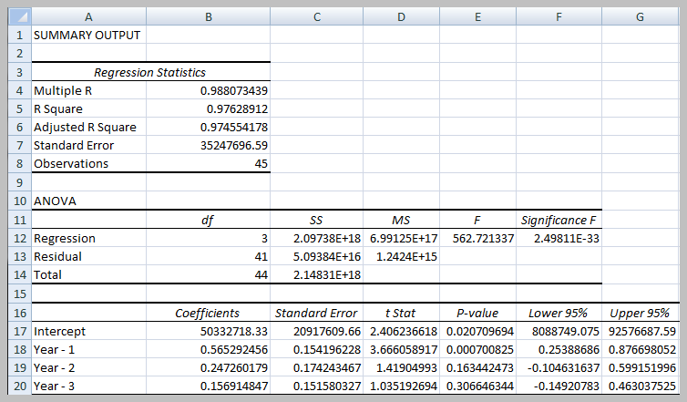
Third-Order Autoregressive Model

Slide 25
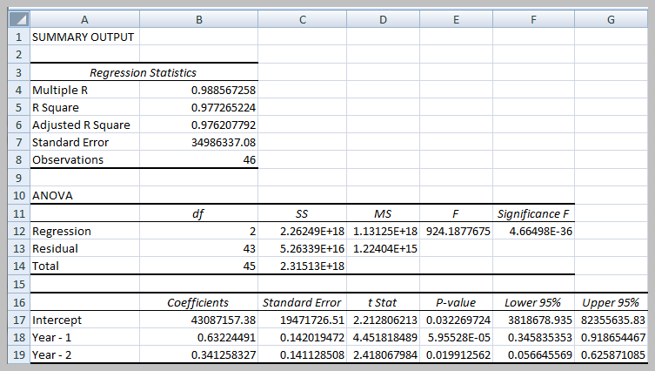
Second-Order Autogressive Model

Slide 26
Forecasting Models With Seasonality
Additive model
Multiplicative model

Slide 27

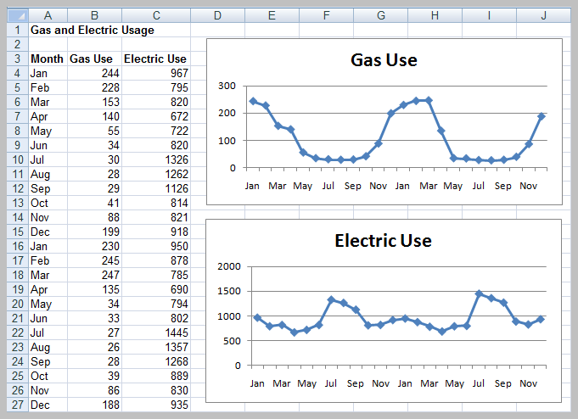
Incorporating Seasonality into Regression Models
Use dummy variables. Example:

Slide 28
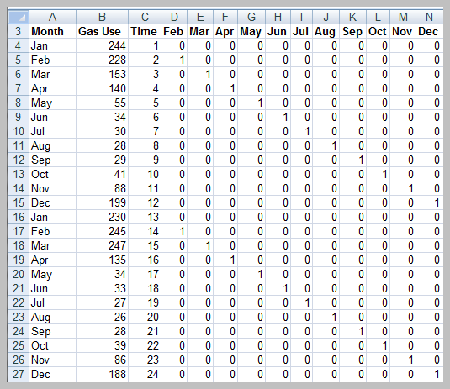
Data Matrix

Slide 29
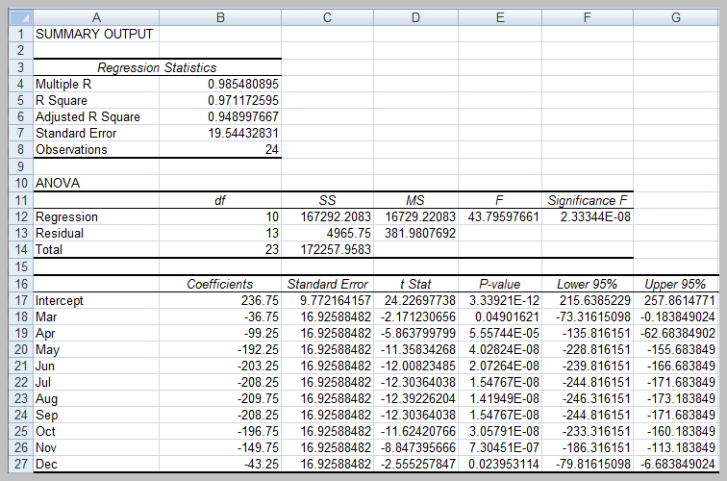
Regression Model Results

Slide 30

Model

Slide 31
Models for Trend and Seasonality
Holt-Winters Additive Model
Holt-Winters Multiplicative Model

Slide 32
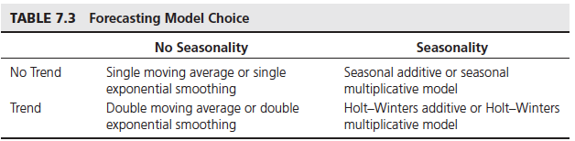
Model Choice

Slide 33
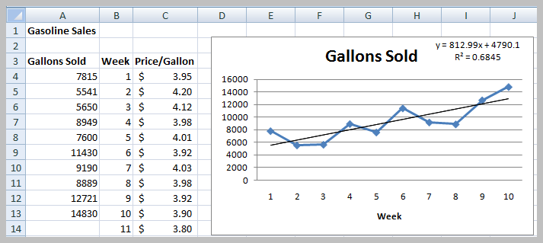
Regression Forecasting With Causal Variables
Sales (week 11) = 4790.1 + 812.00(11) = 13,733 gallons

Slide 34
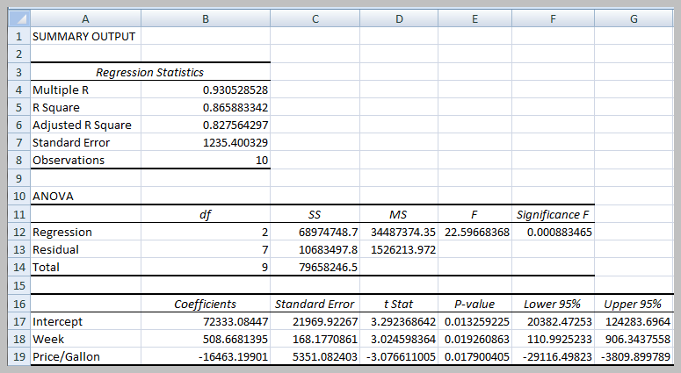
Causal Model
Sales = β₀ + β₁Week + β₂ Price/Gallon
Sales = 72333.08 + 508.67 Week – 16463.20 Price/Gallon
Sales (week 11) = 72333.08 + 508.67(11) - 16463.2(3.80) = 13,733 gallons

Slide 35
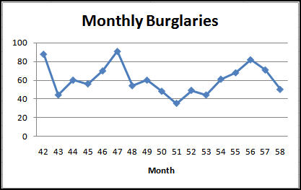
CB Predictor
Excel add-in for forecasting
Integrated with Crystal Ball software
Example: Burglary Data

Slide 36
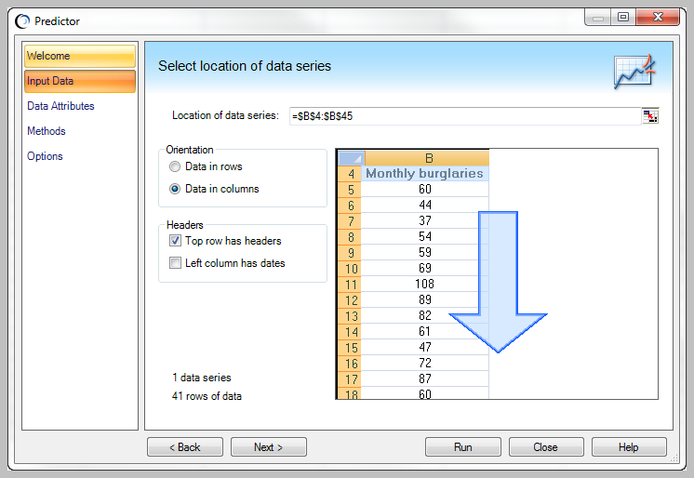
Input Data Dialog

Slide 37
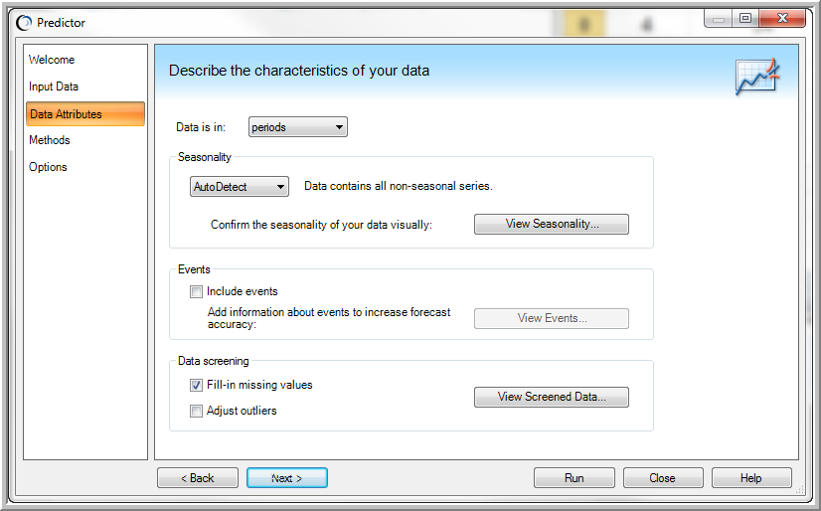
Data Attributes Dialog

Slide 38
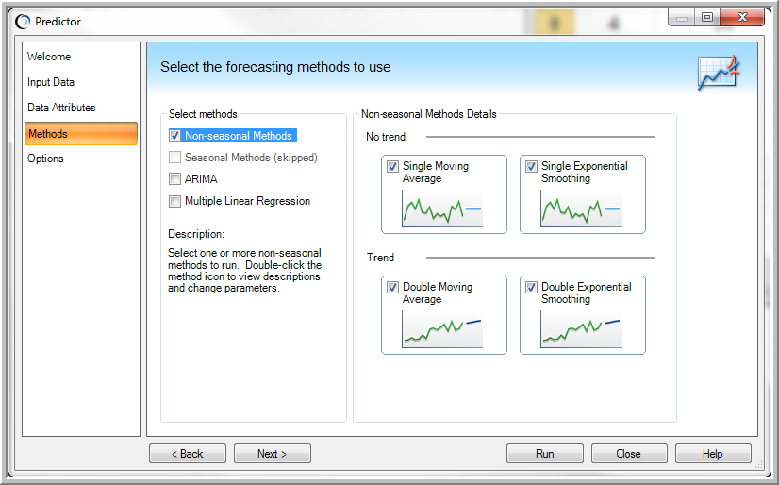
Methods Dialog

Slide 39
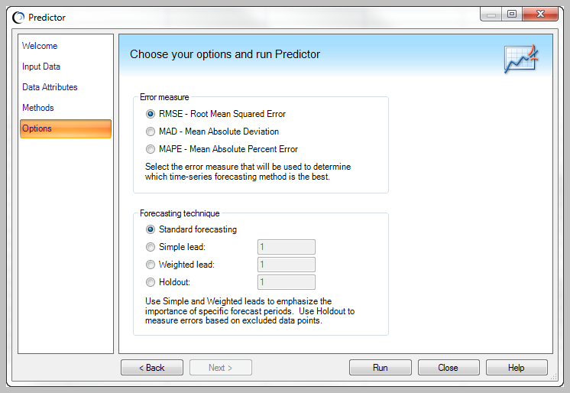
Options Dialog

Slide 40
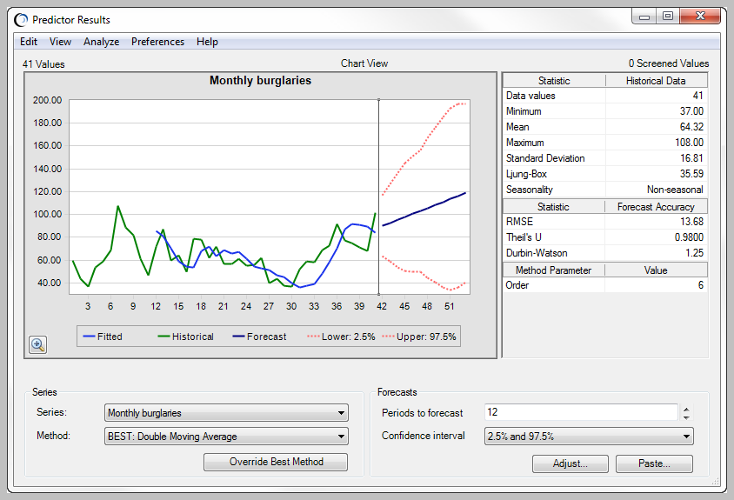
CB Predictor Results for Forecasting Burglaries

Slide 41
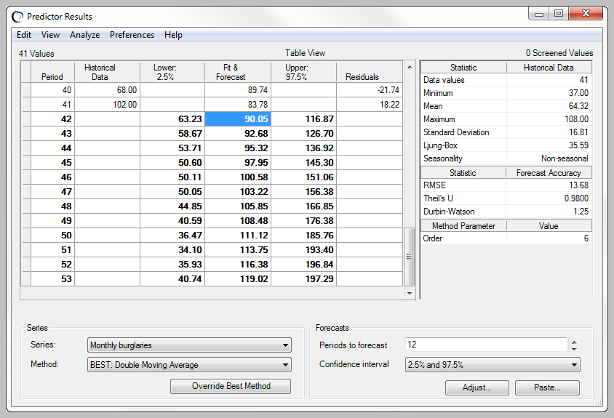
CB Predictor Table View

Slide 42
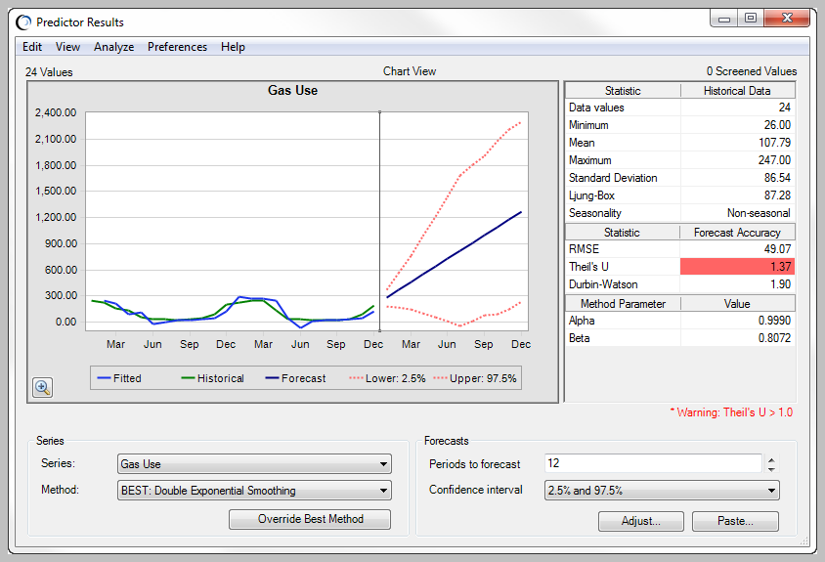
CB Predictor Results for Gas Use Example

Slide 43
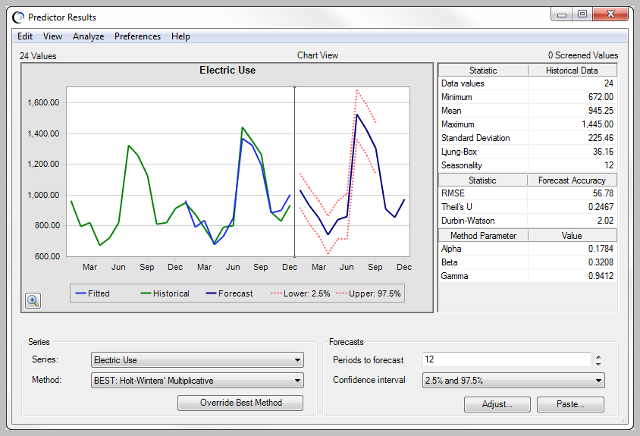
CB Predictor Results for Electric Use Example

Slide 44
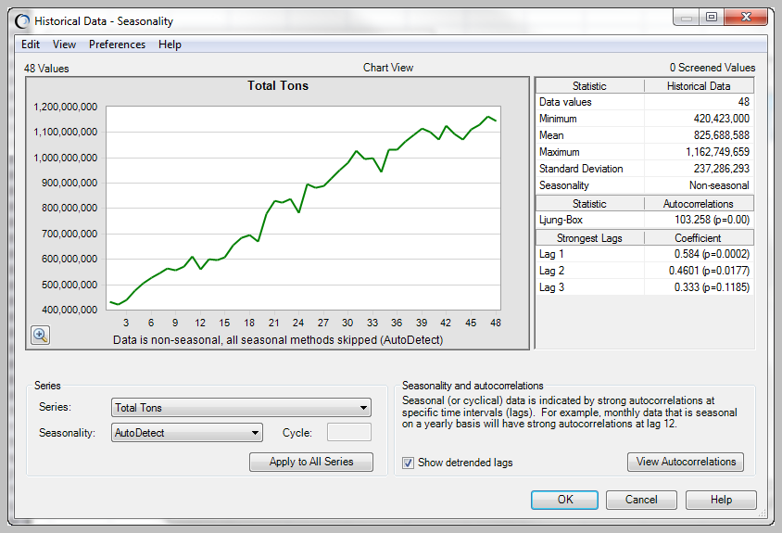
CB Predictor Seasonality Dialog

Slide 45
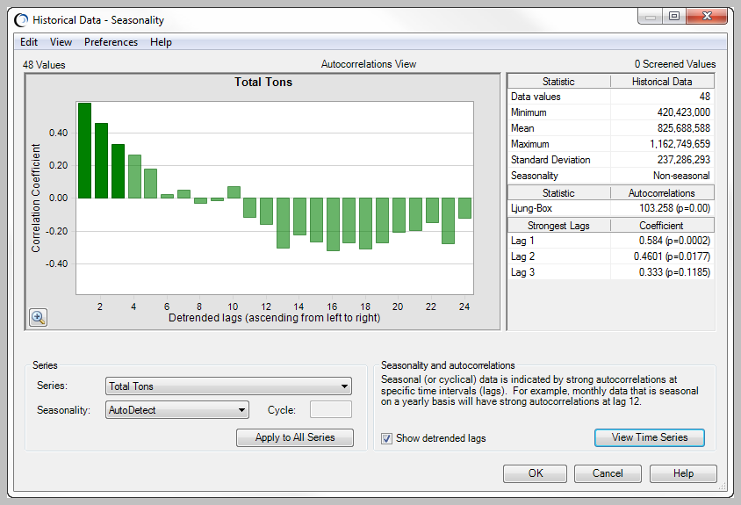
Autocorrelations in CB Predictor

Slide 46
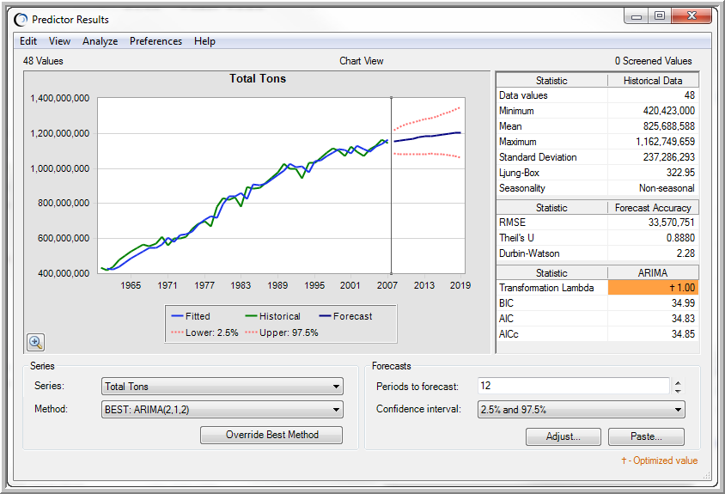
CB Predictor ARIMA Model for Coal Production

Slide 47
Summary
Forecasting Techniques
Qualitative and Judgmental Methods
Indicators and Indexes
Example Dept. of Commerce Index of Leading Indicators
Time Series
Statistical Forecasting Methods
Error Metrics and Forecast Accuracy

Slide 48
Review Questions
What are the components of a time series?
What does the Delphi Method involve?
Name three statistical forecasting methods mentioned in the document.

Slide 49



Thank You

