Slide 1


Storage Technologies
IT403
Prepared by
Dr. Ahmed El-Douh
Lecture 9

Slide 2



Storage Technologies
Lecture 9
IT403
Disaster Recovery Technology and Its Applications
Prepared by
Dr. Ahmed El-Douh

Slide 3
Objectives
Upon completion of this module, you will be able to:
  Describe the concepts and importance of Disaster Recovery.
  Differentiate the Advantages and Disadvantages of common Disaster Recovery solutions.
  Understand the technical principles of Disaster Recovery solutions.
  Learn how to deploy a Disaster Recovery solution through case study of typical application of Disaster Recovery Solution.

Slide 4
Chapter
Outlines
09
Overview of Disaster Recovery Solution.
Architecture of Disaster Recovery Solution.
Common Disaster Recovery Technologies.

Slide 5


Chapter
09
Overview of Disaster Recovery Solution

Slide 6
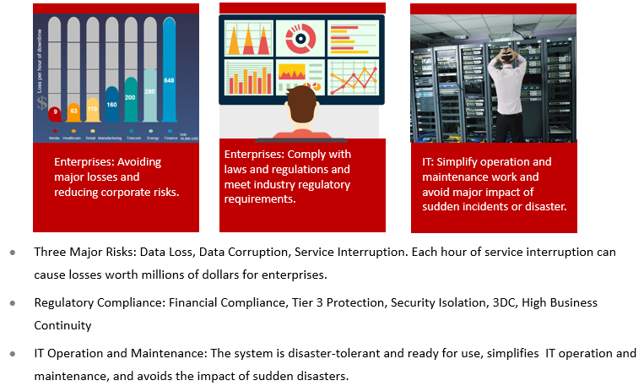
Demand For Disaster Recovery

Slide 7
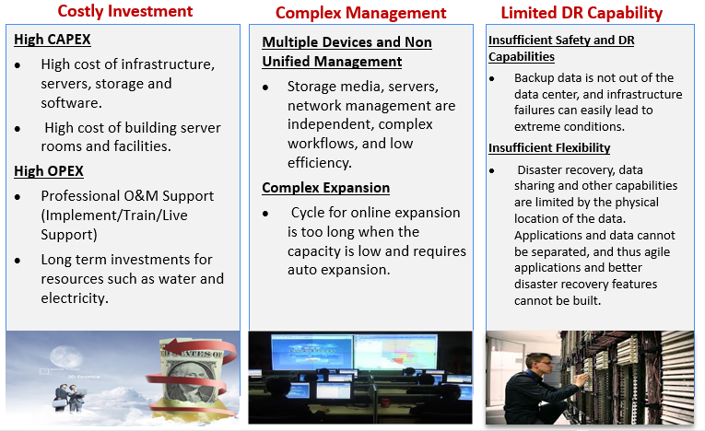
Challenges Of Disaster Recovery

Slide 8
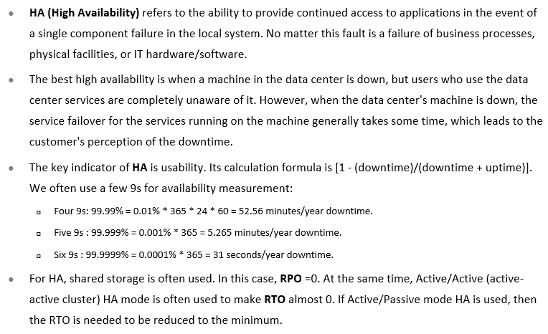
What is HA ?

Slide 9
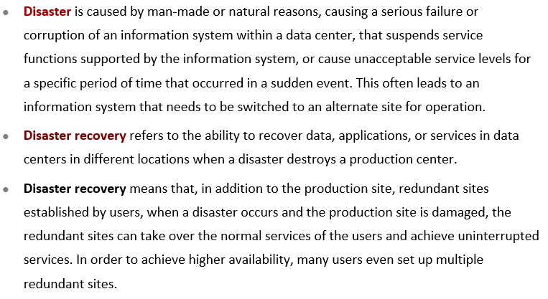
What is Disaster Recovery (DR)?

Slide 10
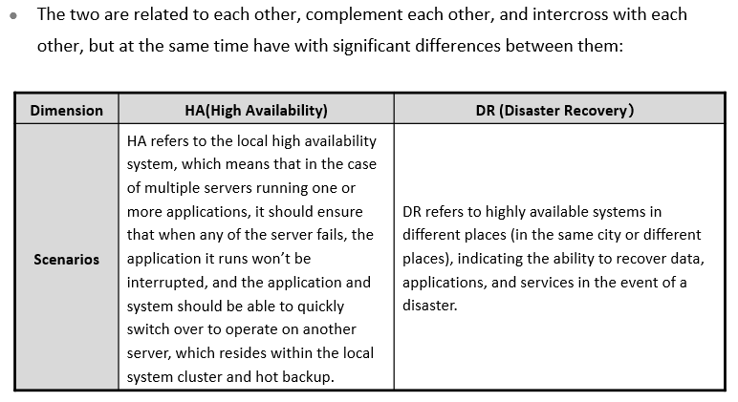
The Relationship between HA and DR (1)

Slide 11
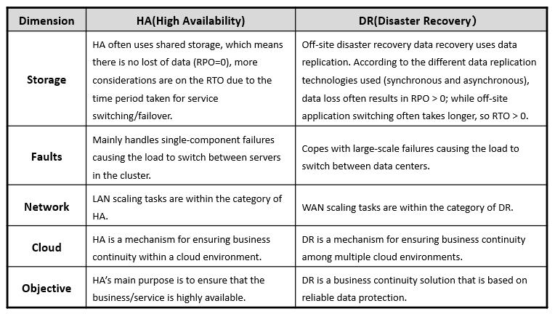
The Relationship between HA and DR (2)

Slide 12
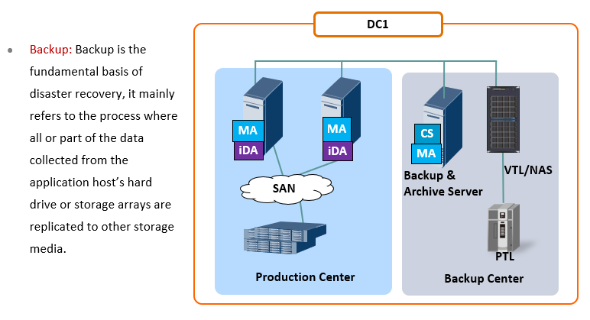
Differences Between DR & Backups (1)

Slide 13
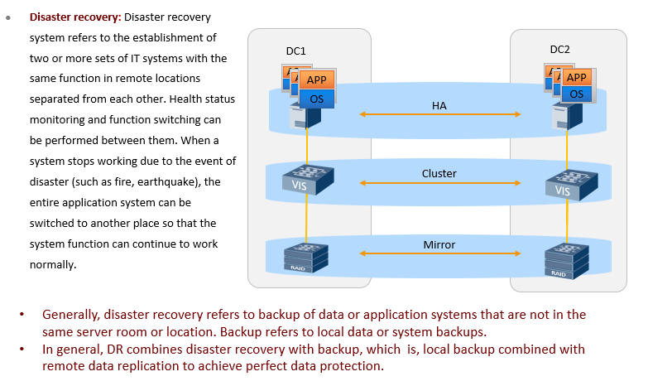
Differences Between DR & Backups (2)

Slide 14
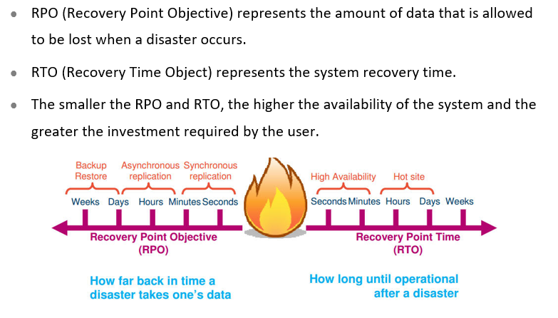
Key Indicators For Measuring DR System Performance

Slide 15
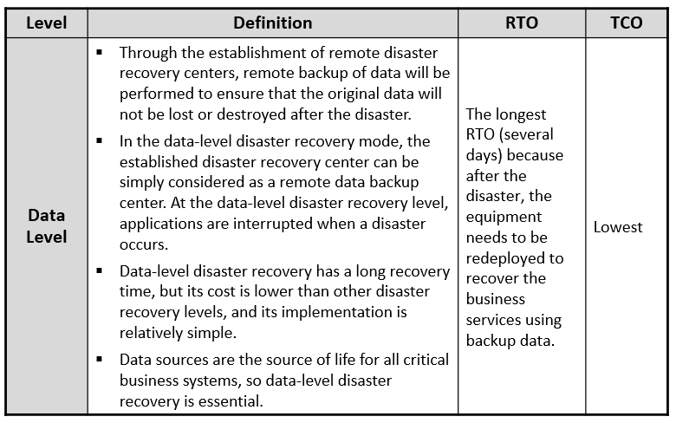
Levels Of DR Systems

Slide 16
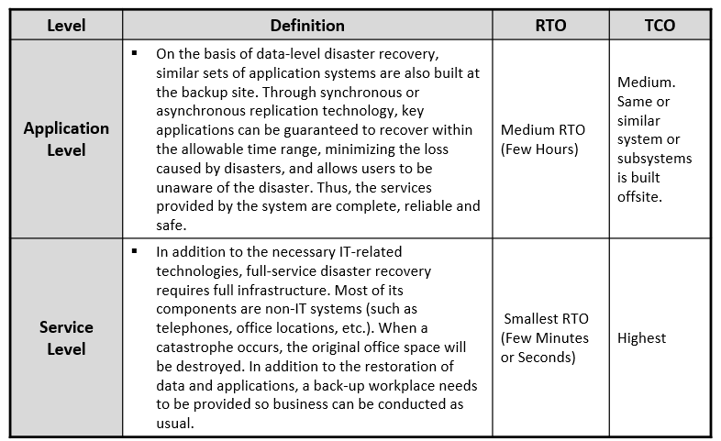
Levels Of DR Systems

Slide 17
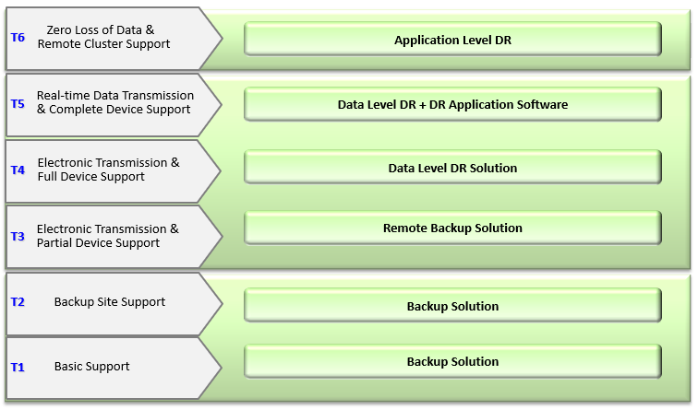
Benchmark Analysis Of DR Construction Levels

Slide 18
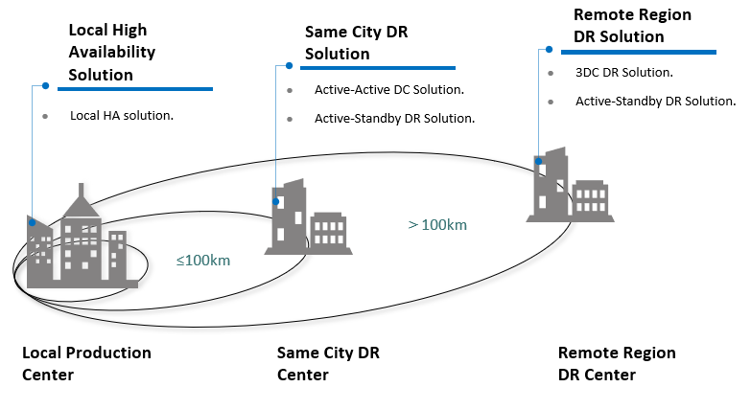
Panorama Of DR Solution

Slide 19
Chapter
09
Architecture of Disaster Recovery Solution

Slide 20
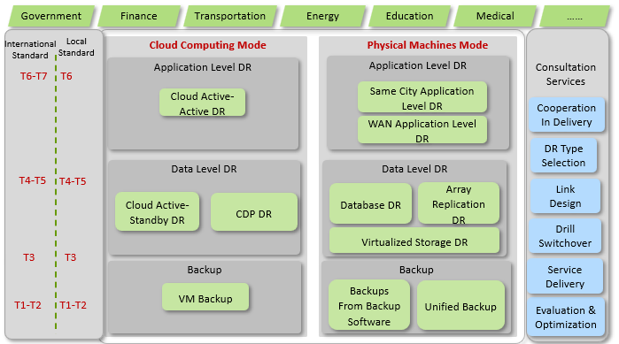
DR Backup Solution Framework

Slide 21
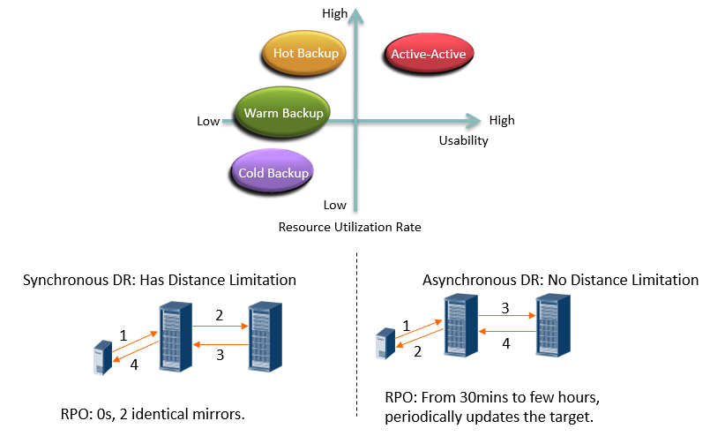
DR Design Model: Combination of Synchronous & Asynchronous

Slide 22
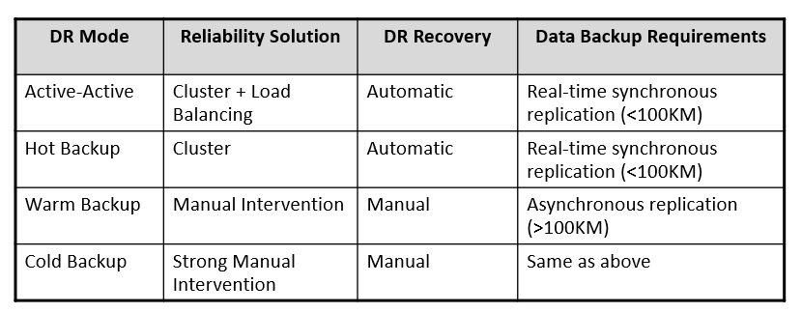
DR Design Model: Combination of Synchronous & Asynchronous

Slide 23
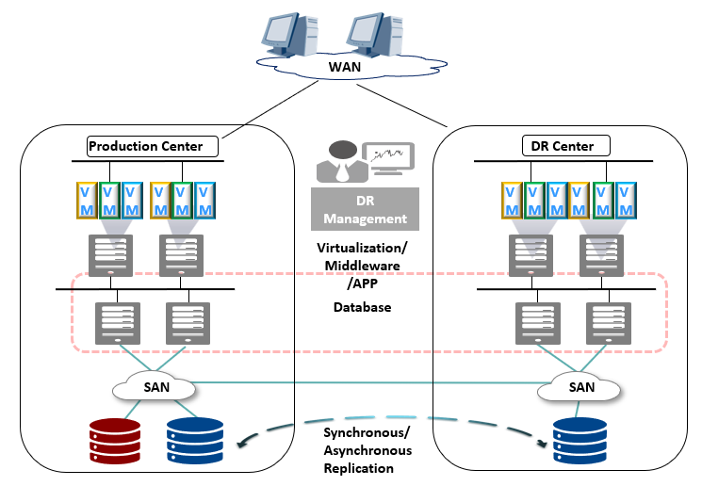
Active - Standby DR Solution

Slide 24
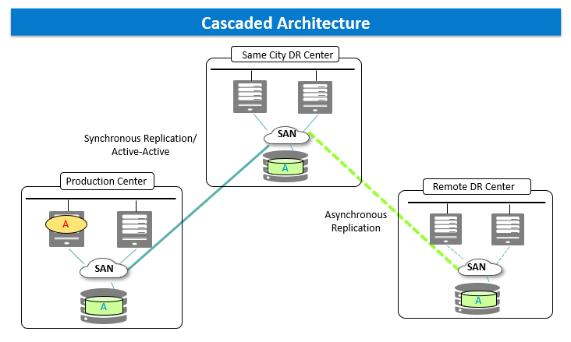
Three Datacenter (3DC) DR Solution (1)

Slide 25
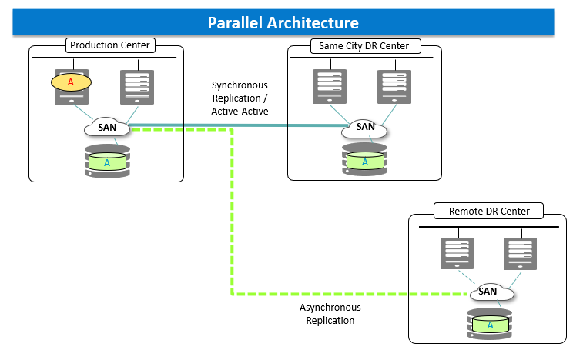
Three Datacenter (3DC) DR Solution (2)

Slide 26
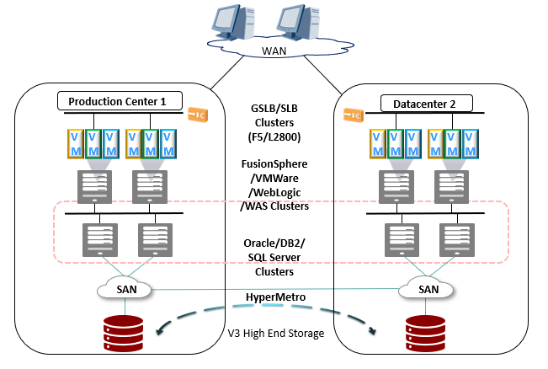
Active - Active DR Solution

Slide 27
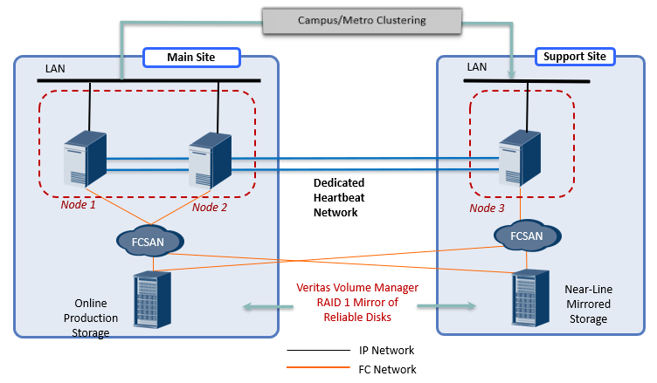
Campus/Same City Application Level DR (Physical Machines Mode)

Slide 28
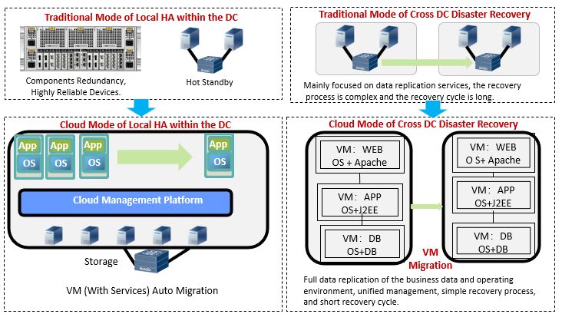
Evolution of New DR Model Under Cloud Computing

Slide 29
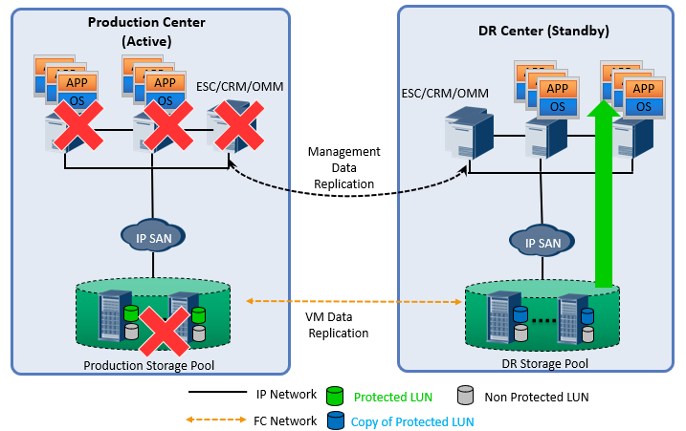
Cloud Active - Standby Data Level DR Implementation Method

Slide 30
Chapter
09
Common Disaster Recovery Technologies

Slide 31
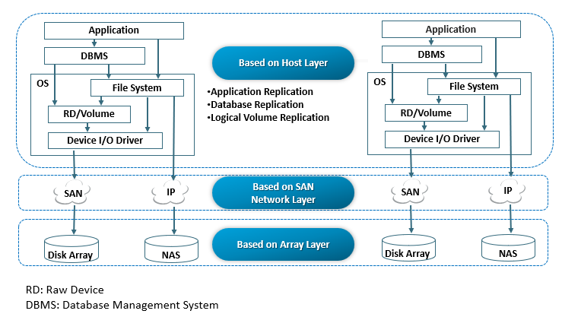
Main Technologies For DR

Slide 32
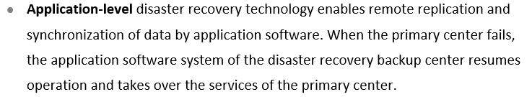
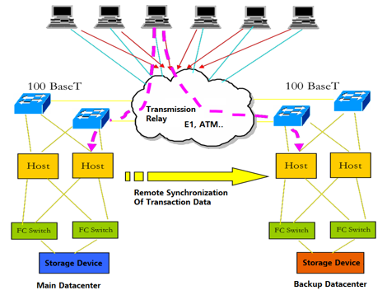
Host Layer DR Technology - Application Level

Slide 33
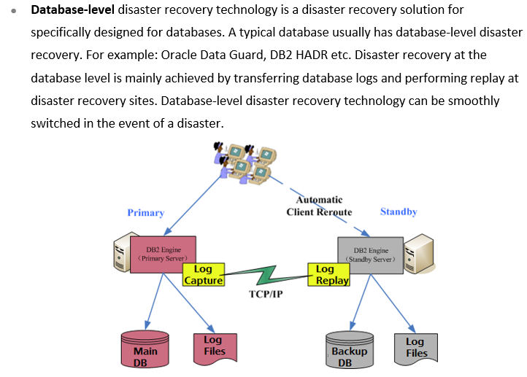
Host Layer DR Technology - Data Level

Slide 34
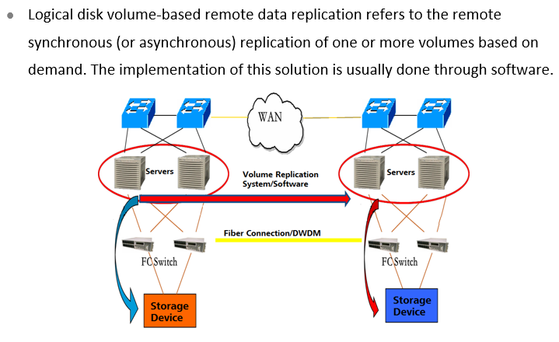
Host Layer DR Technology - Logical Volume Level

Slide 35
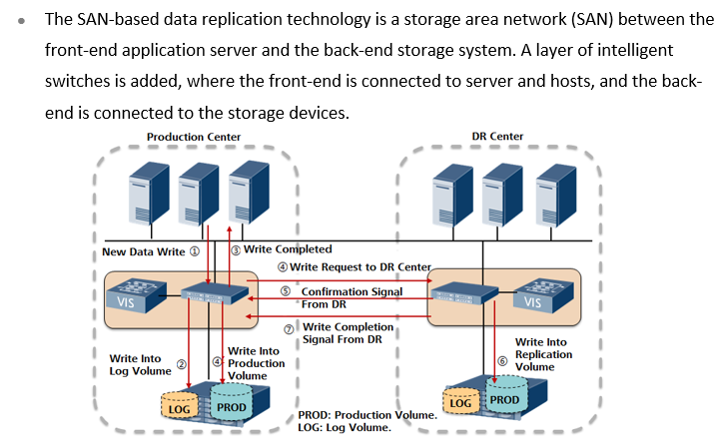
Network Layer DR Technology

Slide 36
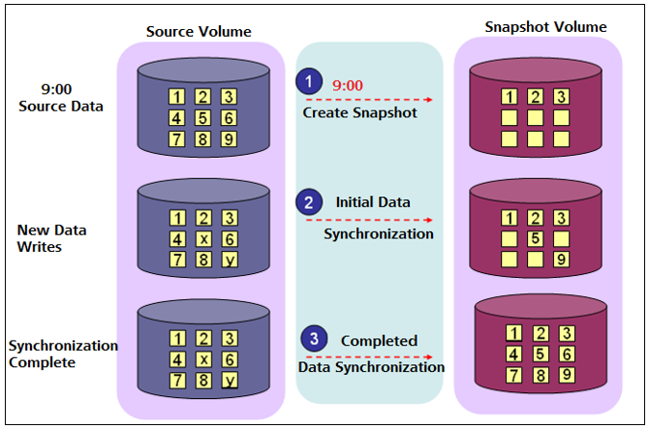
Network Layer Full Space Snapshot Working Principle

Slide 37
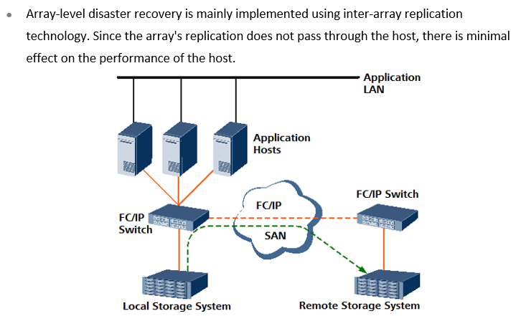
Array Level DR Technology

Slide 38
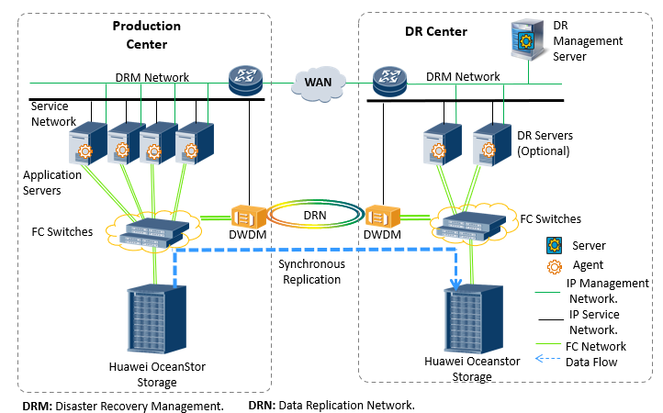
SAN Synchronous Replication DR

Slide 39
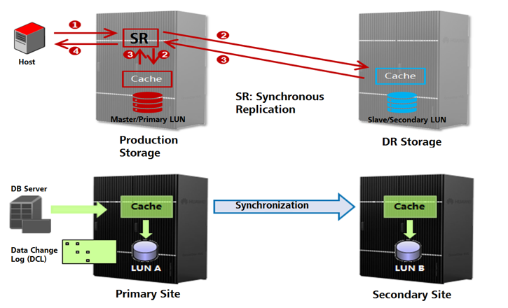
Working Principles of SAN Synchronous Replication

Slide 40
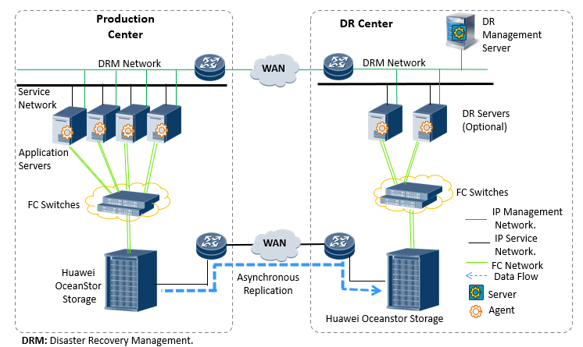
SAN Asynchronous Replication DR

Slide 41
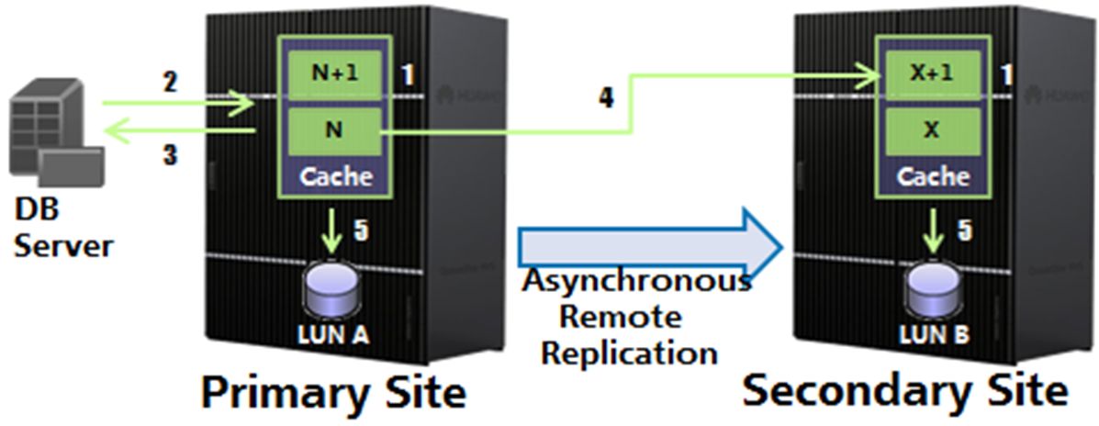
Working Principle Of SAN Asynchronous Replication

Slide 42
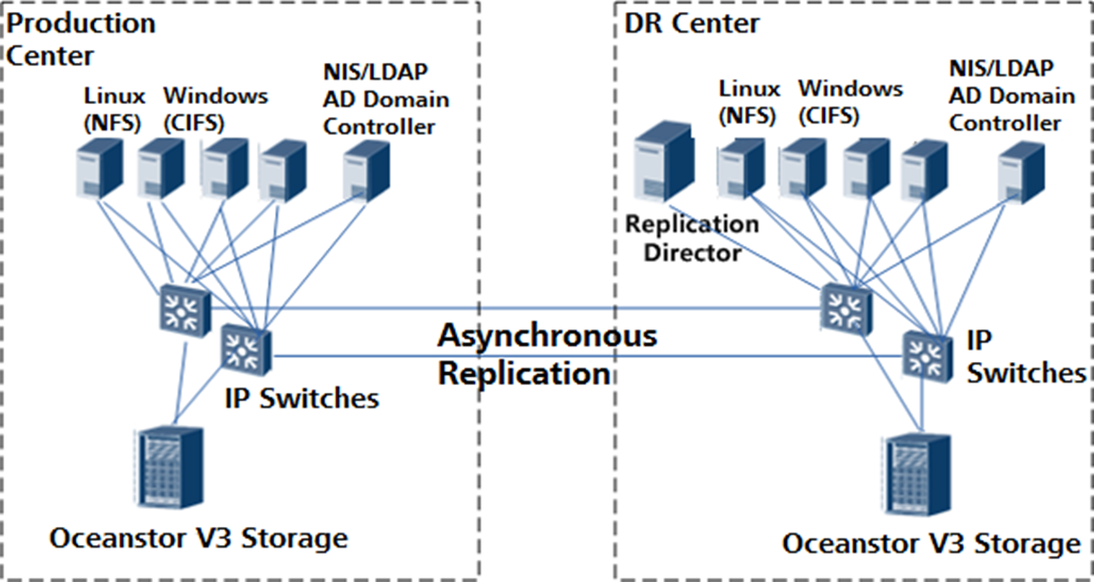
NAS Asynchronous Replication DR

Slide 43
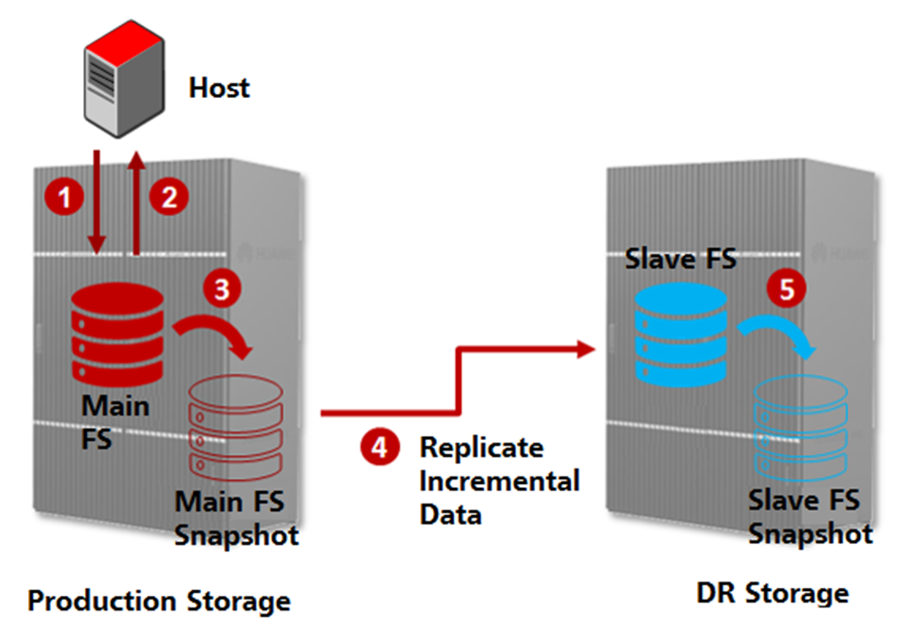
Working Principles Of NAS Asynchronous Replication

Slide 44
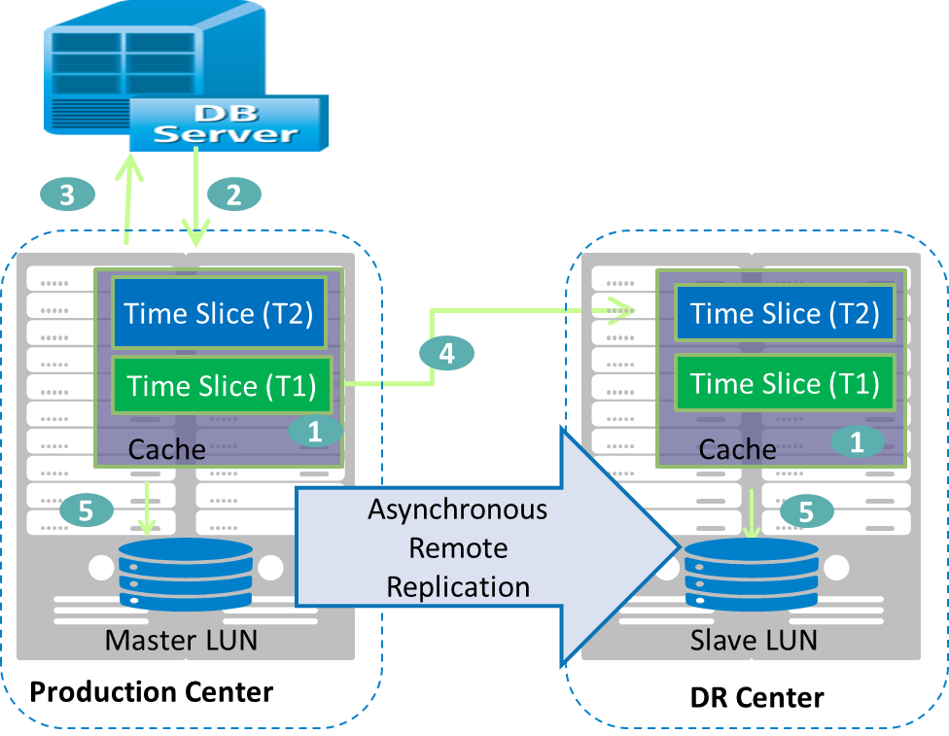
Multi Time Point Asynchronous Remote Replication –
Seconds Level RPO

Slide 45
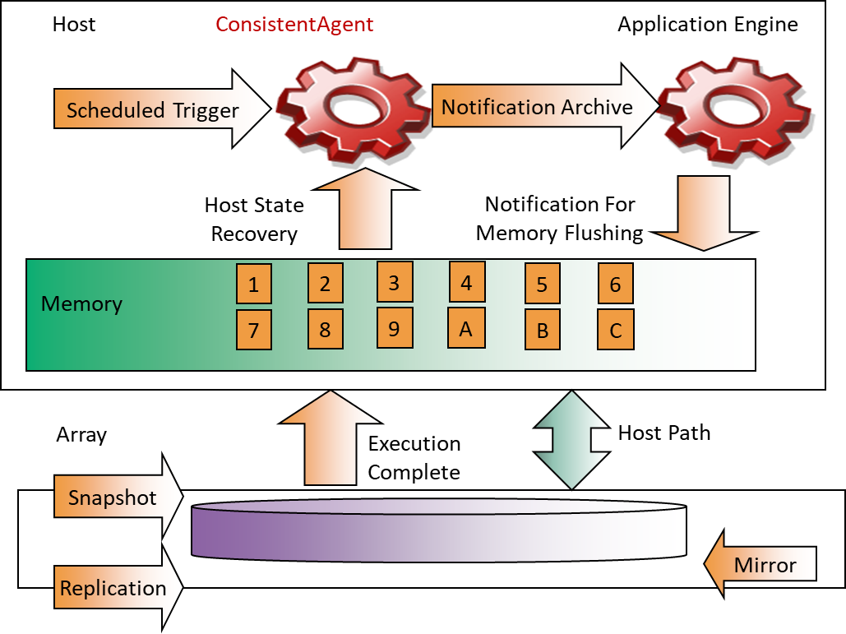
Remote Replication - Application Consistency

Slide 46
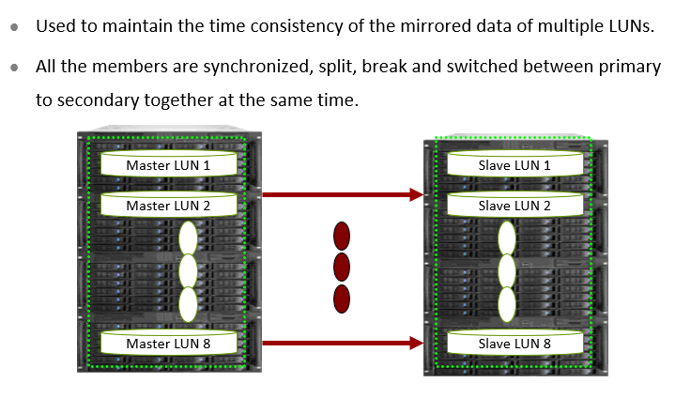
Remote Replication - Consistency Group

Slide 47
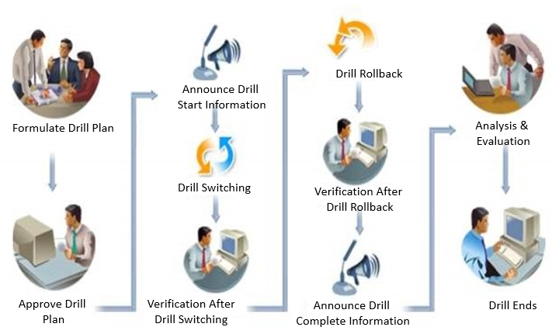
Typical DR Drill Solution

Slide 48



Thank You

