Slide 1


DIGITAL MEDIA ETHICS
DGM 723
Prepared by:
Dr. Sherihan Mohamed
Lecture 4

Slide 2



DMG 723
DIGITAL MEDIA ETHICS
Chapter 3
Copying and Distributing via Digital Media
Prepared by:
Dr. Sherihan Mohamed

Slide 3

Lecture 3
Remember:
** Information and privacy in the global digital Age.
** “Privacy” and private life: Changing attitudes in the age of social media and mobile devices
** “Privacy” and private life: Cultural and philosophical considerations
** “Privacy” and private life: Cultural differences and ethical pluralism

Slide 4
Lecture 4
Outlines:
** Introduction
** What Do You Know About Copying & Distributing?
** How Copyrighting Works.
** The Ethics Of Copying.
** Ai's Impact On Copyright.

Slide 5

What Do You Know About
Copying & Distributing?
Lecture 4

Slide 6
Introduction
Lecture 4
“When you share, post, or upload content that is covered by intellectual property rights (like photos or videos) on or in connection with our Products, you grant us a non-exclusive, transferable, sub-licensable, royalty-free, and worldwide license to host, use, distribute, modify, run, copy, publicly perform or display, translate, and create derivative works of your content (consistent with your privacy and application settings).” Facebook

Slide 7
“We work closely with our member record companies to ensure that fans, parents, students, and others in the business have the tools and the resources they need to make the right listening, purchasing and technical decisions. We also work hard to protect artists and the music community from music theft.” Recording Industry Association of America [RIAA], “About Piracy,”

Slide 8
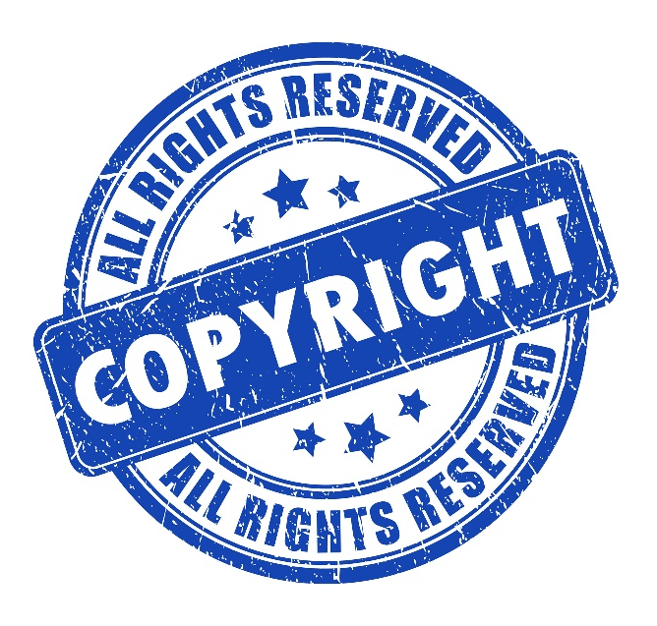
What Do You Know About Copying & Distributing?
Lecture 4
What is Copyright?
A copyright is a type of intellectual property that gives its owner the exclusive right to copy, distribute, adapt, display, and perform a creative work, usually for a limited time. The creative work may be in a literary, artistic, educational, or musical form.

Slide 9
Copyright is a type of intellectual property that protects original works of authorship as soon as an author fixes the work in a tangible form of expression. In copyright law, there are a lot of different types of works, including paintings, photographs, illustrations, musical compositions, sound recordings, computer programs, books, poems, blog posts, movies, architectural works, plays, and so much more!

Slide 10
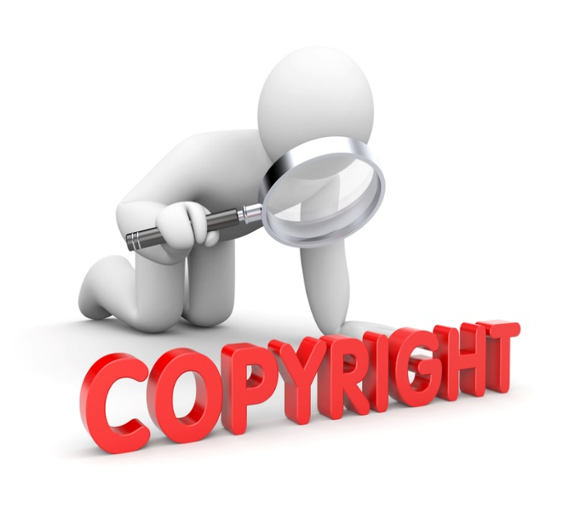
What Do You Know About Copying & Distributing?
Lecture 4
Copyright is intended to protect the original expression of an idea in the form of a creative work, BUT NOT the idea itself. A copyright is subject to limitations based on public interest considerations, such as the fair use doctrine in the United States.

Slide 11
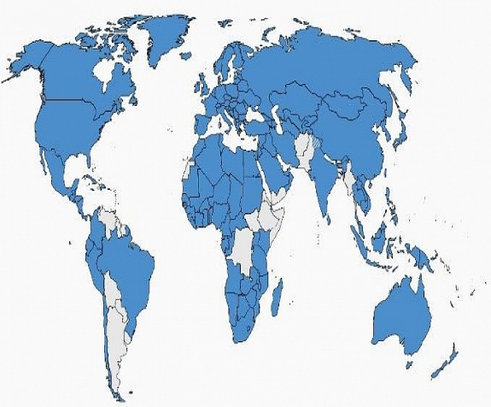
Copyrights can be granted by public law and are in that case considered "TERRITORIAL RIGHTS". This means that copyrights granted by the law of a certain state do not extend beyond the territory of that specific jurisdiction.

Slide 12
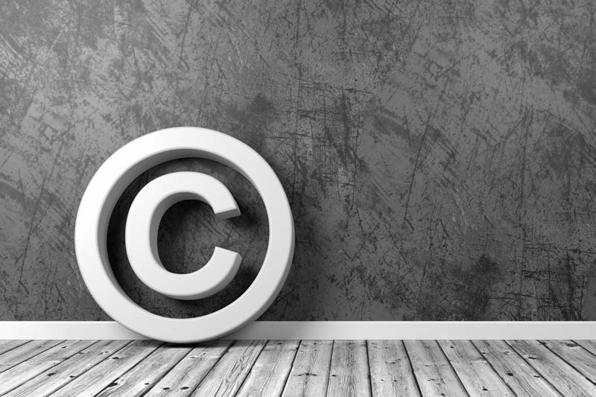
What Do You Know About Copying & Distributing?
Lecture 4
Copyrights of this type Vary By Country; many countries, and sometimes a large group of countries, have made agreements with other countries on procedures applicable when works "cross" national borders or national rights are inconsistent.

Slide 13
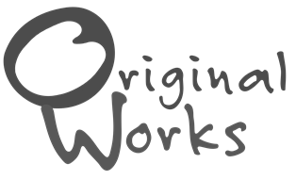
Copyright is originality and fixation
Original Works: Works are original when they are independently created by a human author and have a minimal degree of creativity. Independent creation simply means that you create it yourself, without copying.

Slide 14
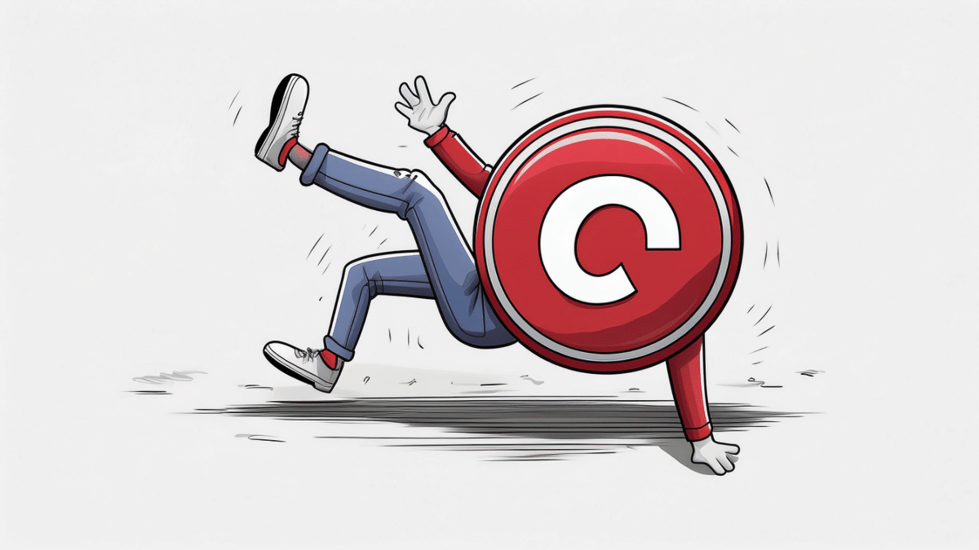
What Do You Know About Copying & Distributing?
Lecture 4
Fixed Works: A work is fixed when it is captured (either by or under the authority of an author) in a sufficiently permanent medium, such that the work can be perceived, reproduced, or communicated for more than a short time. For example, a work is fixed when you write it down or record it.

Slide 15
Overview of the concept:
The concept of copyright first developed in England. In reaction to the printing of "scandalous books and pamphlets", the English Parliament passed the Licensing of the Press Act 1662, which required all intended publications to be registered with the government-approved Stationers' Company, giving the Stationers the right to regulate what material could be printed.

Slide 16
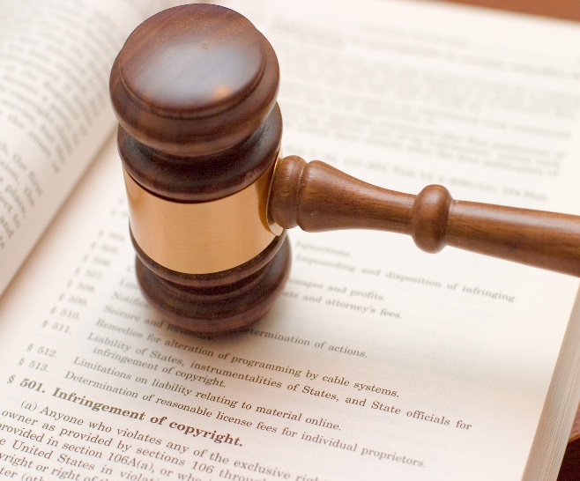
What Do You Know About Copying & Distributing?
Lecture 4
Copyright laws allow products of creative human activities, such as literary and artistic production, to be preferentially exploited and thus incentivized.
Different cultural attitudes, social organizations, economic models and legal frameworks are seen to account for why copyright emerged in Europe.

Slide 17
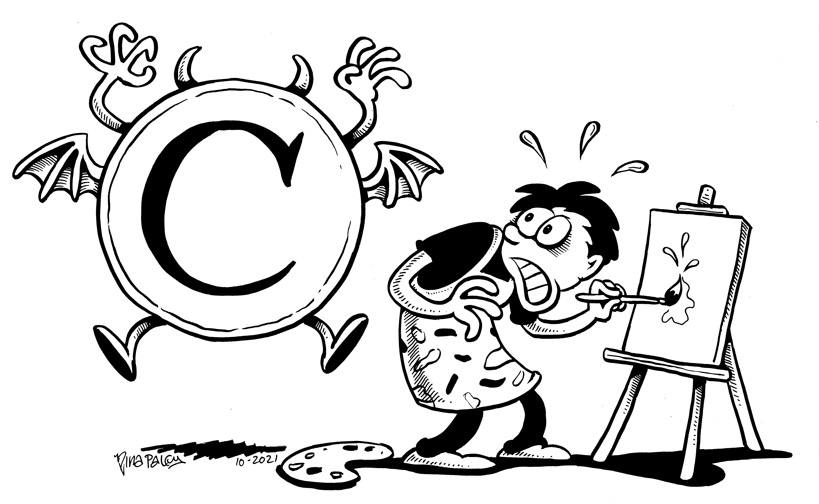
Copyright has developed into a concept that has a significant effect on nearly every modern industry, including NOT JUST literary work, BUT ALSO forms of creative work such as sound recordings, films, photographs, software, and architecture.

Slide 18
Lecture 4
How Copyrighting Works

Slide 19
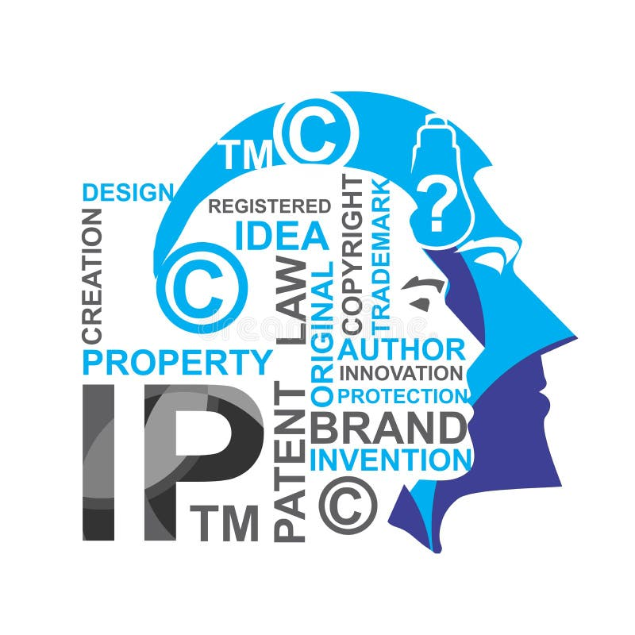
How Copyrighting Works
Lecture 4
When someone creates a product that is viewed as Original and that required significant mental activity to create, this product becomes an intellectual property that must be protected from unauthorized duplication. This work is considered a Unique Creation.

Slide 20
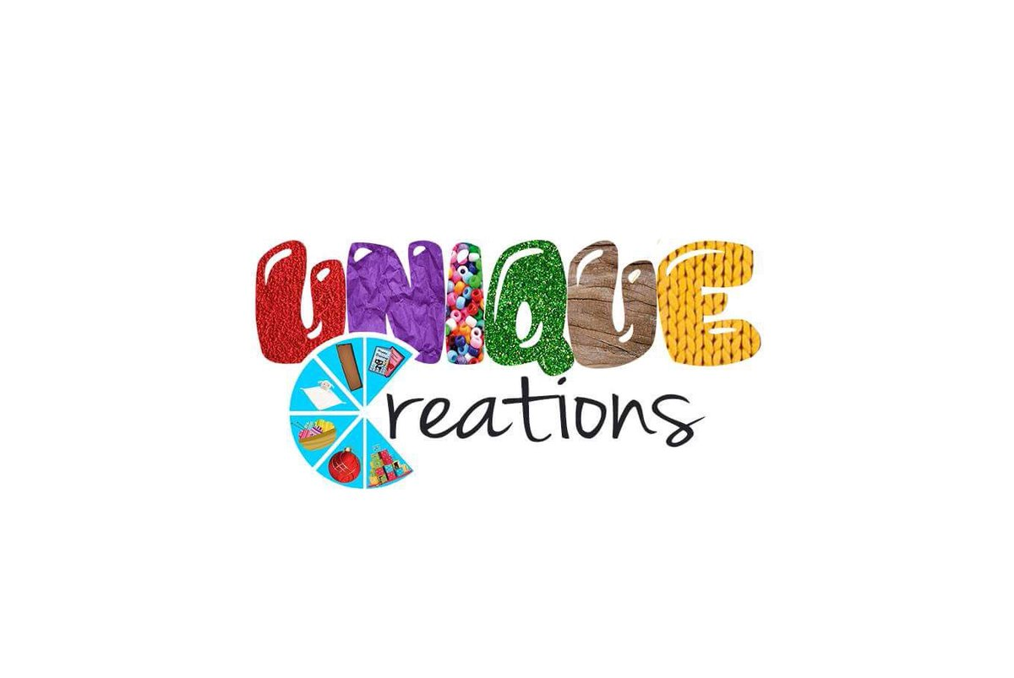
Examples of unique creations include computer software, art, poetry, graphic designs, musical lyrics and compositions, novels, film, original architectural designs, website content, etc. One safeguard that can be used to legally protect an original creation is copyright.

Slide 21
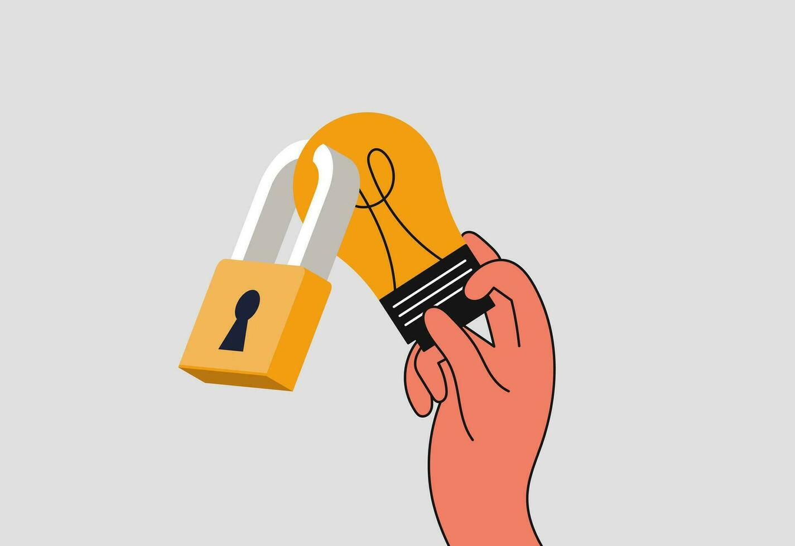
How Copyrighting Works
Lecture 4
Under copyright law, a work is considered original if the author created it from independent thinking void of duplication. This type of work is known as an Original Work of Authorship (OWA). Anyone with an original work of authorship automatically has the copyright to that work, preventing anyone else from using or replicating it.

Slide 22
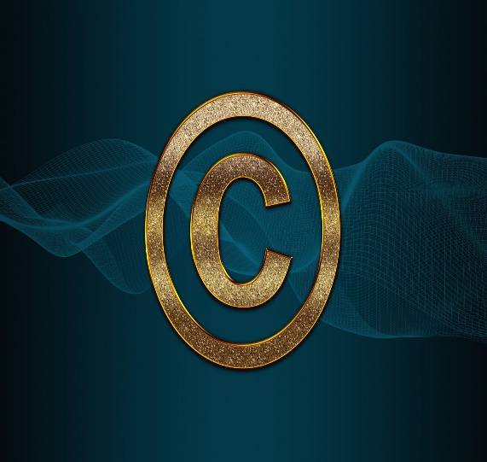
NOT ALL TYPES of work can be copyrighted. A copyright does not protect ideas, discoveries, concepts, or theories. Brand names, logos, slogans, domain names, and titles also cannot be protected under copyright law. For an original work to be copyrighted, it has to be in tangible form.

Slide 23
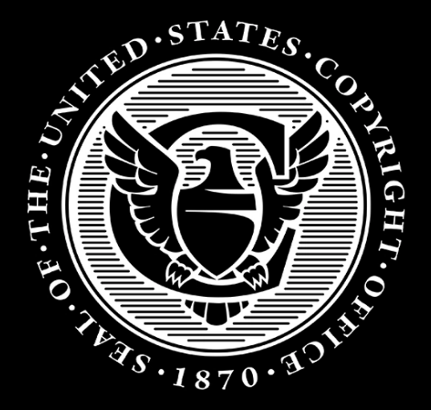
How Copyrighting Works
Lecture 4
This means that any speech, discoveries, musical scores, or ideas have to be written down in physical form in order to be protected by copyright.
In the U.S., original owners are protected by copyright laws all of their lives until 70 years after their death.

Slide 24
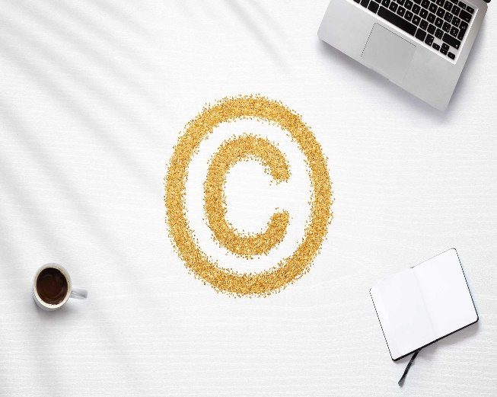
If the original author of the copyrighted material is a corporation, the copyright protection period is 95 years from the date of publication or 120 years, whichever expires first.

Slide 25
Lecture 4
The Ethics Of Copying

Slide 26
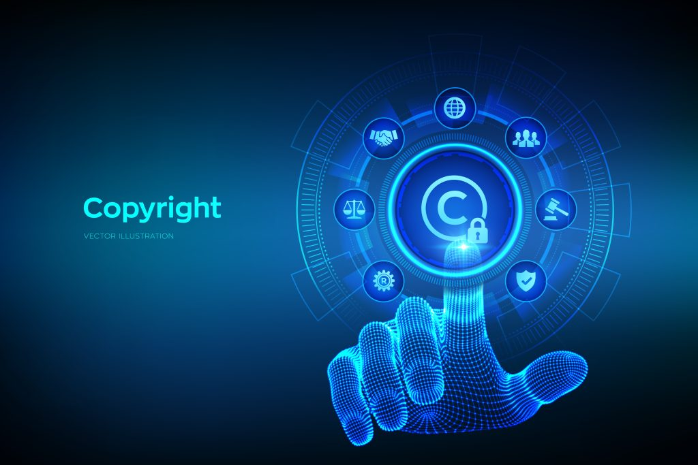
The Ethics Of Copying
Lecture 4
There are a number of characteristics of digital media that make the copying and distribution of various kinds of information – whether representing software, a text, a song, or video, etc. much easier than with analogue media.

Slide 27
That is, once we have access to the various components required – access that, despite the grave difficulties of the “digital divide,” is likewise growing rapidly around the world – copying and distributing a file in digital format is both trivially Easy and all but Cost-free.
Moreover, the general rules, guidelines, and laws applicable to such copying are wide-ranging and frequently shifting.

Slide 28
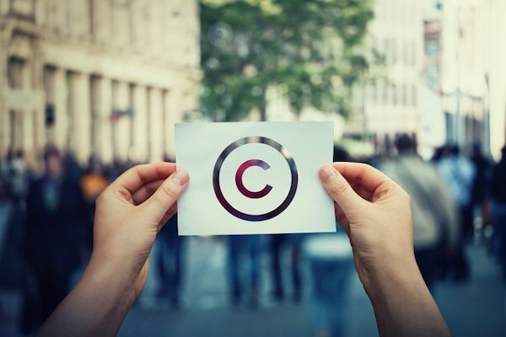
The Ethics Of Copying
Lecture 4
Key Aspects of Copyright in Digital Media:
1. Ownership: Copyright protects original works once they are fixed in a tangible or digital medium.
The creator (or employer in cases like "work for hire") holds the copyright unless it is transferred or sold.

Slide 29
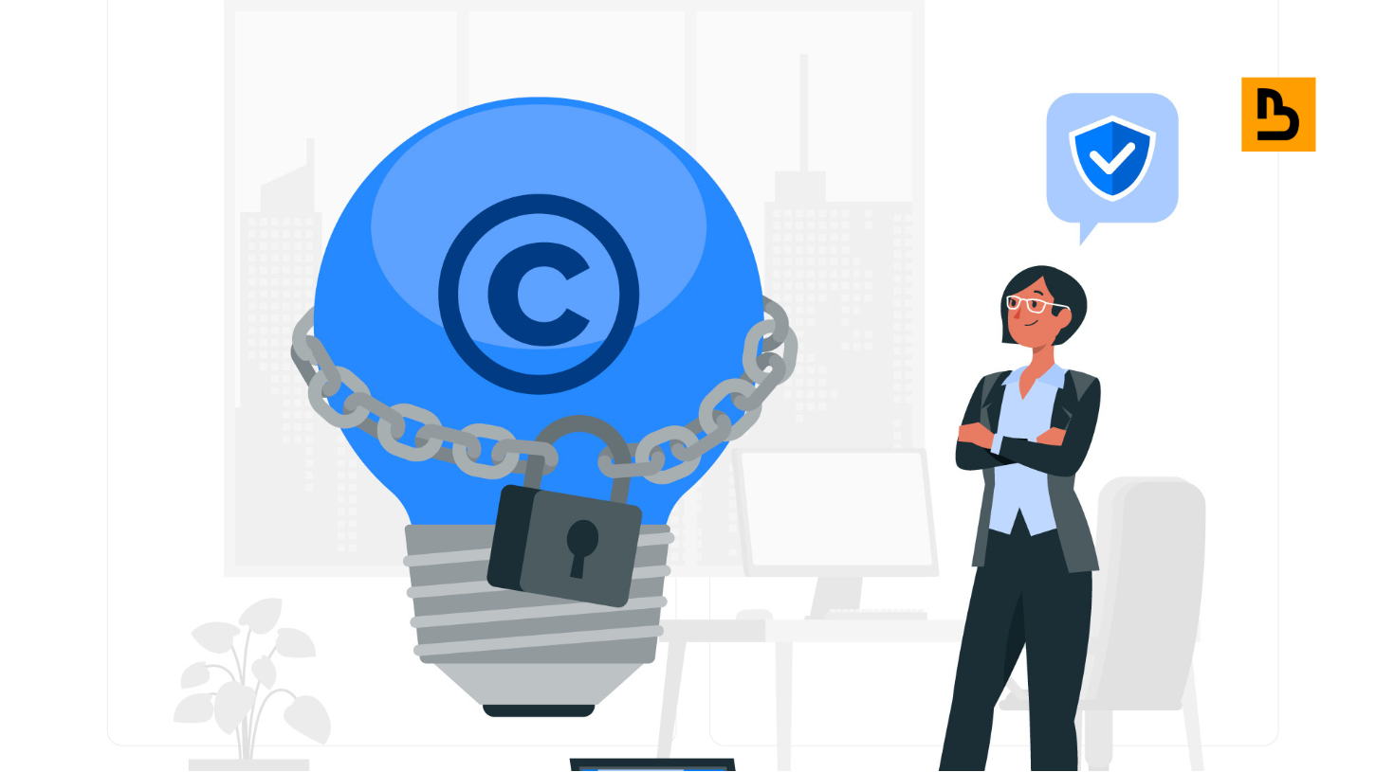
2. Rights of the Creator: Exclusive rights include reproduction, distribution, performance, display, and creation of derivative works.
Creators can license these rights to others for compensation.

Slide 30
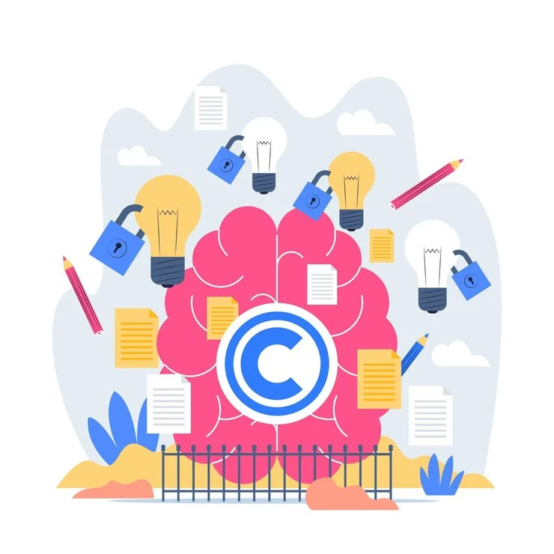
The Ethics Of Copying
Lecture 4
3. Duration of Copyright: Typically lasts the creator's lifetime plus 70 years (depending on jurisdiction). Corporate-owned works often have shorter durations.

Slide 31
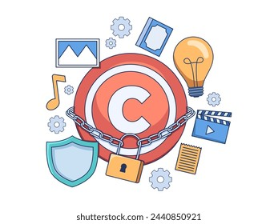
4. Digital Rights Management (DRM): Tools like encryption are used to prevent unauthorized copying or sharing of copyrighted digital content.

Slide 32
The Ethics Of Copying
Lecture 4
5. Challenges in Digital Media:
Ease of Duplication: Digital content can be easily copied and shared, often infringing copyrights.
Global Distribution: Copyright enforcement across borders is difficult.
User-Generated Content: Platforms like YouTube or TikTok create complexities in determining ownership.

Slide 33
Lecture 4
Ai's Impact On Copyright

Slide 34
AI is transforming the way content is created, consumed, and protected, raising new copyright challenges and opportunities:
1. AI-Generated Content:
Who owns content created by AI?
AI tools can produce art, music, articles, and videos, BUT copyright laws typically require human authorship.

Slide 35
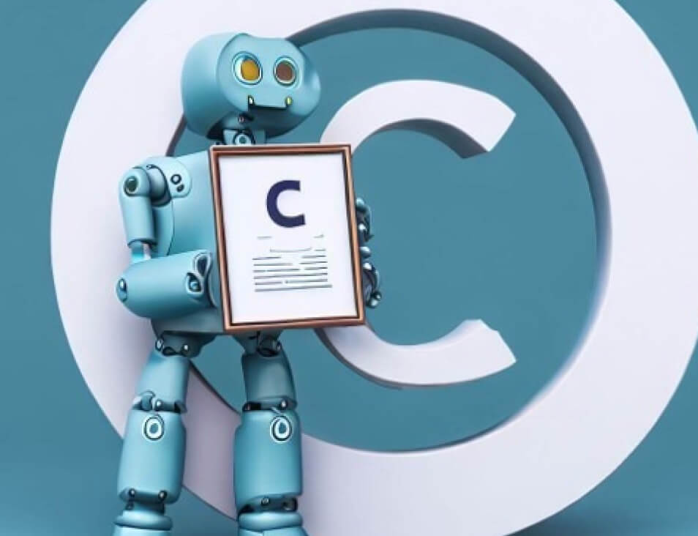
Ai's Impact On Copyright
Lecture 4
Some jurisdictions DO NOT grant copyright to AI-generated works, WHILE others are beginning to explore new frameworks.
Example: An AI writes a song. Does the programmer, user, or AI itself own the rights?
As of now, the creator of the AI (or the one who directed the AI) typically owns the output.

Slide 36
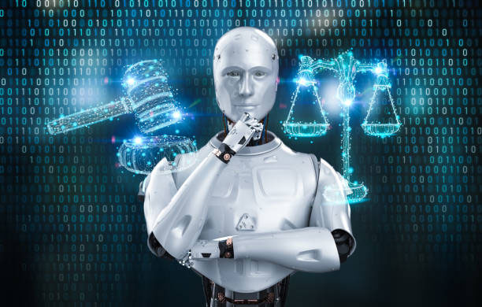
2. Training AI on Copyrighted Material:
Many AI models are trained on datasets containing copyrighted content without explicit permission.
Creators argue that using their works to train AI without consent or compensation violates their copyright.

Slide 37
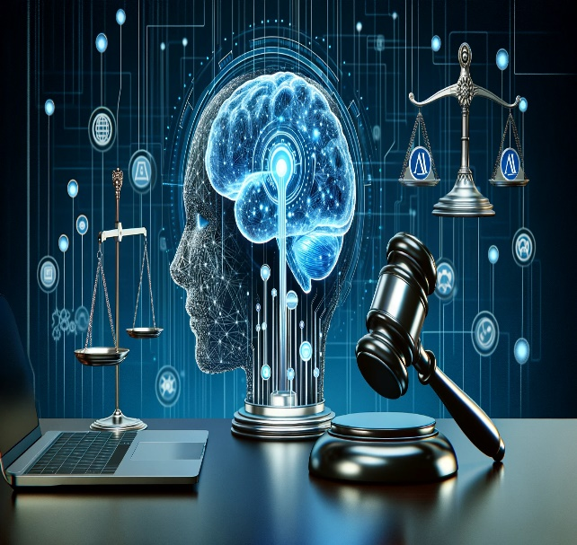
Ai's Impact On Copyright
Lecture 4
Ethical and Legal Concerns:
Models like ChatGPT or DALL·E generate content based on copyrighted data, creating questions about fair use.
Some lawsuits (e.g., from artists or writers) are challenging the use of copyrighted material in training datasets.

Slide 38
3. Infringement and Detection:
AI tools can make it easier to plagiarize or replicate copyrighted content.
Deepfake technologies or AI-generated images may copy styles or directly replicate protected works.
Solutions: AI is also being used to detect copyright infringement by scanning online content for unauthorized use of protected works.

Slide 39
Ai's Impact On Copyright
Lecture 4
4. Ownership of Derivative Works:
AI often produces derivative works that are based on existing copyrighted material.
For instance, an AI model trained on a famous artist's paintings may create works in their style. Determining whether such outputs constitute infringement is a complex and evolving legal question.

Slide 40
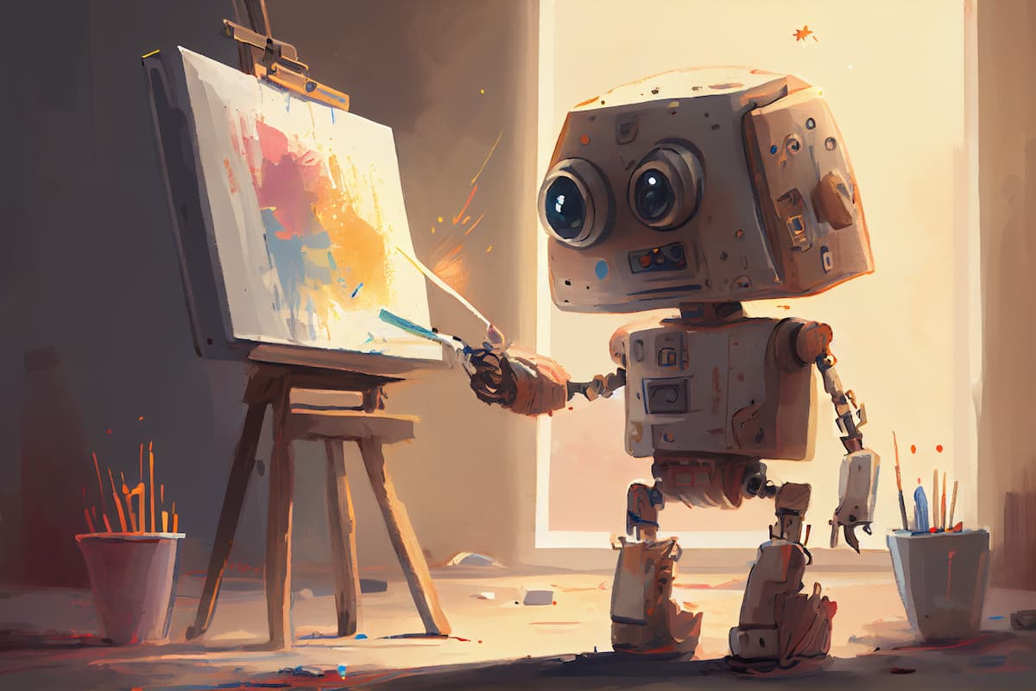
5. Fair Use Debate:
AI-generated outputs might fall under "fair use" for purposes like parody, education, or commentary.
Courts are increasingly grappling with whether AI uses, such as training datasets or creative outputs, qualify as fair use.

Slide 41
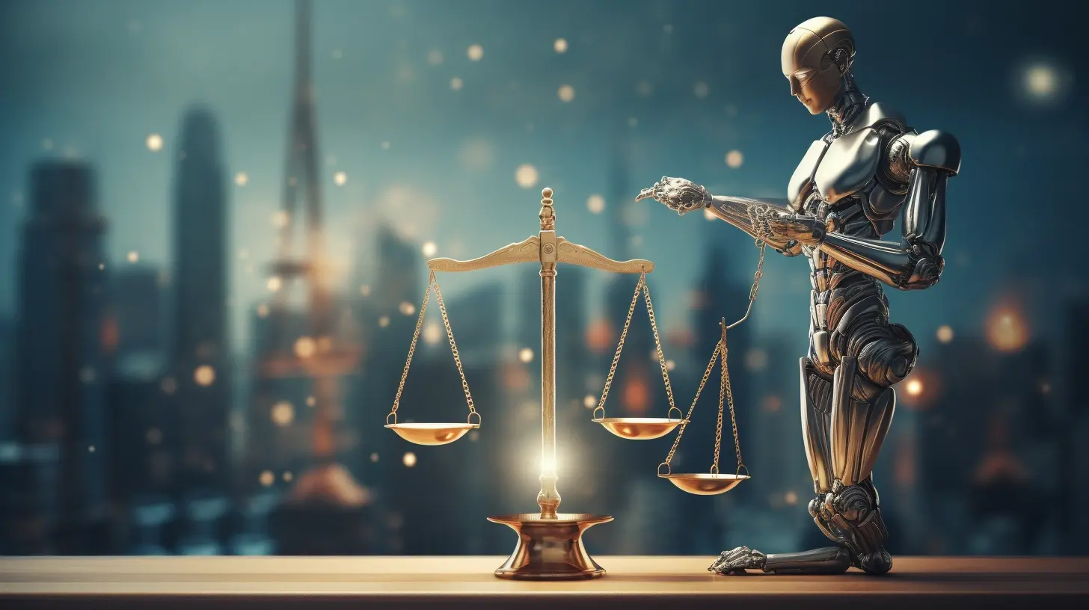
Ai's Impact On Copyright
Lecture 4
6. Copyright and Moral Rights:
Moral rights (e.g., the right to attribution or protection from distortion) may be overlooked in AI-generated works.
AI systems may mimic an artist's work without credit, raising ethical concerns even if no copyright laws are broken.

Slide 42
Future Implications and Recommendations
1. Updated Copyright Laws: Governments must revise copyright frameworks to address AI-generated content and training practices.
2. Licensing Models for Training: Content creators could license their works for AI training in exchange for compensation.
3. AI-Driven Copyright Management: AI tools can be employed to monitor and protect copyrighted works, ensuring fair compensation for creators.

Slide 43
Ai's Impact On Copyright
Lecture 4
4. Transparency in AI Systems: AI developers should disclose the datasets used to train their models to allow copyright holders to verify usage.
5. Clear Ownership Frameworks: Policies should clarify who owns AI-generated works to reduce disputes and uncertainty.
AI is pushing the boundaries of what copyright means in the digital age, creating a need for careful regulation and ethical guidelines to balance innovation with creators' rights.

Slide 44
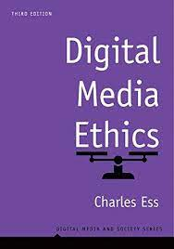

Digital Media Ethics (Digital Media and Society Series), 3rd Edition, by Charles Ess
Intro
Recommended Reference

Slide 45
Lecture 4
Outlines:
** Introduction
** What Do You Know About Copying & Distributing?
** How Copyrighting Works.
** The Ethics Of Copying.
** Ai's Impact On Copyright.

Slide 46



Thank You

Slide 47
DIGITAL MEDIA ETHICS
Lecture 4
DMG 723
Prepared by:
Dr. Sherihan Mohamed

