Slide 1


Employment Relations
Labor unions – Good or bad?
Prepared by Dr. Nourhan Sayed
HRM 624
2nd Lecture
Lecture (2)

Slide 2




Employment Relations
Labor unions – Good or bad?
Lecture (2)
HRM 624
2nd Lecture
Prepared by
Dr. Nourhan Sayed
www.midocean.ae

Slide 3
Four Schools of Thought
The Neoliberal School.
The Human Resource Management School.
The Industrial Relations School.
The Critical Industrial Relations School.

Slide 4
1st school: The Neoliberal School

Slide 5
The Neoliberal School
Focuses on the economic activity of self-interested agents.
Efficiency, equity, and voice achieved through free-market competition.
Idealized, prefect competition results in the optimal allocation and pricing of resources.

Slide 6
The Neoliberal School
The conditions of the labor problem are not seen as exploitation
Rather, employees are paid their economic value.
Employees are free to quit if they feel they are being exploited.

Slide 7
The Neoliberal School
Solution to the labor problem?
Ensure competition.
Macroeconomic stimuli to reduce unemployment.
Remove unnecessary government regulation.
The best protection an employee has against his or her current employer are other employers.
As long as there is (perfect) competition, employment outcomes are not seen as a problem.

Slide 8
The Neoliberal School
View of labor unions in the neoliberal school of thought
Unions are seen as labor market monopolies that interfere with the invisible hand of free market competition; distort efficient outcomes.
Strike threat is used to raise wages above their competitive levels.
Restrictive work rules interfere with the discipline of the market by protecting lazy workers.

Slide 9

The Neoliberal School
To those who believe in perfect competition
Labor unions are bad.

Slide 10
2nd school:Human Resource Management School

Slide 11

Human Resource Management School
Believes that the labor problem stems from poor management
Poor selection, motivation, training, supervision.
Solution to the labor problem?
Better management.

Slide 12

Human Resource Management School
Solution to the labor problem?
Better management.

Slide 13

Human resource management philosophy
Align the interests of workers and the firm via better management.
Create motivated and efficient workers.
Firms should design and implement better supervisory methods.
Selection procedures.
Training methods.
Compensation systems.
Evaluation and promotion mechanisms.

Slide 14

Human Resource Management School
View of unions in this school of thought
Unions are unnecessary “outside, third parties”.
If a company has well-designed HR practices, workers will be satisfied and will not support a union.
Independent labor unions are also seen as adversarial, a barrier to cooperation.

Slide 15

Human Resource Management School
But companies get the union they deserve.
If a company is practicing bad management, workers will seek unionization to combat these poor practices.

Slide 16
3rd School:The Industrial Relations School

Slide 17

The Industrial Relations School
Key belief: The labor problem stems from unequal bargaining power between corporations and individual workers

Slide 18
The Industrial Relations School
The IR school accepts corporations as efficient, valuable organizations
So not opposed in principle to markets or corporations.
But sees labor markets as destructively competitive.
  Need institutional checks and balances to achieve equity and voice.

Slide 19

The Industrial Relations School
Institutional labor economists believed that there were many labor market imperfections
Persistent unemployment.
Company towns dominated by a single employer.
Lack of worker savings and other safety nets.

Slide 20
The Industrial Relations School
Compared to the other schools of thought, the causes of the labor problem are different
So the solutions are different.
Labor unions and other government policies (for example, minimum wage laws) to help increase worker power to better balance employer power.

Slide 21

The Industrial Relations School
View of unions in this school of thought
Unions are important as a way to better balance corporate power in the labor market.
Can provide meaningful voice to employees by being independent rather than controlled by companies.
Independent labor unions can elect their own leaders, collect and spend their own dues money, establish their organizational objectives and strategies, and strike.

Slide 22

The Industrial Relations School
So based on the assumptions and beliefs of the IR school, unions are important for striking a balance between efficiency, equity, and voice
This school of thought provides the intellectual foundations for United States labor law and supporters of labor unions.

Slide 23
4th School:The Critical Industrial Relations School

Slide 24

The Critical Industrial Relations School
Grows out of earlier “Marxist industrial relations” school, and also referred to as a radical perspective
The “critical” label comes from being critical of existing societal institutions and social orderings.

Slide 25
The Critical Industrial Relations School
The critical school
Emphasizes that capitalist institutions do not simply exist but are created by society.
Focuses on how dominant groups design and control institutions to serve their own interests.

Slide 26
The Critical Industrial Relations School
The causes of labor problem
Employers’ dominant power in the workplace, and reinforced by significant influence over other societal institutions (for example, legal system and law enforcement).

Slide 27

The Critical Industrial Relations School
The solutions to the labor problem
Restructuring the nature of capitalism.
For some: replacing capitalism with socialism.
For others: significant changes in power structures and influence.

Slide 28
The Critical Industrial Relations School
View of unions in this school of thought
Strong, militant unions can benefit workers.
Fighting for improved compensation, better working conditions, and greater control over workplace decision making.
Mobilizing and raising working class consciousness.

Slide 29
The Critical Industrial Relations School
Emphasis is on aggressive, labor movement activism that links workers across industries, occupations, and regions.
  Adherents to this school of thought are critical of the pragmatic, collective-bargaining focus of many United States unions.
Believe that they do enough to challenge capital’s power in the workplace and society.

Slide 30
Four Schools of Thought
The schools reflect alternative perspectives on the fundamental assumptions of human resources and industrial relations
Is labor just a commodity?
Are employers and employees equals in competitive labor markets?
What is the nature of conflict between employers and employees?
Essential for understanding views of labor unions (plus views of HRM and other work-related institutions)

Slide 31
Importance of Views on Empl. Rel. Conflict

Slide 32
Importance of Views on Empl. Rel. Conflict
Unitarism (HR School)
Employees and employers have a unity of interests so effective management policies can align these interests for the benefit of all.
Conflict is not an inherent or a permanent feature of the employment relationship (rather, it’s a manifestation of poor HR policies or specific interpersonal clashes).

Slide 33
Importance of Views on Empl. Rel. Conflict
Pluralism (IR School)
Employees and employers have some inherent conflicts of interests and some mutual interests.
All interests are legitimate (similar to a pluralist political system) so cannot always prioritize employer or employee interests.

Slide 34
Importance of Views on Empl. Rel. Conflict
Class-based (Critical IR School)
Emphasizes inherent and antagonistic conflicts of interest between employers and employees.
But not limited to clashes over terms and conditions of employment (pluralism).
More of a social conflict of unequal power relations in many aspects of society.

Slide 35
Competing Views of Labor Unions
In Each School of Thought… | Labor Unions are…
Neoliberalism | Bad: monopolies that benefit a few at the expense of everyone else.
Human Resource Management | Unnecessary: effective management policies are best. Also, unions add unproductive conflict.
Industrial Relations | Important: necessary to counter corporate bargaining power and to balance efficiency, equity, and voice in democratic, capitalist societies.
Critical (Marxist) Industrial Relations | Important but inadequate: An important mechanism for the struggle against capitalists and for protecting workers, but with systemic imbalances, need greater socio-political changes for true reform.
Table divided into two columns summarizes four schools of thoughts. Column 1 represents "In each school of thought" and column 2 represents "Labor Unions are…"

Slide 36
Competing Views of Labor Unions
To understand labor unions and labor relations it is imperative to understand the beliefs of the different schools of thought
More generally, these four schools of thought continue to be the key frameworks for analyzing all aspects of the employment relationship in the 21st century and for thinking about how to improve employment issues

Slide 37
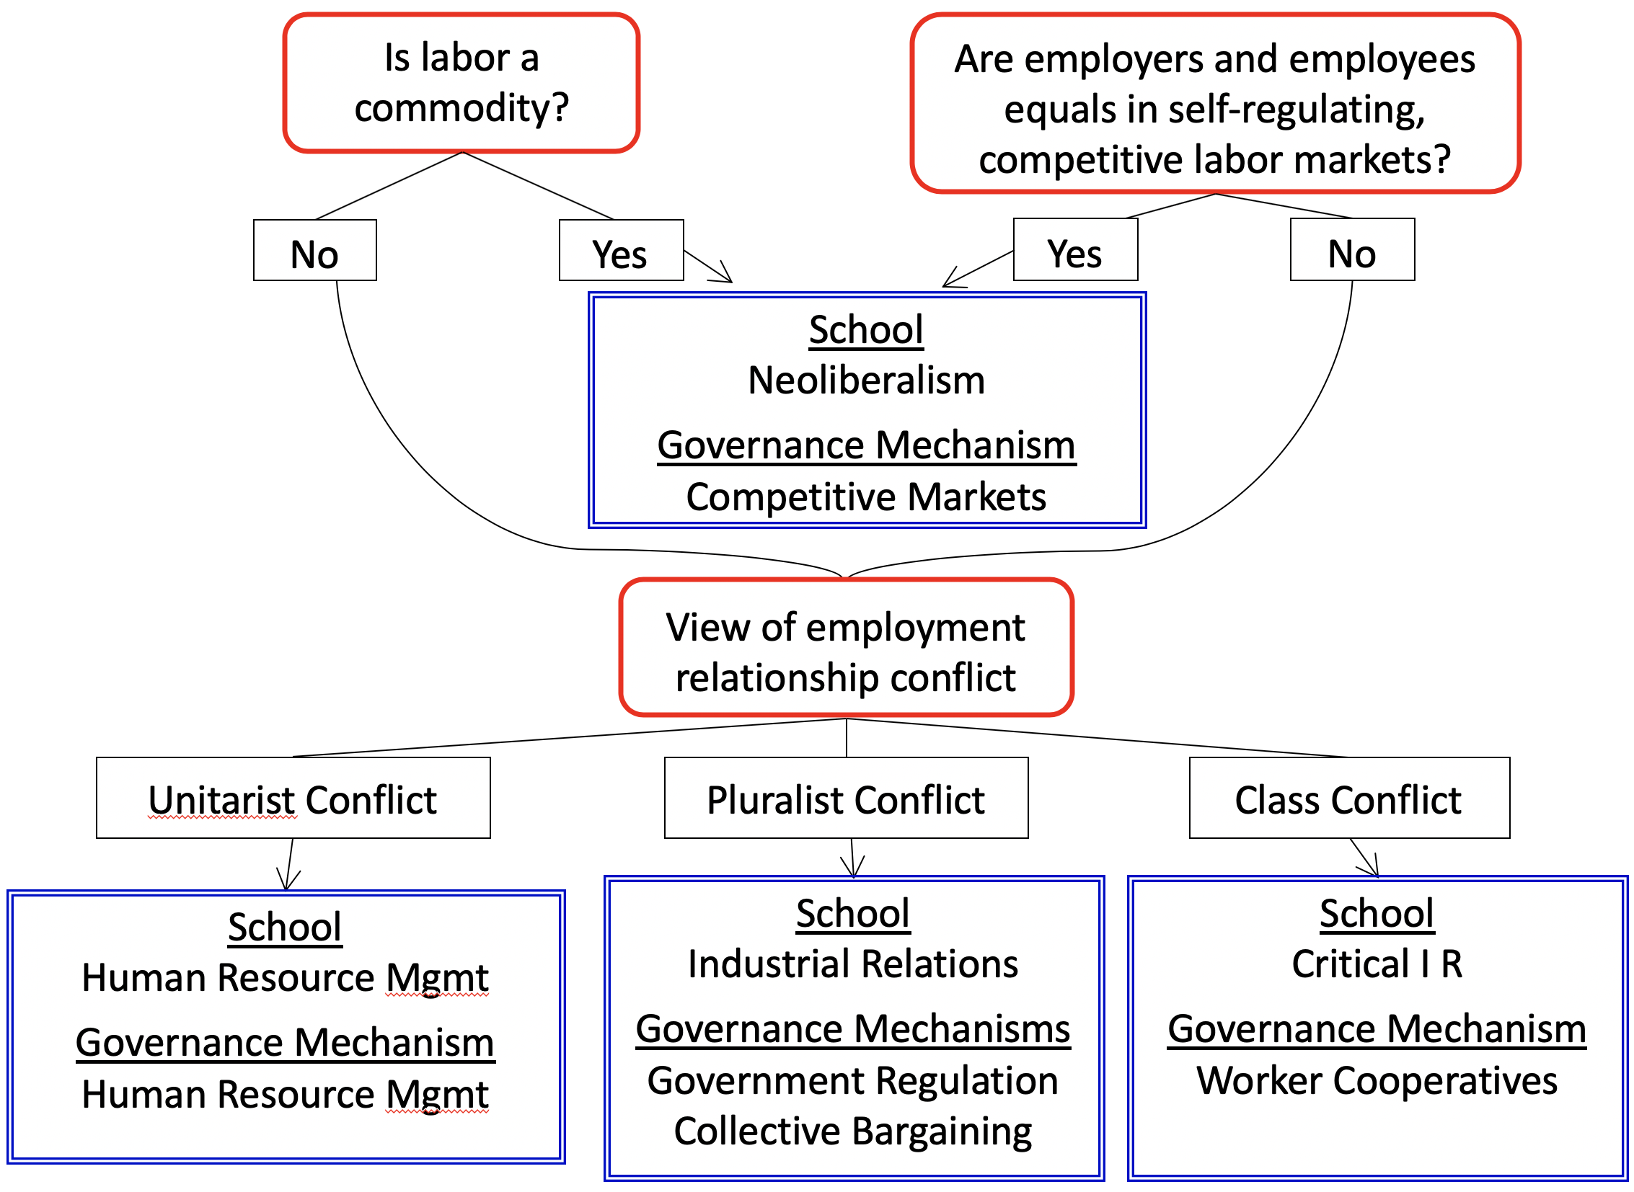
The Intellectual Foundations of the Options for Governing the Workplace
The Intellectual
Foundations of the
Options for
Determining
Employment Terms and
Conditions

Slide 38
What Do Unions Do?

Slide 39
What Do Unions Do?
So…are unions good or bad?
Approach 1: Conceptual
Approach 2: Empirical
Evaluate the research evidence on what unions tend to do.
On balance, are these things beneficial or harmful, and to whom?
But requires using one of the schools as a frame of reference to evaluate!
For example, is the union wage premium good or bad?

Slide 40
More Broadly, What Do Unions Do?
A labor movement is a social movement
Workers and unions from multiple workplaces join together to pursue common interests.
Unions are not purely workplace institutions.

Slide 41
More Broadly, What Do Unions Do?
www.midocean.ae
Extending the I R view
A democratic society is seen as a pluralist society in which numerous groups have common and conflicting interests.
The labor movement represents workers in the political.
Unions are seen as balancing the economic power of employers in the workplace, and as balancing the political power of employers in the political arena.
Labor unions can also be important organizations in civil society where individuals gather to socialize, discuss issues, pursue charitable goals, and form a sense of community.
Often with a much greater diversity of individuals than when people gather with friends and others outside of the workplace.

Slide 42
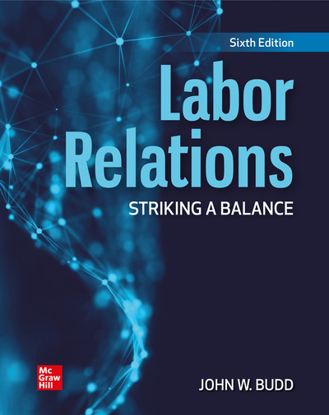
John W. Budd , Labor relations text bok , MC Graw-Hill , 6th edition .
List of references
Textbook:
John W. Budd , Labor relations textbook , MC Graw-Hill , 6th edition .

Slide 43



Thank You

