Slide 1


Project Governance
Prepared by Dr. Fayez Jrad
PMG 424
Lecture 06

Slide 2



Project Governance
Lecture 06
PMG 424
Towards an Integrated Governance Model
Prepared by
Dr. Fayez Jrad

Slide 3
Chapter
Learning Outcomes
06
Explain the need for different governance structures within organizations.
Develop a model of projects, programs, portfolios governance.
Provide a practical perspective of the various governance institutions.
Understand how different governance institutions impact organizations.

Slide 4
Linking Governance of Projects, Programs, and Portfolios
Governance of projects, programs, and portfolios must be looked at in terms of the macro level to see how their respective roles are linked together in the context of the wider organization.
As there is a huge variety of organizational structures, governance orientations and objectives can vary within different companies.
One example can be as following:

Slide 5
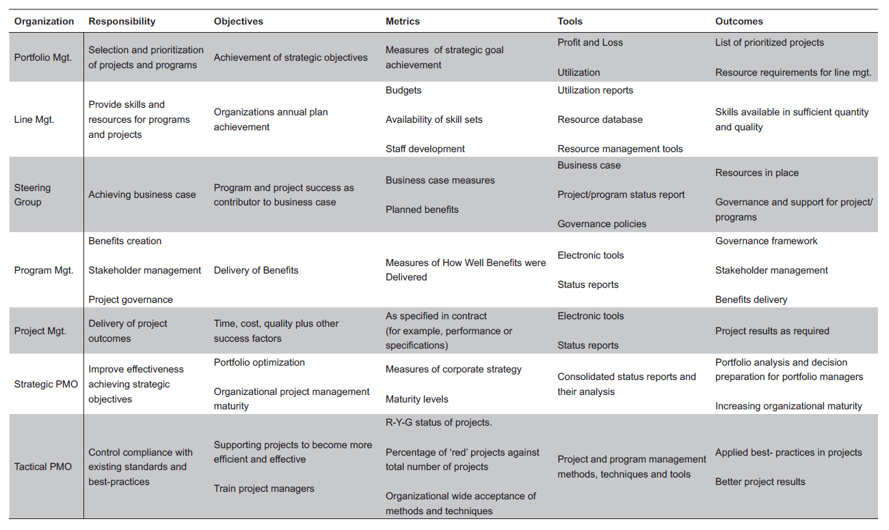
www.midocean.ae

Slide 6
No One-Size-Governance-Fits-All
The previous example shows how the responsibilities of the organizations are broken down hierarchically, as are the associated objectives and their metrics.
Since governance orientations and objectives can vary not only based on industry, but also between different companies in the same industry and their metrics, it is thus not possible to identify a one size fits all standard.

Slide 7
The Governance Model
A governance model focuses on three main components:
Governance paradigm (transaction).
Governance institutions (agency).
Institutional theory (legitimacy).

Slide 8
Governance Paradigm
A typical prerequisite for the model is a governance paradigm that defines the corporate perspective in relation to project management needs.
The paradigm may vary by different organizations within the corporation due to:
A particular organization’s specific objectives.
The management culture instilled by the leaders of that organization.
Contextual requirements when networking with other firms.

Slide 9
Importance of Governance Paradigm
Circumstances may cause organizations to override their default paradigm on a temporary basis.
The default paradigm is often not communicated explicitly but set implicitly by the board of directors or other managers if delegated to them.
The paradigm of choice controls the processes, policies and control mechanisms used by the corporation.

Slide 10
Importance of Governance Paradigm
A Paradigm of Choice Reflects the Underlying Assumptions About Communication and Interaction That Takes Place Within the Organization, Thus Determines How the Organization Can Be Governed

Slide 11
Governance Institutions
The principal institutions in the governance model are the board of directors, steering groups, and PMOs.
Governance at each node in the hierarchy aims to accomplish its own objectives within the wider context of the organization; this is done by:

Slide 12
The Macro View of Governance
Governing the ‘transaction’ of the next lower node by looking at the process and tasks they use to achieve their goals (contract).
Governing the next lower node as an agency to accomplish change, utilize resources in the best possible way and minimize risks.
This is done by aligning objectives and balancing information between the governing organization and its agency.

Slide 13
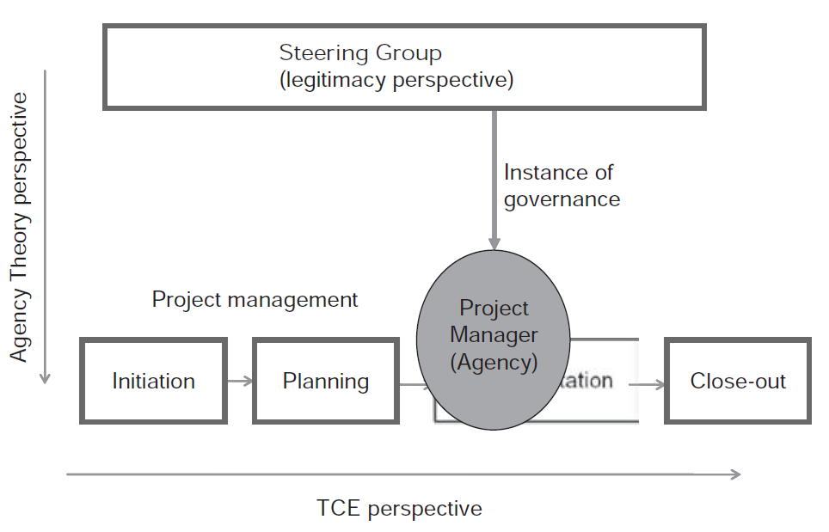
Example of Project Governance Hierarchy
The principal governance hierarchy of a project with its Transaction Costs Economics (TCE) and Agency Theory perspectives.

Slide 14
Institutional Theory (Legitimacy)
Institutional theory is the third and final component of the theoretical model for governance of projects.
Institutional theory uses legitimacy to emphasize conformance with society and stakeholder values and expectations.
It complements the primary determinants of organizational success; the rational perspectives of efficiency and effectiveness, and links governance to the more subjective aspects of management.

Slide 15
What is Legitimacy?
Legitimacy aims to ensure that actions carried out and decisions taken during governance are performed in way that achieves legitimacy within its context.
Legitimacy is A Generalized Perception Or Assumption That the Actions of An Entity Are Desirable, Proper, Or Appropriate Within Some Socially Constructed System of Norms, Values, Beliefs, and Definitions

Slide 16
The Importance of Legitimacy
Legitimacy as a perception or assumption, which represents a reaction of the environment to the organization as they see it.
Legitimacy reflects the extent of congruence between the behaviors of the legitimated entity (for example, the governance institutions) and the shared beliefs of some social group (for example, stakeholders and society-at-large).
Legitimacy is the outcome of an effective, ethical governance system.

Slide 17
The Importance of Legitimacy
Legitimacy enables us to frame (and measure) the appropriateness with which a (social) enterprise is governed.
The governance system and processes must be repeatable over time, to continue meeting the needs of primary stakeholders, hence maintaining legitimacy.
Legitimacy includes the idea that the ultimate aim for the (social) enterprise is long-term sustainability.

Slide 18
How To Achieve Legitimacy
Organizations will need to seek legitimacy to justify their existence.
Governance institutions achieve legitimacy by making decisions based on their legitimacy within a given context (society, company culture etc.).

Slide 19
Legitimacy Forms
Legitimacy is an umbrella term which is the combination of the three lower-level specific forms:
Pragmatic Legitimacy.
Moral Legitimacy.
Cognitive Legitimacy.

Slide 20
Pragmatic Legitimacy
Pragmatic legitimacy is based on self-interest.
It legitimizes actions that achieve highest benefit or utility in the eyes of the stakeholders or society in general.

Slide 21
Moral Legitimacy
Moral legitimacy is based on ethical approval of actions.
It legitimizes activities undertaken within the boundaries of the broader norms of society, no matter what the outcome may be.

Slide 22
Cognitive Legitimacy
Cognitive legitimacy is based on comprehensibility and taken-forgrantedness.
It legitimizes actions that are predictable, meaningful and self-evident by the perceiver.

Slide 23
Legitimacy and Institutions
Governance institutions make decisions that balance benefit maximization, moral appropriateness and ease of understanding in the wider organizational context.
Strong technical environments (technology companies) foster the need for pragmatic and moral legitimacy.
Strong institutional environments (schools) favor sense-making, which fosters the need for cognitive and moral legitimacy even at the expense of their constituents.

Slide 24
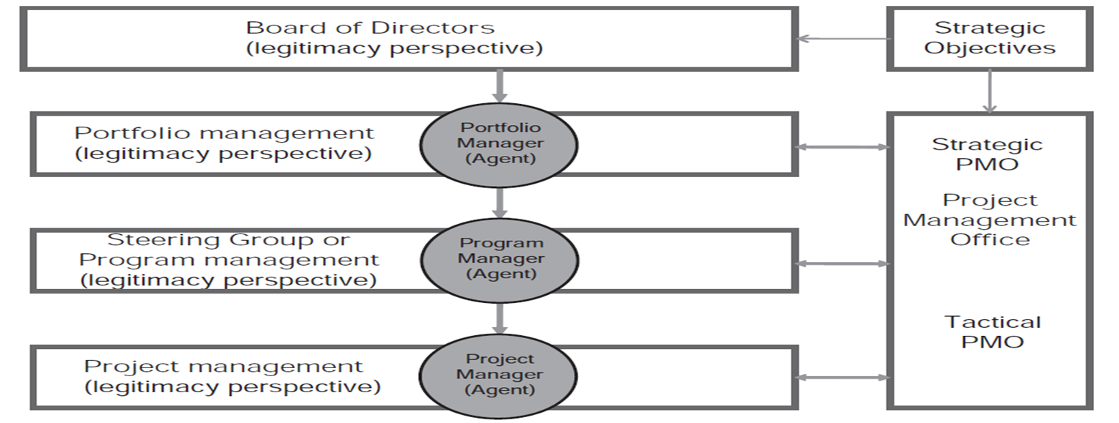
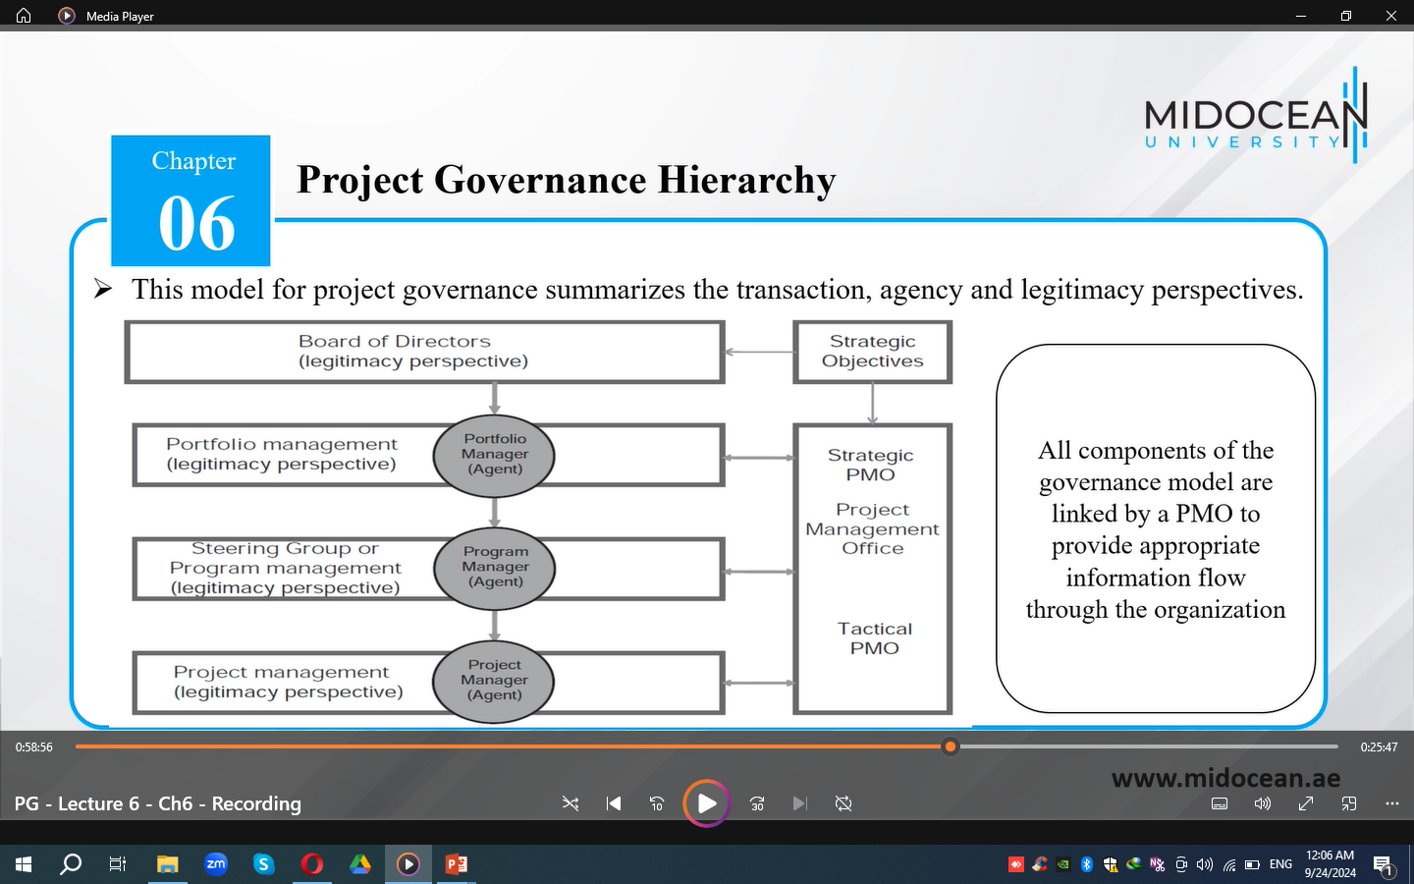
Project Governance Hierarchy
This model for project governance summarizes the transaction, agency and legitimacy perspectives.

Slide 25
Implications of Legitimacy
The legitimacy perspective enables governance actions, including the project and its management, to gain social acceptance.
Balancing pragmatic, moral and cognitive legitimacy for a given project context increases acceptance and ‘social value’ of a project.
While this balance has the very real measurable benefit of reducing overhead costs, it also has the not insignificant ‘soft’ benefit of legitimizing the governance institution in the eye of the stakeholder and potentially society at large.

Slide 26
The Total Project Governance Model
The governance model for projects is complemented by the governance framework for project management.
The three steps of governance framework of project management (Chapter 4) can be seen as a third dimension for the governance paradigm and the governance of projects, programs, and portfolios.
The governance paradigm provides the link between governance of projects and governance of project management.

Slide 27
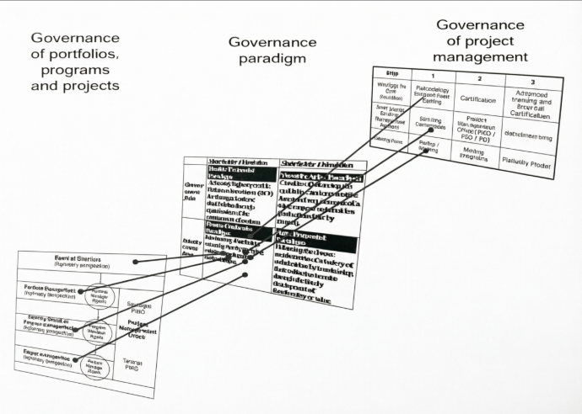

Slide 28
The Role of Governance Paradigms
A control paradigm such as the Conformist supports approaches as outlined in Step 1 of the project management governance framework; that is, methodology compliance, audits and steering group observation.
Contrarily, a Versatile Artist paradigm fosters autonomy and trust in the project manager, aligning the entire organization (through the use of project management maturity models) to support the project-way-of-working the project manager has the flexibility and trust to balance requirements of various stakeholders.

Slide 29
The Role of Governance Paradigms
The four governance paradigms tie together and categorize:
the various ways of managing a project, given the implication stemming from Transaction Costs Economics (TCE), agency theory and legitimacy;
the corporate governance orientation chosen, either primarily stakeholder or primarily shareholder oriented;
the project management capabilities and practices deemed appropriate for all projects throughout the organization.

Slide 30
The Role of Governance Paradigms
The Governance paradigm influences the extent to which a corporation implements Steps 1–3 of the governance model for project management.
It then synchronizes these project management capabilities with the level of control and autonomy needed for projects throughout the organization.

Slide 31
In the Total Model of Project Governance, A Paradigm Represents the Tool Used For Linking Project Management Capabilities With Requirements In Accordance With the Wider Corporate Governance Orientation

Slide 32
Conclusion
As there is a huge variety of organizational structures, it is not possible to identify a one-size-fits-all in terms of how project, program, and portfolio governance are linked to the context of the wider organization.
It is important to thoughtfully decide on the suitable governance paradigm for an organization as it controls the processes, policies and control mechanisms used by the corporation.

Slide 33
Conclusion
A typical prerequisite for the model is a governance paradigm that defines the corporate perspective in relation to project management needs.
The paradigm may vary by different organizations within the corporation due to a particular organization’s specific objectives, the management culture instilled by the leaders of that organization, and the contextual requirements when networking with other firms.

Slide 34
Conclusion
The principal organizations in the governance model are the board of directors, steering groups, and PMOs.
Governance at each node in the hierarchy aims to accomplish its own objectives within the wider context of the organization.

Slide 35
Conclusion
Legitimacy is a generalized perception or assumption that the actions of an entity are desirable, proper, or appropriate within some socially constructed system of norms, values, beliefs, and definitions.
Legitimacy aims to ensure that actions carried out and decisions taken during governance are performed in way that achieves legitimacy within its context.

Slide 36
Conclusion
The project governance model links existing theories to model the way projects and project management are governed in project-based organizations.
It gives insight into the interaction between the different governance organizations, their roles and tasks, as well as the link to the project management skills and capabilities required to achieve governance objectives.

Slide 37
Task 1
Explain the benefits of linking the three components of project, program, and portfolio governance on the wider organization?

Slide 38
Task 2
Explain how the responsibilities of the principal governance institutions are broken down hierarchically, as are the associated objectives and their metrics? You may develop a table?

Slide 39

Reference

Slide 40



Thank You

