Slide 1



Strategic and Operational
Management
MGM 630 (part 3)
Lecture 8
Prepared by
Dr. Ahmad AL-Naimi

Slide 2

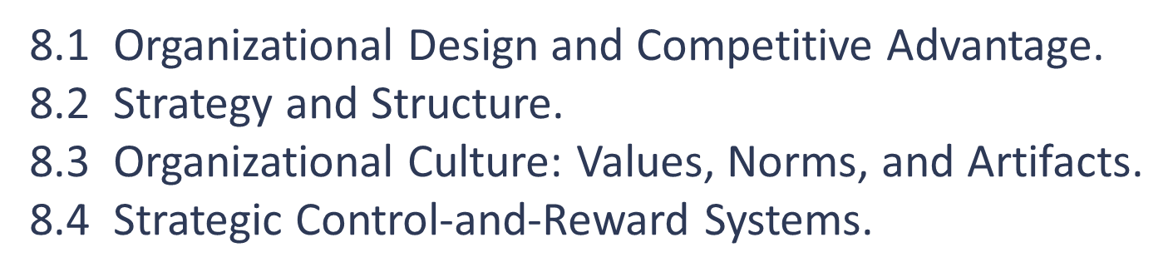
Lecture
LECTURE OUTLINE
08
2–2

Slide 3
Lecture
LEARNING OBJECTIVES
08
1. Define organizational design and list its three components.
2. Explain how organizational inertia can lead established firms to failure.
3. Define organizational structure and describe its four elements.
4. Compare and contrast mechanistic versus organic organizations.
5. Describe different organizational structures and match them with appropriate strategies.
6. Describe the elements of organizational culture, and explain where organizational cultures can come from and how they can be changed.
7. Compare and contrast different strategic control-and-reward systems.
2–3

Slide 4

Lecture
TITLE OF LECTURE
Organizational Design:
Structure, Culture, and Control
08
8.1 Organizational Design and Competitive Advantage
Organizational design is the process of creating, implementing, monitoring, and modifying the structure, processes, and procedures of an organization. The key components of organizational design are structure, culture, and control. The goal is to design an organization that allows managers to effectively translate their chosen strategy into a realized one. Not surprisingly, the inability to implement strategy effectively is the number-one reason boards of directors fire CEOs.

Slide 5
Lecture
TITLE OF LECTURE
Organizational Design:
Structure, Culture, and Control
08
1. Organizational Inertia: the Failure of Established Firms
To implement a formulated business strategy successfully, structure must accommodate strategy, not the other way around. In reality, however, a firm’s strategy often follows its structure. This reversal implies that some managers consider only strategies that do not change existing organizational structures; they do not want to confront the inertia that often exists in established organizations.

Slide 6

TITLE OF LECTURE
Organizational Design:
Structure, Culture, and Control
Lecture
08
Inertia, a firm’s resistance to change the status quo, can set the stage for the firm’s subsequent failure. Successful firms often plant the seed of subsequent failure: They optimize their organizational structure to the current situation. That tightly coupled system can break apart when internal or external pressures occur. Note that organizational inertia is often the result of success in a particular market during a particular time; it becomes difficult to argue with success. The pattern for successful firms often follows a particular path:

Slide 7

Lecture
TITLE OF LECTURE
Organizational Design:
Structure, Culture, and Control
08
1. Mastery of, and fit with, the current environment.
2. Success, usually measured by financial measurements.
3. Structures, measures, and systems to accommodate and manage size.
4. A resulting organizational inertia that tends to minimize opportunities and challenges created by shifts in the internal and external environment.

Slide 8

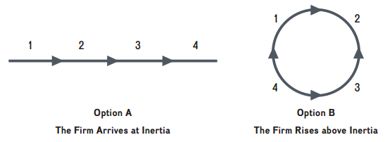
TITLE OF LECTURE
Organizational Design:
Structure, Culture, and Control
Lecture
08
What’s missing, of course, is the conscious strategic decision to change the firm’s internal environment to fit with the new external environment, turning four steps leading to the endpoint of inertia (Option A) into the kind of a virtual circle where the firm essentially reboots and reinvents itself (Option B).

Slide 9

TITLE OF LECTURE
Organizational Design:
Structure, Culture, and Control
Lecture
08
Consider that the need for structural reorganization can be especially intense in many industries where the rate of change is high and potential disruption frequent. Consider also that business leaders find it much easier to create and manage within developed structures than to restructure their organizations to be where they will need to be in future. Exhibit 11.2 shows how success in the current environment can lead to a firm’s down-fall in the future, when the tightly coupled system of strategy and structure experiences internal or external shifts.

Slide 10

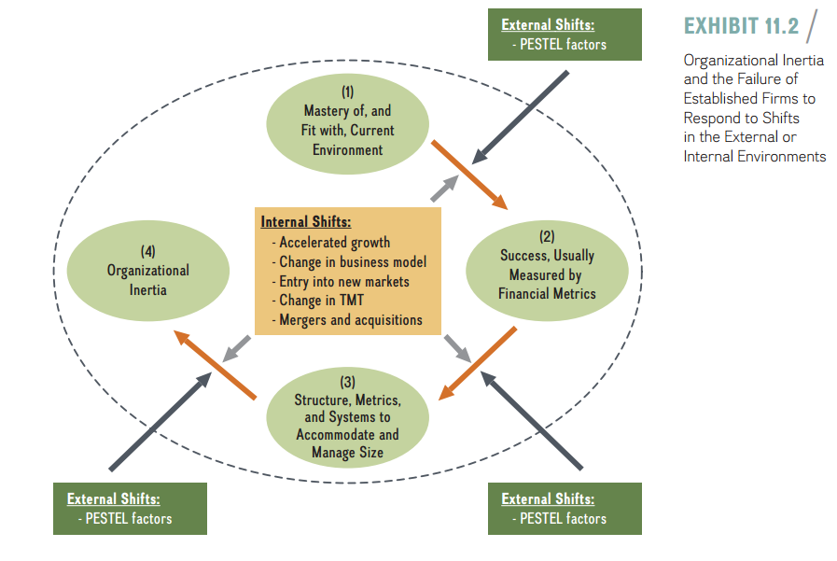
TITLE OF LECTURE
Organizational Design:
Structure, Culture, and Control
Lecture
08

Slide 11
TITLE OF LECTURE
Organizational Design:
Structure, Culture, and Control
Lecture
08
First, the managers achieve a mastery of, and fit with, the firm’s current environment. Second, the firm often defines and measures success by financial metrics, with a focus on short-term performance. Third, the firm puts in place structures, metrics, and systems to accommodate and manage increasing firm size and complexity due to continued success. Finally, as a result of a tightly coupled albeit successful system, organizational inertia sets in—and with it, resistance to change.

Slide 12
TITLE OF LECTURE
Organizational Design:
Structure, Culture, and Control
Lecture
08
2. Organizational Structure
Some of the key decisions managers must make when designing effective organizations pertain to the firm’s organizational structure. That structure determines how the work efforts of individuals and teams are orchestrated and how resources are distributed. In particular, an organizational structure defines how jobs and tasks are divided and integrated, delineates the reporting relationships up and down the hierarchy, defines formal communication channels, and prescribes how individuals and teams coordinate their work efforts.

Slide 13
TITLE OF LECTURE
Organizational Design:
Structure, Culture, and Control
Lecture
08
The key building blocks of an organizational structure are:
■ Specialization
■ Formalization
■ Centralization
■ Hierarchy

Slide 14
TITLE OF LECTURE
Organizational Design:
Structure, Culture, and Control
Lecture
08
- Specialization. Specialization describes the degree to which a task is divided into separate jobs—that is, the division of labor. Larger firms, such as Fortune 100 companies, tend to have a high degree of specialization; smaller entrepreneurial ventures tend to have a low degree of specialization. For example, an accountant for a large firm may specialize in only one area (e.g., internal audit), whereas an accountant in a small firm needs to be more of a generalist and take on many different things (e.g., internal auditing, plus pay-roll, accounts receivable, financial planning, and taxes). Specialization requires a trade-off between breadth and depth of knowledge. While a high degree of the division of labor increases productivity, it can also have unintended side-effects such as reduced employee job satisfaction due to repetition of tasks.

Slide 15
TITLE OF LECTURE
Organizational Design:
Structure, Culture, and Control
Lecture
08
- Formalization. Formalization captures the extent to which employee behavior is steered by explicit and codified rules and procedures. Formalized structures are characterized by detailed written rules and policies of what to do in specific situations. These are often codified in employee handbooks. McDonald’s, for example, uses detailed standard operating procedures throughout the world to ensure consistent quality and service.

Slide 16
TITLE OF LECTURE
Organizational Design:
Structure, Culture, and Control
Lecture
08
- Centralization. Centralization refers to the degree to which decision making is concentrated at the top of the organization. Centralized decision making often correlates with slow response time and reduced customer satisfaction. In decentralized organizations such as Zappos, decisions are made and problems solved by empowered lower-level employees who are closer to the sources of issues. Different strategic management processes (discussed in Chapter 2) match with different degrees of centralization:
■ Top-down strategic planning takes place in highly centralized organizations.
■ Planned emergence is found in more decentralized organizations.

Slide 17
Lecture
TITLE OF LECTURE
Organizational Design:
Structure, Culture, and Control
08
- Hierarchy. Hierarchy determines the formal, position-based reporting lines and thus stipulates who reports to whom. Let's assume two firms of roughly equal size: Firm A and Firm B. If many levels of hierarchy exist between the frontline employee and the CEO in Firm A, it has a tall structure. In contrast, if there are few levels of hierarchy in Firm B, it has a flat structure.

Slide 18
TITLE OF LECTURE
Organizational Design:
Structure, Culture, and Control
Lecture
08
- The number of levels of hierarchy, in turn, determines the managers’ span of control—how many employees directly report to a manager. In tall organizational structures (Firm A), the span of control is narrow. In flat structures (Firm B), the span of control is wide, meaning one manager supervises many employees. In recent years, firms have de-layered by reducing the headcount (often middle managers), making themselves flatter and more nimble. This, however, puts more pressure on the remaining managers who have to supervise and monitor more direct reports due to an increased span of control.

Slide 19
Lecture
TITLE OF LECTURE
Organizational Design:
Structure, Culture, and Control
08
3. Mechanistic VS. Organic Organizations
Several of the building blocks of organizational structure frequently appear together, creating distinct organizational forms—mechanistic or organic organizations.
- Mechanistic Organizations. Mechanistic organizations are characterized by a high degree of specialization and formalization and by a tall hierarchy that relies on centralized decision making. The fast food chain McDonald’s fits this description quite well.

Slide 20
Lecture
TITLE OF LECTURE
Organizational Design:
Structure, Culture, and Control
08
- Organic Organizations. Organic organization shave a low degree of specialization and formalization, a flat organizational structure, and decentralized decision making. Organic structures tend to be correlated with the following: a fluid and flexible information flow among employees in both horizontal and vertical directions; faster decision making; and higher employee motivation, retention, satisfaction, and creativity.

Slide 21
Lecture
TITLE OF LECTURE
Organizational Design:
Structure, Culture, and Control
08
8.2 Strategy and Structure
The important and interdependent relationship between strategy and structure directly impacts a firm’s performance. Moreover, the relationship is dynamic—changing over time in a somewhat predictable pattern as firms grow in size and complexity. Successful new ventures generally grow first by increasing sales, then by obtaining larger geo-graphic reach, and finally by diversifying through vertical integration and entering into related and unrelated businesses.

Slide 22
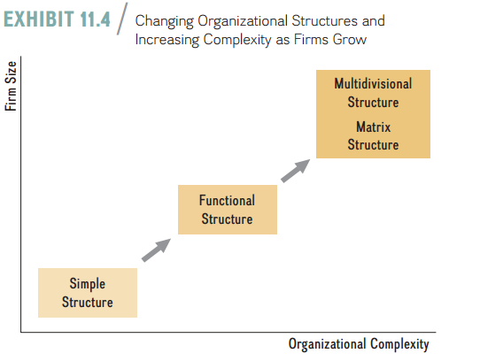
Lecture
TITLE OF LECTURE
Organizational Design:
Structure, Culture, and Control
08
Different stages in a firm’s growth require different organizational structures. This important evolutionary pattern is depicted in Exhibit 11.4. As we discuss next, organizational structures range from simple to functional to multidivisional to matrix.

Slide 23
Lecture
TITLE OF LECTURE
Organizational Design:
Structure, Culture, and Control
08
- Simple Structure
A simple structure generally is used by small firms with low organizational complexity. In such firms, the founders tend to make all the important strategic decisions and run the day-to-day operations.

Slide 24
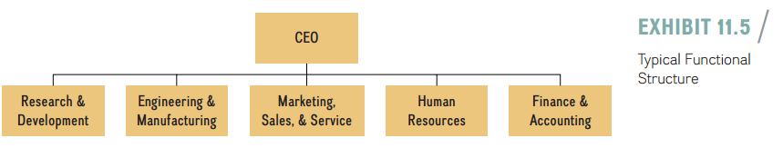
Lecture
TITLE OF LECTURE
Organizational Design:
Structure, Culture, and Control
08
- Functional Structure
As sales increase, firms generally adopt a functional structure, which groups employees into distinct functional areas based on domain expertise. These functional areas often correspond to distinct stages in the value chain such as R&D, engineering and manufacturing, and marketing and sales, as well as supporting areas such as human resources, finance, and accounting. Exhibit 11.5 shows a functional structure, with the lines indicating reporting and authority relationships.

Slide 25
Lecture
TITLE OF LECTURE
Organizational Design:
Structure, Culture, and Control
08
- Multidivisional Structure
Over time, as a firm diversifies into different product lines and geographies, it generally implements a multidivisional or a matrix structure (as shown in Exhibit 11.4). The multidivisional structure(or M-form) consists of several distinct strategic business units (SBUs), each with its own profit-and-loss (P&L) responsibility. Each SBU is operated more or less independently from one another, and each is led by a CEO (or equivalent general manager) who is responsible for the unit’s business strategy and its day-to-day operations.

Slide 26
Lecture
TITLE OF LECTURE
Organizational Design:
Structure, Culture, and Control
08
The CEOs of each division report to the corporate office, which is led by the company’s highest-ranking executive (titles vary and include president or CEO for the entire corporation). Because most large firms are diversified to some extent across different product lines and geographies, the M-form is a widely adopted organizational structure.

Slide 27
Lecture
TITLE OF LECTURE
Organizational Design:
Structure, Culture, and Control
08
Consider that Zappos is an SBU under Amazon, which employs a multidivisional structure. Also, W.L. Gore uses a multidivisional structure to administer its differentiation and related diversification strategies. It has four product divisions (electronic products, industrial products, medical products, and fabrics division) with manufacturing facilities in the United States, China, Germany, Japan, and Scotland, and business activities in 30 countries across the globe.

Slide 28
Lecture
TITLE OF LECTURE
Organizational Design:
Structure, Culture, and Control
08
A typical M-form is shown in Exhibit 11.7. In this example, the company has four SBUs, each led by a CEO. Corporations may use SBUs to organize around different businesses and product lines or around different geographic regions. Each SBU represents a self-contained business with its own hierarchy and organizational structure. Note that in Exhibit 11.7, SBU 2 is organized using a functional structure, while SBU 4 is organized using a matrix structure. The CEO of each SBU must determine which organizational structure is most appropriate to implement the SBU’s business strategy.

Slide 29
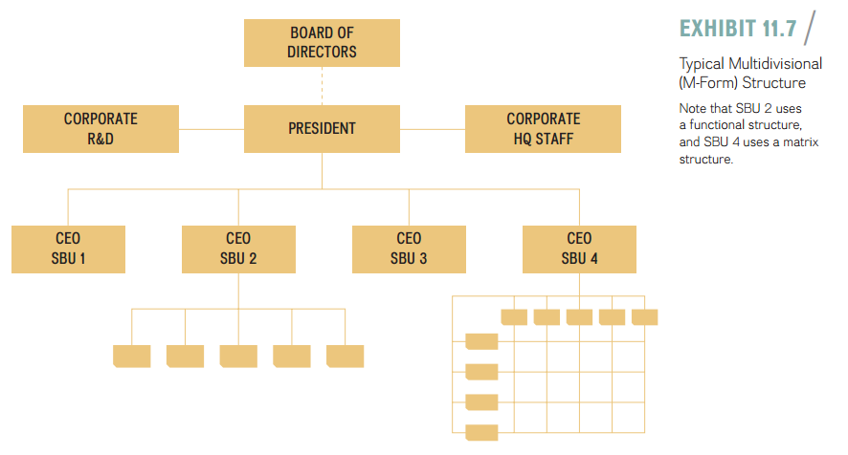
Lecture
TITLE OF LECTURE
Organizational Design:
Structure, Culture, and Control
08

Slide 30
Lecture
TITLE OF LECTURE
Organizational Design:
Structure, Culture, and Control
08
- Matrix Structure
To reap the benefits of both the M-form and the functional structure, many firms employ a mix of these two organizational forms, called a matrix structure. Exhibit 11.9 shows an example. In it, the firm is organized according to SBUs along a horizontal axis (like in the M-form), but also has a second dimension of organizational structure along a vertical axis. In this case, the second dimension consists of different geographic areas, each of which generally would house a full set of functional activities. The idea behind the matrix structure is to combine the benefits of the M-form (domain expertise, economies of scale, and the efficient processing of information) with those of the functional structure (responsiveness and decentralized focus).

Slide 31
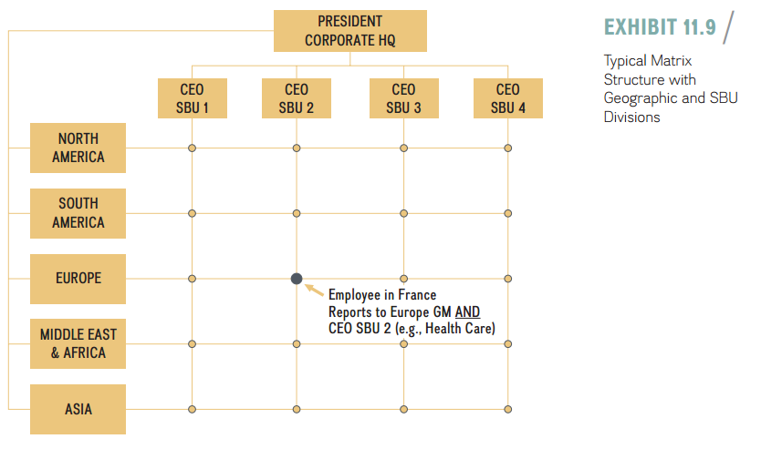
Lecture
TITLE OF LECTURE
Organizational Design:
Structure, Culture, and Control
08

Slide 32
Lecture
TITLE OF LECTURE
Organizational Design:
Structure, Culture, and Control
08
8.3 Organizational Culture: Values, Norms, and Artifacts
Organizational culture is the second key building block when designing organizations for competitive advantage. Just as people have distinctive personalities, so too do organizations have unique cultures that capture “how things get done around here.” Organizational culture describes the collectively shared values and norms of an organization’s members. Values define what is considered important. Norms define appropriate employee attitudes and behaviors.

Slide 33
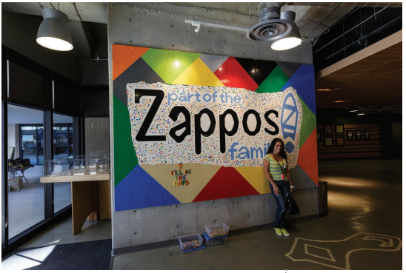
Lecture
TITLE OF LECTURE
Organizational Design:
Structure, Culture, and Control
08
Employees learn about an organization’s culture through socialization, a process whereby employees internalize an organization’s values and norms through immersion in its day-to-day operations. Zappos’ new-employee orientation and immersion is now a four-week extensive course. Successful socialization, in turn, allows employees to function productively and to take on specific roles within the organization. Strong cultures emerge when the company’s core values are widely shared among the firm’s employees and when the norms have been internalized.

Slide 34
Lecture
TITLE OF LECTURE
Organizational Design:
Structure, Culture, and Control
08
Corporate culture finds its expression in artifacts. Artifacts include elements such as the design and layout of physical space (e.g., cubicles or private offices); symbols (e.g., the type of clothing worn by employees); vocabulary; what stories are told (see the Zappos pizza-ordering example that follows); what events are celebrated and highlighted; and how they are celebrated (e.g., a formal dinner versus a casual BBQ when the firm reaches its sales target).

Slide 35
TITLE OF LECTURE
Organizational Design:
Structure, Culture, and Control
Lecture
08
- Where DO Organizational Cultures Come From?
Often, company founders define and shape an organization’s culture, which can persist for many decades after their departure. This phenomenon is called founder imprinting. Founders set the initial strategy, structure, and culture of an organization by transforming their vision into reality. Famous founders who have left strong imprints on their organizations include Steve Jobs (Apple), Walt Disney (Disney), Michael Dell (Dell), Sergey Brin and Larry Page (Google), Oprah Winfrey (Harpo Productions and OWN, the Oprah Winfrey Network), Bill Gates (Microsoft), Larry Ellison (Oracle), Ralph Lauren (Polo Ralph Lauren), Martha Stewart (Martha Stewart Living Omnimedia), and Herb Kelleher (Southwest Airlines).

Slide 36
TITLE OF LECTURE
Organizational Design:
Structure, Culture, and Control
Lecture
08
- How does Organizational Culture Change?
An organization’s culture can be one of its strongest assets, but also its greatest liability. An organization’s culture can turn from a core competency into a core rigidity if a firm relies too long on the competency without honing, refining, and upgrading as the firm and the environment change. (See discussion in Chapter 4.) Over time, the original core competency is no longer a good fit and turns from an asset into a liability. This is the time when a culture needs to change.

Slide 37
TITLE OF LECTURE
Organizational Design:
Structure, Culture, and Control
Lecture
08
- Organizational Culture And Competitive Advantage
Can organizational culture be the basis of a firm’s competitive advantage? For this to occur, the firm’s unique culture must help it in some way to increase its economic value creation(V–C). That is, it must either help in increasing the perceived value of the product/service and/or lower its cost of production/delivery. Moreover, according to the resource-based view of the firm, the resource—in this case, organizational culture—must be valuable, rare, difficult to imitate, and the firm must be organized to capture the value created. The VRIO principles must apply even as to organizational culture itself.

Slide 38
TITLE OF LECTURE
Organizational Design:
Structure, Culture, and Control
Lecture
08
8.4 Strategic Control-and-Reward Systems
Strategic control-and-reward systems are the third and final key building block when designing organizations for competitive advantage. Strategic control-and-reward systems are internal governance mechanisms put in place to align the incentives of principals (shareholders) and agents (employees). These systems allow managers to specify goals, measure progress, and provide performance feedback.

Slide 39
TITLE OF LECTURE
Organizational Design:
Structure, Culture, and Control
Lecture
08
- Input Controls
Input controls seek to define and direct employee behavior through a set of explicit, codified rules and standard operating procedures. Firms use input controls when the goal is to define the ways and means to reach a strategic goal and to ensure a predictable outcome. They are called input controls because management designs these mechanisms so they are considered before employees make any business decisions; thus, they are an input into the value-creating activities.

Slide 40
TITLE OF LECTURE
Organizational Design:
Structure, Culture, and Control
Lecture
08
- Output Controls
Output controls seek to guide employee behavior by defining expected results (out-puts), But leave the means to those results open to individual employees, groups, or SBUs. Firms frequently tie employee compensation and rewards to predetermined goals, such as a specific sales target or return on invested capital. When factors internal to the firm determine the relationship between effort and expected performance, outcome controls are especially effective. At the corporate level, outcome controls discourage collaboration among different strategic business units. They are best applied when a firm focuses on a single line of business or pursues unrelated diversification.

Slide 41
TITLE OF LECTURE
Organizational Design:
Structure, Culture, and Control
Lecture
08
Operational Management: From Strategy to Execution
Operational management is the administration of the firm’s day-to-day business practices—designing, executing, and improving the processes that transform inputs into goods and services. While strategy formulation decides where and how the firm competes, operational management determines how the chosen strategy is executed on the ground. It is the bridge between strategic intent and the elements discussed in this chapter: structure, culture, and control systems must all be arranged so that daily operations deliver the intended strategy.

Slide 42
TITLE OF LECTURE
Organizational Design:
Structure, Culture, and Control
Lecture
08
Operations and Competitive Advantage
Well-managed operations directly support a firm’s strategic position. Four operational priorities matter most: cost—eliminating waste to support cost-leadership strategies; quality—consistent, defect-free output that supports differentiation; speed—shorter lead times and faster response to customers; and flexibility—the ability to adjust volume and product mix as demand shifts. Because these capabilities are built over time and embedded in organizational routines, they are difficult for rivals to imitate and can become a source of sustainable competitive advantage.

Slide 43
TITLE OF LECTURE
Organizational Design:
Structure, Culture, and Control
Lecture
08
How Structure Shapes Day-to-Day Operations
The building blocks of organizational structure directly shape operations. Specialization determines how work is divided into jobs and how efficient individual tasks become. Formalization provides the standard operating procedures (SOPs) that make output predictable and safe. Centralization decides whether operational decisions are made at the top or delegated to the front line. Hierarchy and span of control determine how quickly operational problems are escalated and resolved. Effective operational management balances these building blocks to fit the firm’s strategy.

Slide 44
TITLE OF LECTURE
Organizational Design:
Structure, Culture, and Control
Lecture
08
Operating in Mechanistic vs. Organic Organizations
Mechanistic organizations suit stable environments and efficiency-driven operations: high specialization, strict SOPs, and centralized decision making enable standardized, low-cost, high-volume production. Organic organizations suit dynamic environments: low formalization, decentralized decision making, and fluid teams allow operations to adapt quickly and support innovation. Operational managers must match the operating model to the environment—applying mechanistic discipline where reliability matters most, and organic flexibility where responsiveness matters most.

Slide 45
TITLE OF LECTURE
Organizational Design:
Structure, Culture, and Control
Lecture
08
Matching Operations to Organizational Structure
Each structure creates different operational demands. In a simple structure, the founder directly supervises daily operations. A functional structure allows deep operational expertise—dedicated production, logistics, and quality functions—but requires strong cross-functional coordination. In a multidivisional (M-form) structure, each SBU runs its own operations while the corporate office monitors performance. A matrix structure shares operational resources across projects and geographies, increasing flexibility but demanding careful management of dual reporting lines.

Slide 46
TITLE OF LECTURE
Organizational Design:
Structure, Culture, and Control
Lecture
08
Organizational Culture as an Operational Asset
Culture guides operational behavior where rules cannot reach. Shared values and norms encourage employees to solve problems, flag defects, and improve processes without waiting for instructions—the foundation of continuous improvement (kaizen), lean operations, and total quality management. Cultures that value discipline, safety, and customer focus reduce the need for costly supervision and controls. Because such cultures are valuable, rare, and difficult to imitate, operational excellence rooted in culture can underpin a sustained competitive advantage.

Slide 47
TITLE OF LECTURE
Organizational Design:
Structure, Culture, and Control
Lecture
08
Controlling Operations: Input and Output Controls
Strategic control-and-reward systems keep operations aligned with strategy. Input controls—budgets, resource allocations, SOPs, and training—define how work is to be done before it happens, and suit predictable, standardized operations. Output controls—KPIs such as unit cost, defect rates, on-time delivery, and return on invested capital—define expected results while leaving the means to employees, and suit operations where initiative matters. Effective operational management combines both, tying rewards to the measures that reflect strategic priorities.

Slide 48

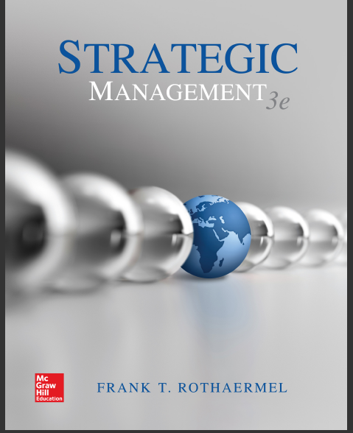
TITLE OF LECTURE
Organizational Design:
Structure, Culture, and Control
Strategic management, third edition, 2017 By Frank t. Rothaermel
Georgia Institute of Technology.
Thank You

