Slide 1



Secure Operating Systems (CYB610)
Master of Science in Cybersecurity
Lecture 2
Basic Components of OS Security
Dr. Ibrahim Gomaa
Faculty of Informatics
Midocean University
Lecture-2

Slide 2


Chapter
Topics
02
This chapter covers the following topics and concepts:
What is the Vulnerabilities
How the Methods of Defense work
What is the Software Controls
What is the Protected Objects and Methods of Protection
What is the Protection Types

Slide 3
Chapter
Goals
02
When you complete this chapter, you will be able to:
Describe the Security goals
Describe the Vulnerabilities
Explain the Principles of Adequate Protection
Differentiate between the Methods of Securing the Operating Systems
Explain the Protection Types

Slide 4
Chapter
What are the vulnerabilities?
02
Physical vulnerabilities (Eg. Computer can be stolen)
Natural vulnerabilities (Eg. Earthquake)
Hardware and Software vulnerabilities (Eg. Failures)
Media vulnerabilities (Eg. Hard disks can be stolen)
Communication vulnerabilities (Ex. Wires can be tapped)
Human vulnerabilities (Eg. Insiders)
Poorly chosen passwords
Software bugs (non reliability of software)
– buffer overflow attacks

Slide 5
Chapter
02
Vulnerabilities
  When we prepare to specify, design code, or test a secure system, we try to imagine the vulnerabilities that would prevent us from reaching one or more of our three security goals (C-I-A)
  The three assets (hardware, software and data) and the connections among them are all potential security weak points

Slide 6
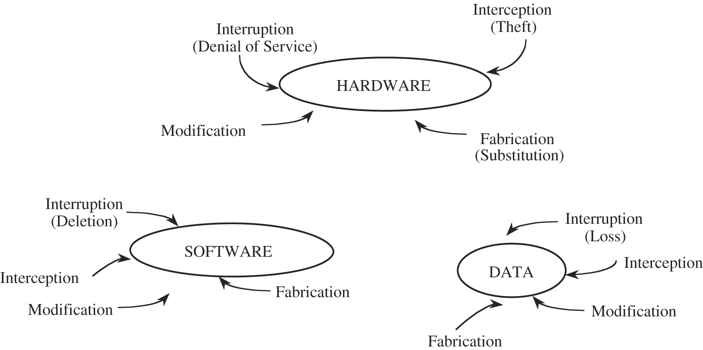
Chapter
02
Vulnerabilities

Slide 7
Chapter
02
Software Vulnerabilities
  Software is surprisingly easy to delete and to copy
  Software is vulnerable to modifications that either cause it to fail or cause it to perform an unintended task

Slide 8
Chapter
02
Software Vulnerabilities
  Logic bomb: a program that has been maliciously modified to fail when certain conditions are met or when a certain date or time is reached
  Trojan horse: a program that overtly does one thing while covertly doing another
  Virus: a specific type of malwares that can be used to spread its "infection" from one computer to another

Slide 9
Chapter
02
Software Vulnerabilities
  Trapdoor: a secret entry point in software that allows unauthorized access to a system, bypassing normal security measures
  Information leaks in a program: code that makes information accessible to unauthorized people or programs

Slide 10
Chapter
02
Data Vulnerabilities
  More people know how to use or interpret data.
  Confidential data leaked to a competitor may narrow a competitive edge.
  Data incorrectly modified can cost human lives.
  Inadequate security may lead to financial liability if certain personal data is made public.

Slide 11
Chapter
02
Principle of Adequate Protection
  Security measures should be proportionate to the value and sensitivity of the information or resources being protected.
  It emphasizes that protection should be sufficient to mitigate identified threats and risks, but not excessive or unnecessarily costly.
  Computer items must be protected only until they lose their value
  They must be protected to a degree consistent with their value

Slide 12
Chapter
02
Methods of Defense
  Harm occurs when a threat is realized against a vulnerability
  To protect against harm, we can neutralize the threat, close the vulnerability, or both
  The possibility for harm to occur is called risk

Slide 13
Chapter
02
Methods of Defense
  We can deal with harm in several ways:
    Prevent it, by blocking the attack or closing the vulnerability
    Deter it, by making the attack harder
    Deflect it, by making another target more attractive
    Detect it, either as it happens or some time after the fact
    Recover from its effects

Slide 14
Chapter
02
Software Controls
  Internal program controls: parts of the program that enforce security restrictions, such as access limitations
  Operating system and network system controls: limitations enforced by the operating system or network to protect each user from all other users

Slide 15
Chapter
02
Software Controls
  Independent control programs: application programs, such as password checkers, intrusion detection utilities, or virus scanners, that protect against certain types of vulnerabilities
  Development controls: quality standards under which a program is designed, coded, tested, and maintained, to prevent software faults from becoming exploitable vulnerabilities

Slide 16
Chapter
02
Principle of Effectiveness
    The degree to which a system achieves its intended purpose accurately and completely, ultimately fulfilling user needs and goals
    Controls must be used—and used properly—to be effective.
    They must be efficient, easy to use, and appropriate

Slide 17
Chapter
02
Operating System
An operating system is the software on a computer that manages the way different programs use their hardware and regulates the ways that a user controls the computer.
Operating systems are found on almost any device that contains a computer with multiple programs—from cellular phones and video game consoles to supercomputers and web servers.
Some popular modern operating systems for personal computers include Microsoft Windows, Mac OS X, and Linux.

Slide 18
Chapter
02
Operating System
Operating system functions can be categorized as:
  Access control.
  Identity and credential management.
  Information flow.
  Audit and integrity protection.
  Each of these activities has security implications.

Slide 19
Chapter
02
Objects and Methods of Protection
What kinds of things operating systems can protect ?
What methods are available for protecting them?
Once upon a time, there were no operating systems: Users entered their programs directly into the machine in binary.
The first operating systems were simple utilities, designed to assist individual programmers and to smooth the transition from one user to another.

Slide 20
Chapter
02
Objects and Methods of Protection
Operating systems took on a much broader role as the notion of multiprogramming was implemented
  Two users could interleave access to the resources of a single computing system.
  Researchers developed concepts such as scheduling, sharing, and parallel use.
  Protecting one user's programs and data from other users' programs became an important issue in multi-programmed operating systems.

Slide 21
Chapter
02
Protected Objects
Memory
Sharable I/O devices, such as disks
Serially reusable I/O devices, such as printers and tape drives
Sharable programs and sub-procedures
Networks
Sharable data

Slide 22
Chapter
02
Security features in Operating System
An operating system manages and controls access to hardware components
Older operating systems focused on ensuring data confidentiality
Modern operating systems support four basic functions
  Positively identify a user
  Restrict access to authorized resources
  Record user activity
  Ensure proper communications with other computers and devices (sending and receiving data)

Slide 23
Chapter
02
Security features in ordinary OS
Authentication of users
  password comparison
Protection of memory
  user space, paging, segmentations
File and I/O device access control
  access control matrix
Allocation & access control to general objects

Slide 24
Chapter
02
Security features in ordinary OS
Identification and Authentication
Mandatory (enforce multilevel security by classifying the data and users into various security classes) and
Discretionary Access Control (grant privileges to users)
Object use and reuse protection (Subject and object)
Anti-virus scan
Accountability and Audit (security log)
Firewall
Intrusion detection (patterns of normal system usages, anomalies)

Slide 25
Chapter
02
Protection Types
Do not protect
Isolate
Share all or share nothing
Share via access limitation
Share by capabilities
Limit use of an object

Slide 26
Chapter
02
Protection Types
Do not protect. Operating systems with no protection are appropriate when sensitive procedures are being run at separate times.
Isolate. When an operating system provides isolation, different processes running concurrently are unaware of the presence of each other. Each process has its own address space, files, and other objects

Slide 27
Chapter
02
Protection Types
Limit use of an object. This form of protection limits not just the access to an object, but the use made of that object after it has been accessed. For example, a user may be allowed to view a sensitive document, but not to print a copy of it.

Slide 28
Chapter
02
Security Methods of Operating Systems
The basis of protection is separation
  separation: keeping one user's objects separate from other users
    physical separation
    temporal separation
    logical separation
    cryptographic separation

Slide 29
Chapter
02
Security Methods of Operating Systems
physical separation, in which different processes use different physical objects, such as separate printers for output requiring different levels of security.
temporal separation, in which processes having different security requirements are executed at different times

Slide 30
Chapter
02
Security Methods of Operating Systems
logical separation, in which users operate under the illusion that no other processes exist, as when an operating system constrains a program's accesses so that the program cannot access objects outside its permitted domain.
cryptographic separation, in which processes conceal their data and computations in such a way that they are unintelligible to outside processes

Slide 31
Chapter
02
Security Methods of Operating Systems
the first two approaches are very stringent and can lead to poor resource utilization.
Therefore, we would like to shift the burden of protection to the operating system to allow concurrent execution

Slide 32
Chapter
02
Security Methods of Operating Systems
We want to separate users and their objects, but we also want to be able to provide sharing for some of those objects.
An operating system can support separation and sharing in several ways, offering protection at any of several levels.

Slide 33
Chapter
02
Basic Terms
The kernel
  The core of the operating system
  Includes a monolithic core and modular components
The distribution
  A unified collection of applications, services, drivers, and libraries configured with the kernel
  Managed by either a company or a group of volunteers

Slide 34
Chapter
02
Security Relates to the Kernel
Kernel philosophy
  Kernel is robust
  Includes a core and supplemental modular components
  Monolithic part of kernel contains drivers and options essential to the kernel boot process
  Modular part of kernel adds everything else needed for smooth operation
Basic kernels
  Development work is managed by the Kernel Organization
  Source code for the kernel can be acquired at https://kernel.org
  Building a custom kernel requires source code

Slide 35
Chapter
02
Security Relates to the Kernel
Distribution-specific kernels
  Distribution-specific kernel has been compiled and built with the intended hardware in mind
  Name of the kernel file generally includes the version number as well as the hardware architecture
    Example: Debian Linux has a kernel named vmlinuz-5.10.0-8-amd64
Custom kernels
  kernel is highly customizable
  Different configuration interfaces exist, including a text-based one using the Ncurses library

Slide 36
Chapter
02
Securing a System During the Boot Process
Boot process security
  Grand Unified Boot (GRUB) loader
    Unless password protected, the GRUB boot loader can be used to boot a system into single-user mode, with full administrative privileges
  Use nonstandard port numbers for key services
  Virtual physical security
    Anyone who gains access to a virtual machine can more easily change virtual physical components

Slide 37
Chapter
02
Security Issues Beyond the Basic Operating System
Security issues with the graphical user interface (GUI)
  Programs written for GUIs have a larger set of libraries that get added during the build; more code that can be broken
  Reduce the number of installed packages to reduce the potential for vulnerabilities

Slide 38
Chapter
02
Tracking the Latest Security Updates
O.S security updates for:
  Regular users
  Home hobbyists
  Power users
  administrators
  Update administration

Slide 39
Chapter
02
Summary
This chapter explained :
Kinds of the Vulnerabilities
How the Methods of Defense work
The Software Controls
The meaning of Protected Objects and Methods of Protection
The Protection Types

Slide 40



Thank You

