Slide 1




IT111 - Introduction to Information Technology
Bachelor of Science in Information Technology
Eng. Eman Hamdy
Lecture 0 - Overview

Slide 2

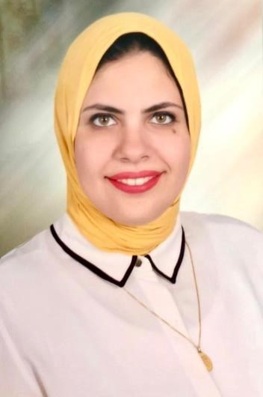

Course Staff
Eng. Eman Hamdy
Master: Arab Academy for Science, Technology and Maritime Transport.
B.Sc.: Arab Academy for Science, Technology and Maritime Transport. Faculty of Computer Science.
IT111 - Introduction to Information Technology
Lecture 00
Eng. Eman Hamdy

Slide 3
Lecture
Course Overview
00
Upon successful completion of this course, students should be able to:
Identify the historical development of computer science and technologies and their applications.
Distinguish and converting between different number systems.
Describe how computer represent, manipulate different data types and how to communicate with peripheral devices.
Describe the basic structures and functional components of computer hardware.
Describe basic operating systems functions and how they do it.
IT111 - Introduction to Information Technology
Lecture 00 – Course Overview
Eng. Eman Hamdy

Slide 4
Lecture
Learning Overview
00
Compare different operating systems.
Describe constructions and operation of computer networks, applications of networks, Internet.
IT111 - Introduction to Information Technology
Lecture 00– Course Overview
Eng. Eman Hamdy

Slide 5
Lecture
00
IT111 - Introduction to Information Technology | IT111 - Introduction to Information Technology
الاسابيع | النظرى | العملى | الدرجات
اليوم التوجيهى
الاسبوع 1 | Introduction | Introduction to windows basics | 8
الاسبوع 2 | Numbering systems | Numbering systems | 8
الاسبوع 3 | Data Storage | Microsoft Power point | 8
الاسبوع 4 | Data Storage cont. | Microsoft word | 8
الاسبوع 5 | Operation on Data | Microsoft excel | 8
الاسبوع 6 | Computer Organization | Microsoft Access | 8
الاسبوع 7 | Computer Organization cont. | Flowchart | 8
الاسبوع 8 | Computer Organization cont. | Flowchart | 8
الاسبوع 9 | Operating Systems | Python programing language | 8
الاسبوع 10 | Computer Networks and Internet | Python programing language | 8
الاسبوع 11 | مراجعة
IT111 - Introduction to Information Technology
Lecture 00– Course Overview
Eng. Eman Hamdy

Slide 6

Reference
Credit Hours: 3 credit hours.
  Required Textbook:
Foundations of Computer Science,
4th Edition
Behrouz Forouzan
IT111 - Introduction to Information Technology
Lecture 00 – Reference Book
Eng. Eman Hamdy

Slide 7

Thank you

