Slide 1



Threat Defense and Information Security
Development Trends
Lecture 4
HCIA-Security
Prepared by
Dr. Abdelrhman Ahmed

Slide 2
Chapter
04
Forward
• The previous courses have introduced some basic concepts and knowledge about information security and common attack types.
• Consider this question: What measures should we take to ensure enterprises' information security?
• Defense against security threats not only requires professional tools but also the awareness of everyone involved in information security construction.

Slide 3
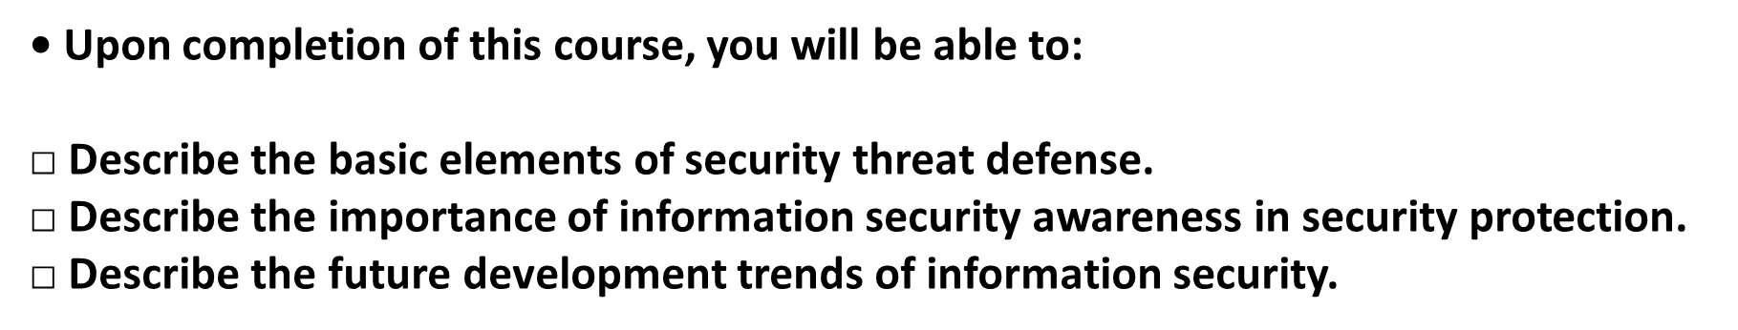
Chapter
04
Objectives

Slide 4
Chapter
04
Key Elements of Information Security Protection

Slide 5
Chapter
04
Information Security Protection Methods

Slide 6
Chapter
04
Cybersecurity Awareness survey
• According to the Survey Report on Cyber Security Awareness of Chinese Internet Users launched by Qihoo 360, 24.1% have a unique password for each account, and 61.4% use different passwords. However, 13.8% use the same password for all accounts, which has high security risks.

Slide 7
Chapter
04
Public Wi-Fi Security Awareness

Slide 8
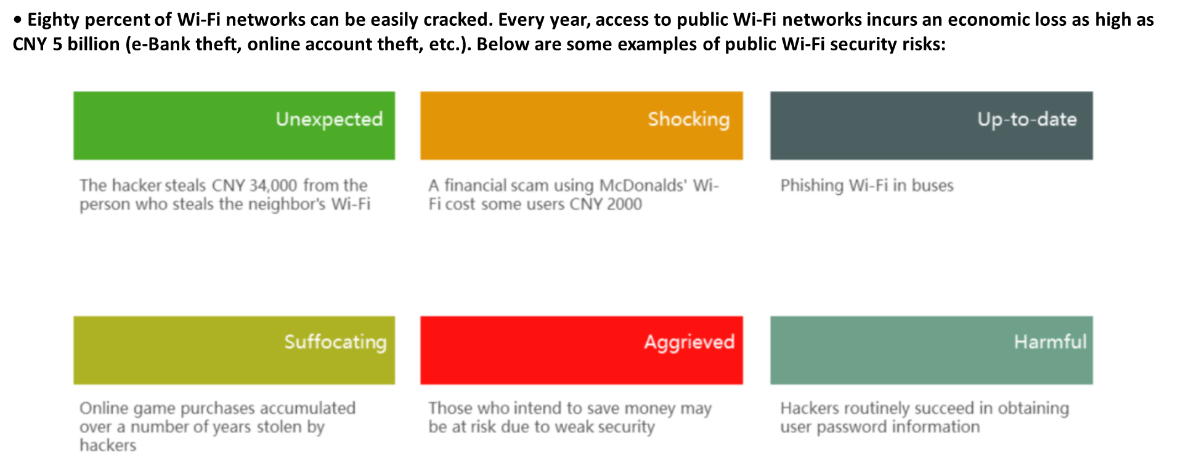
Chapter
04
Security Risks of Wi-Fi in Public Places

Slide 9
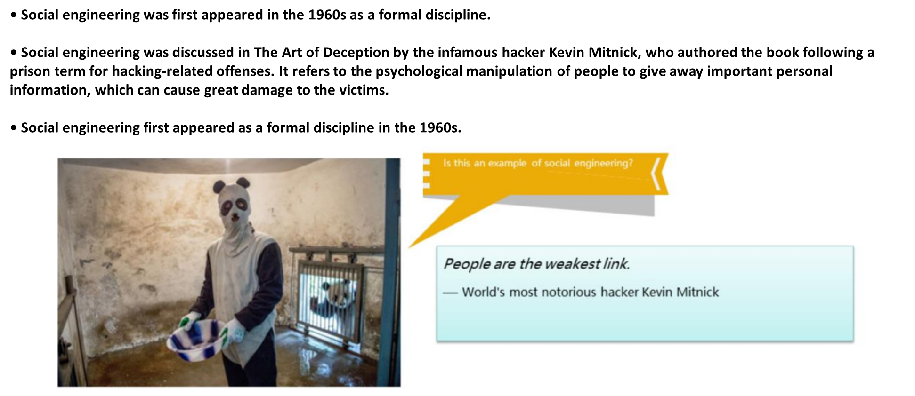
Chapter
04
Social Engineering

Slide 10
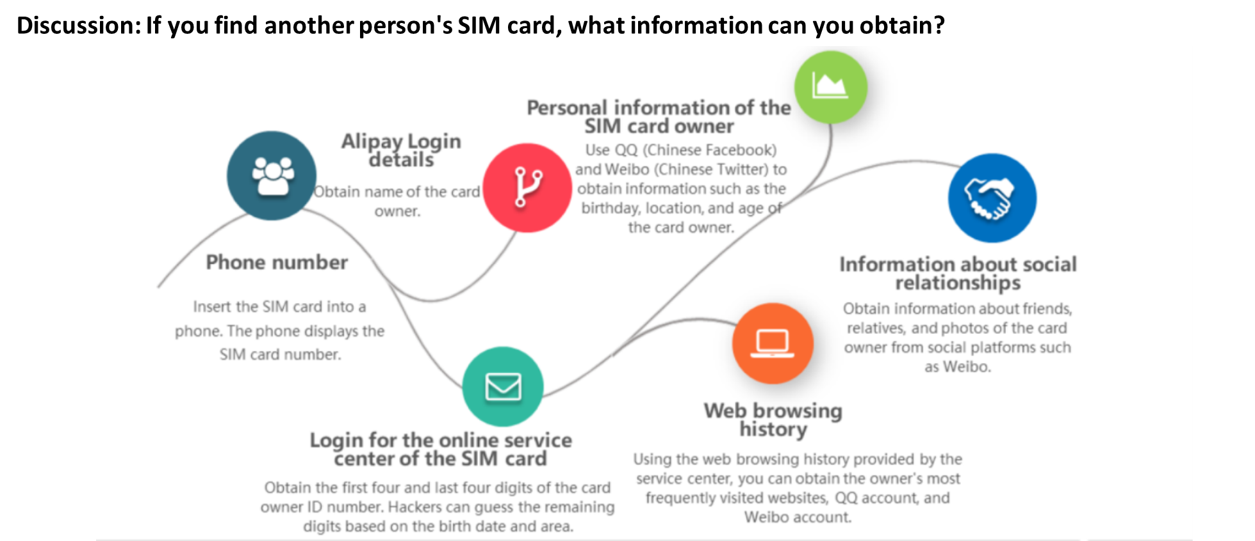
Chapter
04
Case Study

Slide 11
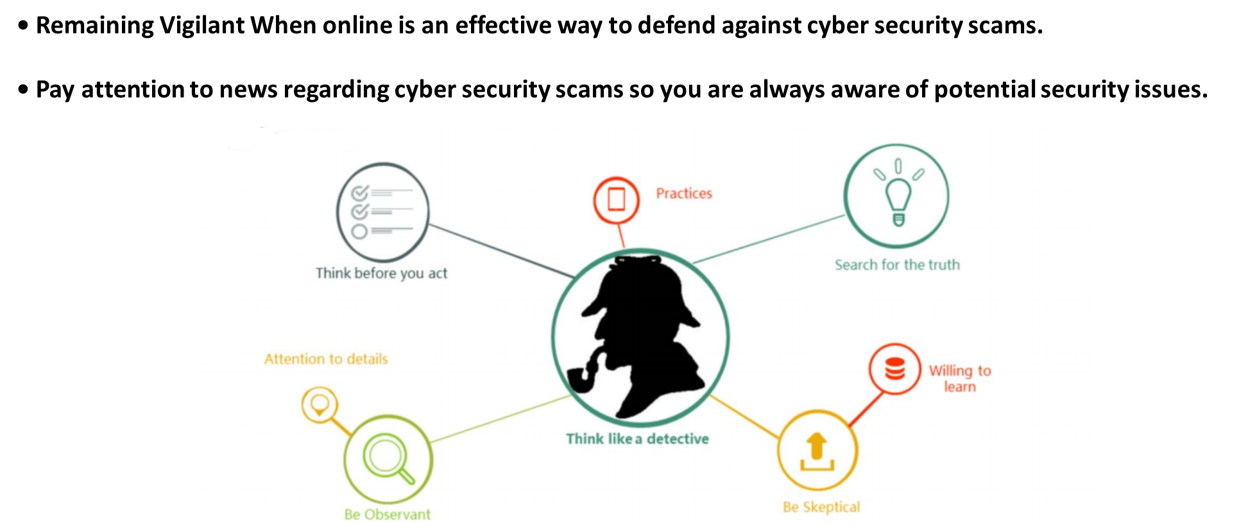
Chapter
04
Fostering Security Awareness

Slide 12
Chapter
04
Gartner Top 10 Security Technologies

Slide 13
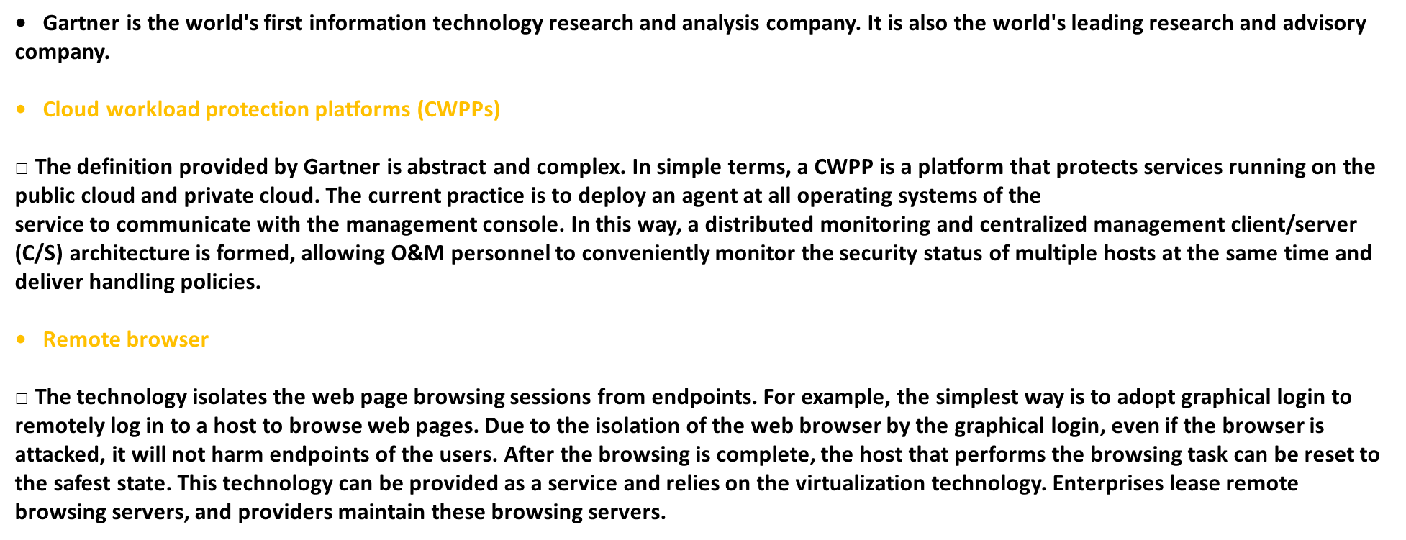
Chapter
04
Gartner Top 10 Security Technologies
Gartner Top 10 Security Technologies

Slide 14
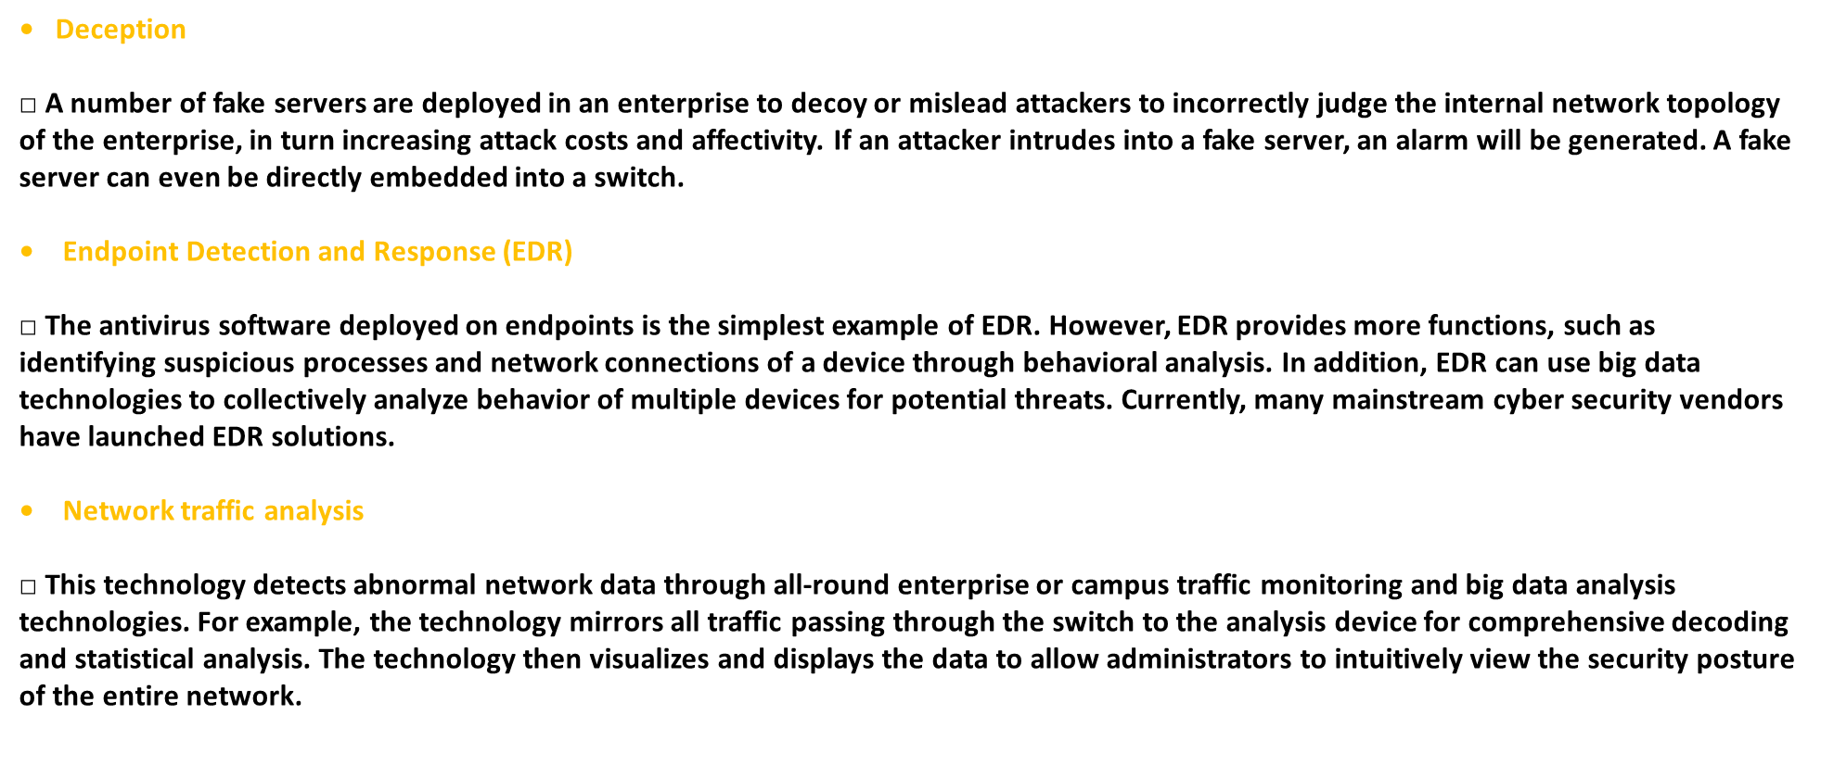
Chapter
04
Gartner Top 10 Security Technologies

Slide 15
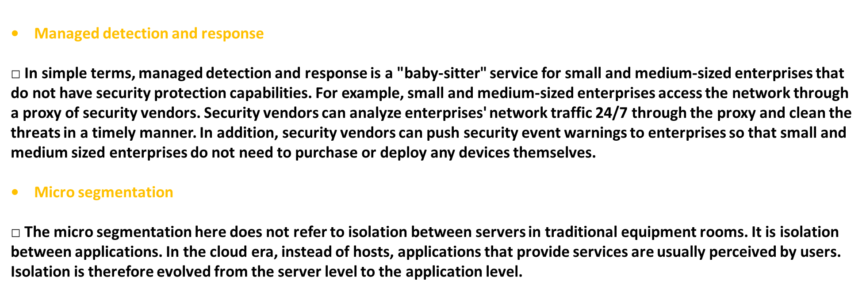
Chapter
04
Firewall Development History

Slide 16
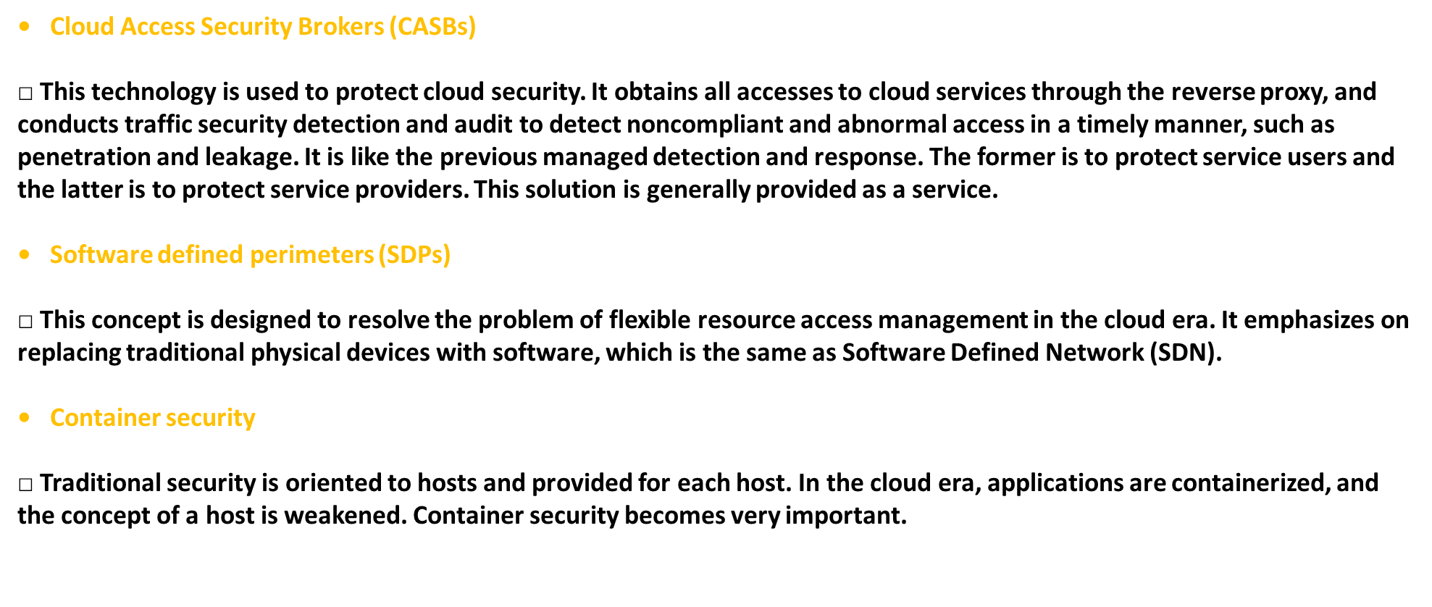
Chapter
04
Firewall Security Zone

Slide 17
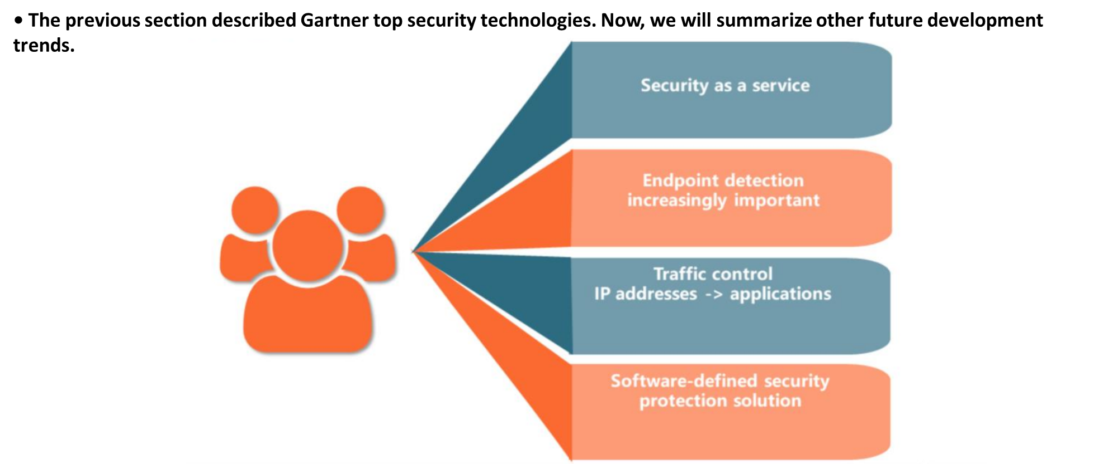
Chapter
04
Future Development Trends of Security Protection

Slide 18
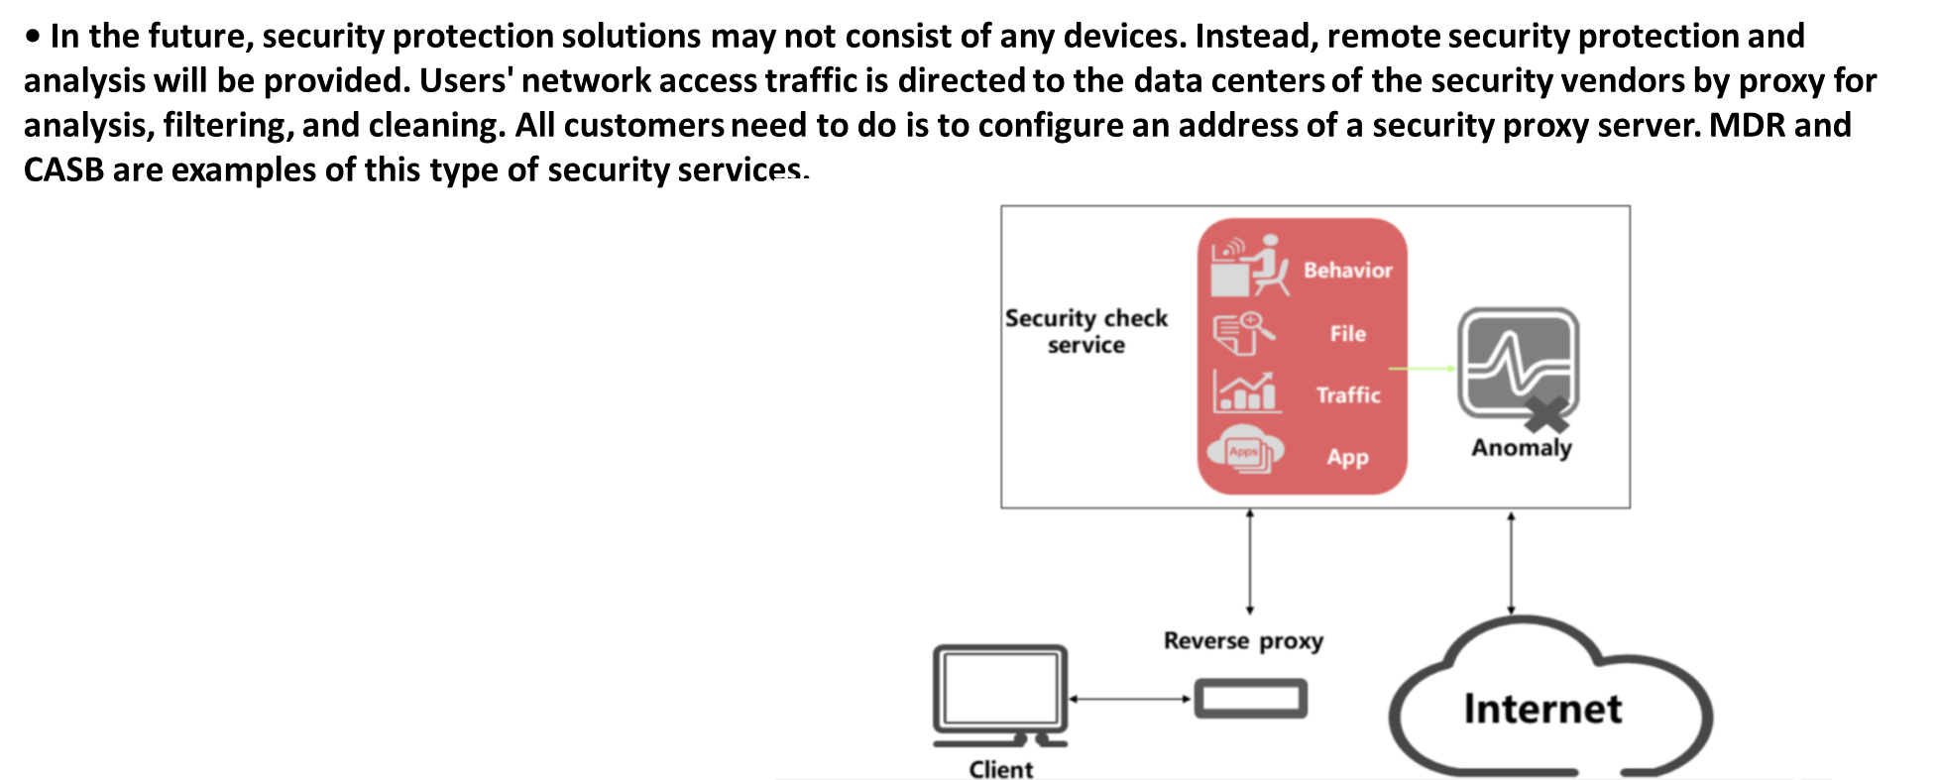
Chapter
04
Trend 1: Security as a Service

Slide 19
Chapter
04
Trend 2: Endpoint Detection Increasingly Important

Slide 20
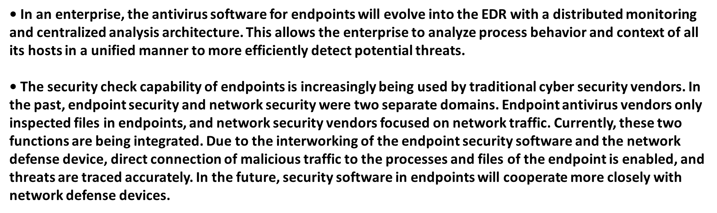
Chapter
04
Trend 2: Endpoint Detection Increasingly Important

Slide 21
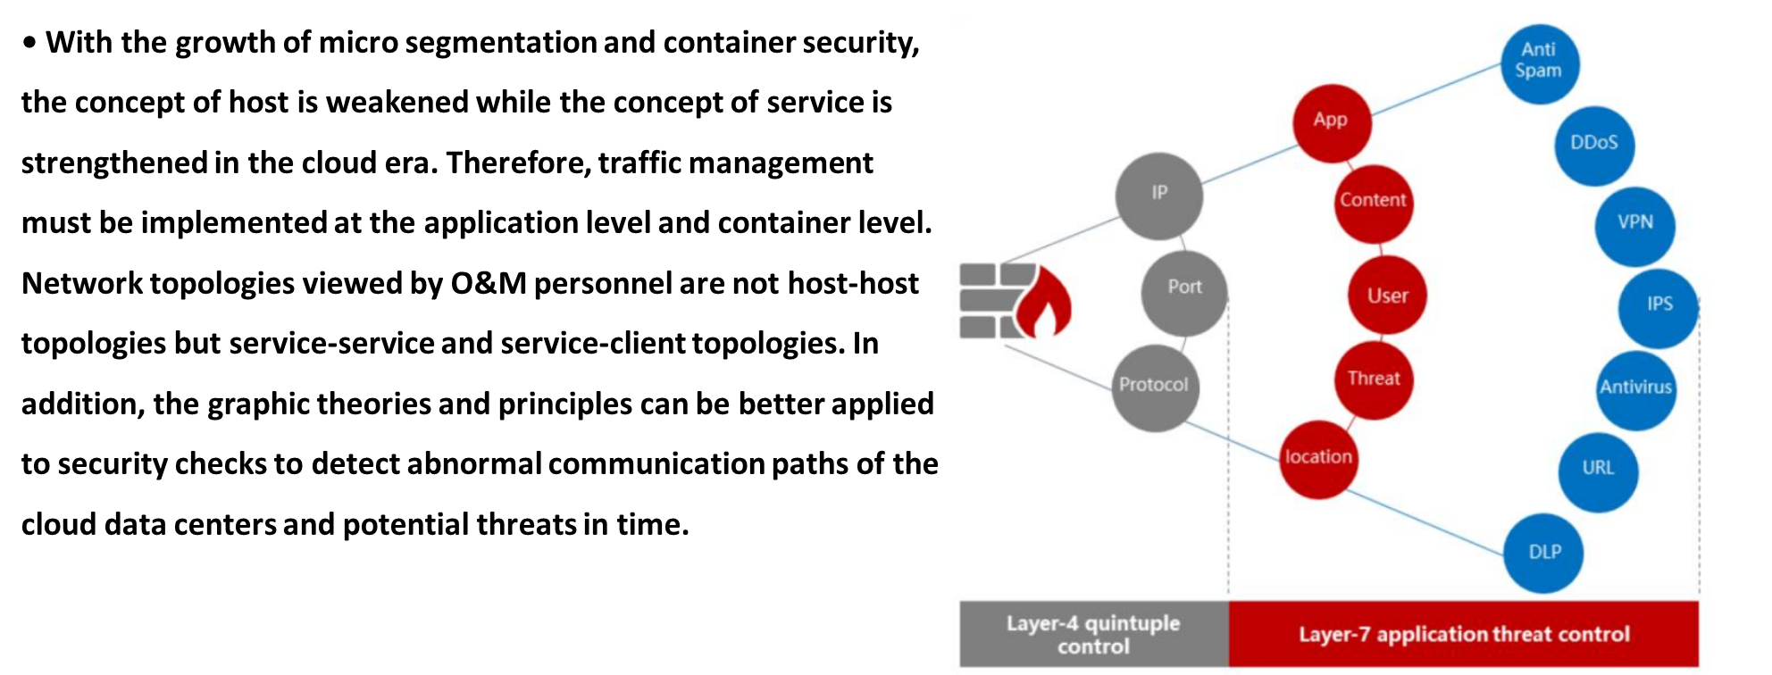
Chapter
04
Trend 3: Traffic Control — from IP Addresses to Applications

Slide 22
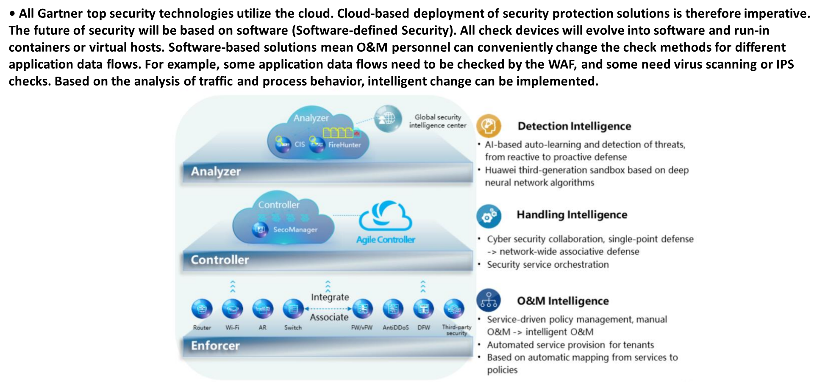
Chapter
04
Trend 4: Software-defined Security Solution (Huawei SDSec)

Slide 23



Thank You

