Slide 1


Project Feasibility Study
PMG201
Prepared by Dr. Manal El-Sayed
ALLOCATING RESOURCES TO THE PROJECT
Lecture 9

Slide 2

Expediting a Project.
Resource Loading.
Resource Leveling.
Allocating Scarce Resources to Projects.
Allocating Scarce Resources to Several Projects.
Goldratt’s Critical Chain.

Slide 3

ALLOCATING RESOURCES TO THE PROJECT
Projects compete with each other for the same resources in two different ways. The problem here is which project gets to use the resource first and which must wait. The project that must wait may suffer a schedule delay that makes it late. Just as projects may compete for resources, different activities of the same project may compete. Two or more concurrent activities الأنشطة المتزامنة might require the same personnel, or equipment, or even work space. One activity will be given priority, and the other(s) must wait.

Slide 4

1. Expediting a Project
When task durations are estimated, an assumption is made that task resources are set at “ normal” levels. This is the “ standard practice” assumption. Traditionally, CPM project duration estimates also include a “ crash” estimate together with estimates of the crash time and the resources required to shorten the duration of project activities. By selectively choosing which activities to crash and by how much, we can determine the minimum cost for all possible project completion times.

Slide 5
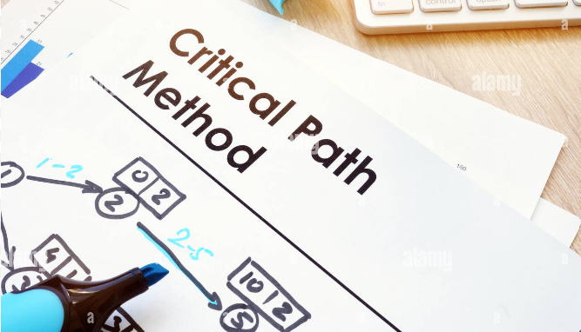
The Critical Path Method
In traditional PERT/CPM, the rules of “ standard practice ” apply and the normal task duration estimate is made with the normal or standard - practice resource usage. Then a second estimate, referred to as the crash duration, is made based on the resources required to expedite the task.

Slide 6

Fast - Tracking a Project
In addition to crashing a project in order to expedite it, تسريع المشروع a project can use fast-tracking which involves executing activities at the same time rather than sequentially. This is called performing in parallel. Unlike one activity following the other as most projects are done, fast-tracking doesn’t wait for one activity to end before another begins.
Some activities are dependent on others and cannot start or stop until another starts or stops. Fast-tracking in project management will only work if all the activities are able to overlap with one another. تتداخل مع بعضها البعض However, if project activities don’t overlap then fast-tracking is a viable alternative, as it usually doesn’t add any extra costs.

Slide 7
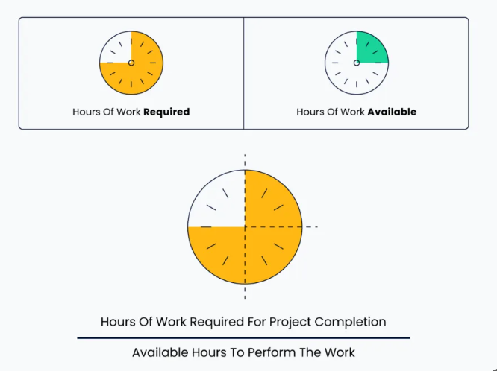
2. Resource Loading
From the first day on the job, the PM is concerned with resource loading . Resource loading refers to the amounts of specific resources that are scheduled for use on specific activities or projects at specific times. It usually takes the form of a list or table.

Slide 8
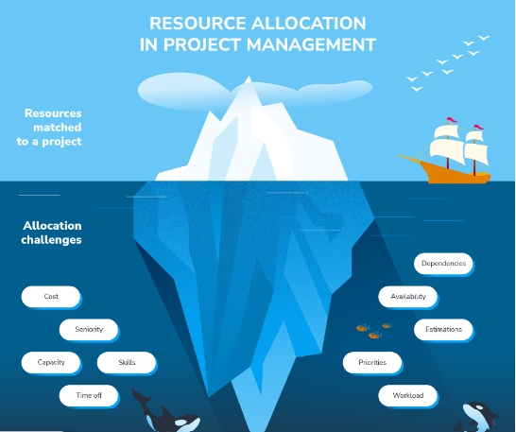
Resource Loading
Resource loading is usually displayed as a list of the amounts of specific resources assigned for use on specific project activities at specific times, or as a graph showing the level of a resource ’ s capacity required against the project calendar. To be useful for scheduling, the resource must have a calendar showing the resource ’ s availability.

Slide 9

Resource Loading
The calendar should include hours — and days — worked each week, any holidays on which the resource will not be available, and any other information affecting the availability of the resource. Resource cost per unit of usage should be included on the calendar, plus any additional cost for overtime or over use. Overscheduling a resource may cause serious problems for the PM.

Slide 10
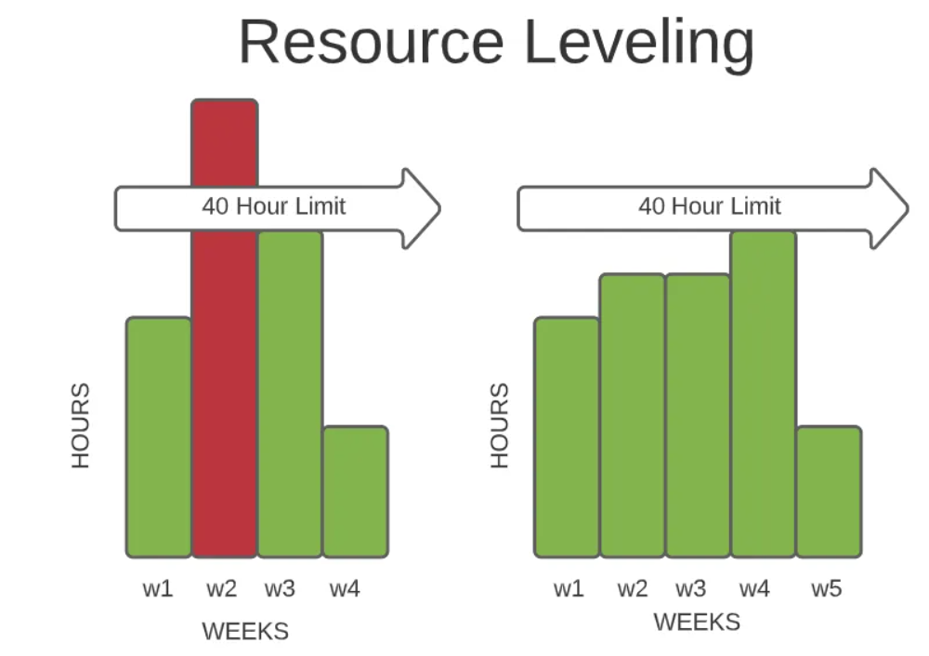
3. Resource Leveling
A technique in which start and finish dates are adjusted based on resource constraints with the goal of balancing the demand for resources with the available supply. Resource leveling can be used when shared or critically required resources are available only at certain times or in limited quantities, or are over-allocated, such as when a resource has been assigned to two or more activities during the same time, or there is a need to keep resource usage at a constant ثابت level.
PMBOK 6.5.2.3

Slide 11
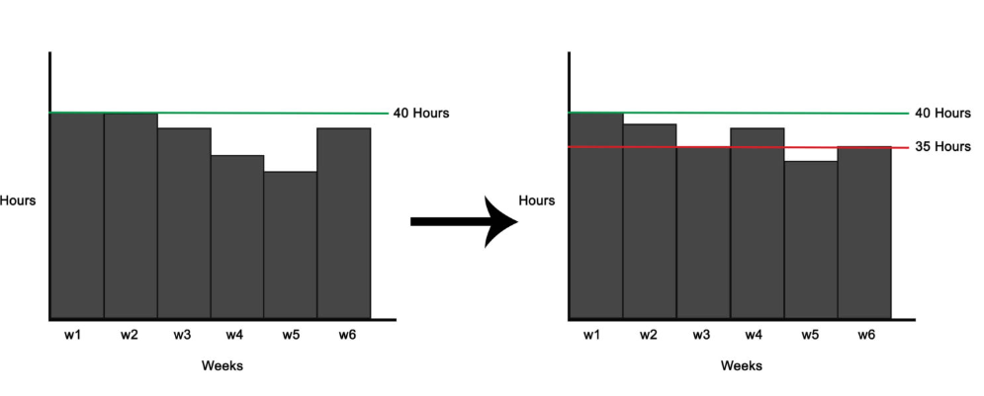
Resource Leveling
These techniques keep resources from being overstretchedارهاق while ensuring that projects have everything they need to succeed. This strategy helps the team maintain a healthy work-life balance. Here are a few reasons why resource optimization المستوى الامثلcan help your project and team.
To make the most out of your resources.
To keep deficits to a minimum.
To avoid task overloads among team members.
To ascertainيتيقن that project out is of high-quality.

Slide 12
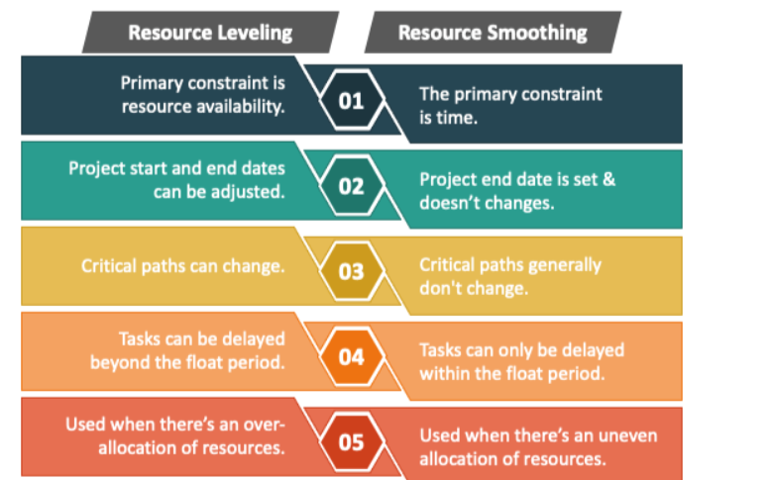

Slide 13
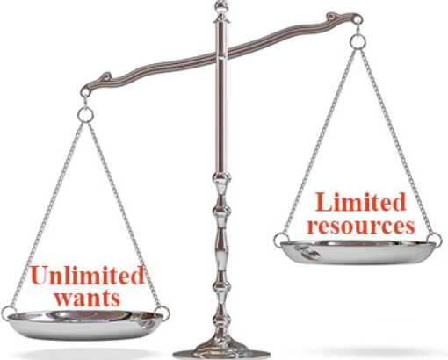
4. Allocating Scarce Resources to Projects
Most solutions start with the PERT/CPM schedule. Given this initial solution, each activity is examined period by period and resource by resource. If the demand for a resource exceeds its supply, the software considers the tasks one by one and assigns resources to the tasks according to some priority rule chosen by the PM. Tasks that receive resources under this rule proceed as originally scheduled.

Slide 14
Allocating Scarce Resources to Projects
Tasks that do not get resources are delayed until ongoing tasks are completed and the required resources are freed - up for use. No matter what priority rule is used, the project ’ s technology always takes precedence.

Slide 15
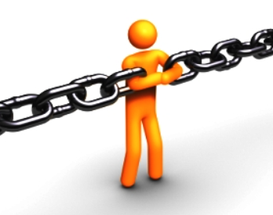
Some Comments about Constrained Resources
Every time a project falls behind schedule, the PM is apt to plead for more resources. In spite of the PM ’ s complaints about the scarcity of resources, serious cases of resource scarcity rarely apply to resources in general, but rather to one or two very specific resources.

Slide 16
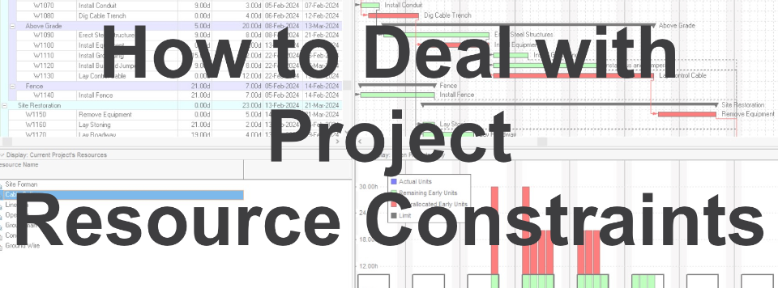
Some Comments about Constrained Resources
As soon as possible — This is the standard rule in scheduling. Activities are scheduled to start on their ESTs, earliest start times and resources are made available with that in mind.
As late as possible — With this rule, resources are made available so that activities start on their LSTs latest start time. whenever possible without increasing the project ’ s duration. This may seem irrational, but it preserves the firm ’ s resources and delays cash outflows as long as possible.يوفر التدفقات النقدية الخارجة لأطول فترة ممكنة

Slide 17
Some Comments about Constrained Resources
Shortest task duration first
Shorter tasks are given priority over longer tasks. This rule maximizes the number of tasks that can be completed by a system in a given time period.
Minimum slack first
When two or more tasks compete with each other, one should choose the task with minimum total slack. This rule usually minimizes the number of late activities.

Slide 18
Some Comments about Constrained Resources
Most critical followers
The number of successors on the critical path(s) for each activity is counted. Activities with a higher number of critical successors take precedence. The rationale here is that such activities would cause the greatest damage to the desired project schedule if they are late.
Most successors
The same as the previous rule except that all successors are counted. This rule has the same rationale as the preceding rule.

Slide 19
Some Comments about Constrained Resources
Most resources first
The greater the use of a specific resource on a task, the higher the task ’ s priority for the resource. This rule is based on the assumption that more important activities have a greater demand for scarce resources.

Slide 20

5. Allocating Scarce Resources to Several Projects
Pseudo activities, الأنشطة الزائفة
• Used to link several project together
• Have duration but do not require any resources.
This approach allows a set of projects to be dealt with as though it were a single project.
Allocating scarce resources among multiple projects is more complicated than the single project case, but is not different in its basic logic. The several projects are linked with pseudoactivities and treated as if they were the individual activities of a single project..
.

Slide 21
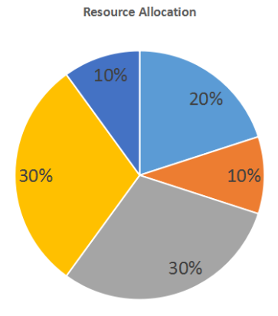
Resource Allocation and the Project Life Cycle
Once the most urgent cases (as measured by the priority rule) have been given resources, the next most urgent cases receive their resources. The process continues until there are no more activities.
The less urgent activities become more urgent as period after period passes until they rise far enough up the priority rank list and receive their resources.

Slide 22
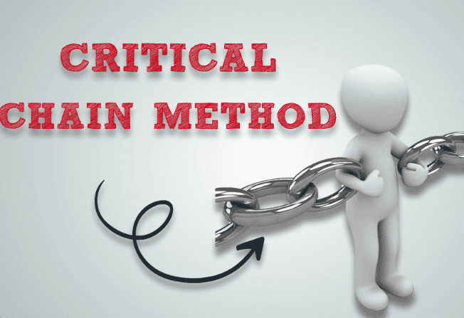
Goldratt’s Critical Chain
To begin our discussion of Goldratt ’ s approach, imagine for the moment that you are sitting in a room full of people with extensive experience as both project team members and project managers. Now imagine the responses you would hear if the group were asked the question: “ What are the things annoyed you most about the projects you have been involved with? ” Typical of the responses that we have gotten to that question are:

Slide 23
Goldratt’s Critical Chain
Project due dates are too often unrealistic.
There are too many changes made in the project ’ s scope.
Key resources and data are often unavailable when needed.
The budget is frequently unrealistic and therefore often exceeded.
It seems like my project is always in competition for resources with other projects.

Slide 24
Goldratt’s Critical Chain
The critical chain concept identifies the facts that activity times are unknown and independent, that workers will inflate their time estimates to protect themselves, early completion tasks will not be reported, the work will expand to fill the time, tasks will not be started until the last minute, multitasking will be misapplied, resource demands will be uneven متفاوتة and result in task delays, and more projects and tasks will be undertaken to increase resource utilization.

Slide 25
Goldratt’s Critical Chain
All these contribute to project delays and inefficiencies. To correct these problems, a project buffer مخزن المؤقت للمشروع is added at the end of a project, the release of projects and tasks is based on the availability of bottleneck resources, من موارد عنق الزجاجة ، and time buffers are added to resources that feed bottleneck resources.
Notes:
The critical chain of activities is the traditional critical path but includes the effect of resources on the schedule. This means that the critical chain is the list of activities that have no float after any resource conflicts have been resolved. This is really the definition of the critical path as it is normally used. It is somewhat misleading that nearly all of the examples, including ours, calculate the critical path without showing the effect of resource conflicts.

Slide 26
Critical Chain Method Vs Critical Path Method in Project Management
The terms ‘Critical chain method’ and ‘Critical path method’ are often used interchangeably. However, they are different and imply distinct meanings.
Critical chain method | Critical path method
Keep buffers مخازن مؤقتة for both task dependencies and resource requirements. Integrate project, resource, and feeding buffers in the project workflow. Keep a check on how quickly the different buffers are being utilized to determine project health. | Determine the sequence of tasks that would take the most time to be completed. Keep a check on whether tasks are completed within the set timeline to determine project health.

Slide 27

Benefits of Critical Chain Project Management
Deliver projects faster
Utilize resources optimally
Tackle inefficiencies head-on
Prevent mismanagement of floats
Stay within defined project scope and budget
Increase team productivity

Slide 28
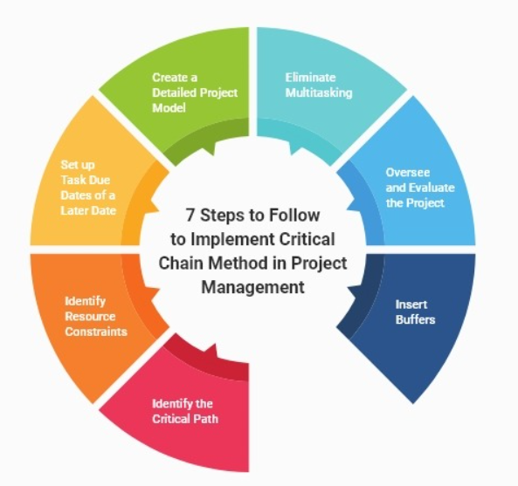
7 Steps to Implement Critical Chain Method in Project Management
1. Identify the Critical Path
This step forms the foundation of your critical chain project management process. In this, you identify the sequence of tasks that will take the longest to complete.
2. Identify Resource Constraints
Once you have listed down the tasks, next you must start allocating resources. While allocating resources, consider any restraints that may come to mind.

Slide 29
3. Set up Task Due Dates of a Later Date
This practice will help you create a schedule that gives adequate time to each task. This way, you can ensure that each task is given sufficient time, eliminating haphazard and rushed task execution.
4. Insert Buffers
Inserting buffers is one of the most crucial steps. The right placement of these buffers in the critical chain can make or break the entire project.

Slide 30
5. Create a Detailed Project Model
Creating a detailed project model is the next step for a sure-shot project execution plan.
A project model includes task time estimates, its description, the assigned resources, and the due dates.
6. Eliminate Multitasking
Multi-tasking is often glorified to dictate better outcomes in less time. However, it is not always reliable and productive.
7. Oversee and Evaluate the Project
Merely setting up the project workflow is not enough, it is imperative to keep a close eye on how the tasks are moving forward, step by step.

Slide 31


