Slide 1



Introduction to Research Methods
Prepared by Dr. Mona Moustafa Elashry
MGM 333
Revision
Lecture 11

Slide 2



CH1:
CH1: Major research paradigms

Slide 3

Research is an organized, systematic, data-based, critical, objective, scientific inquiry into a specific problem that needs a solution.

Slide 4
Characteristics of Scientific Research..
Purposiveness
Rigor
Testability
Replicability
Precision
Objectivity
Generalizability
Parsimony

Slide 5
Purposiveness.
The manager has started the research with a definite aim or purpose.
The focus is on increasing the commitment of employees to the organization, as this will be a beneficial in many ways.

Slide 6
Rigor
A good theoretical base and a sound methodological design would add rigor to a purposive study.
Rigor means carefulness, and the degree of exactitude الدقة in research investigations

Slide 7
Testability.
After taking random selection of employees of the organization, and the study of previous research done of the area of organizational commitment, the researcher develops certain hypotheses on how employee commitment can be enhanced.

Slide 8
Testability.
Then these hypotheses can be tested by applying certain statistical tests to the data collected for the purpose.
Scientific research tends itself to testing logically developed hypotheses to see whether or not the data support the hypotheses that are developed

Slide 9
Replicability
The results of the tests of hypotheses should be supported again and again when the same type of research is repeated in other similar circumstances.
If the results are repeated, we will gain confidence in the scientific nature of our research

Slide 10
Precision and Confidence
Precision refers to the closeness of the findings to reality based on a sample.
Confidence refers to the probability that our estimations are correct.

Slide 11
Objectivity
The conclusions drawn through the interpretation of the results of data analysis should be objective.
The conclusions should be based on the facts of the findings derived from actual data, and not on our own subjective or emotional values.
The more objective the interpretation of the data, the more scientific the research investigation becomes.

Slide 12
Generalizability
Generalizability refers to the scope of applicability of the research findings in one organizational setting to other settings.
The wider the range of applicability of the solutions generated by research, the more useful the research is to the users

Slide 13
Parsimony.
Parsimony refers to simplicity in explaining the phenomena or problems that occur, and in generating solutions for the problems.
Economy in research models is achieved when we can build into our research framework a lesser number of variables that would explain the variance far more efficiently than a complex set of variables that would only marginally add to the variance explained.

Slide 14
The research hierarchy

Slide 15
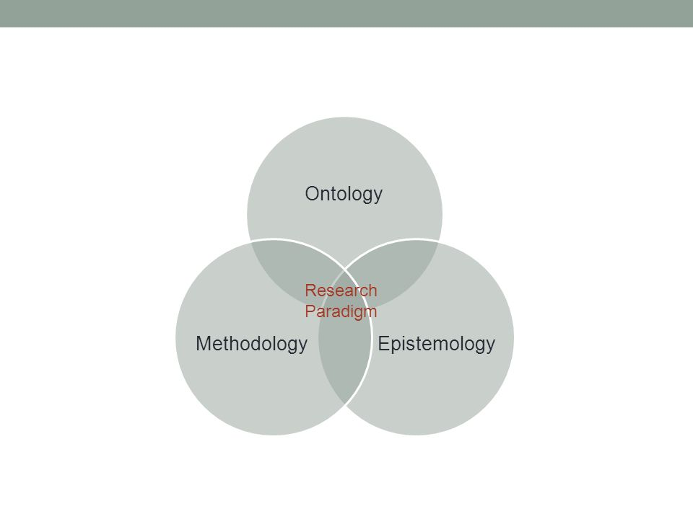
Research Paradigms

Slide 16
Why does it matter?
Ontology - is the nature of reality, different ways of constructing reality; ‘how things are’ and ‘how things really work’ (Denzin & Lincoln, 1988 p.210)
Epistemology - is the philosophy of how we can know that reality; different forms of knowledge of that reality.
Methodology - is the practice of how we come to know that reality; the tools we use to know that reality.

Slide 17
Paradigm differences The three questions then are;
What is the nature of reality? - This is the ontological question concerning the nature and form of reality.
What is the nature of the relationship between the knower and the known? – This is the epistemological question.
How we can come to know it? - This is the methodological question.

Slide 18
The Major Paradigms
Positivism:
Associated with quantitative research
Interpretivist / constructivist
Associated with qualitative research
Post-positivism:
Mixed methods

Slide 19
Positivism
Positivists see the world as a collection of observable facts which can be measured.
Ontological stance - Realism
There exists a single, tangible, objective reality. We can understand it through the laws that govern it.
Epistemological stance - Objectivist / dualist
Objective observation leading to discovery of that reality
Methodology
Experimental, objective observation.
Purpose
predication / control / explanation / verification (1798–1857) (1596-1650)

Slide 20
Positivism
What can we ‘know’?
“… those who are seeking the strict way of truth should not trouble themselves about any object concerning which they cannot have a certainty equal to arithmetic or geometrical demonstration” (Descartes, as cited in Lines, 2001, p. 172).
If it can’t be counted or measured with certainty then we can never truly know it.
Questions: What? How much? Relationships / casual effect Those best answered with Numerical precision Hypothesis formulation

Slide 21
Definitions
Research methodology: This is the theoretical perspective of the research, that is the overall nature of the research activity.
Research method: This is the bounded system created by the researcher to engage in empirical investigation, the overall approach, often referred to as a ‘strategy.’
Research techniques: These are the individual data collection techniques applied within the method. The most obvious example of lack of distinction between method and techniques is the use of the terms ‘survey’ and ‘questionnaire’; very often the two are used interchangeably within the research methods literature.
Research instrument: This is the devise that is designed or trained to collect the data necessary to provide insight or offer answers to the questions being asked.

Slide 22
Quantitative research
Quantitative research begins with a theoretical framework established from the literature review a hypothesis will emerge and the variables within that hypothesis can be identified.
The notion of a hypothesis can also be translated into research aims and objectives it is only compulsory to have a hypothesis when true experimental research is chosen as the method select the most appropriate research method calculate the sample and design the data collection within that method.

Slide 23
Qualitative research
The emergent design of qualitative research does not allow for a detailed plan before the research begins ‘the research design must therefore be ‘played by ear’; it must unfold, cascade, roll, emerge’ (Lincoln and Guba, 1985 p.203)
Human research instrument: The researcher plays the role of ‘instrument’ trained to capture the data as it ‘comes in’
Emergent design Responding the story as it reveals itself
Negotiated outcomes Interaction between the researcher and the researched – interpretation based on the relationship between the two.

Slide 24
MIXED METHODS DESIGNS
Creswell, J.W. and Plano Clark, V.L., 2011. Choosing a mixed methods design. Designing and conducting mixed methods research, 2, pp.53-106.
Triangulation Design
Exploratory Design
Explanatory Design
Creswell, J.W. and Plano Clark, V.L., 2011. Choosing a mixed methods design. Designing and conducting mixed methods research, 2, pp.53-106.

Slide 25
Triangulation Design
Creswell, J.W. and Plano Clark, V.L., 2011. Choosing a mixed methods design. Designing and conducting mixed methods research, 2, pp.53-106.
The most common and well-known approach to mixing methods is the Triangulation Design. The purpose of this design is “to obtain different but complementary data on the same topic”
Creswell, J.W. and Plano Clark, V.L., 2011. Choosing a mixed methods design. Designing and conducting mixed methods research, 2, pp.53-106.

Slide 26
Triangulation Design
Creswell, J.W. and Plano Clark, V.L., 2011. Choosing a mixed methods design. Designing and conducting mixed methods research, 2, pp.53-106.
Variants of the Triangulation Design:
the convergence model
the data transformation model
the validating quantitative data model

Slide 27
The Explanatory Design
Creswell, J.W. and Plano Clark, V.L., 2011. Choosing a mixed methods design. Designing and conducting mixed methods research, 2, pp.53-106.
The Explanatory Design is a two-phase mixed methods design. The overall purpose of this design is quantitative results.
This design starts with the collection and analysis of quantitative data. This first phase is followed by the subsequent collection and analysis of qualitative data.
The second, qualitative phase of the study is designed so that it follows from (or connects to) the results of the first quantitative phase.

Slide 28
The Exploratory Design
Creswell, J.W. and Plano Clark, V.L., 2011. Choosing a mixed methods design. Designing and conducting mixed methods research, 2, pp.53-106.
As with the Explanatory Design, the intent of the two-phase Exploratory Design is that the results of the first method (qualitative) can help develop or inform the second method (quantitative).

Slide 29
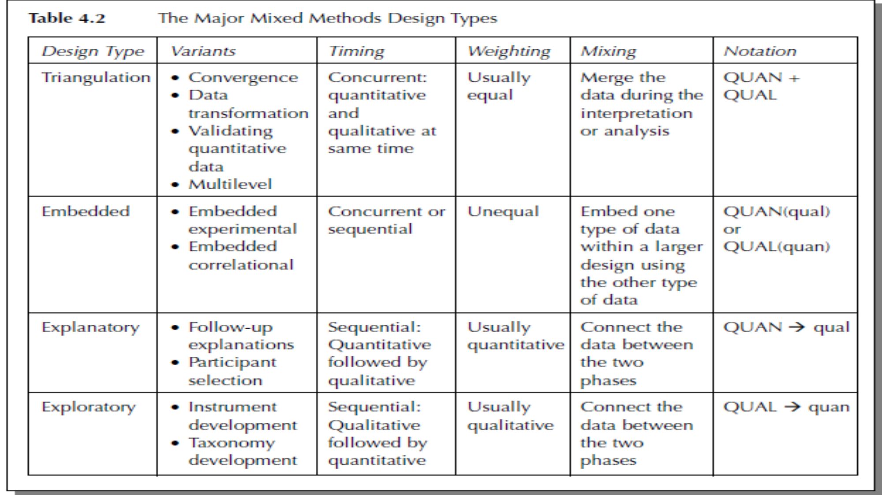

Slide 30
CH2: Reviewing literature

Slide 31
What is meant by literature review?
A literature review is a critical discussion of all significant, publicly available literature that contributes to the understanding of a subject.

Slide 32
The truth is:
The literature review process is a continuous one throughout the lifespan of the research project; there will be a point at which your individual critical analysis of items will be synthesized but you will not stop there.

Slide 33
What is meant by literature review?
Is the documentation of a comprehensive review of the published and unpublished work from secondary sources of data in the areas of specific interest to the researcher.

Slide 34
What is meant by literature review?
Literature review is a ‘runway’ because it should:
Clarify your own research aims
provide you with the depth and breadth of subject knowledge necessary
Form the theoretical framework for your own empirical investigation
Contribute to your research design.

Slide 35
From your review you can then move on to the next stage in the research process:
framing your research question, aims and objectives or hypothesis based on what you have discovered from within the published literature.

Slide 36
CH3: Defining the research

Slide 37
Both qualitative and quantitative research demand the development of a theoretical and conceptual framework; after the conceptual stage the two approaches begin to move forward in their own discrete fashion.

Slide 38
Designing a conceptual framework
Essentially the research question should itself determine the design of your study but it is usually the case that naturally qualitative researchers ask questions such as: Why? How? What?, and naturally quantitative researchers ask such questions as How many? How often? Where?

Slide 39
The research hypothesis
Hypothesis testing is only carried out in quantitative or positivist research; very often qualitative or interpretivist research will culminate in the generation of a working hypothesis but it is not the driving force behind the research design.

Slide 40
The research hypothesis
Although devising and testing hypotheses is useful in most quantitative research, it is an essential part of statistical inference.
Hypothesis testing is an attempt to investigate the relationship between two or more variables.

Slide 41
Constructing your hypothesis
Hypothesis testing is deductive: the problem is stated and then data is collected in direct response to the stated problem.
You can see that there is a rigid structure to this approach that dictates the empirical data collection.
An experimental hypothesis will have three types of variable: an independent variable, a dependent variable and intervening variables

Slide 42
Constructing your hypothesis
The independent variable is the condition that is manipulated by the researcher
The dependent variable is the effect of this manipulation
The intervening variables are all of those things the research has no control over. It is important to acknowledge the potential impact of intervening variables on any research findings

Slide 43
CH4: The research proposal

Slide 44
Why write a proposal?
There are a number of reasons for preparing a research proposal. In the case of funded research it is quite simply that there will be no funding without one.
All funding bodies have their own framework for a submission of a research proposal; in many cases these frameworks are now in electronic form and very structured, often restricting the writer to a specific number of characters in each section.

Slide 45
Structure of a research proposal
A formal document means that there is a formula which, if followed carefully, ensures that you have covered all of the areas you need to cover in order to present your proposed research.
Although requirements for a research proposal can often differ slightly according to funding body, academic or professional body regulations, there is an almost universally accepted list of contents’ that is expected.

Slide 46
Structure of a research proposal
Bear this in mind when you examine this proposed structure, which includes:
a clearly defined title and introduction
a statement of aims and objectives, or a hypothesis
a review of the literature
a research design an intended sample
a list of procedures for data processing and analysis
a definition of anticipated research outputs
a statement of anticipated constraints
a discussion of any ethical considerations and how these will be handled
a project timetable

Slide 47
Intended sample
Defining your method(s) may well imply you will use a particular data collection
technique but, whether this is the case or not, it is necessary to explain how you
intend to collect the data you need for your investigation. The questions you should
be answering here are:
• What data collection techniques will you be using?
• Why have you decided to use these techniques?
Your choice of sampling technique will depend very much on your research design.
It is important in a research proposal to identify how a sample will be achieved, and the technique and procedures that will be used.
It is also important to identify the research population, the size of the sample that will be used, if this can be determined at this stage, and how the sample will be contacted.

Slide 48
Limitations based on design
Defining your method(s) may well imply you will use a particular data collection
technique but, whether this is the case or not, it is necessary to explain how you
intend to collect the data you need for your investigation. The questions you should
be answering here are:
• What data collection techniques will you be using?
• Why have you decided to use these techniques?
Limitations are inevitable in many research studies.
It is far more usual to make compromises in research design than it is to do everything we would like to do, exactly as we would like to do it.
What matters is that these limitations are identified and explained from the outset.

Slide 49
CH5: Sampling

Slide 50
Why sample?
Sampling is the process of selecting a few from the many in order to carry out empirical research.

Slide 51
Why sample?
Sampling is used when it is not possible or practical to include the entire research population in your study, which is usually the case

Slide 52
Why sample?
It is totally inappropriate to engage in a small-scale, localized qualitative study then attempt to generalize from the findings.

Slide 53
Why sample?
A rather simplistic rule of thumb is to assume that quantitative research will tend to use probability sampling techniques and qualitative research will tend to use purposive sampling.

Slide 54
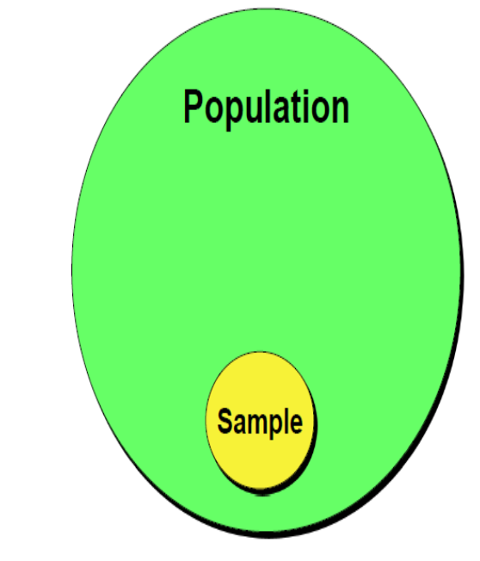
Population and sample
Population – A group that includes all the cases (individuals, objects, or groups) in which the researcher is interested.
■ Sample – A relatively small subset from a population

Slide 55
Population and sample- Relevant Terms
An element is a single member of the population.
A subject is a single member of the sample, just as an element is a single member of the population.

Slide 56
Sampling is a vital stage in the research process; the outcomes, rigour and trustworthiness of your research all rely on the robustness of the sample and how that sample was identified.
The sampling technique you apply must be appropriate to your research goals and conform to the research tradition you have chosen for your investigation.

Slide 57
For most research, investigators often have to make do with whatever subjects they can gain access to. Generalizations from such samples are not valid and the results only relate to the subjects from whom they are derived’ (Burns, 2000, 85). In qualitative research this is exactly as it should be.

Slide 58
Generalization, in this sense, is not a goal of qualitative research but it often is in quantitative research.
Whichever tradition you are following be very careful about claims you make based on the sample you have studied.

Slide 59
CH6: Research data management

Slide 60
Introduction-research data and its management challenges
Research data management (RDM) comprises the activities that keep your data secure, accessible and usable.
It is a fundamental part of good research practice.

Slide 61
Why is research data management important?
There are seven fundamental reasons why managing research data matters:
To comply with an agreed research requirement
To work effectively and efficiently
To protect the data
To enable data use and/or re-use
To share data with others
To preserve the data
As good research practice.

Slide 62
Why is research data management important?
A requirement
Different stakeholders, such as research funders or universities, could place requirements on what you do with your research data.
In such cases, you would have no choice but to manage the data in accordance with these requirements.

Slide 63
Why is research data management important?
To protect the data
This means keeping your data safe, safeguarding it, protecting it.
This covers many things from avoiding loss, theft, accidental deletion, corruption of files and virus attack to avoiding obsolescence, i.e. the inability to read the data storage device and/or format.

Slide 64
Why is research data management important?
To enable data use and/or re-use
Data has value as an enabler of new opportunities and to analyze situations through time.
In addition, re-using data makes good economic sense. There is a subtle but important distinction between use and re-use.

Slide 65
Why is research data management important?
To share data with others
Often original research will benefit from appropriate sharing and in some instances this will be imperative to work as a research team.
Data can only be effectively and efficiently shared if it is well managed to ensure that confidential data is protected but that data can be appropriately accessed as required.

Slide 66
Why is research data management important?
To share data with others
In re-using data new data can be generated from the original data, for example by:
migrating data into a different format
creating new visualizations of the data
enhancing the data, e.g. by adding additional information
integrating the data with other data to create a combined dataset
applying new analyses and techniques to the data.

Slide 67
Why is research data management important?
To preserve the data
If we are to be able to use/re-use data then preservation must be considered as early as possible, especially in the digital environment.

Slide 68
Why is research data management important?
As good research practice
A final reason why research data management is important is that it is simply part of good research practice, in the same way as is the initial literature review, project management, consent, methodological design, etc.

Slide 69
The research process
planning the project
collecting data (finding and accessing existing data to re-use it; obtaining new research data)
processing and analyzing data
producing outputs (sharing data with other researchers and the stages at which it may need to be shared and with whom; publishing results and scholarly articles, books, etc.)

Slide 70
The data lifecycle
planning what to do, the data management plan
documenting the research process and activities, file structures and metadata for files, documents, etc.
storage (which aligns to the previous point) and access/confidentiality requirements
appraisal to decide what to keep, and for how long to keep it, and what to securely delete/destroy
preservation
publication and sharing of data.

Slide 71
CH7: Ethics in research

Slide 72
Research ethics is a field which is constantly changing, and its boundaries are at times quite fuzzy. What might be acceptable research behaviour one year may be unacceptable the next. (Bow, 1999, 254)

Slide 73
Gaining access to the field
The keys to access are almost always in the hands of multiple gatekeepers, both formal and informal.

Slide 74
Informed consent
When research participants give informed consent it means that they understand what they are agreeing to, accept what is being asked of them and are comfortable with the purpose of the research and the intended use of the data they are providing.

Slide 75
Informed consent
There are occasions when it is impossible to engage in research without individual subjects understanding, agreeing to and signing a formal consent form.

Slide 76
Informed consent
Individuals who are below the legal age of consent, or those not classed as competent, should never be questioned, observed or investigated in any way without the formal written consent of their parents or guardians.

Slide 77
Anonymity or confidentiality?
There is a distinction between anonymity and confidentiality.
You are guaranteed total confidentiality with regard to anything you say, do or write in relation to this research within the normal boundaries of the law. You will not be asked to reveal anything that could harm or distress you in any way.

Slide 78
Anonymity or confidentiality?
Anonymity implies that the research participant remains totally anonymous during and after the research activity; this can never be the case if the researcher is to meet that person at all during the research process.

Slide 79
Anonymity or confidentiality?
It is even less likely if the researcher has made contact with the participant through a third person, which is the case in most research studies.
You can promise and provide confidentiality, which means that the identity of the participant will not be revealed when using any data provided by that participant.

Slide 80
Anonymity or confidentiality?
Anonymity means nobody knows who the participant is
Confidentiality means nobody will be told the identity of the participant.

Slide 81
Anonymity or confidentiality?
All data will be identified by a fictional name that is only known to the researcher.
Total anonymity cannot be guaranteed as contact with you has been made through your school and you will meet the researcher face-to-face, but no data will be directly associated with you by your real name and in the event of publication no identifying personal data will be revealed.

Slide 82
Anonymity or confidentiality?
All data will be sorted at the home of Alison Pickard and destroyed at the end of the formal period of retention.
The only people with access to this data are the researcher’s supervisors and examiners who may request to see it but in no way will they attempt to identify you through this data.

Slide 83
Anonymity or confidentiality?
Once you have made promises to participants make sure you honour these promises, be careful about labelling audiotapes or attaching names to computer files.
It is usually better to remove all identifying data at the earliest stage to avoid overlooking anything later.

Slide 84
Anonymity or confidentiality?
A common tactic used to provide confidentiality is to refer to participants by a pseudonym, or code, depending on the research method being used.
I prefer pseudonyms in case study research as they retain the personal element of the individual, but codes can be used if you prefer.
The point is to ensure that no real names or identifying information is given when you report the research.

Slide 85
Anonymity or confidentiality?
This is actually a lot more difficult than it seems; there are occasions when it is almost impossible to hide the identity of an individual or an organization.
Many individuals are easily identifiable by their role in an organization; for example, there is only one head of a library service.

Slide 86
Part 2 Research methods

Slide 87
CH8- Case studies
Case study research is a method designed to study the particular within context and has a very specific purpose.

Slide 88
CH8- Case studies
‘The case study has unfortunately been used as a “catch-all” category for anything that does not fit into experimental, survey or historical methods.
The term has also been used loosely as a synonym for ethnography, participant observation, naturalist inquiry and fieldwork’ (Burns, 2000, 458).

Slide 89
CH8- Case studies
Types of case study
Stake identifies three types of case study:
The intrinsic case study
The instrumental case study
The collective case study.

Slide 90
CH8- Case studies
The intrinsic case study
is one that is carried out for no other purpose than to give us a better understanding of the case.
For example, you may wish to examine your own service or department in considerable depth; with an intrinsic case study you would be doing that for no other purpose than to acquire a deeper understanding of the service

Slide 91
CH8- Case studies
The instrumental case study
If we wish to examine a particular phenomenon then we would conduct an instrumental case study. In this case the purpose is to investigate a particular phenomenon or theory and the case itself becomes less important other than as a vehicle for our investigation

Slide 92
CH8- Case studies
The collective case study
The term collective case study is used to describe a research study that uses more than one case to investigate particular phenomena; usually the study is a collection of instrumental cases as it is rare for a study to focus on multiple cases for their own sake, although it is possible

Slide 93
CH8- Case studies
Triangulation
Triangulation within a case study can be achieved by using multiple data collection techniques or multiple sources of evidence, or very commonly both.
Triangulation can be used for two purposes within a case study, depending on the overall approach of the research.
Yin (2008, 92) claims that the purpose of triangulation is ‘to collect information from multiple sources but aimed at corroborating the same facts or phenomenon’.

Slide 94
Ch9- Surveys
The purpose of survey research is to gather and analyse information by questioning individuals who are either representative of the research population or are the entire research population.

Slide 95
Ch9- Surveys
The findings from the survey can then be generalized to the wider population.
Survey research can include qualitative and quantitative research, but is usually quantitative with a limited qualitative element.

Slide 96
Ch9- Surveys
The term ‘survey’ is often used interchangeably with ‘questionnaire’; the two are not the same thing and it can lead to confusion if the distinction between the two is not made very obvious.

Slide 97
Ch9- Surveys
Probability sampling is vital in order to make valid generalizations about the wider population. When non-probability sampling is used you must take care with any statements you make that attempt to generalize to the wider population

Slide 98
Ch10- Experimental research
Experimental research epitomizes the positivist paradigm.
Experiments are possible on systems with stable functions, variables that can be systematically controlled; the human condition does not fall into this category. ‘Effects studies’ have been carried out in many branches of social science, but inference made from these studies is usually tenuous at best.

Slide 99
Ch10- Experimental research
In experimental research we are dealing with a number of different variables:
the independent variable (IV): the phenomenon or situation that is manipulated by the researcher
the dependent variable (DV): the behaviour or effect that is measured by the research as a result of the manipulation

Slide 100
Ch10- Experimental research
In experimental research we are dealing with a number of different variables:
the moderator variable (MV): the factor which is ‘measured, manipulated or selected’ by the researcher to determine whether or not it changes the relationship between the IV and DV
the control variable (CV): a potential IV that is artificially held constant by the researcher throughout the experiment.

Slide 101
Ch15- Historical research
Historical research plays a vital role in the development of theory and practice; it has relevance as a research method in all subject disciplines and although very different from the other research methods discussed in this section, it is still a ‘scientific’ method, which must conform to standards of practice

Slide 102
Ch15- Historical research
The most notable difference between historical research and all other methods available to the researcher is the nature of the ‘evidence’ used to generate theory or test a hypothesis.

Slide 103
Ch15- Historical research
Historical research is essentially qualitative because of the interpretation that is inevitably involved; there are uses for quantifiable data in some investigations but because this approach depends so much on interpretation, by definition it becomes qualitative.

Slide 104
Ch16- Grounded theory
Grounded theory is an approach that uses ‘simultaneous data collection and analysis’ (Charmaz, 2006, 20) and as such can be applied in case study, historical or action research.
It is more about how data is collected and analyzed than about the entire research design.
Grounded theory is a process of qualitative analysis, not a research method; it is a ‘general method of comparative analysis’

Slide 105
Ch16- Grounded theory
Grounded theory is described as ‘a strategy for handling data in research, providing modes of conceptualization for describing and explaining’ (Glaser and Strauss, 1967, 3).

Slide 106
Part 3 Data collection techniques

Slide 107
Introduction
This section will deal with individual techniques for collecting empirical data.
A single research design may include one or more data collection techniques.
If you are aiming for methodological triangulation then you will be engaging in a number of data collection techniques

Slide 108
Introduction
Thank your participants in whatever way is appropriate, whether with a letter, a simple verbal ‘thank you’ or an acknowledgment in the final report. Don’t just walk away.

Slide 109
Ch17- Interviews
The research interview can take a number of different forms, from the very structured, formal interview which is usually a researcher-administered questionnaire, to the very informal, purposeful conversation (Dexter, 1970; Lincoln and Guba, 1985)
The interview can take any form, from the highly structured researcher-administered questionnaire to the highly open purposeful conversation.

Slide 110
Ch17- Interviews
Before you decide what form of interview will suit you best you have to decide if indeed the interview is the most appropriate technique to use.

Slide 111
Ch17- Interviews
Types of interview
Structured interviews: ‘Structured interviewing refers to a situation in which an interviewer asks each respondent a series of preestablished questions with a limited set of response categories’

Slide 112
Ch17- Interviews
Types of interview
Structured interviews: There are two forms of structured interview.
In a standardized, open-ended interview all interviewees are asked the same open-ended questions but allowed to respond in any way they feel is appropriate and with any information they choose to share.

Slide 113
Ch17- Interviews
Types of interview
Structured interviews: There are two forms of structured interview.
In a closed, fixed-response interview interviewees are asked the same questions and choose from a predetermined set of alternative answers. It is also possible to use a combination of the two methods.
Although this type of interview is very similar to the questionnaire the major benefit is the visual and oral clues you can pick up by listening to and watching your respondent..

Slide 114
Ch17- Interviews
Types of interview
Unstructured interviews: Unstructured interviews are used to gain a holistic understanding of the thoughts and feelings of the interviewee: you are there to learn about their point of view. Very often this type of interview is used in the early stages of the research to explore salient issues for further investigation.
Unstructured interviews are concerned with open-ended questions that allow the interviewee to tell their own story in their own words.

Slide 115
Ch18- Questionnaires
Survey data are usually obtained by means of a questionnaire, a series of pre-determined questions that can be either self-administered, administered by mail, or asked interviewers.

Slide 116
Ch18- Questionnaires
There are a number of reasons for using questionnaires in your research:
you can reach a large and geographically dispersed community at relatively low cost
you can harvest data from a larger sample than would be possible using any other technique
anonymity can be offered as well as confidentiality

Slide 117
Ch18- Questionnaires
Forms of questionnaire
Paper-based postal questionnaires
The most common form of questionnaire is the paper-based, printed instrument. The most typical forms of distribution are by post, handing them to individuals at group events or leaving them in a prominent position where people are encouraged to complete and return them to the distribution point.

Slide 118
Ch18- Questionnaires
Forms of questionnaire
Electronic questionnaires
The term ‘electronic questionnaires’ is generally used to cover both online questionnaires and questionnaires contained within an e-mail message;
it does not cover questionnaires produced in a word-processing package and then sent to participants as an attachment: this is still a ‘paper-based’ questionnaire using a different mechanism for distribution

Slide 119
Ch18- Questionnaires
Forms of questionnaire
Researcher-administered questionnaires
Researcher-administered questionnaires usually generate the highest response rate of any questionnaires, because you approach your subject and you complete the questionnaire by asking the questions and filling in the document according to what they tell you.
The most obvious example of this is the market researcher working in the street –

Slide 120
It is also a very good idea to be aware of how you intend to analyze the data and how it will be used to inform the investigation.
Be sure to pilot your instrument with a reasonable number of test subjects before you release it to your sample population.

Slide 121



Slide 122


Thank You

