Slide 1


Slide 2


Slide 3
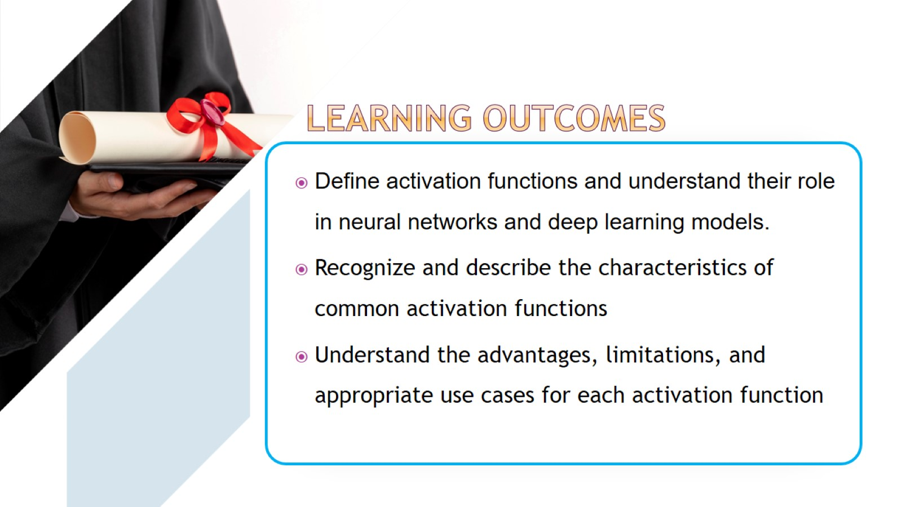

Slide 4
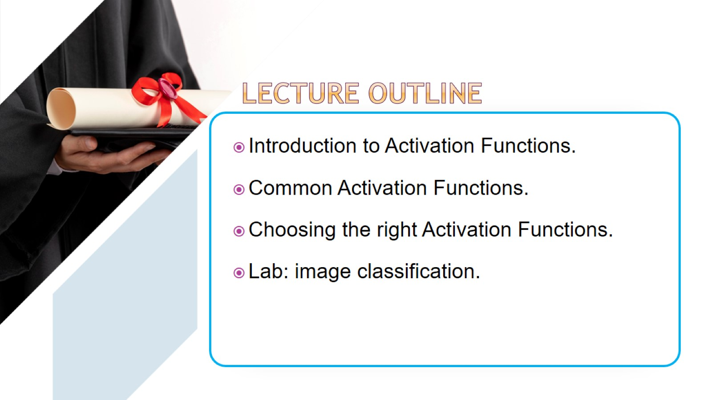

Slide 5
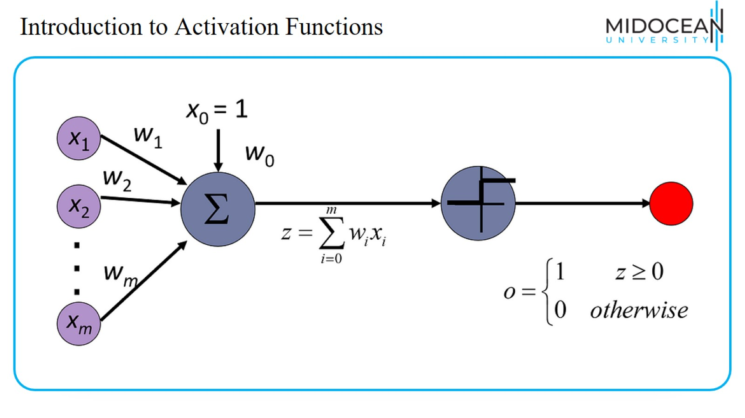
Introduction to Activation Functions

Slide 6
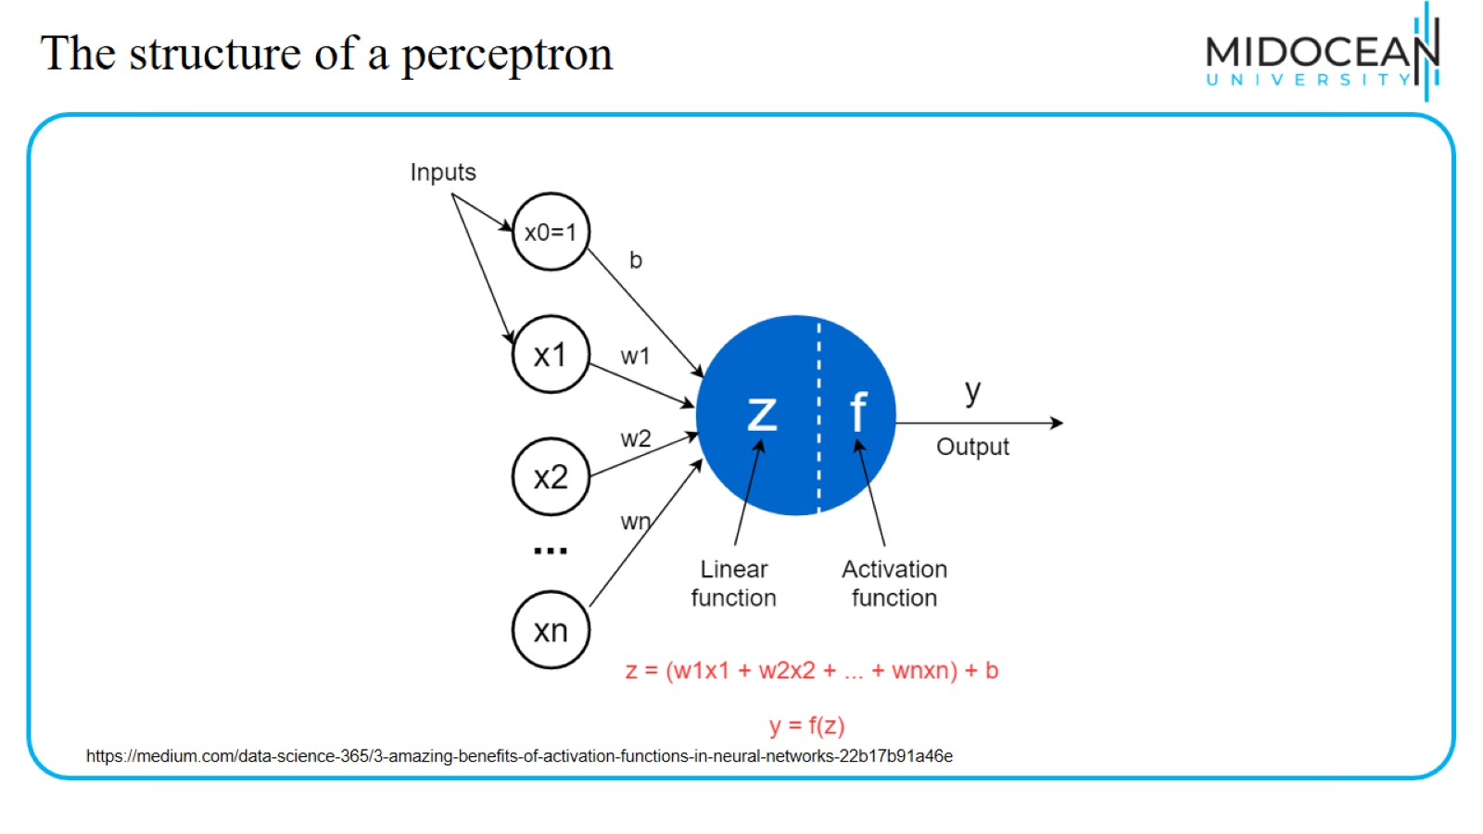
The structure of a perceptron

Slide 7
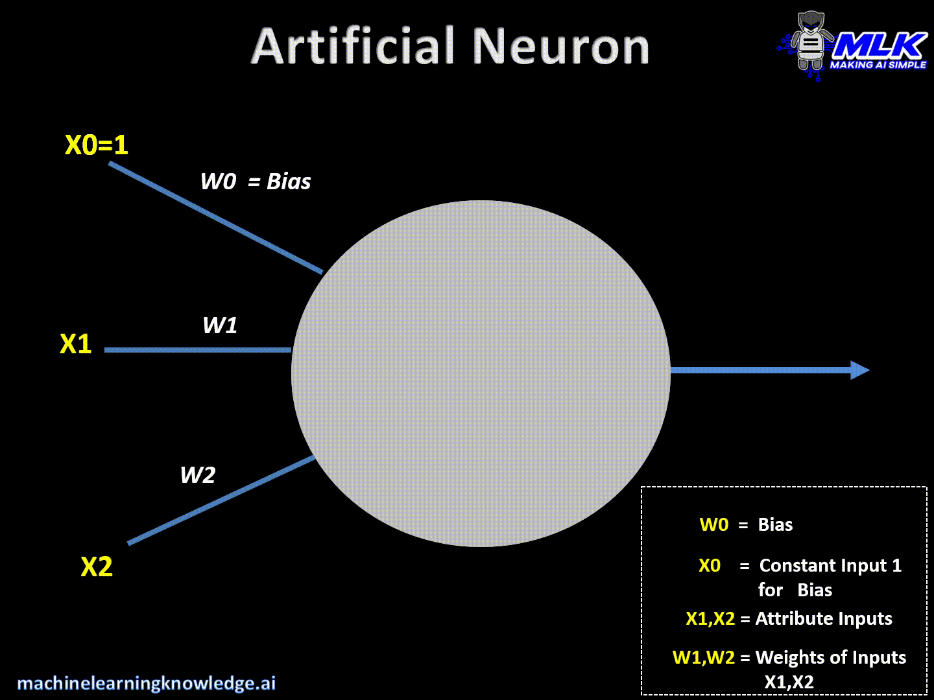
Introduction to Activation Functions
https://machinelearningknowledge.ai/activation-functions-neural-network/

Slide 8
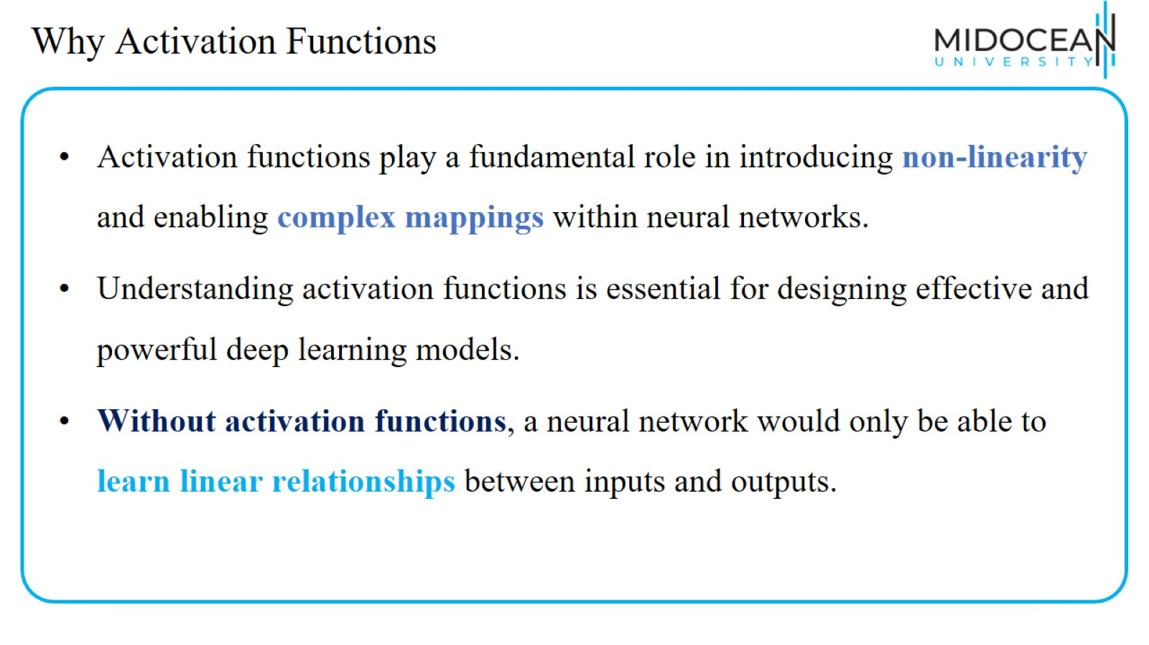
Why Activation Functions

Slide 9
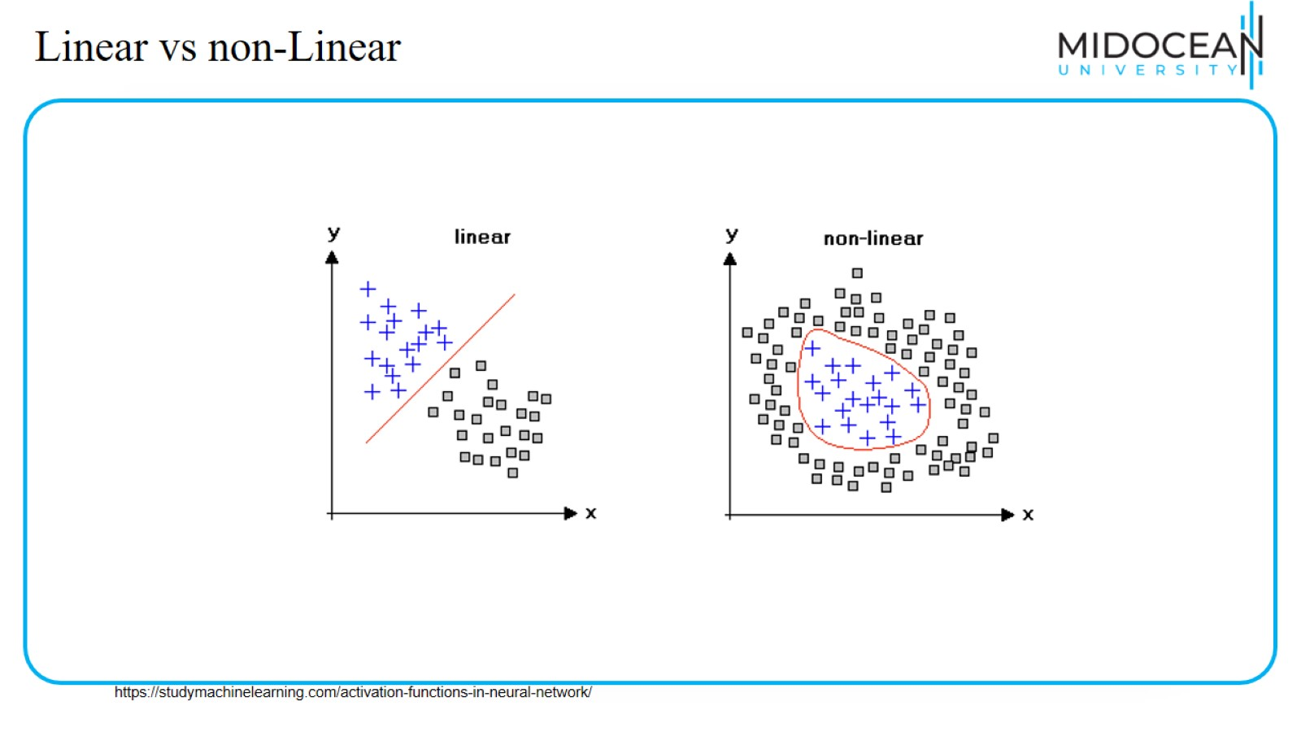
Linear vs non-Linear

Slide 10
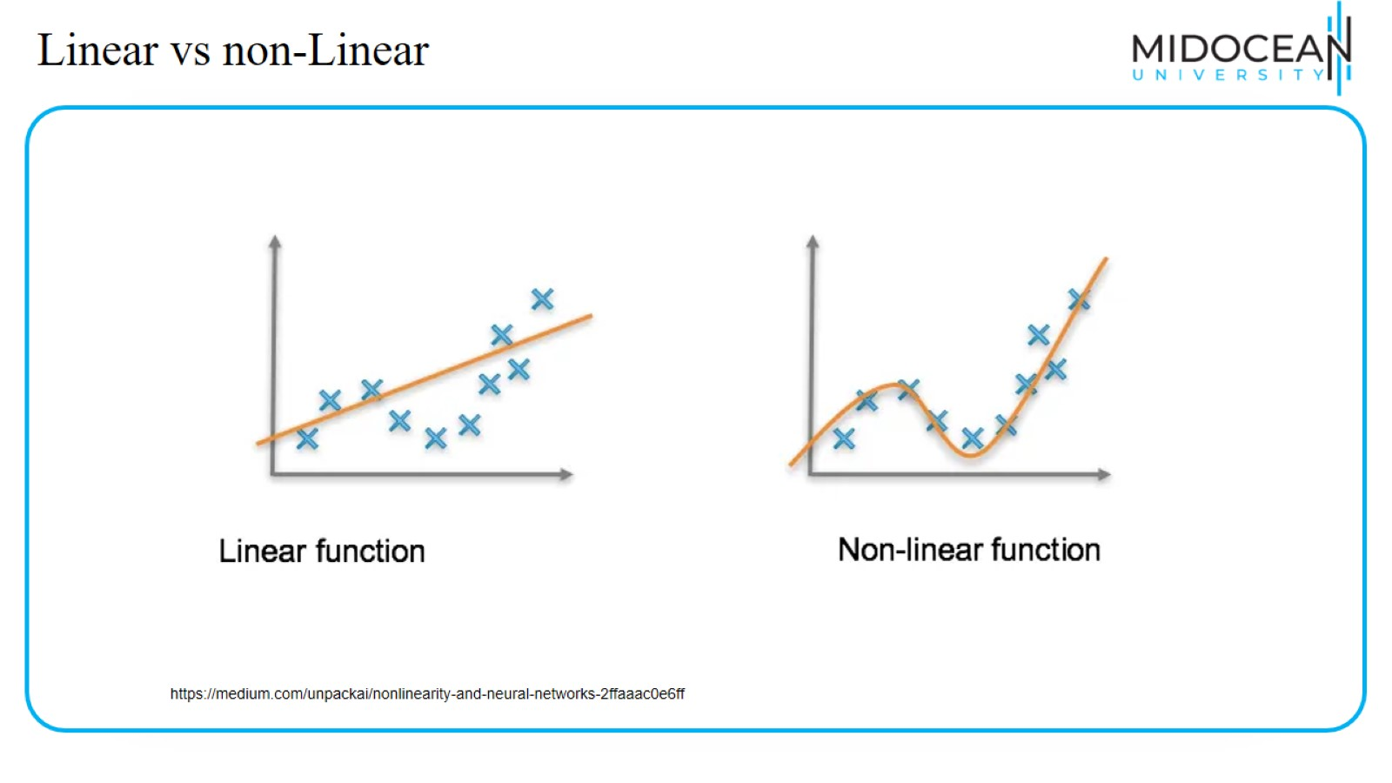
Linear vs non-Linear

Slide 11
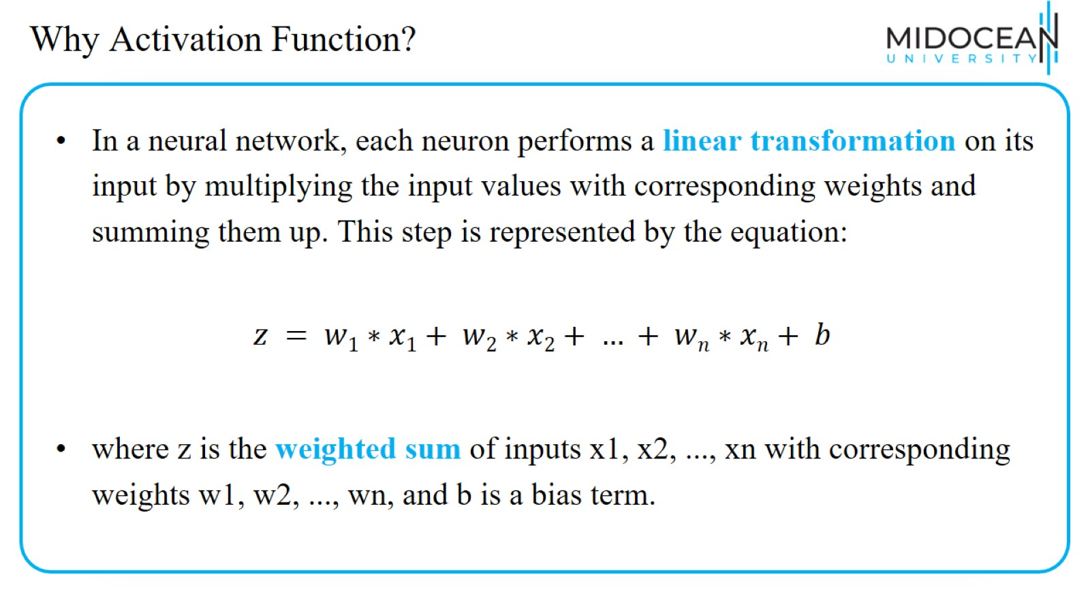
Why Activation Function?

Slide 12
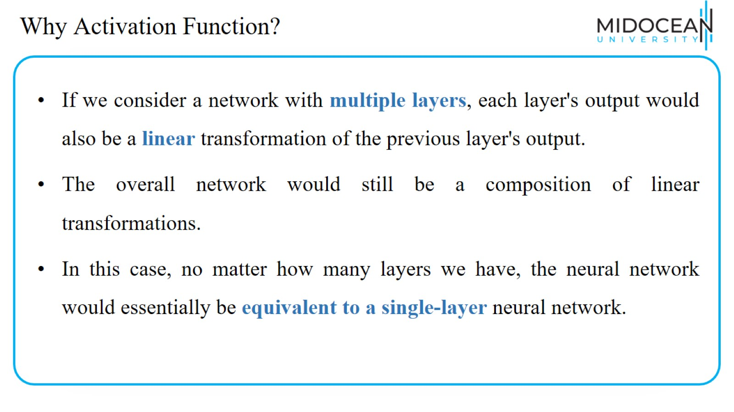
Why Activation Function?

Slide 13
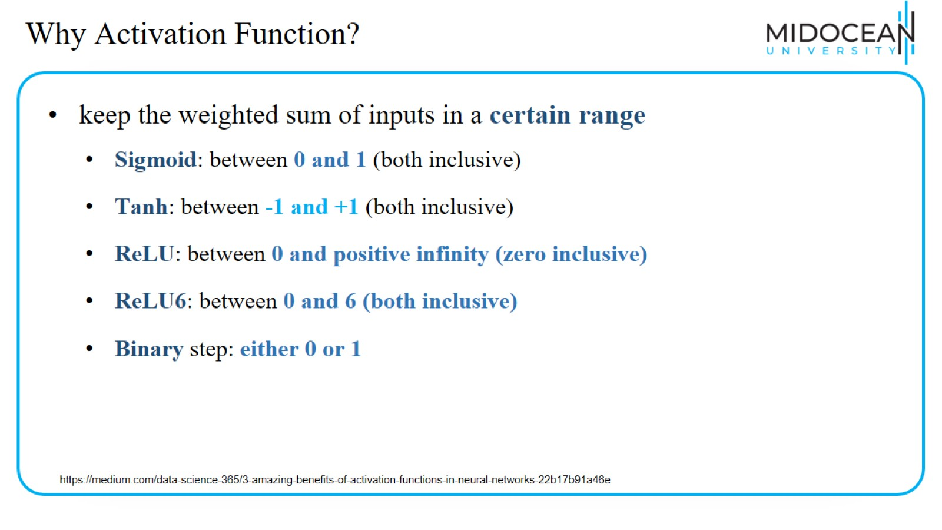
Why Activation Function?

Slide 14
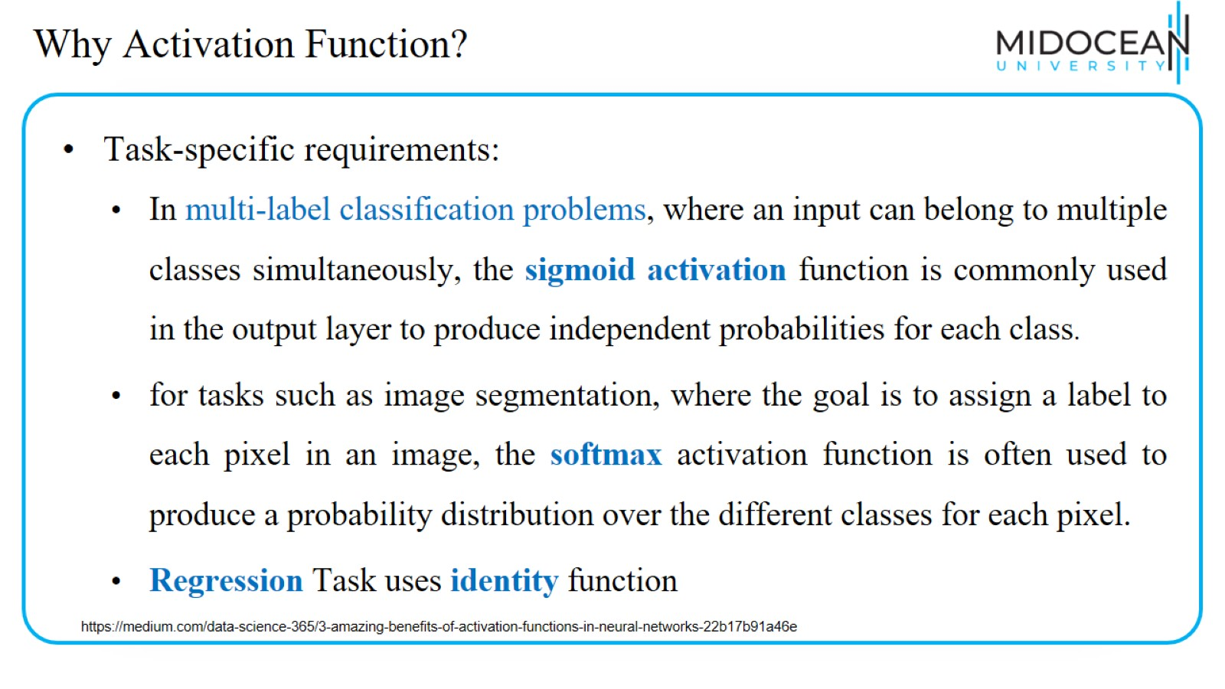
Why Activation Function?

Slide 15
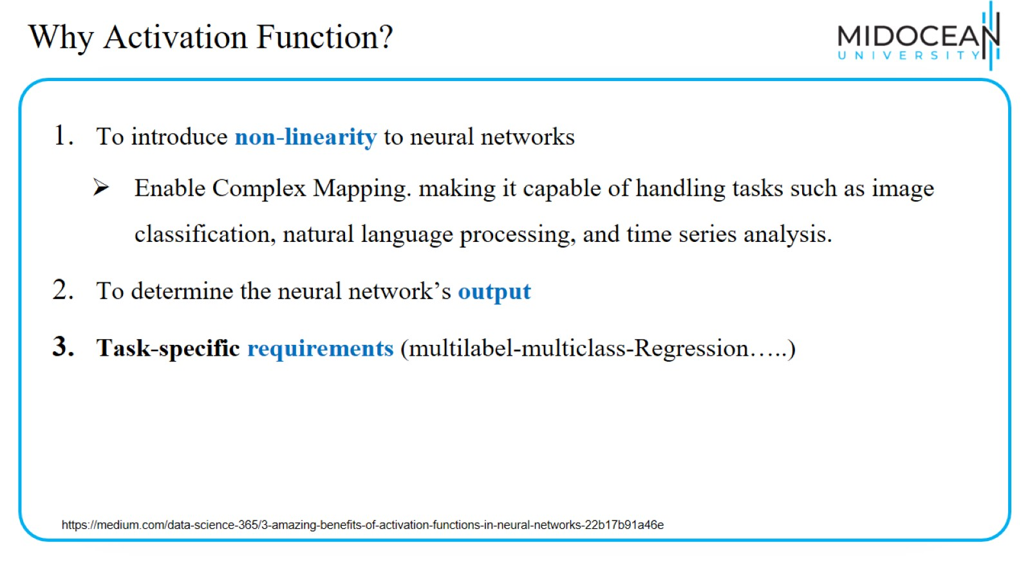
Why Activation Function?

Slide 16
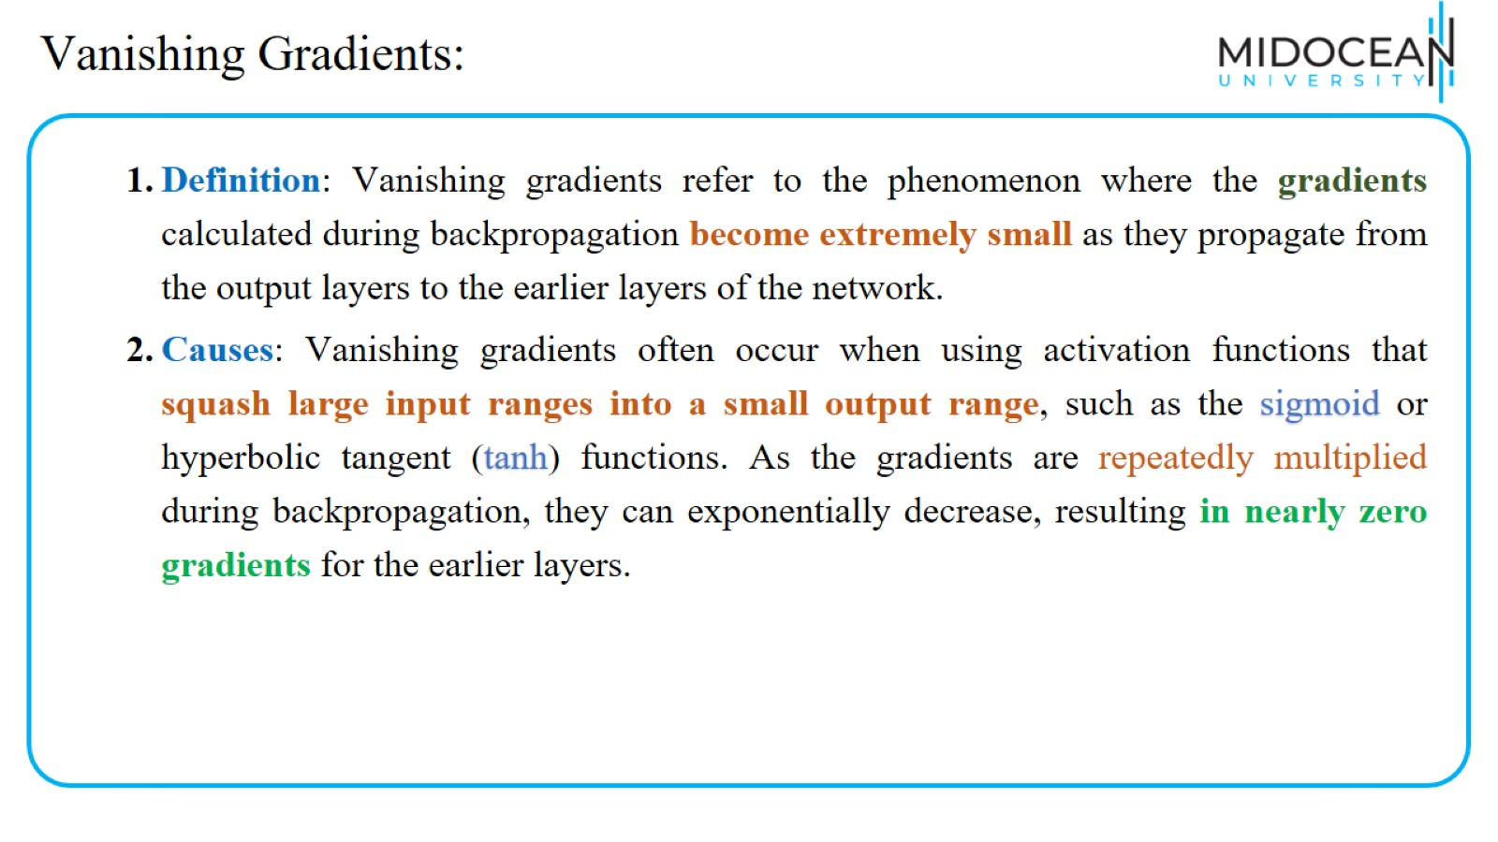
Vanishing Gradients:

Slide 17
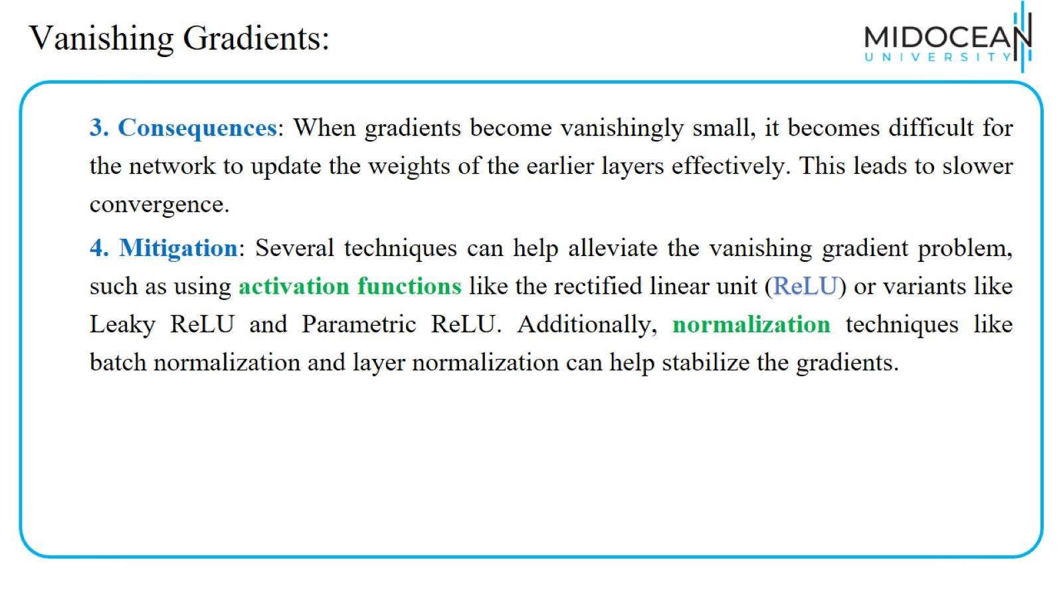
Vanishing Gradients:

Slide 18
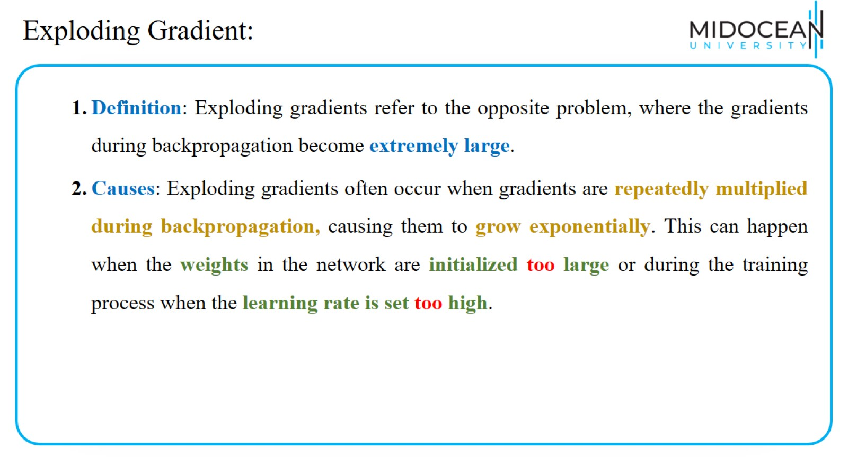
Exploding Gradient:

Slide 19
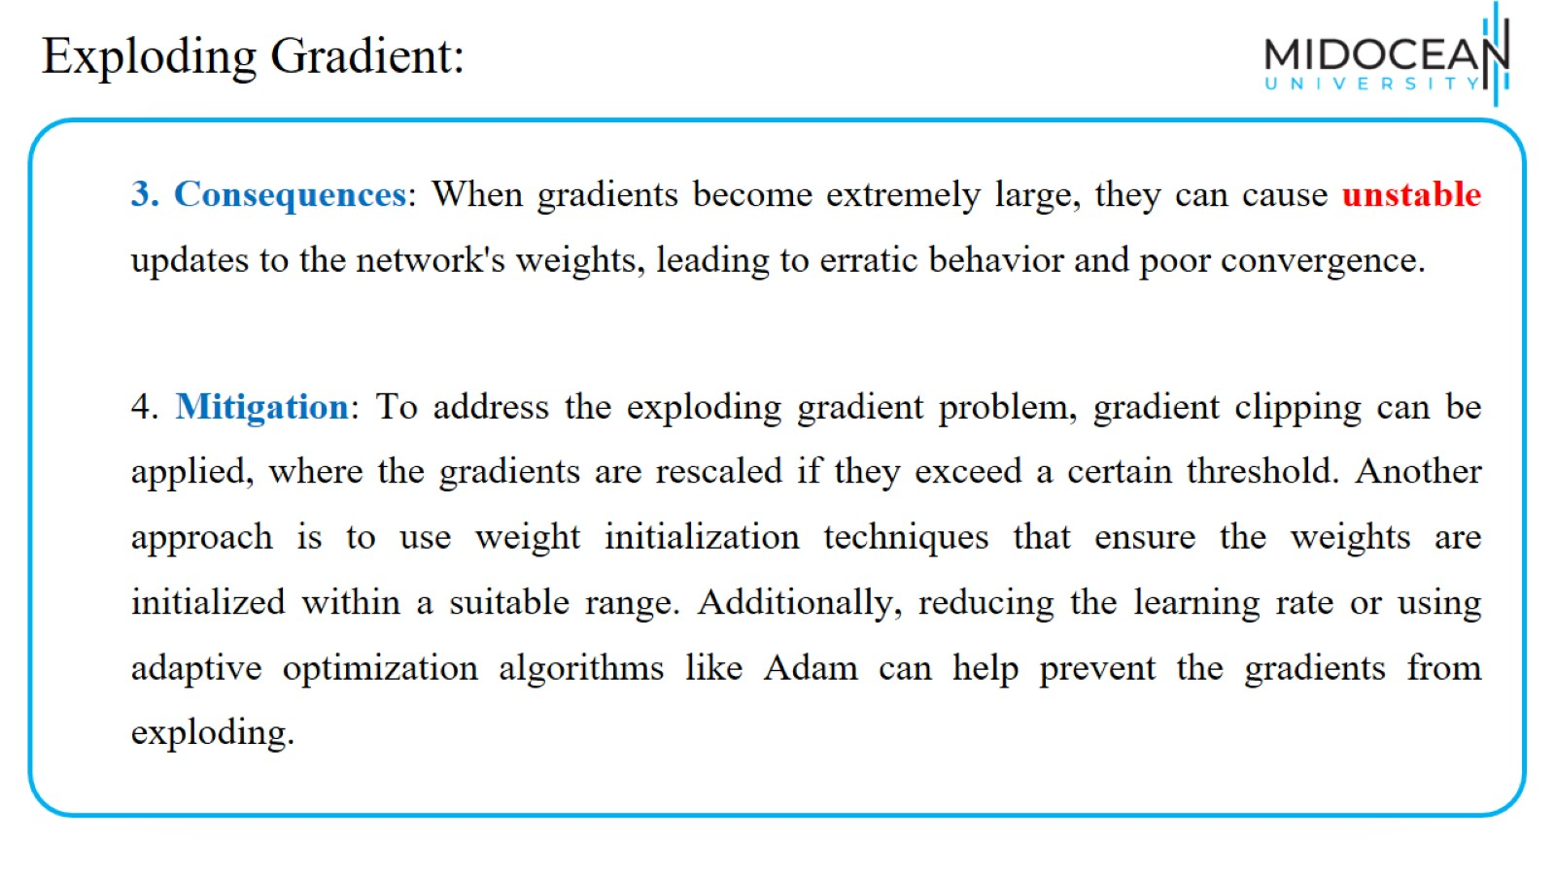
Exploding Gradient:

Slide 20
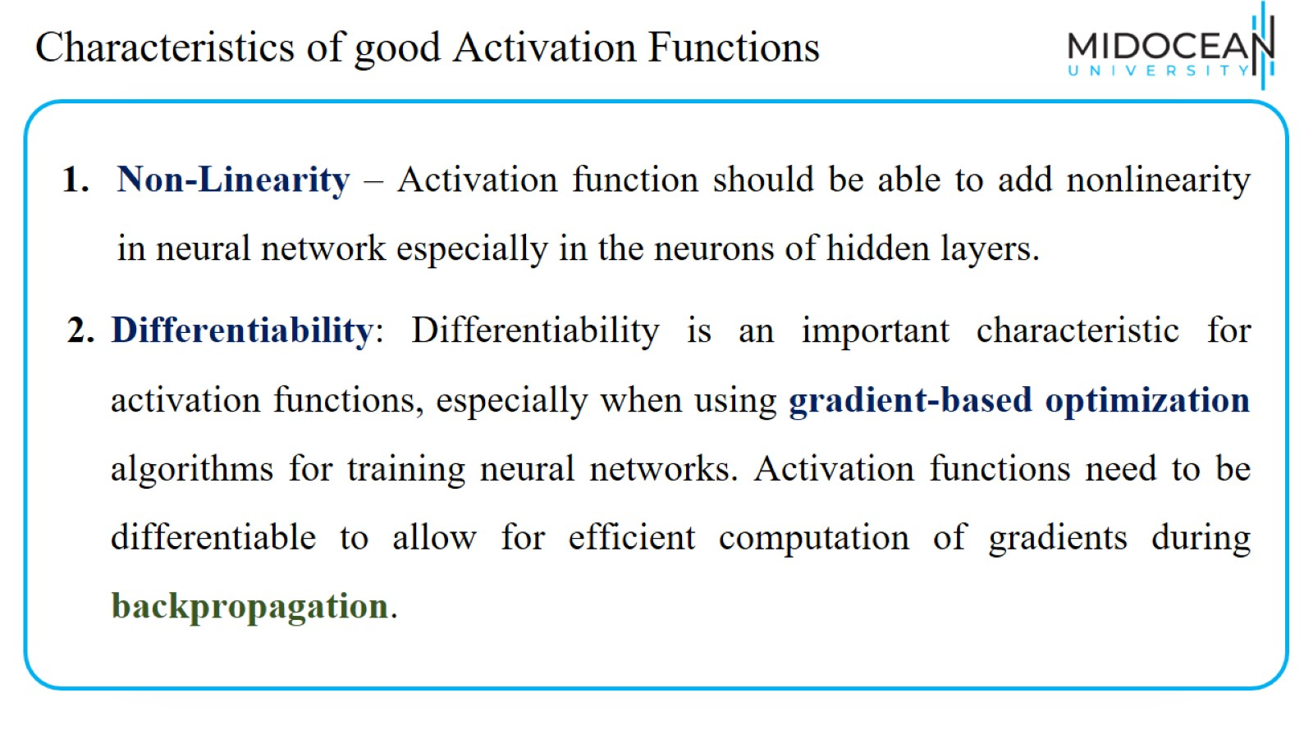
Characteristics of good Activation Functions

Slide 21
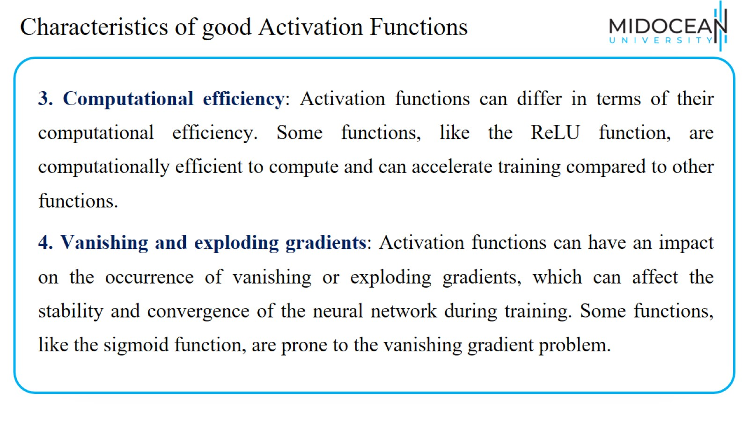
Characteristics of good Activation Functions

Slide 22
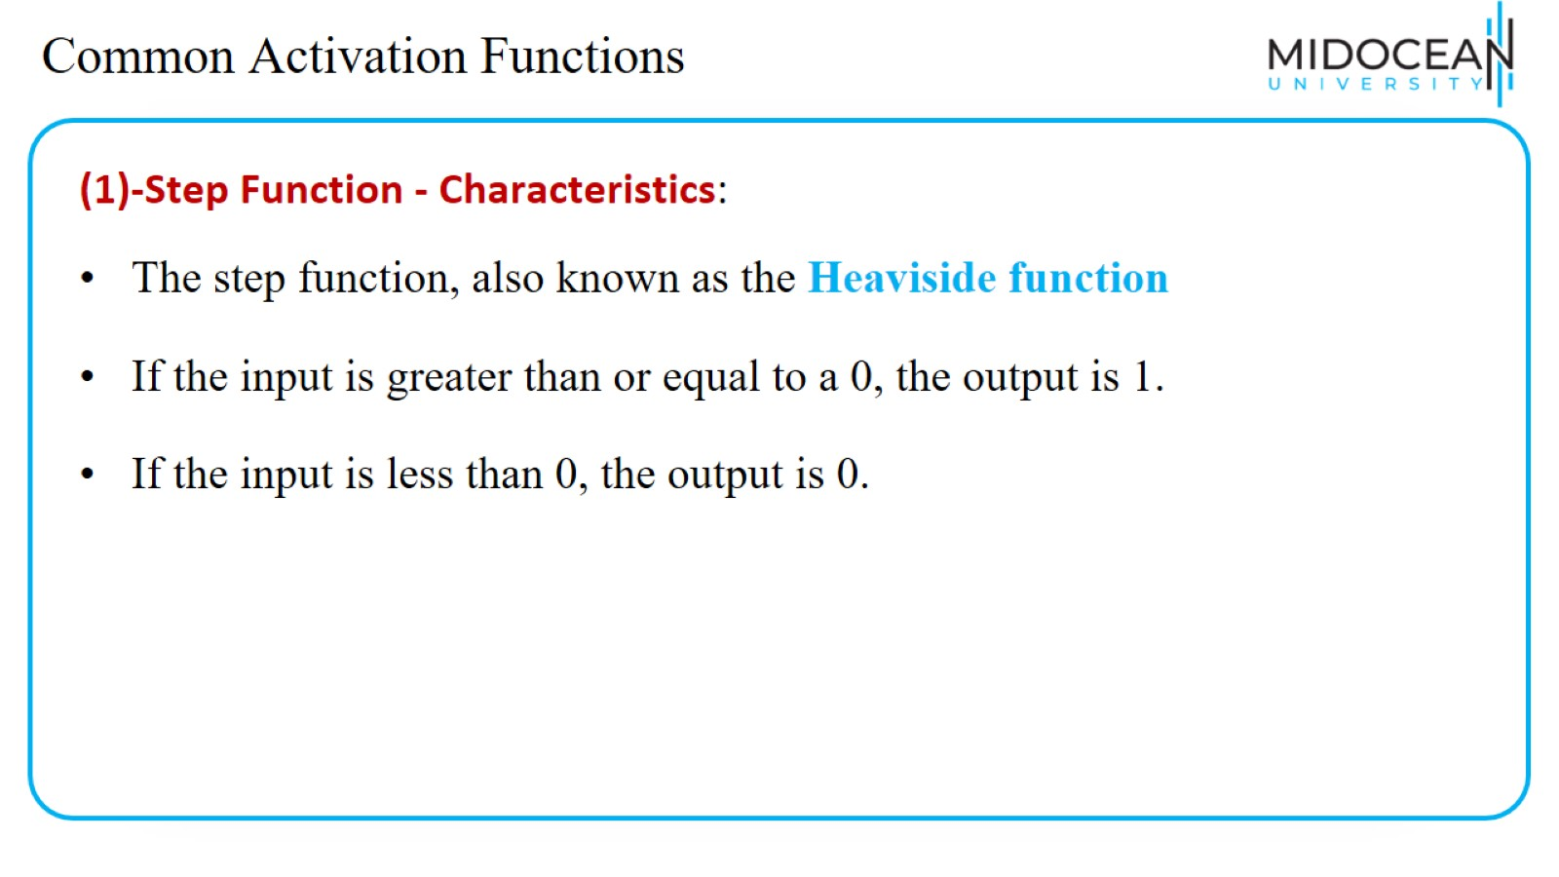
Common Activation Functions

Slide 23

Step Function
https://machinelearningknowledge.ai/activation-functions-neural-network/

Slide 24
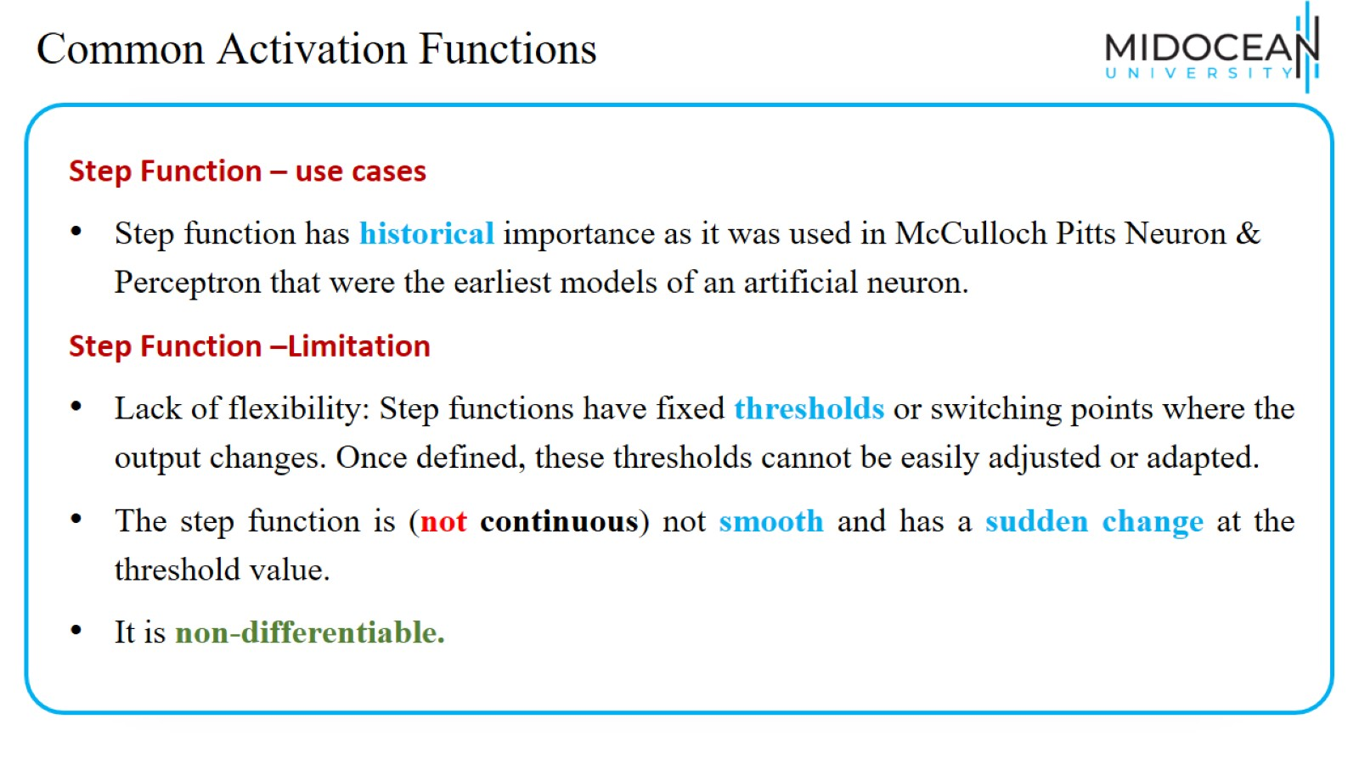
Common Activation Functions

Slide 25
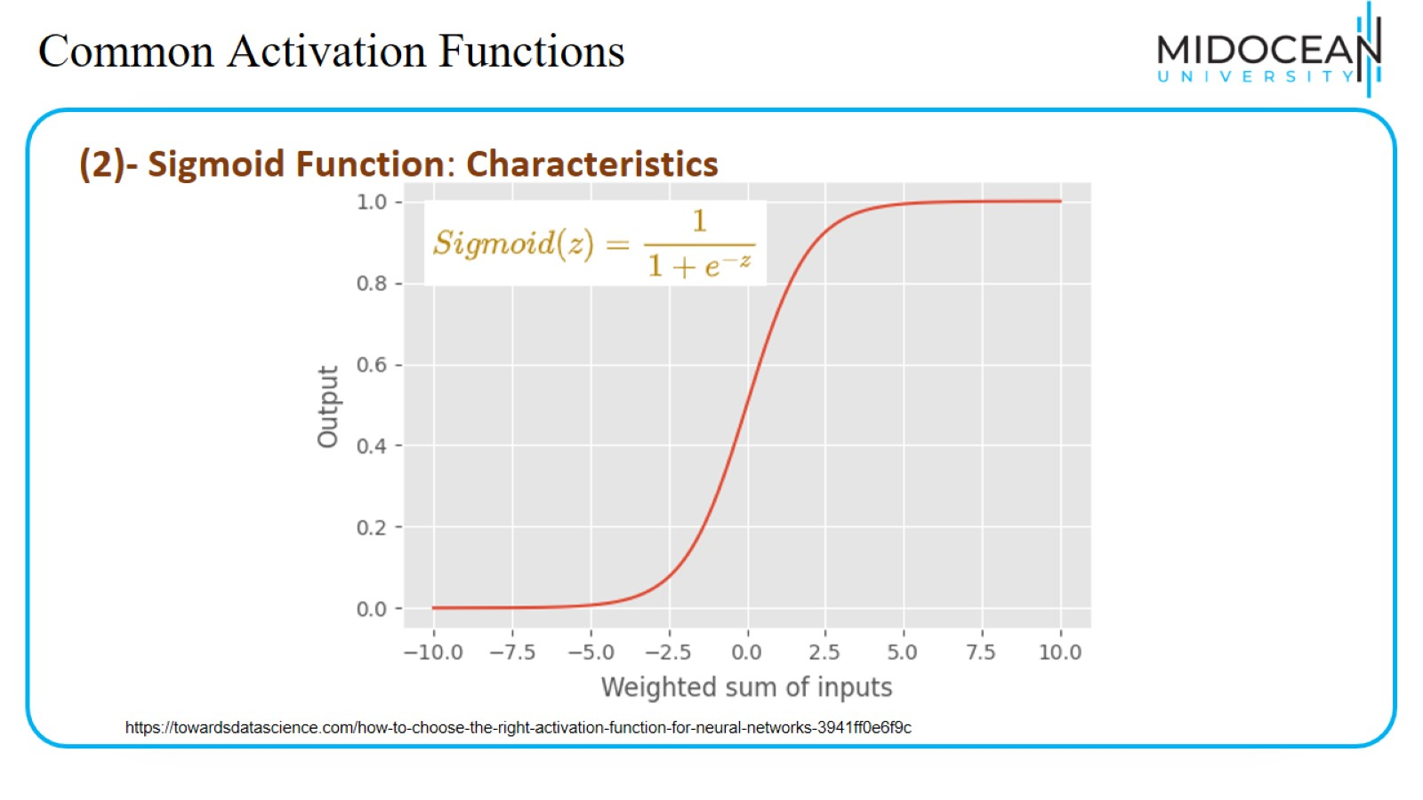
Common Activation Functions

Slide 26
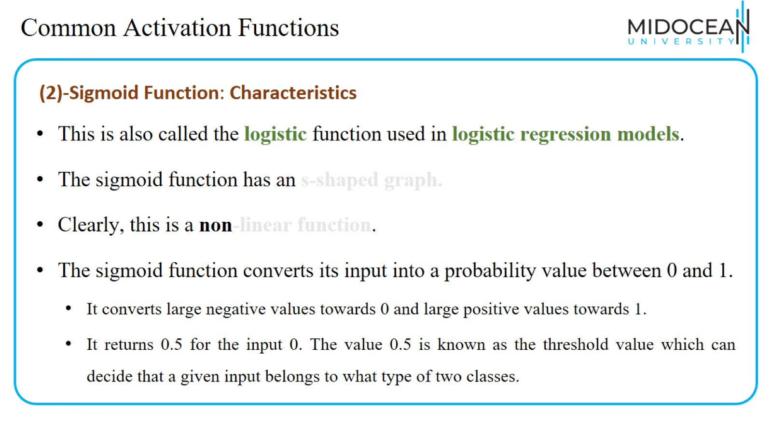
Common Activation Functions

Slide 27

Sigmoid activation function
https://machinelearningknowledge.ai/activation-functions-neural-network/

Slide 28
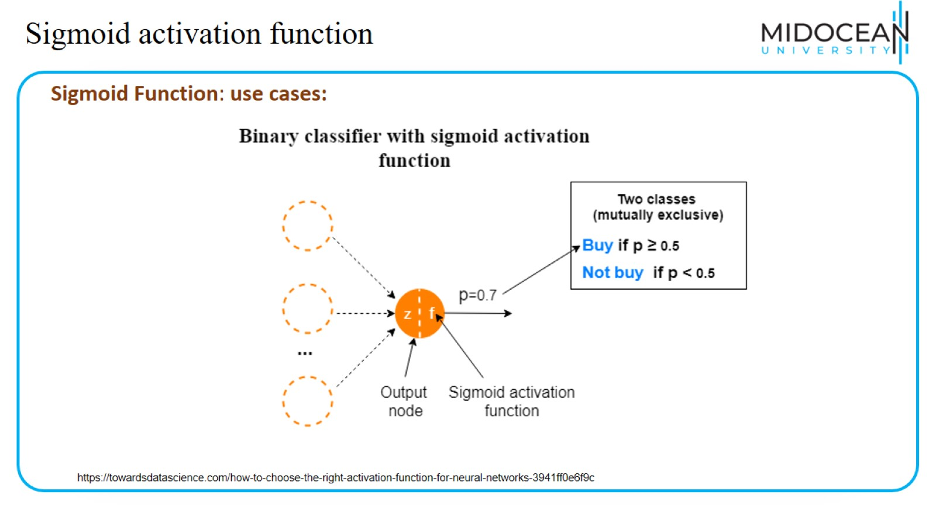
Sigmoid activation function

Slide 29
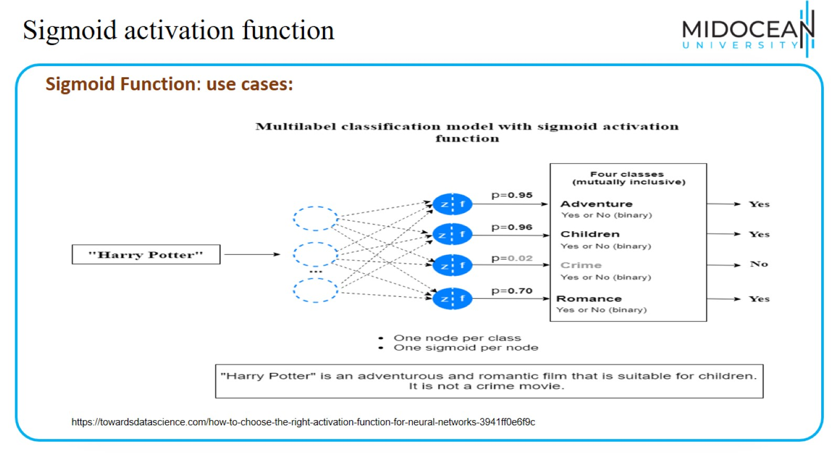
Sigmoid activation function

Slide 30
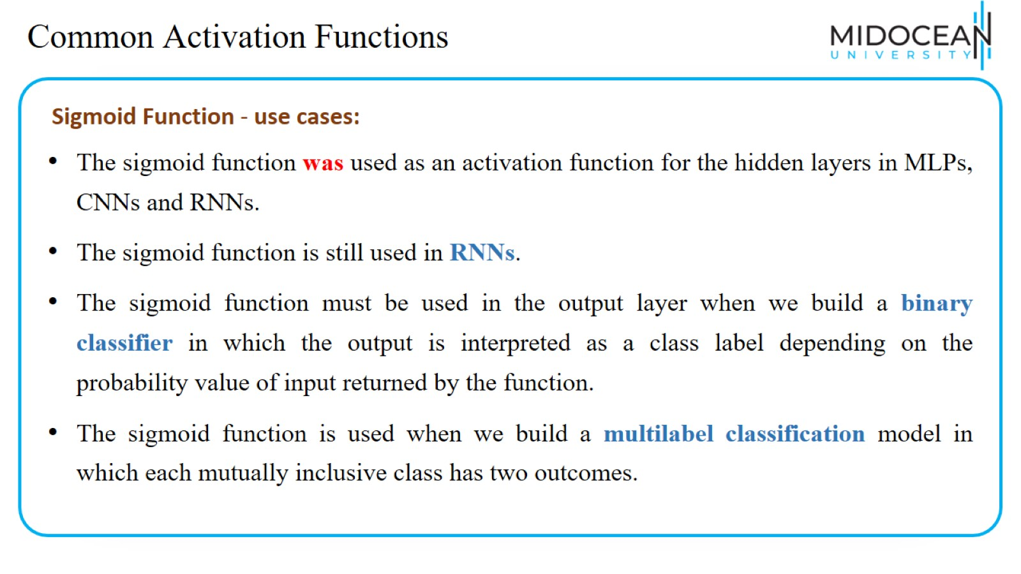
Common Activation Functions

Slide 31
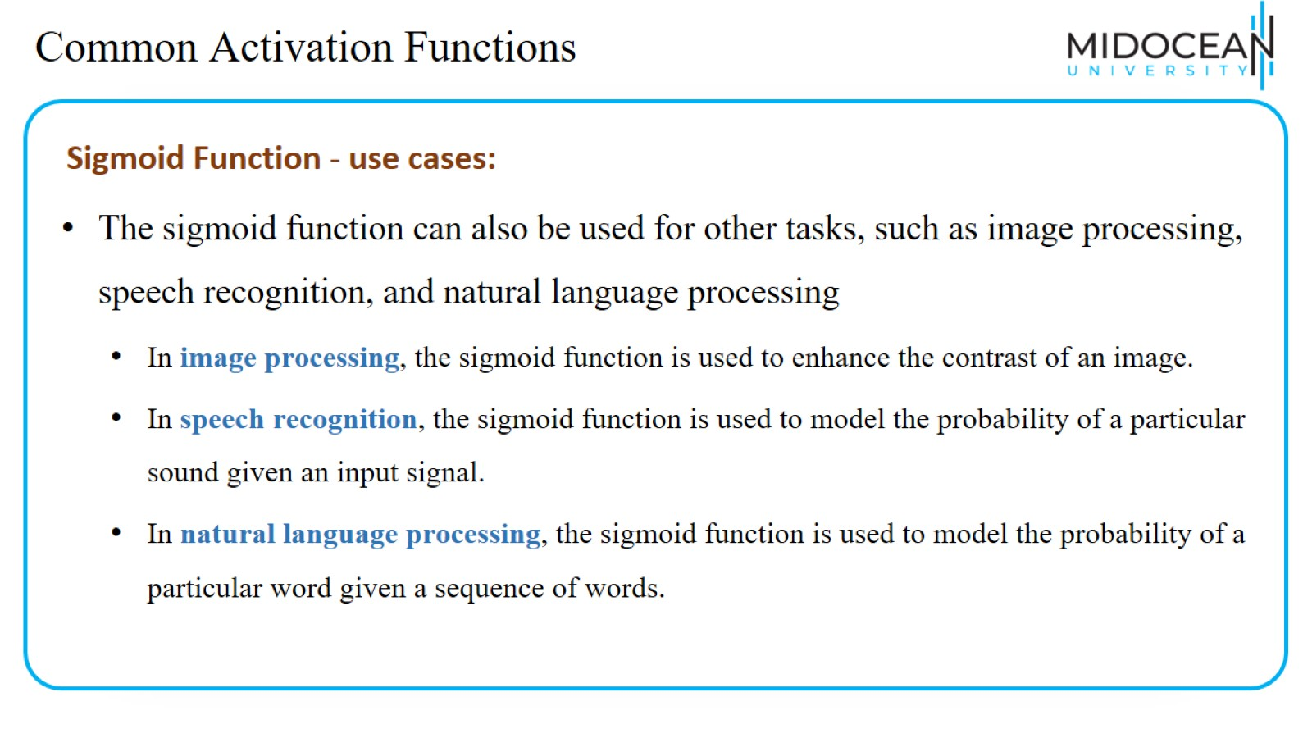
Common Activation Functions

Slide 32
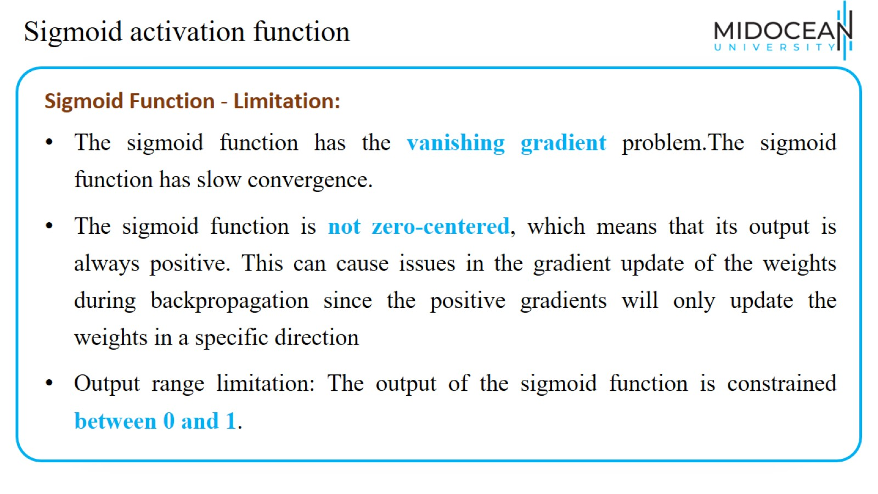
Sigmoid activation function

Slide 33
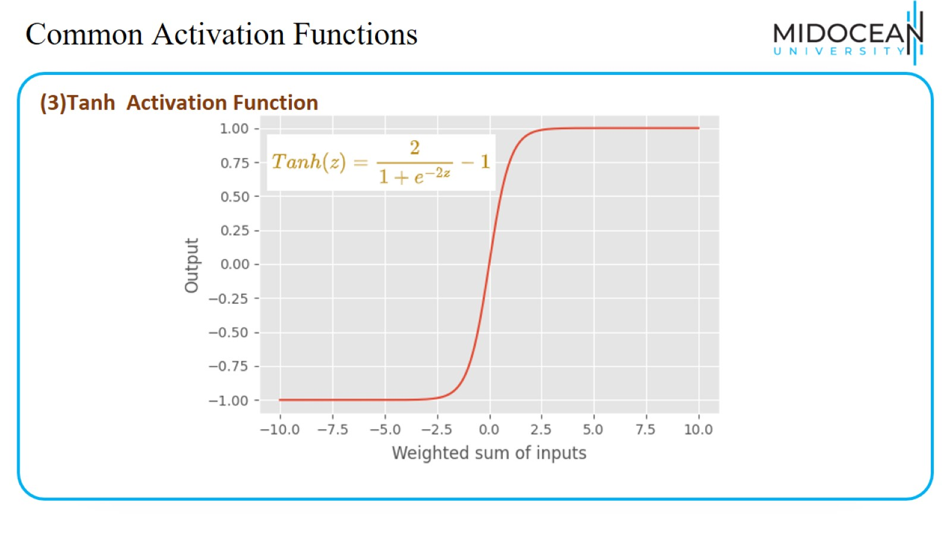
Common Activation Functions

Slide 34
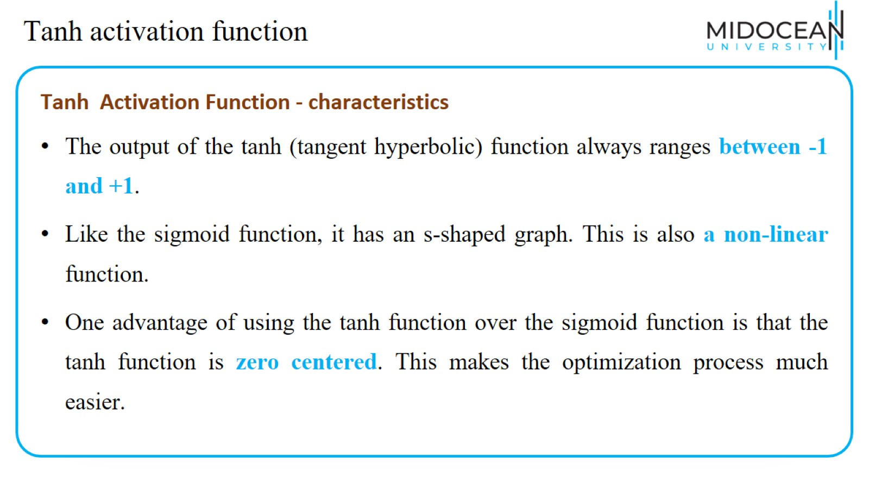
Tanh activation function

Slide 35

Common Activation Functions
https://machinelearningknowledge.ai/activation-functions-neural-network/

Slide 36
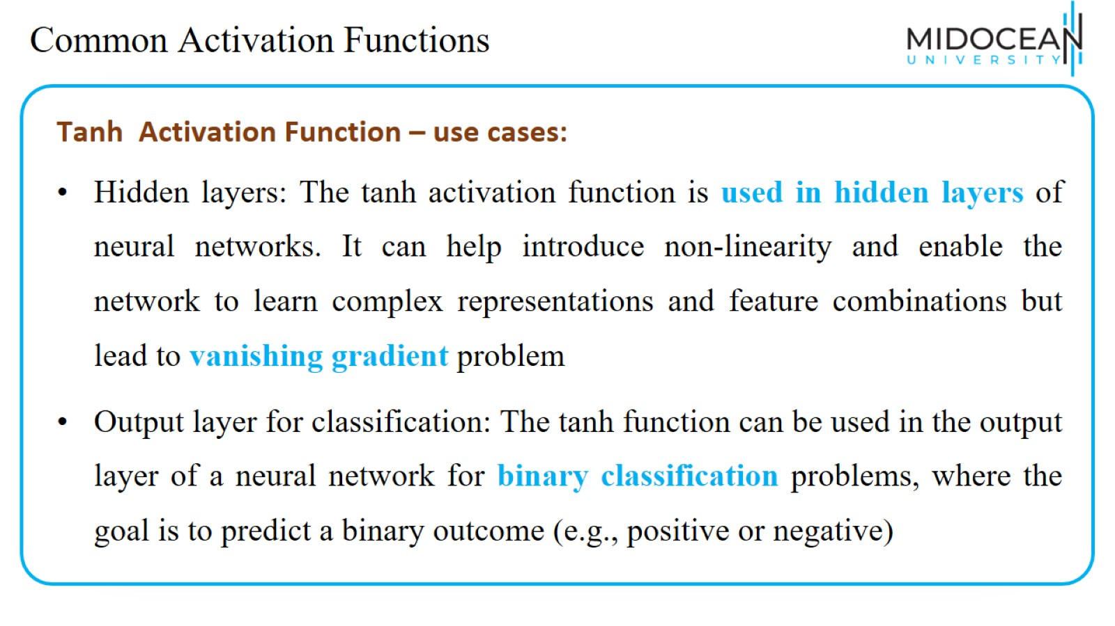
Common Activation Functions

Slide 37
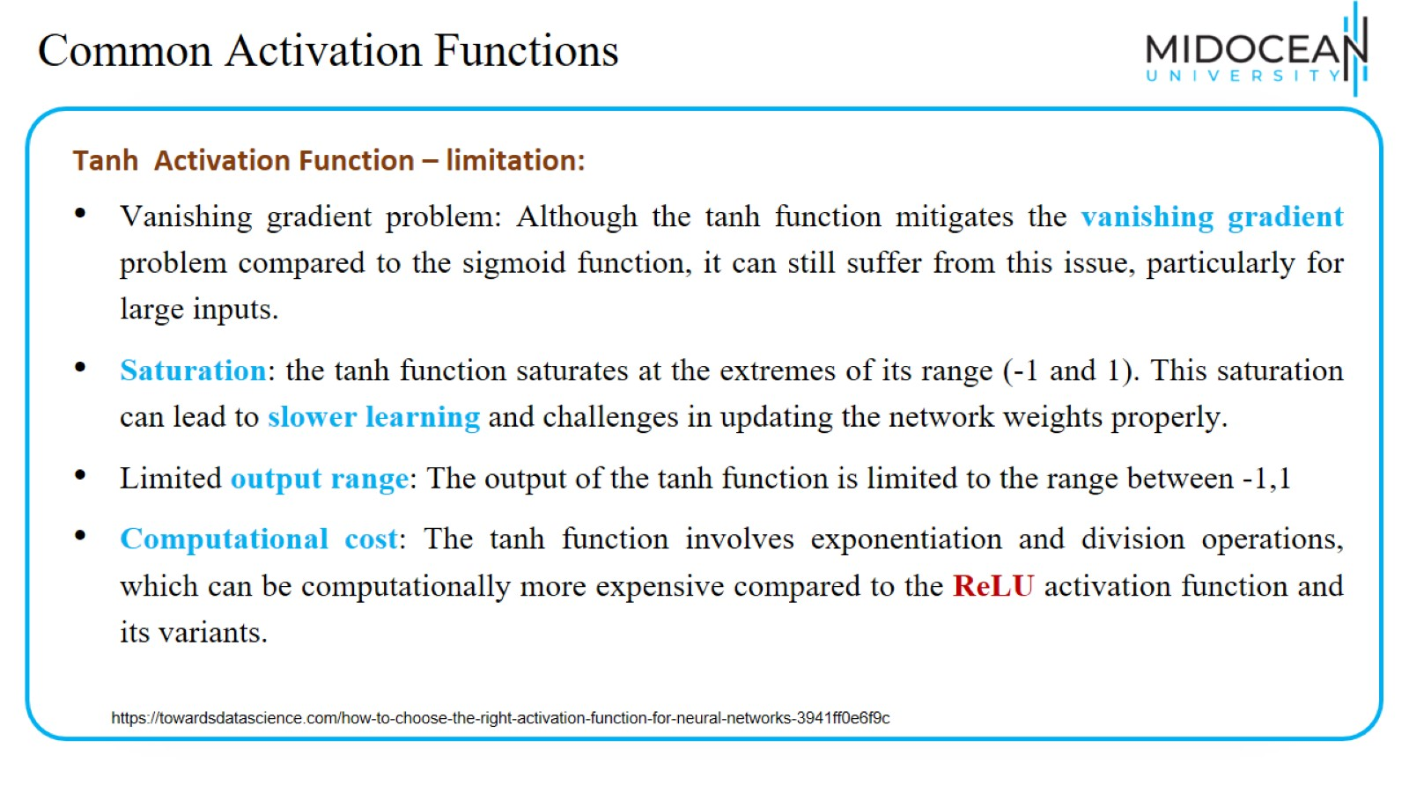
Common Activation Functions

Slide 38
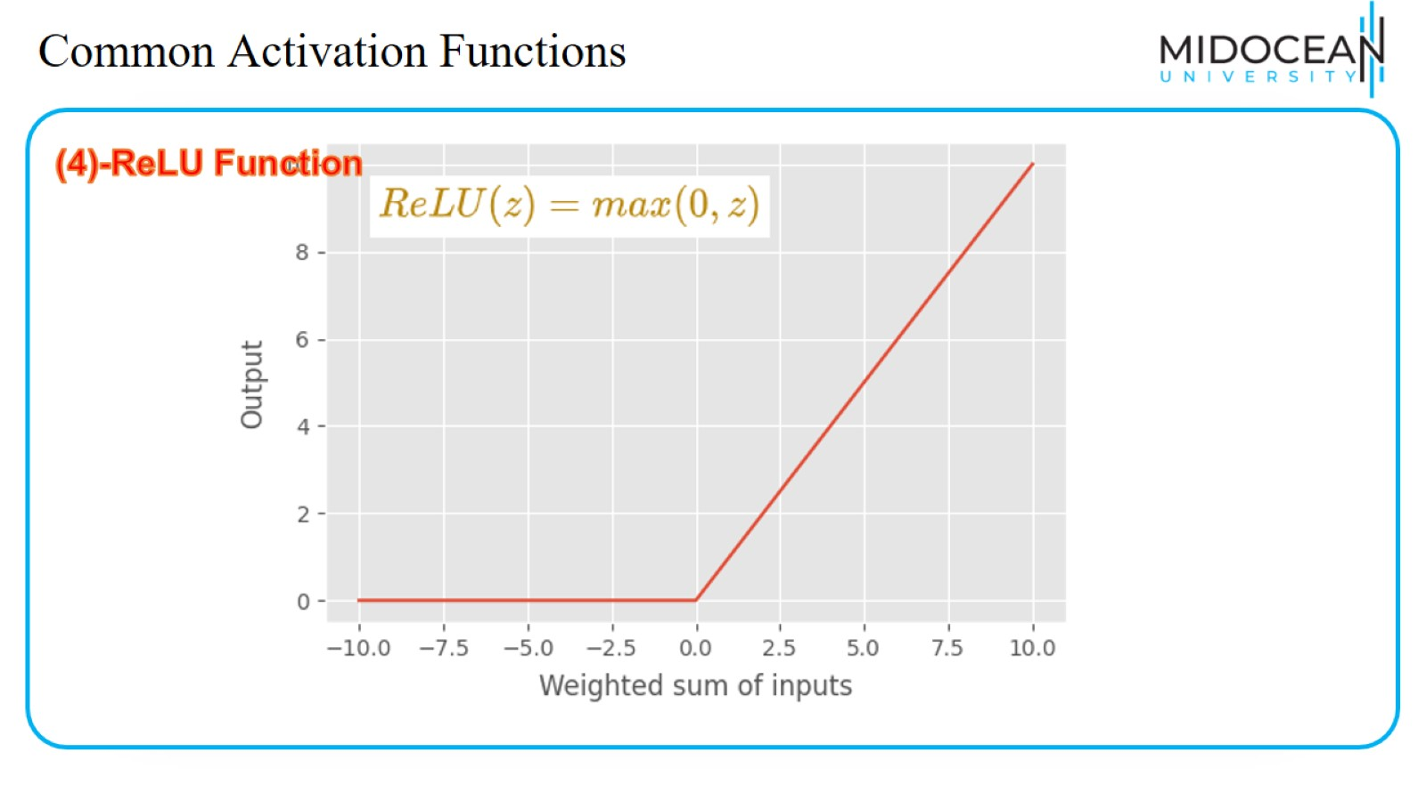
Common Activation Functions

Slide 39

Common Activation Functions
https://machinelearningknowledge.ai/activation-functions-neural-network/

Slide 40
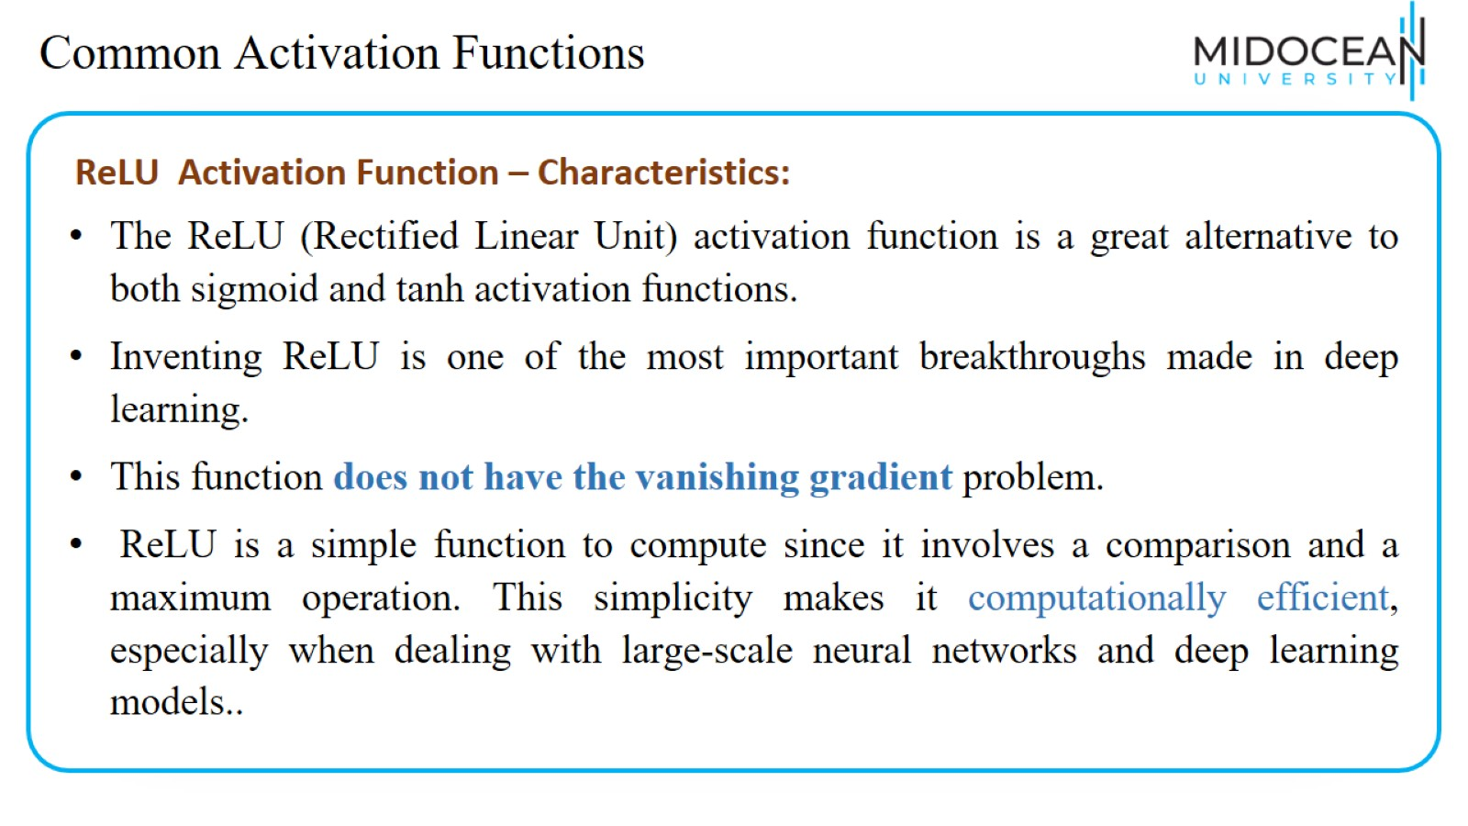
Common Activation Functions

Slide 41
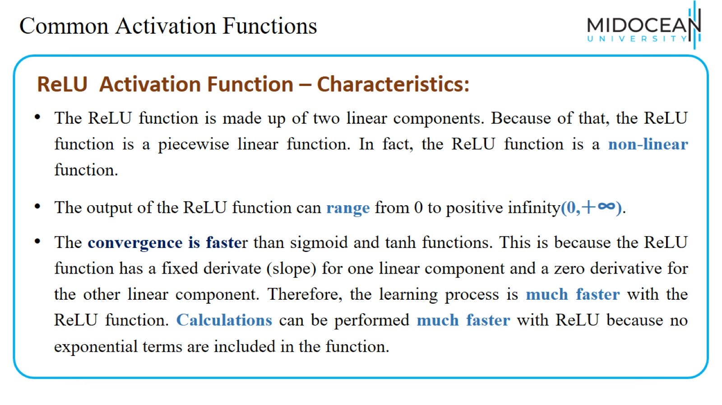
Common Activation Functions

Slide 42
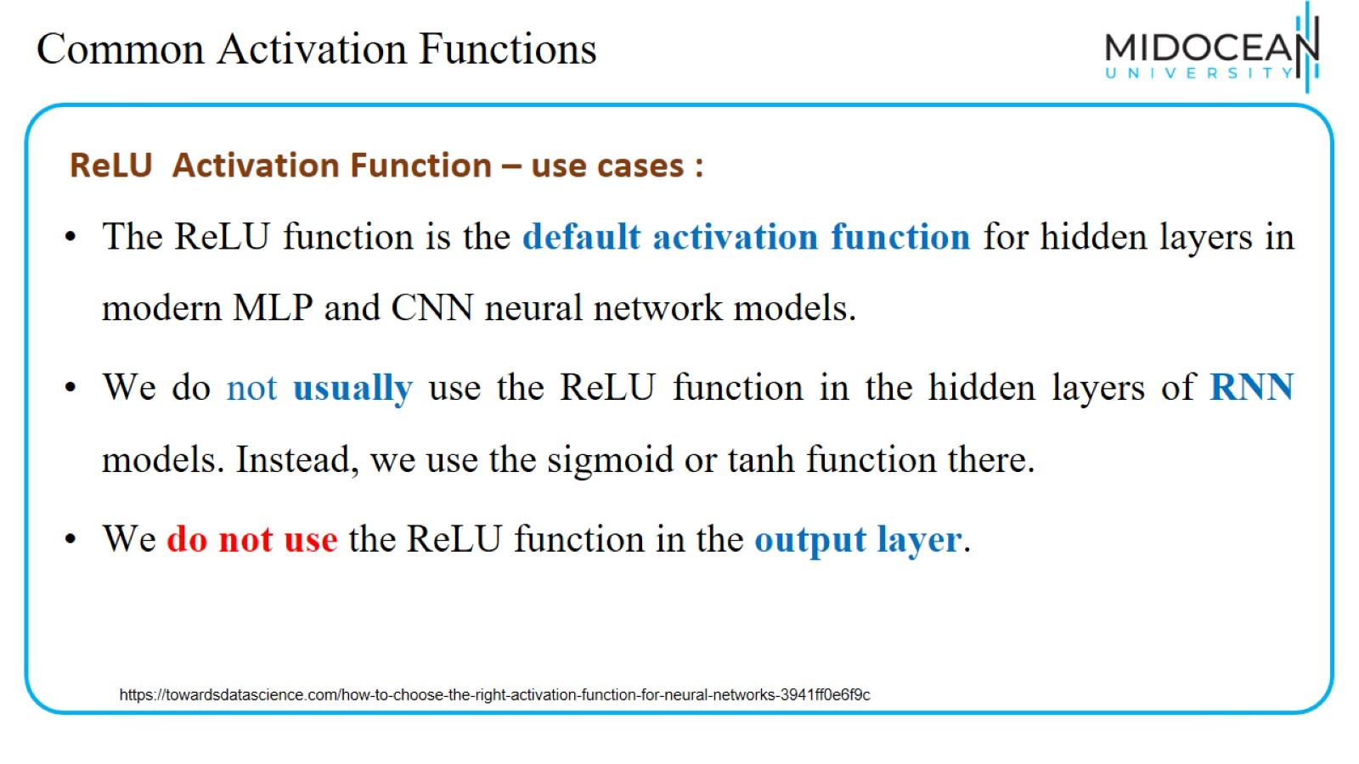
Common Activation Functions

Slide 43
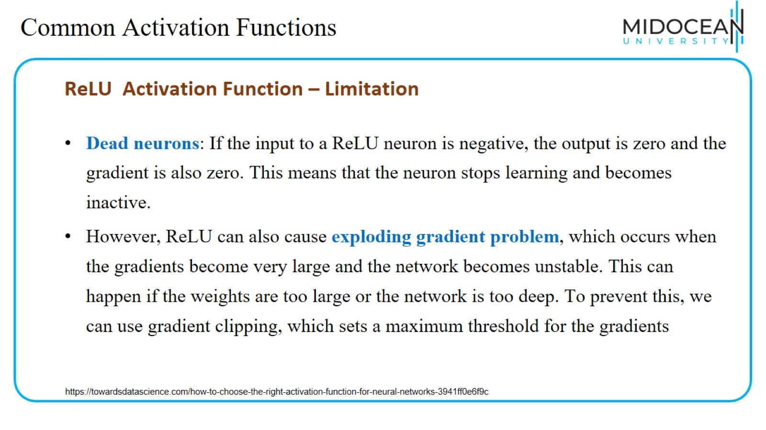
Common Activation Functions

Slide 44
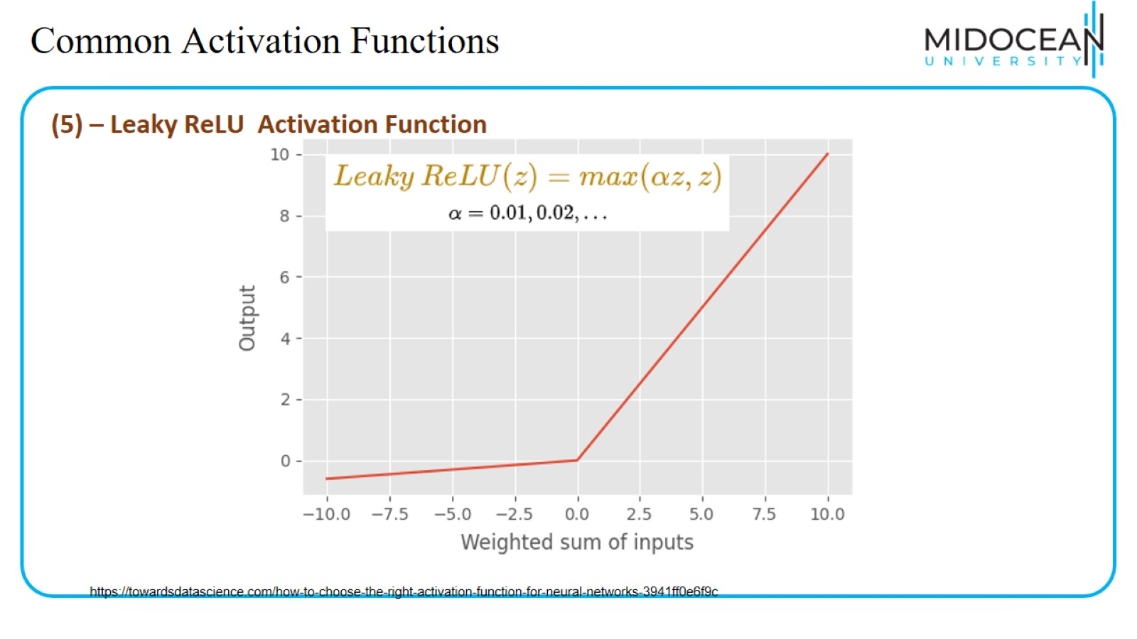
Common Activation Functions

Slide 45

Common Activation Functions
https://towardsdatascience.com/how-to-choose-the-right-activation-function-for-neural-networks-3941ff0e6f9c

Slide 46
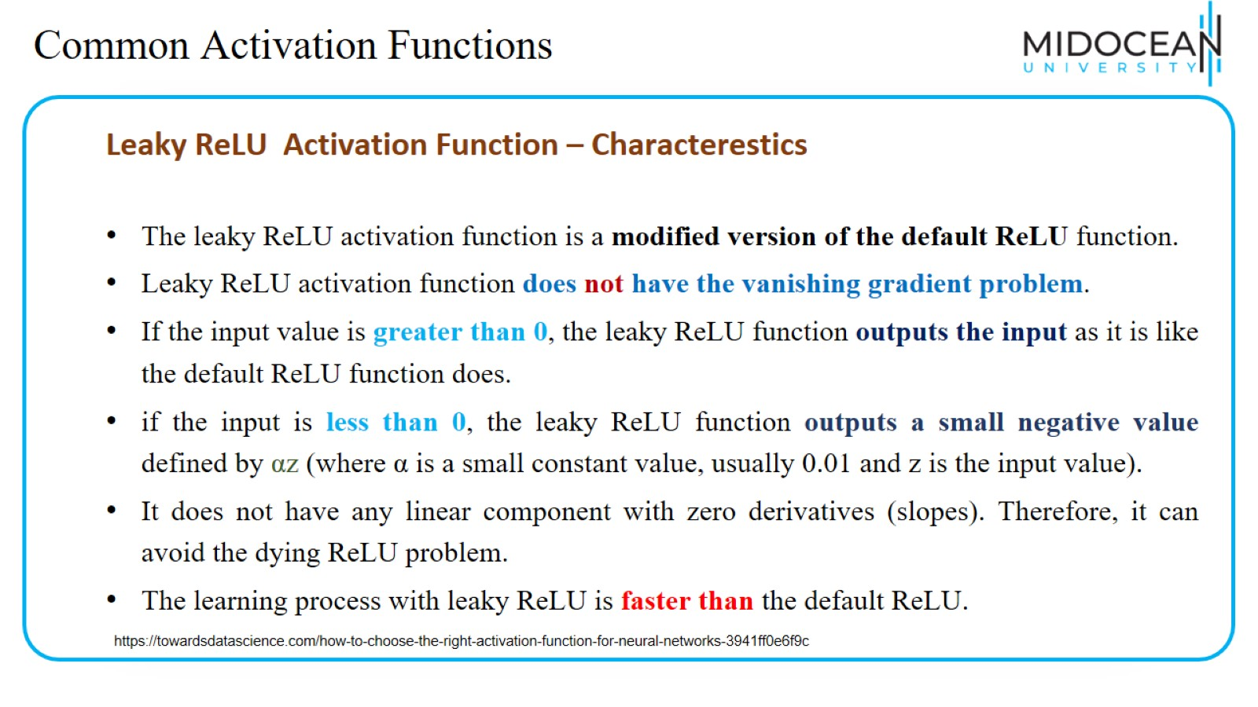
Common Activation Functions

Slide 47
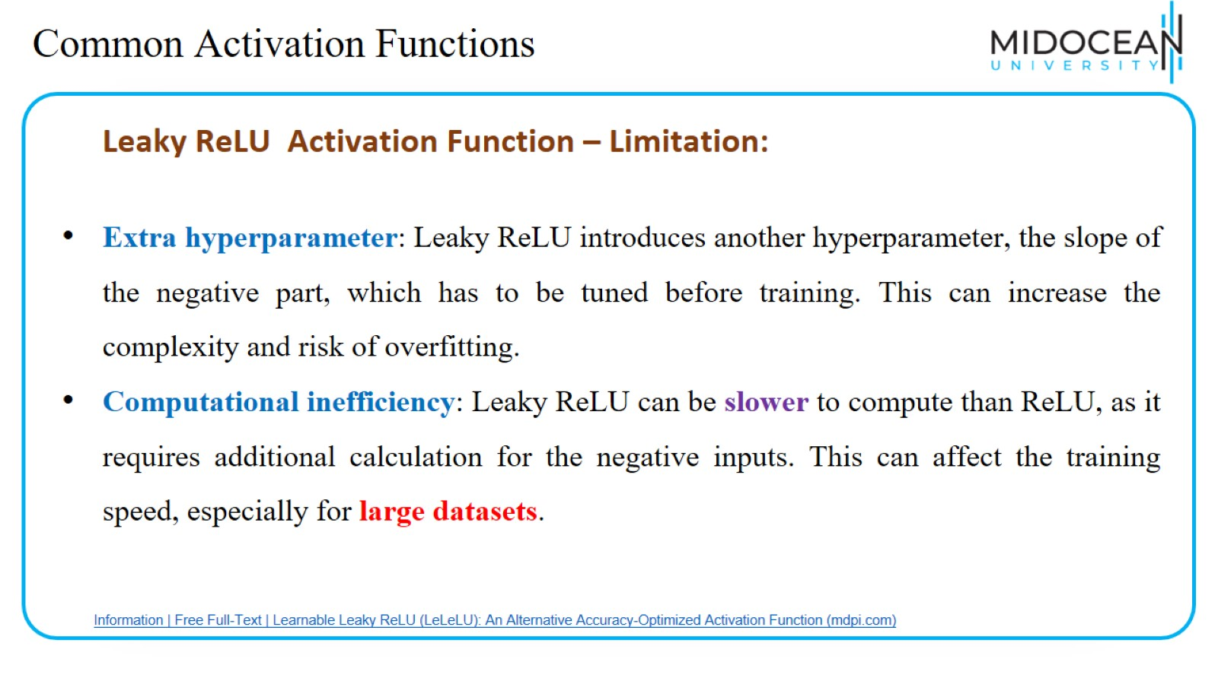
Common Activation Functions

Slide 48
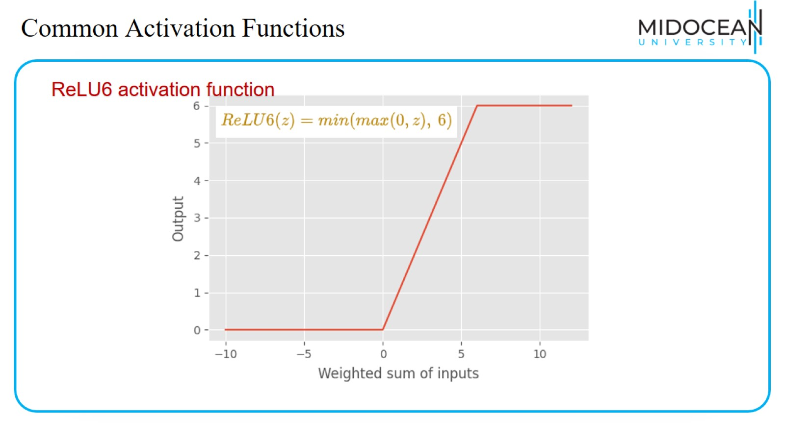
Common Activation Functions

Slide 49
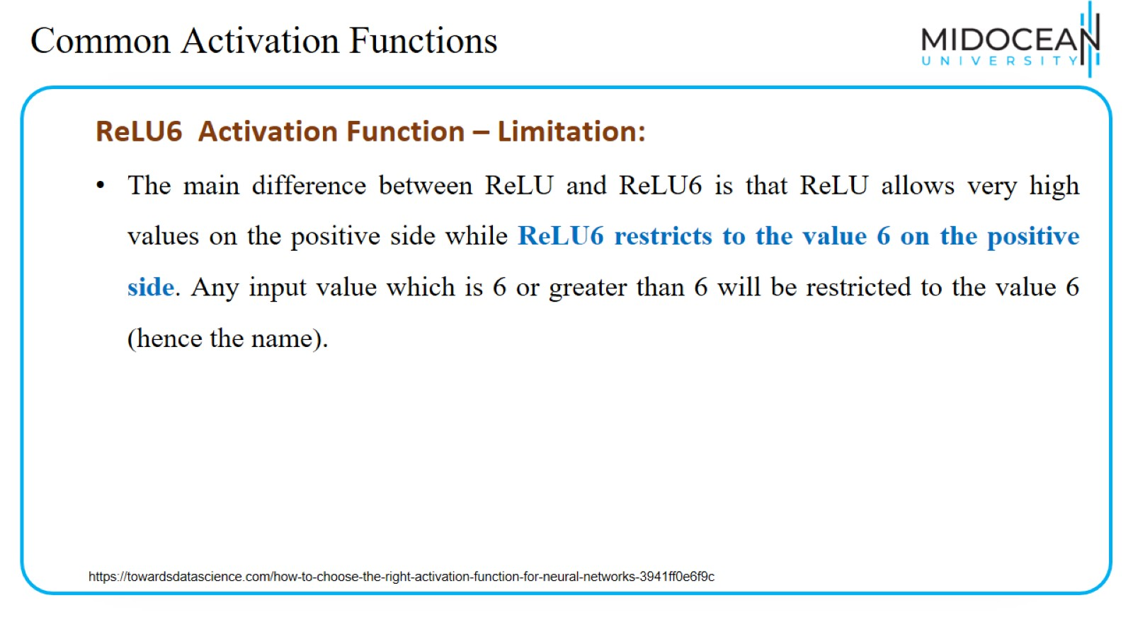
Common Activation Functions

Slide 50
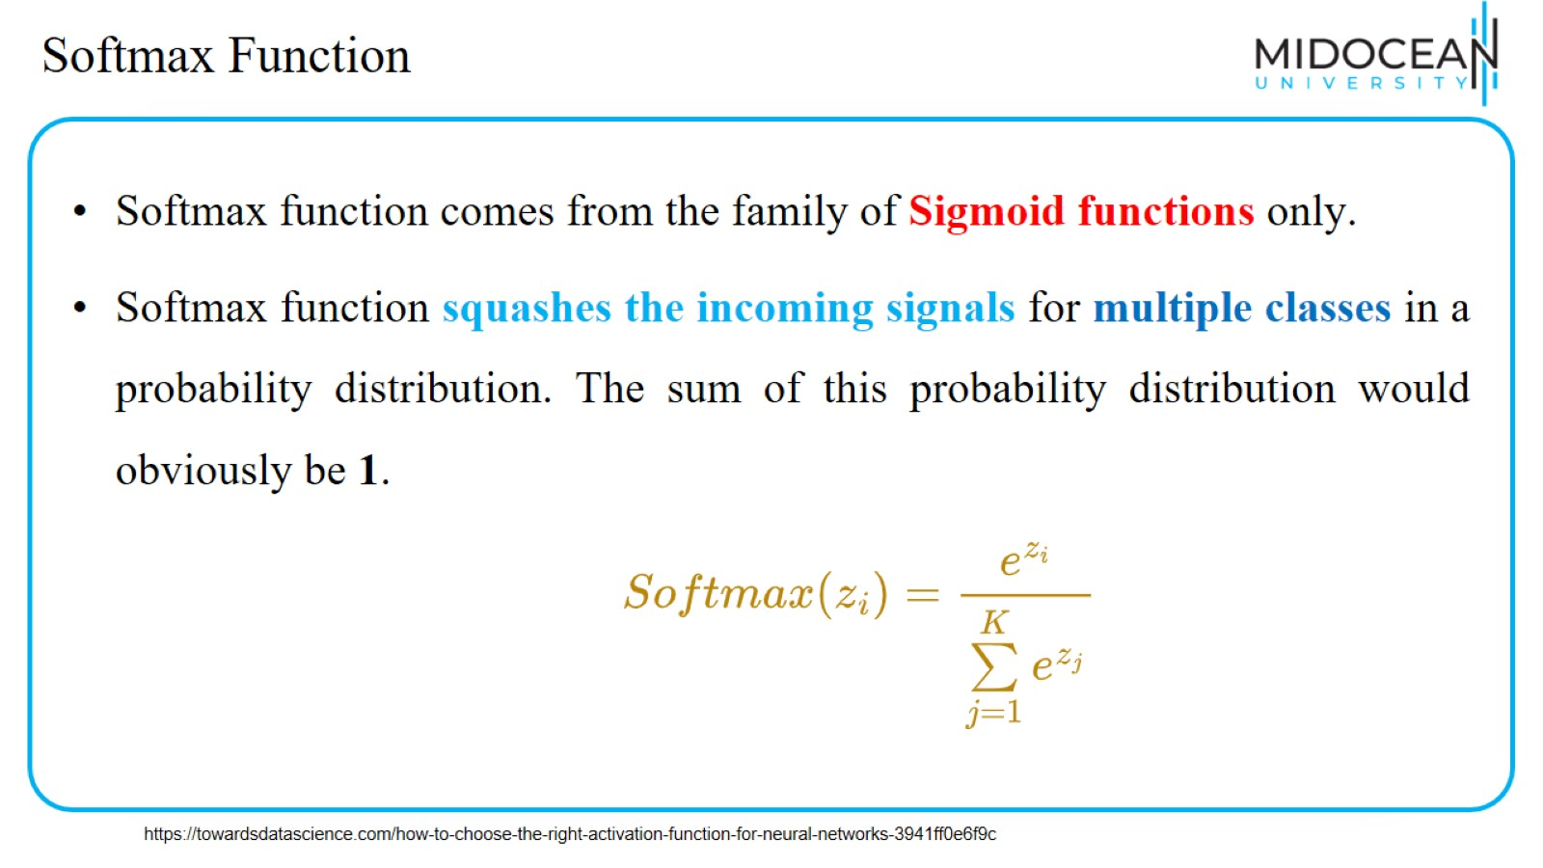
Softmax Function

Slide 51
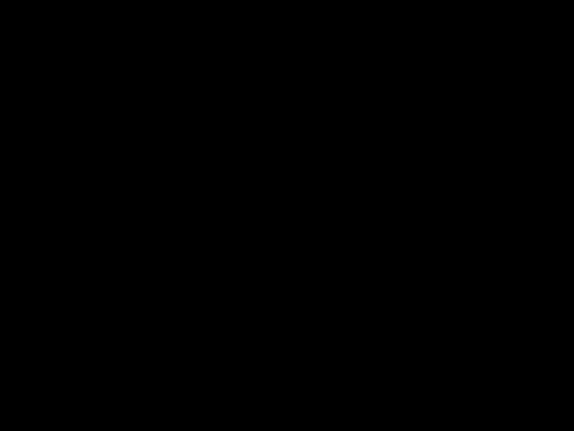
Softmax Function
https://towardsdatascience.com/how-to-choose-the-right-activation-function-for-neural-networks-3941ff0e6f9c

Slide 52
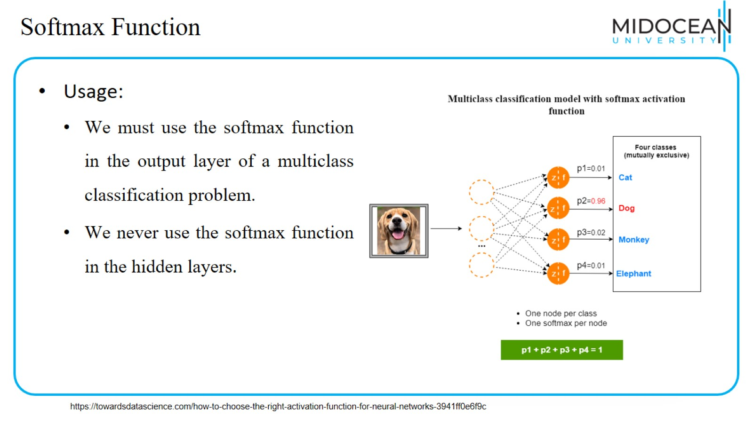
Softmax Function

Slide 53
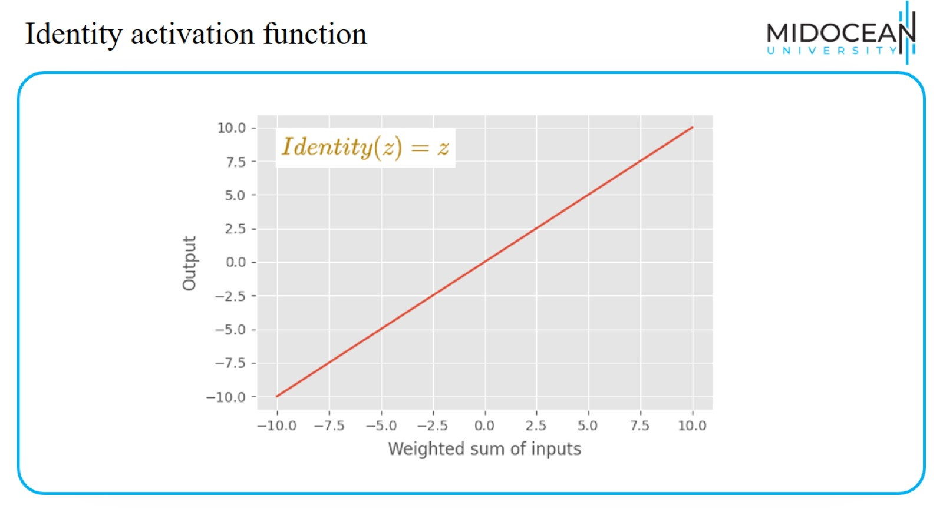
Identity activation function

Slide 54
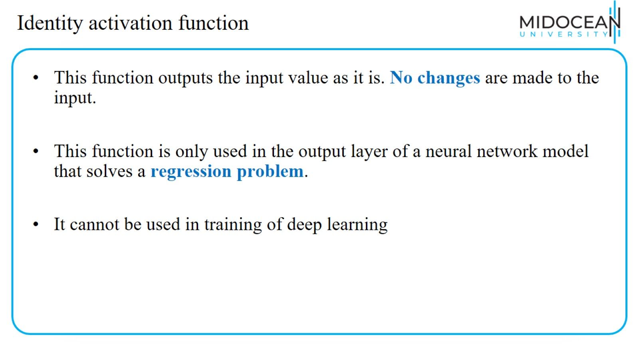
Identity activation function

Slide 55
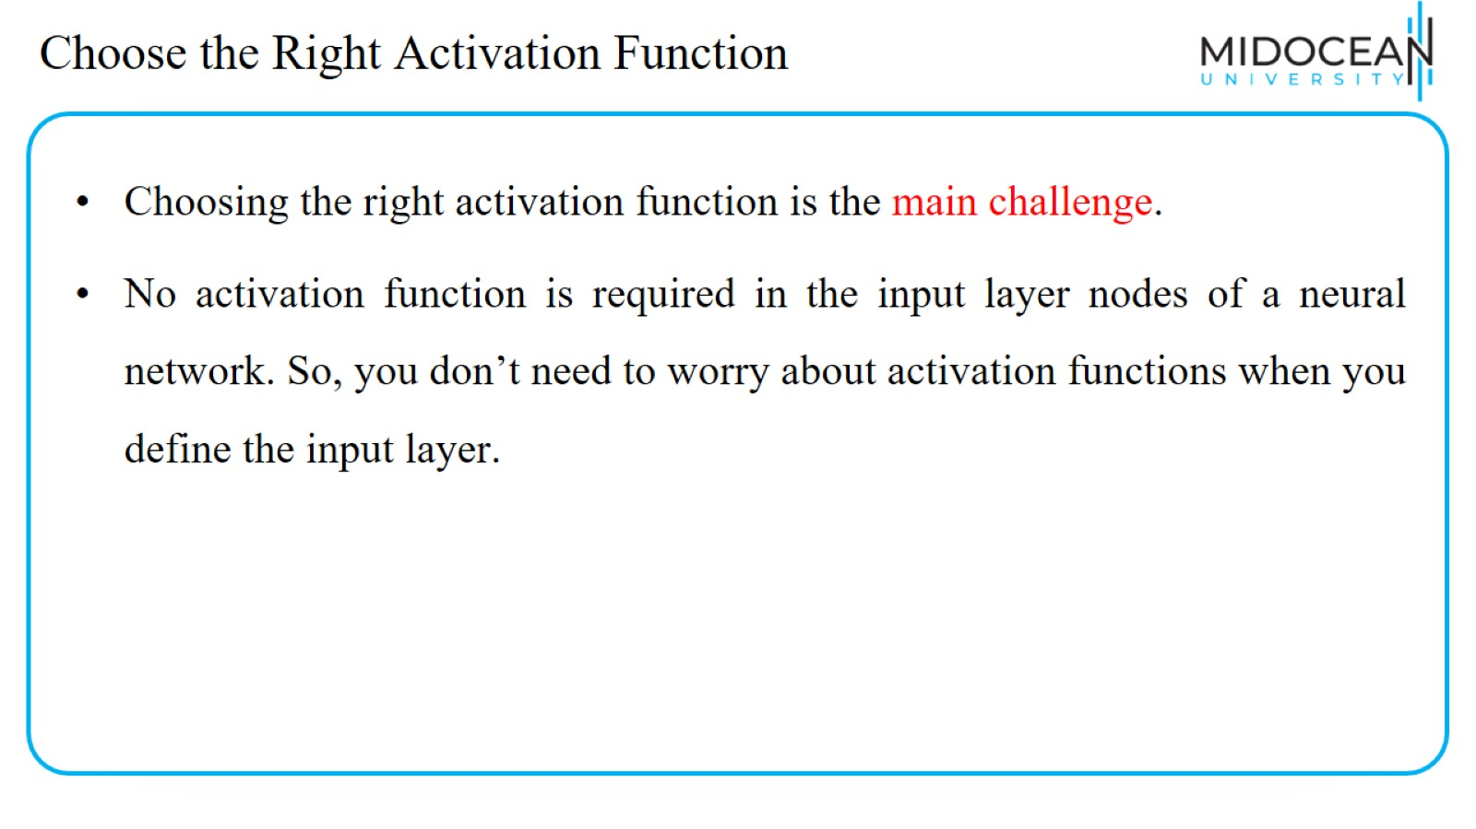
Choose the Right Activation Function

Slide 56
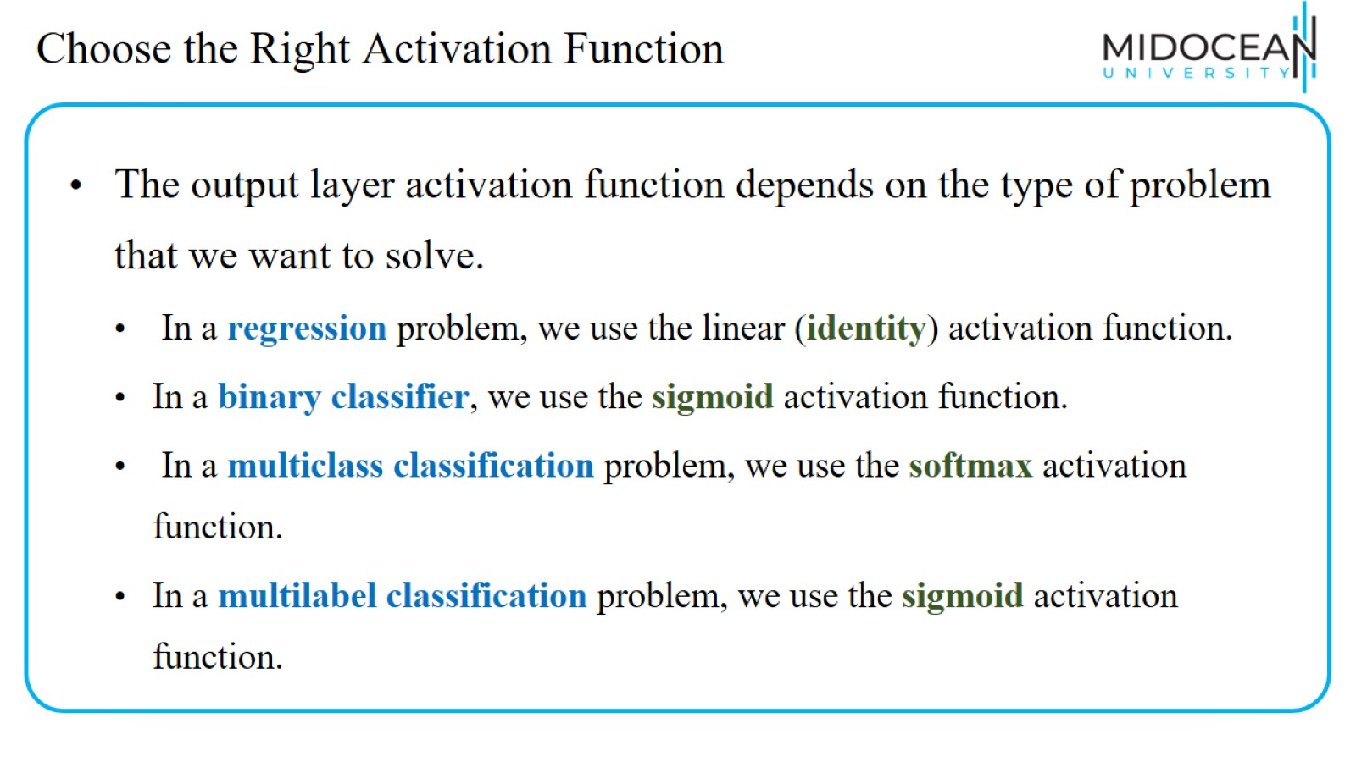
Choose the Right Activation Function

Slide 57
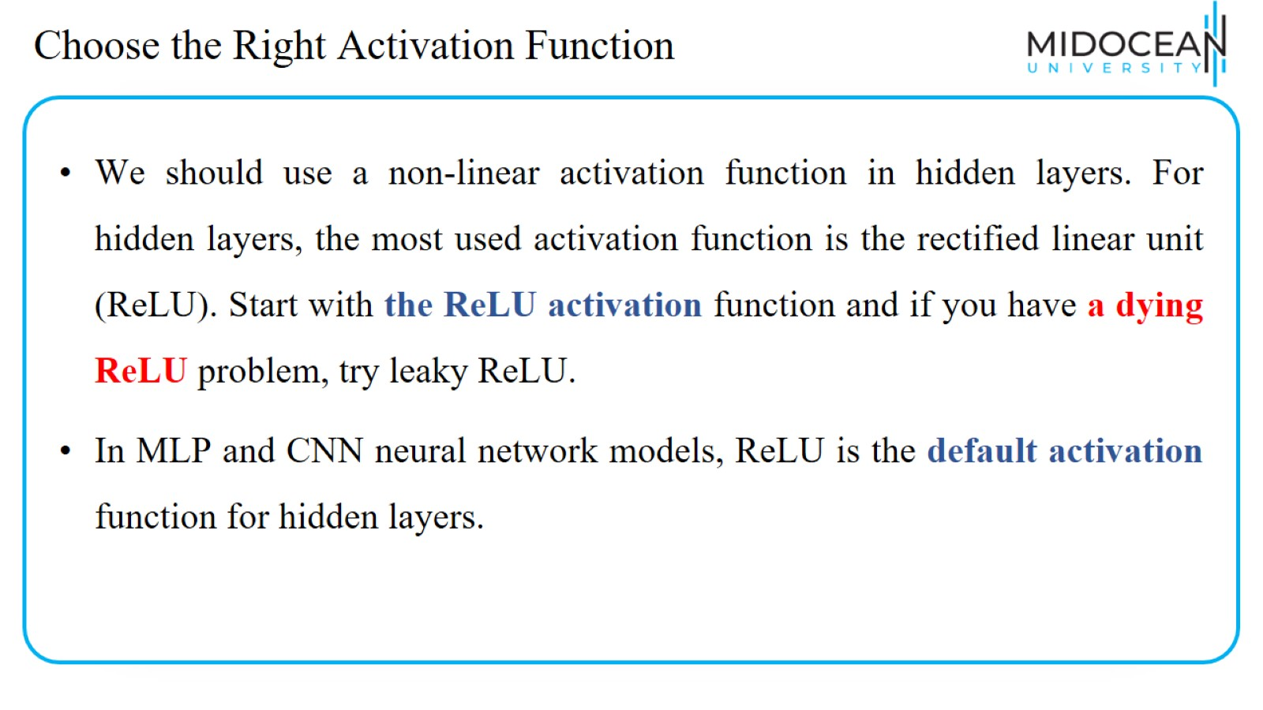
Choose the Right Activation Function

Slide 58

LAB

Slide 59


Slide 60


Slide 61


