Slide 1




Mathematics 3 – MAT132
Dr. Israa Lewaa
Lecture 10 – Mathematical Operations by MATLAB

Slide 2



Lecture Objective
Lecture
05
Chapter Objectives
1- Learn the Importance of MATLAB.
2- Explain more about Elementary Functions.
3- Give a full illustration for Vectors and Matrices.
4- Understand how to conduct Matrix Multiplication.
5- Perform many Practical Examples on MATLAB
Lecture 10 Dr. Israa Lewaa Mathematics 3

Slide 3
Lecture Outline
Lecture
09
Lecture Outline
1- Importance of MATLAB.
2- Elementary Functions.
3- Vectors and Matrices.
4- Matrix Multiplication.
5- Practical Examples on MATLAB
Lecture 10 Dr. Israa Lewaa Mathematics 3

Slide 4
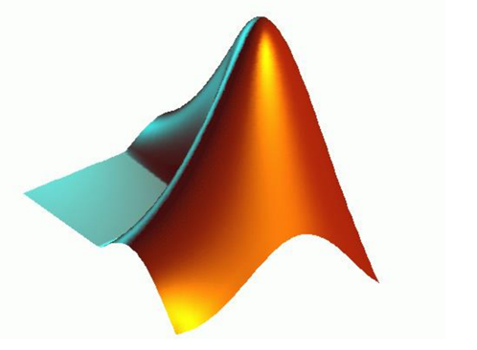
Importance of MATLAB
Lecture
08
Example
Lecture 10 Dr. Israa Lewaa Mathematics 3

Slide 5
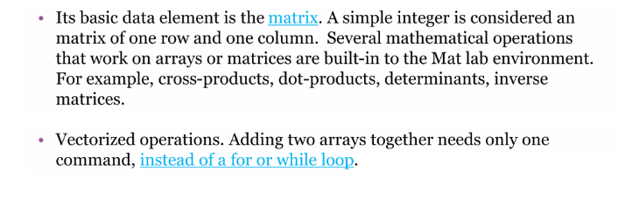
Importance of MATLAB
Lecture
08
Example
Lecture 10 Dr. Israa Lewaa Mathematics 3

Slide 6
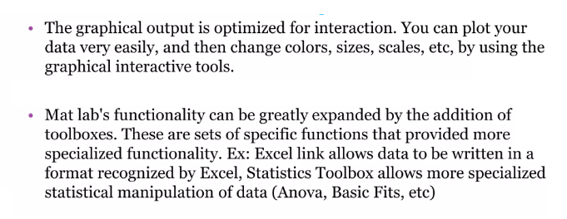
Importance of MATLAB
Lecture
08
Example
Lecture 10 Dr. Israa Lewaa Mathematics 3

Slide 7
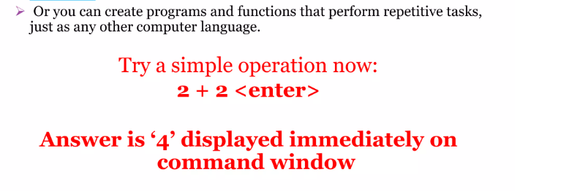
Importance of MATLAB
Lecture
08
Example
Lecture 10 Dr. Israa Lewaa Mathematics 3

Slide 8
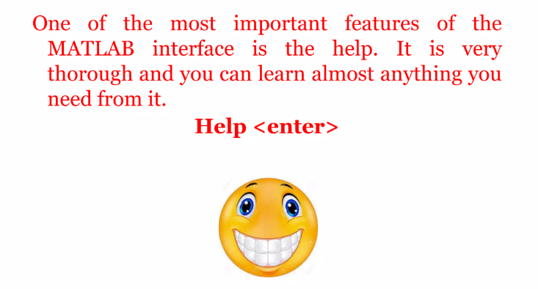
Importance of MATLAB
Lecture
08
Example
Lecture 10 Dr. Israa Lewaa Mathematics 3

Slide 9
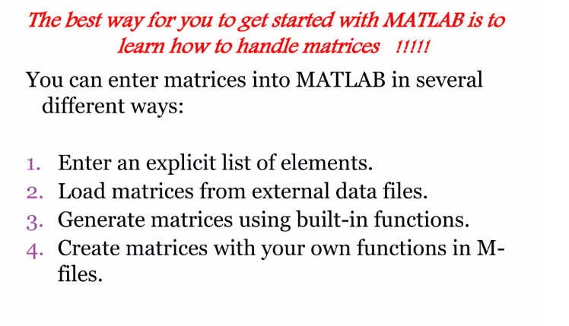
Importance of MATLAB
Lecture
08
Example
Lecture 10 Dr. Israa Lewaa Mathematics 3

Slide 10
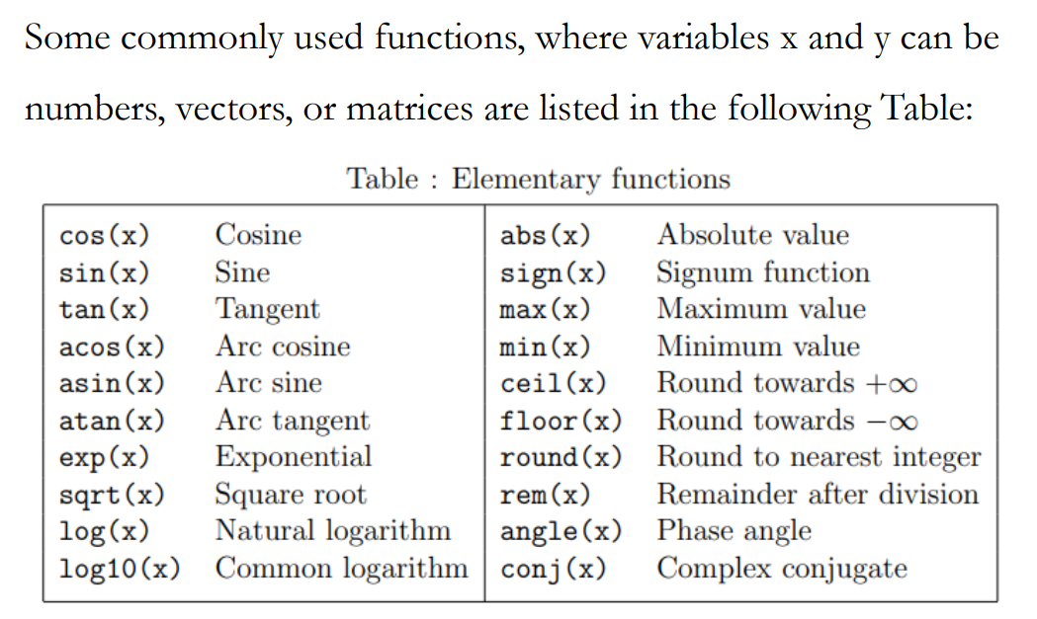
2- Elementary Functions
Lecture
08
1- Integration by parts
Lecture 10 Dr. Israa Lewaa Mathematics 3

Slide 11
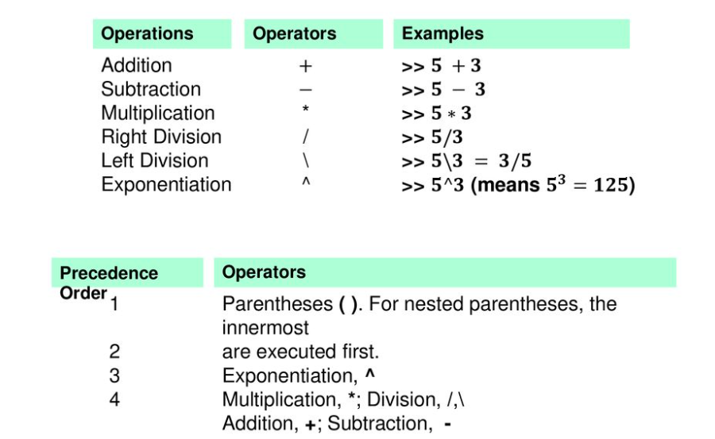
Creating MATLAB variables
Lecture
08
The Definite Integral
Lecture 10 Dr. Israa Lewaa Mathematics 3

Slide 12
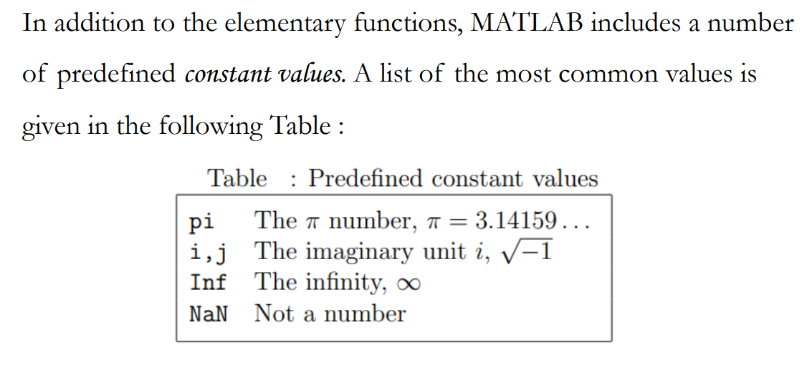
Elementary Functions
Lecture
08
Example
Lecture 10 Dr. Israa Lewaa Mathematics 3

Slide 13
3- Matrices on MATLAB
Lecture
08
Example
Matrices on MATLAB
Lecture 10 Dr. Israa Lewaa Mathematics 3

Slide 14
Matrices and Vectors
Lecture
08
Example
Input matrix
  A = [ 1 2 5; 3 9 0]
Use semicolon ";" to suppress output
Use … for line continuation
Lecture 10 Dr. Israa Lewaa Mathematics 3

Slide 15
Matrices and Vectors
Lecture
08
The Definite Integral
Vector is a special case of matrix
Scalar is considered 1x1 matrix
  g = 9.81 (no [ … ] needed)
X = [ ] creates a null matrix
Lecture 10 Dr. Israa Lewaa Mathematics 3

Slide 16
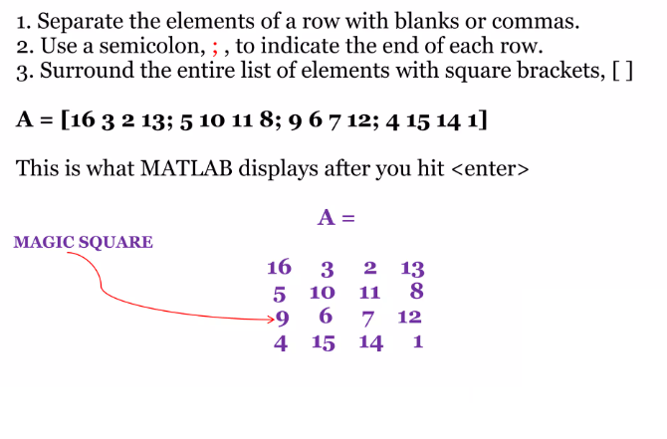
Lecture
08
Matrices and Vectors
Example
Lecture 10 Dr. Israa Lewaa Mathematics 3

Slide 17
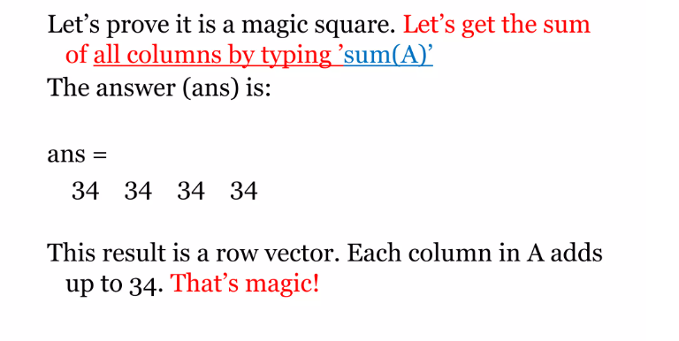
Magic Square
Lecture
08
Example
Lecture 10 Dr. Israa Lewaa Mathematics 3

Slide 18
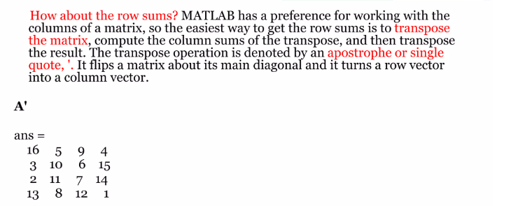
Transpose the matrix
Lecture
08
Example
Lecture 10 Dr. Israa Lewaa Mathematics 3

Slide 19
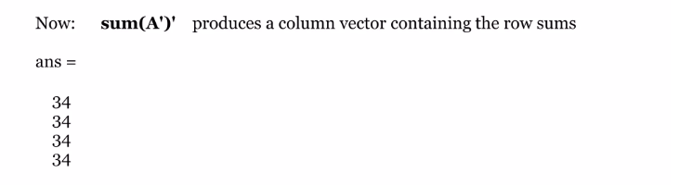
Row Sums
Lecture
08
Example
Lecture 10 Dr. Israa Lewaa Mathematics 3

Slide 20
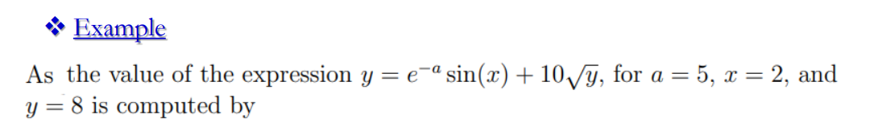
Extra Practice – Example 1
Lecture
08
Example
Lecture 10 Dr. Israa Lewaa Mathematics 3

Slide 21
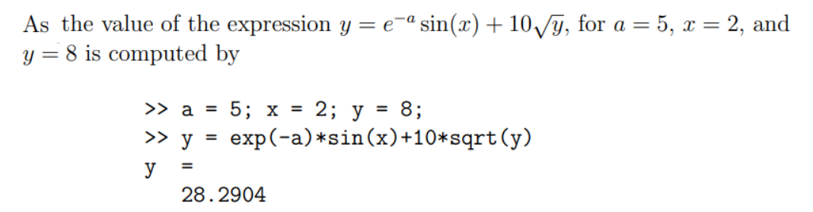
Extra Practice – Example 1 solution
Lecture
08
** Revision – Fundamentals
Lecture 10 Dr. Israa Lewaa Mathematics 3

Slide 22
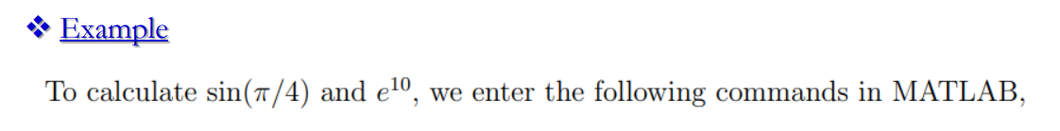
Extra Practice – Example 2
Lecture
08
Example
Lecture 10 Dr. Israa Lewaa Mathematics 3

Slide 23
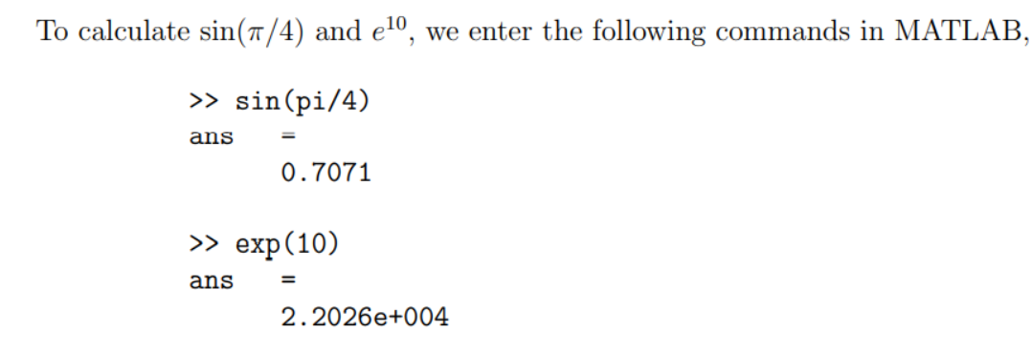
Extra Practice – Example 2 solution
Lecture
08
** Revision – Fundamentals
Lecture 10 Dr. Israa Lewaa Mathematics 3

Slide 24
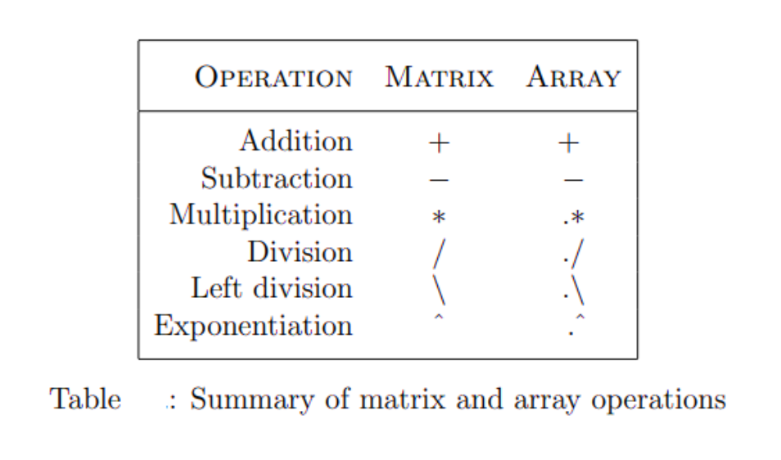
MATLAB Interface
Lecture
07
** EXTRA PRACTISE
Lecture 10 Dr. Israa Lewaa Mathematics 3

Slide 25
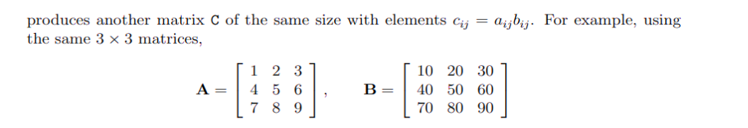
Extra Practice – Example 3
Lecture
08
Example
Lecture 10 Dr. Israa Lewaa Mathematics 3

Slide 26
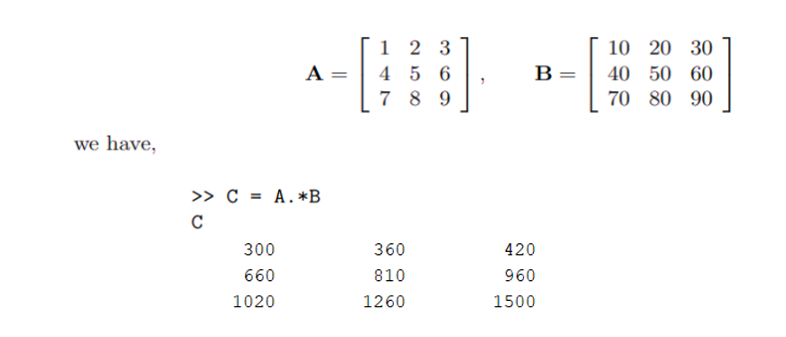
Extra Practice – Example 3 solution
Lecture
08
Example
Lecture 10 Dr. Israa Lewaa Mathematics 3

Slide 27
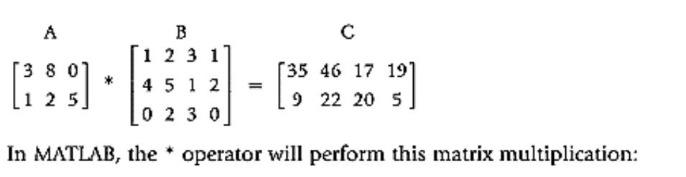
Extra Practice – Example 4
Lecture
08
Example
Lecture 10 Dr. Israa Lewaa Mathematics 3

Slide 28
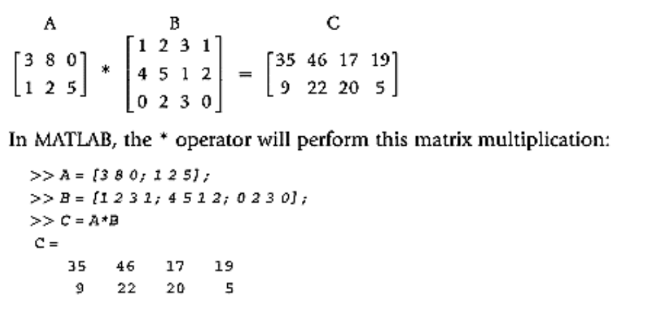
Extra Practice – Example 4 Solution
Lecture
08
Example
Lecture 10 Dr. Israa Lewaa Mathematics 3

Slide 29
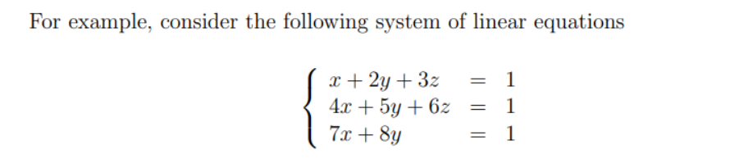
Extra Practice – Example 5
Lecture
07
** EXTRA PRACTISE
Lecture 10 Dr. Israa Lewaa Mathematics 3

Slide 30
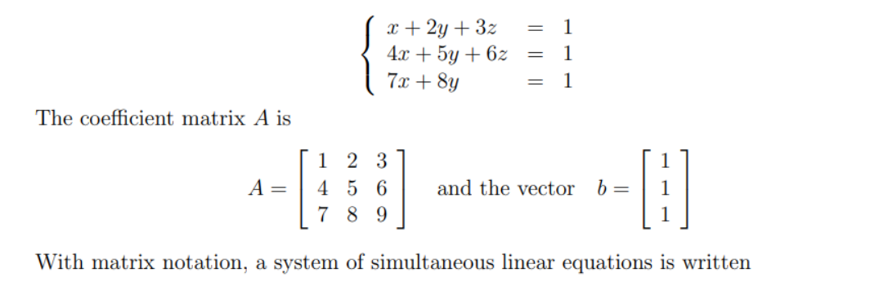
Extra Practice – Example 5 Solution
Lecture
07
** EXTRA PRACTISE
Lecture 10 Dr. Israa Lewaa Mathematics 3

Slide 31
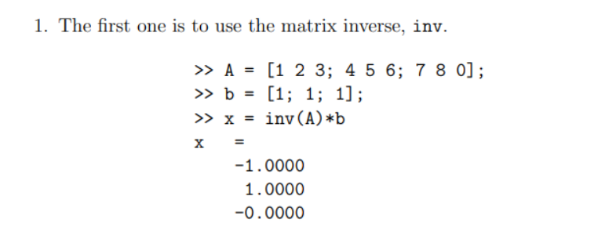
Extra Practice – Example 5 Solution
Lecture
08
Examples for different Methods of Integration
Lecture 10 Dr. Israa Lewaa Mathematics 3

Slide 32
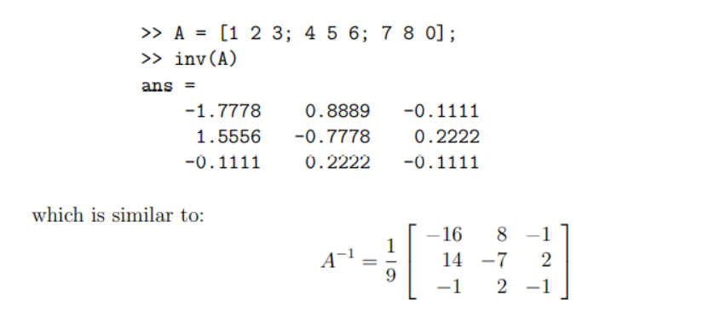
Extra Practice – Example 5 Solution
Lecture
08
Example
Lecture 10 Dr. Israa Lewaa Mathematics 3

Slide 33
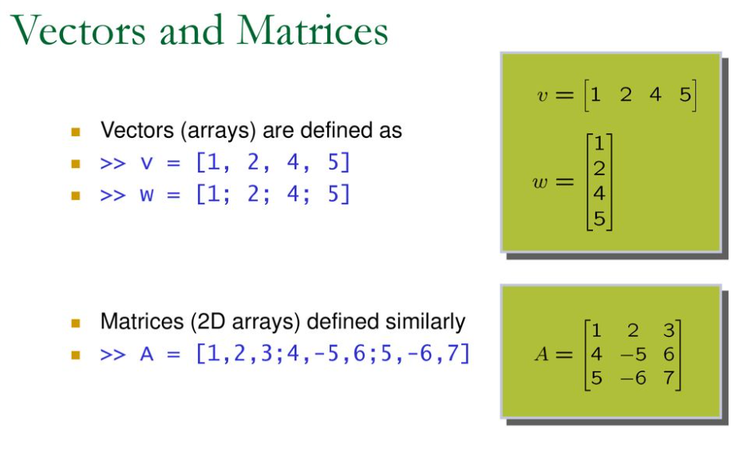
Vectors and Matrices
Lecture
08
Example
Lecture 10 Dr. Israa Lewaa Mathematics 3

Slide 34
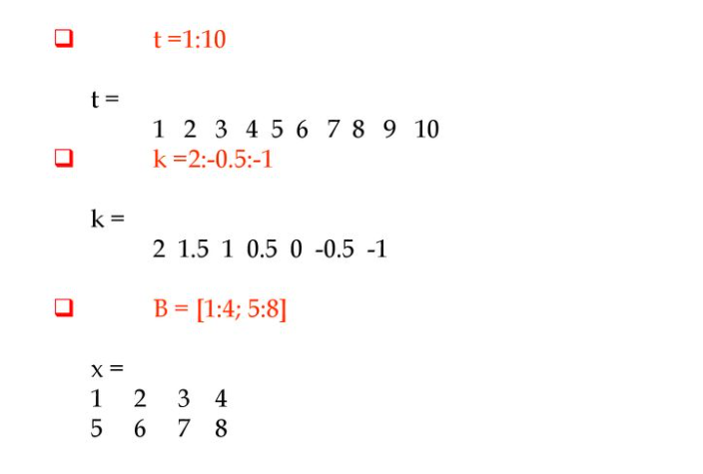
Vectors and Matrices
Lecture
08
The Definite Integral
Lecture 10 Dr. Israa Lewaa Mathematics 3

Slide 35
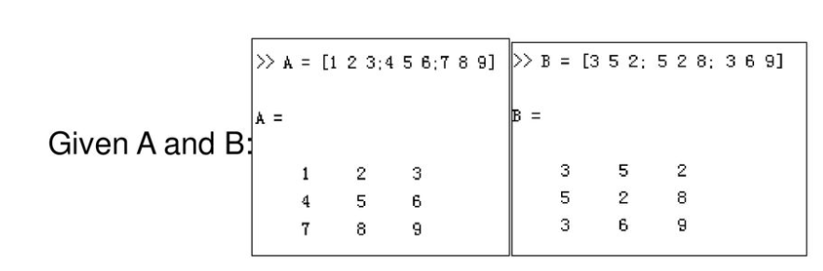
Extra Practice – Example 6
Lecture
08
Example
Lecture 10 Dr. Israa Lewaa Mathematics 3

Slide 36
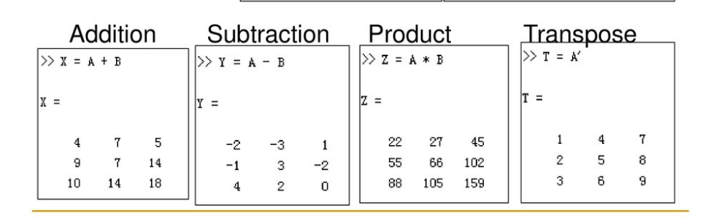
Extra Practice – Example 6 solation
Lecture
08
The Definite Integral
Lecture 10 Dr. Israa Lewaa Mathematics 3

Slide 37
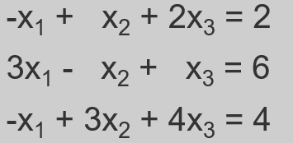
Extra Practice – Example 7
Lecture
08
Example
Lecture 10 Dr. Israa Lewaa Mathematics 3

Slide 38
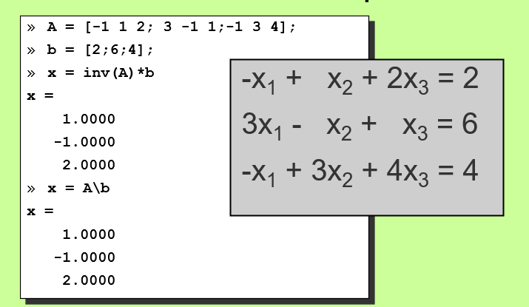
Extra Practice – Example 7 solution
Lecture
08
The Definite Integral
Lecture 10 Dr. Israa Lewaa Mathematics 3

Slide 39
Lecture Summary
Lecture
09
Lecture Summary
1- Importance of MATLAB.
2- Elementary Functions.
3- Vectors and Matrices.
4- Matrix Multiplication.
5- Practical Examples on MATLAB
Lecture 10 Dr. Israa Lewaa Mathematics 3

Slide 40
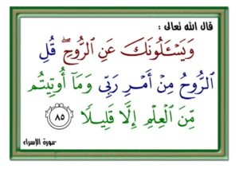
Lecture 10 Dr. Israa Lewaa Mathematics 3

