Slide 1

Global Project Management
Prepared by Dr. Mohamed Hamouda

Slide 2




Global Project Management
Lecture 10
Implémentation Stratégies
Prepared by
Dr. Mohamed Hamouda
www.midocean.ae

Slide 3
Global Project Management
Prepared by Dr. Mohamed Hamouda
Lecture 10
Implémentation Stratégies

Slide 4
PMG 661
RECAPE

Slide 5
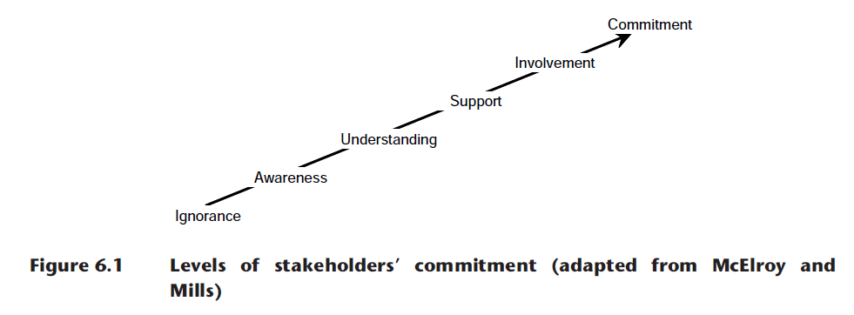
The stakeholder commitment framework

Slide 6

Identifying the stakeholders’ requirements

Slide 7

Distributing information to the global stakeholders

Slide 8
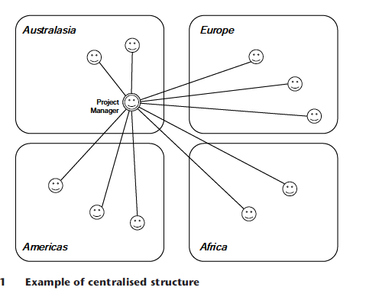
Centralized project management

Slide 9
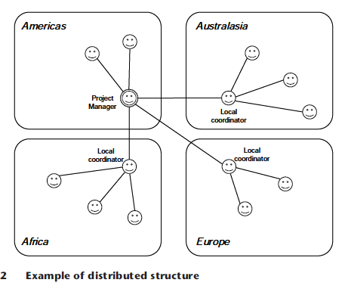
Distributed project management, with local coordinators

Slide 10
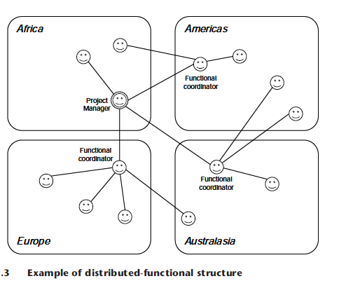
Distributed project management, with functional coordinators

Slide 11
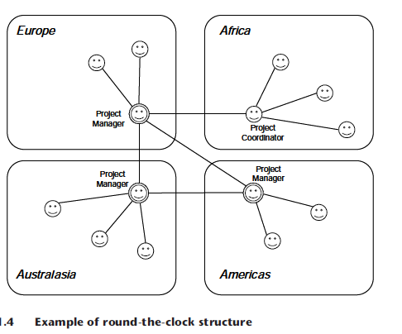
Round-the-clock project management

Slide 12
Global team members’ skills
Culture awareness – the team members that are familiar with the organizational and country cultures involved in the project may also have fewer requirements for training and coaching, and are less likely to generate conflicts. They tend to feel more comfortable than other people when working with a mix of different ethics, standards, policies or working practices.

Slide 13
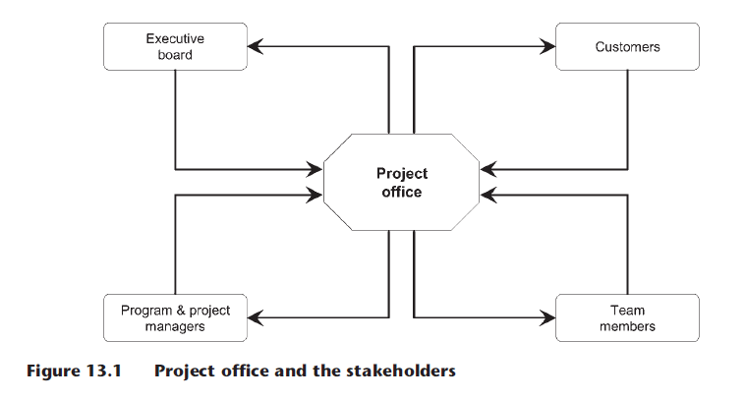
Defining project offices

Slide 14
Global Collaborative Networks
Many organisations form strategic alliances and partnerships to access specific markets, to obtain capital resources or sponsorship, or to share R&D and manufacturing skills. Very often, the relationship is sealed around a group of programs or projects. A seamless exchange of information is essential for these initiatives to be successful.

Slide 15
Collaborative networks: a project-centred approach
Castells (2000) suggests that organisations are evolving from multinational enterprises to international networks, which include large corporations and a series of small and medium business, each in a different country and organizational culture, all with a shared mission to be achieved within a limited timeframe.

Slide 16
Collaborative networks: a project-centred approach
These networks can aggregate the main suppliers, producers and customers with their sub-contractors and service providers, and are strongly reliant on the cooperation among different individuals and on the communication between the computer networks.

Slide 17
Knowledge Sharing
Collaborative environments need to be available on global projects to facilitate the sharing of information about the project and the products. The project manager can create the project management plan with the participation of team members in all locations, and keep all its documents in a shared workspace.

Slide 18
Knowledge Sharing
The team members can organize review cycles for design documents, keeping different versions and a history of the changes. Project-related information, like the global project binder, can be maintained in shared tables or spreadsheets, allowing the owners of tasks, issues and risks to keep their information accurate in real time and accessible to all stakeholders.

Slide 19
Implementation Strategies
When the requirements and needs of your company and main stakeholders have been identified, you need to define a strategy to implement the Global Project Management Framework© at your company. This chapter explains in detail the different alternatives for the framework implementation strategy, following methods and guidelines from other management models and academic theories.

Slide 20
The emotional intelligence guidelines
The Consortium for Research on Emotional Intelligence in Organisations prepared a set of guidelines for the development of social and emotional learning, including management and executive development efforts as well as training in supervisory skills, diversity, teamwork, leadership, conflict management, stress management and stakeholder management.

Slide 21
The emotional intelligence guidelines
These guidelines can allow the implementation of the Global Project Management Framework© together with the principles of emotional intelligence (EI), and are divided into four phases.

Slide 22
PAVING THE WAY
Assess the organization's needs – using the evaluation boxes at the beginning and end of each chapter, determine the global competences requiring improvement at your company. You can assess the existing level of competences by listening to various global project managers in your organization, and comparing the working practices and methods of successful and confident project managers with the behavior and opinions from others who may be seeking answers to their problems.

Slide 23
PAVING THE WAY
Assess the individuals – using the global competences identified in the previous step, and with the help of the global skills , you can organise a team to assess individual competencies on global project management. You can prepare your assessment method using the recommendations for performance appraisals.

Slide 24
PAVING THE WAY
Provide feedback - (in a safe and supportive environment) to individuals on their strengths and weaknesses.
Maximize learner choice – to start the implementation, organize a pilot team, selecting a group of individuals that are motivated to change their methods and learn new practices of global project management.

Slide 25
PAVING THE WAY
Encourage people to participate – organize information sessions on the framework by using your key learning from the different chapters. Obtain support from senior managers and supervisors by showing them the potential benefits of the framework.

Slide 26
PAVING THE WAY
Link learning goals to personal values – using the global skills and the results of individual assessments, help participants to understand whether the framework fits with what matters most to them.

Slide 27
PAVING THE WAY
Adjust expectations – build positive expectations by showing participants that their global communication and people skills can be improved with the help of global collaboration tools and techniques and that such improvement will lead to valued outcomes. Be honest with the possible limitations of the improvements and adoption rates, and with the time it may take to implement the framework across different locations.

Slide 28
PAVING THE WAY
Gauge readiness – assess whether the global project managers are ready to develop the practices in the framework and undergo training. If the readiness level is not appropriate for the implementation, revisit the previous steps or limit the group of participants in the pilot team.

Slide 29
DOING THE WORK OF CHANGE
Foster a positive relationship among the pilot team members – appoint warm, genuine and empathic project coordinators to help you in the change process.

Slide 30
DOING THE WORK OF CHANGE
Make change self-directed – learning is more effective when people direct their own development program, tailoring it to their unique needs, cultures and project types. Let the participants use their creativity to tailor the training approach to their individual learning styles and document their methods, so they can be used by future participants.

Slide 31
DOING THE WORK OF CHANGE
Set clear goals – define a clear set of competencies that can be implemented within the pilot timeframe, and define clear steps to measure the learning progress.

Slide 32
DOING THE WORK OF CHANGE
Break goals into manageable steps – identify the chapters in the framework that can be implemented quickly, to learn how to work together and how to define the good practices. Avoid being overly ambitious and divide the implementation into gradual steps.

Slide 33
DOING THE WORK OF CHANGE
Provide opportunities to practice – encourage participants to try the new practices and techniques repeatedly and consistently in their global projects.

Slide 34
DOING THE WORK OF CHANGE
Give performance feedback – ongoing feedback encourages people to keep their focus on the change process. Request that participants share their project documentation with you, and invite you to their meetings over distance. Provide focused and sustained feedback on their progress.
Rely on experiential methods – encourage the use of development activities that engage all the senses and use new technologies or techniques.

Slide 35
DOING THE WORK OF CHANGE
Build in support – organise regular meetings among the participants, allowing them to share their experiences and provide support to each other. External coaches and mentors specialised in global project management and cross-cultural development can be valuable in helping to support the desired change.

Slide 36
DOING THE WORK OF CHANGE
Use models – publish the framework on the corporate website and mark with colours the different chapters being implemented or already deployed by previous steps (obtain permission from the author before printing and publishing the framework models in any communication media). Encourage the participants to study, analyse and propose changes to the framework, by using the framework web site (www.GlobalProjectManagement. org).

Slide 37
DOING THE WORK OF CHANGE
Enhance insight – ‘self-awareness is the cornerstone of emotional and social competence.’ Help participants to acquire a good understanding of how their use of the practices in the framework and their behaviour affect themselves and others in the global project team.

Slide 38
DOING THE WORK OF CHANGE
Prevent relapse – monitor progress and organize meetings so you can discuss failures and mistakes in order to improve the framework and practices. This will change the drawbacks into opportunities, and not undermine the participants’ motivation.

Slide 39
ENCOURAGING TRANSFER AND MAINTENANCE OF CHANGE
Encourage use of skills on the job – supervisors, other global project managers and global team members must adopt the practices in the framework, participate in the implementation team and be informed of the progress of the framework development and implementation. The senior management must provide a role model during the implementation of the framework.

Slide 40
ENCOURAGING TRANSFER AND MAINTENANCE OF CHANGE
Develop an organizational culture that supports learning – obtain support from different stakeholders to value the practices of a learning organization, building a safe atmosphere for experimentation.

Slide 41
EVALUATING CHANGE
Evaluate – you need to evaluate the benefits of the framework, by evaluating the use of competence or skills against the situation before the framework implementation. You must also assess the success of the framework on satisfying the project needs, by using the same measures that motivated the project initiation.

Slide 42
The maturity model approach
If your company has already implemented, or is considering the implementation of, a maturity model such as the SEI-CMMI®, you can use the same evolutionary strategy to deploy the Global Project Management Framework©. By following the levels shown in Figure 27.1, you will improve the maturity of your organization on global project management and achieve a higher level of effectiveness.

Slide 43
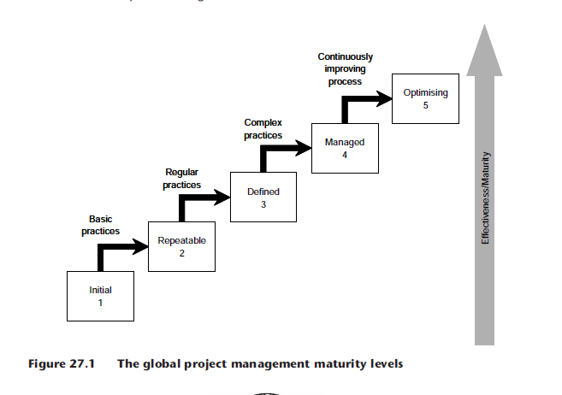

Slide 44
The action research cycles
The framework can be implemented as an internal project, with participation from a small group of six to 12 project managers (as project team members), following the model of emancipatory action research for organizational change. The sponsorship of senior management is mandatory (they can also participate in certain phases), and the participation of other team members in a controlled way can add more ideas to the reflection. Each research cycle would contain the following eight phases (adapted from Zuber-Skerritt, 1996):

Slide 45
The action research cycles
1. Definition of a business plan – to explore the issues in detail, and as the study population is geographically dispersed, in-depth interviews can be conducted by video conference. The project managers’ standpoints need to be identified, in order to build a list of requirements, to understand which of them are already satisfied by the existing methodologies and procedures and to determine what improvements still need to be achieved. In the same interviews, volunteers will be identified, based on individual motivation and commitment levels.

Slide 46
The action research cycles
2. Develop a shared vision – to stimulate creative thinking and to generate data by interaction among the participants, the volunteers are gathered in a nominal group session where the requirements and suggestions (identified in the previous phase) are assembled and compared with the structure of individual practices. The tasks are prioritized and distributed for completion, each project manager becoming responsible for the elaboration of at least one individual practice.

Slide 47
The action research cycles
3. Provide strong leadership – support from the senior managers is obtained to implement the framework and one project manager is selected to supervise the development tasks by the participants (researcher project manager). One sponsor is selected in each geographic location, to obtain the project funding and to ensure the awareness within the company.

Slide 48
The action research cycles
4. Spread shared vision to all departments – the first version of the framework is distributed to all participants that are currently managing global projects, together with the implementation instructions.

Slide 49
The action research cycles
5. Institutionalize revitalization – participants are invited to apply the new practices to their particular global project to observe their strengths and weaknesses.

Slide 50
The action research cycles
6. Get feedback – the researcher project manager collects individual impressions of the implementation phase and suggestions for further improvements. In-depth interviews can be used, according to their applicability, to understand the impact and outcomes of complex processes and issues.

Slide 51
The action research cycles
7. Monitor the whole revitalization process – as the reflection is shaped (refined and reflected) by group interaction, the volunteers will be gathered in a nominal group session, with the aim of achieving a common view of the efficiency level achieved (in comparison to the initial level) and the improvements to be made in the framework, to further increase the efficiency.

Slide 52
The action research cycles
8. Draw conclusions – the findings from the previous phase must be summarized and presented to the sponsors, who will decide on the implementation of the next improvement cycle, and agree on which practices still need to be refined.

Slide 53
The action research cycles
The above cycle of eight phases will be repeated – each step learning from the previous one and shaping the next – until the framework is validated by all participants, senior managers and project sponsors, allowing, ‘firstly, the professional ideal of continuing openness to the development of practice, and secondly the “scientific” ideal of the continuing growth of understanding through critique and revision.’ (Winter, 1989).

