Slide 1

Introduction to economics
Chapter 3
Everyone’s Smart
University
Consumer demand

Slide 2

Consumer demand
Learning Outcomes
Patterns of Consumption
Utility Theory
Marginal Utility
Law of Diminishing Marginal Utility
Price and Quantity
Price Elasticity

Slide 3
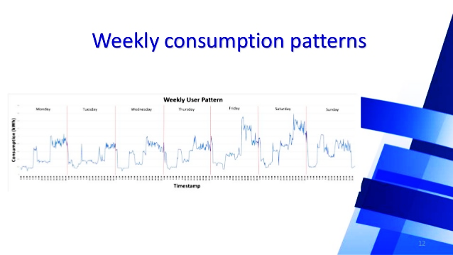
Patterns of Consumption
Consumption represents 2 out of every 3 dollars of GDP.
About 70% of a household’s budget is spent on housing, transportation, food, and health expenditures.
“Essential” items have changed from years ago.
Notes:
Consumers spend their incomes on a variety of goods and services. About 70% of a household’s budget is spent on housing, transportation, food, and health expenditures. “Essential” items have changed from years ago.

Slide 4

Determinants of Demand
What determines what we buy?
  The Sociopsychiatric Explanation
  The Economic Explanation
LO-1
Notes:
What determines what we buy? There are two explanations. The sociopsychiatric explanation says we consume things to satisfy psychological needs. The economic explanation has to do with the willingness and ability to buy certain goods.

Slide 5
Sociopsychiatric Explanation
The desire for goods and services arises from our needs for social acceptance (or envy), security, and ego gratification.
“Keeping up with the Joneses”
Self preservation
Expressions of affluence
LO-1
Notes:
The sociopsychiatric explanation states that the desire for goods and services arises from our needs for social acceptance, security, and ego gratification. We desire goods for the purposes of “keeping up with the Joneses”, self preservation, and to express affluence.

Slide 6

The Economic Explanation
Prices and income are just as relevant to consumption decisions as more basic desires and preferences.
Demand – The ability and willingness to buy specific quantities of a good at alternative prices in a given time period, ceteris paribus.
LO-1
Notes:
The economic explanation states that prices and income are just as relevant to consumption decisions as more basic desires and preferences. As we learned earlier, demand is the ability and willingness to buy specific quantities of a good at alternative prices in a given time period, ceteris paribus.

Slide 7

Determinants of Demand
Tastes - desire for this and other goods
  If a study says ice cream is good for you, the demand for ice cream would increase.
LO-1
Notes:
Market demand is the sum of all individual consumer demands. There are five things that determine the market demand for a specific product: tastes, income, expectations, other goods, and the number of consumers in the market. Tastes refer to the desire for this and other goods. For example, if a study says ice cream is good for you, the demand for ice cream would increase.

Slide 8
Determinants of Demand
Income (of the consumer):
  If you won the lottery you might buy more ice cream.
  The demand for ice cream would increase, shifting the demand curve to the right.
LO-1
Notes:
The second determinant of market demand is the income of the consumer. For example, if you won the lottery you might buy more ice cream. The demand for ice cream would increase, shifting the demand curve to the right.

Slide 9
Determinants of Demand
Expectations (for income, prices, tastes)
  If you knew you were going to get rich soon you might deplete savings to buy more ice cream now.
  This would increase the demand for ice cream.
LO-1
Notes:
The third determinant of market demand is expectations for income, prices, and tastes. For example, if you knew you were going to be very rich soon you might deplete savings to buy more ice cream now. This would increase the demand for ice cream, shifting the curve to the right.

Slide 10
Determinants of Demand
Other goods (their availability and price):
  If the price of chocolate candy bars increased, you might buy ice cream instead of a candy bar.
  This would increase the demand for ice cream.
LO-1
Notes:
The fourth determinant of market demand is the availability and price of other goods. For example, if the price of chocolate candy bars increased, you might buy ice cream instead of a candy bar. This would increase the demand for ice cream, shifting the curve to the right.

Slide 11
Determinants of Demand
The number of consumers in the market:
  If the number of buyers in the ice cream market increased, the market demand for ice cream would increase.
LO-1
Notes:
The last determinant of demand is the number of consumers in the market. For example, if the number of buyers in the ice cream market increased, the market demand for ice cream would increase. This would shift the demand curve to the right.

Slide 12
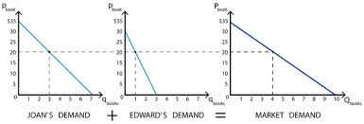
Market Demand
The total quantities of a good or service people are willing and able to buy at alternative prices in a given time period.
Market demand is the sum of all individual demands.
LO-1
Notes:
Market demand is the total quantities of a good or service people are willing and able to buy at alternative prices in a given time period. It is the sum of all individual demands, or the total demand from all consumers of a particular good.

Slide 13
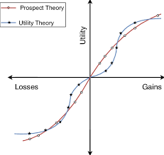
Utility Theory
Economists assume that the more pleasure a product gives, the higher price buyers are willing to pay.
Students who like butter are willing to pay more for buttered popcorn than non-buttered popcorn because it offers more total utility.
LO-1
Notes:
Economists assume that the more pleasure a product gives, the higher price buyers are willing to pay. Students who like butter are willing to pay more for buttered popcorn than non-buttered popcorn because it offer more total utility.

Slide 14
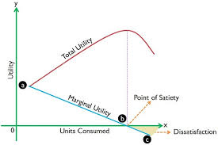
Total Utility
Utility is the pleasure or satisfaction obtained from a good or service.
Total utility is the amount of satisfaction obtained from entire consumption of a product.
LO-1
Notes:
In economics utility means satisfaction. Utility is the pleasure or satisfaction obtained from a good or service. Total utility is the amount of satisfaction obtained from entire consumption of a product. The goal of a consumer is to maximize total utility.

Slide 15
ويوضح جدول رقم (1-3) وحدات المنفعة الكلية المحققة عند استهلاك كميات متتالية من السلعة وذلك خلال مدة معينة ، فعند استهلاك الوحدة الأولى فان المستهلك يحصل على (2) وحدة منفعة وعندما يستهلك (4) وحدات فانه يحصل على (17) وحدة منفعة .
ترتفع المنفعة الكلية إلى 22 وحدة منفعة ((Utile عندما تستهلك 7 وحدات من السلعة ، هما يمثلان أقصى منفعة يحققها المستهلك ، وتبدأ المنفعة الكلية بالانخفاض بعد ذلك رغم زيادة عدد الوحدات المستهلكة من السلعة .
المحدات المستهلكة | 1 | 2 | 3 | 4 | 5 | 6 | 7 | 8 | 9 | 10
لمنفعة الكلبية (وحدة منفعة) | 2 | 6 | 12 | 17 | 21 | 22 | 22 | 20 | 17 | 13

Slide 16
Marginal Utility
Marginal utility is the change in total utility obtained by consuming one additional (marginal) unit of a good or service.
LO-1
Notes:
Marginal utility is the change in total utility obtained by consuming one additional (marginal) unit of a good or service. It is the additional or extra satisfaction received from the next unit. It can be expressed with the formula “change in total utility” divided by “change in quantity”.

Slide 17

4÷ 1=4
جدول (2-3) المنفع الكلية والمنفعة الحدية
الوحدات المستهلكة | المنفعة الكلية (TU) | المنفعة الحدية ((MU
1 | 2 | ــ
2 | 8 | 6
3 | 13 | 5
4 | 17 | 4
5 | 20 | 3
6 | 22 | 2
7 | 22 | 0
8 | 20 | ــ2
9 | 17 | ــ3
10 | 13 | ــ4

Slide 18
م ك
دالة المنفعة الكلية
الكمية المستهلكة من السلعة | المنفعة الكلية | المنفعة الحدية
5
5
1
4
9
2
3
12
3
2
14
4
ك
م ح
1
15
5
دالة المنفعة الحدية
صفر
15
6
-1
14
7
ك
يتبين أنه مع زيادة عدد الوحدات المستهلكة من السلعة تتزايد المنفعة الكلية أما المنفعة الحدية فهي تتناقص مع زيادة عدد الوحدات المستهلكة، وعندما تصل المنفعة الحدية للصفر (عند 6 وحدات)، تصل المنفعة الكلية إلى أعلى مستوى لها وهذا هو حد التشبع. و إذا فرض واستمر المستهلك في زيادة عدد الوحدات المستهلكة من السلعة بعد هذا الحد فإن المنفعة الحدية تصبح سالبة وتتناقص المنفعة الكلية.

Slide 19
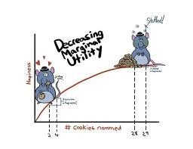
Law of Diminishing Marginal Utility
The marginal utility of a good declines as more of it is consumed in a given time period.
Suppose a student who enjoys popcorn can eat all he/she wants for free.
  The first box consumed is very rewarding.
  The third box is decent, etc.
  After eating the sixth box, she gets sick.
LO-1
Notes:
The marginal utility of a good declines as more of it is consumed in a given time period. Marginal utility eventually falls because the additional units become less satisfying. Let’s say a student who enjoys popcorn can eat all he/she wants for free. The first box consumed is very rewarding, the second box is good, the third box is decent, etc. After eating the sixth box, he/she gets sick.

Slide 20
Law of Diminishing Marginal Utility
As long as the marginal utility is positive, the consumer receives additional satisfaction and total utility increases.
Additional quantities of a good yield increasingly smaller increments of satisfaction.
LO-1
Notes:
As long as the marginal utility is positive, the consumer receives additional satisfaction and total utility increases. Additional quantities of a good yield increasingly smaller increments of satisfaction.

Slide 21
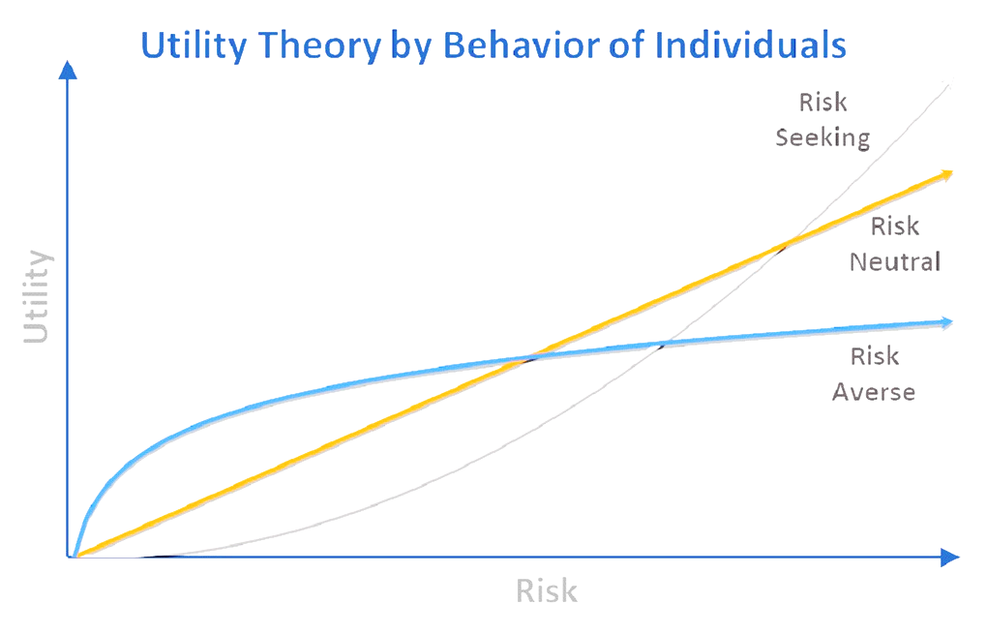
Utility Theory
An absolute measure of utility is not possible because the perception of satisfaction differs among individuals.
Diminishing marginal utility is a common experience.
It is a sufficient basis for economic predictions of consumer behavior.
LO-1
Notes:
An absolute measure of utility is not possible because the perception of satisfaction differs among individuals. Utility is subjective and varies from one person to another. Diminishing marginal utility is a common experience and a sufficient basis for economic predictions of consumer behavior.

Slide 22
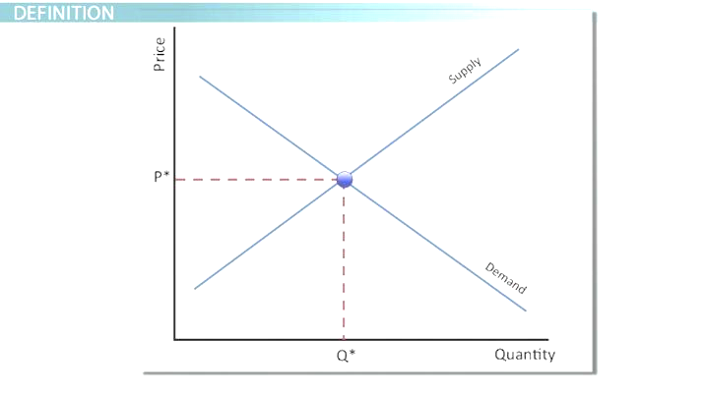
Price and Quantity
Many forces determine how much we are willing to buy.
Economists focus on the relationship between price and quantity rather than trying to explain all the forces at once.
  This is the ceteris paribus (all other things equal) assumption.
السعر الكمية
LO-1
Notes:
Many forces determine how much we are willing to buy. Economists focus on the relationship between price and quantity rather than trying to explain all the forces at once. Again, this is the ceteris paribus (all other things equal) assumption that we use in order to think like economists.

Slide 23
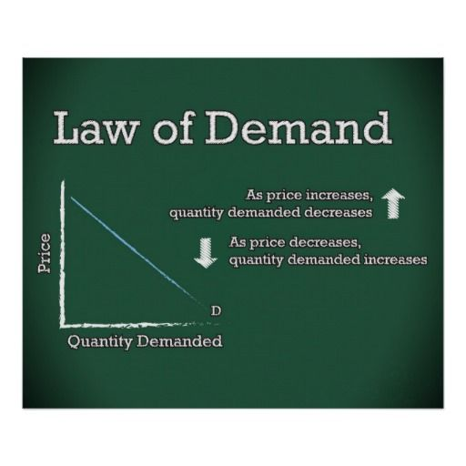
Law of Demand
The concepts of marginal utility and ceteris paribus explain the downward slope of the demand curve.
With given income, tastes, expectations, and prices of other goods and services, people are willing to buy additional quantities of a good only if its price falls.
LO-1
Notes:
The concepts of marginal utility and ceteris paribus explain the downward slope of the demand curve. With given income, tastes, expectations, and prices of other goods and services, people are willing to buy additional quantities of a good only if its price falls. A decrease in the price of a good will lead to an increase in the amount the consumer will is willing to buy.

Slide 24
Law of Demand
The higher the marginal utility, the more you are willing to pay.
Diminishing marginal utility explains why price must decrease in order for you to continue to buy a good or service.
LO-1
Notes:
The higher the marginal utility, the more you are willing to pay. Diminishing marginal utility explains why price must decrease in order for you to continue to buy a good or service.

Slide 25
Law of Demand
According to the law of demand, the quantity of a good demanded in a given time period increases as its price falls, ceteris paribus.
LO-1
Notes:
According to the law of demand, the quantity of a good demanded in a given time period increases as its price falls, ceteris paribus. There is an inverse relationship between the price and quantity demanded of a good.

Slide 26
Demand Curve
The quantities of a good a consumer is willing and able to buy at alternative prices in a given time period, ceteris paribus.
LO-1
Notes:
أن منحنى الطلب سالب الميل أي ينحدر من أعلى إلى أسفل ومن اليسار إلى اليمين، ويعكس ميل المنحنى السالب قانون الطلب، أي العلاقة العكسية بين سعر السلعة والكمية المطلوبة منها مع بقاء العوامل الأخرى ثابتة.

Slide 27
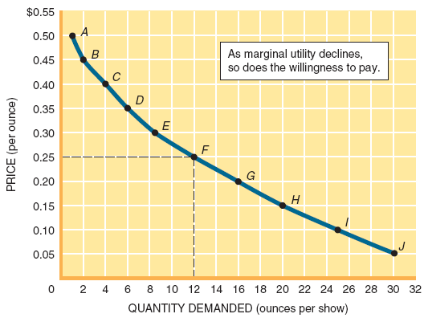
Figure 3.2
Notes:
أن منحنى الطلب سالب الميل أي ينحدر من أعلى إلى أسفل ومن اليسار إلى اليمين، ويعكس ميل المنحنى السالب قانون الطلب، أي العلاقة العكسية بين سعر السلعة والكمية المطلوبة منها مع بقاء العوامل الأخرى ثابتة.

Slide 28
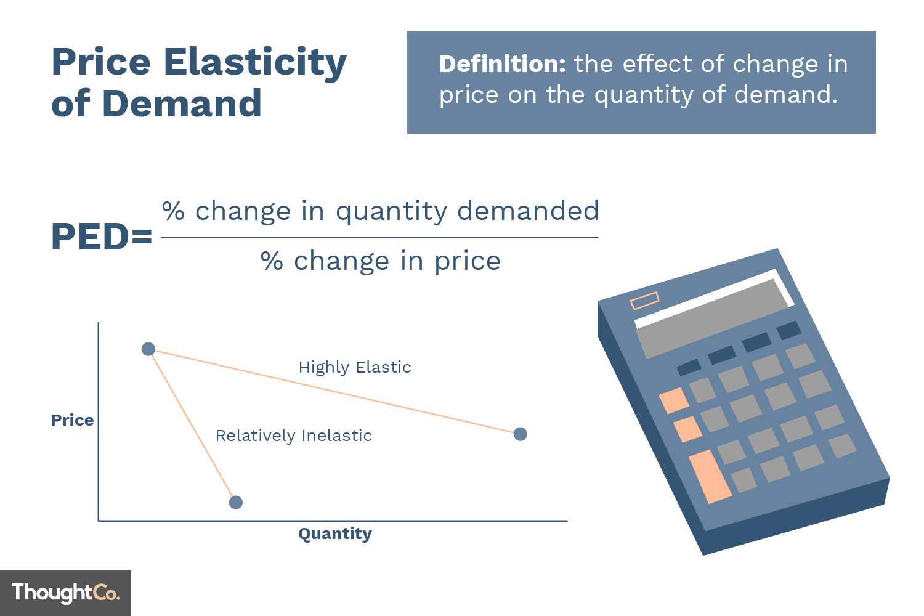
Price Elasticity
The response of consumers to a change in price is measured by the price elasticity of demand.
LO-2
Notes:
Elasticity refers to sensitivity to change or responsiveness. The response of consumers to a change in price is measured by the price elasticity of demand.

Slide 29
Price Elasticity
The price elasticity of demand is the percentage change in quantity demanded divided by the percentage change in price.
LO-2
Notes:
The price elasticity of demand is the percentage change in quantity demanded divided by the percentage change in price. It measures the responsiveness of quantity demanded of a good to a change in its price.

Slide 30
Price Elasticity
The price of popcorn goes up 20% and the quantity demanded goes down 10%.
The price elasticity of demand is:
percentage change in
quantity demanded
–10%
(E)
=
=
=
– 0.5
percentage change
20%
in price
LO-2
Notes:
If the price of popcorn goes up 20% and the quantity demanded goes down 10%, the price elasticity of demand is -0.5. Price elasticity of demand is a negative number; for simplicity, however, the neagtive sign is dropped.

Slide 31
عند انخفاض سعر سلعة معينة بمقدار10% مما أدى الى زيادة الكمية المطلوبة من تلك السلعة بمقدار 5%المطلوب احسب مقدار التغير في المرونة السعرية
+ 5
= ــــــــــــــــــــــــــــــــــــــــــــــــــــــــــــــــــــــــــــــــــــــــــــــــــ = - 5
-10
نسبة التغير في الكمية المطلوبة
مرونة لطلب السعرية = ــــــــــــــــــــــــــــــــــــــــــــــــــــــــــــــــــــــــــــــــــــــــــــــــــ =
نسبة التغير في الثمن
السالب تدل على العلاقة العكسية لا توجد قيمة
رياضية

Slide 32
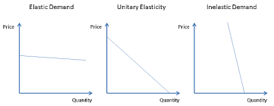
Elastic versus Inelastic Demand
Demand can be elastic, inelastic, or unitary elastic.
Notes:
Demand can be elastic, inelastic, or unitary elastic. An explanation of each follows.

Slide 33
Elastic Demand
Consumer response is large relative to the change in price.
+ 5
= ــــــــــــــــــــــــــــــــــــــــــــــــــــــــــــــــــــــــــــــــــــــــــــــــــ = - 5
-10
نسبة التغير في الكمية المطلوبة
مرونة لطلب السعرية = ــــــــــــــــــــــــــــــــــــــــــــــــــــــــــــــــــــــــــــــــــــــــــــــــــ =
نسبة التغير في الثمن
طلب مرن
LO-2
Notes:
Elastic means sensitive to a change in price. Demand is elastic if the absolute value of E is greater than 1. Consumer response is large relative to the change in price.

Slide 34
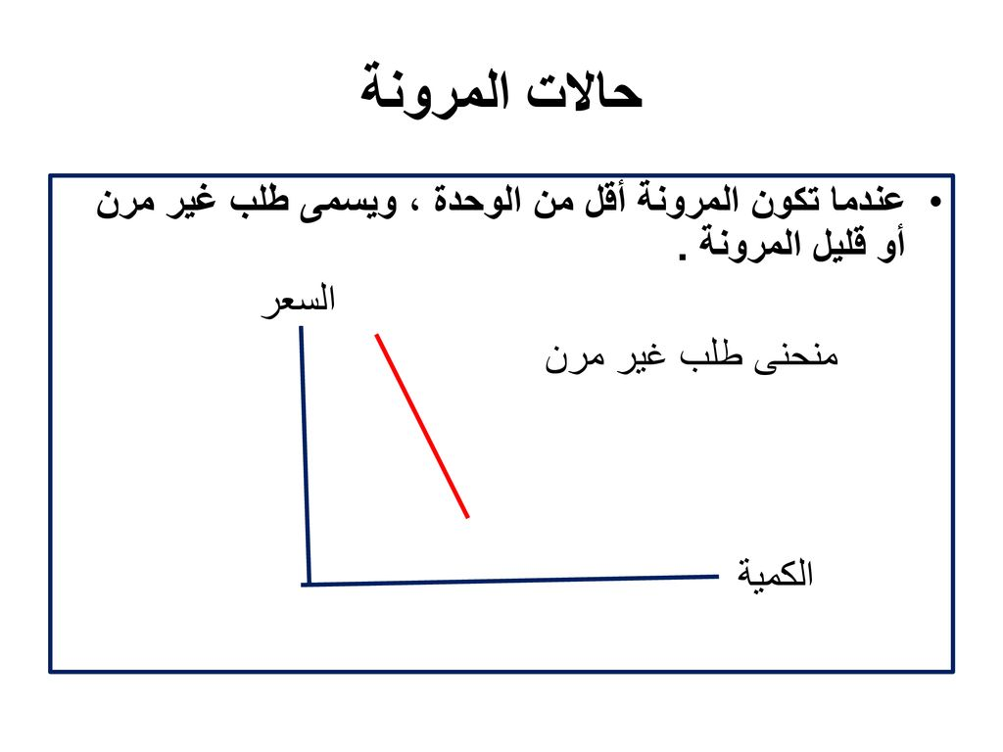
Inelastic Demand
Demand is inelastic if the absolute value of E is less than 1.
Consumers are not very responsive to price changes.
التغير النسبي في الكمية المطلوبة اقل من التغير النسبي في السعر
25% 20%
طلب غبر مرن
سلع ضرورية
LO-2
Notes:
Inelastic means insensitive to a change in price. Demand is inelastic if the absolute value of E is less than 1. Consumers are not very responsive to price changes.

Slide 35
Unitary Elastic Demand
Demand is unitary elastic if the absolute value of E equals 1.
The percentage change in quantity demanded is equal to the percentage change in price.
LO-2
Notes:
Demand is unitary elastic if the absolute value of E equals 1. The percentage change in quantity demanded is equal to the percentage change in price.

Slide 36
Price Elasticity & Total Revenue
Price elasticity explains why producers cannot charge the highest possible price.
Although one would think otherwise, higher prices may actually reduce total sales revenue.
LO-3
Notes:
Price elasticity explains why producers cannot charge the highest possible price. One may think otherwise, but higher prices may actually reduce total sales revenue. This is true if the demand is elastic.

Slide 37
Price Elasticity & Total Revenue
Total revenue - the price of a product multiplied by the quantity sold in a given time period.
Total revenue = price x quantity sold
LO-3
Notes:
Total revenue is the price of a product multiplied by the quantity sold in a given time period.

Slide 38
Elasticity and Total Revenue
A price cut increases total revenue if demand is price elastic.
A price cut decreases total revenue if demand is price inelastic.
A price cut does not change total revenue if demand is unitary elastic.
LO-3
Notes:
A price cut decreases total revenue if demand is price inelastic. A price cut increases total revenue if demand is price elastic. A price cut does not change total revenue if demand is unitary elastic.

Slide 39
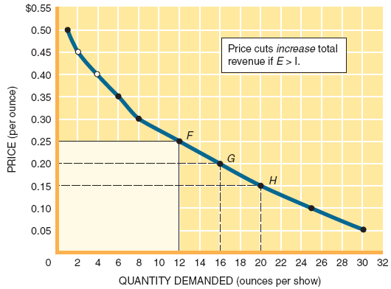
Figure3.5

Slide 40
Determinants of Price Elasticity
Differences in price elasticity are explained by several factors:
  Whether the Good is a Necessity or Luxury
  The Availability of Substitutes
  The Price Relative to Income
LO-4
Notes:
Differences in price elasticity are explained by several factors. There are three determinants of price elasticity: whether the good is a necessity or luxury, the availability of substitutes, and the price relative to income.

Slide 41
Necessities versus Luxuries
Some goods are so critical to our everyday life that we regard them as necessities.
Demand for necessities is relatively inelastic.
LO-4
Notes:
Some goods are so critical to our everyday life that we regard them as necessities. Demand for necessities is relatively inelastic. Toothpaste and gasoline are examples of necessities.

Slide 42
Necessities versus Luxuries
A luxury good is something we’d like to have but aren’t likely to buy unless our income jumps or the price declines sharply.
Demand for luxury goods is relatively elastic.
LO-4
Notes:
A luxury good is something we’d like to have but aren’t likely to buy unless our income jumps or the price declines sharply. Demand for luxury goods is relatively elastic. Vacation travel and HDTV are examples of luxury goods.

Slide 43
Availability of Substitutes
The greater the availability of substitutes, the higher the price elasticity of demand.
The smaller the availability of substitutes, the lower the price elasticity of demand.
LO-4
Notes:
The greater the availability of substitutes, the higher the price elasticity of demand. The smaller the availability of substitutes, the lower the price elasticity of demand. For example, the demand for Toyotas is more elastic than the demand for cars in general, because there are more substitutes for Toyotas than for cars in general.

Slide 44
Price Relative to Income
If the price of a product is very high relative to the consumer’s income, the demand will tend to be elastic.
If the price of a product is very low relative to the consumer’s income, the demand will tend to be inelastic.
LO-4
Notes:
If the price of a product is very high relative to the consumer’s income, the demand will tend to be elastic. If the price of a product is very low relative to the consumer’s income, the demand will tend to be inelastic. For example, the demand for a house (an expensive good) will tend to be elastic while the demand for a candy bar (an inexpensive good) will tend to be inelastic.

Slide 45
Substitute & Complementary Goods
Substitute Goods:
  The demand for a good increases when the price of a substitute for the good goes up.
Complementary Goods:
  The demand for a good decreases when the price of a complement to the good goes up.
LO-4
Notes:
Substitute goods represent an “either/or” choice, where one good is purchased or the other. The demand for a good increases when the price of a substitute for the good goes up. Complementary goods “go together”, where both goods are purchased at the same time. The demand for a good decreases when the price of a complement to the good goes up.

Slide 46
Changes in Income
Income is a determinant of demand.
We illustrate income changes with shifts of the demand curve.
LO-4
Notes:
Income is a determinant of demand. We illustrate income changes with shifts of the demand curve. For example, an increase in income would shift the demand curve to the right.

Slide 47
Are Wants Created?
Advertising is not the only reason consumption has increased.
Personality and social interaction dynamics have changed how much we consume.
A successful advertising campaign is one that shifts the demand curve to the right.
LO-5
Notes:
Advertising is not the only reason consumption has increased. Personality and social interaction dynamics have changed how much we consume. A successful advertising campaign is one that shifts the demand curve to the right.

Slide 48

End of chapter 3

