Slide 1



Deep Learning & Neural Networks
Dr. Shahira Ahmed
DS710
Lecture 6

Slide 2


Slide 3

Lecture Outline
Main Types of Neural Network
Neural Network Topology
Main type of Layers of Deep Neural Network
Lab: Live Demo Your First Neural Network
www.midocean.ae

Slide 4
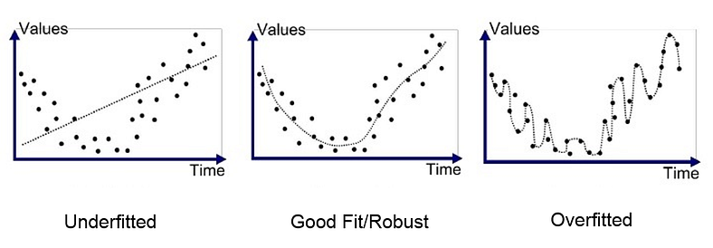
Overfitting versus underfitting
https://medium.com/swlh/machine-learning-how-to-prevent-overfitting-fdf759cc00a9

Slide 5
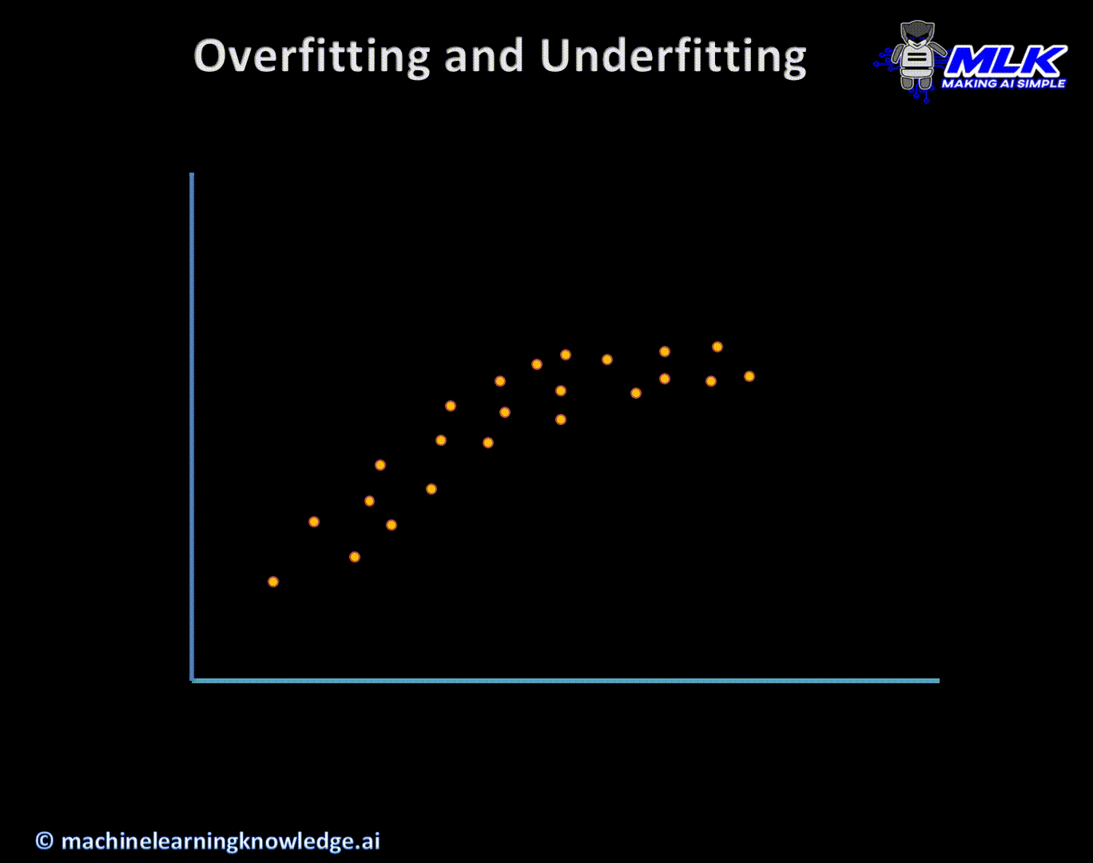
Overfitting versus underfitting
https://machinelearningknowledge.ai/overfitting-and-underfitting-in-machine-learning-animated-guide-for-beginners/

Slide 6
Overfitting
Overfitting is an undesirable machine learning behavior that occurs when the machine learning model gives accurate predictions for training data but not for new data.
An overfit model can give inaccurate predictions and cannot perform well for all types of new data.
amazon

Slide 7
How can you prevent overfitting?
Early stopping pauses the training phase before the machine learning model learns the noise in the data. However, getting the timing right is important; else the model will still not give accurate results.
Pruning: You might identify several features or parameters that impact the final prediction when you build a model. Feature selection—or pruning—identifies the most important features within the training set and eliminates irrelevant ones. For example, to predict if an image is an animal or human, you can look at various input parameters like face shape, ear position, body structure, etc. You may prioritize face shape and ignore the shape of the eyes.
amazon

Slide 8
How can you prevent overfitting?
Regularization
  a collection of training/optimization techniques that seek to reduce overfitting
  These methods try to eliminate those factors that do not impact the prediction outcomes by grading features based on importance.
  For example, mathematical calculations apply a penalty value to features with minimal impact. Consider a statistical model attempting to predict the housing prices of a city in 20 years. Regularization would give a lower penalty value to features like population growth and average annual income but a higher penalty value to the average annual temperature of the city.
amazon

Slide 9
How can you prevent overfitting?
Ensembling
  Ensembling combines predictions from several separate machine learning algorithms. Some models are called weak learners because their results are often inaccurate.
  Ensemble methods combine all the weak learners to get more accurate results.
  Bagging and boosting are examples of ensemble models
amazon

Slide 10
How can you prevent overfitting?
Data augmentation
  a machine learning technique that changes the sample data slightly every time the model processes it.
  You can do this by changing the input data in small ways. When done in moderation, data augmentation makes the training sets appear unique to the model and prevents the model from learning their characteristics.
  For example, applying transformations such as translation, flipping, and rotation to input images.
amazon

Slide 11
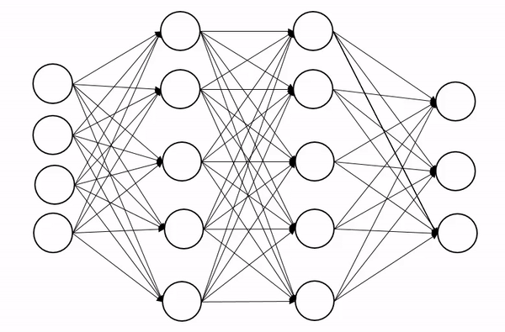
How can you prevent overfitting?
Dropout is a regularization technique used in neural networks to prevent overfitting. Overfitting occurs when a neural network becomes too specialized to the training data and performs poorly on unseen data. Dropout helps address this issue by randomly setting a fraction of the input units (neurons) to 0 at each update during training.
https://www.analyticsvidhya.com/blog/2022/08/dropout-regularization-in-deep-learning/

Slide 12
How can you prevent overfitting?
Dropout is a powerful technique for reducing overfitting and improving the generalization performance of neural networks.
However, it's important to find an appropriate dropout rate, as using too high a dropout rate may result in underfitting, while using too low a dropout rate may not provide sufficient regularization.
The optimal dropout rate may vary depending on the specific problem and dataset, so it's often necessary to experiment and tune the dropout rate to achieve the best results.

Slide 13
What is underfitting?
Underfitting is another type of error that occurs when the model cannot determine a meaningful relationship between the input and output data.
You get underfit models if they have not trained for the appropriate length of time on a large number of data points.

Slide 14
Neural Network Topologies
Topology of a neural network refers to the way the Neurons are connected, and it is an important factor in network functioning and learning.

Slide 15
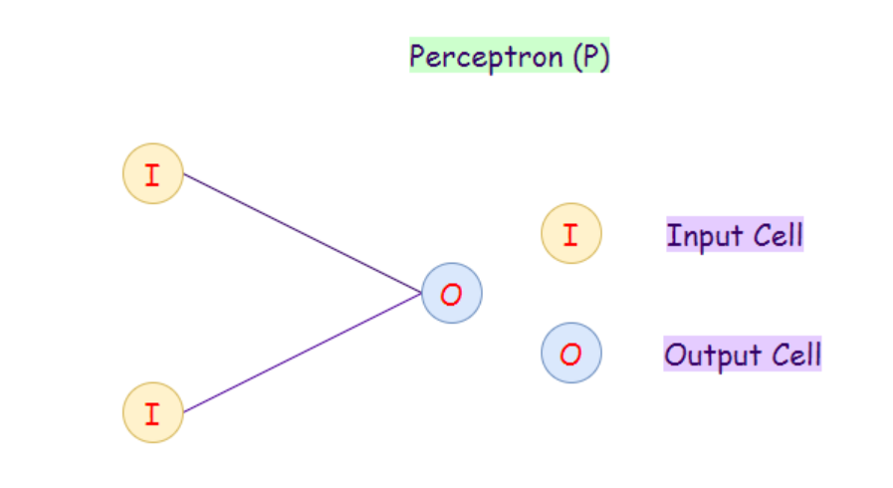
Neural Network Topologies
Perceptron
The perceptron model is also known as a single-layer neural network. This neural net contains only two layers:
  Input Layer
  Output Layer
  Applications:
  Classification
https://towardsai.net/p/machine-learning/main-types-of-neural-networks-and-its-applications-tutorial-734480d7ec8e

Slide 16
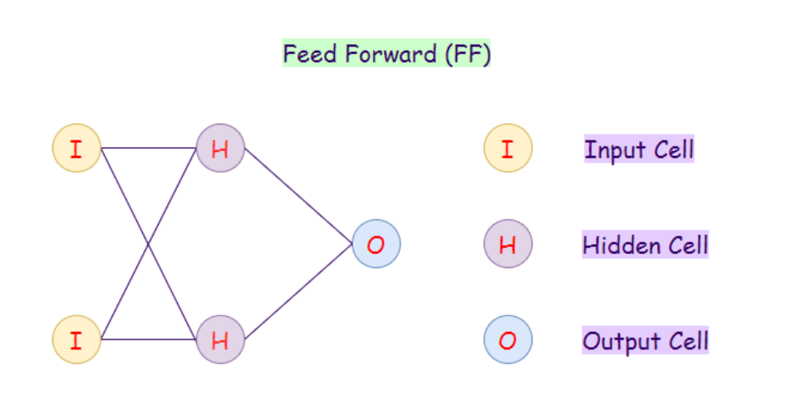
Neural Network Topologies
Feed-forward Neural Network
There are no back-loops in the feed-forward network. Hence, to minimize the error in prediction, we generally use the backpropagation algorithm to update the weight values.
https://towardsai.net/p/machine-learning/main-types-of-neural-networks-and-its-applications-tutorial-734480d7ec8e

Slide 17

Neural Network Topologies
Feed-forward Neural Network
A feed-forward neural network is an artificial neural network in which the nodes do not ever form a cycle.
In this neural network, all of the perceptrons are arranged in layers where the input layer takes in input, and the output layer generates output.
The hidden layers have no connection with the outer world; that’s why they are called hidden layers.
In a feed-forward neural network, every perceptron in one layer is connected with each node in the next layer. Therefore, all the nodes are fully connected. There is no connection between the nodes in the same layer.
Need as many neurons as coefficients of my feature vector.

Slide 18
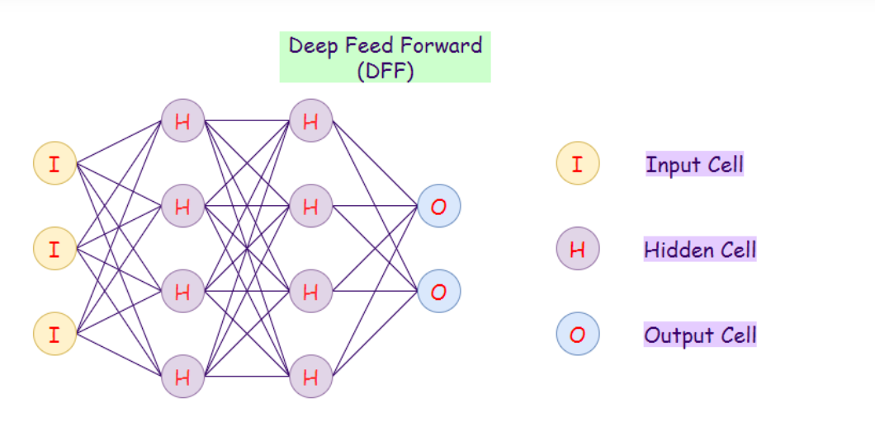
Neural Network Topologies
Deep Feed-forward (DFF):
https://towardsai.net/p/machine-learning/main-types-of-neural-networks-and-its-applications-tutorial-734480d7ec8e

Slide 19
Neural Network Topologies
Deep Feed-forward (DFF):
A deep feed-forward network is a feed-forward network that uses more than one hidden layer.
The main problem with using only one hidden layer is the one of overfitting, therefore by adding more hidden layers, we may reduced overfitting and improved generalization.
https://towardsai.net/p/machine-learning/main-types-of-neural-networks-and-its-applications-tutorial-734480d7ec8e

Slide 20

Neural Network Topologies
Recurrent Neural Network (RNN):
Recurrent neural networks (RNNs) are a variation to feed-forward (FF) networks. In this type, each of the neurons in hidden layers receives an input with a specific delay in time(cycle).
https://www.analyticsvidhya.com/blog/2021/06/a-visual-guide-to-recurrent-neural-networks/

Slide 21
Recurrent Neural Network (RNN):
The input layer in architecture for our DNN is fixed. n a feed-forward neural network, the number of neurons in the input layer is determined by the number of features in the input data.
Different input size. Add Zeros to make the input size equal.

Slide 22
Recurrent Neural Network (RNN):
Number of parameters becomes astronomically high. Suppose the maximum length of the sentence is 20 which pretty small for most data sets available. Let the number of words in corpus= 20k (considering a very small corpus)
Then each input will become 400k dimensional and with just 10 neurons in the hidden layer, our number of parameters becomes 4 million! To have a proper network means having billions of parameters. To overcome this we need to have a network with weight sharing capabilities

Slide 23
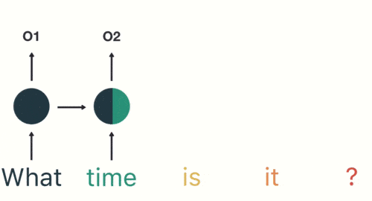
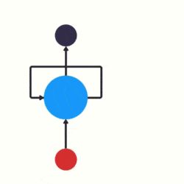
Recurrent Neural Network (RNN):
https://easyai.tech/en/ai-definition/rnn/

Slide 24
Neural Network Topologies
Recurrent Neural Network (RNN):
We use this type of neural network where we need to access previous information in current iterations. For example, when we are trying to predict the next word in a sentence, we need to know the previously used words first.
RNNs can process inputs and share any lengths and weights across time. The model size does not increase with the size of the input, and the computations in this model take into account the historical information.
However, the problem with this neural network is the slow computational speed. It cannot remember info from a long time ago.

Slide 25
Recurrent Neural Network (RNN)
RNNs are a type of neural network that are designed to process sequential data, such as text, audio, or time series data. They can “remember” or store information from previous inputs, which allows them to use context and dependencies between time steps.
It can use variable-length input

Slide 26
Recurrent Neural Network (RNN):
LSTMs are a type of RNN that use special type of memory cell and gates to store and output information. LSTMs are effective at storing and accessing long-term dependencies. They are slower to train and run than other types of RNNs.
GRUs are simplified version of LSTMs that use single “update gate” to control the flow of information into the memory cell. GRUs are easier to train and faster to run than LSTMs, but they may not be as effective at storing and accessing long-term dependencies.

Slide 27
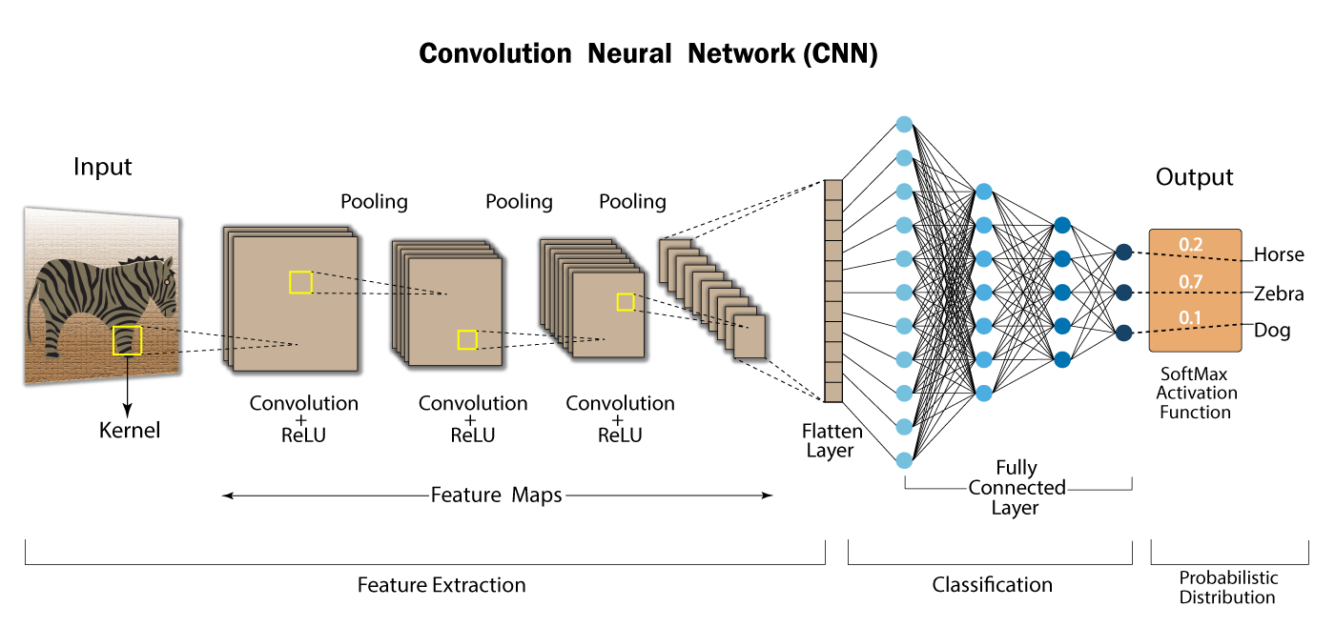
Convolutional Neural Network (CNN)
https://www.analyticsvidhya.com/blog/2022/03/basics-of-cnn-in-deep-learning/

Slide 28


Convolutional Neural Network (CNN)

Slide 29
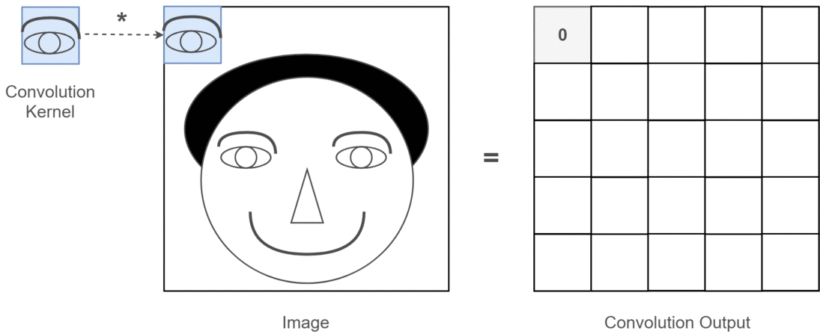
Convolutional Neural Network (CNN)
https://towardsdatascience.com/light-on-math-machine-learning-intuitive-guide-to-convolution-neural-networks-e3f054dd5daa

Slide 30
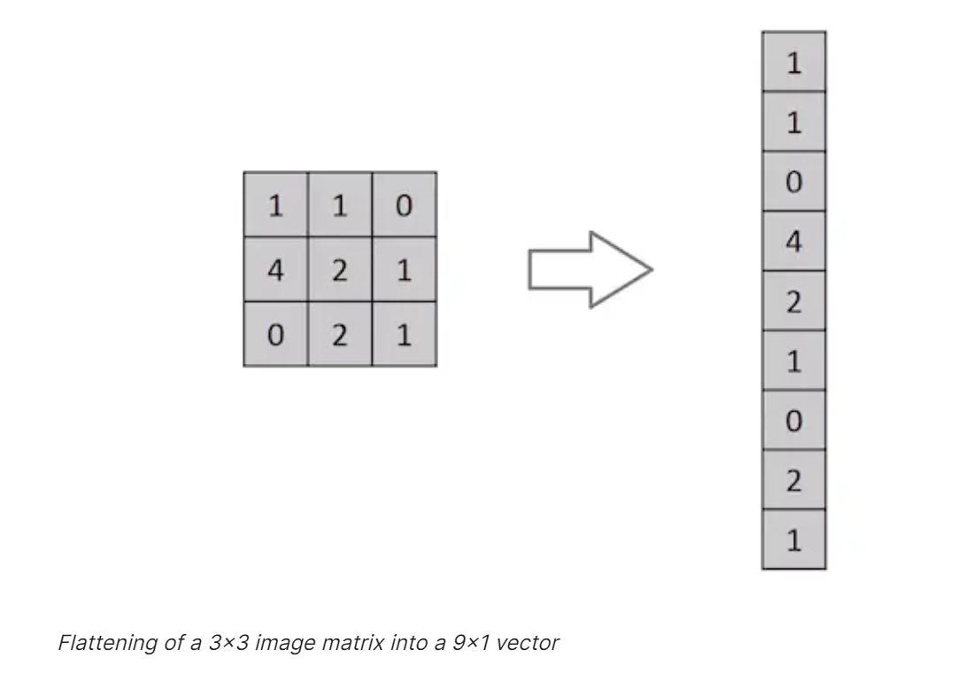
Convolutional Neural Network (CNN)
Why ConvNets over Feed-Forward Neural Nets?
https://saturncloud.io/blog/a-comprehensive-guide-to-convolutional-neural-networks-the-eli5-way/

Slide 31
Convolutional Neural Network (CNN)
An image is nothing but a matrix of pixel values, right? So why not just flatten the image (e.g. 3x3 image matrix into a 9x1 vector) and feed it to a Multi-Level Perceptron for classification purposes? Uh.. not really.
In cases of extremely basic binary images, the method might show an average precision score while performing prediction of classes but would have little to no accuracy when it comes to complex images having pixel dependencies throughout.
A ConvNet is able to successfully capture the Spatial and Temporal dependencies in an image
https://saturncloud.io/blog/a-comprehensive-guide-to-convolutional-neural-networks-the-eli5-way/

Slide 32
Convolution Neural Network
eNet-5
AlexNet
VGGNet
GoogLeNet
ResNet
DenseNet
MobileNet
SqueezeNet
NASNet
Xception
ShuffleNet
EfficientNet
Inception-ResNet
MobileNetV2
MobileNetV3
ResNeXt
DarkNet
YOLO
(You Only Look Once)
SSD (Single Shot MultiBox Detector)
CapsuleNet
SENet (Squeeze-and-Excitation Network)
PNasNet (Progressive Neural Architecture Search Network)
HRNet (High-Resolution Network)
EfficientDet
RegNet (Designing Network Architectures for Resource-Constrained Training)

Slide 33
Other Types of DNN
Feed-forward Neural Networks (FNN)
Convolutional Neural Networks (CNN)
Recurrent Neural Networks (RNN)
Long Short-Term Memory (LSTM) Networks
Gated Recurrent Unit (GRU) Networks
Autoencoders
Generative Adversarial Networks (GAN)
Transformers
Deep Belief Networks (DBN)
Radial Basis Function Networks (RBFN)
Deep Q-Networks (DQN)
Restricted Boltzmann Machines (RBM)
Hopfield Networks
Boltzmann Machines
Self-Organizing Maps (SOM)
Deep Residual Networks (ResNet)
Capsule Networks
Echo State Networks (ESN)
Deep Reinforcement Learning Networks
Modular Neural Networks
Attention-based Neural Networks
Hybrid Neural Networks
Spiking Neural Networks (SNN)
Neural Turing Machines (NTM)
Deep Variational Autoencoders (VAE)

Slide 34
Build Your First Neural Network-TensorFlow
TensorFlow is an free open source platform for machine learning. TensorFlow is a rich system for managing all aspects of a machine learning system
TensorFlow was developed by the Google Brain team for internal Google use in research and production.
TensorFlow is not limited to Python only. While Python is the most commonly used language for TensorFlow, TensorFlow also provides support for other programming languages such as C++, Java, JavaScript, Swift, and Go.
tensor : A multidimensional array

Slide 35
Build Your First Neural Network-Keras
Keras is an open source framework a high-level neural networks API written in Python. It is capable of running on top of popular deep learning frameworks such as TensorFlow, Microsoft Cognitive Toolkit (CNTK), or Theano. Keras provides a user-friendly interface for designing, training, and evaluating deep learning models.
https://www.dataquest.io/blog/tutorial-introduction-to-keras/

Slide 36
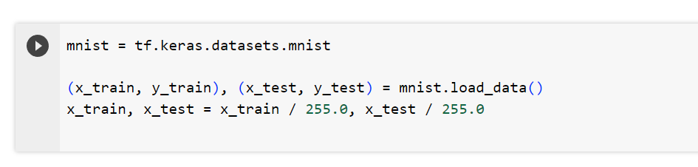
Build Your First Neural Network
Load

Slide 37
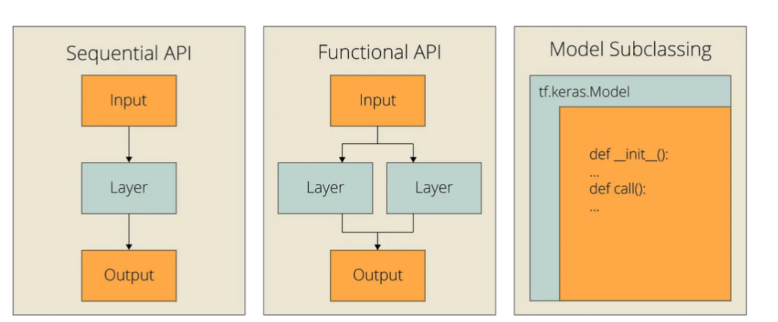
Build Your First Neural Network-Keras
https://towardsdatascience.com/3-ways-to-build-neural-networks-in-tensorflow-with-the-keras-api-80e92d3b5b7e

Slide 38
Build Your First Neural Network
The Sequential API allows you to build models by stacking layers on top of each other.
The Functional API in Keras allows you to build more complex models with multiple inputs or outputs or models with shared layers
https://www.dataquest.io/blog/tutorial-introduction-to-keras/

Slide 39
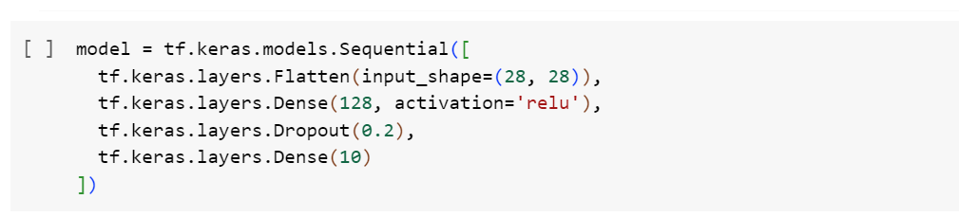
Build Your First Neural Network(sequential model)
There are many types of layers available in the Keras Sequential API.
https://www.dataquest.io/blog/tutorial-introduction-to-keras/

Slide 40
Build Your First Neural Network
  There are many types of layers available in the Keras Sequential API.
  One of the most common layer types is the Dense layer, a fully connected layer.
  Flatten layer: a layer that flattens the multi-dimensional input tensors into a single dimension — used as a transition layer between convolutional or recurrent layers and fully connected layers in a neural network.
  Dropout layer: a layer that randomly sets input units to 0 (using a defined frequency) during training time — used as a regularization technique to prevent overfitting in neural networks.
https://www.dataquest.io/blog/tutorial-introduction-to-keras/

Slide 41
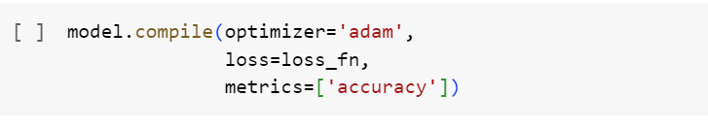
Build Your First Neural Network
Compiling a Model with Keras
Once you’ve built a model using the Keras Sequential API, you’ll need to compile it before it can be used for training. When compiling the model, you’ll need to specify both a loss function and an optimizer.

Slide 42
Build Your First Neural Network
Fitting a Model with Keras
  Finally, to use Keras for deep learning, the compiled model must be fit to a training dataset.
    model.fit(X_train, y_train)
  To evaluate the performance of the model after training, you can use evaluate:
    test_loss, test_accuracy = model.evaluate(x_test, y_test)

Slide 43
LAB

Slide 44
A Short History of Programming languages
Nothing
machine code
assembly languages

Slide 45
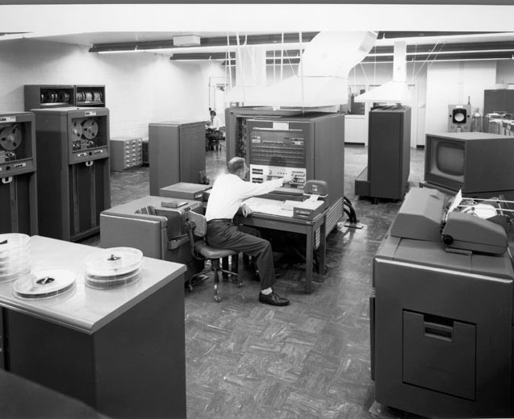
A Short History of Programming languages
1954: IBM develops the 704 – Successor to the 701
All programming done in assembly
Problem – Software costs exceeded hardware costs!
* http://www.columbia.edu/cu/computinghistory/704.html

Slide 46
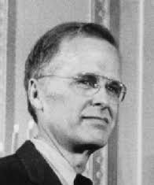

A Short History of Programming languages
Fortran I
  1958 – >50% of all software is in FORTRAN
  Performance is close to hand-written assembly!
  Faster Development time.
http://www.columbia.edu/cu/computinghistory/backus.html

Slide 47
A Short History of Programming languages
Fortran I
  1958 – >50% of all software is in FORTRAN
  Performance is close to hand-written assembly!
  Faster Development time.
C
JAVA
Python
http://www.columbia.edu/cu/computinghistory/backus.html

Slide 48
Why Python?
Python is a popular language for AI because
  it is easy to learn
  has a large and active community
  offers powerful libraries for data analysis and visualization and has excellent machine-learning libraries.

Slide 49
Why Python?
Anaconda
Colab

Slide 50
What is Anaconda?
Anaconda is actually a distribution of software that comes with conda, Python, and over 150 scientific packages and their dependencies.
The application conda is a package and environment manager. Anaconda is a fairly large download (~500 MB) because it comes with the most common data science packages in Python.
If you don't need all the packages or need to conserve bandwidth or storage space, there is also Miniconda, a smaller distribution that includes only conda and Python. You can still install any of the available packages with conda, it just doesn't come with them.
Udacity - Deep Learning Foundation

Slide 51
Installing Anaconda
Anaconda is available for Windows, Mac OS X, and Linux. You can find the installers and installation instructions at https://www.anaconda.com/download/

Slide 52

Google Colaboratory
Colab is a hosted Jupyter Notebook service that requires no setup to use and provides free access to computing resources, including GPUs and TPUs. Colab is especially well suited to machine learning, data science, and education.

