Slide 1

Entrepreneurship & Innovation
Prepared by Dr. Amany Ramadan
ENT 611
Entrepreneurship & Innovation
Lecture 6

Slide 2


Creativity and Opportunity
Chapter
6
www.midocean.ae

Slide 3

Students Need to know
www.midocean.ae

Slide 4

Students Need to know
What is startup?
What is Idea generation and its process?
What is Opportunity?
What is Creativity ?
What is the difference between creativity and opportunity?

Slide 5
What’s a Startup?
www.midocean.ae

Slide 6
The first answer is fairly obvious – it’s a new business!
However, we should think about this a little more closely.
Looking back at your first-year studies, the work you’ve already done and your reading, we hope that you’ve noticed that businesses change and develop over their lifetimes. They go through “stages of growth” or “staged development”.
As businesses develop, so they need different strategies to support progress.
Start-up is only the first phase of the business lifecycle, so it is worth looking at the strategies, plans and challenges that affect that particular phase.
www.midocean.ae

Slide 7
Challenges – Professional and Personal
Professional
Personal
How much will it cost?
Where will we get the money?
How do we distribute our product?
How do we identify our market?
Etc., etc., etc.
Do I understand the business?
Who will buy this?
Why will they buy it from me?
What is the risk?

Slide 8

What is Creativity?
www.midocean.ae

Slide 9
We often associate the term with artistic endeavour – writing, painting, making music.
However, we can be creative in business life as well.
www.midocean.ae

Slide 10
A definition:
“…the ability or quality displayed when solving hitherto unsolved problems, when developing original and novel solutions to problems others have solved differently, or when developing original and novel… products” (Parkhurst, 1999).
www.midocean.ae

Slide 11

What does the definition tell us?
www.midocean.ae

Slide 12
It tell us that:
Creativity can be about developing new products
BUT
It can also be about developing new solutions.
www.midocean.ae

Slide 13
Solutions?
www.midocean.ae

Slide 14
What do we mean by solutions?
In this context, it could mean
new processes to help us do something better
new ways of using existing products
new services to supply to new or existing customers etc.
New ways of thinking about things!
www.midocean.ae

Slide 15

“Solving Problems”
www.midocean.ae

Slide 16
Take care with this use of the word “problem”…
The normal use of this word might suggest that there is something wrong
In a business context, we might use the word simply to represent something which makes the customer’s activities less efficient/enjoyable/simple
www.midocean.ae

Slide 17
So, a “problem” might be something quite trivial, everyday or simple – however, by providing a cost effective solution, we please our customer and make money
Examples
Velcro – a simple alternative to the shoelace.
A keyring that beeps – you can find your keys anywhere in the room
Gore-tex – water resistant jackets.
www.midocean.ae

Slide 18
Creativity and Commerce
So, think of creativity in terms of ways of thinking which support commercial opportunities, whether in developing new processes, services or products.
www.midocean.ae

Slide 19
What’s an Opportunity?
“An opportunity has the qualities of being attractive,
desirable and timely and is anchored in a product or service
which creates value for buyer or end user”
www.midocean.ae

Slide 20
What’s an Opportunity?
A new or improved product
A new service
A new means of production
A new way of distributing the product or service
An improved service
New combinations
Or a hybrid of the above
www.midocean.ae

Slide 21
Opposing Definitions
www.midocean.ae

Slide 22
We can therefore see that there is a difference between the commonly held definitions of “Creativity and Opportunity” and the definitions used in a business context.
We may think that creativity is related to artistic or cerebral activity and opportunity is a matter of chance.
Business management theory suggests that in a commercial context, creativity can be learned or developed and that it need not relate to complete novelty; opportunity can be created or developed.
www.midocean.ae

Slide 23
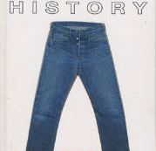
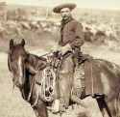
Example: Rise of Levi’s
Problem:
  Working Clothes for Mining Workers do Not Last
Solution:
  First Pair of Jeans

Slide 24
Who is Creative and How Can We Be Creative?
Are creative people born or made?
Think back to your first year management studies and discussions of what constitutes an entrepreneur, and whether these skills can be learned.
The literature suggests that creativity can be innate (you’re born with it), but can also be learned (you get better with practice).
www.midocean.ae

Slide 25
Creativity – Nature or Nurture?
Let’s look at the field of music:
If we want to be great musicians what do we need?
A good “ear” – which may have some biological origin
Talent – again, an innate trait.
But also THEORY, STUDY, PRACTICE, PRACTICE, PRACTICE!
www.midocean.ae

Slide 26
Creativity – Nature or Nurture?
If I am super-talented through natural chance, I may become a great pianist – but only if I study hard
If I am not super-talented but I study hard, I may not be the greatest pianist in the world, but I can certainly become competent – and even make a living from it.
www.midocean.ae

Slide 27
Nature or Nurture?
If business creativity depends on nature, then only a few of us can operate in that sphere.
Result – business grinds to a halt!
Luckily, we know, from experience and from research that we can learn techniques which support creativity.
So, we may not all be creative business gurus who come up with fabulous ideas while sitting in our armchairs
BUT
We can apply creative techniques and thinking processes which help us develop new ideas and keep our businesses flexible and successful.
www.midocean.ae

Slide 28
Why is Creativity Important?
All business sectors seek novelty
  Consumer products
  Media
  Fashion
  Travel
Even seemingly conventional sectors respond to novelty, e.g. medicine seeks new formulations of existing drugs.
Note that some novelty may be “better”, e.g. better medicine, some is simply a response to the desire for something new, e.g. fashion.
So, a continual drive for novel developments suggests that creative thinking is key to success.
www.midocean.ae

Slide 29

Can We Learn Creativity?
We can argue that although we might not be able to learn how to turn ourselves into creative people, we can learn how to think about business creatively.
www.midocean.ae

Slide 30
Creative Thinking
What are some of the attributes of creative thinking?
Flexibility – willing to look at an issue from many angles, not set in our ways.
Originality – attempts to find non-typical responses to problems.
Non-judgemental – not rejecting a potential solution without giving it appropriate consideration.
www.midocean.ae

Slide 31
Creative Thinking
What are some of the attributes of creative thinking?
Flexibility – willing to look at an issue from many angles, not set in our ways.
Originality – attempts to find non-typical responses to problems.
Non-judgemental – not rejecting a potential solution without giving it appropriate consideration.
www.midocean.ae

Slide 32
What Stops Business Creativity?
Barriers are understandable, but nevertheless can prevent or slow the development of new ideas:
  Fear – change is always frightening.
  Risk – am I risking my established business?
  Convention – we’ve always done it this way.
  Self-doubt – if it’s that good, surely somebody else would have made it by now?
  Fear of failure
www.midocean.ae

Slide 33

Creating Creativity
We don’t just sit waiting for the “lightbulb moment”
We approach our problem systematically
www.midocean.ae

Slide 34

De Bono’s creative process
Generating knowledge and awareness
  Reading, learning, researching, finding out about the world in general and the area in which you wish to operate
Incubation
  Time for reflection
Idea generation
  Using your own knowledge and creative thinking techniques e.g. brainstorming, to create ideas
Evaluation and Implementation
  Choosing your idea and making it work!

Slide 35

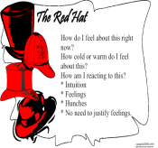
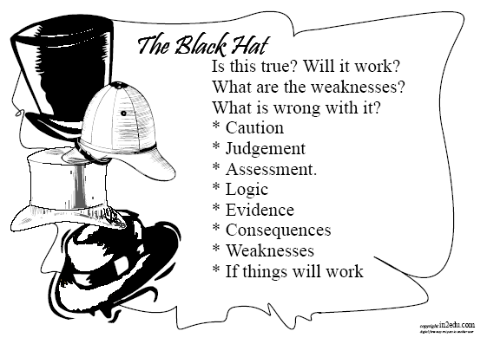



Edward De Bono: ‘Six’ Thinking Hats (1985)
Archives, Reports, Media, Articles, Books, Biographies, Images, Audio & Digital Media
Does my Direction Feel Right? Could I be Looking in the Wrong Place? Asking the Wrong Questions?
What Can I do Different? Is there Anything More to Look at? What are the Weaknesses?
Benefits to Independent Artists? Why is it Worth it? For Whom is it of Interest? Why Can it Be Done? Because it Can……
Alternative Ways? New Methods or Tools? New Stance? New View of Your Original Stance?
What Has Been Done? What is Still to do? How to Proceed?

Slide 36
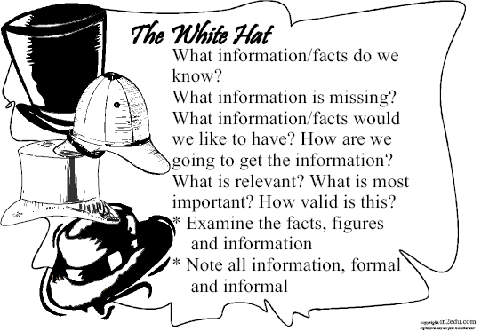

Slide 37


Slide 39
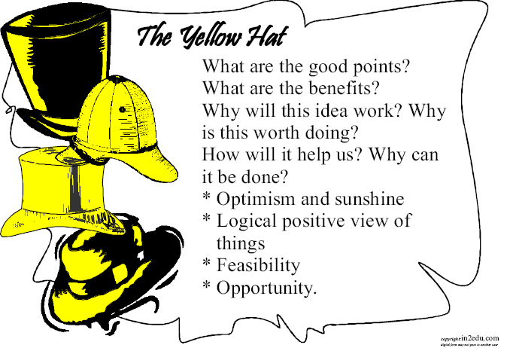

Slide 40
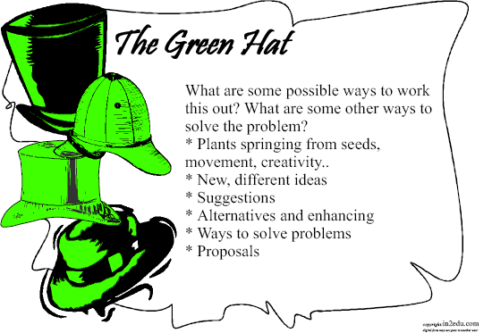

Slide 41
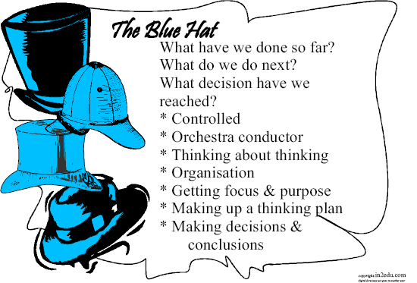

Slide 42
The Unique Blue Hat
The blue hat is different from the other hats because it is involved with directing the thinking process itself
We use the blue hat whenever we suggest the next hat to be used
The blue hat need not be acknowledged at every turn however there are some points which it is often helpful:
At the outset of a discussion – Lets decide what we want to think about and which hats we will use?
At a midpoint to restate the thinking goal – I think we are getting away from what we wanted to talk about. Can someone recall what we decided to talk about?
At the end to summarise what thinking has been done – Think of a sentence that tells about what we have been doing today?
www.midocean.ae

Slide 43
Evaluation Sequence
To discover the positive aspects and negative aspects of an idea. You use the yellow hat (sunny optimism) before the black hat (caution).
You could follow up with the green hat (new ideas) and red hat (emotion, feelings) thinking.
Examples: Consider positive and negative
Not doing homework one night
www.midocean.ae

Slide 44
Caution Sequence
Looking critically at situations. You are first considering facts with the white hat.
Then use the black hat to discover difficulties.
This can be followed up with some blue hat or red hat thinking.
Examples: consider the consequences
Not letting someone know where you are going.
www.midocean.ae

Slide 45
Design Sequence
Creating:
  New ideas
  Products
  Improvements to existing designs.
For this, we could use the blue (control), green (creative new ideas) and red (emotions, feelings) hats.
www.midocean.ae

Slide 46
Other Sequences
Red + White
Comparing fact and opinion
Black + Yellow + Green
Comparing and synthesising (coming up with new ideas from the known)
White + Blue
What do we know (facts) and where are we going (planning)
www.midocean.ae

Slide 47
Example: Creative Problem Solving Steps
1. Problem Definition
I Used the Explorer Mindset To look at the Larger Issues Related to Entrepreneurship (Quadrant C and D thinking) Then to find the main issues of interest the detective mindset was used (using Quadrant A and B thinking)
2. Idea Generation
In the second stage, brainstorming a multitude of creative
ideas using the imaginative, intuitive mindset of an
Artist (Quadrant C and D thinking)
3. Idea Synthesis
In the creative idea evaluation phase, I try to obtain
more practical, solutions using the mindset
of an engineer (Quadrants D and A thinking)
4. Idea Judgement
In the critical idea evaluation phase, I must determine
which ideas And solutions are best, thinking like a Judge
(Quadrants A and B)
5. Solution Implementation
Putting the solution into practice requires the mindset of the producer where the focus is primarily on carrying out the data collection within the research project (Quadrant B and C are especially important, but the whole brain must be used)
Prior
Literature
Records,
Data
Collection
Is there
Another
Way?
Reflect
Who is
it For?
Review
Methods

Slide 48
Recognising an Opportunity
www.midocean.ae

Slide 49
Recognising an Opportunity
Opportunities are not like raindrops – they do not fall at our feet.
Well, not usually! From time to time something might just happen which allows an entrepreneur to move forward.
However, if we wait for an opportunity to turn up, we will probably never succeed.
As creative businesspeople we seek or develop opportunities.
www.midocean.ae

Slide 50
Drucker’s Opportunity Scan
Internal
The unexpected - can we react to change?
Incongruity – can we cope with the difference between what we thought would happen and what actually happened? This could create an opportunity.
Inadequacy in underlying processes – can exiting processes and procedures be improved?
Changes in our industry or our market – can we respond positively?
External
Changes in demographics – age, income, health, etc.
Changes in perception, mood, meaning - can we react to changes in fashion, culture, attitudes.
New knowledge – science and industry affect our products and processes.

Slide 51
Idea Generation
www.midocean.ae

Slide 52
Idea?
Coming up with an innovative idea on which to base a business start-up or project is not easy
Most ideas come to us through experience – often negative experiences
Problem solving and idea generation often go hand in hand
Change is a catalyst in much the same way – change creates new ‘problems’ requiring new ‘solutions’
www.midocean.ae

Slide 53
The Business Idea: Ideation
Opportunity identification
Creativity - idea generation
Idea development
Continual refinement
www.midocean.ae

Slide 54
Examples: Change
What were the main business opportunities associated with the drink-driving laws?
What were the main opportunities associated with the smoking ban?
www.midocean.ae

Slide 55
Innovation in the wider sense
Just as opportunities can be created by changes in the environment, the environment can be changed by ideas that have been developed into opportunities.
  Low cost airlines
  Internet
www.midocean.ae

Slide 56
New Industries: Low-Cost Airlines
The Airlines
  Entrepreneurial idea – revolutionised the industry. E.g.,
    Use of remote airports – reduces cost
    On board catering sales – income
    Seat allocation sales – income
Other opportunities created by this change, e.g.,
    Bus services from remote airports
    Retail expansion at formerly low-use airports
    Accommodation
LOOK FOR CHANGE TO GAIN IDEAS
www.midocean.ae

Slide 57
Developing Creativity
Brainstorming – alone or in a group
E-brainstorming
Templates – A problem,
Templates - An interest

Slide 58
Brainstorming
Brainstorming – non judgemental
All ideas count
Do not try and evaluate as you go on
www.midocean.ae

Slide 59


www.midocean.ae
Fillis, I. (2002) An Andalusian Dog or a Rising Star? Creativity and the Marketing/Entrepreneurship Interface. Journal of Marketing Research, 18(1), 379-395.
Chapter
6
References

Slide 60




Thank You

