Slide 1



Deep Learning & Neural Networks
Dr. Shahira Ahmed
DS710
Lecture 7

Slide 2


Slide 3

Learning Outcomes
Define activation functions and understand their role in neural networks and deep learning models.
Recognize and describe the characteristics of common activation functions
Understand the advantages, limitations, and appropriate use cases for each activation function
www.midocean.ae

Slide 4
Lecture Outline
Introduction to Activation Functions.
Common Activation Functions.
Choosing the right Activation Functions.
Lab: image classification.
www.midocean.ae

Slide 5
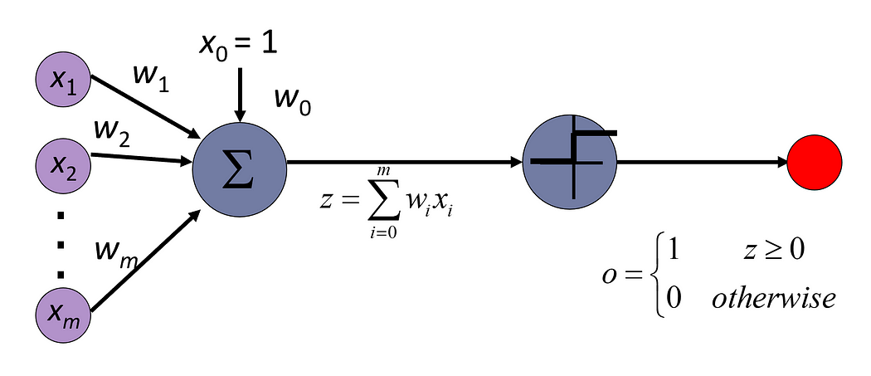
Introduction to Activation Functions

Slide 6
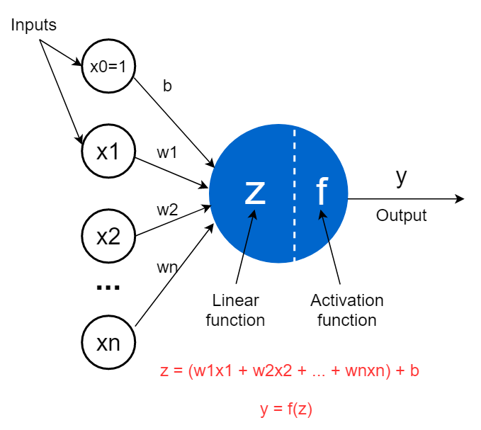

The structure of a perceptron
https://medium.com/data-science-365/3-amazing-benefits-of-activation-functions-in-neural-networks-22b17b91a46e

Slide 7
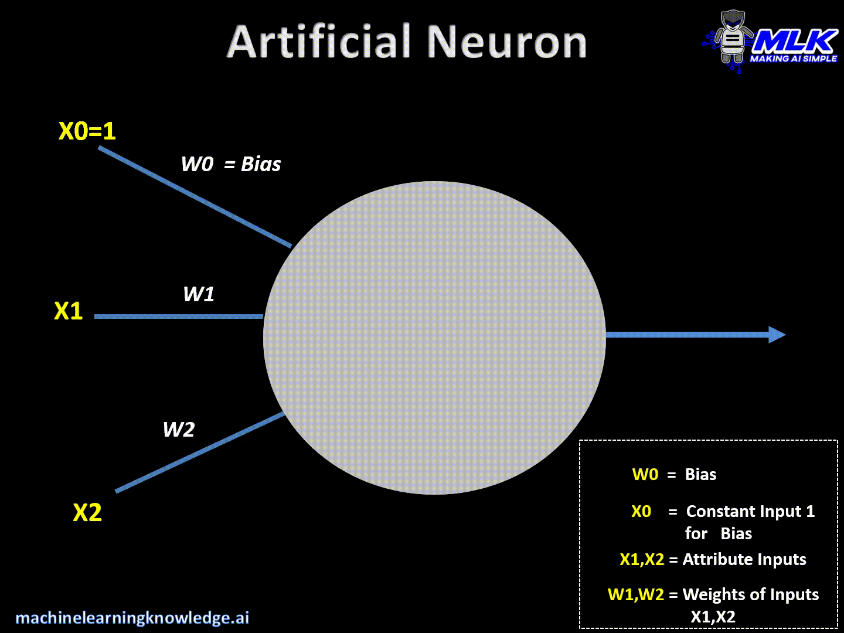
Introduction to Activation Functions
https://machinelearningknowledge.ai/activation-functions-neural-network/

Slide 8
Why Activation Functions
Activation functions play a fundamental role in introducing non-linearity and enabling complex mappings within neural networks.
Understanding activation functions is essential for designing effective and powerful deep learning models.
Without activation functions, a neural network would only be able to learn linear relationships between inputs and outputs.

Slide 9
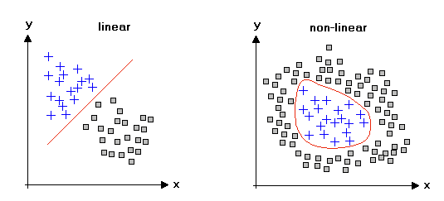
Linear vs non-Linear
https://studymachinelearning.com/activation-functions-in-neural-network/

Slide 10
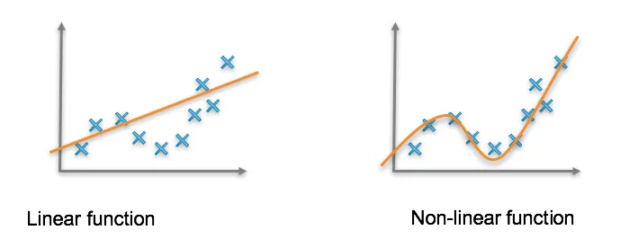
Linear vs non-Linear
https://medium.com/unpackai/nonlinearity-and-neural-networks-2ffaaac0e6ff

Slide 11
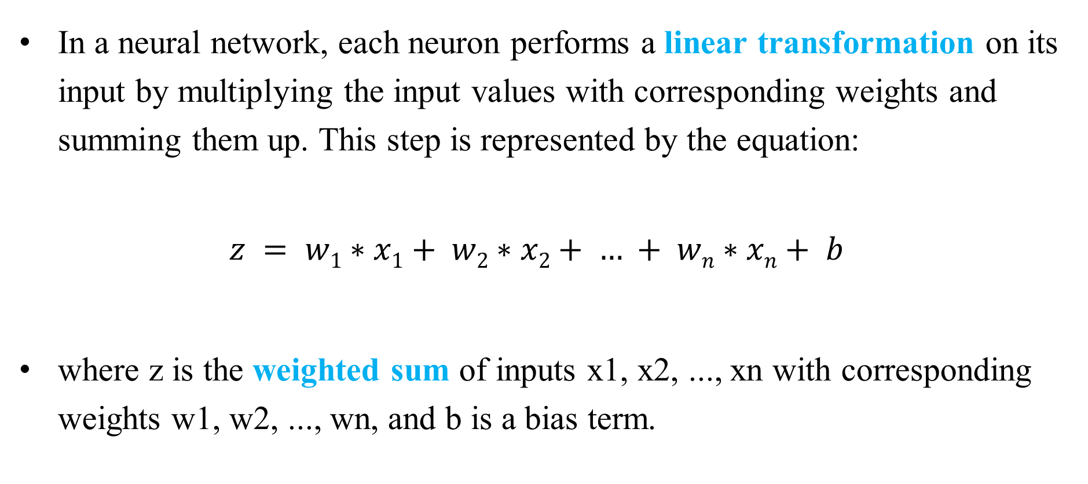
Why Activation Function?
In a neural network, each neuron performs a linear transformation on its input by multiplying the input values with corresponding weights and summing them up. This step is represented by the equation:
$$z = w1∗x1+ w2∗x2+ … + wn∗xn+ b$$
where z is the weighted sum of inputs x1, x2, ..., xn with corresponding weights w1, w2, ..., wn, and b is a bias term.

Slide 12
Why Activation Function?
If we consider a network with multiple layers, each layer's output would also be a linear transformation of the previous layer's output.
The overall network would still be a composition of linear transformations.
In this case, no matter how many layers we have, the neural network would essentially be equivalent to a single-layer neural network.

Slide 13
Why Activation Function?
keep the weighted sum of inputs in a certain range
  Sigmoid: between 0 and 1 (both inclusive)
  Tanh: between -1 and +1 (both inclusive)
  ReLU: between 0 and positive infinity (zero inclusive)
  ReLU6: between 0 and 6 (both inclusive)
  Binary step: either 0 or 1
https://medium.com/data-science-365/3-amazing-benefits-of-activation-functions-in-neural-networks-22b17b91a46e

Slide 14
Why Activation Function?
Task-specific requirements:
  In multi-label classification problems, where an input can belong to multiple classes simultaneously, the sigmoid activation function is commonly used in the output layer to produce independent probabilities for each class.
  for tasks such as image segmentation, where the goal is to assign a label to each pixel in an image, the softmax activation function is often used to produce a probability distribution over the different classes for each pixel.
  Regression Task uses identity function
https://medium.com/data-science-365/3-amazing-benefits-of-activation-functions-in-neural-networks-22b17b91a46e

Slide 15
Why Activation Function?
To introduce non-linearity to neural networks
  Enable Complex Mapping. making it capable of handling tasks such as image classification, natural language processing, and time series analysis.
To determine the neural network’s output
Task-specific requirements (multilabel-multiclass-Regression…..)
https://medium.com/data-science-365/3-amazing-benefits-of-activation-functions-in-neural-networks-22b17b91a46e

Slide 16
Vanishing Gradients:
  Definition: Vanishing gradients refer to the phenomenon where the gradients calculated during backpropagation become extremely small as they propagate from the output layers to the earlier layers of the network.
  Causes: Vanishing gradients often occur when using activation functions that squash large input ranges into a small output range, such as the sigmoid or hyperbolic tangent (tanh) functions. As the gradients are repeatedly multiplied during backpropagation, they can exponentially decrease, resulting in nearly zero gradients for the earlier layers.

Slide 17
Vanishing Gradients:
  3. Consequences: When gradients become vanishingly small, it becomes difficult for the network to update the weights of the earlier layers effectively. This leads to slower convergence.
  4. Mitigation: Several techniques can help alleviate the vanishing gradient problem, such as using activation functions like the rectified linear unit (ReLU) or variants like Leaky ReLU and Parametric ReLU. Additionally, normalization techniques like batch normalization and layer normalization can help stabilize the gradients.

Slide 18
Exploding Gradient:
  Definition: Exploding gradients refer to the opposite problem, where the gradients during backpropagation become extremely large.
  Causes: Exploding gradients often occur when gradients are repeatedly multiplied during backpropagation, causing them to grow exponentially. This can happen when the weights in the network are initialized too large or during the training process when the learning rate is set too high.

Slide 19
Exploding Gradient:
  3. Consequences: When gradients become extremely large, they can cause unstable updates to the network's weights, leading to erratic behavior and poor convergence.
  4. Mitigation: To address the exploding gradient problem, gradient clipping can be applied, where the gradients are rescaled if they exceed a certain threshold. Another approach is to use weight initialization techniques that ensure the weights are initialized within a suitable range. Additionally, reducing the learning rate or using adaptive optimization algorithms like Adam can help prevent the gradients from exploding.

Slide 20
Characteristics of good Activation Functions
Non-Linearity – Activation function should be able to add nonlinearity in neural network especially in the neurons of hidden layers.
Differentiability: Differentiability is an important characteristic for activation functions, especially when using gradient-based optimization algorithms for training neural networks. Activation functions need to be differentiable to allow for efficient computation of gradients during backpropagation.

Slide 21
Characteristics of good Activation Functions
3. Computational efficiency: Activation functions can differ in terms of their computational efficiency. Some functions, like the ReLU function, are computationally efficient to compute and can accelerate training compared to other functions.
4. Vanishing and exploding gradients: Activation functions can have an impact on the occurrence of vanishing or exploding gradients, which can affect the stability and convergence of the neural network during training. Some functions, like the sigmoid function, are prone to the vanishing gradient problem.

Slide 22
Common Activation Functions
(1)-Step Function - Characteristics:
The step function, also known as the Heaviside function
If the input is greater than or equal to a 0, the output is 1.
If the input is less than 0, the output is 0.

Slide 23

Step Function
https://machinelearningknowledge.ai/activation-functions-neural-network/

Slide 24
Common Activation Functions
Step Function – use cases
Step function has historical importance as it was used in McCulloch Pitts Neuron & Perceptron that were the earliest models of an artificial neuron.
Step Function –Limitation
Lack of flexibility: Step functions have fixed thresholds or switching points where the output changes. Once defined, these thresholds cannot be easily adjusted or adapted.
The step function is (not continuous) not smooth and has a sudden change at the threshold value.
It is non-differentiable.

Slide 25
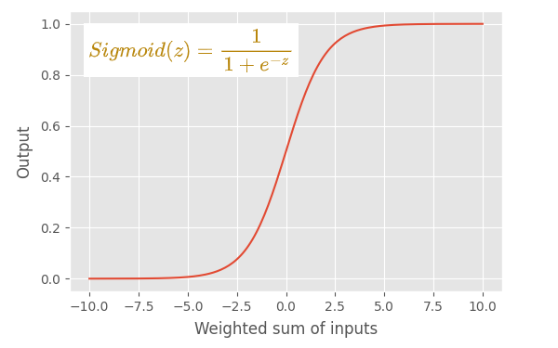
Common Activation Functions
(2)- Sigmoid Function: Characteristics
https://towardsdatascience.com/how-to-choose-the-right-activation-function-for-neural-networks-3941ff0e6f9c

Slide 26
Common Activation Functions
(2)-Sigmoid Function: Characteristics
This is also called the logistic function used in logistic regression models.
The sigmoid function has an s-shaped graph.
Clearly, this is a non-linear function.
The sigmoid function converts its input into a probability value between 0 and 1.
  It converts large negative values towards 0 and large positive values towards 1.
  It returns 0.5 for the input 0. The value 0.5 is known as the threshold value which can decide that a given input belongs to what type of two classes.

Slide 27
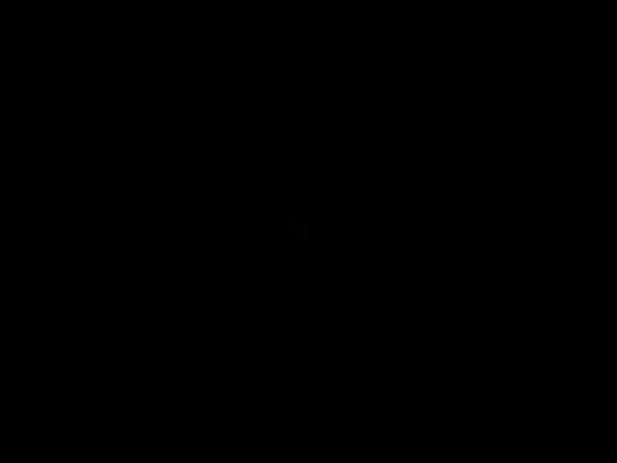
Sigmoid activation function
https://machinelearningknowledge.ai/activation-functions-neural-network/

Slide 28
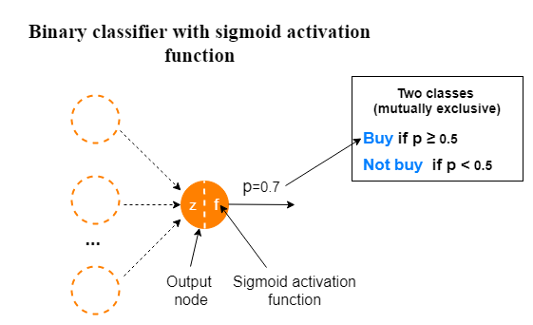
Sigmoid activation function
Sigmoid Function: use cases:
https://towardsdatascience.com/how-to-choose-the-right-activation-function-for-neural-networks-3941ff0e6f9c

Slide 29
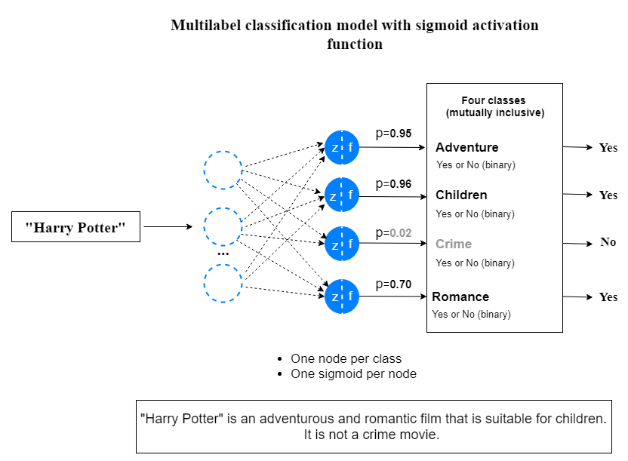
Sigmoid activation function
Sigmoid Function: use cases:
https://towardsdatascience.com/how-to-choose-the-right-activation-function-for-neural-networks-3941ff0e6f9c

Slide 30
Common Activation Functions
Sigmoid Function - use cases:
The sigmoid function was used as an activation function for the hidden layers in MLPs, CNNs and RNNs.
The sigmoid function is still used in RNNs.
The sigmoid function must be used in the output layer when we build a binary classifier in which the output is interpreted as a class label depending on the probability value of input returned by the function.
The sigmoid function is used when we build a multilabel classification model in which each mutually inclusive class has two outcomes.

Slide 31
Common Activation Functions
Sigmoid Function - use cases:
The sigmoid function can also be used for other tasks, such as image processing, speech recognition, and natural language processing
  In image processing, the sigmoid function is used to enhance the contrast of an image.
  In speech recognition, the sigmoid function is used to model the probability of a particular sound given an input signal.
  In natural language processing, the sigmoid function is used to model the probability of a particular word given a sequence of words.

Slide 32
Sigmoid activation function
Sigmoid Function - Limitation:
The sigmoid function has the vanishing gradient problem.The sigmoid function has slow convergence.
The sigmoid function is not zero-centered, which means that its output is always positive. This can cause issues in the gradient update of the weights during backpropagation since the positive gradients will only update the weights in a specific direction
Output range limitation: The output of the sigmoid function is constrained between 0 and 1.

Slide 33
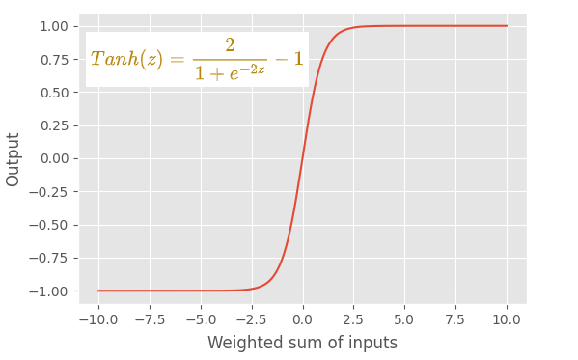
Common Activation Functions
(3)Tanh Activation Function

Slide 34
Tanh activation function
Tanh Activation Function - characteristics
The output of the tanh (tangent hyperbolic) function always ranges between -1 and +1.
Like the sigmoid function, it has an s-shaped graph. This is also a non-linear function.
One advantage of using the tanh function over the sigmoid function is that the tanh function is zero centered. This makes the optimization process much easier.

Slide 35

Common Activation Functions
https://machinelearningknowledge.ai/activation-functions-neural-network/

Slide 36
Common Activation Functions
Tanh Activation Function – use cases:
Hidden layers: The tanh activation function is used in hidden layers of neural networks. It can help introduce non-linearity and enable the network to learn complex representations and feature combinations but lead to vanishing gradient problem
Output layer for classification: The tanh function can be used in the output layer of a neural network for binary classification problems, where the goal is to predict a binary outcome (e.g., positive or negative)

Slide 37
Common Activation Functions
Tanh Activation Function – limitation:
Vanishing gradient problem: Although the tanh function mitigates the vanishing gradient problem compared to the sigmoid function, it can still suffer from this issue, particularly for large inputs.
Saturation: the tanh function saturates at the extremes of its range (-1 and 1). This saturation can lead to slower learning and challenges in updating the network weights properly.
Limited output range: The output of the tanh function is limited to the range between -1,1
Computational cost: The tanh function involves exponentiation and division operations, which can be computationally more expensive compared to the ReLU activation function and its variants.
https://towardsdatascience.com/how-to-choose-the-right-activation-function-for-neural-networks-3941ff0e6f9c

Slide 38
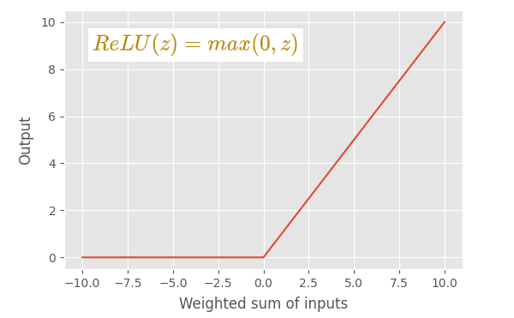
Common Activation Functions
(4)-ReLU Function

Slide 39

Common Activation Functions
https://machinelearningknowledge.ai/activation-functions-neural-network/

Slide 40
Common Activation Functions
ReLU Activation Function – Characteristics:
The ReLU (Rectified Linear Unit) activation function is a great alternative to both sigmoid and tanh activation functions.
Inventing ReLU is one of the most important breakthroughs made in deep learning.
This function does not have the vanishing gradient problem.
ReLU is a simple function to compute since it involves a comparison and a maximum operation. This simplicity makes it computationally efficient, especially when dealing with large-scale neural networks and deep learning models..

Slide 41
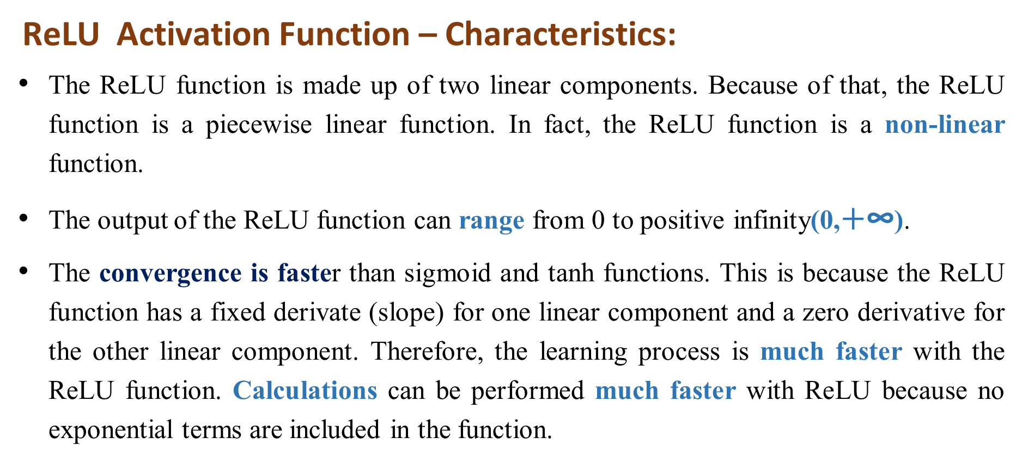
Common Activation Functions
ReLU Activation Function – Characteristics:
The ReLU function is made up of two linear components. Because of that, the ReLU function is a piecewise linear function. In fact, the ReLU function is a non-linear function.
The output of the ReLU function can range from 0 to positive infinity(0,$+\text{∞}$).
The convergence is faster than sigmoid and tanh functions. This is because the ReLU function has a fixed derivate (slope) for one linear component and a zero derivative for the other linear component. Therefore, the learning process is much faster with the ReLU function. Calculations can be performed much faster with ReLU because no exponential terms are included in the function.

Slide 42
Common Activation Functions
ReLU Activation Function – use cases :
The ReLU function is the default activation function for hidden layers in modern MLP and CNN neural network models.
We do not usually use the ReLU function in the hidden layers of RNN models. Instead, we use the sigmoid or tanh function there.
We do not use the ReLU function in the output layer.
https://towardsdatascience.com/how-to-choose-the-right-activation-function-for-neural-networks-3941ff0e6f9c

Slide 43
Common Activation Functions
  ReLU Activation Function – Limitation
  Dead neurons: If the input to a ReLU neuron is negative, the output is zero and the gradient is also zero. This means that the neuron stops learning and becomes inactive.
  However, ReLU can also cause exploding gradient problem, which occurs when the gradients become very large and the network becomes unstable. This can happen if the weights are too large or the network is too deep. To prevent this, we can use gradient clipping, which sets a maximum threshold for the gradients
https://towardsdatascience.com/how-to-choose-the-right-activation-function-for-neural-networks-3941ff0e6f9c

Slide 44
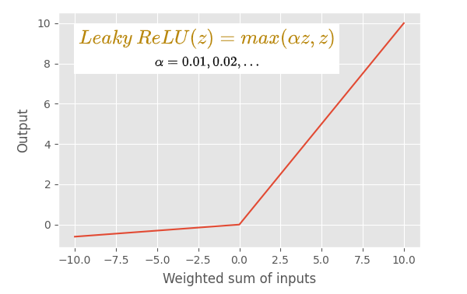
Common Activation Functions
  (5) – Leaky ReLU Activation Function
https://towardsdatascience.com/how-to-choose-the-right-activation-function-for-neural-networks-3941ff0e6f9c

Slide 45

Common Activation Functions
https://towardsdatascience.com/how-to-choose-the-right-activation-function-for-neural-networks-3941ff0e6f9c

Slide 46
Common Activation Functions
  Leaky ReLU Activation Function – Characterestics
  The leaky ReLU activation function is a modified version of the default ReLU function.
  Leaky ReLU activation function does not have the vanishing gradient problem.
  If the input value is greater than 0, the leaky ReLU function outputs the input as it is like the default ReLU function does.
  if the input is less than 0, the leaky ReLU function outputs a small negative value defined by αz (where α is a small constant value, usually 0.01 and z is the input value).
  It does not have any linear component with zero derivatives (slopes). Therefore, it can avoid the dying ReLU problem.
  The learning process with leaky ReLU is faster than the default ReLU.
https://towardsdatascience.com/how-to-choose-the-right-activation-function-for-neural-networks-3941ff0e6f9c

Slide 47
Common Activation Functions
  Leaky ReLU Activation Function – Limitation:
Extra hyperparameter: Leaky ReLU introduces another hyperparameter, the slope of the negative part, which has to be tuned before training. This can increase the complexity and risk of overfitting.
Computational inefficiency: Leaky ReLU can be slower to compute than ReLU, as it requires additional calculation for the negative inputs. This can affect the training speed, especially for large datasets.
Information | Free Full-Text | Learnable Leaky ReLU (LeLeLU): An Alternative Accuracy-Optimized Activation Function (mdpi.com)

Slide 48
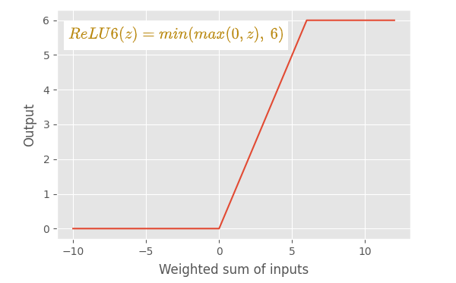
Common Activation Functions
ReLU6 activation function

Slide 49
Common Activation Functions
  ReLU6 Activation Function – Limitation:
  The main difference between ReLU and ReLU6 is that ReLU allows very high values on the positive side while ReLU6 restricts to the value 6 on the positive side. Any input value which is 6 or greater than 6 will be restricted to the value 6 (hence the name).
https://towardsdatascience.com/how-to-choose-the-right-activation-function-for-neural-networks-3941ff0e6f9c

Slide 50
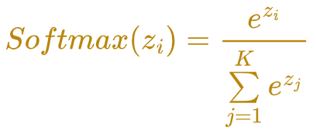
Softmax Function
Softmax function comes from the family of Sigmoid functions only.
Softmax function squashes the incoming signals for multiple classes in a probability distribution. The sum of this probability distribution would obviously be 1.
https://towardsdatascience.com/how-to-choose-the-right-activation-function-for-neural-networks-3941ff0e6f9c

Slide 51
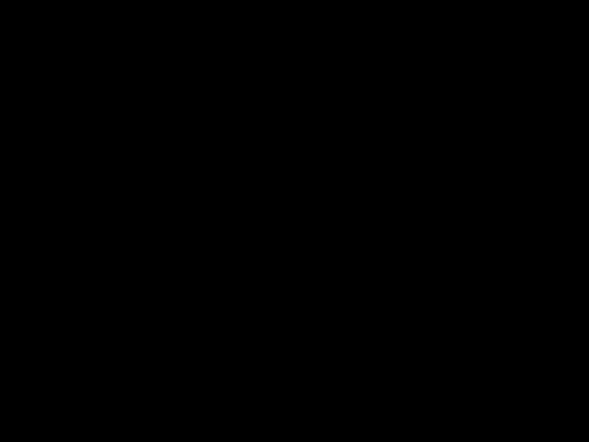
Softmax Function
https://towardsdatascience.com/how-to-choose-the-right-activation-function-for-neural-networks-3941ff0e6f9c

Slide 52
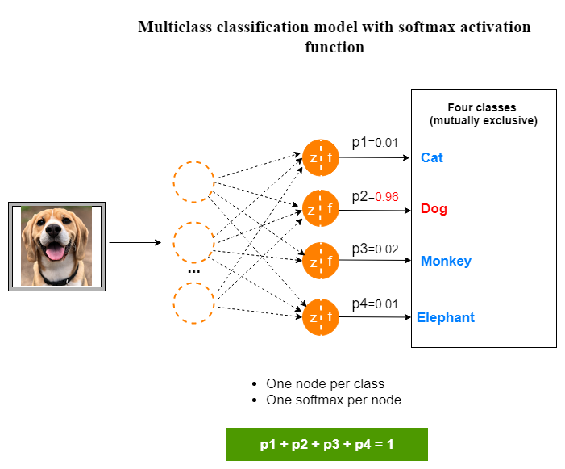
Softmax Function
Usage:
  We must use the softmax function in the output layer of a multiclass classification problem.
  We never use the softmax function in the hidden layers.
https://towardsdatascience.com/how-to-choose-the-right-activation-function-for-neural-networks-3941ff0e6f9c

Slide 53
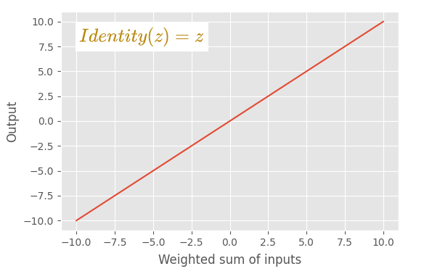
Identity activation function

Slide 54
Identity activation function
This function outputs the input value as it is. No changes are made to the input.
This function is only used in the output layer of a neural network model that solves a regression problem.
It cannot be used in training of deep learning

Slide 55
Choose the Right Activation Function
Choosing the right activation function is the main challenge.
No activation function is required in the input layer nodes of a neural network. So, you don’t need to worry about activation functions when you define the input layer.

Slide 56
Choose the Right Activation Function
The output layer activation function depends on the type of problem that we want to solve.
  In a regression problem, we use the linear (identity) activation function.
  In a binary classifier, we use the sigmoid activation function.
  In a multiclass classification problem, we use the softmax activation function.
  In a multilabel classification problem, we use the sigmoid activation function.

Slide 57
Choose the Right Activation Function
We should use a non-linear activation function in hidden layers. For hidden layers, the most used activation function is the rectified linear unit (ReLU). Start with the ReLU activation function and if you have a dying ReLU problem, try leaky ReLU.
In MLP and CNN neural network models, ReLU is the default activation function for hidden layers.

Slide 58
Lecture Summary
Activation functions play a crucial role in deep learning by introducing non-linearity to neural networks.
ReLU (Rectified Linear Unit) is a widely used activation function due to its simplicity and efficiency.
www.midocean.ae

Slide 59
Lecture Suumary
Leaky ReLU are variants of ReLU that address the "dying ReLU" problem
Sigmoid and tanh activation.
Identity, softmax
Lab: Image Classification
www.midocean.ae

