Slide 1
Intro to Windows 10

Slide 2
Why windows 10?
Windows 10 is the latest Microsoft Operating System.
  Is replacing Windows 7 on campus
  Much more friendly than Windows 8
  More Secure

Slide 3
What’s New in windows 10?
A few feature highlights
• Start menu
• Using tiles
• How to search
• Task view
• Snap enhancements
• Quick access tools
Personalization and Settings
• Personalize your lock screen
• Themes
• Desktop and Colors

Slide 4
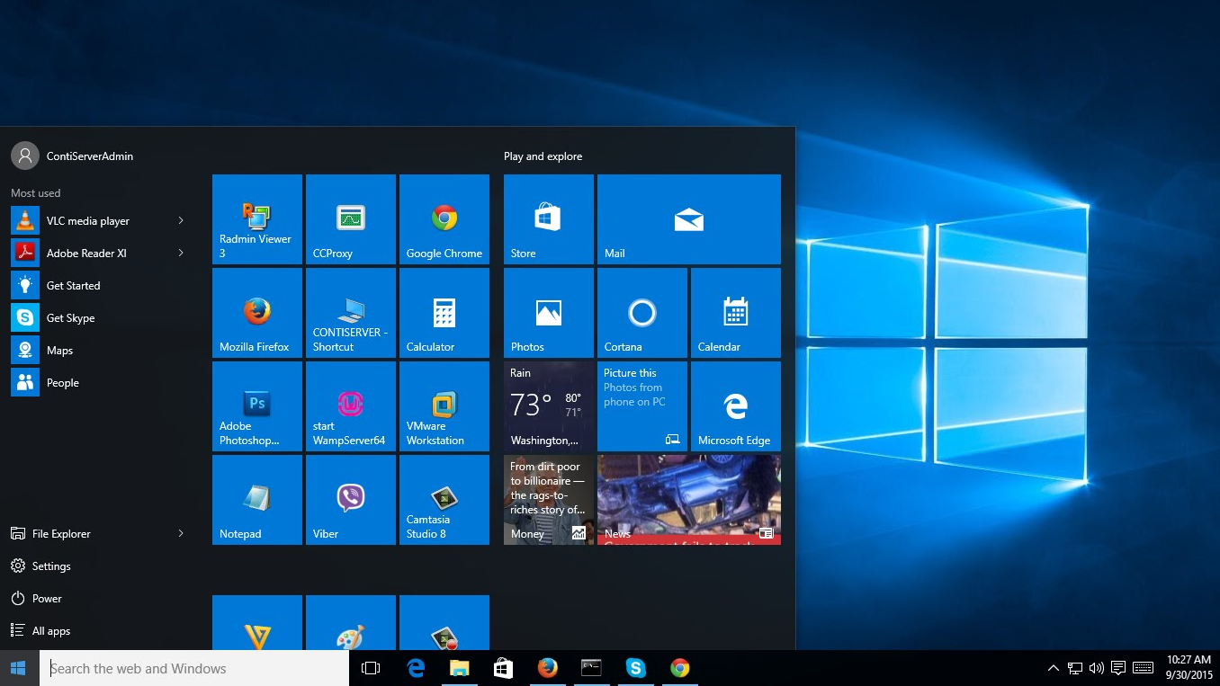
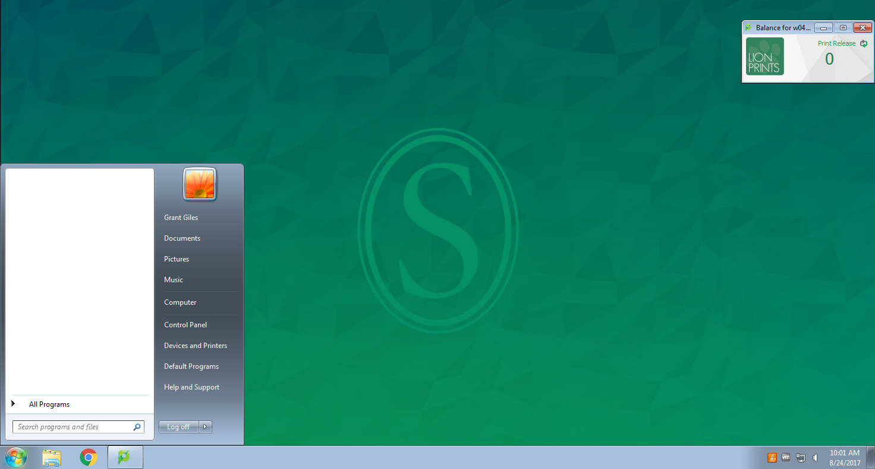
Start Menu
Windows 10:
Windows 7:

Slide 5
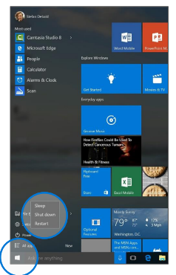
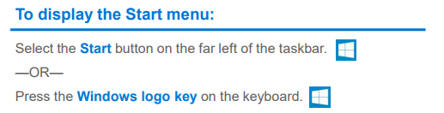
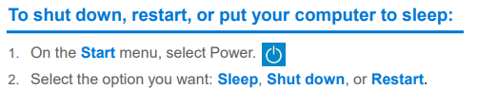
How to use the start menu:

Slide 6
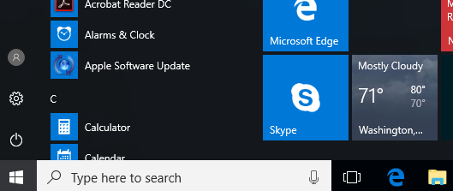
How-to Search
Windows 10 Start menu comes with a great Search tool.
  Search apps
  Search files
  Search the web
  Use Cortana

Slide 7

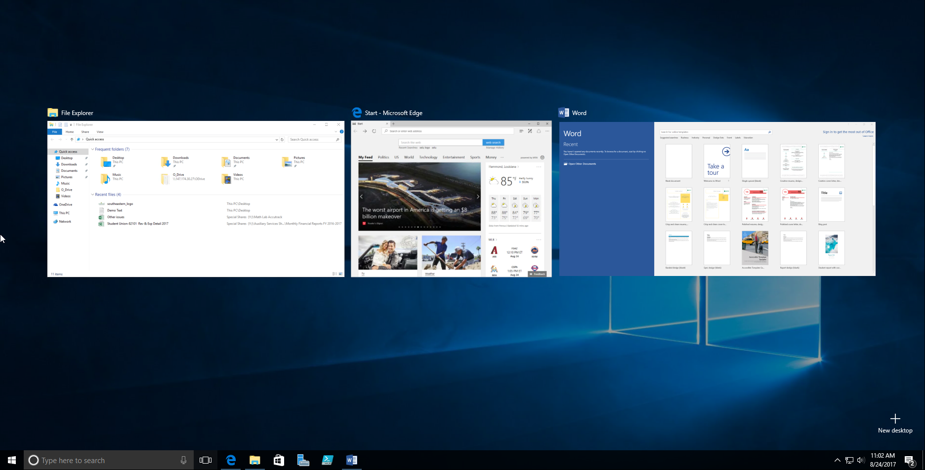
Task View
One of the best parts of windows.
Separate all apps into a spread out view to find the window you are looking for.
Great for organization!
Also “Windows + TAB”

Slide 8
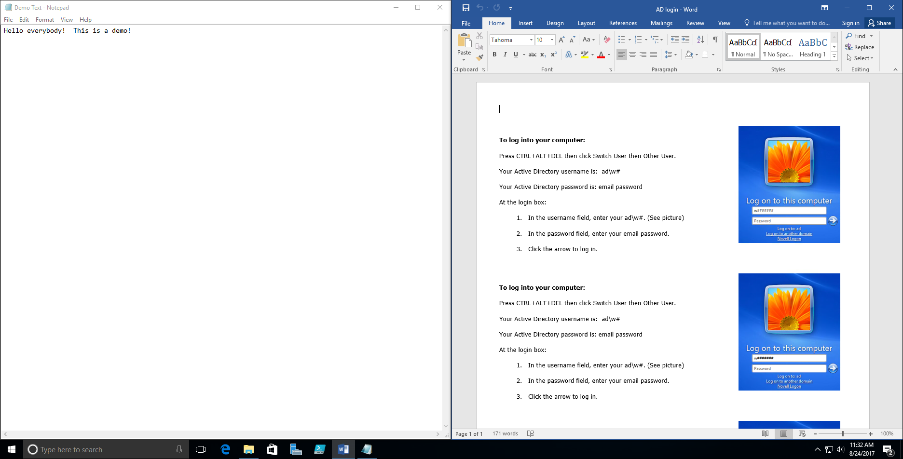
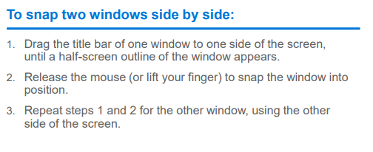
SnAp Enhancements
What are snap enhancements?
Split-screen view, up to four ways.

Slide 9
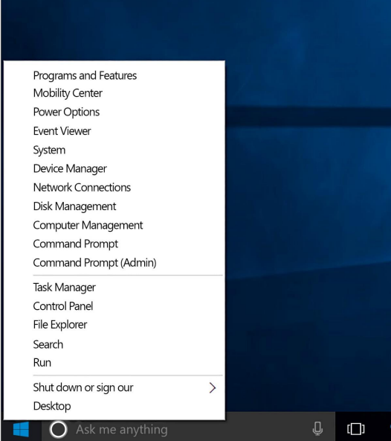
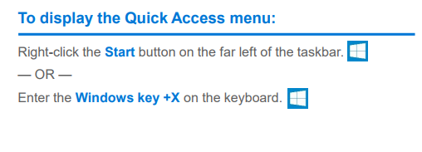
Quick Access Tools
The Quick Access menu provides access to advanced system tools such as Power Options, Task Manager, and Control Panel.

Slide 10
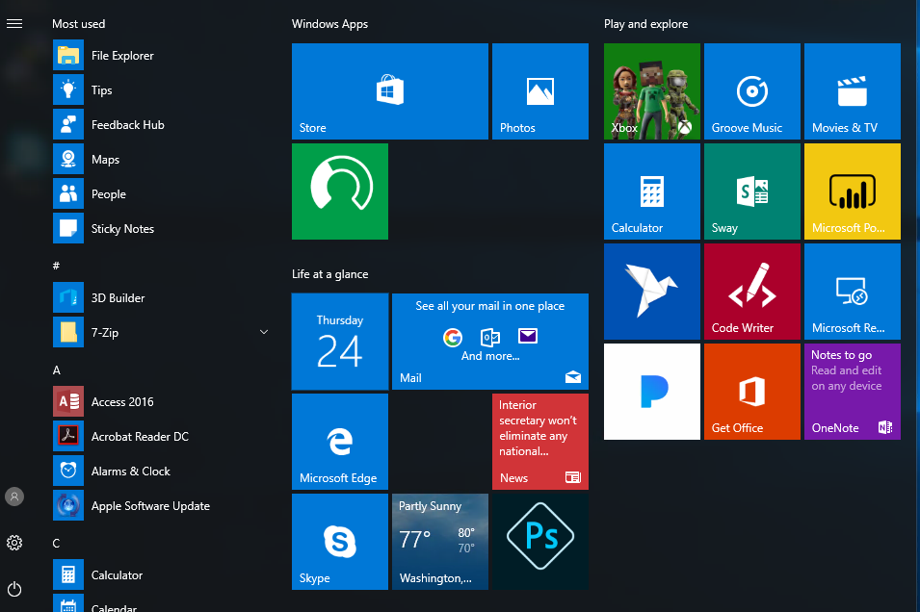
Personalization and Settings:
Settings gets from start button

Slide 11
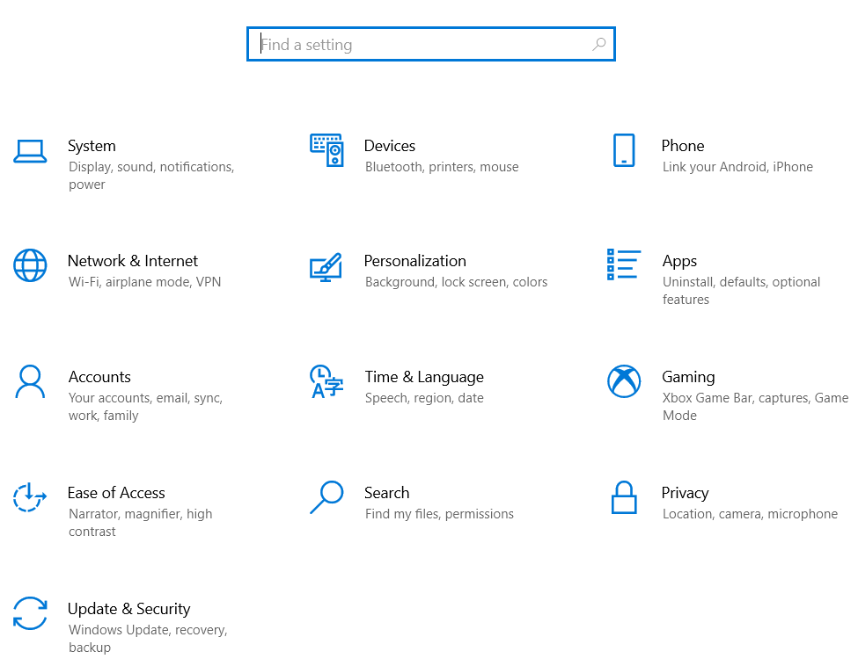
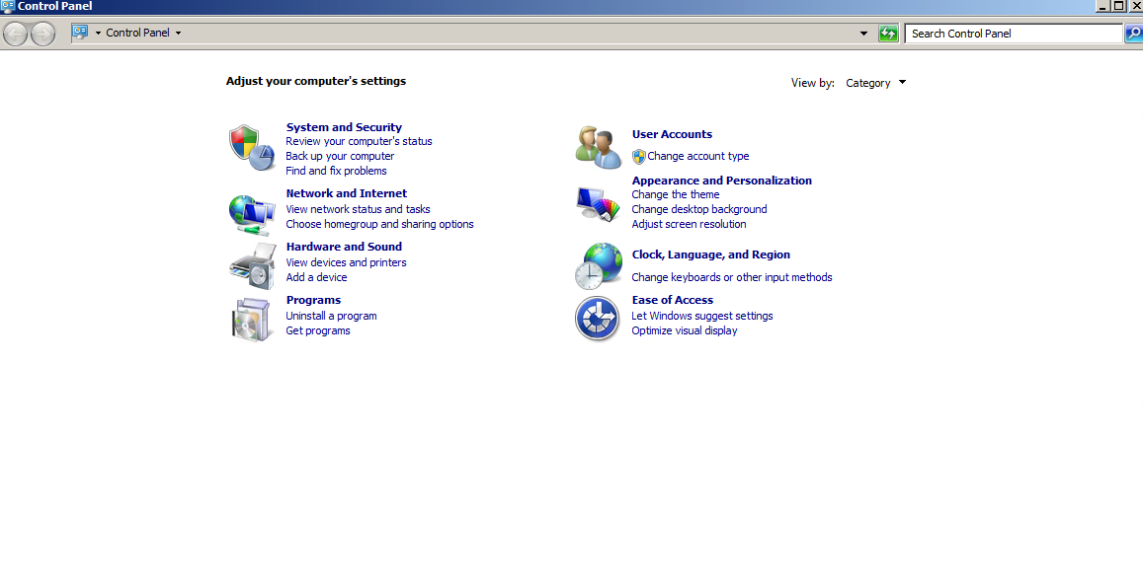
Settings in Windows 7 vs Windows 10
Windows 10:
Windows 7:

Slide 12
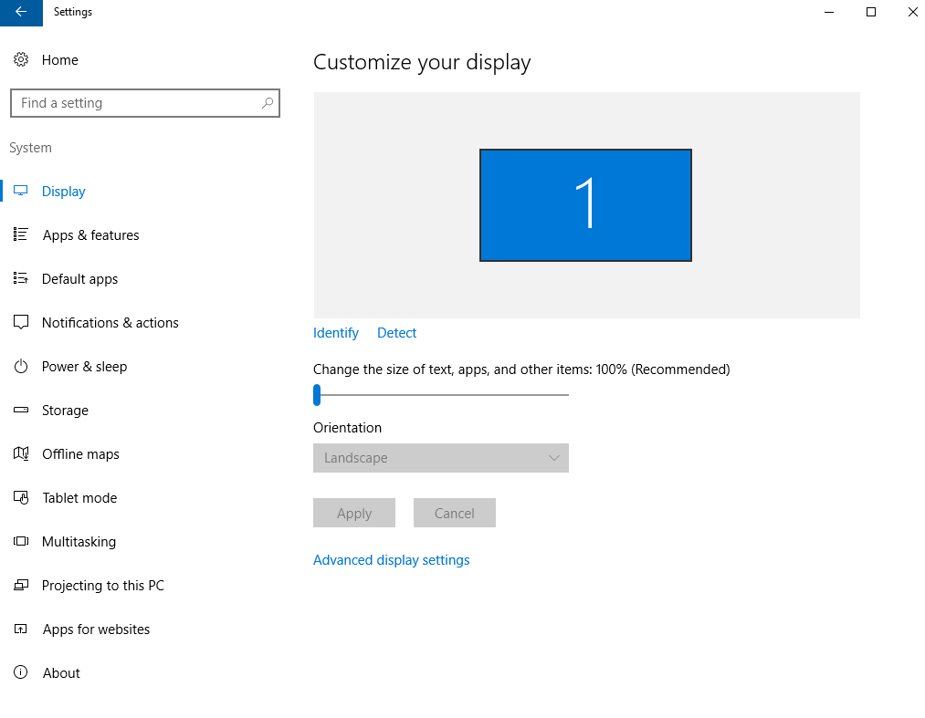
Settings for System
Settings here change system configurations (Display resolution/monitors, default apps, power, etc.)

Slide 13
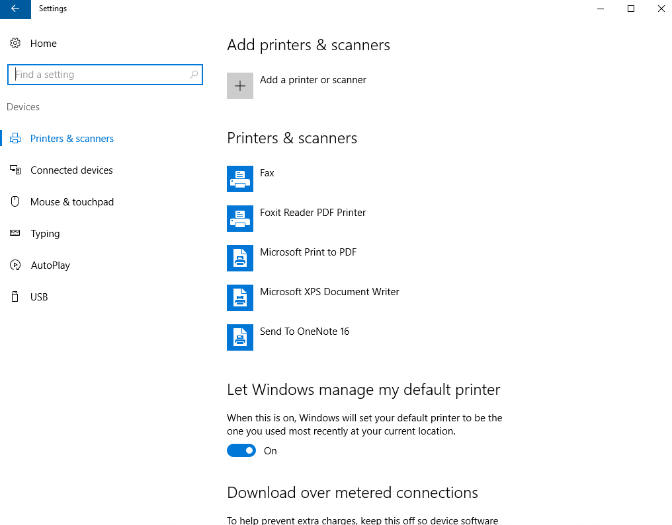
Settings for devices
Manage settings for external devices (printers, mice, scanners, mouse,USB)

Slide 14
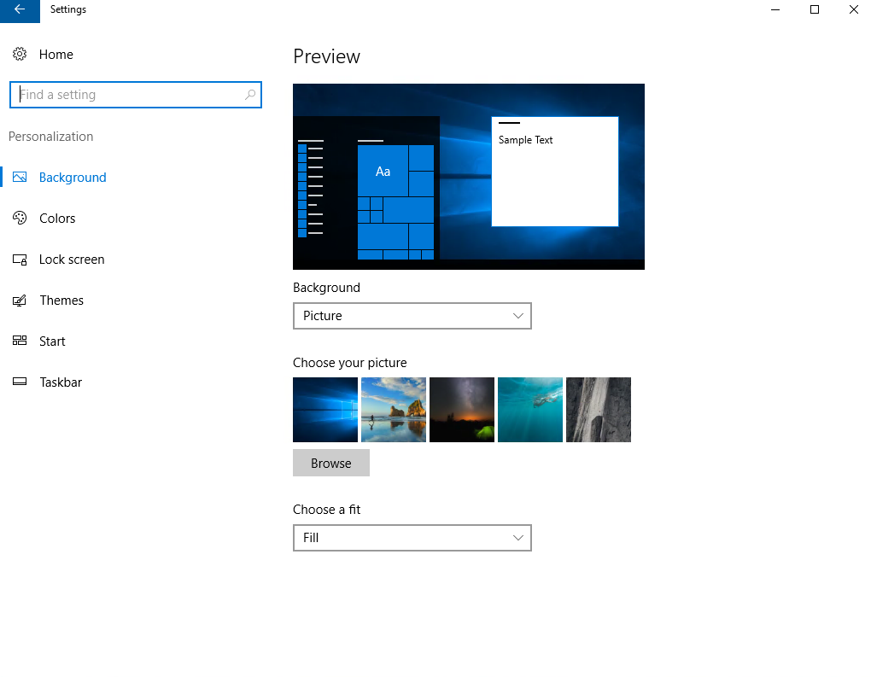
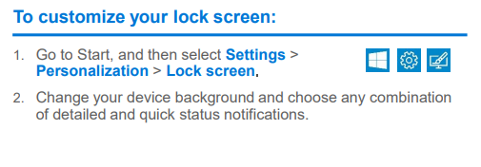
Personalization Settings
Tweak your lock screen to your liking. Change the background to a favorite photo or slide show, or show upcoming calendar events, social network updates, and other app and system notifications.

Slide 15
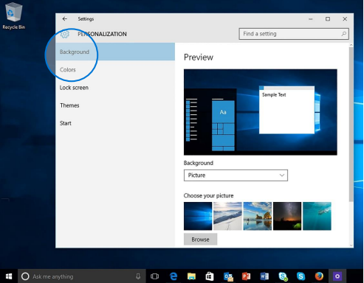
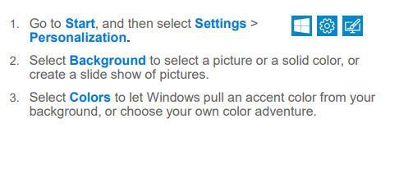
Personalization settings (cont.)
Choose a picture worthy of gracing your desktop background, and to change the accent color for Start, the taskbar, and other items. The preview window gives you a sneak peek of your changes as you make them.

Slide 16
Adding Shortcuts to desktop
Click the Start button
Scroll to the app you want
Hold down the left mouse button
Drag the app to the desktop

Slide 17
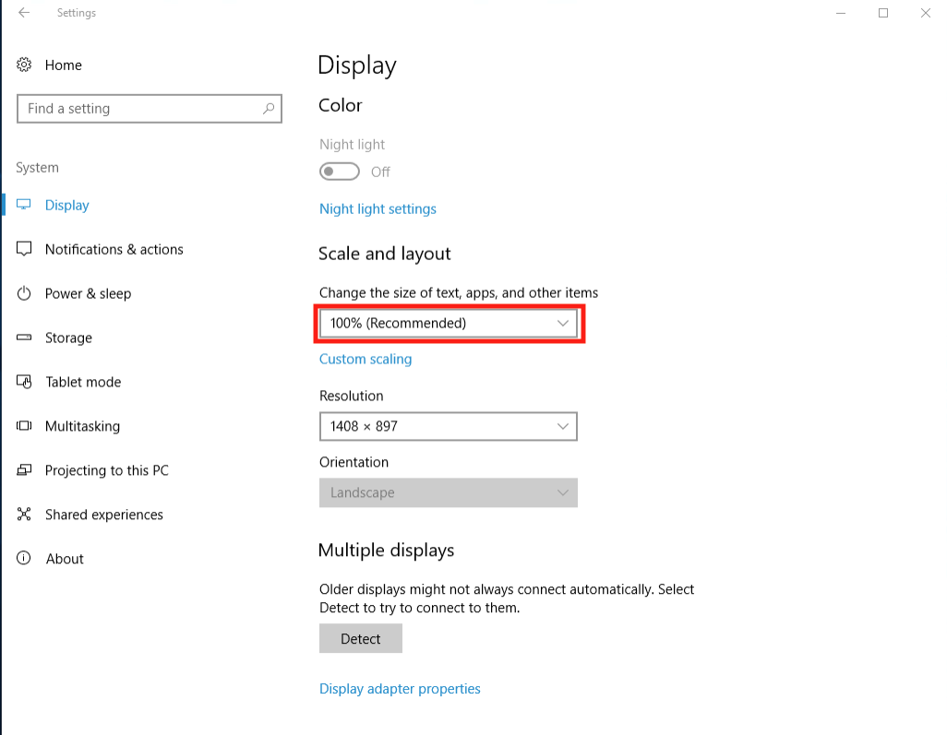
Why is everything hard to see?
Display options are allowed in all versions of Windows.
Under Settings > System > Display
  Choose “Scale and Layout”
  The dropdown allows you to enlarge text, apps, and other items.

Slide 18
Questions??
THANK YOU ☺

