Slide 1


Human Resources Management
Robert L. Mathis ⏐ John H. Jackson
Prepared by Dr. Samah Abdelfatah
MGM 243
Lecture 08

Slide 2



Part 3: Developing HRM
Performance Management and Appraisal
Chapter
11
Lecture 08
MGM 243
Prepared by
Dr. Samah Abdelfatah
www.midocean.ae

Slide 3

Chapter
Learning Outcomes
11
After you have read this chapter, you should be able to:
Identify the components of performance management systems.
Distinguish between performance management and performance appraisal.
Explain the differences between administrative and developmental uses of performance appraisal.
Discuss the importance of training managers and employees about performance appraisal and give examples of rater errors.
Identify several concerns about appraisal feedback and ways to make it more effective
www.midocean.ae

Slide 4
IDENTIFYING AND MEASURING
EMPLOYEE PERFORMANCE
Chapter
11
Performance Management System
Series of activities designed to ensure that the organization gets the performance it needs from its employees.
Processes used to identify, encourage, measure, evaluate, improve, and reward employee performance.
Performance Appraisal
  Process of determining how well employees do their job relative to a standard and communicating that information to the employee
  What an employee does and does not do.
    Quantity of output • Quality of output
    Timeliness of output • Presence at work
    Cooperativeness
www.midocean.ae

Slide 5
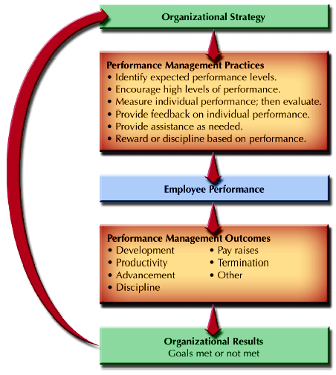
Linkage Between Strategy, Outcomes,
and Organizational Results
FIGURE 11-1
www.midocean.ae

Slide 6

Chapter
Performance-Focused Organizational Cultures
11
Some corporate cultures are based on entitlement, meaning that adequate performance and stability dominate the organization. As a result, performance appraisal activities are seen as having little tie to performance and as being primarily a “bureaucratic exercise.”
At the other end of the spectrum is a performance-driven organizational culture that is focused on results. Performance appraisals link results to employee compensation and development.
www.midocean.ae

Slide 7
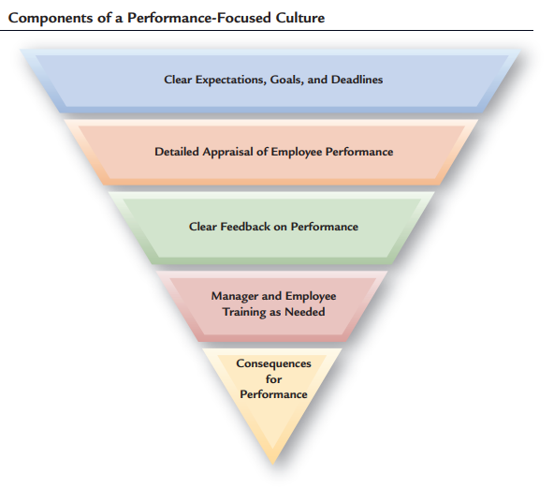
Components of a Performance-Focused Culture
FIGURE 11-2
www.midocean.ae

Slide 8
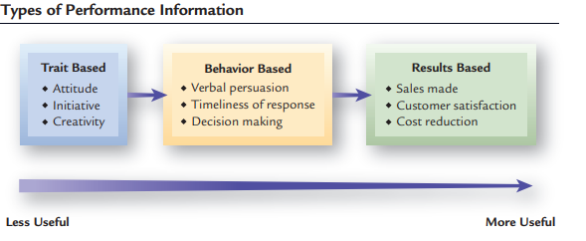
TYPES OF PERFORMANCE INFORMATION
Trait-based
Information
Job
Performance?
Behavior-based
Information
Results-based
Information
FIGURE 11-3
www.midocean.ae

Slide 9
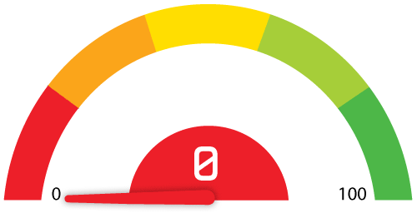
Chapter
PERFORMANCE STANDARDS
11
Expected levels of performance
  Benchmarks
  Goals
  Targets
Characteristics of Well-defined Standards
  Realistic
  Measurable
  Clearly understood
www.midocean.ae

Slide 10
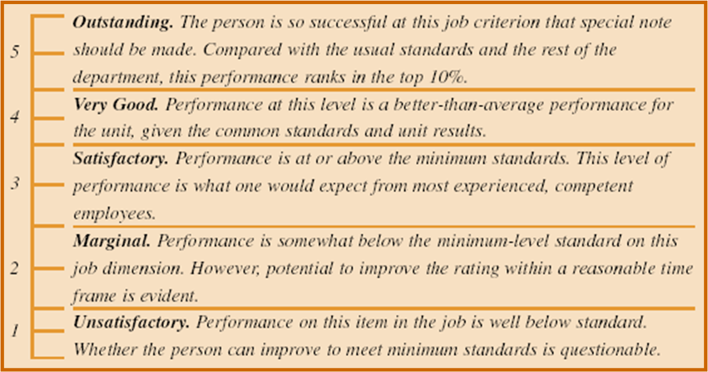
EXAMPLE OF TERMS DEFINING STANDARDS
www.midocean.ae

Slide 11
USES OF PERFORMANCE APPRAISAL
Performance
Appraisal
Administrative Uses of Appraisals
Developmental Uses of Appraisals
Three administrative uses of appraisal impact managers and employees the most:
(1) determining pay adjustments; (2) making job placement decisions on promotions, transfers, and demotions
(3) choosing employee disciplinary actions up to and including termination of employment.
Source of information and feedback, for future development.
Identifying employee strengths, weaknesses, potentials, and training needs through performance appraisal feedback.
www.midocean.ae

Slide 12
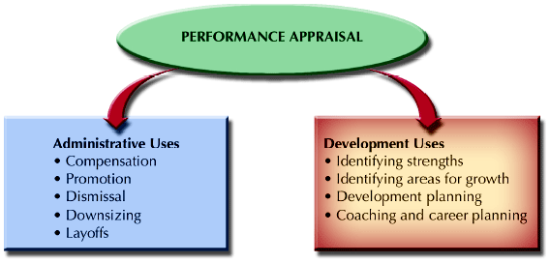
CONFLICTING ROLES FOR PERFORMANCE APPRAISAL
Figure 11–4
www.midocean.ae

Slide 13
Chapter
Decisions About the Performance Appraisal Process
11
Appraisal Responsibilities The appraisal process can benefit both the organization and the employees, if done properly.
Informal vs. Systematic Appraisal Processes
  Informal Appraisal
    Day-to-day contacts, largely undocumented
  Systematic Appraisal
    Formal contact at regular time intervals, usually documented
www.midocean.ae

Slide 14
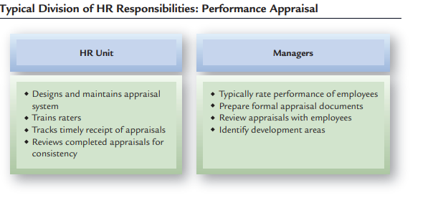
Typical Division of HR Responsibilities: Performance Appraisal
www.midocean.ae

Slide 15
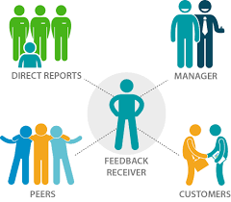
Chapter
WHO CONDUCTS APPRAISALS
11
Supervisors who rate their subordinates
Employees who rate their supervisors
Team members who rate each other
Outside sources
Employees’ self-appraisal
Multisource (360° feedback) appraisal
www.midocean.ae

Slide 16
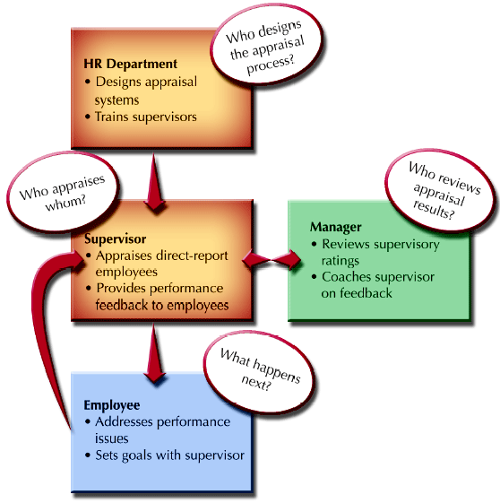
Traditional Performance Appraisal: Logic And Process
Figure 11–5
www.midocean.ae

Slide 17
EMPLOYEE RATING OF MANAGERS
Advantages
  Helps in identifying competent managers
  Serves to make managers more responsive to employees
  Can contribute to the career development of managers
Disadvantages
  Negative reactions by managers to employee ratings
  Subordinates’ fear of reprisals may inhibit them from giving realistic (negative) ratings
  Ratings are useful only for self-improvement purposes
www.midocean.ae

Slide 18
TEAM/PEER RATINGS
Disadvantages
  Can negatively affect working relationships.
  Can create difficulties for managers in determining individual performance.
  Organizational use of individual performance appraisals can hinder the development of teamwork
Advantages
  Helps improve the performance of lower-rated individuals
  Peers have opportunity to observe other peers.
  Peer appraisals focus on individual contributions to teamwork and team performance.
www.midocean.ae

Slide 19
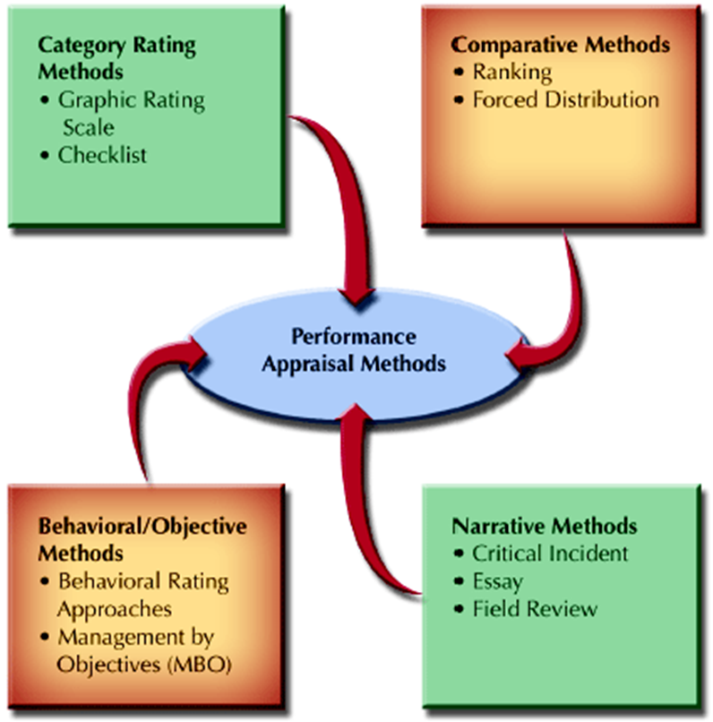
PERFORMANCE APPRAISAL METHODS
Figure 11–6
www.midocean.ae

Slide 20
Chapter
1. CATEGORY RATING METHODS
11
1. Graphic Rating Scale
A scale that allows the rater to indicate an employee’s performance on a continuum.
    Job criteria scales
    Behavioral scales
Drawbacks
  Restrictions on the range of possible rater responses
  Differences in the interpretations of the meanings of scale items and scale ranges by raters
  Poorly designed scales that encourage rater errors
  Rating form deficiencies that limit the effectiveness of the appraisal
www.midocean.ae

Slide 21
1. CATEGORY RATING METHODS (CONT’D)
2. Checklists
  A performance appraisal tool that uses a list of statements or work behaviors that are checked by raters.
    Can be quantified by applying weights to individual checklist items.
    Drawbacks:
    Interpretation of item meanings by raters
    Weighting creates problems in appraisal interpretation
    Assignment of weights to items by persons other than the raters
www.midocean.ae

Slide 22
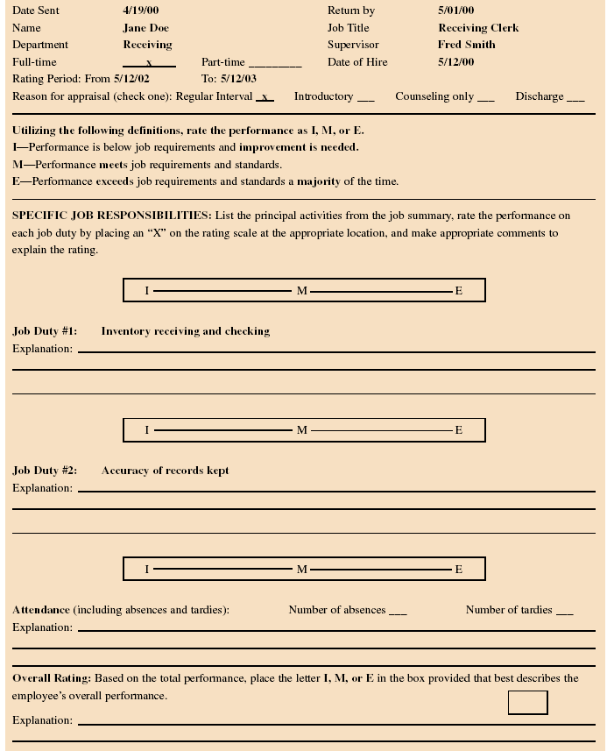
SAMPLE PERFORMANCE APPRAISAL FORM
www.midocean.ae

Slide 23
SAMPLE PERFORMANCE APPRAISAL FORM CONT
www.midocean.ae

Slide 24
2. COMPARATIVE METHODS
1. Ranking
  Listing of all employees from highest to lowest in performance.
  Drawbacks:
    Does not show size of differences in performance between employees
    Implies that lowest-ranked employees are unsatisfactory performers.
    Becomes an unwieldy process if the group to be ranked is large.
www.midocean.ae

Slide 25
2. COMPARATIVE METHODS (CONT’D)
2. Forced Distribution
  Performance appraisal method in which ratings of employees are distributed along a bell-shaped curve.
Drawbacks:
  Assumes a normal distribution of performance.
  Resistance by managers to placing individuals in the lowest or highest groups.
  Providing explanation for placement in a higher or lower grouping can be difficult.
  Is not readily applicable to small groups of employees.
www.midocean.ae

Slide 26
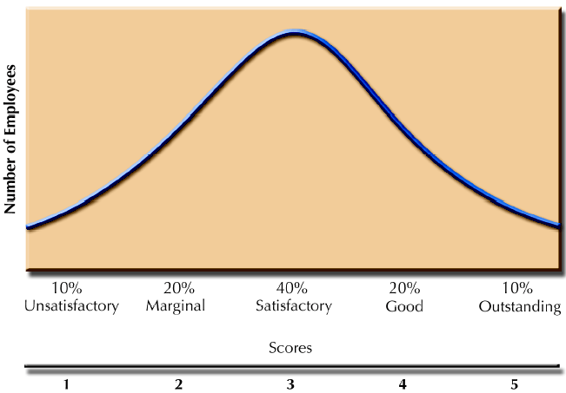
FORCED DISTRIBUTION ON A BELL-SHAPED CURVE
Figure 11–7
www.midocean.ae

Slide 27
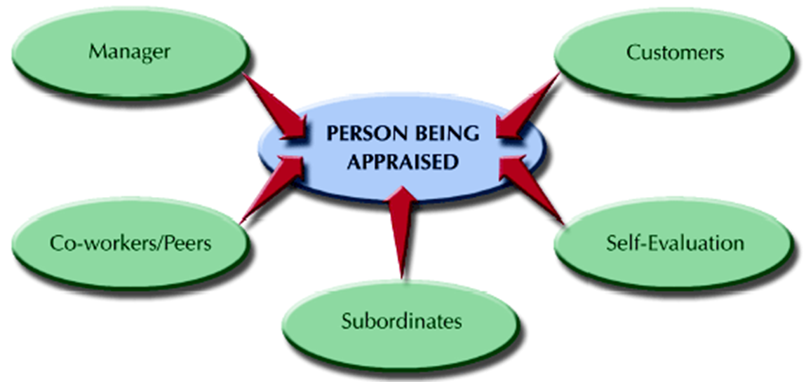
3. NARRATIVE METHODS
Figure 11–8
www.midocean.ae

Slide 28
3. NARRATIVE METHODS CONT.
1. Critical Incident
  Manager keeps a written record of highly favorable and unfavorable employee actions.
Drawbacks
  Variations in how managers define a “critical incident”
  Time involved in documenting employee actions
  Most employee actions are not observed and may become different if observed
  Employee concerns about manager’s “black books”
www.midocean.ae

Slide 29
3. NARRATIVE METHODS CONT.
2. Essay Method: Manager writes a short essay describing an employee’s performance.
Drawbacks
  Depends on the managers’ writing skills and their ability to express themselves.
3. Field Review :Outside reviewer interviews the manager about the performance of each employee and develops a rating for the employees from the interview notes.
  Drawbacks
  The external reviewer may lack sufficient knowledge of the employees' daily work.
  The evaluation may rely heavily on the manager's information, which may be biased.
  This method can be costly and time-consuming.
www.midocean.ae

Slide 30
4. BEHAVIORAL/OBJECTIVE METHODS
1. Behavioral Rating Approach
  Assesses employees’ behaviors instead of other characteristics
  Consists of a series of scales created by:
    Identifying important job dimensions
    Creating statements describing a range of desired and undesirable behaviors (anchors)
Types of behavioral scales
    Behaviorally Anchored Rating Scales (BARS)
    Behavioral Observation Scales (BOS)
    Behavioral Expectation Scales (BES)
www.midocean.ae

Slide 31
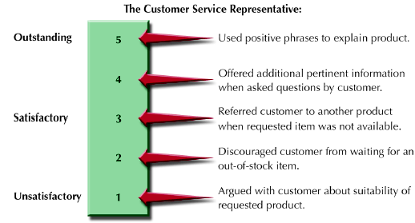
CUSTOMER SERVICE SKILLS (BOS)
Figure 11–9
www.midocean.ae

Slide 32
4. BEHAVIORAL/OBJECTIVE METHODS CONT.
2. Management by Objectives
  Specifying the performance goals that an individual and his or her manager agree to try to attain within an appropriate length of time.
Key MBO Ideas
  Employee involvement creates higher levels of commitment and performance.
  Encourages employees to work effectively toward achieving desired results.
  Performance measures should be measurable and should define results.
www.midocean.ae

Slide 33
THE MBO PROCESS
Job Review and Agreement
Development of Performance Standards
Guided Objective Setting
Continuing Performance Discussions
www.midocean.ae

Slide 34
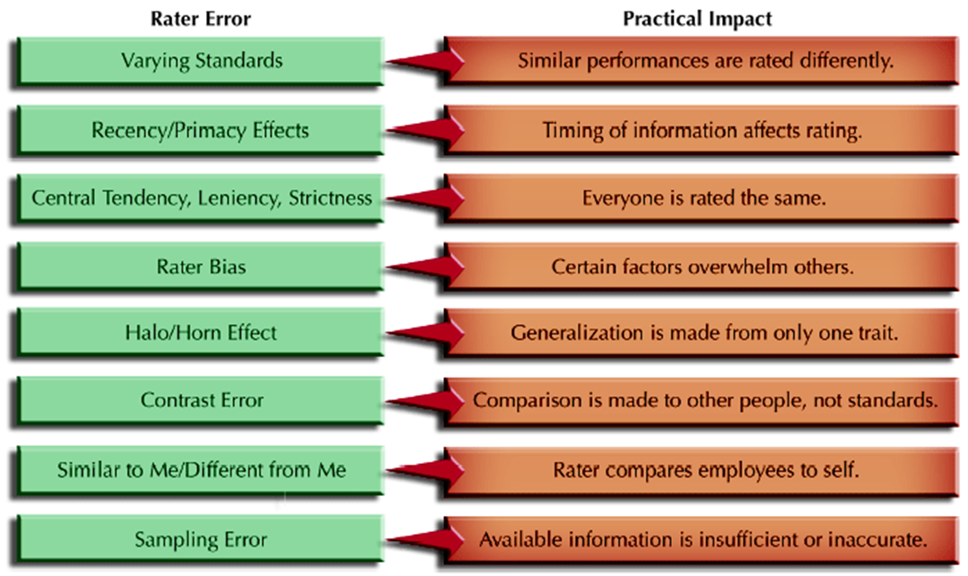
COMMON RATER ERRORS
Figure 11–10
www.midocean.ae

Slide 35
FEEDBACK AS A SYSTEM
Data
Evaluation
of Data
Feedback
System
Action Based on Evaluation
www.midocean.ae

Slide 36
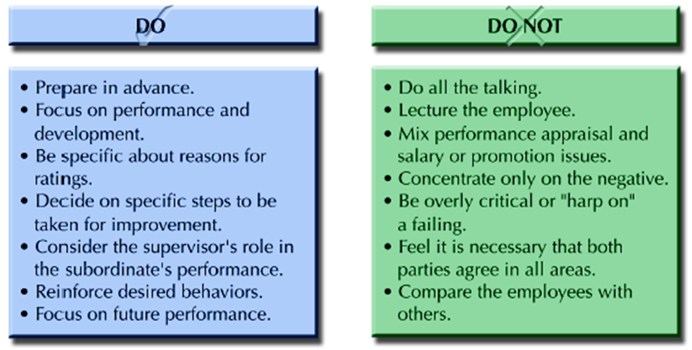
APPRAISAL INTERVIEW HINTS
Figure 11–11
www.midocean.ae

Slide 37
PERFORMANCE APPRAISALS and the LAW
Legally Defensible PA System
  Appraisal criteria based on job analysis
  Absence of disparate impact and evidence of validity
  Formal evaluation criterion that limit managerial discretion
  Formal rating instrument linked to job duties and responsibilities
  Training of supervisors in conducting appraisals
  Review process to prevent undue control of careers
  Counseling to help poor performers improve
www.midocean.ae

Slide 38
PERFORMANCE MANAGEMENT SYSTEM
Effective PMS systems are:
  Consistent with the strategic mission of the organization
  Beneficial as development tool
  Useful as an administrative tool
  Legal and job-related
  Viewed as generally fair by employees
  Effective in documenting employee performance
www.midocean.ae

Slide 39
SUMMARY
Performance Management System
Performance Appraisal
Linkage Between Strategy, Outcomes, And Organizational Results
Performance-focused Organizational Cultures
Types Of Performance Information
Uses Of Performance Appraisal
Decisions About The Performance Appraisal Process
Who Conducts Appraisals
Performance Appraisal Methods
Common Rater Errors
Performance Appraisals And The Law
Effective PMS systems are

Slide 40



Thank You

