Slide 1


Introduction to Finance
Prepared by
Dr. Mohamed Hussein
Assistant Professor of Accounting
MGM237
Lecture 1

Slide 2



Introduction To Finance
Lecture 1
MGM237 An Overview of Finance
Prepared by
Dr. Mohamed Hussein

Slide 3

Chapter
An Overview of Finance
01

Slide 4

Chapter
An Overview of Finance
1
What is Finance ?
Areas of Finance
Finance Versus Economics and Accounting
Forms of Business Organization
The Main Financial Goal: Creating Value for Investors
Stockholder–Manager Conflicts
Stockholder–Debtholder Conflicts

Slide 5

Chapter
What Is Finance?
01
Finance is the study and management of money, investments, and other financial instruments.
It involves the processes of raising capital, managing assets, and making decisions about how to allocate resources to optimize returns and minimize risks.

Slide 6

Chapter
What Is Finance?
01
Finance encompasses a broad range of activities, including:
Personal Finance: Managing individual or household budgets, savings, investments, and debt.
Corporate Finance: Focusing on the financial decisions made by businesses, including capital structure, investment strategy, and financing decisions.

Slide 7

Chapter
What Is Finance?
01
Public Finance: Involves government expenditures, taxation, and budgeting to manage public funds and infrastructure investments.
Financial Markets: Where financial instruments, such as stocks, bonds, and derivatives, are traded.
Overall, finance seeks to optimize the allocation of funds to achieve objectives such as profitability, liquidity, and solvency.

Slide 8

Chapter
What Is Finance?
01
Finance is defined by Webster’s Dictionary as “the system that includes the circulation of money, the granting of credit, the making of investments, and the provision of banking facilities.”
Finance has many facets, which makes it difficult to provide one concise definition.

Slide 9
Chapter
Key Components of Finance:
01
Circulation of Money:
Involves the movement of funds between individuals, businesses, and financial institutions.
Facilitates economic activities by ensuring that money flows smoothly within the economy.
Granting of Credit:
Pertains to the provision of loans and credit facilities to individuals and businesses.
Enables consumers to make purchases and businesses to invest and expand operations without needing immediate capital.

Slide 10
Chapter
Key Components of Finance:
01
Making of Investments:
Involves allocating funds into various assets such as stocks, bonds, real estate, and other investment vehicles.
Aims to generate returns and grow wealth over time.
Provision of Banking Facilities:
Encompasses a range of services provided by banks and financial institutions, including checking and savings accounts, mortgages, and financial advising.
Supports both personal and business financial needs.

Slide 11
Chapter
An Overview of Finance
1
What is Finance ?
Areas of Finance
Finance Versus Economics and Accounting
Forms of Business Organization
The Main Financial Goal: Creating Value for Investors
Stockholder–Manager Conflicts
Stockholder–Debtholder Conflicts

Slide 12
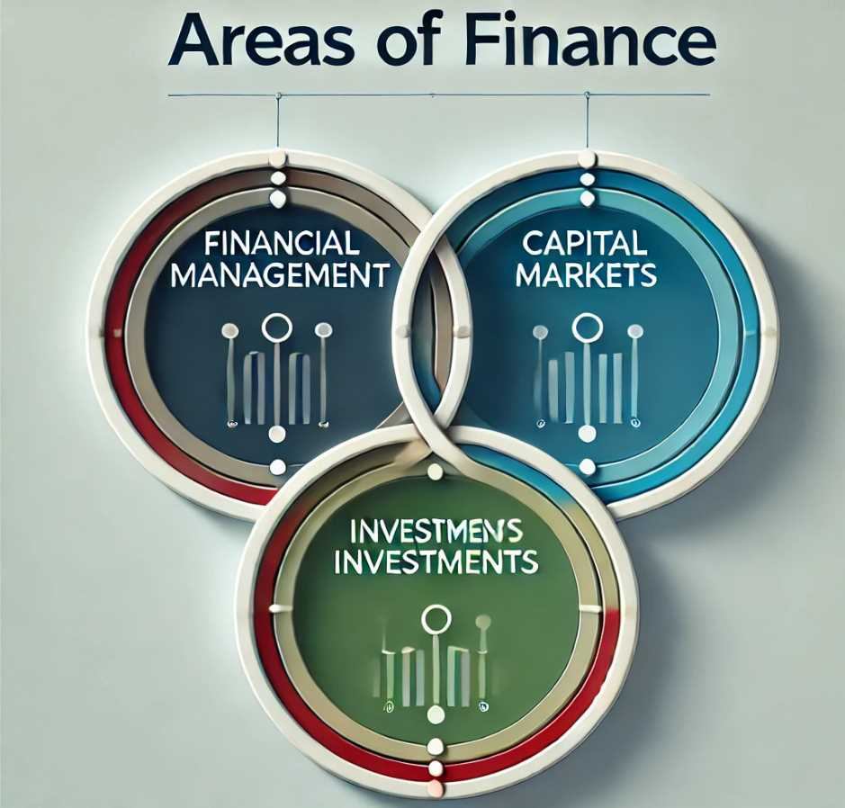
Chapter
Areas OF Finance
01
Finance as taught in universities is generally divided into three areas:
Financial management.
capital markets.
investments.
Financial management, also called corporate finance, focuses on decisions relating to how much and what types of assets to acquire, how to raise the capital
needed to purchase assets, and how to run the firm to maximize its value.

Slide 13
Chapter
Financial Management (Corporate Finance)
01
Key Areas:
Operational Management:
  Managing the company's financial operations to ensure efficiency and profitability.
  Implementing budgeting processes, financial reporting, and performance monitoring to maintain and enhance the company's financial health.
Objectives:
Optimize the capital structure to balance debt and equity.
Ensure sufficient liquidity to meet short-term obligations.
Enhance shareholder value through strategic financial decisions.

Slide 14
Chapter
Financial Management (Corporate Finance)
01
Key Areas:
Asset Acquisition:
  Determining the types and amounts of assets the company needs to acquire to achieve its business objectives.
  Evaluating potential investments in assets such as machinery, technology, real estate, and other capital goods.
Capital Raising:
  Identifying and securing the necessary capital to purchase assets.
  Deciding between different sources of financing, such as equity (issuing stocks), debt (taking loans or issuing bonds), or internal funds (retained earnings).

Slide 15
Chapter
Areas OF Finance
01
Capital markets relate to the markets where interest rates, along with stock
and bond prices, are determined. Also studied here are the financial institutions that supply capital to businesses. Banks, investment banks, stockbrokers,
mutual funds, insurance companies, and the like bring together “savers” who
have money to invest and businesses, individuals, and other entities that need capital for various purposes.

Slide 16
Chapter
Capital Markets
01
Focus: Capital Markets pertain to the venues where financial securities such as stocks and bonds are issued and traded. This area involves understanding how interest rates and security prices are determined and the role of various financial institutions in facilitating the flow of capital.
Key Areas:
Interest Rates and Security Pricing:
  Analyzing how interest rates are set and how they influence the pricing of financial instruments like bonds and stocks.
  Understanding the factors that drive supply and demand in the markets, thereby affecting asset prices.

Slide 17
Chapter
Capital Markets
02
Key Areas:
Financial Institutions:
  Studying the roles of different financial institutions, including banks, investment banks, stockbrokers, mutual funds, and insurance companies.
  Understanding how these institutions mobilize savings from individuals ("savers") and channel them to businesses, individuals, and other entities in need of capital.

Slide 18
Chapter
Capital Markets
02
Key Areas:
Market Dynamics:
  Exploring how information, regulations, and economic indicators impact capital markets.
  Analyzing market trends, investor behavior, and the impact of global events on financial markets.
Objectives:
Facilitate efficient allocation of capital within the economy.
Provide mechanisms for risk management and liquidity.
Support economic growth by enabling businesses to raise funds for expansion and innovation.

Slide 19
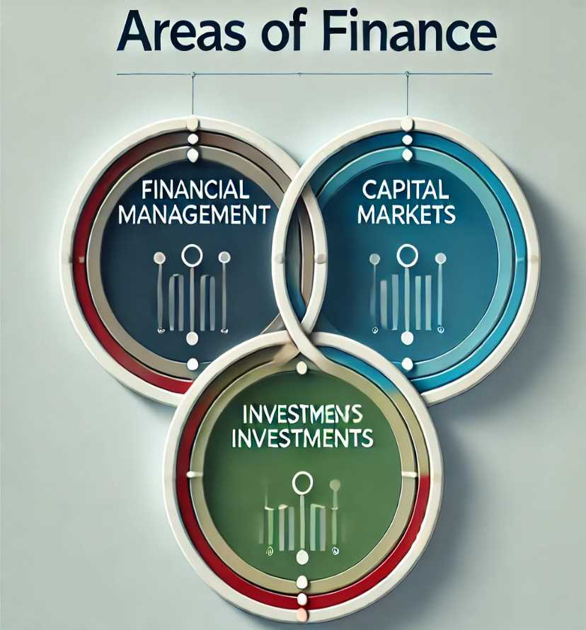
Chapter
Areas OF Finance
01
Investments, relate to decisions concerning stocks and bonds and include a number of activities:
(1) Security analysis deals with finding the proper values of individual securities (i.e., stocks and bonds).
(2) Portfolio theory deals with the best way to structure portfolios, or “baskets,” of stocks and bonds.

Slide 20
Chapter
Areas OF Finance
01
Rational investors want to hold diversified portfolios in order to limit risks, so choosing a properly balanced portfolio is an important issue for any investor.
(3) Market analysis deals with the issue of whether stock and bond markets at any given time are “too high,” “too low,” or “about right.”

Slide 21
Chapter
Investments
01
Focus: The Investments area concentrates on how individuals and institutions allocate their capital into various financial instruments to achieve desired returns. It involves analyzing different types of investment vehicles, assessing their risk and return profiles, and making informed investment decisions.
Key Areas:
Investment Vehicles:
  Studying a range of investment options including stocks, bonds, real estate, mutual funds, exchange-traded funds (ETFs), and alternative investments.
  Understanding the characteristics, advantages, and disadvantages of each investment type.

Slide 22
Chapter
Investments
01
Portfolio Management:
Learning how to construct and manage investment portfolios to optimize returns while managing risk.
Implementing diversification strategies to spread risk across different asset classes and securities.
Risk and Return Analysis:
Evaluating the relationship between risk and expected returns.
Utilizing financial models and metrics to assess the performance of investments and make data-driven decisions.

Slide 23
Chapter
Investments
01
Portfolio Management:
Learning how to construct and manage investment portfolios to optimize returns while managing risk.
Implementing diversification strategies to spread risk across different asset classes and securities.
Risk and Return Analysis:
Evaluating the relationship between risk and expected returns.
Utilizing financial models and metrics to assess the performance of investments and make data-driven decisions.

Slide 24
Chapter
An Overview of Finance
1
What is Finance ?
Areas of Finance
Finance Versus Economics and Accounting
Forms of Business Organization
The Main Financial Goal: Creating Value for Investors
Stockholder–Manager Conflicts
Stockholder–Debtholder Conflicts

Slide 25

Chapter
Finance Versus Economics and Accounting
01
Primary Focus
Main Areas
Core Objectives

Slide 26
Chapter
Finance Versus Economics and Accounting
01
Criteria | Finance | Economics | Accounting
Primary Focus | Managing money, investments, and the allocation of financial resources to maximize value. | Studying how societies allocate scarce resources to produce and distribute goods and services. | Recording, classifying, and summarizing financial transactions to provide accurate financial information for decision-making.

Slide 27
Chapter
Finance Versus Economics and Accounting
01
Criteria | Finance | Economics | Accounting
Main Areas | Financial management. - Capital Markets - Investments | - Microeconomics - Macroeconomics - International Economics - Development Economics | - Financial Accounting - Management Accounting - Tax Accounting - Auditing

Slide 28
Chapter
Finance Versus Economics and Accounting
02
Criteria | Finance | Economics | Accounting
Core Objectives | - Maximizing investment returns - Minimizing financial risks - Optimizing capital structure | - Understanding economic growth and development - Analyzing the impact of economic policies - Studying resource and wealth distribution | - Ensuring accuracy of financial records - Compliance with financial regulations and standards - Providing useful information for management decisions

Slide 29
Chapter
An Overview of Finance
1
What is Finance ?
Areas of Finance
Finance Versus Economics and Accounting
Forms of Business Organization
The Main Financial Goal: Creating Value for Investors
Stockholder–Manager Conflicts
Stockholder–Debtholder Conflicts

Slide 30
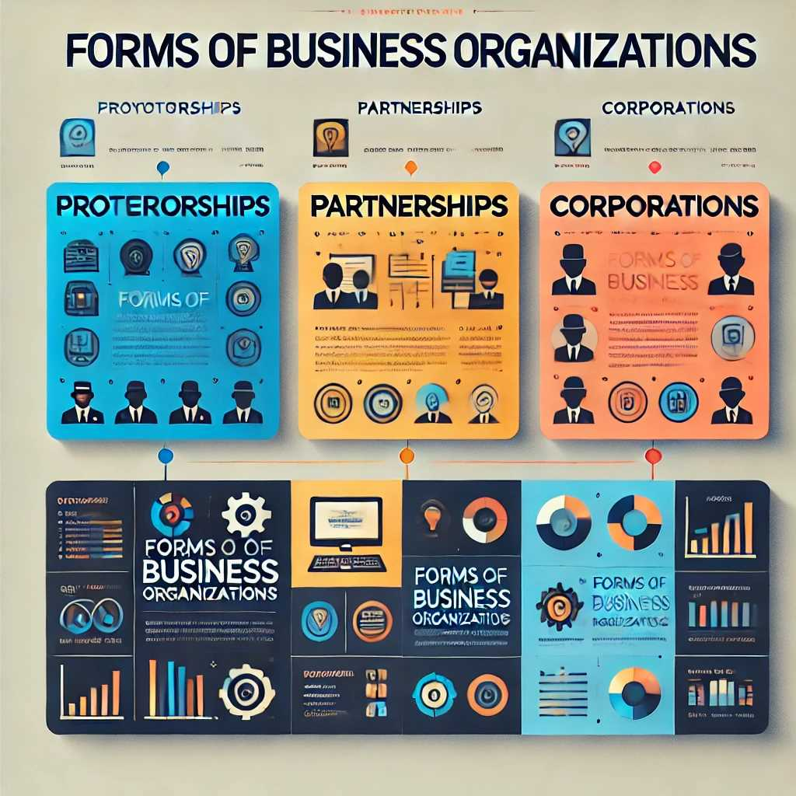
Chapter
FORMS OF BUSINESS ORGANIZATION
01
The basics of financial management are the same for all businesses, large or small,
regardless of how they are organized. Still, a firm’s legal structure affects its
operations and thus should be recognized.

Slide 31
Chapter
FORMS OF BUSINESS ORGANIZATION
01
There are three main forms of business organizations:
Proprietorships.
Partnerships.
Corporations.
limited liability companies (LLCs)
limited liability partnerships (LLPs)

Slide 32

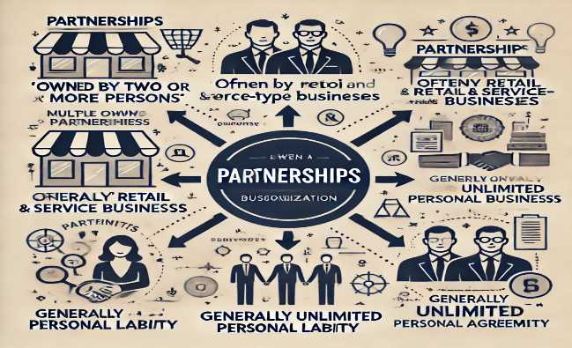
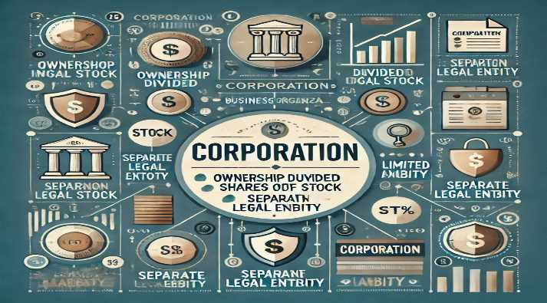
Chapter
FORMS OF BUSINESS ORGANIZATION
01
Owned by one person
Owner is often manager/operator
Owner receives any profits, suffers any losses, and is personally liable for all debts
Owned by two or more persons
Often retail and service-type businesses
Generally unlimited personal liability
Partnership agreement
Ownership divided into shares of stock
Separate legal entity organized under state corporation law
Limited liability

Slide 33

Chapter
FORMS OF BUSINESS ORGANIZATION
01
A proprietorship is an unincorporated business owned by one individual. Going
into business as a sole proprietor is easy—a person begins business operations.
Proprietorships have three important advantages:
(1) They are easy to form.
(2) They are subject to few government regulations.
(3) They are subject to lower income taxes than are corporations.
.

Slide 34

Chapter
FORMS OF BUSINESS ORGANIZATION
01
A partnership is a legal arrangement between two or more people Who decide to do business together. Partnerships are similar to proprietorships in that they can be established relatively easily and inexpensively.
Moreover, the firm’s income is allocated on a pro rata basis to the partners and is taxed on an individual basis.
This allows the firm to avoid the corporate income tax.

Slide 35

Chapter
FORMS OF BUSINESS ORGANIZATION
01
Limited Liability Company (LLC)
Hybrid Structure: Combines elements of corporations and partnerships/sole proprietorships.
Limited Liability: Owners (called members) are protected from personal liability for business debts.
Flexible Management: Can be managed by members or designated managers.
Pass-Through Taxation: Profits are passed to owners without corporate taxes, similar to a partnership or sole proprietorship.
Ownership: Can be owned by one or more members (individuals, corporations, or even other LLCs).
.

Slide 36

Chapter
FORMS OF BUSINESS ORGANIZATION
01
Limited Liability Partnership (LLP)
Partnership with Limited Liability: Primarily used by professionals like lawyers, doctors, accountants.
Limited Liability: Partners are not personally liable for the actions or debts of other partners, though they might be liable for their own misconduct.
Pass-Through Taxation: Profits pass through to partners who report them on their personal tax returns.
Flexible Structure: Partners share in management but enjoy personal liability protection.

Slide 37

Chapter
FORMS OF BUSINESS ORGANIZATION
01
A corporation is a legal entity created by a state, and it is separate and distinct from its owners and managers.
It is this separation that limits stockholders’ losses to the amount they invested in the firm.
the corporation can lose all of its money, but its owners can lose only the funds that they invested in the company.

Slide 38

Chapter
FORMS OF BUSINESS ORGANIZATION
01
Corporations also have unlimited lives, and it is easier to transfer shares of stock in a corporation than one’s interest in an unincorporated business.
These factors make it much easier for corporations to raise the capital necessary to operate large businesses.
Thus, companies such as Hewlett-Packard and Microsoft generally
begin as proprietorships or partnerships, but at some point, they find it advantageous to become a corporation.

Slide 39
Chapter
An Overview of Finance
1
What is Finance ?
Areas of Finance
Finance Versus Economics and Accounting
Forms of Business Organization
The Main Financial Goal: Creating Value for Investors
Stockholder–Manager Conflicts
Stockholder–Debtholder Conflicts

Slide 40
The Main Financial Goal: Creating Value for Investors
Chapter
01
In public corporations, managers and employees work on behalf of the shareholders ,who own the business, and therefore they have an obligation to pursue policies that promote stockholder value.
While many companies focus on maximizing a broad range of financial objectives, such as growth, earnings per share, and market share, these goals should not take precedence over the main financial goal, which is to create value for investors.

Slide 41
The Main Financial Goal: Creating Value for Investors
Chapter
01
If a manager is to maximize stockholder wealth, he or she must know how
that wealth is determined.
we shall see that the value of any asset is the present value of the stream of cash flows that the asset provides to its owners over time.
stock prices are based on cash flows expected in future years, not just in the current year. Thus, stock price maximization requires us to take a long-run view of operations. At the same time, managerial actions that affect a company’s value may not immediately be reflected in the company’s stock price.

Slide 42
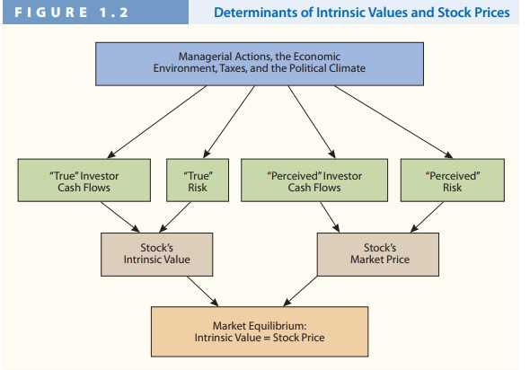
The Main Financial Goal: Creating Value for Investors
Chapter
01

Slide 43

The Main Financial Goal: Creating Value for Investors
Chapter
01
1. Managerial Actions, the Economic Environment, Taxes, and the Political Climate
This top section represents the external factors and actions that influence investor behavior and the stock's value. These factors can change investor expectations, risks, and cash flows, ultimately affecting both the intrinsic and perceived value of the stock.

Slide 44

The Main Financial Goal: Creating Value for Investors
Chapter
01
2. "True" Investor Cash Flows and "True" Risk
These are fundamental factors related to the intrinsic value of the stock.
"True" Investor Cash Flows: The actual or fundamental cash flows expected by investors.
"True" Risk: The real risks associated with the stock that investors consider.

Slide 45

The Main Financial Goal: Creating Value for Investors
Chapter
01
3. Stock’s Intrinsic Value
Based on true cash flows and risks, this represents the actual or fundamental value of the stock. This is what the stock is theoretically worth based on all available information.

Slide 46

The Main Financial Goal: Creating Value for Investors
Chapter
01
4. "Perceived" Investor Cash Flows and "Perceived" Risk
These represent the investors' perceptions of the stock's future cash flows and risks, which may differ from the actual or "true" values.
"Perceived" Investor Cash Flows: What investors believe will be the future cash flows.
"Perceived" Risk: The risks that investors think the stock carries.

Slide 47

The Main Financial Goal: Creating Value for Investors
Chapter
01
5. Stock’s Market Price
Based on perceived investor cash flows and risks, this is the price at which the stock is currently trading in the market. It reflects the collective perceptions of all market participants.

Slide 48

The Main Financial Goal: Creating Value for Investors
Chapter
01
6. Market Equilibrium
The diagram indicates that market equilibrium is achieved when the stock’s intrinsic value equals its market price. This means that investor perceptions align with the stock's actual value, resulting in no pressure for the price to change.

Slide 49
The Main Financial Goal: Creating Value for Investors
Chapter
01
The top box indicates that managerial actions, combined with the economy, taxes, and political conditions, influence the level and riskiness of the company’s future cash flows, which ultimately determine the company’s stock price.
As you might expect, investors like higher expected cash flows, but they dislike risk; so, the larger the expected cash flows and the lower the perceived risk, the higher the stock’s price.

Slide 50

The Main Financial Goal: Creating Value for Investors
Chapter
01
The second row of boxes differentiates what we call “true” expected cash flows
and “true” risk from “perceived” cash flows and “perceived” risk.
By “true,” we mean the cash flows and risk that investors would expect if they had all of the information that existed about a company. “Perceived” means what investors expect,
given the limited information they have.

Slide 51

The Main Financial Goal: Creating Value for Investors
Chapter
01
To illustrate, in early 2001, investors had information that caused them to think Enron was highly profitable and would enjoy high and rising future profits.
They also thought that actual results would be close to the expected levels and hence that Enron’s risk was low.
However, true estimates of Enron’s profits, which were known by its executives, but not the investing public, were much lower; Enron’s true situation was extremely risky

Slide 52

The Main Financial Goal: Creating Value for Investors
Chapter
01
Consequences OF Having a Short- run Focus
Ideally, managers adhere to this long-run focus, but there are numerous examples in recent years where the focus for many companies shifted to the short run.
Perhaps most notably, prior to the recent financial crisis, many Wall
Street executives received huge bonuses for engaging in risky transactions that
generated short-term profits. Subsequently, the value of these transactions collapsed, causing many of these Wall Street firms to seek a massive government bailout.

Slide 53

The Main Financial Goal: Creating Value for Investors
Chapter
01
Consequences OF Having a Short- run Focus
A bailout is when the government gives financial support to rescue a company that is in financial trouble and possibly at risk for bankruptcy.

Slide 54

The Main Financial Goal: Creating Value for Investors
Chapter
01
Consequences OF Having a Short- run Focus
there have been other examples where managers have focused on short-run profits to the detriment of long-term value.
For example, Wells Fargo implemented incentives to reward employees for signing up customers to new accounts.
Unfortunately, to obtain bonuses some employees created fake accounts or signed up customers for unauthorized credit cards.

Slide 55
The Main Financial Goal: Creating Value for Investors
Chapter
01
Consequences OF Having a Short- run Focus
This led to the firing of thousands of employees, as well as its CEO and other senior managers, and millions of dollars in fines for Wells Fargo.
With these types of concerns in mind, many academics and practitioners stress the need for
boards and directors to establish effective procedures for corporate governance.
Component of strong governance.

Slide 56
The Main Financial Goal: Creating Value for Investors
Chapter
01
Consequences OF Having a Short- run Focus
This involves putting in place a set of rules and practices to ensure that managers act in shareholders’ interests while also balancing the needs of other key constituencies such as customers, employees, and affected citizens.
Having a strong, independent board of directors is viewed as an important component of strong governance.

Slide 57

The Main Financial Goal: Creating Value for Investors
Chapter
01
Effective governance requires holding managers accountable for poor performance and understanding the important role that executive compensation plays
in encouraging managers to focus on the proper objectives.

Slide 58
Chapter
An Overview of Finance
1
What is Finance ?
Areas of Finance
Finance Versus Economics and Accounting
Forms of Business Organization
The Main Financial Goal: Creating Value for Investors
Stockholder–Manager Conflicts
Stockholder–Debtholder Conflicts

Slide 59
Chapter
Stockholder–Manager Conflicts
01
It has long been recognized that managers’ personal goals may compete with
shareholder wealth maximization.
Managers might be more interested in maximizing their own wealth than their stockholders’ wealth; therefore, managers might pay themselves excessive salaries.
Effective executive compensation plans motivate managers to act in their stockholders’ best interests.
Agency problem: the likelihood that managers may place personal goals ahead of corporate goals

Slide 60
Chapter
Stockholder–Manager Conflicts
01
Useful motivational tools include
reasonable compensation packages,
firing of managers who don’t perform well
The threat of hostile takeovers
Compensation packages should be sufficient to attract and retain able managers, but they should not go beyond what is needed.
Compensation policies need to be consistent over time.

Slide 61
Chapter
An Overview of Finance
1
What is Finance ?
Areas of Finance
Finance Versus Economics and Accounting
Forms of Business Organization
The Main Financial Goal: Creating Value for Investors
Stockholder–Manager Conflicts
Stockholder–Debtholder Conflicts

Slide 62
Chapter
Stockholder–Debtholder Conflicts
01
Conflicts can also arise between stockholders and debtholders. Debtholders, which
include the company’s bankers and its bondholders, generally receive fixed payments regardless of how well the company does, while stockholders do better when the company does better.
This situation leads to conflicts between these two groups, to the extent that stockholders are typically more willing to take on risky projects.

Slide 63
Chapter
An Overview of Finance
1
What is Finance ?
Areas of Finance
Finance Versus Economics and Accounting
Forms of Business Organization
The Main Financial Goal: Creating Value for Investors
Stockholder–Manager Conflicts
Stockholder–Debtholder Conflicts

Slide 64



Thank You

