Slide 1
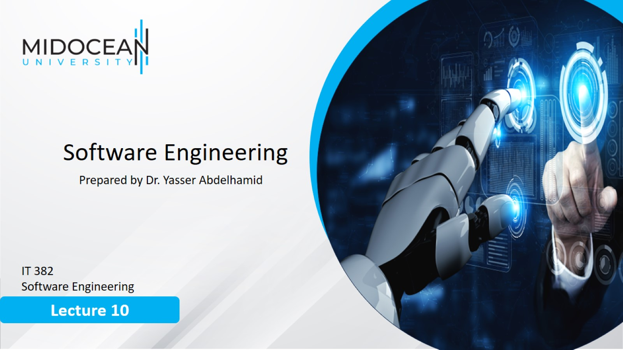

Slide 2
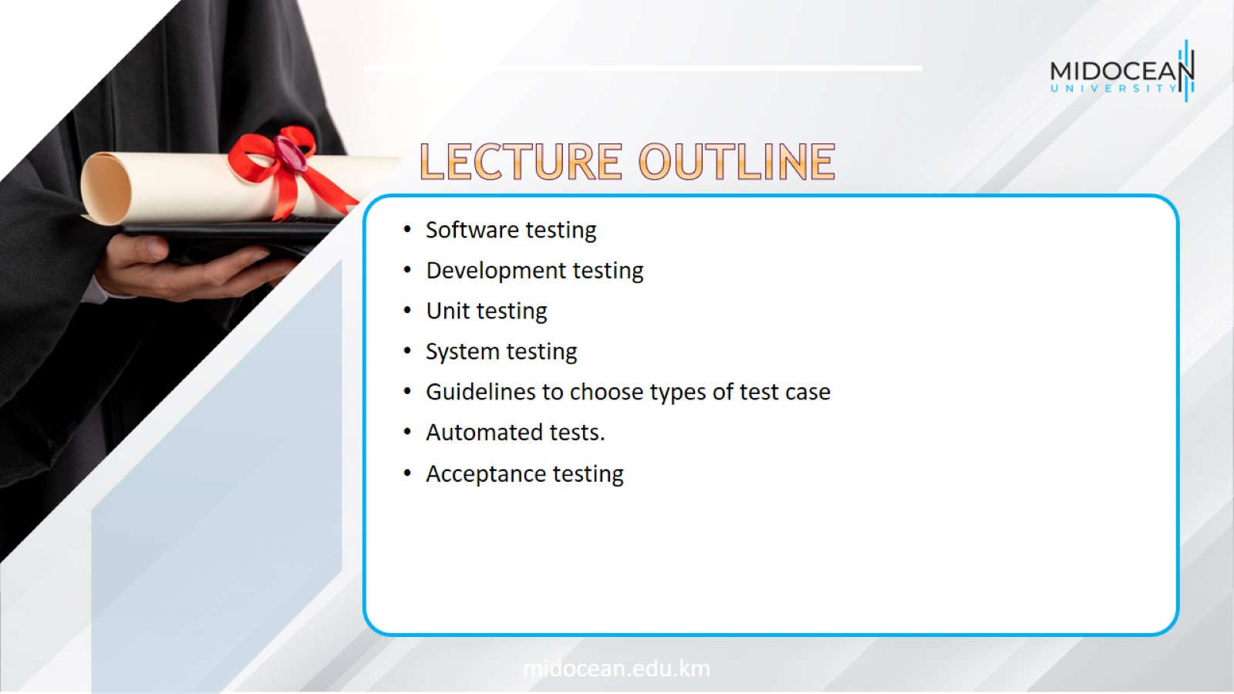

Slide 3
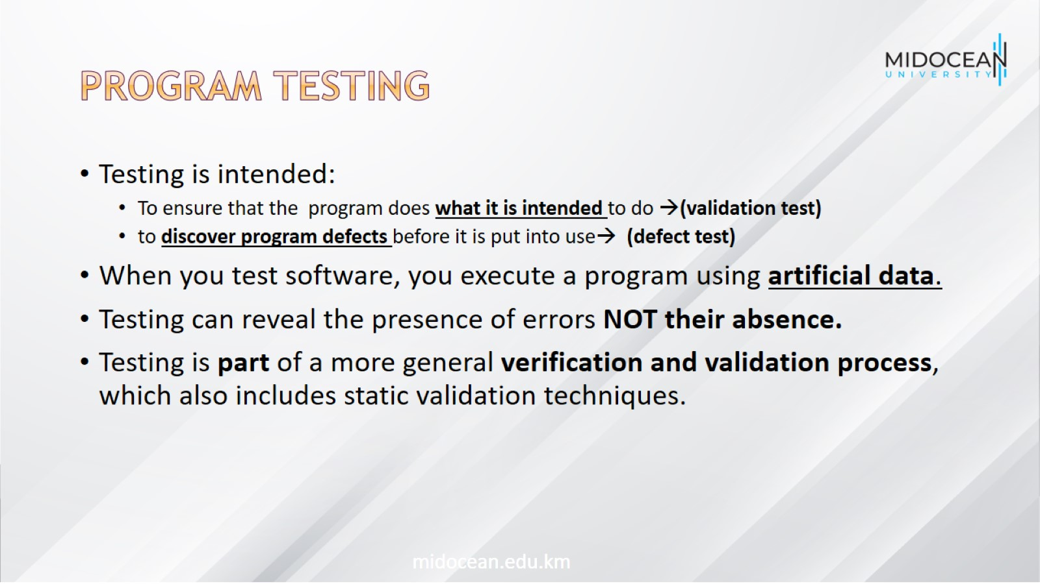
Program testing

Slide 4
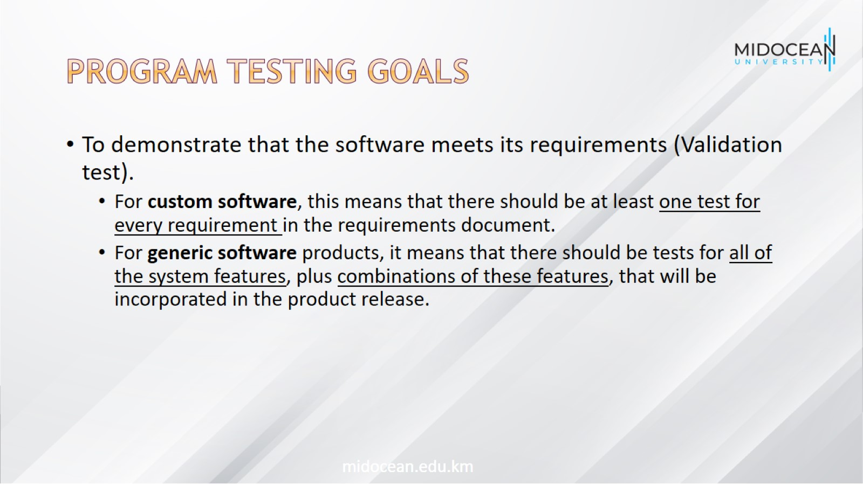
Program testing goals

Slide 5
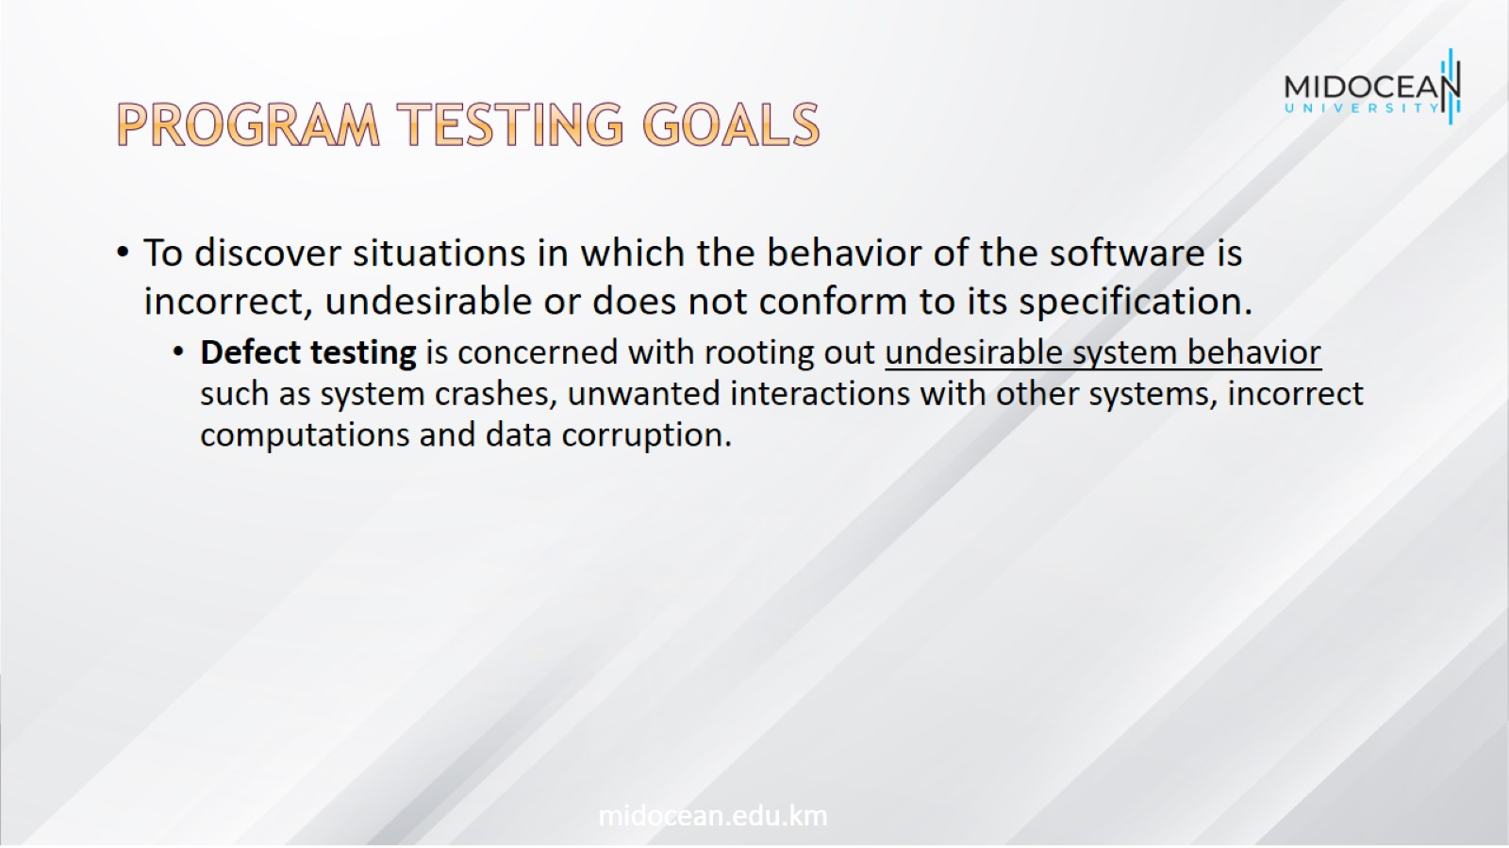
Program testing goals

Slide 6
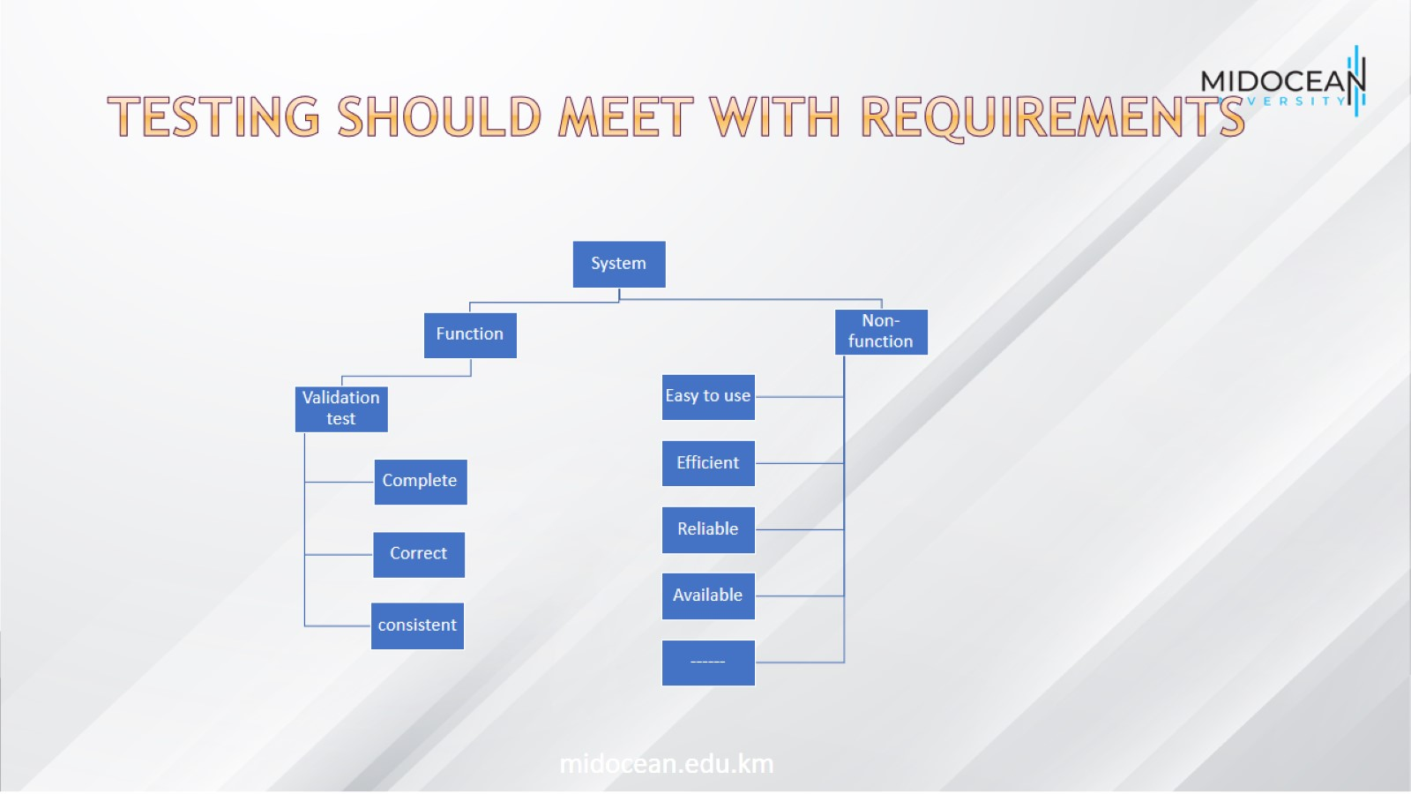
Testing should meet with requirements

Slide 7
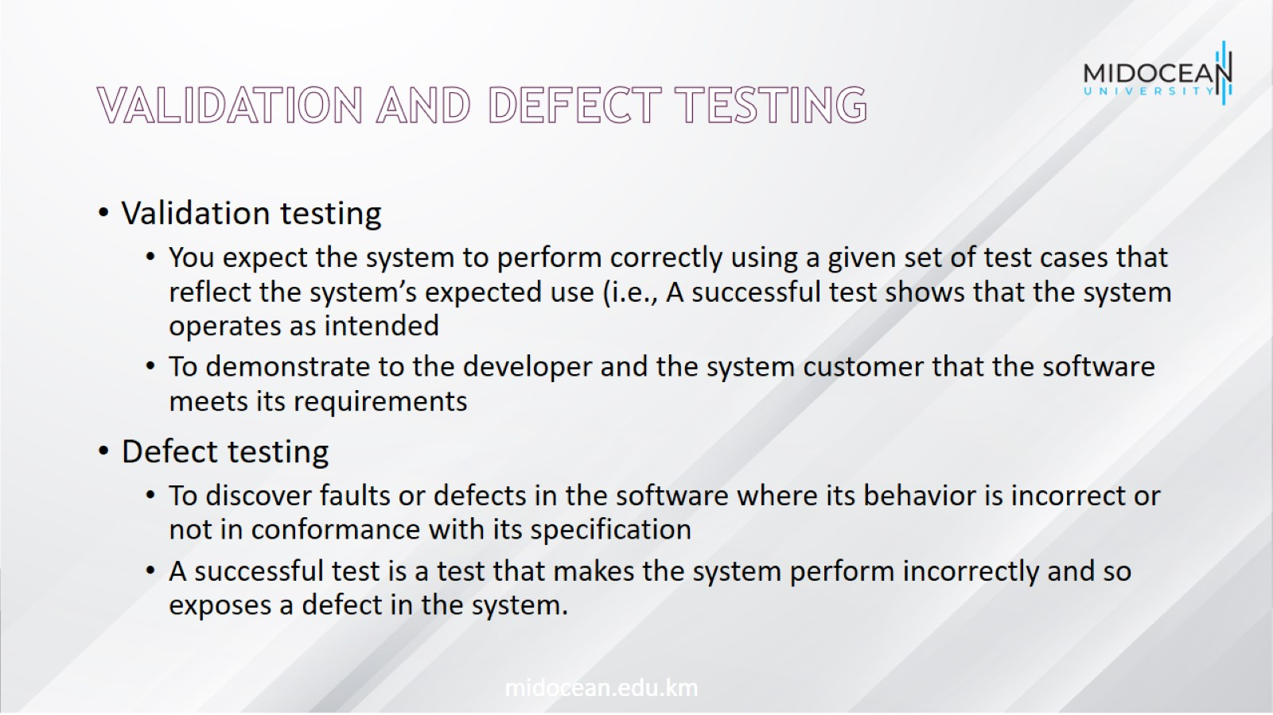
Validation and defect testing

Slide 8
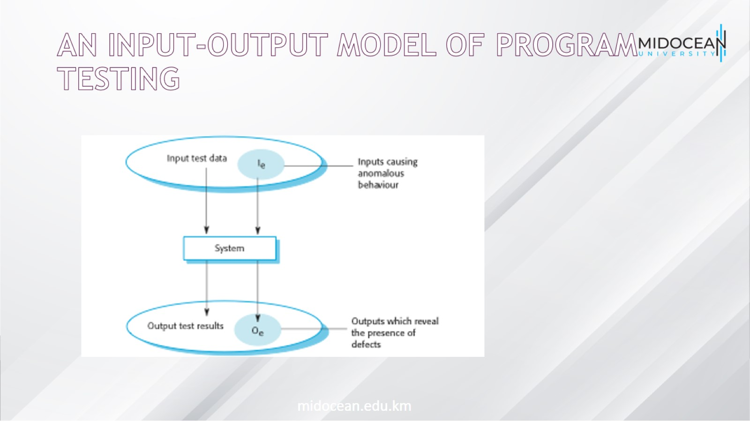
An input-output model of program testing

Slide 9
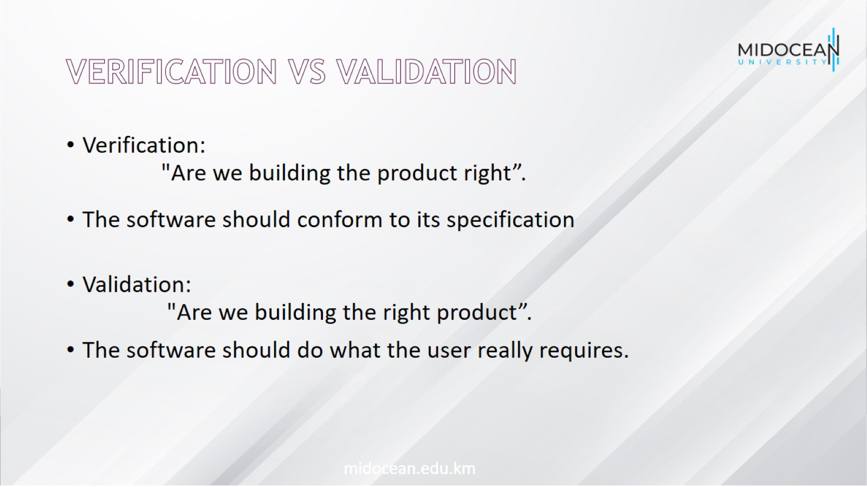
Verification vs validation

Slide 10
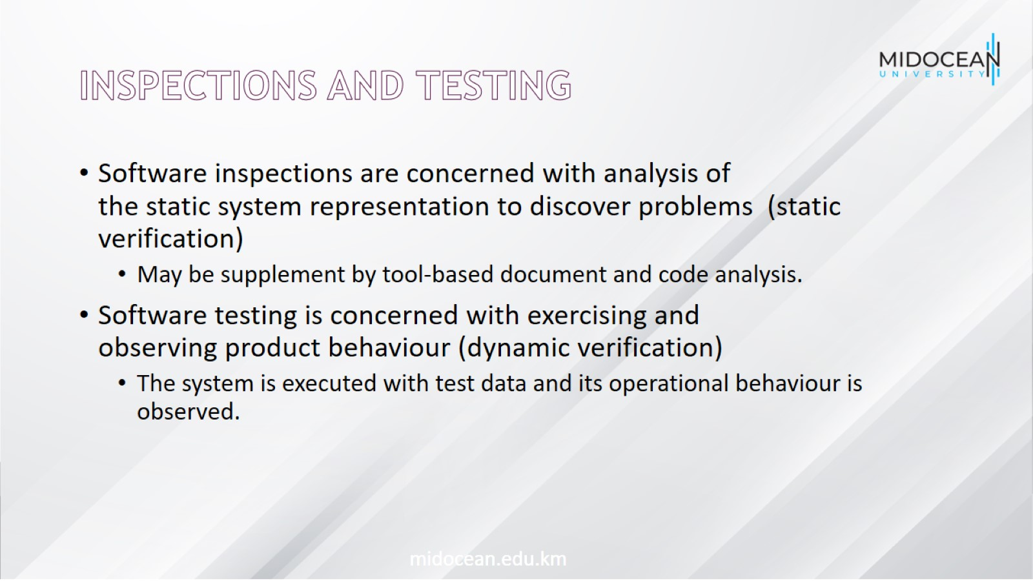
Inspections and testing

Slide 11
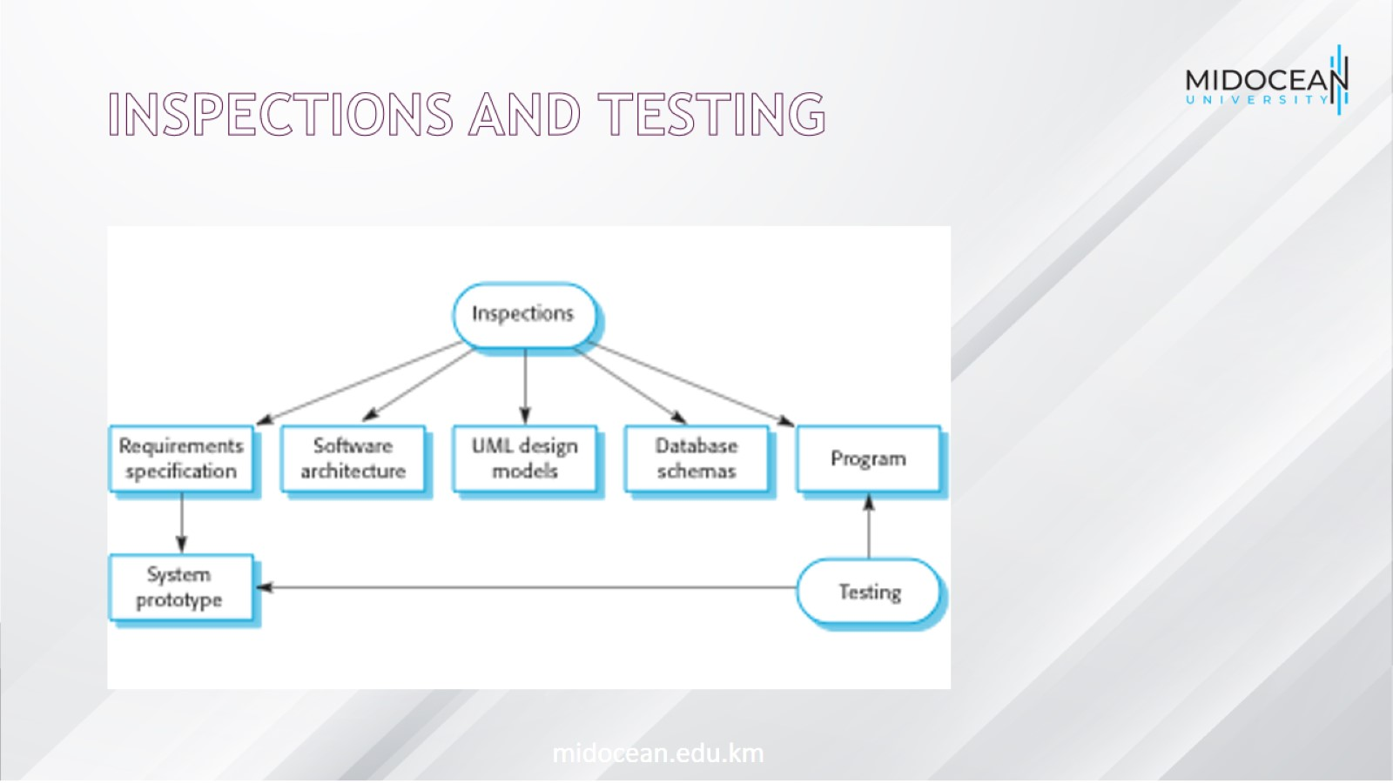
Inspections and testing

Slide 12
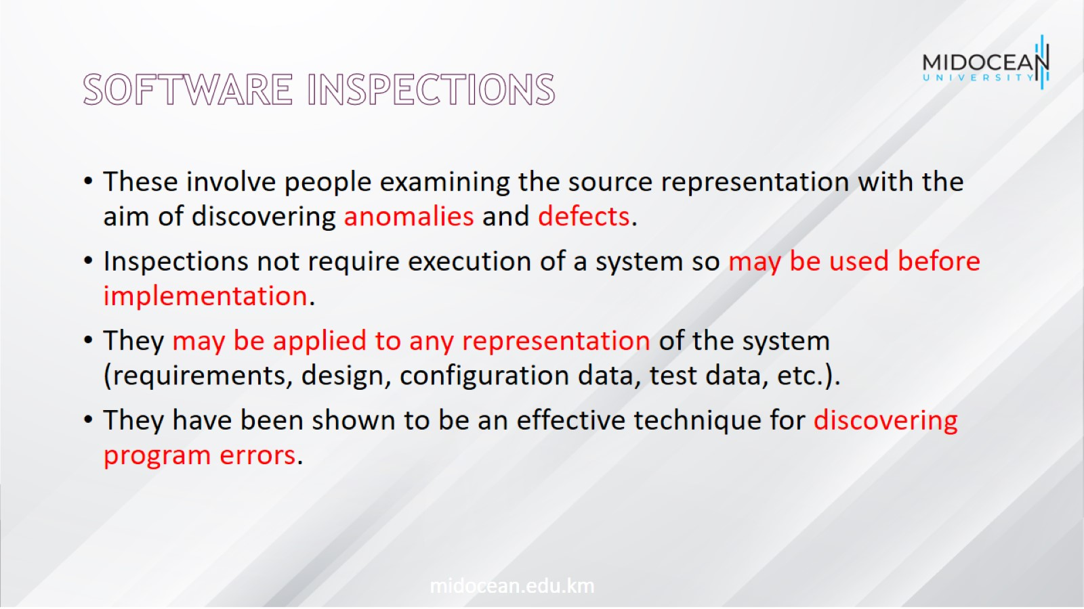
Software inspections

Slide 13
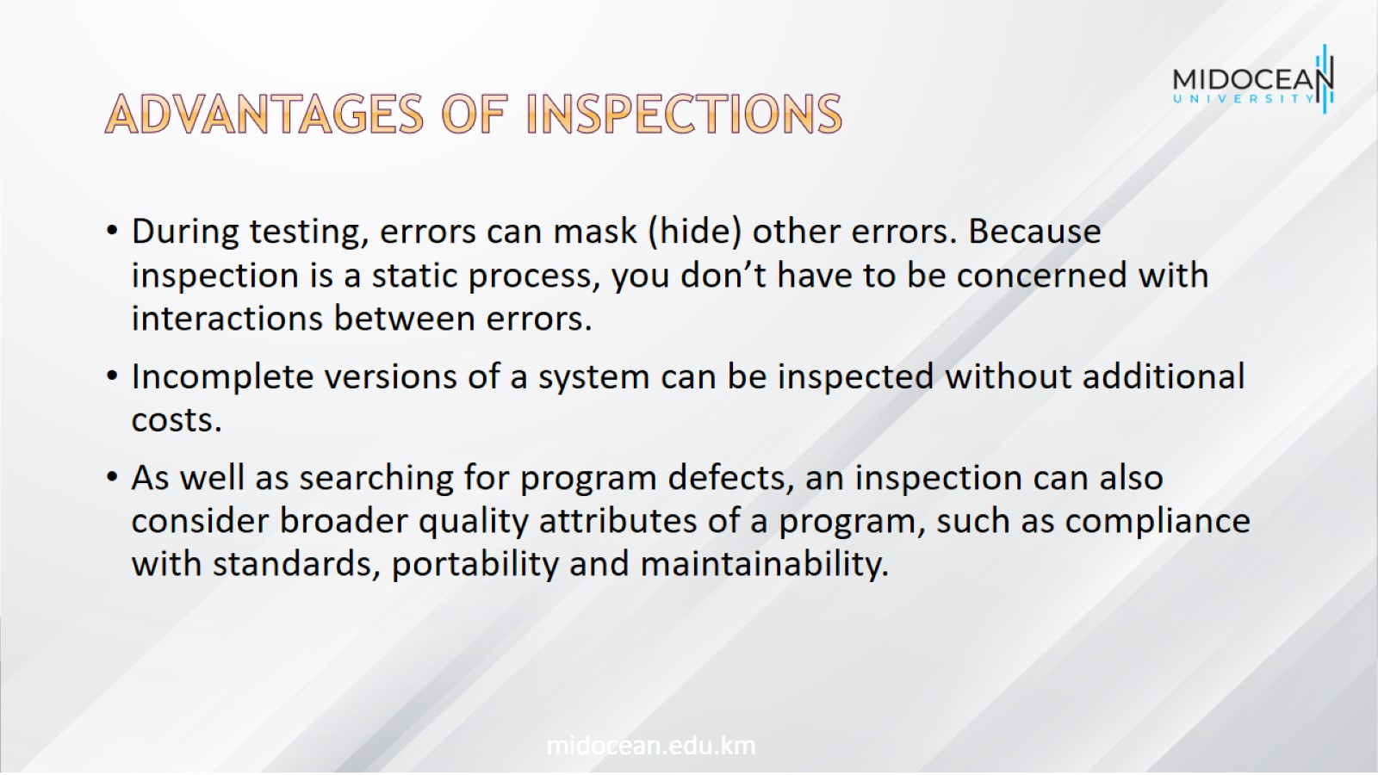
Advantages of inspections

Slide 14
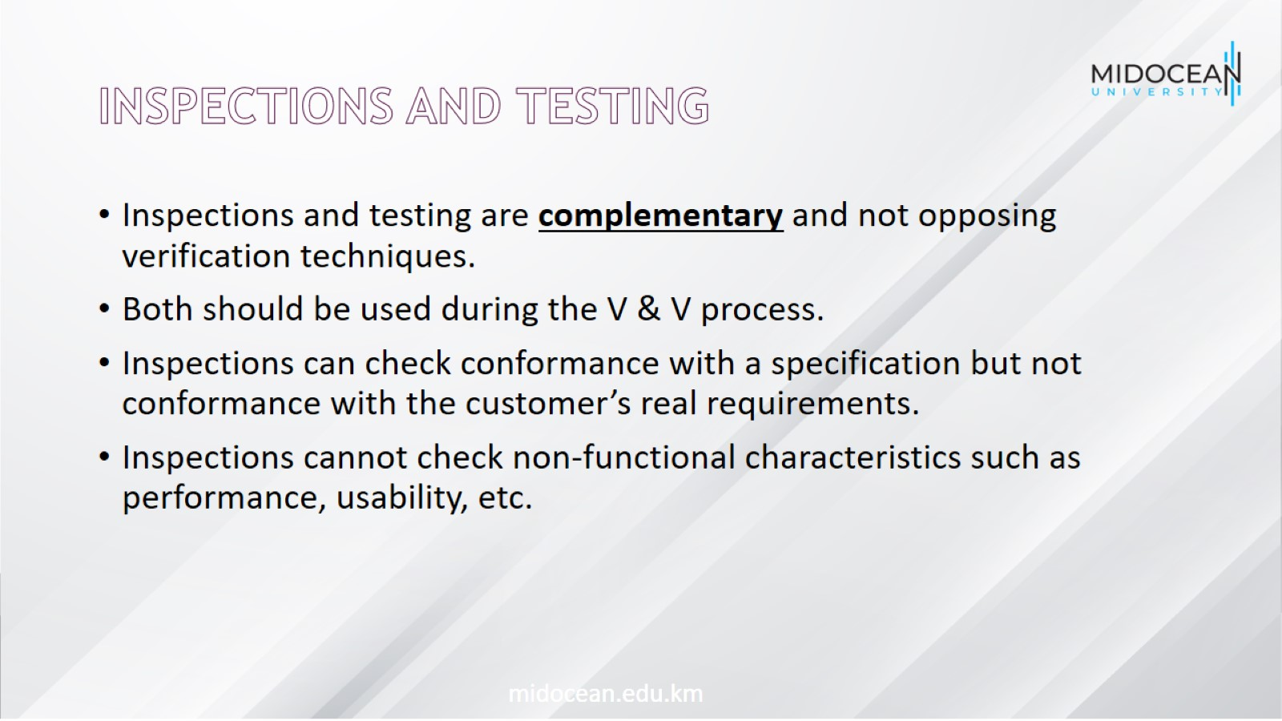
Inspections and testing

Slide 15
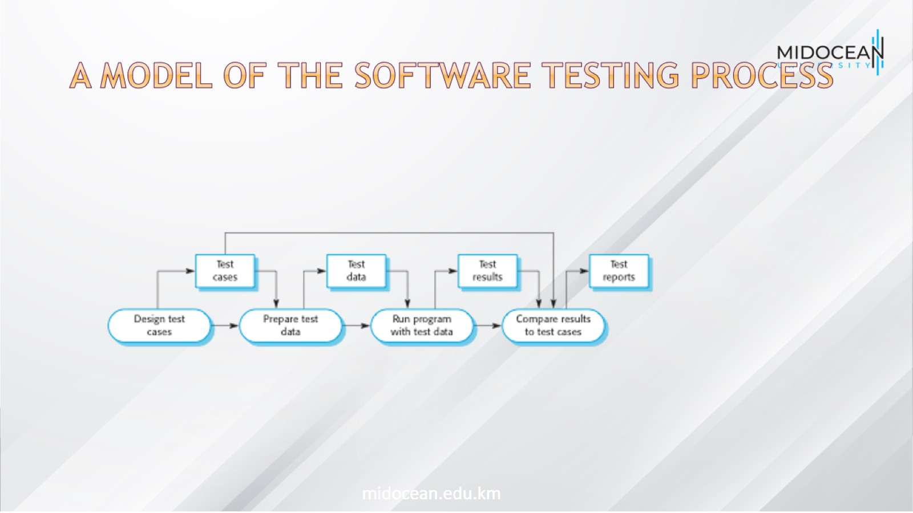
A model of the software testing process

Slide 16
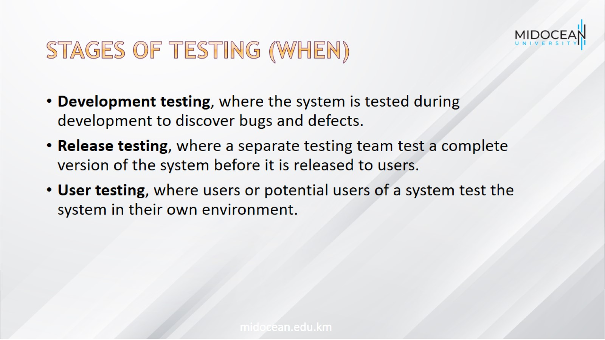
Stages of testing (When)

Slide 17
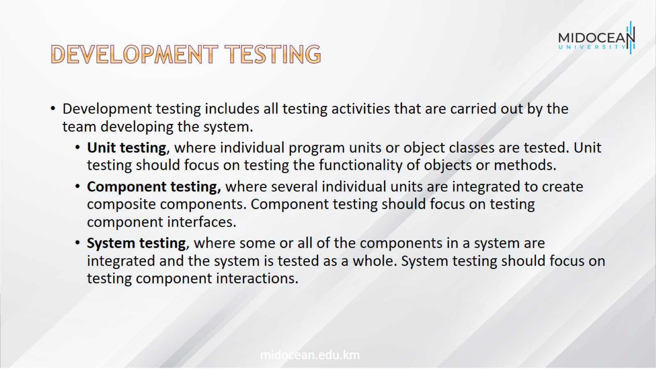
Development testing

Slide 18
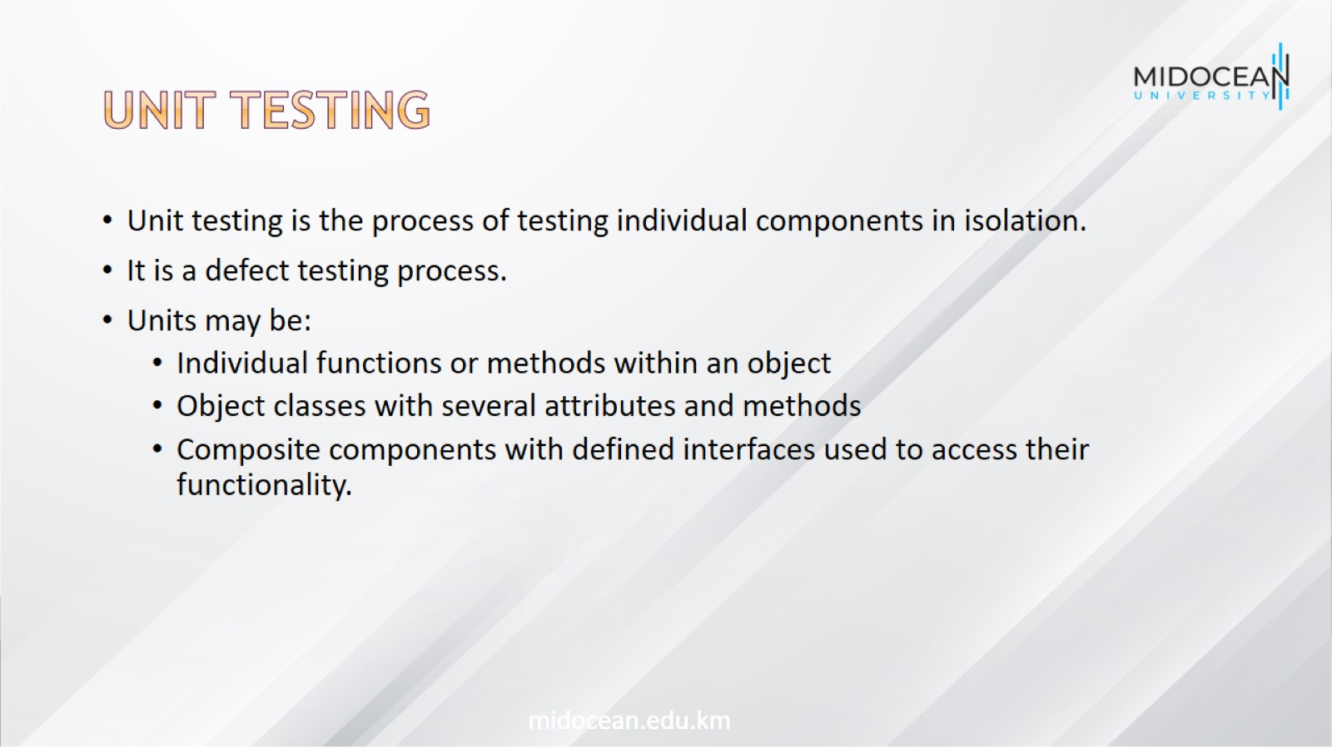
Unit testing

Slide 19
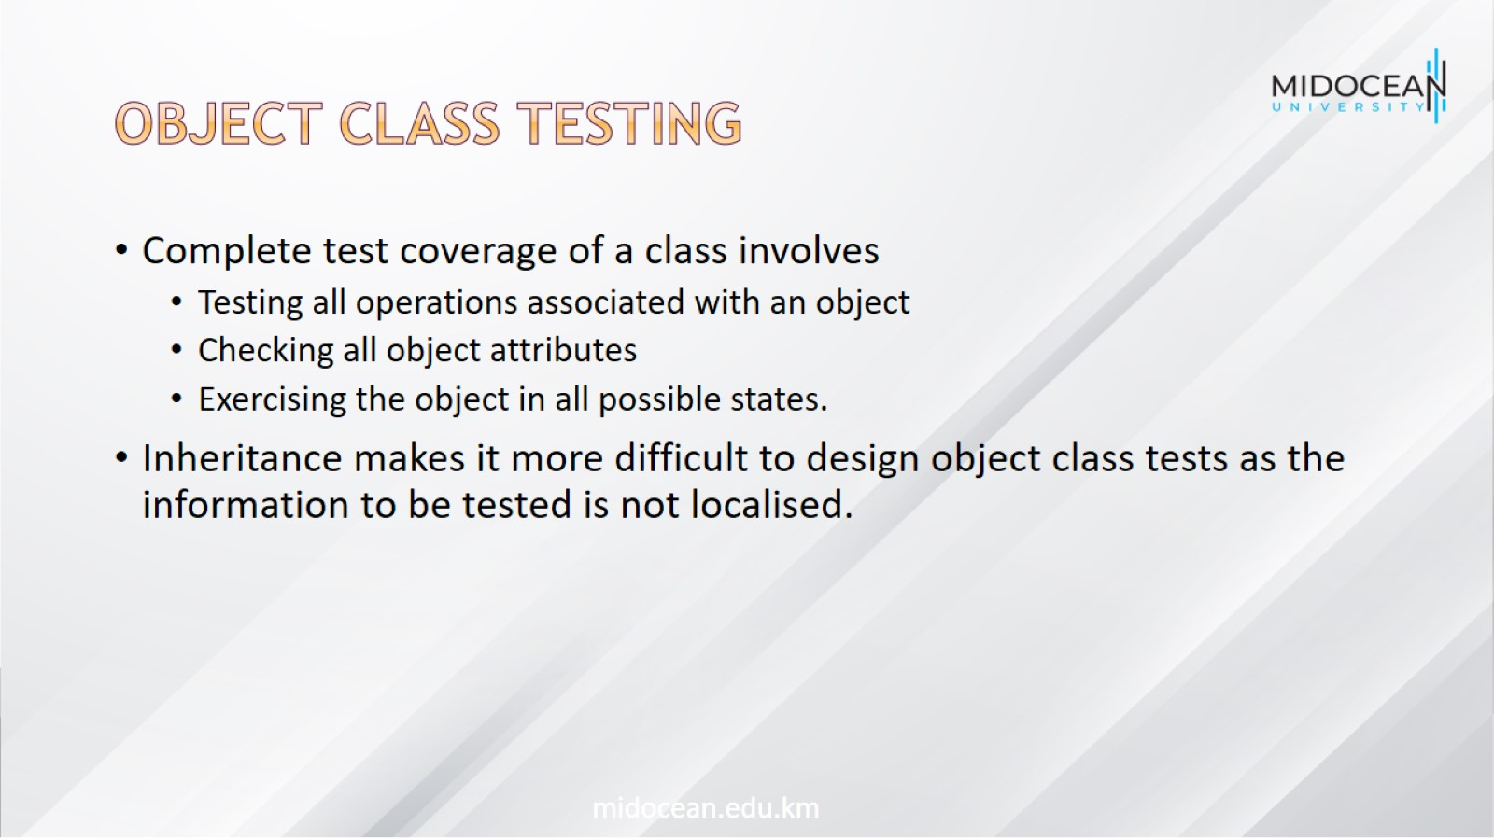
Object class testing

Slide 20
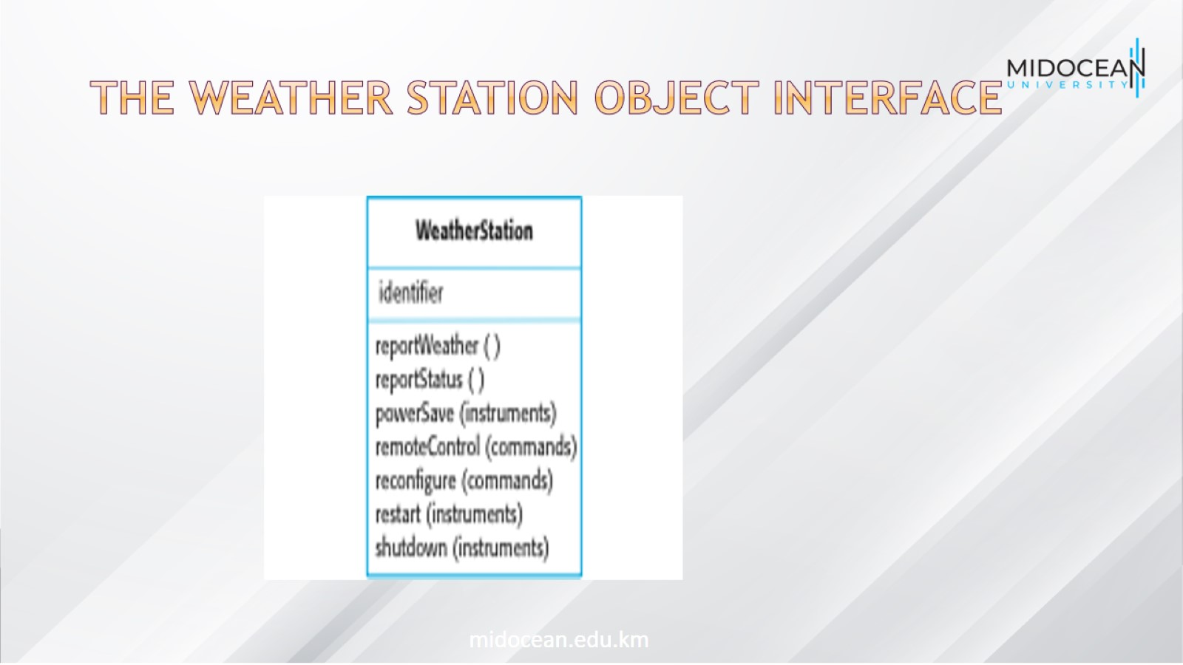
The weather station object interface

Slide 21
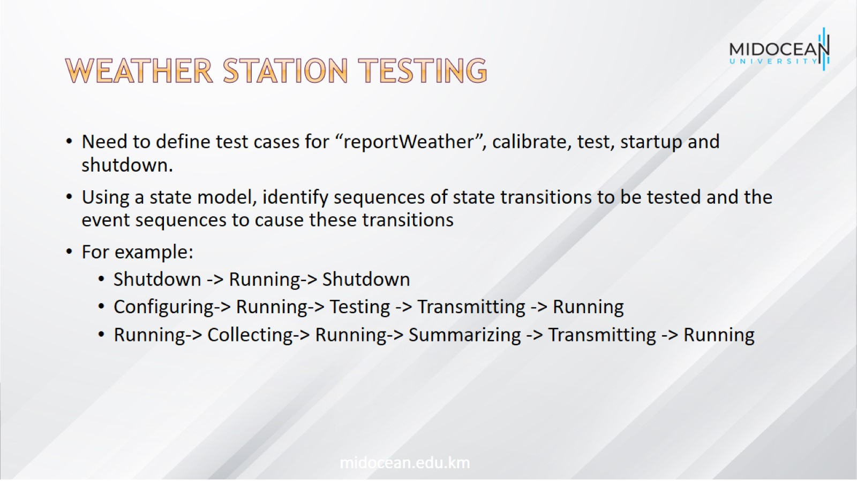
Weather station testing

Slide 22
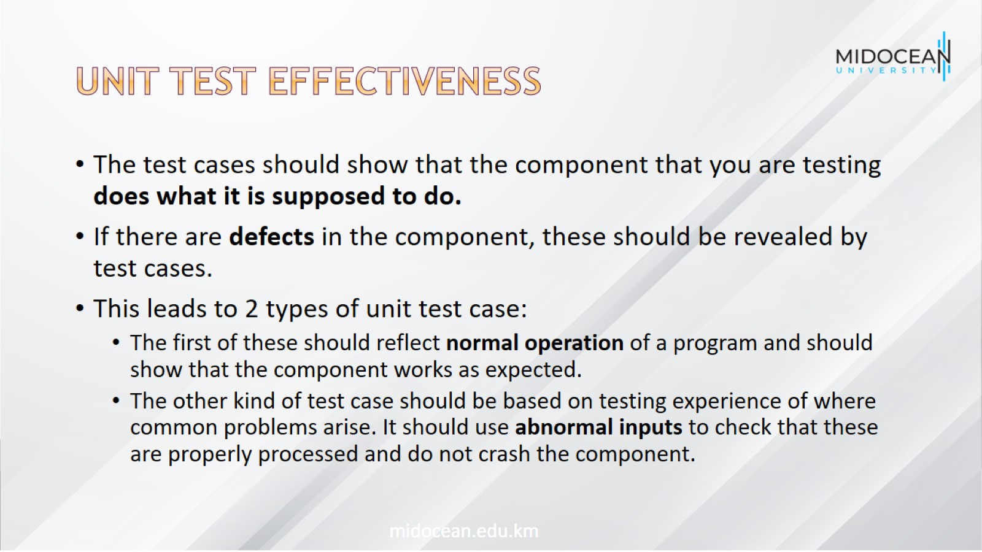
Unit test effectiveness

Slide 23
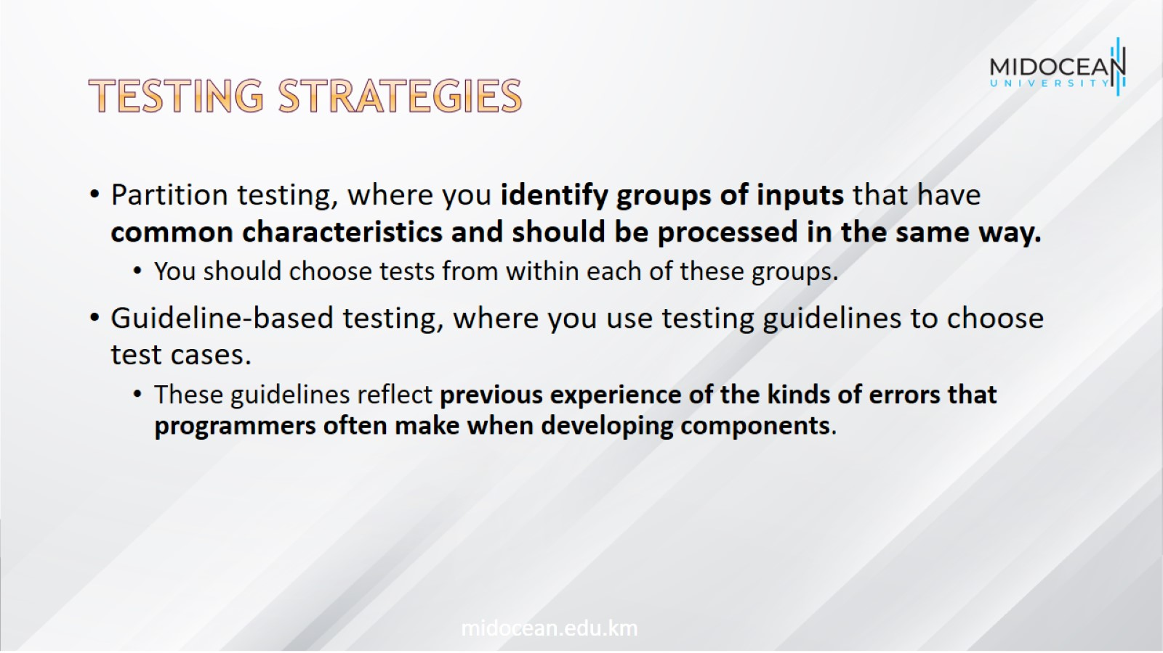
Testing strategies

Slide 24
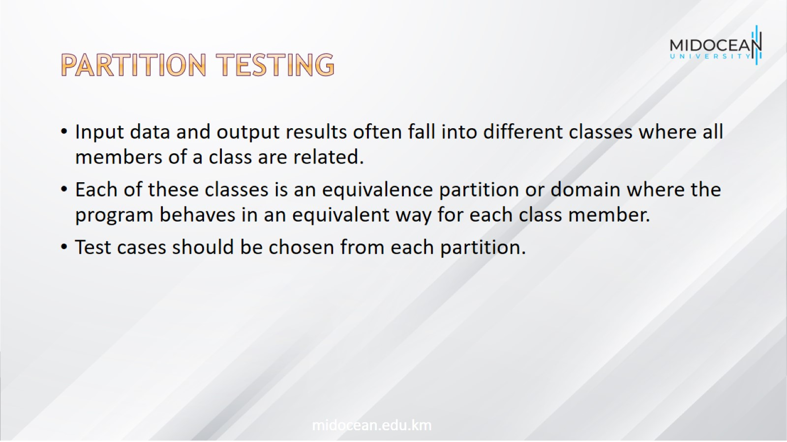
Partition testing

Slide 25
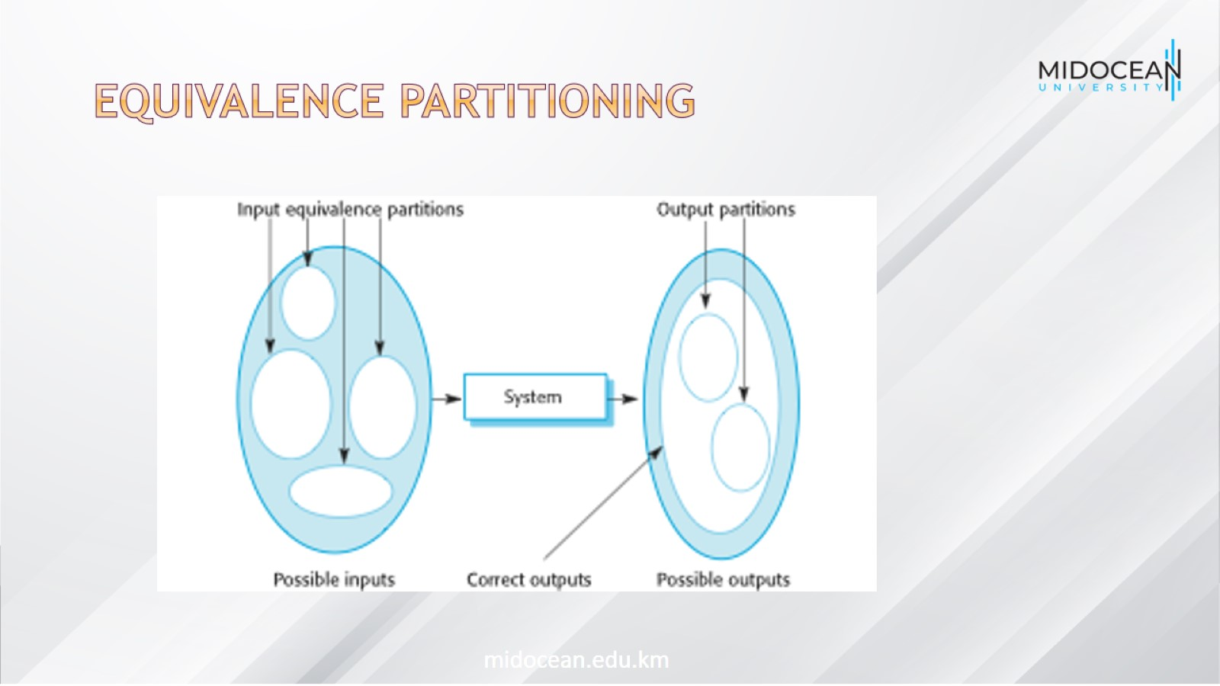
Equivalence partitioning

Slide 26
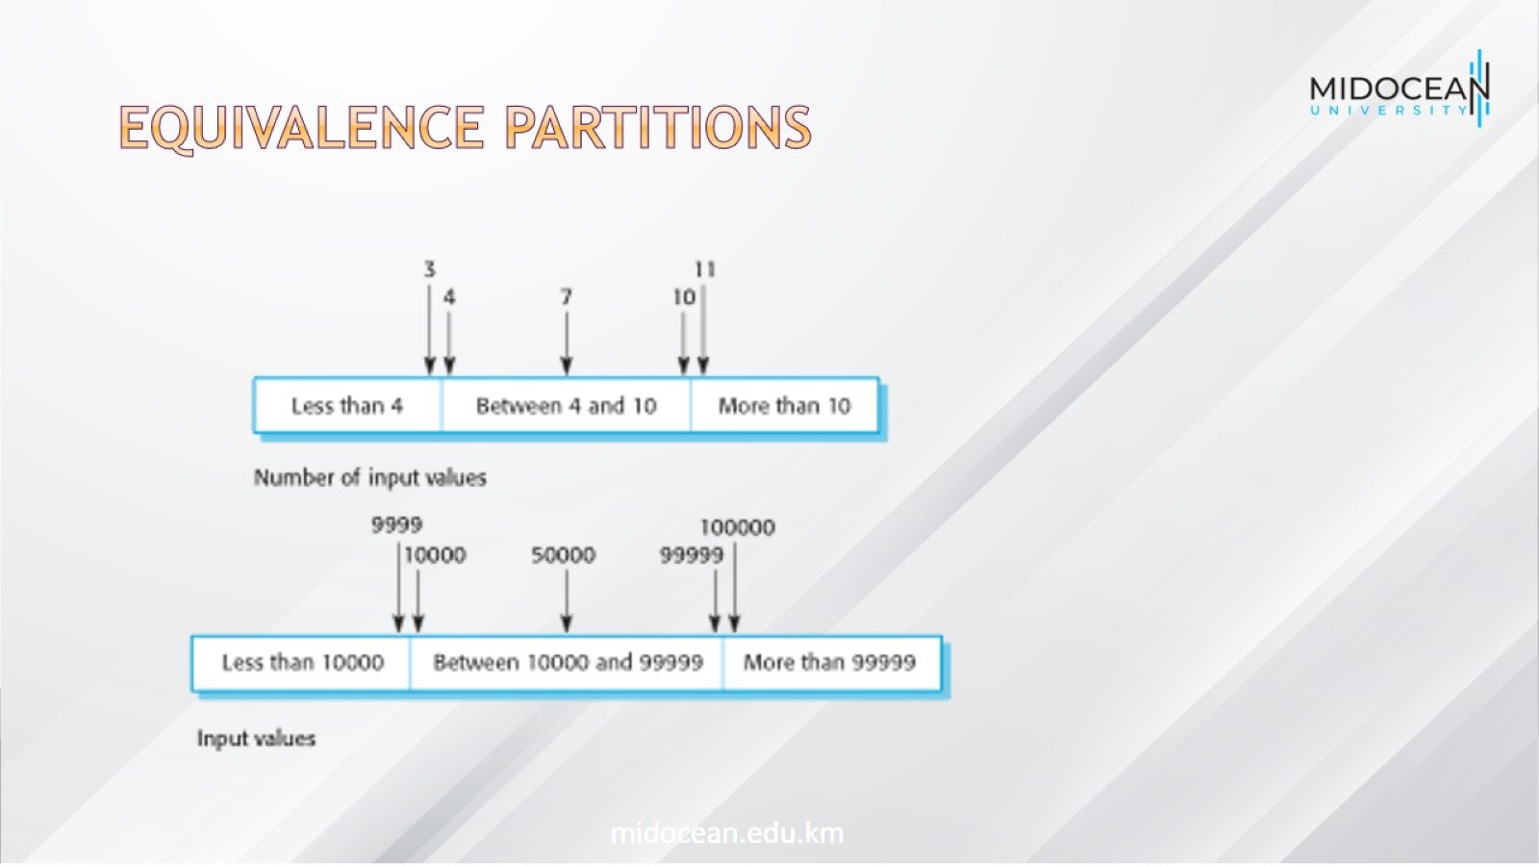
Equivalence partitions

Slide 27
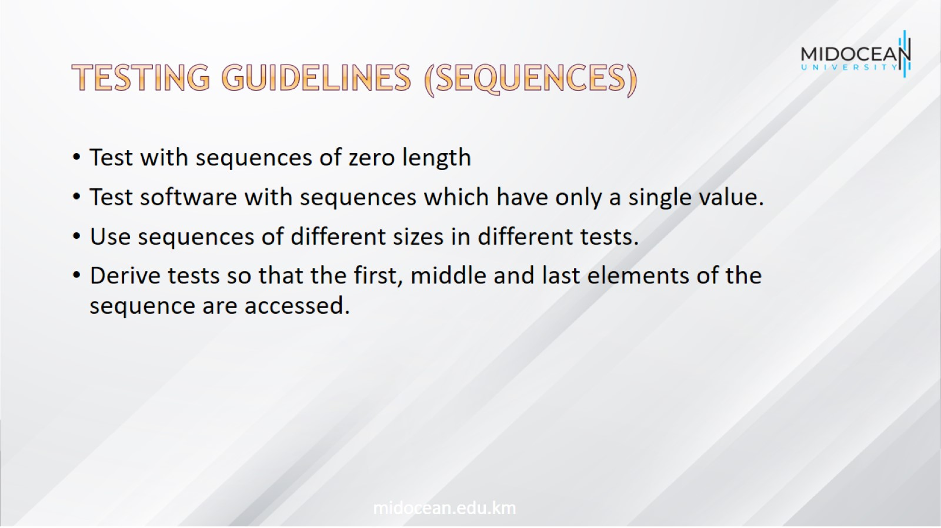
Testing guidelines (sequences)

Slide 28
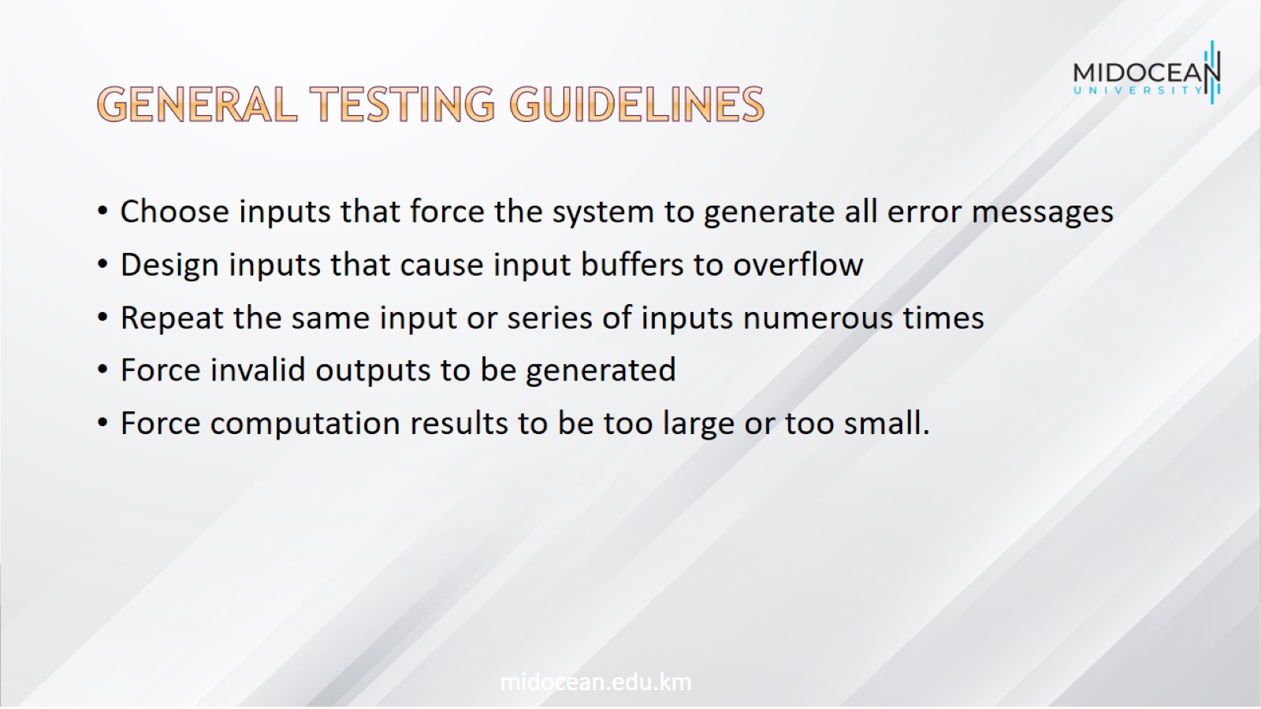
General testing guidelines

Slide 29
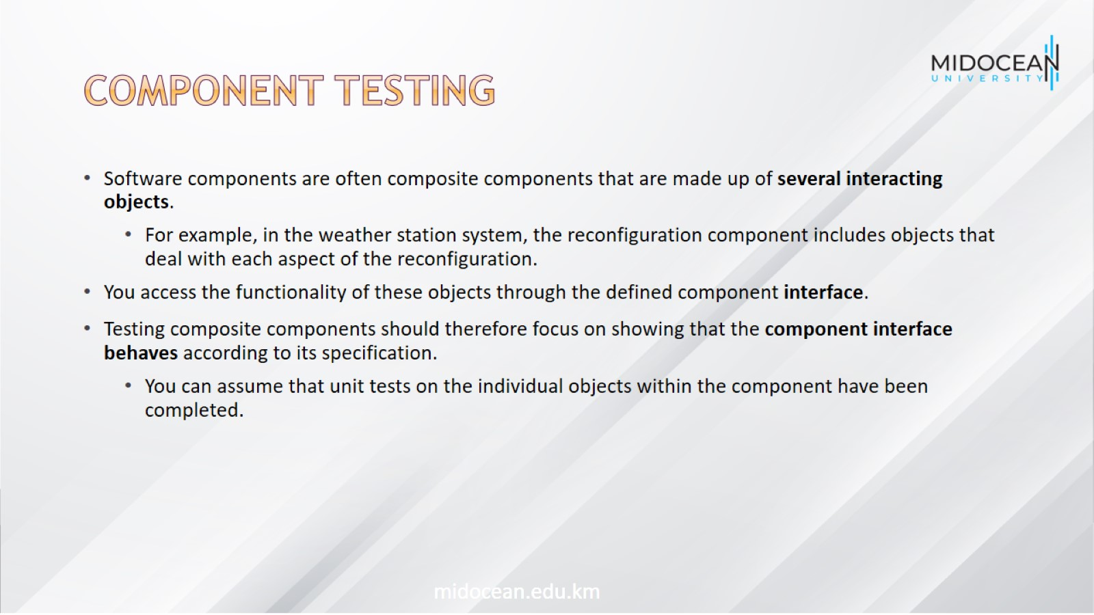
Component testing

Slide 30
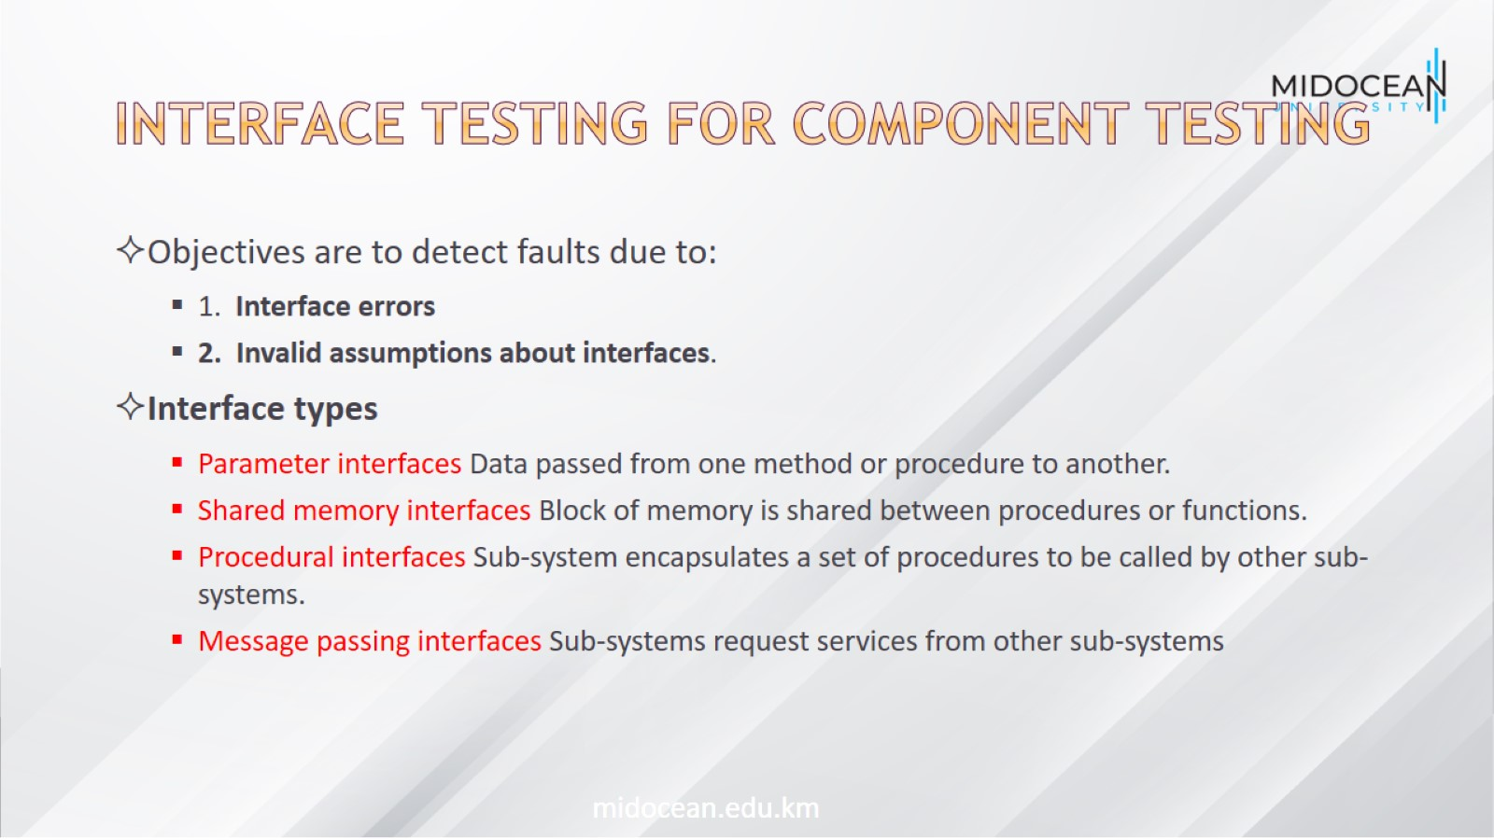
Interface testing for component testing

Slide 31
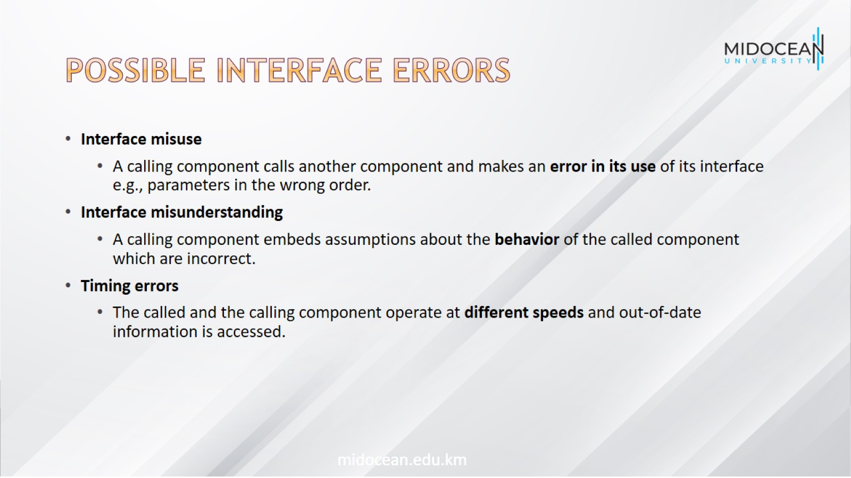
Possible Interface errors

Slide 32
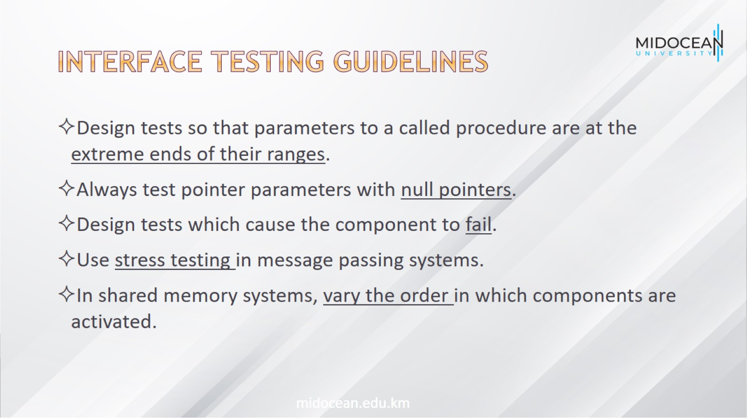
Interface testing guidelines

Slide 33
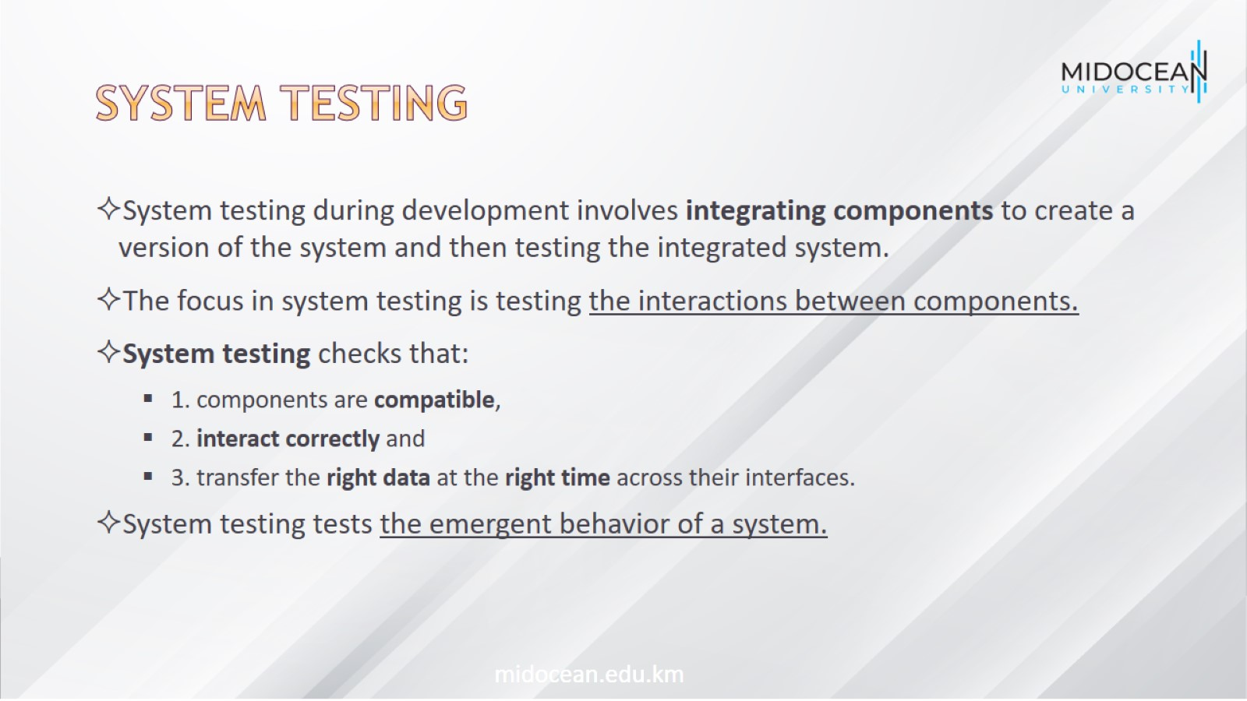
System Testing

Slide 34
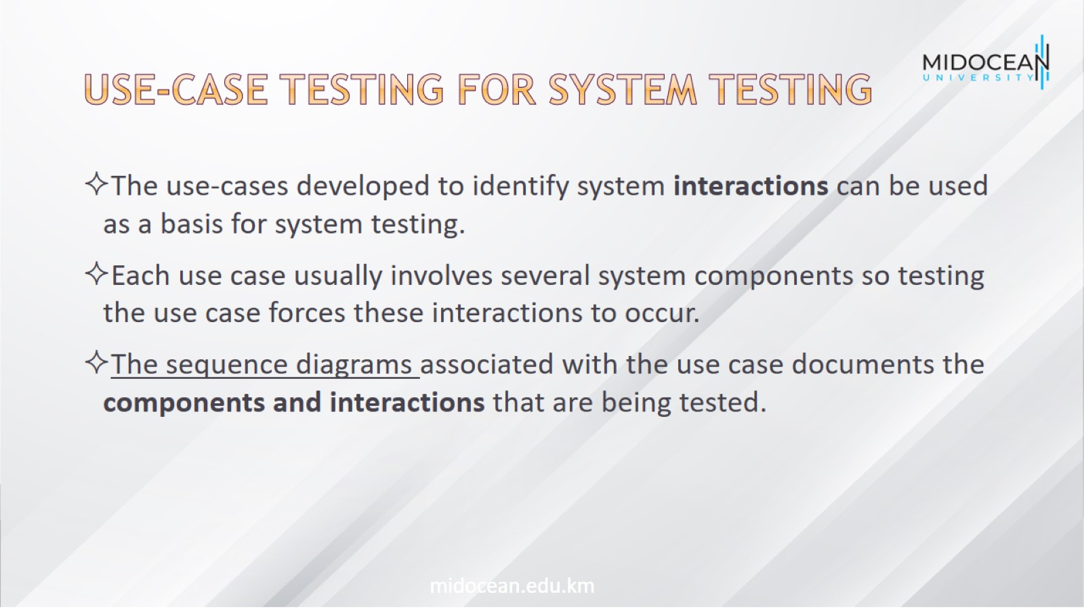
Use-case testing for system testing

Slide 35
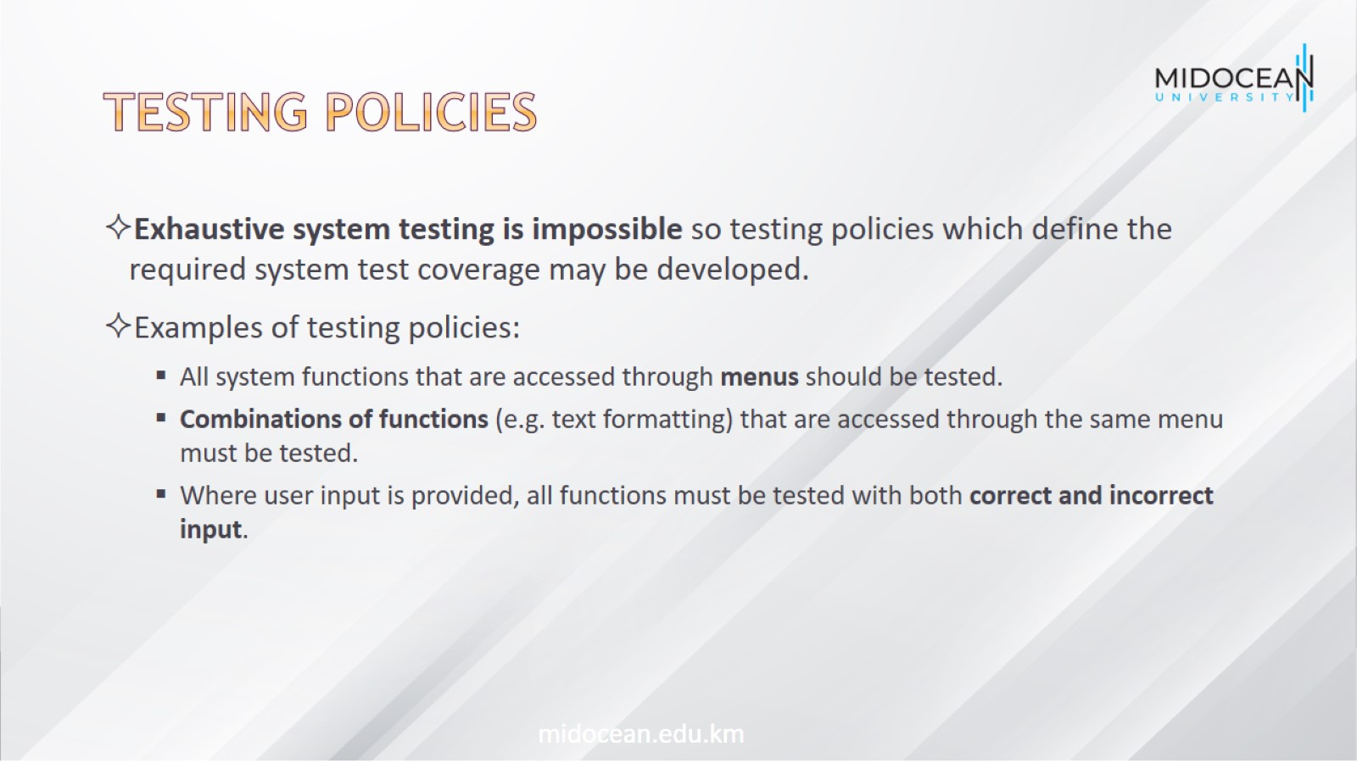
Testing policies

Slide 36
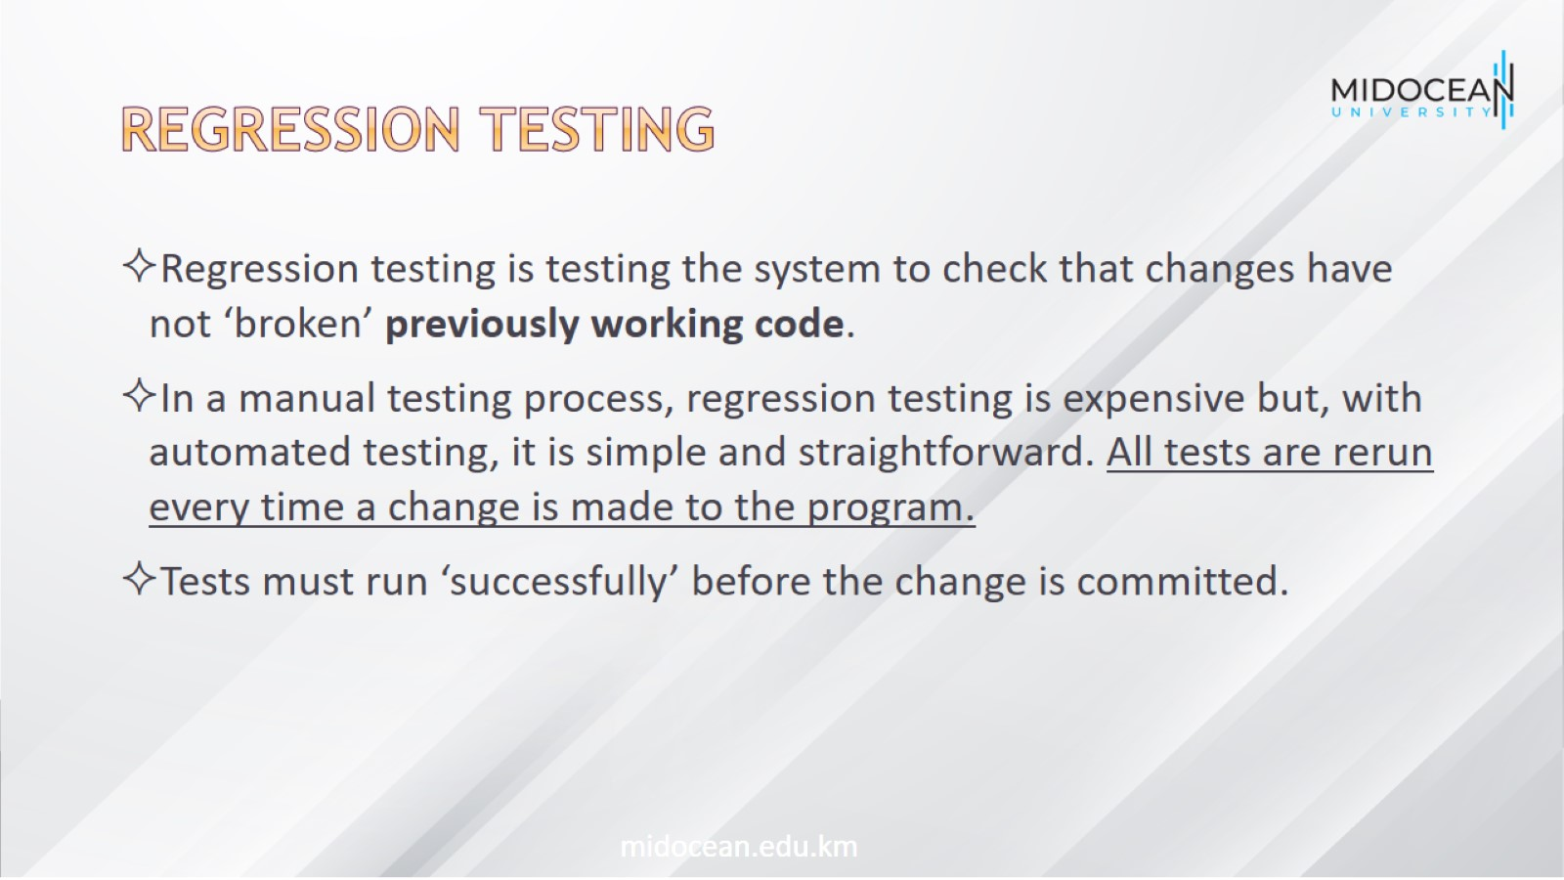
Regression testing

Slide 37
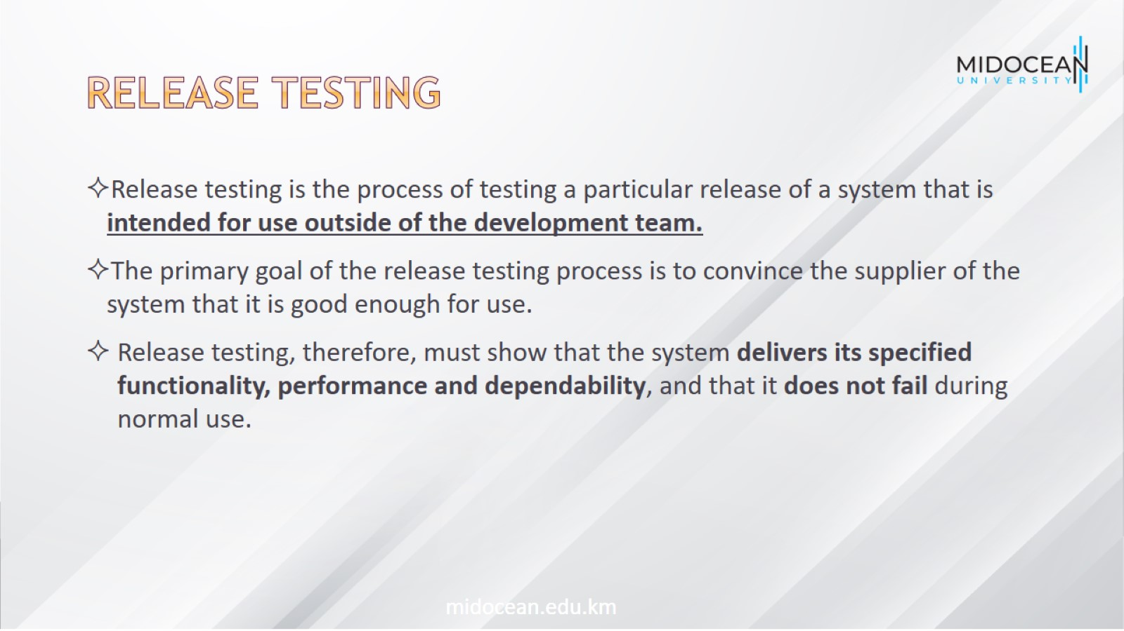
Release testing

Slide 38
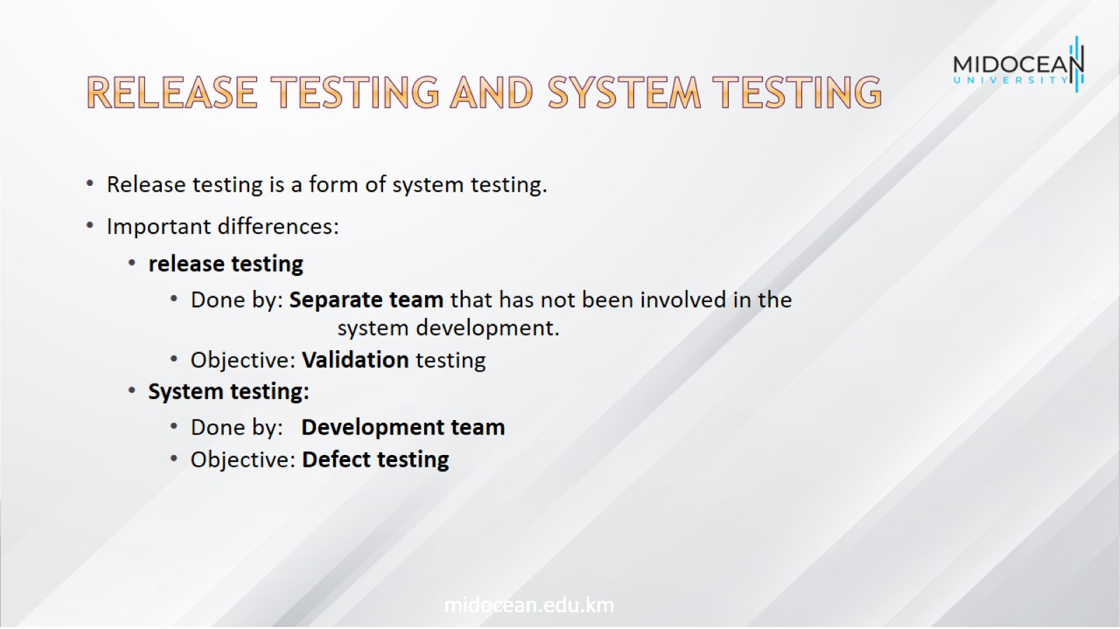
Release testing and system testing

Slide 39
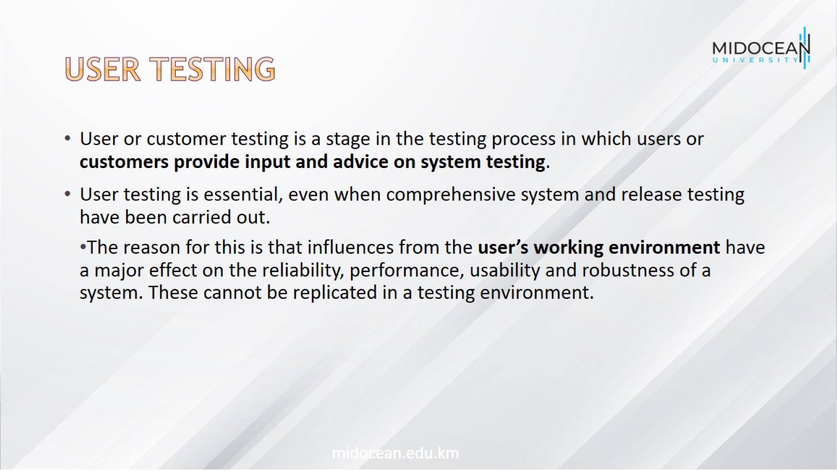
User testing

Slide 40
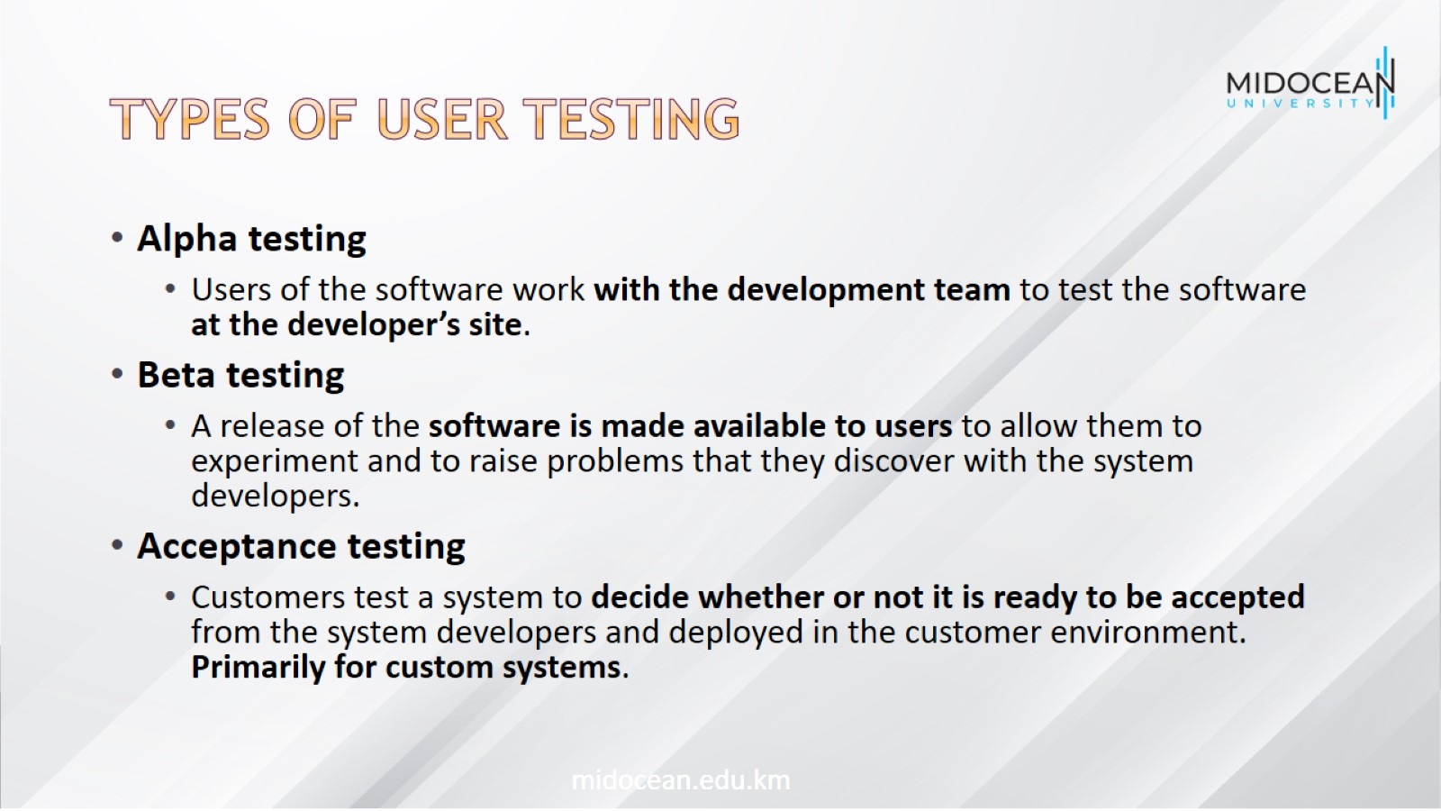
Types of user testing

Slide 41

Latest advancements in software engineering

Slide 42
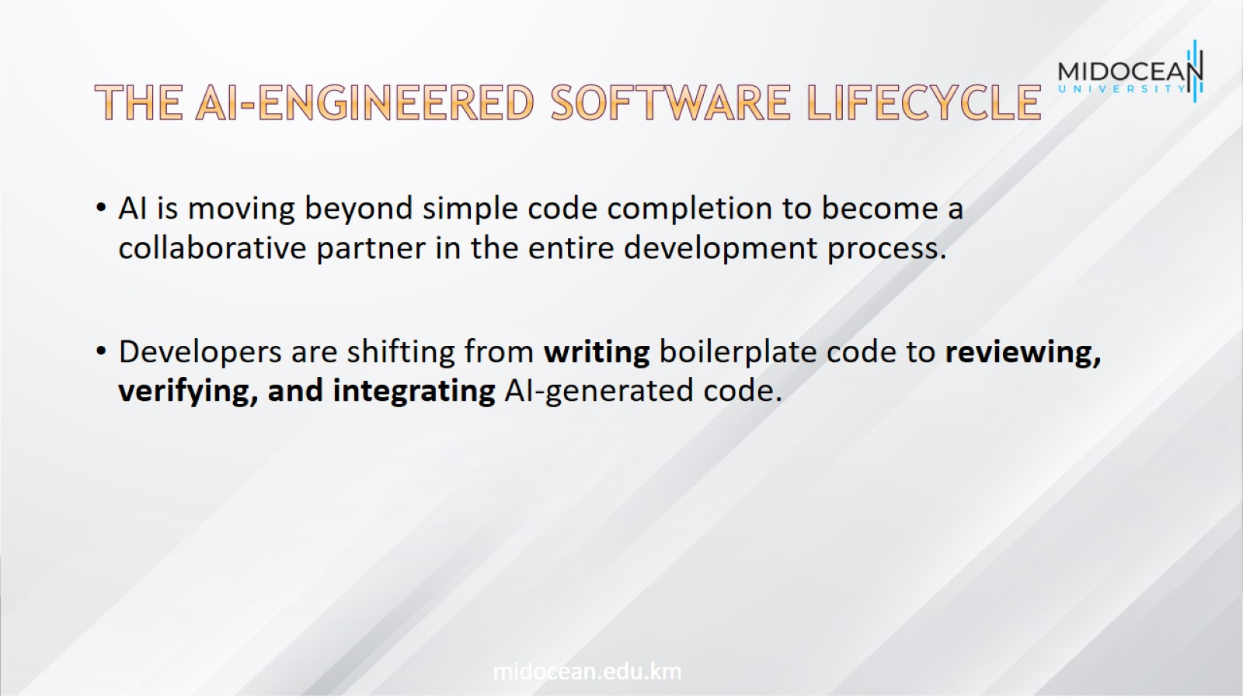
The AI-Engineered Software Lifecycle

Slide 43
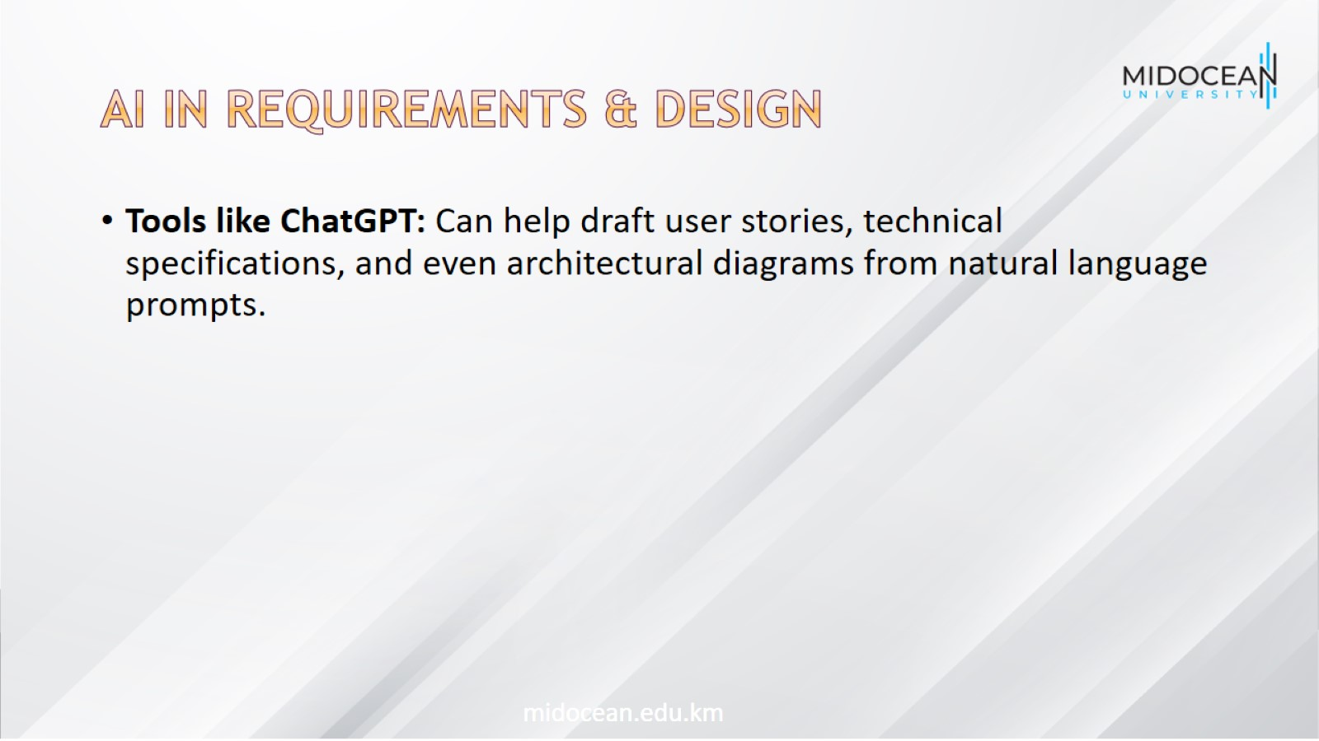
AI in Requirements & Design

Slide 44
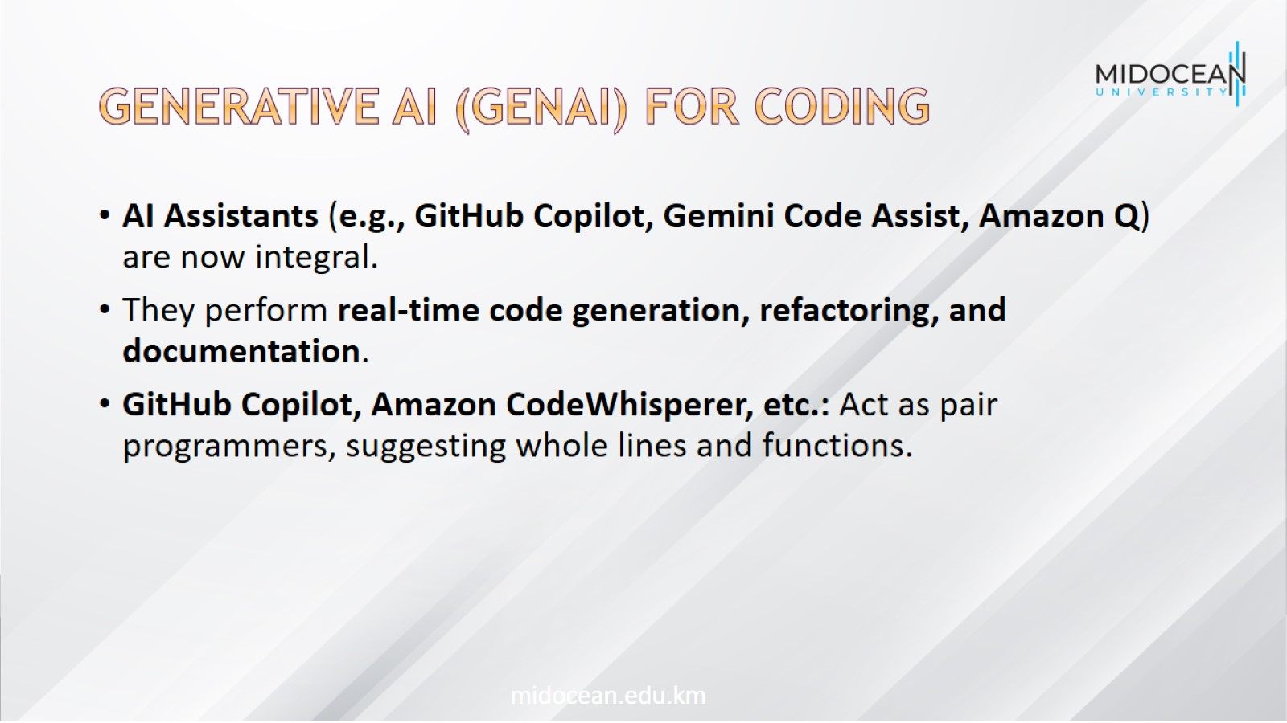
Generative AI (GenAI) for Coding

Slide 45
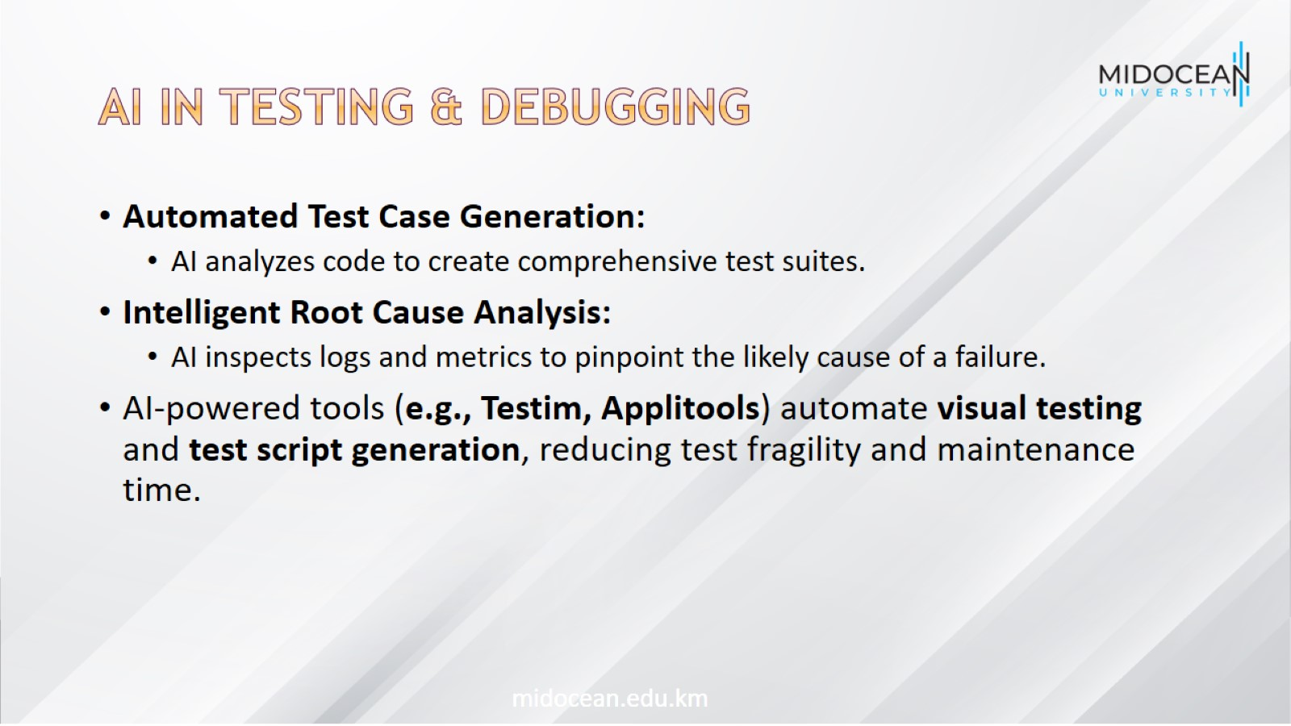
AI in Testing & Debugging

Slide 46
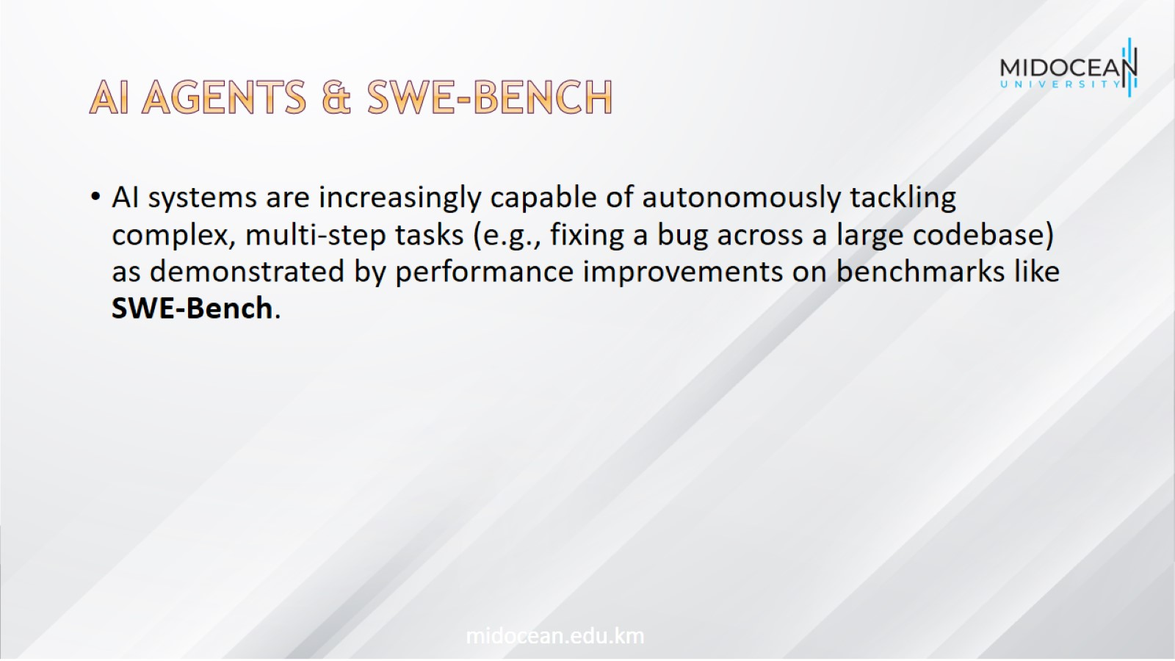
AI Agents & SWE-Bench

Slide 47
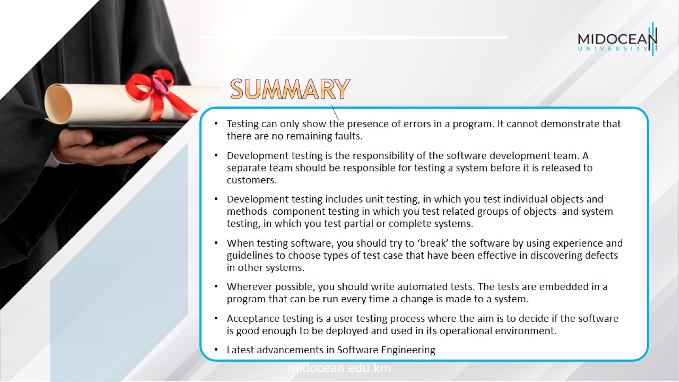

Slide 48


