Slide 1


Slide 2
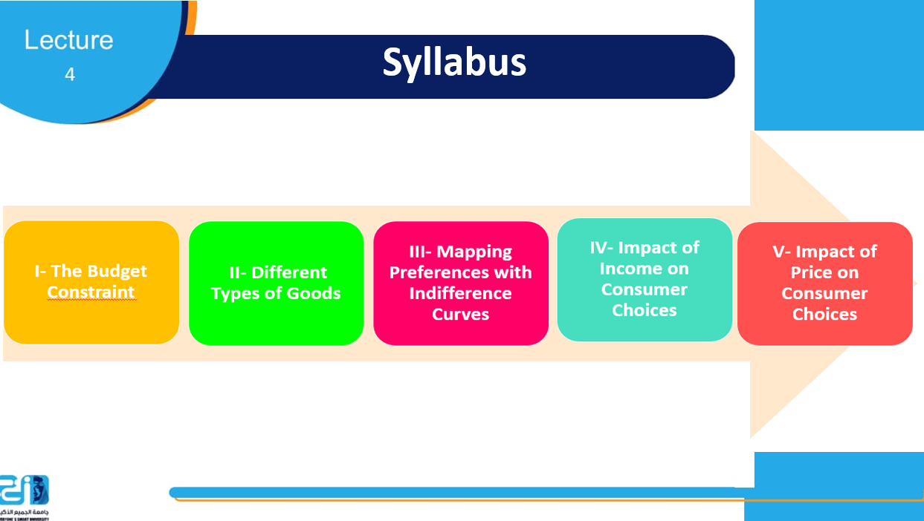

Slide 3
I- Introducing the Budget Constraint
I-1- Trade-offs
I-2- Budget Curves
I-3-Indifference Curves

Slide 4


I- The Budget Constraint -1-
I- The Budget Constraint -1-
I-1-Trade-offs
Trade-off is a situational decision that involves diminishing or losing one quality, quantity, or property of a set or design in return for gains in other aspects.
a tradeoff is where one thing increases, and another must decrease.
To expand upon this definition further, the business concept of opportunity cost via trade-offs is a central building block in understanding budget constraints.
An opportunity cost is defined as the foregone value of the next best alternative in a given action.
I-1-Trade-offs
Trade-off is a situational decision that involves diminishing or losing one quality, quantity, or property of a set or design in return for gains in other aspects.
a tradeoff is where one thing increases, and another must decrease.
To expand upon this definition further, the business concept of opportunity cost via trade-offs is a central building block in understanding budget constraints.
An opportunity cost is defined as the foregone value of the next best alternative in a given action.

Slide 5
I- The Budget Constraint -2-
I-2- The concept of budget constraint
The idea is that a given consumer is limited in consumption relative to the amount of capital they possess.
As a result, consumers analyze the optimal way in which to leverage their purchasing power to maximize their utility and minimize opportunity costs.
This is achieved through using budget constraints, which represent the plausible combinations of products and/or services a buyer is capable of purchasing with its capital on hand.

Slide 6
I- The Budget Constraint -3-
I-3- The Budget line
It indicates the relationship between two goods relative to
opportunity costs, which defines the value of each good relative to one
another.
Budget line: A line curve demonstrates the relationship between two goods relative to opportunity costs, essentially deriving the relative value of each good based on quantity and utility.

Slide 7
I- The Budget Constraint -4-
In the rest of the course, we Wil consider that:
P_{X} = Price of good X
X = Q_{X} = Quantity of good x
P_{Y} = Price of good y
Y = Q_{Y} = Quantity of good y
B = Budget or
I=Income

Slide 8
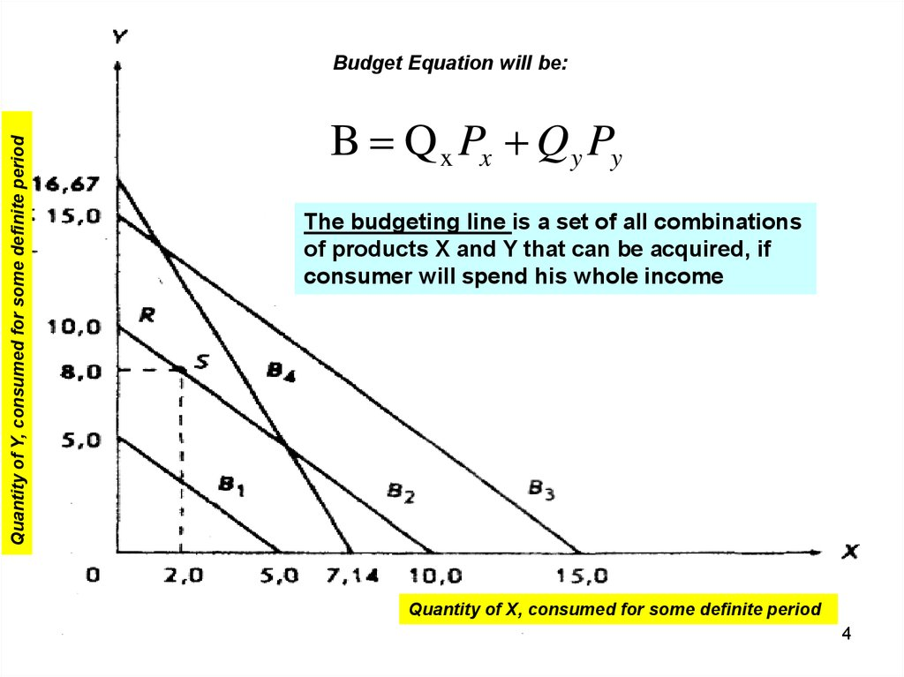
  .
P_{X} = Price of good X
Q_{X} = Quantity of good X
P_{Y} = Price of good Y
Q_{Y} = Quantity of good Y
B = Budget

Slide 9
I- The Budget Constraint -6-
I-4- The concept of the Budget Set or the Feasible Set
Suppose that a consumer has a fixed amount of money to spend, M. There are two goods X and Y, with associated prices P_{X} and P_{Y}.
The feasible choices that the consumer can make satisfy:
P_{X}X + P_{Y}Y ≤ B
In addition, we will focus on consumption and rule out negative consumption, so x ≥ 0 and y ≥ 0.
This gives a Budget Set or Feasible Set, as illustrated in the figure in the next slide.
The Budget Set is the set of goods a consumer can afford to purchase.

Slide 10
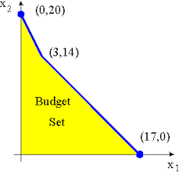
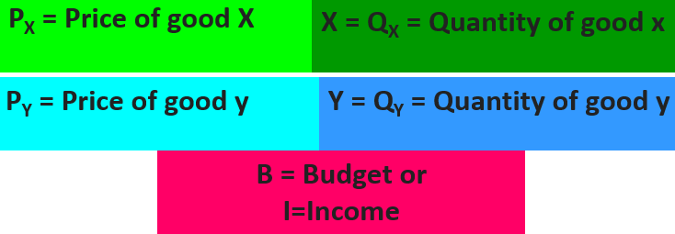
I- The Budget Constraint -7-
A Budget Set implies the set of all the possible combinations of two goods that the consumer can afford or buy, which his/her income, at the existing market prices.
Basically, it contains all those combinations in the positive quadrant, fall under or on the budget line. It can be expressed as:
P_{X}Q_{X} + P_{Y}Q_{Y} ≤ B
Where,

Slide 11
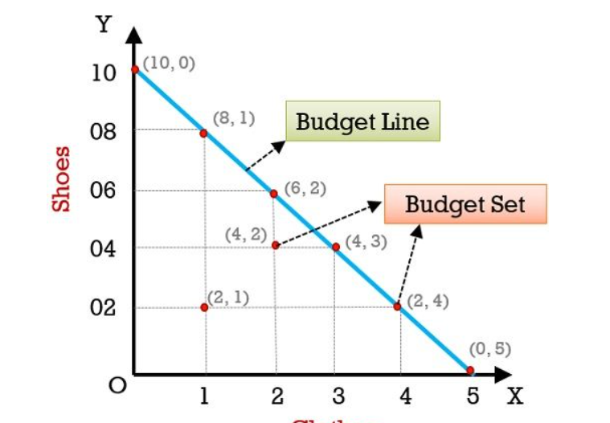
I- The Budget Constraint -8-
Conclusion
Basically, Budget Line shows the price ratio between two goods, i.e.
X and Y or the rate at which one commodity can be exchanged for the other, where the prices of the two goods are given.
Budget line depends on the consumer’s income and price of the commodities.

Slide 12

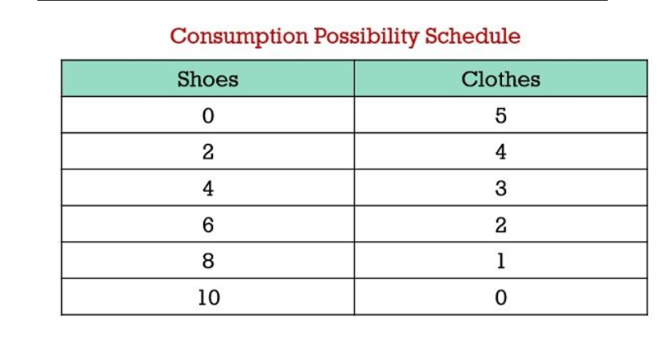
Exercise:
The Budget line and The Budget Set
I- The Budget Constraint -7-
The table represented below highlights the bundles of clothes
(P_{x =}$ 200) and shoes (P_{y =}$100)
a consumer can buy, spending his income ( budget), i.e $ 1000.
Now let’s take a look at the graph representing Budget Line and Budget Set:

Slide 13
I- The Budget Constraint -9-
I-5- The Indifference Curves
Indifference curves: They underline the way in which a given consumer interprets the value of each good relative to one another, demonstrating how much of ‘good X‘ is equivalent in utility to a certain quantity of ‘good Y‘ (and vice versa).
Any point along the indifference curve will represent indifference to the consumer, or simply put equivalent preference for one combination of goods or the other.
In the next figure, it is clear that the budget curve has been included in conjunction with the indifference curves, which allows insight as to the ideal actual quantity of each good is optimal for this specific consumer.

Slide 14
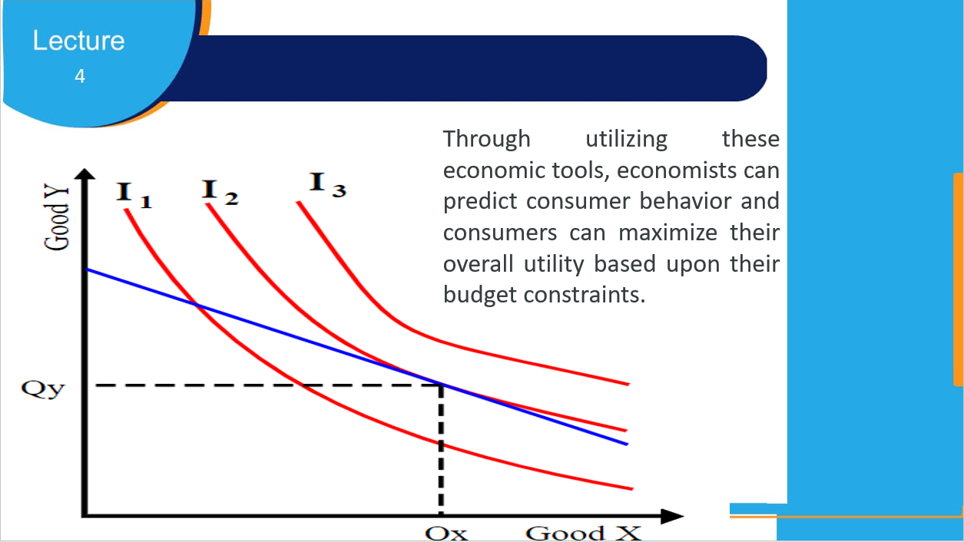
I- The Budget Constraint -10-

Slide 15
I- The Budget Constraint -11-
The Indifference Curves: The Indifference curves are designed to represent an equal perception of overall value in a given basket of goods relative to a specific consumer.
That is to say that each point along the curve is considered by the consumer of equivalent value despite alterations in the quantity of each good, as these trade-offs are consider of equal value and thus indifferent.

Slide 16
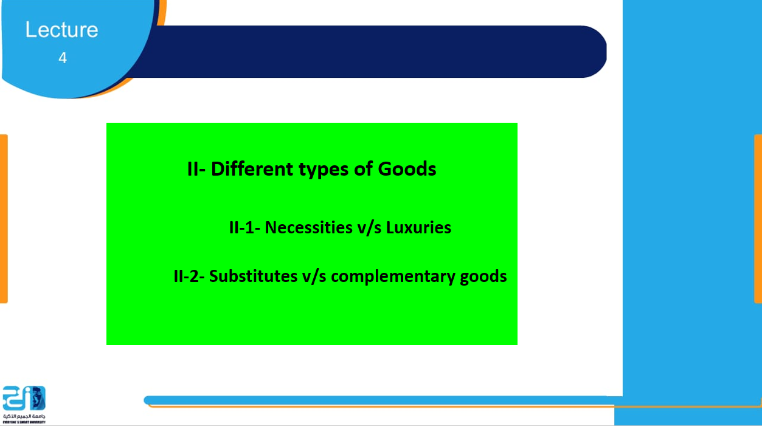

Slide 17

II- Different types of goods -1-
II-1- Necessities v/s Luxuries
Differences in price elasticity are explained by several factors:
  Whether the Good is a Necessity or Luxury
  The Availability of Substitutes
  The Price Relative to Income

Slide 18
II- Different types of goods -2-
II-1-1- Necessities
A necessity is something you absolutely must have, almost regardless of the price.
Some goods are so critical to our everyday life that we
regard them as necessities.
Demand for necessities is relatively inelastic.
Toothpaste and gasoline are examples of necessities.

Slide 19
II- Different types of goods -3-
II-1-2- Luxuries
A luxury good is something we’d like to have but aren’t likely to buy unless our income jumps or the price declines sharply:
It is something that would be nice to have, but it’s
not absolutely necessary.
Demand for luxury goods is relatively elastic.
Vacation travel and diamonds are examples of luxury goods.

Slide 20
II- Different types of goods -4-
  Some goods are so critical to our everyday life that we regard
  them as necessities.
Demand for necessities is relatively inelastic.
A luxury good is something we’d like to have but aren’t
likely to buy unless our income jumps or the price declines sharply.
Demand for luxury goods is relatively elastic.

Slide 21
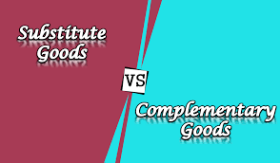
II- Different types of goods -5-
II-2- Substitutes v/s complementary goods
II-2-1- Substitute Goods
  Substitute Products correspond to goods/services which are of a different nature but which meet the same consumer need.
  In other words, they represent purchasing alternatives and diversify the overall offer.
  Customers may choose the product they prefer if it's available and consider substitutes if the price, availability or quality of their preferred product changes.

Slide 22
II- Different types of goods -6-
  A substitute good may be perfect or imperfect:
  * A perfect substitute is a product that's identical to the original item
  * An imperfect substitute is a product that's similar but noticeably different from the original good.
  For the substitutes, the demand for a good increases when the price of a substitute for the good goes up.
The greater the availability of substitutes, the higher the price elasticity of demand.
  The smaller the availability of substitutes, the lower the price elasticity of demand.
Notes:
For example, the demand for Toyotas is more elastic than the demand for cars in general, because there are more substitutes for Toyotas than for cars in general.

Slide 23
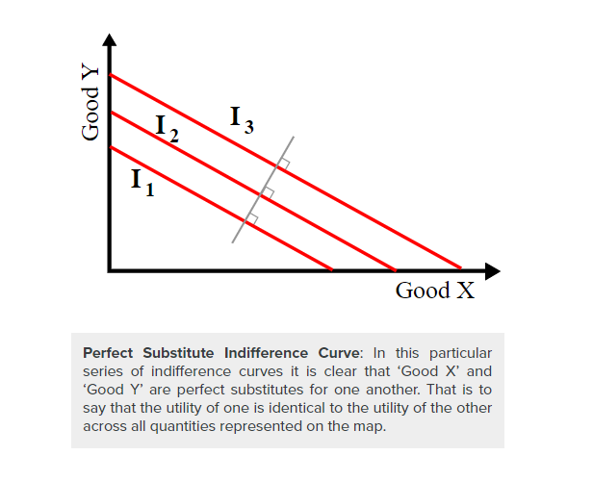
II- Different types of goods -7-
Perfect Substitutes:
A perfect substitute is a situation where two goods are viewed as identical.
When products are perfect substitutes, indifference curves will will look the graph. These lines are essentially perfectly straight, and that demonstrates that the relative utility of ‘Good X’ compared to that of ‘Good Y’ is equivalent regardless of the amount in question.
Exp: *a one-dollar bill is a perfect substitute for another dollar bill.
*butter from two different producers are also considered perfect substitutes; the producer may be different, but their purpose and usage are the same

Slide 24
II- Different types of goods -8-
II-2-2- Complementary Goods
  Complementary Good is one that is utilized in conjunction with another good or service.
  When consumed alone, the complimentary product usually has little or no value.
  Nonetheless, when combined with another commodity or service, it adds to the entire worth of the bid.
  For the complementaries, the demand for a good decreases when the price of a complement to the good goes up.

Slide 25
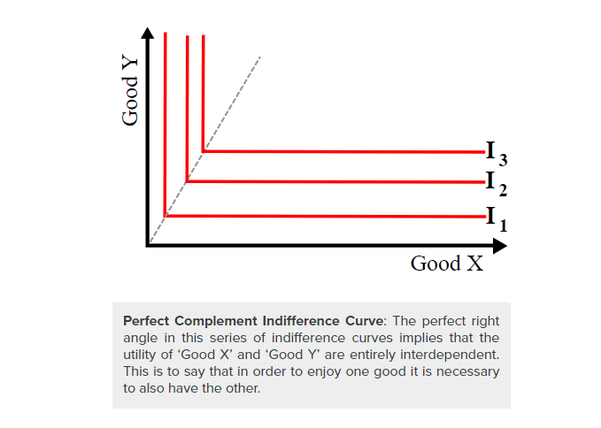
II- Different types of goods -9-
Perfect Complements: The opposite of a perfect substitute is a perfect complement, which is illustrated graphically through curves with perfect right angles at the center. These right angles, and the subsequent straight horizontal and vertical lines, demonstrate that ‘Good X’ and ‘Good Y’ are inherently tied to one another and that the consumption of one is dependent upon the consumption of the other.
Exp: Right shoe and left shoe. You need exactly one right shoe with every left shoe.

Slide 26
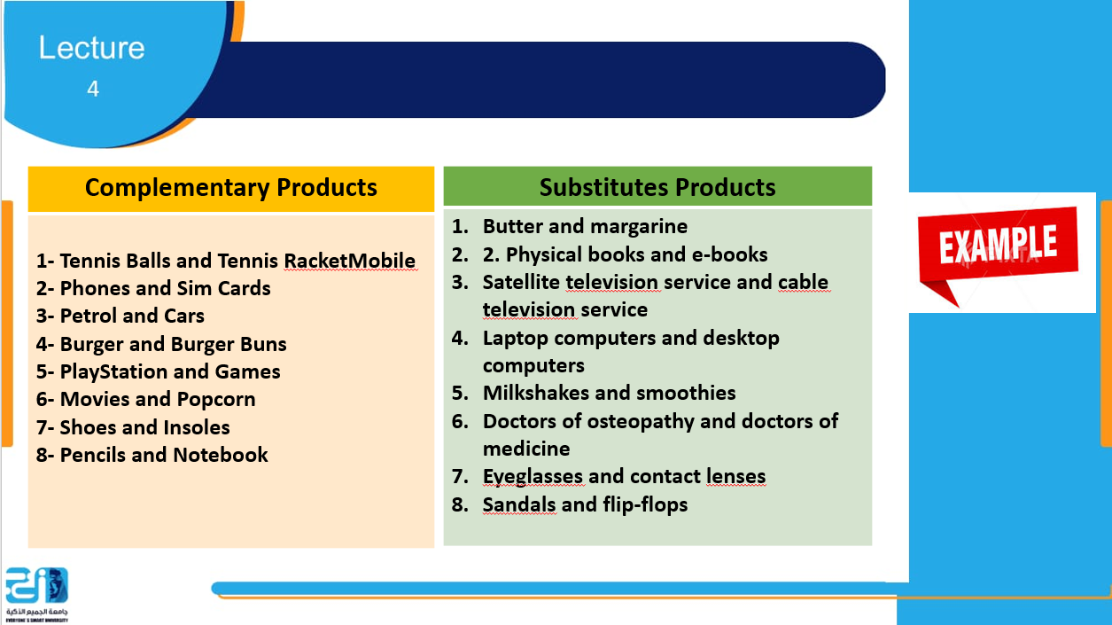
II- Different types of goods -10-

Slide 27
II- Different types of goods -11-
II-3- Price Relative to Income
If the price of a product is very high relative to the consumer’s income, the demand will tend to be elastic.
If the price of a product is very low relative to the consumer’s income, the demand will tend to be inelastic.

Slide 28
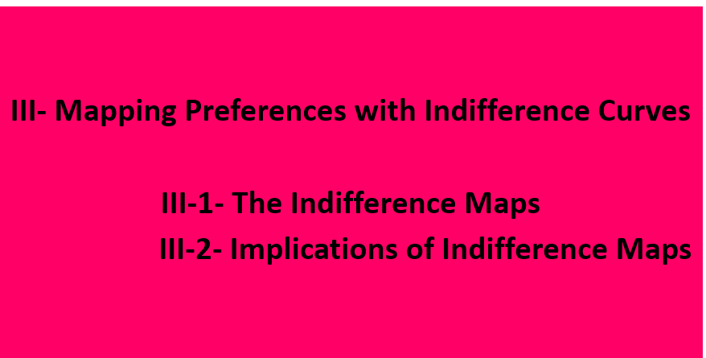

Slide 29

III- Mapping Preferences with
Indifference Curves -1-
III-1- The Indifference Maps
Economists mapping consumer preferences use indifference curves to illustrate series of goods that represent equivalent utility.
Consumer preference varies substantially from individual to individual and market to market, requiring comprehensive economic observation of consumer choices and behaviors.
These indifference curves, when mapped graphically alongside other curves, is called an indifference map that allows us to compare more than two products/services, each specific standard indifference map will be about creating a benchmark between two.

Slide 30
III- Mapping Preferences with
Indifference Curves -2-
.
For example one could compare relatively similar goods/services (i.e. apples vs. oranges) or dramatically different goods/services (i.e. university training vs. automobile purchasing).
These two items being compared represent the x and y axis of a indifference map.
A consumer will always prefer to be on the indifference curve farthest from the origin of the axes, it means the higher one.

Slide 31
III- Mapping Preferences with
Indifference Curves -3-
III-2-Implications of Indifference Maps
After constructing the required inputs to generate a comprehensive indifference map, an economist can derive conclusions based upon the properties of the illustration.
In framing these implications it is useful to identify the two potential extremes that can be outlined via with indifference curves.

Slide 32
III- Mapping Preferences with
Indifference Curves -4-
Combining an understanding of these inputs with the extremes demonstrated an indifference map, economists are able to draw meaningful conclusions regarding consumer choices and purchasing behaviors in the context of two goods.
The comparison between the goods demonstrates the relative utility one has compared to another, and the way in which consumers will act when posed with a decision between various products and services.

Slide 33
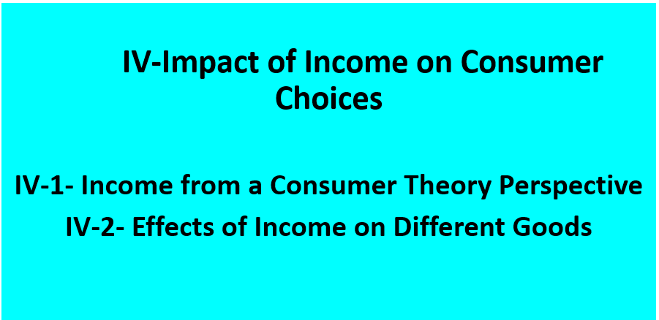

Slide 34

IV- Impact of Income on Consumer
Choices -1-
Consumer choices are predicated on various economic circumstances, and recognizing the relationship between these circumstances and an individual’s purchasing behavior allows economists to recognize and predict consumer choice trends.
One of the central considerations for a consumer in deciding upon their purchasing behaviors is their overall income or wage levels, and thus their budgetary constraints.
These budgetary constraints, when applied to a series of products and services, can be optimized to capture the most utility for the consumer based on their purchasing power.

Slide 35
IV- Impact of Income on Consumer
Choices -2-
IV-1- Income from a Consumer Theory Perspective
The simplest way to demonstrate the effects of income on overall consumer choice, from the viewpoint of Consumer Theory, is via an income-consumption curve for a normal good.
The basic premise behind this curve is that the varying income levels (as illustrated by the green income line curving upwards) will determine different quantities and balanced baskets along the provided indifference curves for the two goods being compared in this graph.
These differences in quantity reflect the increase or decrease an a given individual’s purchasing power, thus the income effect could be summarized as the increase in relative utility captured by a consumer with more monetary power.

Slide 36
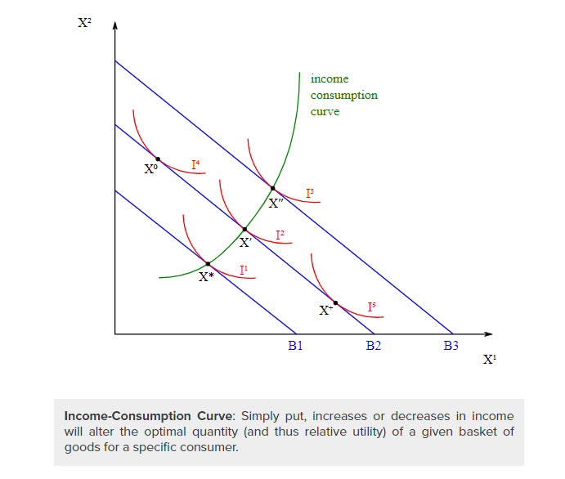

Slide 37
IV- Impact of Income on Consumer
Choices -4-
The wealth effect differs slightly from the income effect.
In fact, the wealth effect reflects changes in consumer choice based on perceived wealth, not actual income.
For example, if a person owns a stock that appreciates in price, they perceive that they are wealthier and may spend more, even though they have not realized those gains so their income has not increased.

Slide 38
IV- Impact of Income on Consumer
Choices -5-
III-2- Effects of Income on Different Goods
Income effects on consumer choice grow more complex as the type of good changes, as different product and services demonstrate different properties relative to both other products/services and a consumers preferences and utility.
As a result, it is useful to outline the differences in income effects on normal, inferior, complementary and substitute goods.

Slide 39
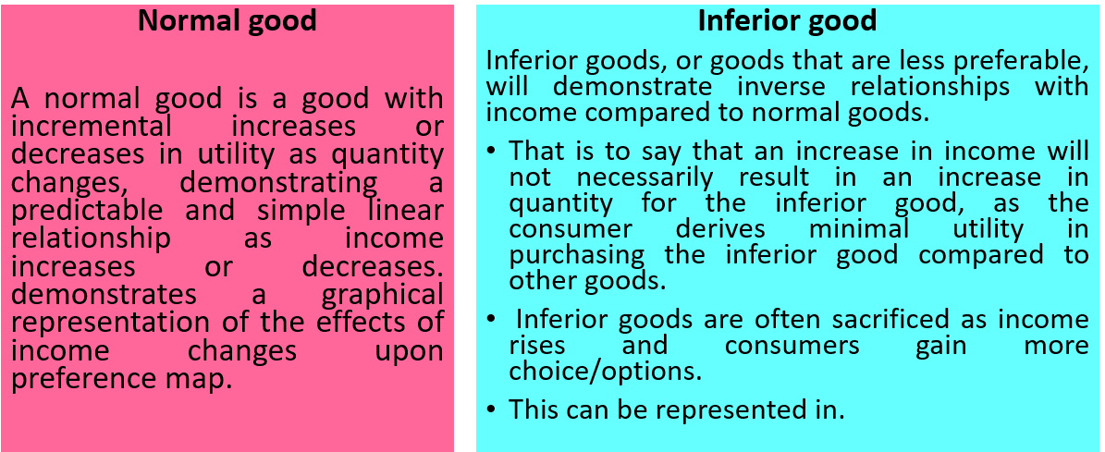

III- Impact of Income on Consumer
Choices -6-

Slide 40
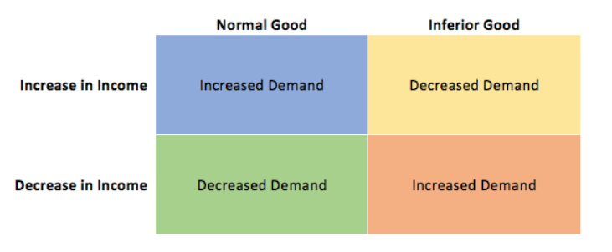
III- Impact of Income on Consumer
Choices -7-

Slide 41
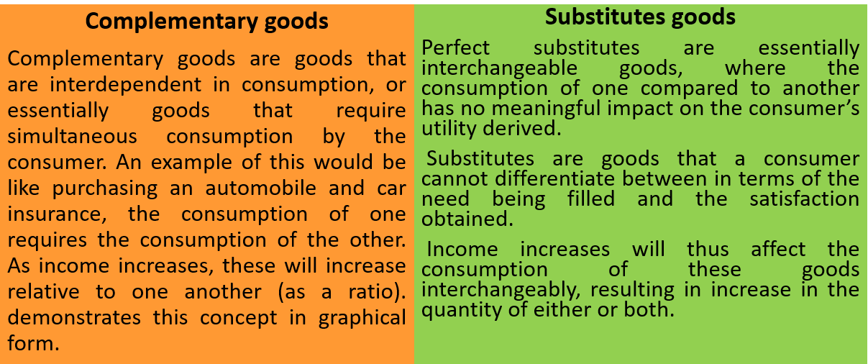
III- Impact of Income on Consumer
Choices -8-

Slide 42

III- Impact of Income on Consumer
Choices -9-

Slide 43
IV- Impact of Income on Consumer
Choices -10-
In merging Consumer Theory and consumer choices with income level, the primary takeaway is that an increase in income will increase the prospective utility that consumer can acquire in the market.
Understanding how this applies in a general fashion, alongside the specific circumstances dictating specific types of goods, it becomes fairly straight-forward to predict consumer purchasing behaviors at differing income levels.

Slide 44
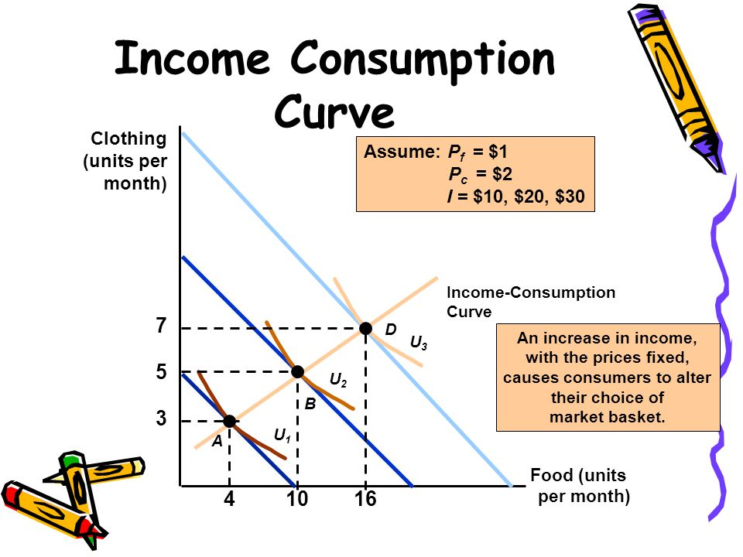
IV- Impact of Income on Consumer
Choices -11-

Slide 45
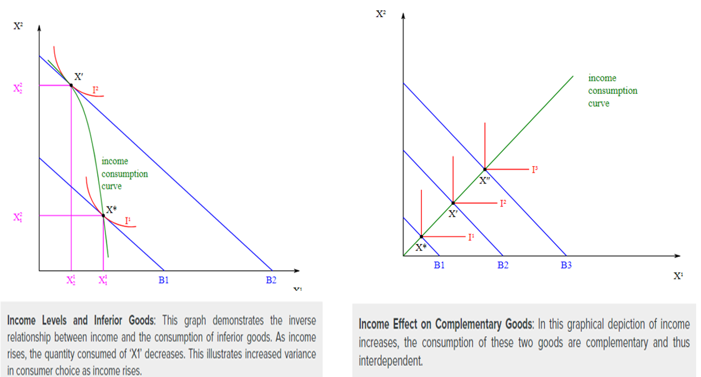

Slide 46
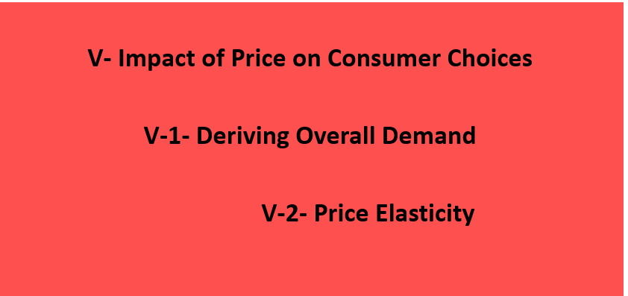

Slide 47

V- Impact of Price on Consumer Choices
-1-
The demand curve shows how consumer choices respond to changes in price.
In almost all cases, consumer choices are driven by prices: As price goes up, the quantity that consumers demand goes down.
This correlation between the price of goods and the willingness to make purchases is represented clearly by the generation of a demand curve (with price as the y-axis and quantity as the x-axis).
The construction of demand, which shows exactly how much of a good consumers will purchase at a given price, is defining of consumer choice theory.

Slide 48
V- Impact of Price on Consumer Choices-2-
V-1- Deriving Overall Demand
The generation of a demand curve is done by calculating what price consumers are willing to pay for a given quantity of a good or service.
For normal goods or services, demand is illustrated with a downward sloping curve, where the quantity on the x-axis will generally increase as the price on the y-axis decreases (and vice versa).
The quantity demanded may change in response to both to shifts in demand (and the creation of a new demand curve, as demonstrated in) and movements along the established demand curve.

Slide 49
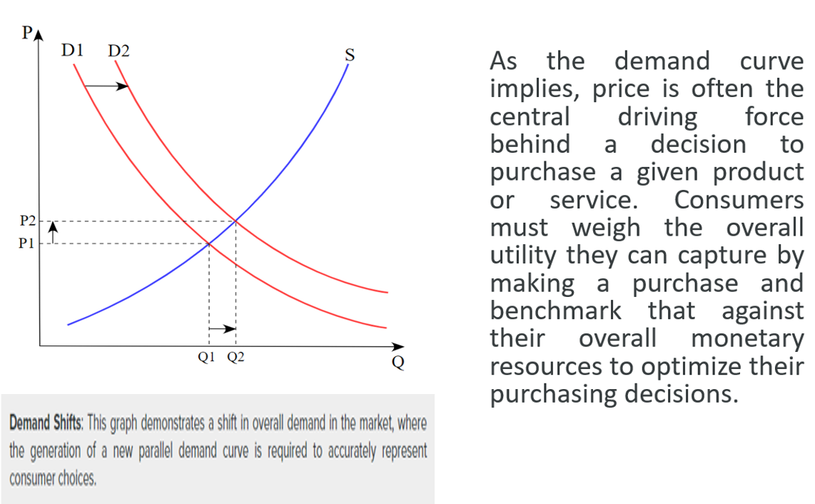
V- Impact of Price on Consumer Choices-3-

Slide 50

V- Impact of Price on Consumer Choices -4-
V-2- Price Elasticity
A critical consideration of product/service pricing is the price elasticity of a given good, which indicates how responsive demand is to a change in price.
Price elasticity is essentially a measurement of how much any deviations in price will drive the overall quantity purchased up or down, underlining to what extent consumer purchasing decisions will be dictated by pricing.
A highly elastic good will see consumers much less likely to purchase when prices are high and much more likely to purchase when prices are low, while a good with low elasticity will see consumers purchasing the same quantity regardless of small price changes.

Slide 51

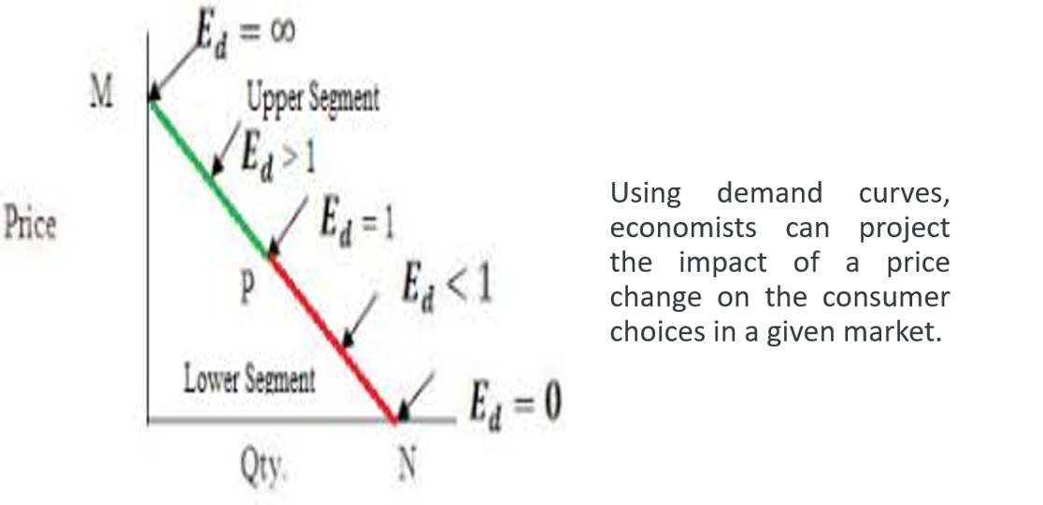
Price Elasticity: As this graph demonstrates, the slope of the demand curve will vary as a direct result of how elastic consumer purchasing behaviors will be compared to price changes.

Slide 52


Slide 53
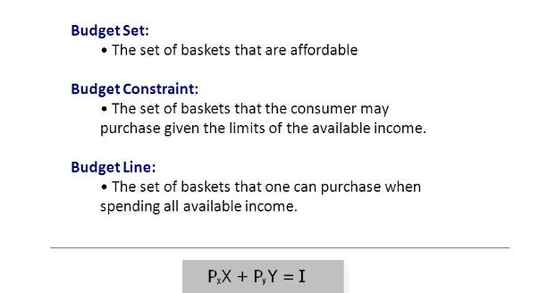
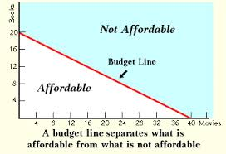

Slide 54
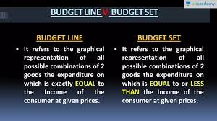


Slide 55
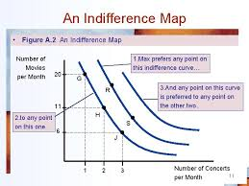
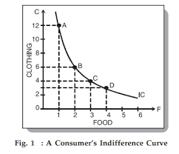
Indifference Curves
Indifference Maps

Slide 56
Income-consumption Curve

Slide 57
Perfect Subtitute Indifference Curve
Perfect Complement Indifference Curve

Slide 58


