Slide 1

PMG 506
Advanced Project Management
LECTURE 10: PROJECT MONTITORING AND CONTROLLING – REVIEW 14 APR 2021
Everyone’s Smart
University
دكتور مهندس استشاري ادارة المشروعات
Eng. Dr. Akram Mustafa Suliman Ali,
PhD. AU, BEng. & MSc. AAST, CEng CMarEng MIMarEST, PE, PMP®,
ASQ CSSBB, ISO Lead Auditor, NDT Level II,

Slide 2
Qa VS QC

Slide 3
STUDENT QUESTION
Activities and management processes that take place to make sure that the project and project deliverables are at the required quality level is known as:
‫تُعرف الأنشطة وعمليات الإدارة التي تتم للتأكد من أن نواتج المشروع والمشروع بمستوى الجودة المطلوب باسم:‬
a. Quality defect‫ عيب الجودة‬
b. Quality Assurance‫ ضمان الجودة‬
c. Quality failure‫ فشل الجودة‬
d. Quality control‫ مراقبة الجودة‬
Internal monitoring and control of project deliverables, to ensure that they meet the quality targets set for the project is known as:
يُعرف الرصد والمراقبة الداخليان لنواتج المشروع ، للتأكد من أنها تلبي أهداف الجودة المحددة للمشروع باسم‪:‬
a. Quality Assurance‫ ضمان الجودة‬
b. Quality defect‫ عيب الجودة‬
c. Quality control‫ مراقبة الجودة‬
d. Quality failure‫ عيب الجودة

Slide 4
My REPLY
Dear Mr. Bandar,
Please share with your collegues
First question: The answer is Quality Assurance and the key words here are "project and project deliverables".
Second question: The answer is Quality Control and the words here are "project deliverable" and "meet quality targets"

Slide 5
PROJECT

Slide 6
project
Instructions:
اخر موعد للتسليم هو يوم الخميس 820-05-2021 في تمام الساعة ٩ مساءً.
الإجابة متاحة باللغة الإنجليزية أو اللغة العربية مع مراعاة أن تكون المصطلحات العلمية باللغة الانجليزية.
يتم تسليم المشروع في صيغة ملف . pdf مع الالتزام نموذج الجامعة ولن تقبل أي مستندات أخري.
يجب مراعاة أقسام البحث الرئيسية (مقدمة Introduction، دراسات علمية سابقة Literature Review، طريقة البحث Methodology ،النتائج والمناقشة Results and Discussion ، وأخيراً المراجع References . وان كان هناك ملحقات Appendices يتم إضافتها)
يجب الالتزام بـ Theme موحّد كما يلي:
حجم الخط 12.
نوع الخط Arial.
لون الخط أسود.
المسافة بين الأسطر line spacing 1.5
عدد صفحات البحث (لا يقل عن ثلاث صفحات ولا يزيد عن ست صفحات).

Slide 7
PROJECT
You are required to document your role in administering a project.
The project may be set in a business, social, sporting, or family environment but must be of a significant size and scale.
If you do not have an actual project to write about you may complete the project hypothetically.
This report will be between three to six pages in length.
This is a significant research project.

Slide 8
Project
Your report must address each ONE of the following issues:
Identify and describe the purpose, scope, and objectives of the project. Display this information using an appropriate tool.
Describe how the team is given an outline of the project.
Describe the strategies that are going to be set up to maintain communication with the team members.
Describe the tools that are going to be used to monitor the goals, time frames or milestones.
Identify project milestones and activities. Display this information using an appropriate tool.
Create a budget and link the costs to the key milestones for a project.
Describe how you are going to divide tasks and resources amongst a project team. Display this information using an appropriate tool.
Briefly describe how the progress will be monitored.
How are current project records maintained? Who has responsibility for this? provide some recommendations on how this process could be improved.
Describe the current procedure for finalizing projects. Create your own procedure and identify how you will evaluate the success of the project.
Legislation that may affect the project including health and safety, and anti-discrimination legislation.

Slide 9
LECTURE REVISION

Slide 10
Project performance management
Schedule
Budget
Scope
Quality
Communications
Risk
Procurement
Stake Holder Engagement
Change
PLAN
ACTUAL
Variance Analysis

Slide 11
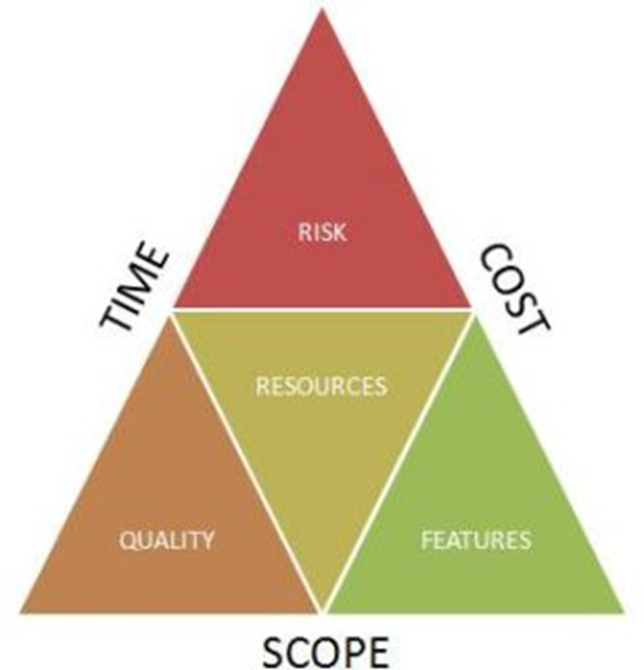
Project recovery technique
Cost Crashing
Fast Tracking
Redefine Scope
  (Less Features)
  (Control Changes)
Re-plan Quality
  (Less Testing)
  (Lower Grade)
  (Cheaper Resources)
  (Available Resources)
  (Replace Suppliers)
  (Re-negotiate sub-contractors)
Re-plan Risk
Reassign Management Resources

Slide 12
EARNED VALUE MANAGEMENT
Combines Scope, Schedule and Budget
Provides a true “Project Health Indicator”
Uses past to predict the future
Only as reliable as the FACTS
GIGO = Garbage in garbage out

Slide 13
Earned value basics
PV = Planned Value = Baseline = BCWS (Budgeted Cost of Work Scheduled)
AC = Actual Cost = Actual Costs Incurred = ACWP (Actual Cost of Work Performed)
EV = Earned Value = Cost of Value Delivered = BCWP (Budgeted Cost of Work Performed)

Slide 14
Variables used in EVA
Acronym | Variable
BCWS | Budgeted Cost for Work Scheduled: The amount budgeted for a task between its start day and today. For example, say that you expected a task to take 10 days and $1000. Today is day 3. The BCWS on day 3 is $300. Planned Value
BCWP | Budgeted Cost for Work Performed/ Earned Value: The percentage of the task budget that corresponds to the task’s completion status. For example, if the $1000 task is only 10% complete on day 3, its BCWP is $100
ACWP | Actual Cost for Work Performed: The actual cost of the task so far. Fore example, if have spent $500 of your $1000 by day 3, the ACWP is $500. Actual Cost

Slide 15
S – Curves
TCPI = (BAC – BCWP) / ( BAC – AC)
TCPI = (5000 – 4000) / (5000 – 4800)
TCPI = 1000 / 200 = 5 ☹
CV = BCWP – ACWP
CV = 4000 – 4800
CV = -800
☹
SV = BCWP – BCWS
CV = 4000 – 4500
CV = -500
☹
SPI = BCWP / BCWS
SPI = 4000 / 4500
SPI= 0.89
☹
PV
CPI = BCWP / ACWP
CPI = 4000 / 4800
CPI = 0.83
☹
EV
STC = Duration / SPI
STC = 5 / 0.89 = 5.62
EAC = BAC / CPI
EAC = 5,000 / 0.83 = 6,025
CV = EV – AC
SV = PV – PV
CPI = EV / AC
SPI = EV / PV

Slide 16
Earned Value Calculations
Acronym | Variance | Calculation
CV | Cost Variance | BCWP - ACWP
SV | Schedule Variance | BCWP - BCWS
CVP | Cost Variance Percentage | CV / BCWP % (-ve value means cost overrun) ☹
SVP | Schedule Variance Percentage | SV/ BCWP % (-ve value means work is behind schedule) ☹
EAC | Estimate At Completion | BAC / (CPI)
STC | Schedule to Complete | Original duration / (SPI)
SPI | Schedule Performance Index | BCWP/ BCWS (>1 = Leading) ☺
CPI | Cost Performance Index | BCWP/ AC (> 1 = cost underrun) ☺
TCPI | To Complete Performance Index | (BAC – BCWP) / (BAC – AC) (>1 = BAD) ☹

Slide 17
Task
Your team has presented you with the following status data for the Develop Recipes work package: Actual work performed = 40%; actual cost to date =$ 2,500; budgeted cost for work packages = $ 7,500; number of days scheduled = 30 days; actual number of days = 20 days
  What are
    BCWS
    $5000
    BCWP
    $3000
    ACWP
    $2500
What is the cost variance for this work package? What does this number mean?
  BCWP-ACWP = $500
What is the schedule variance for this work package? What does this number mean? What calculations can you use to provide a more meaningful schedule variance number?
  BCWP – BCWS = - $2000
What is the cost variance percentage?
  {(BCWP – ACWP)/BCWP} X 100% = 16%

Slide 18
Getting Back on Track
When do you check for variances?
Before each project status report is due.
Methodology for dealing with variance
Face the issue and deal with it as it emerges.

Slide 19
Task
The first step in dealing with variance is to a) Find its cause.
  Plan to take corrective action
  Determine overall project impact or repetition
  Present the information to stakeholders
  Prepare to negotiate trade-offs

Slide 20
Review
List 3 skills that a project manager needs to establish project momentum
What is the word for the difference between actual and estimated costs or time
The benefit of conducting EVA is
  It provides a more accurate project baseline that other tracking methods
  Management can understand EVA better than other measures
  It allows you to see interrelationships between cost and schedule
  It shows you how to get a project back on track
Why is it important to monitor for cost or schedule variances systematically?
Boundary Management; Team Building; Conflict Management; Communication
Variance
Recover project using Cost, Quality and Time “Trade Offs”

Slide 21


