Slide 1


Supply Chain Management
Prepared by Dr. Tarek Mohamed
MGM 660
Lecture 10

Slide 2


Sustainability and the Supply Chain &
New trends in Supply Chains
Lecture 10
MGM 660
Prepared by
Dr. Tarek Mohamed

Slide 3

Course Agenda
Chapter
Define supply chain sustainability.
Explain the three pillars of sustainability.
Identify the benefits and challenges of sustainable supply chains.
Understand how sustainability affects procurement, manufacturing, logistics, and reverse logistics.
Analyze real-world company examples of sustainable supply chain practices.
What’s trending right now in Supply chains
Major research themes in Supply-chain Academia & Practice

Slide 4
What is a Sustainable Supply Chain?
A sustainable supply chain is the management of material, information, and
financial flows while considering:
Environmental protection
Social responsibility
Economic performance
The objective is to create value throughout the supply chain while minimizing
negative environmental and social impacts.
Improving sustainability performance may require accepting higher short-term
costs to achieve long-term strategic benefits.

Slide 5
Sustainability Across Supply Chain Activities
1. Sustainable Procurement
Focuses on purchasing from suppliers that meet environmental and social standards.
Examples:
Selecting ISO 14001-certified suppliers
Purchasing recyclable materials
Choosing local suppliers to reduce transportation emissions
Ethical sourcing

Slide 6
Sustainability Across Supply Chain Activities
2. Sustainable Manufacturing
Objectives include:
Reducing waste
Improving energy efficiency
Using renewable energy
Water conservation
Cleaner production technologies
Examples:
Solar-powered factories
Lean manufacturing
Zero-waste initiatives

Slide 7
Sustainability Across Supply Chain Activities
3. Sustainable Transportation
Strategies include:
Route optimization
Electric vehicles
Alternative fuels
Intermodal transportation
Consolidated shipments
Benefits:
Lower fuel costs
Reduced carbon emissions
Improved delivery efficiency

Slide 8
Sustainability Across Supply Chain Activities
4. Sustainable Warehousing
Examples include:
LED lighting
Smart energy management
Solar panels
Green buildings
Automated inventory systems

Slide 9
Sustainability Across Supply Chain Activities
5. Sustainable Packaging
Objectives:
Reduce packaging material
Recyclable packaging
Biodegradable materials
Reusable containers
Benefits:
Lower waste
Lower transportation cost
Better customer perception

Slide 10
Sustainability Across Supply Chain Activities
6. Reverse Logistics
Activities include:
Product returns
Recycling
Remanufacturing
Refurbishment
Proper disposal
Benefits:
Recover product value
Reduce landfill waste
Improve sustainability

Slide 11
Role of Sustainability in a Supply Chain
Focusing on sustainability allows a supply chain to better serve more conscious customers while often improving supply chain performance
Customers have usually backed up words about the importance of sustainability without a willingness to pay more for sustainable products.
Sustainable supply chain management can create competitive advantage while supporting environmental and social responsibility
Three pillars of sustainable development
  Economic sustainability
  Environmental sustainability
  Social sustainability
Factor categories
  Reducing risk and improving the financial performance of the supply chain
  Community pressures and government mandates
  Attracting customers that value sustainability

Slide 12
Role of Sustainability in a Supply Chain
Environmental Sustainability
Examples:
Carbon footprint reduction
Renewable energy
Water conservation
Waste reduction
Circular economy
Green procurement
Social Sustainability
Includes:
Safe working conditions
Fair wages
Human rights protection
Supplier code of conduct
Diversity and inclusion
Community engagement
Economic Sustainability
Focuses on:
Long-term profitability
Operational efficiency
Innovation
Risk management
Cost reduction
Business continuity

Slide 13
Role of Sustainability in a Supply Chain
In reality, actions in a supply chain improve both sustainability and supply chain surplus.
Most effort expended in reducing risk
Activity slow as actions may require upfront investment
Barriers to increased focus on sustainability
  Insufficient return on investment
  Customers’ unwillingness to pay a premium for green products
  Difficulty evaluating sustainability across a product life cycle

Slide 14
Key Pillars of Sustainability
Measuring performance along all three pillars may be required to evaluate the impact of sustainability-related efforts
Companies that invest in sustainability may improve both profitability and brand reputation
Sustainability initiatives often require collaboration across multiple supply chain partners.
Sustainability should be integrated into every stage of the supply chain, from sourcing to product disposal.
Two fundamental challenges for social and environmental pillars
  Scope of measurement
  Absolute of relative measures

Slide 15
Circular Economy vs. Linear Economy
Linear Economy
Take → Make → Use → Dispose
Circular Economy
Take → Make → Use → Reuse → Repair → Refurbish → Recycle
Benefits:
Less waste
Better resource utilization
Lower environmental impact

Slide 16
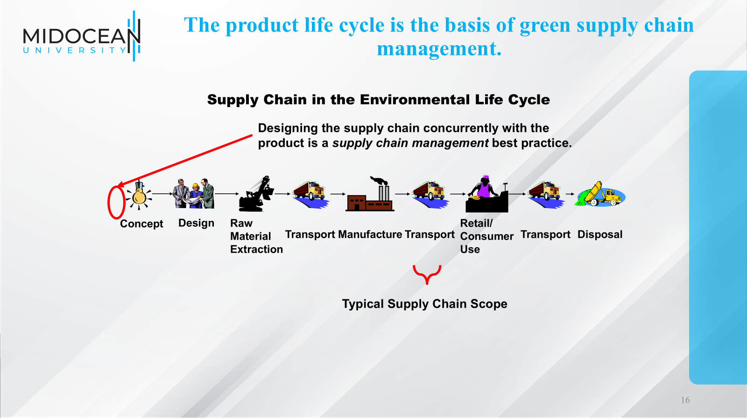

Slide 17
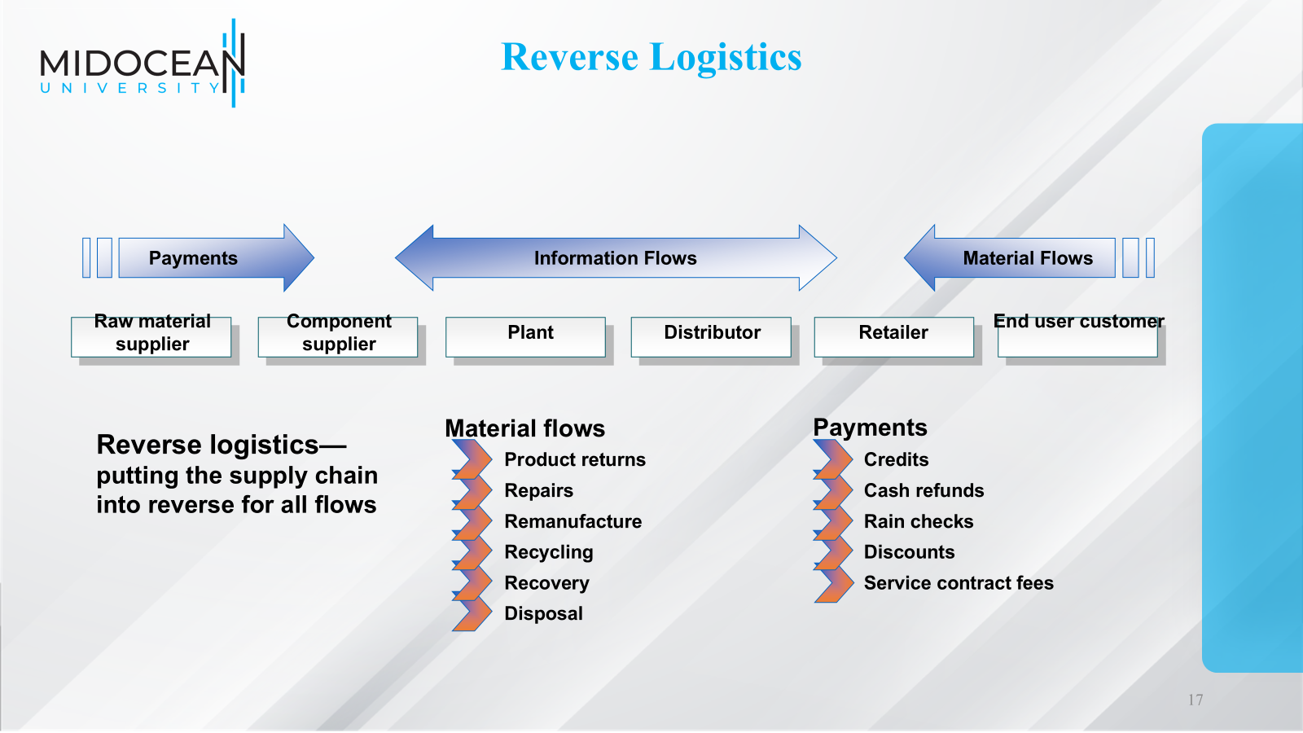

Slide 18
Reverse Logistics
“A complete supply chain dedicated to the reverse flow of products and materials for the purpose of returns, repair, remanufacture, and/or recycling.”
Can represent major costs to a company
Amount of goods returned
  up to 50% in the publishing industry
  90% of automotive starter motors or alternators
Companies are taking responsibility of the return of packaging materials
Reverse Logistics – Information
Goods are returned to supplier
Information is also needed
  reason / approval for the return
  credit information

Slide 19
Reverse Logistics
Supplier
Customer
Returned Goods
Information

Slide 20
Green Logistics
Green supply chain management includes environmental considerations throughout the product life cycle.
Return and disposal of packaging materials
Return and disposal of environmentally sensitive materials
  heavy metals
  solvents
Use of reusable (returnable) packaging

Slide 21
Returned Goods
Quality demands by customers
Damage or defects
Excessive inventories
Seasonal inventories
Out-of-date inventories
Remanufacturing or refurbishment

Slide 22
Returned Goods - Disposition
Returned to inventory
Refurbished for resale
Sold into alternate markets
Disassembled to retrieve components
Sorted for material recovery
Value

Slide 23
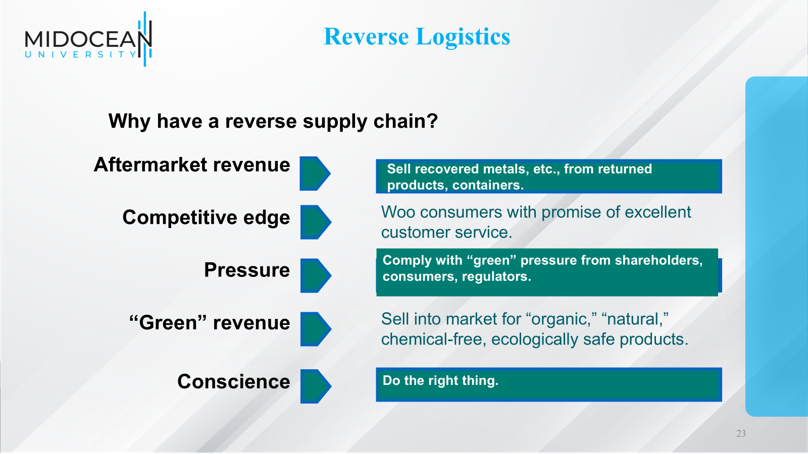

Slide 24
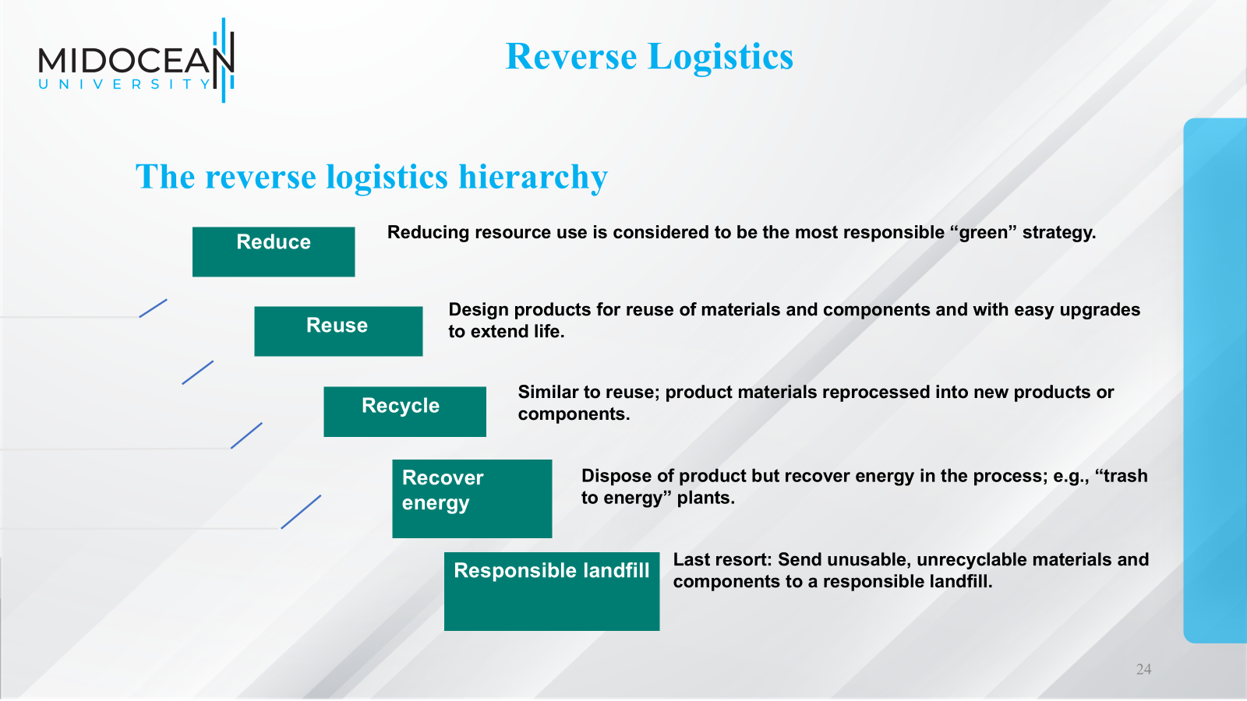

Slide 25
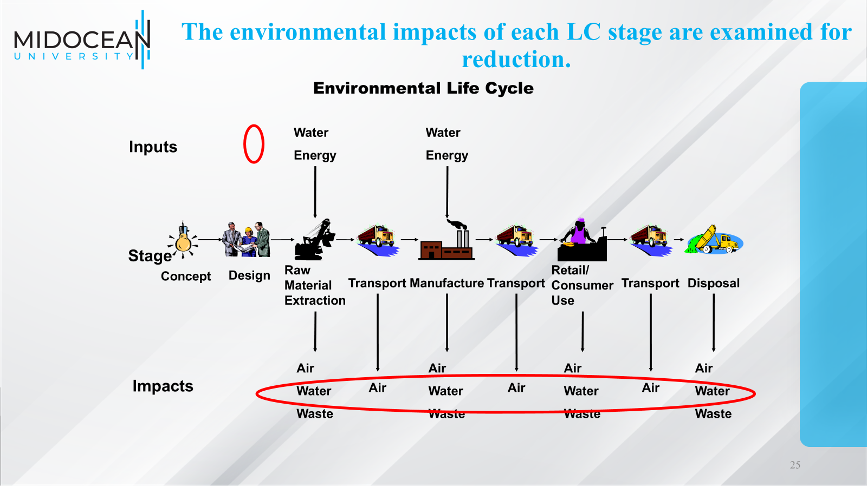

Slide 26
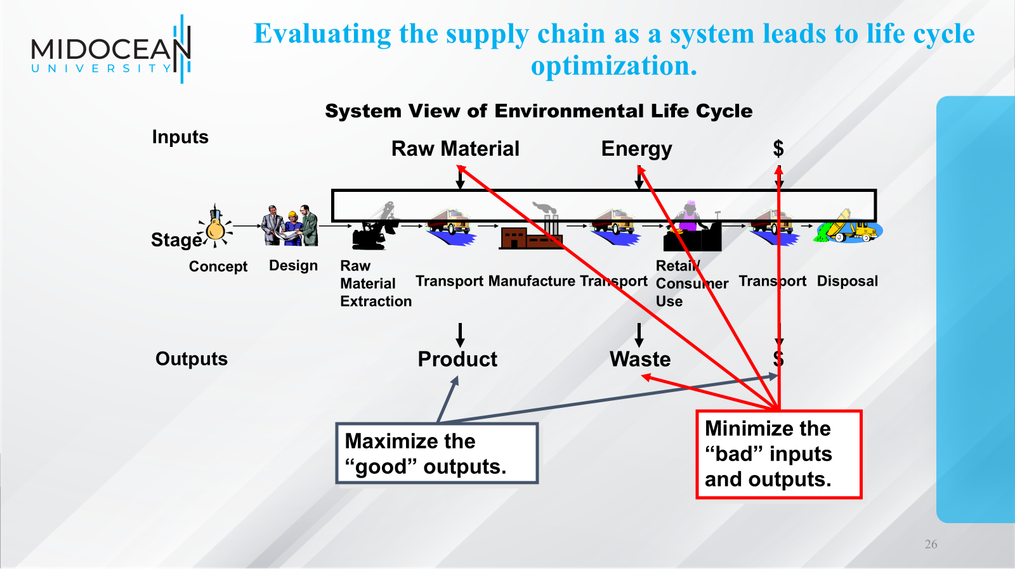

Slide 27
Reverse Logistics
Supply chain design for reverse logistics
  Reverse flows require their own systems.
    Information flows need worldwide data warehouse.
    Cash flows (credits, etc.) need customer-centered approach.
    Product flows need reverse forecasting, special collection locations, processing centers, and transportation.
  Reverse revenues minus reverse expenses can bring profits.
  Life cycle design considers the 4 Rs in all phases of product life.
    Design for wise use of resources, reuse of old products.
    Prepare for returns before introduction.
    Develop systems to support continued use, upgrades in maturity.
    Be prepared for end-of-life cycle, especially with dangerous goods.

Slide 28
Reverse Logistics
The payoffs
Lucrative customer service contracts
Fewer, or no, costly returns
Enhanced customer loyalty and reputation
Revenues for materials in product returns
More efficient products and logistical tactics
New types of jobs
More sustainable use of energy and resources
Reduction of harmful emissions and pollutants
Reduced need for landfills and incinerators

Slide 29
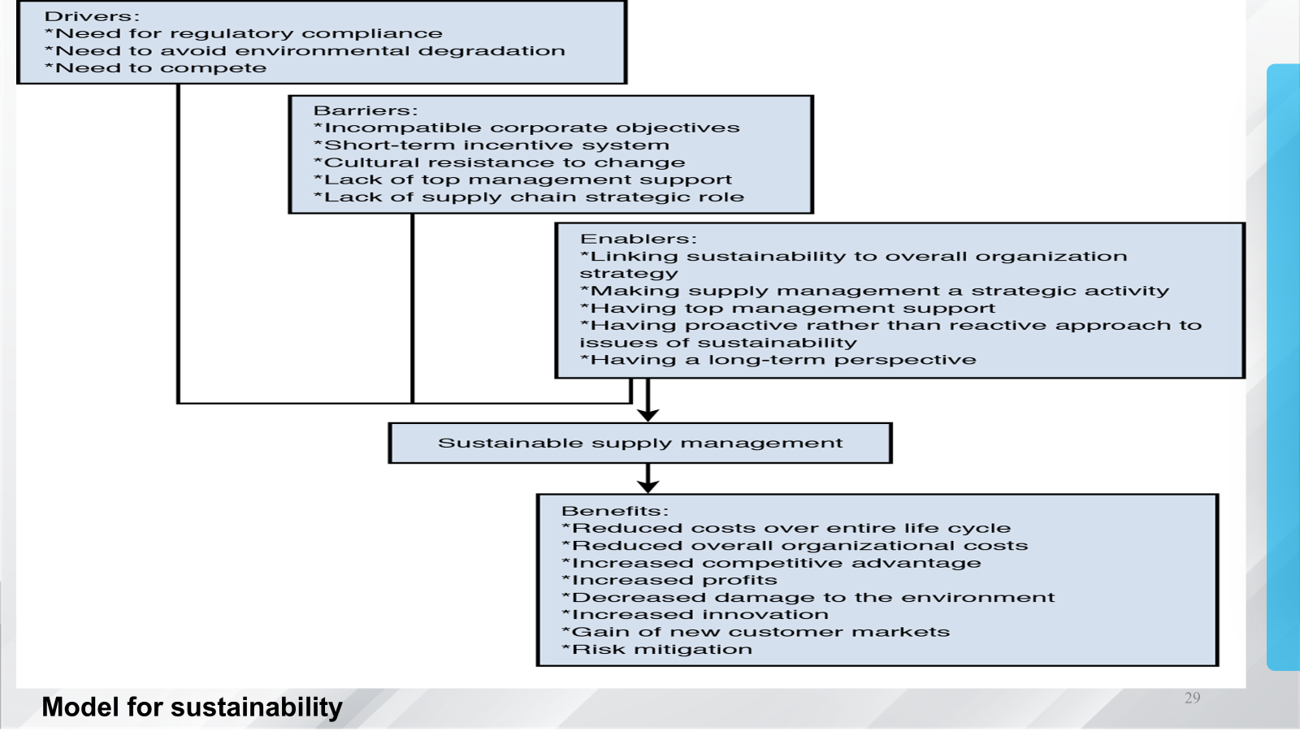

Slide 30
Sustainability and Supply Chain Drivers
Supply Chain Drivers
Supply chain drivers are classified into two categories:
A. Logistics Drivers
Facilities
Inventory
Transportation
B. Cross-Functional Drivers
Sourcing
Information
Pricing
Match pillars with drivers
Measure environmental impact for each driver along each of the social and environmental categories

Slide 31
Facilities
Consumers of energy and water and emitters of waste and green- house gases
Separate the improvement opportunities into those that generate positive cash flows and those that do not
Facilities often offer the best opportunity to simultaneously improve the environmental and financial performances through innovation
Sustainable Practices
Green building design (LEED-certified facilities)
Solar panels and renewable energy
LED lighting
Smart energy management systems
Water recycling systems
Waste reduction programs
Energy-efficient equipment

Slide 32
Inventory
Most supply chains focus on raw materials, work in process, finished goods
Inventory in a landfill
Cost borne collectively by society
Reduce harmful inventory, unlock unused value
“Cradle to cradle” design
Sustainable Inventory Strategies
Just-in-Time (JIT)
Better demand forecasting
AI-based inventory optimization
Product life-cycle management
Inventory sharing
Reduced safety stock where appropriate

Slide 33
Transportation
Improve environmental performance through resource and emission reduction
Product design can play a significant role
Sustainable Transportation Strategies
Electric vehicles
Alternative fuels
Route optimization
Shipment consolidation
Intermodal transportation
Local sourcing
Autonomous delivery technologies

Slide 34
Sourcing
Greatest social and environmental impact occurs in the extended supply chain
Impact has grown with increased global sourcing
Verifying and tracking supplier performance with regard to sustainability a major challenge
Sustainable Procurement
Supplier environmental audits
Ethical sourcing
Local sourcing
Fair labor practices
Supplier sustainability scorecards
Supplier collaboration

Slide 35
Information
One of the biggest challenges to improved supply chain sustainability
Absence of standards for measurement and reporting means that some claims of environmental improvement are not verifiable
Sustainable Information Systems
ERP systems
IoT sensors
AI analytics
Blockchain
Digital twins
Carbon tracking software

Slide 36
Pricing
Differential pricing can improve the utilization of assets, leading to resource reduction
  Delays the need for additional capacity
Consumption visibility and differential pricing potentially lead to reduce resource consumption
Biggest challenge is changing the customer’s willingness to pay
Government incentives can encourage customers and firms
Sustainable Pricing Strategies
Dynamic pricing
Carbon pricing
Discounts for eco-friendly products
Deposit-refund systems
Incentives for reusable packaging

Slide 37
Closed-Loop Supply Chains
Improve sustainability by designing products that use fewer resources and can be recycled and remanufactured
Depends on
  The incentive to recycle or remanufacture
  The cost to recycle or remanufacture
Cannibalization of demand for new products
Cost of recycling or remanufacturing has a significant impact on the process of recycling

Slide 38
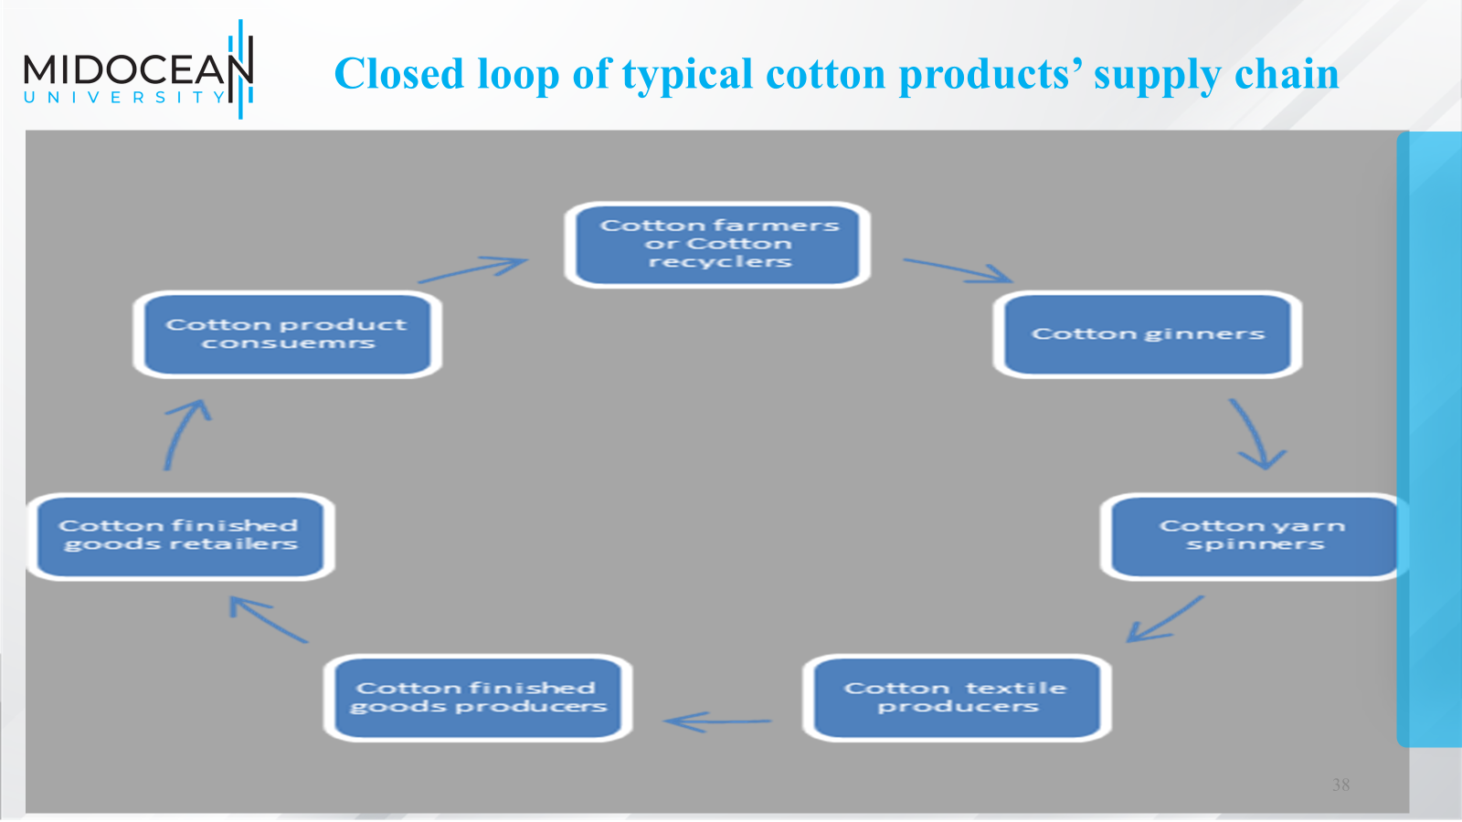

Slide 39
Pricing of Sustainability
Internalize the “monetary value” of the social or environmental cost
Incorporate suitable prices for the social and environmental impacts of different actions
Significant challenges to setting these prices

Slide 40
Pricing Emissions
Firms will not put sufficient effort into reducing GHGs unless they are “forced” to reduce emissions or required to pay for the social cost of their emission
Two approaches
  Carbon tax
  Cap-and-trade system

Slide 41
Pricing Emissions
Evaluating pricing mechanisms
  Cost of administration
  Price volatility
  Emission uncertainty
  New information uncertainty
  Industry competitiveness
  Wealth transfer to energy-exporting countries
  Revenue neutrality

Slide 42
Challenges of Sustainability
High initial investment
Supplier resistance
Lack of sustainability data
Global supply chain complexity
Measuring sustainability performance
Balancing cost and environmental go

Slide 43
Key Sustainability Metrics (KPIs)
Carbon emissions (CO₂)
Energy consumption
Water usage
Waste generation
Recycling rate
Supplier sustainability score
Percentage of renewable energy used
On-time delivery with reduced emissions

Slide 44
Real-World Company Examples
1. Patagonia
Uses recycled materials in clothing.
Repairs and resells used garments through circular economy initiatives.
Promotes responsible sourcing and environmental conservation.
2. Unilever
Works with suppliers to reduce greenhouse gas emissions.
Promotes sustainable agriculture.
Reduces plastic packaging across many product lines.

Slide 45
Real-World Company Examples
3. IKEA
Uses renewable energy.
Sources wood from responsibly managed forests.
Designs products for recycling and reuse.
4. DHL
Invests in electric delivery vehicles.
Optimizes transportation routes using digital technologies.
Targets significant reductions in logistics-related emissions.
5. Apple
Expands the use of recycled materials in devices.
Uses renewable electricity in many operations.
Encourages supplier adoption of clean energy.

Slide 46
Technology Supporting Sustainable Supply Chains
Technology | Sustainability Contribution
Artificial Intelligence (AI) | Forecasting, route optimization, demand planning
Internet of Things (IoT) | Energy monitoring, predictive maintenance
Blockchain | Traceability and ethical sourcing
Big Data Analytics | Waste reduction and demand forecasting
Robotics | Energy-efficient automation
Digital Twins | Supply chain simulation and optimization

Slide 47
Summary
Sustainability has become a strategic requirement rather than an optional initiative.
Organizations that integrate environmental protection, social responsibility,
and economic performance throughout procurement, production, logistics, warehousing, and reverse logistics can reduce costs, strengthen resilience, comply with regulations, enhance their reputation, and achieve long-term competitive advantage.
Successful supply chains balance the needs of People, Planet, and Profit while creating value for customers and society.

Slide 48
What’s Trending Right Now in Supply Chains
1. Artificial Intelligence (AI) & Generative AI
AI-powered demand forecasting
Inventory optimization
Supplier risk prediction
AI procurement assistants
Warehouse automation
Generative AI for supply chain planning and reporting
Examples: Amazon, Walmart, Unilever

Slide 49
What’s Trending Right Now in Supply Chains
2. Supply Chain Resilience
Multi-sourcing
Nearshoring
Regional manufacturing
Business continuity planning
Risk management
Drivers
COVID-19 lessons
Geopolitical conflicts
Climate disruptions

Slide 50
What’s Trending Right Now in Supply Chains
3. Sustainability & Green Supply Chains
Net-zero supply chains
Carbon footprint reduction
Circular economy
Reverse logistics
Green procurement
ESG reporting
KPIs
CO₂ emissions
Energy consumption
Waste reductionWater usage

Slide 51
What’s Trending Right Now in Supply Chains
4. Digital Supply Chains
Digital transformation
Cloud-based ERP
Digital twins
End-to-end visibility
Real-time monitoring
Technologies
IoT
Cloud Computing
AI
Big Data

Slide 52
What’s Trending Right Now in Supply Chains
5. Supply Chain Visibility
Real-time shipment tracking
Inventory visibility
Supplier visibility
Control towers
Benefits
Faster decisions
Better customer service
Reduced disruptions

Slide 53
What’s Trending Right Now in Supply Chains
6. Internet of Things (IoT)
Applications include:
Smart warehouses
Smart shelves
Temperature monitoring
Fleet tracking
Predictive maintenance

Slide 54
What’s Trending Right Now in Supply Chains
7. Blockchain
Applications:
Product traceability
Food safety
Counterfeit prevention
Smart contracts
Supplier transparency
Industries:
Food
Pharmaceuticals
Luxury goods

Slide 55
What’s Trending Right Now in Supply Chains
8. Last-Mile Delivery Innovation
Delivery lockers
Electric vehicles
Delivery drones
Delivery robots
Crowd shipping
Route optimization

Slide 56
Applications of Artificial Intelligence in the SC
AI optimizes inventory management . This is done by analyzing sales data, supply chain dynamics, and external variables to maintain ideal stock.
Demand forecasting. AI-powered demand forecasting enables companies to predict future demand for products with high accuracy by analyzing a wide range of data sources.
Improved warehouse efficiency. AI, specifically ML models, helps lay out warehouses more efficiently by being able to evaluate the quantity of materials
More-timely deliveries. Manufacturers that assemble products via complex supply chains are especially dependent on timely and well-coordinated deliveries .
AI can help make supply chains more sustainable by optimizing routes and reducing carbon emissions through smart logistics.

Slide 57
Major Research Themes in Supply-Chain Academia & Practice

Slide 58
Summary of Learning Objectives
Define supply chain sustainability.
Explain the three pillars of sustainability.
Identify the benefits and challenges of sustainable supply chains.
Understand how sustainability affects procurement, manufacturing, logistics, and reverse logistics.
Analyze real-world company examples of sustainable supply chain practices.
What’s trending right now in Supply chains
Major research themes in Supply-chain Academia & Practice

Slide 59
Essential Reference
Lysons, K., & Farrington, B. (2020). Procurement and supply chain management. Pearson UK.
Chopra, S., & Meindl, P. (2016). Global Edition. Pearson Education Limited. Chapter 18.
Morris, P. W., & Pinto, J. K. (Eds.). (2007). The Wiley guide to project technology, supply chain, and procurement management (Vol. 4). John Wiley & Sons.
Schwalbe, K. (2015). Information technology project management. Cengage Learning.
Supply Chain Council

Slide 60

Thank You

