Slide 1


Storage Technologies
IT403
Prepared by
Dr. Ahmed El-Douh
Lecture 6

Slide 2



Storage Technologies
Lecture 6
IT403
Storage Reliability Technologies
Common Advanced Storage Technologies
Prepared by
Dr. Ahmed El-Douh

Slide 3
Objectives
Upon completion of this module, you will be able to:
  Describe the concepts, principles and types of RAID technologies.
  Describe the principles of RAID 2.0+ technologies.
  Understand the Multipathing technologies of hosts.
  Understand the technologies implemented for ensuring the reliability of hard disk.

Slide 4
Chapter
Outlines
06
Traditional RAID Technologies.
RAID 2.0+ Technologies.
Multipathing Technologies.
Disk Reliability Technologies.

Slide 5


Chapter
06
Traditional RAID Technologies

Slide 6
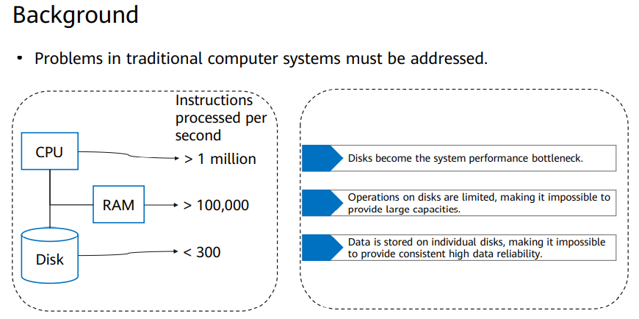
Traditional RAID Technologies

Slide 7
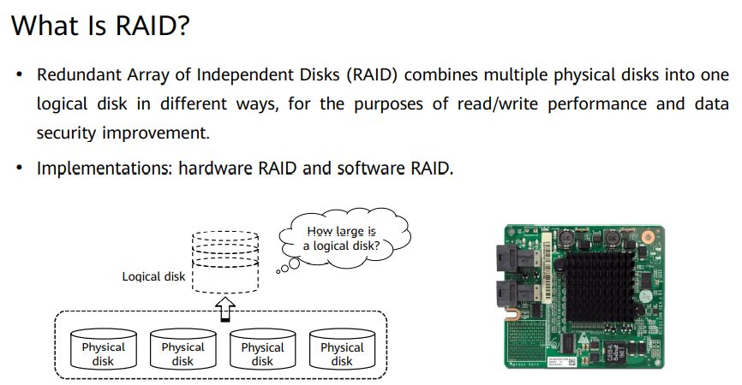
Traditional RAID Technologies

Slide 8
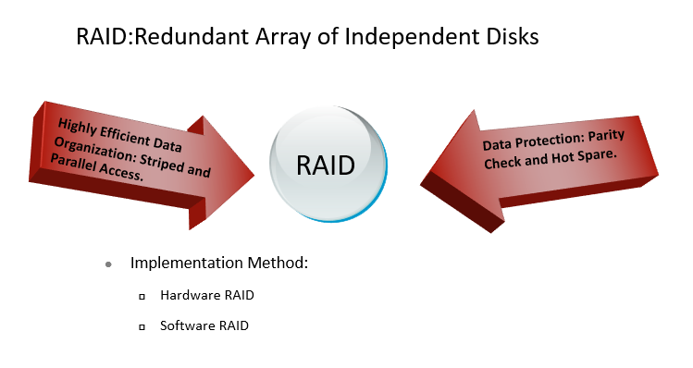
The Basic Concepts and Implementation of RAID

Slide 9
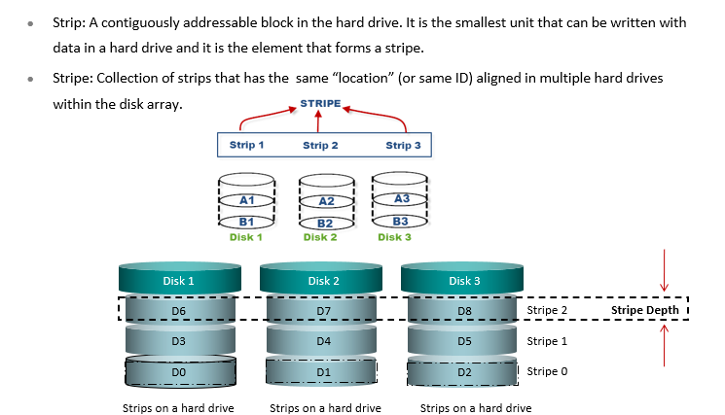
The Forms of RAID Data Organization

Slide 10
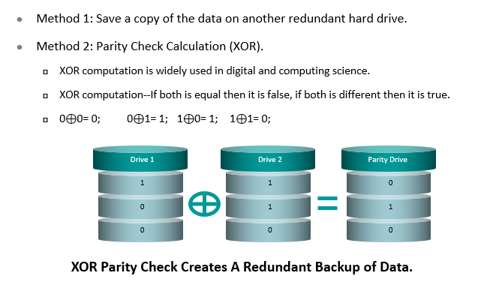
RAID Data Protection Methods

Slide 11
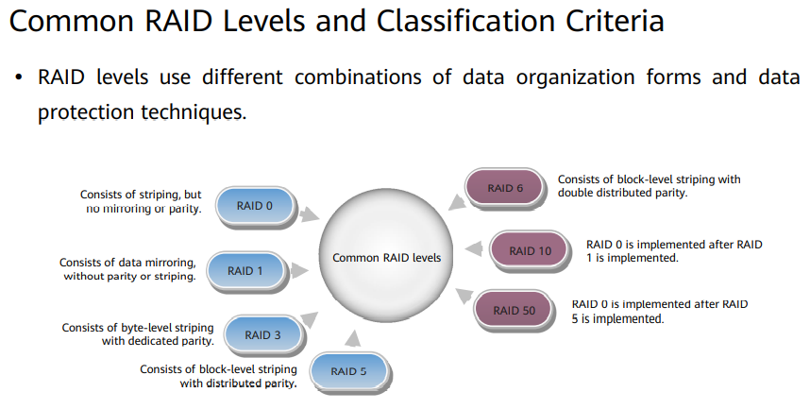
RAID Technologies

Slide 12
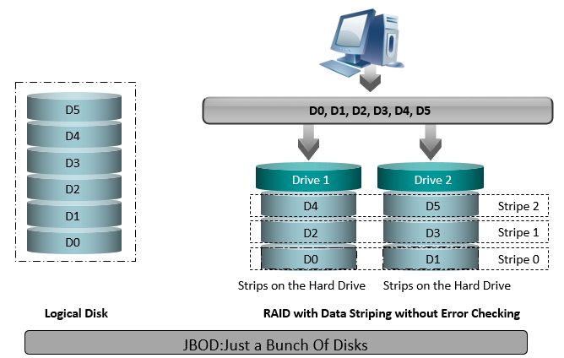
The Working Principles of RAID 0

Slide 13
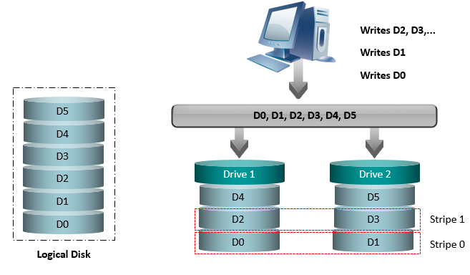
Data Writing of RAID 0

Slide 14
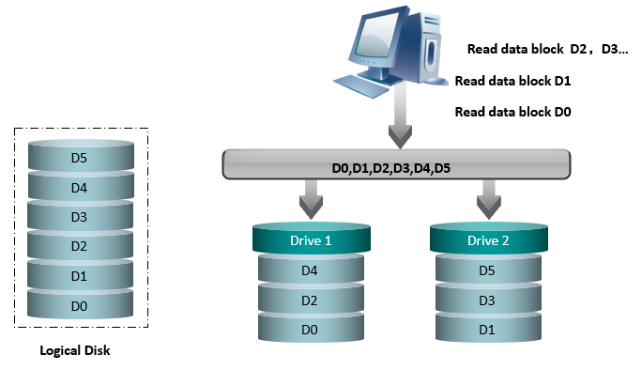
Data Reading of RAID 0

Slide 15
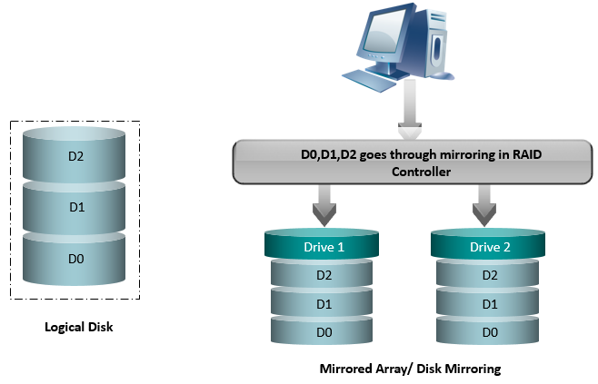
The Working Principles of RAID 1

Slide 16
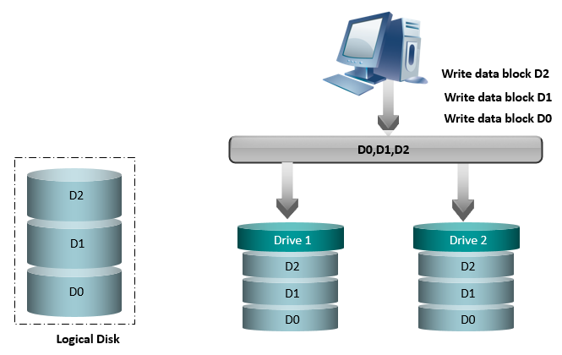
Data Writing of RAID 1

Slide 17
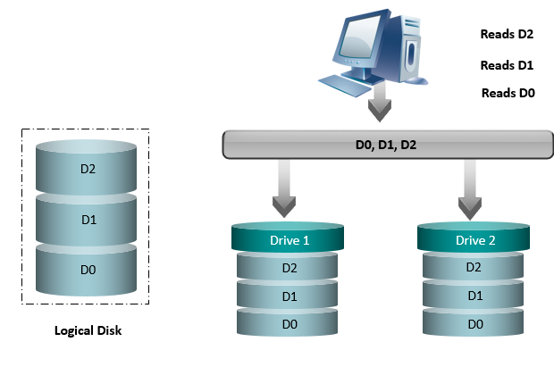
Data Reading of RAID 1

Slide 18
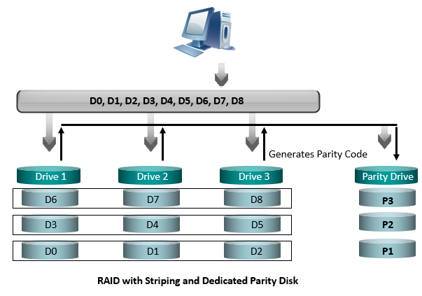
The Working Principles of RAID 3

Slide 19
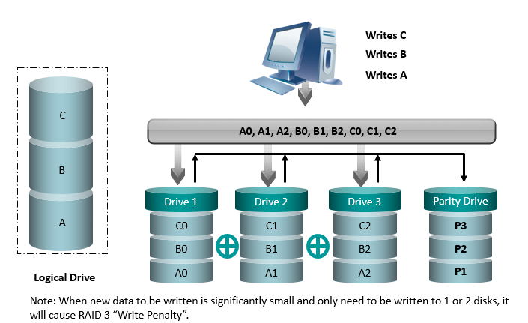
Data Writing of RAID 3

Slide 20
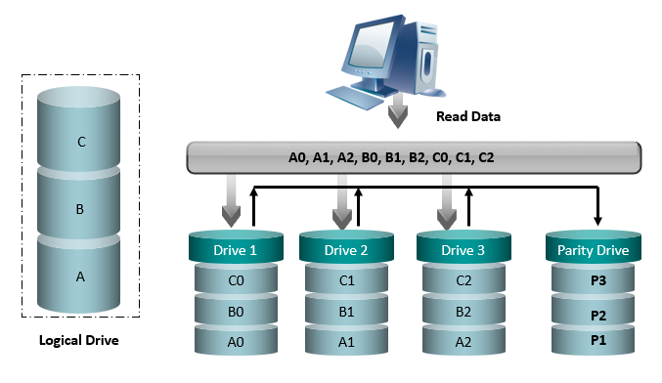
Data Reading of RAID 3

Slide 21
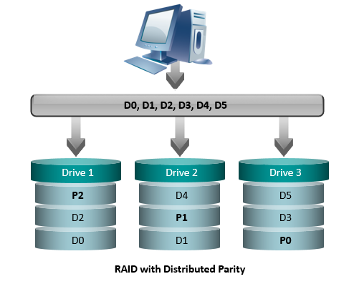
Working Principles of RAID 5

Slide 22
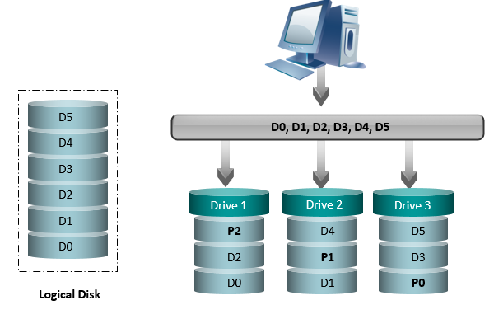
Data Writing of RAID 5

Slide 23
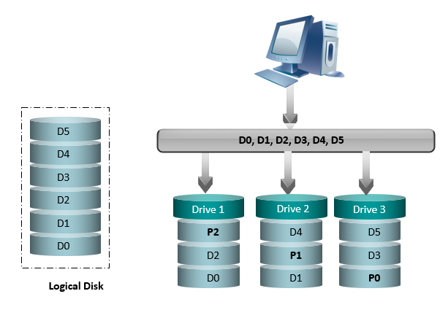
Data Reading of RAID 5

Slide 24
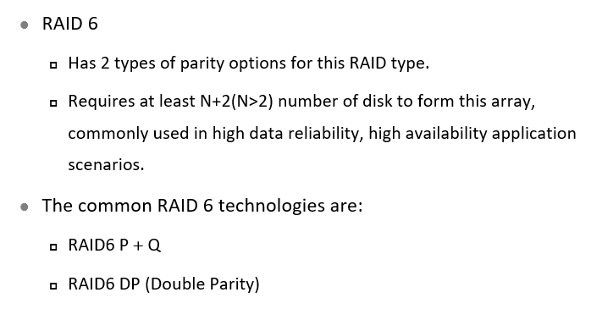
Overview of RAID 6

Slide 25
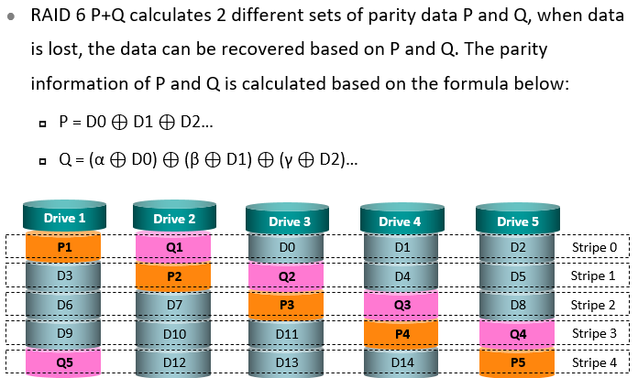
Working Principles of RAID 6 P+Q

Slide 26
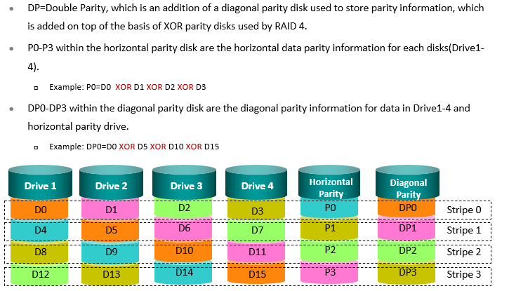
Working Principles of RAID 6 DP

Slide 27
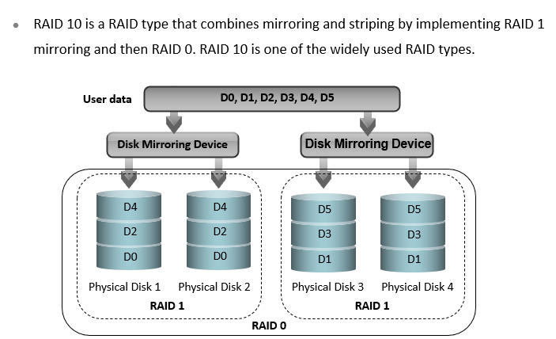
Hybrid RAID - RAID 10

Slide 28
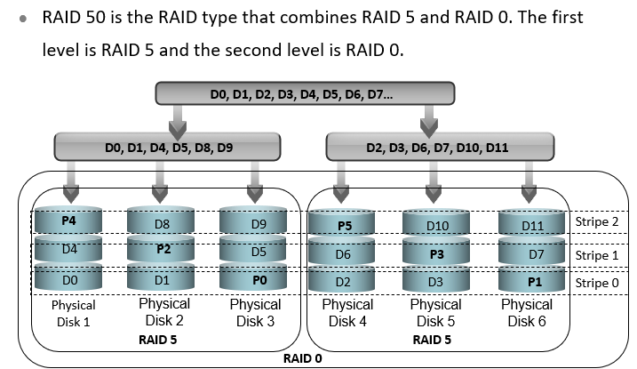
Hybrid RAID - RAID 50

Slide 29
Chapter
06
RAID 2.0+ Technologies

Slide 30
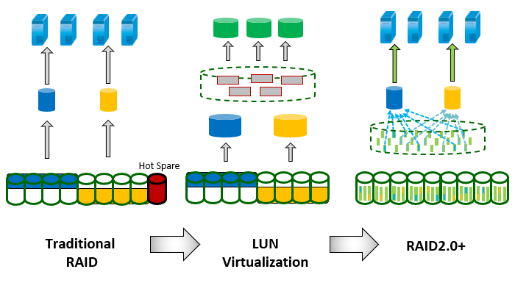
Development of RAID Technologies

Slide 31
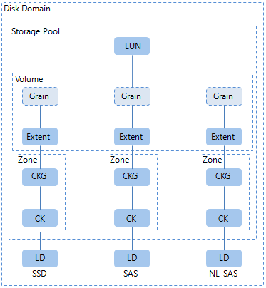
Logical Objects of RAID 2.0+ Software

Slide 32
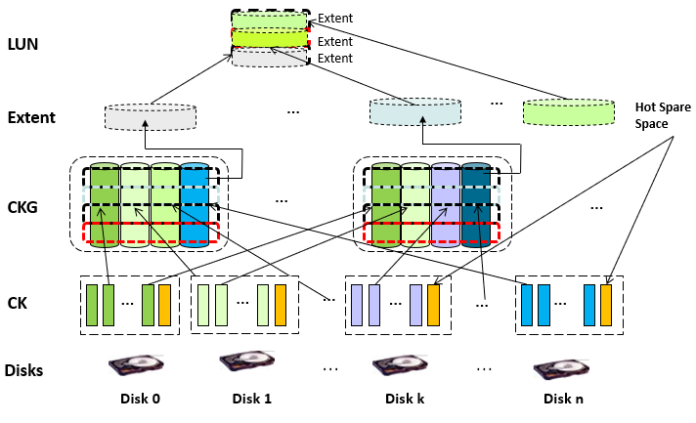
Basic Principles of RAID 2.0+

Slide 33
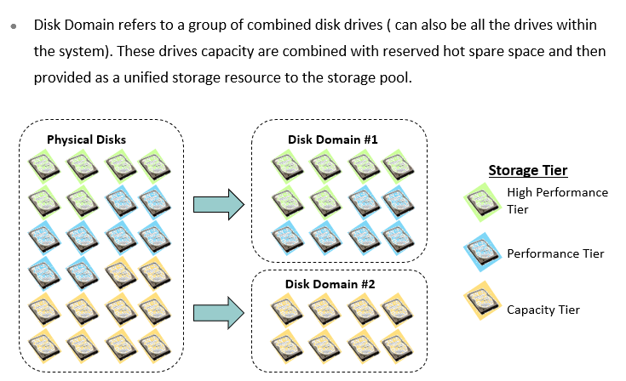
Disk Domain

Slide 34
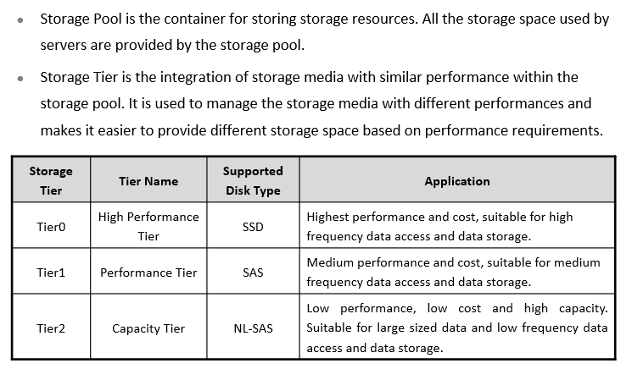
Storage Pool & Tier

Slide 35
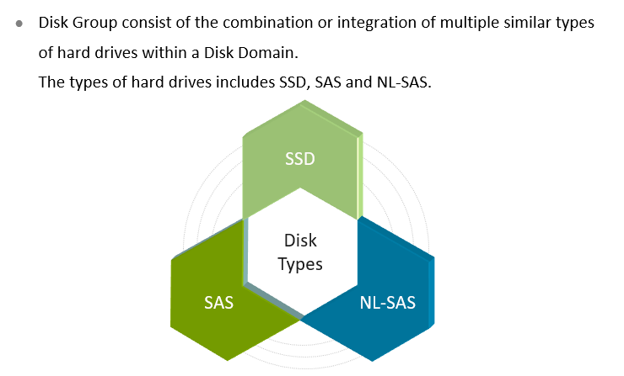
Disk Group (DG)

Slide 36
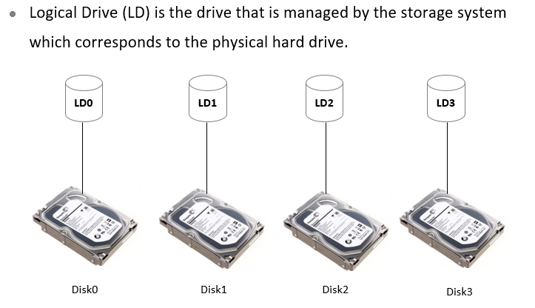
Logical Drive (LD)

Slide 37
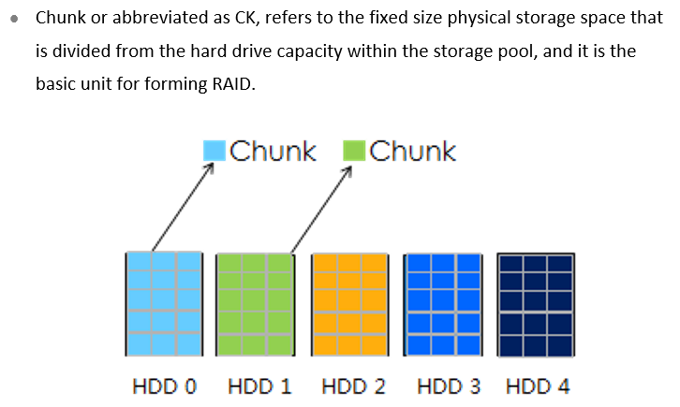
Chunk (CK)

Slide 38
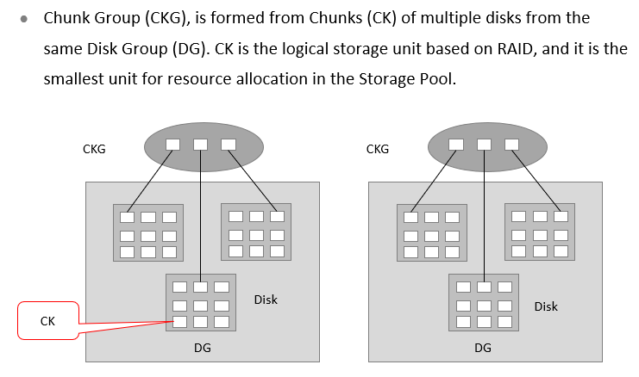
Chunk Group (CKG)

Slide 39
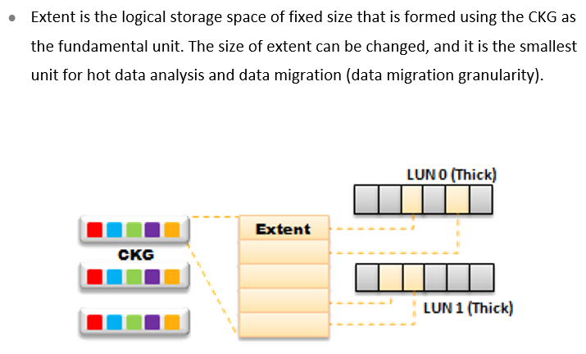
Extent

Slide 40
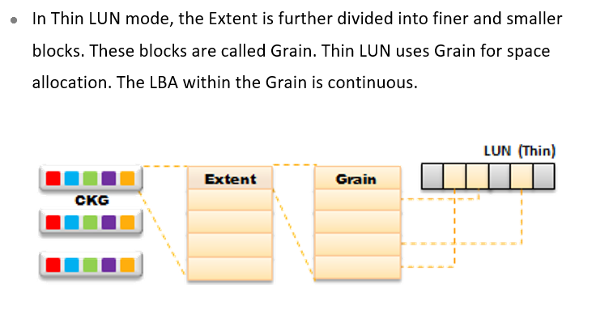
Grain

Slide 41
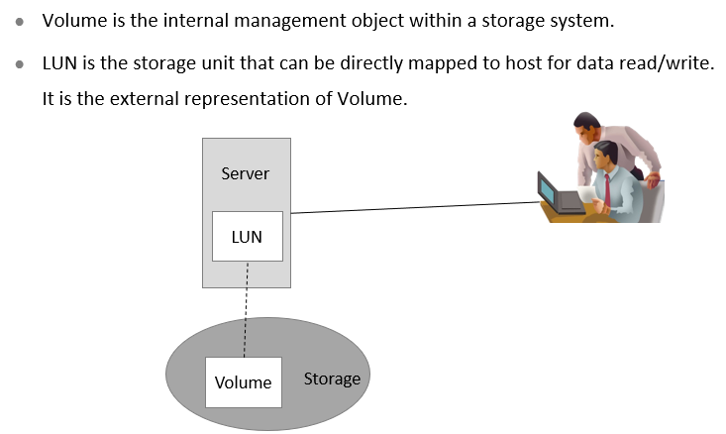
Volume & LUN

Slide 42
Chapter
06
Multipathing Technologies

Slide 43
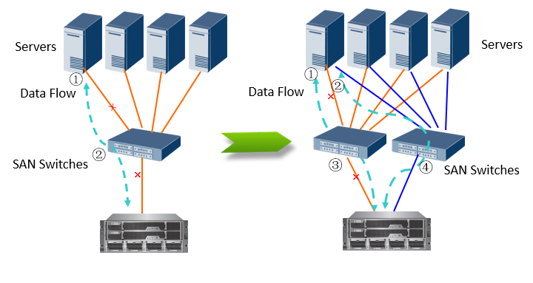
Multipathing Technologies

Slide 44
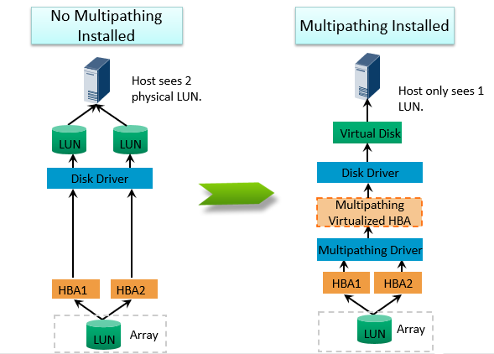
Working Principles of Multipathing Technologies

Slide 45
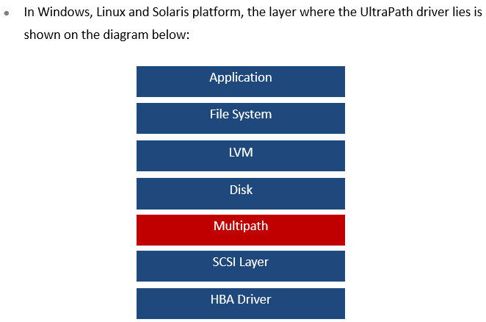
Integration Method Of Multipathing Software with the Operating System

Slide 46
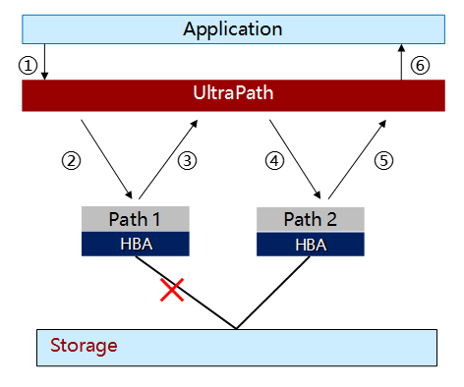
UltraPath Feature - Failover

Slide 47
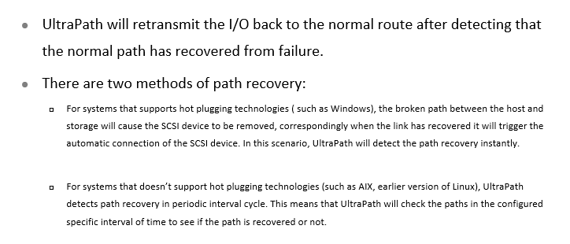
UltraPath Feature - Failback

Slide 48
Chapter
06
Disk Reliability Technologies

Slide 49
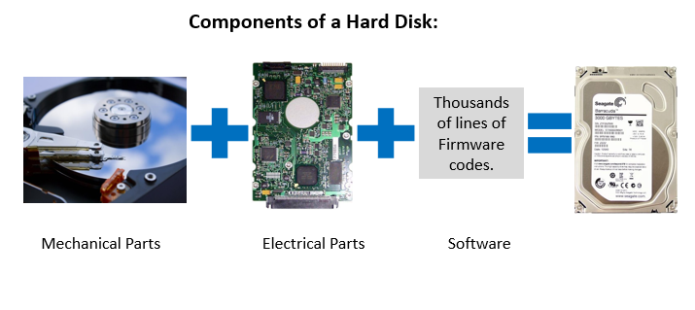
Disk Reliability

Slide 50
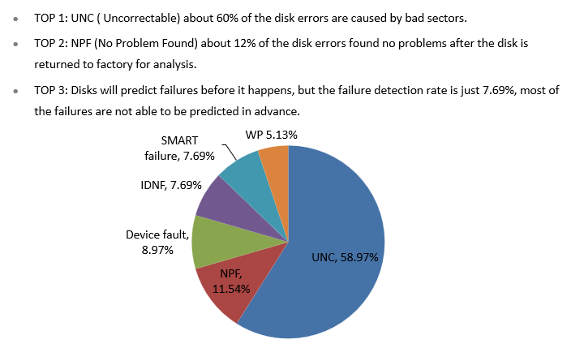
Types of Disk Failures

Slide 51



Disk Smart Scan & Bad Sector Recovery
Technical Principle:
  Characteristics that produces bad sectors: Temporal Locality, Spatial Locality, Data Decay.
  Storage systems periodically scans all the storage media to find any hidden errors.
  Scanning algorithm: cross scanning, dynamic rate adjustment.
  When the system founds a bad sector, it tries to restore the data using the redundancy capability of RAID, after it recovers the data, it writes it back to the disk.
Technical Advantage:
  Detect hidden data safety risks and run recovery actions to minimize the overall system risks due to faulty drives.
  Increases the disk drives service life and protects the user investment.
Disk Bad Sector Recovery Technology
a
b
c
d
e
f
g
h
I
IP/FC SAN
1
2
3
4
5
3
6
7
8
9

Slide 52
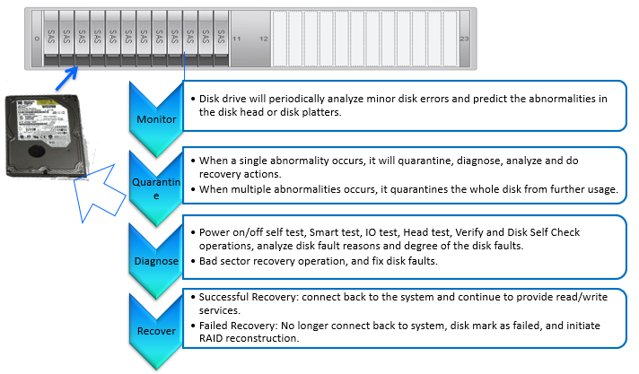
Smart Online Disk Diagnostics System

Slide 53
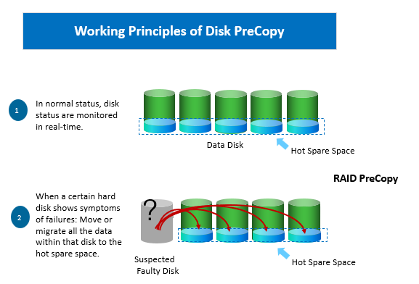
Disk PreCopy

Slide 54
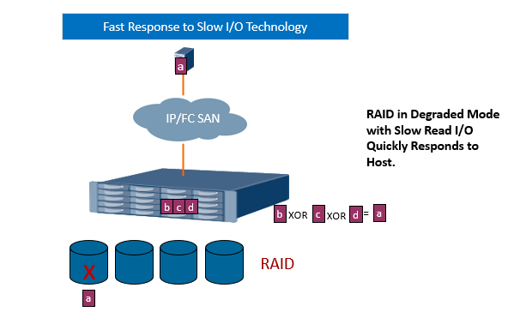
Fast Response to Slow I/O

Slide 55
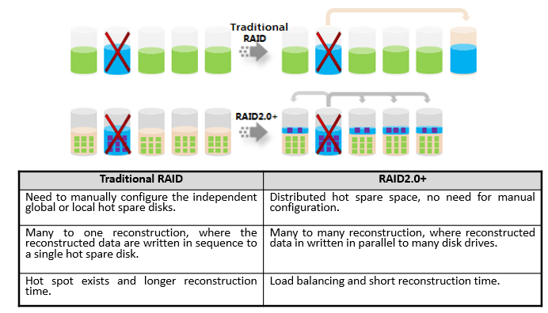
Overview of RAID Reconstruction Technologies

Slide 56
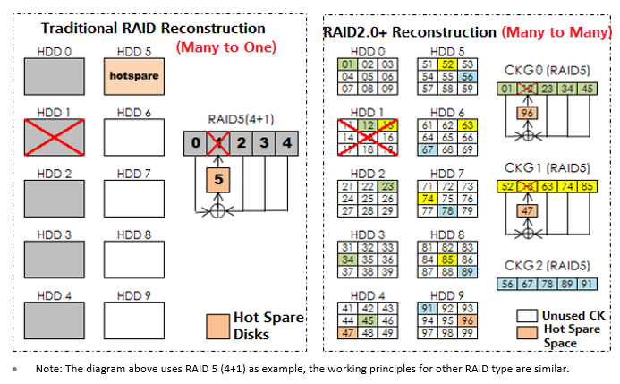
Technical Principles of RAID Reconstruction

Slide 57



Thank You

