Slide 1

Digital Consumer Behavior
Prepared by Dr. Noha El Aswad
Lecture 5
MKT713_
Master of Digital Marketing

Slide 2
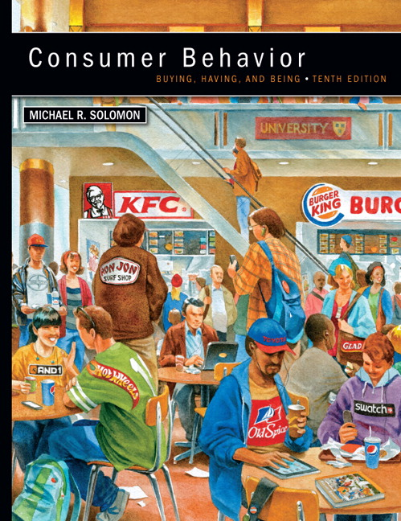

Chapter
01
Buying, Having, Being
CONSUMER BEHAVIOR, 10e
Michael R. Solomon

Slide 3
Chapter
01
Chapter Objectives
When you finish this chapter, you should understand why:
Consumers use products to help them define their identities in different settings.
Consumer behavior is a process.
Marketers need to understand the wants and needs of different consumer segments.

Slide 4
Chapter
01
Chapter Objectives (continued)
The Web is changing consumer behavior.
Consumer behavior relates to other issues in our lives.
Many different types of specialists study consumer behavior.
There are two major perspectives that seek to understand and study consumer behavior.

Slide 5
Chapter
01
Lecture objectives
When you finish this lecture, you should understand:
The rest of Learning Objective 2
Quick revision on Learning Objective 1&2
Roles in the buying process
Consumers’ Impact
The role of consumer behaviour in the marketing process
The definitions of marketing

Slide 6
Chapter
01
Lecture objectives
Learning Objective 3
Quick revision on Learning Objective 1&2
Segmenting Consumers: Demographics
Popular Culture
Consumer-Brand Relationships

Slide 7
Chapter
01
Lecture objectives (continued)
Learning Objective 4
Social Media
Learning Objective 5
Marketing Ethics and Public Policy
Do Marketers Create Artificial Needs?
Do Marketers Promise Miracles?

Slide 8
Chapter
01
Lecture objectives (continued)
Learning Objective 6
Many specialists study consumer behavior.
Disciplines in Consumer Research
Learning Objective 7
Major perspectives on consumer behavior:

Slide 9
Chapter
01
Quick revision of learning objective 1&2
Learning Objective 1
Consumers use products to help them define their identities
Consumers segmented by demographics and psychographics
Consumers understood in part based on their consumption communities and reference groups.
The concept of consumption community

Slide 10
Chapter
01
Quick revision of learning objective 1&2
Learning Objective 1
Consumer identity theory
Brands target consumers using market segmentation strategies.
Consumers may choose brands that match with their own identities.
Consumer behavior: the study of the processes involved when individuals or groups select, purchase, use, or dispose of products, services, ideas, or experiences to satisfy needs and desires.

Slide 11
Chapter
01
Quick revision of learning objective 1&2
Learning Objective 2
Consumer behavior is a process.
Consumer behavior is an ongoing process
The exchange
Expanded view

Slide 12
Chapter
01
Quick revision of learning objective 1&2
Learning Objective 2
A consumer
The purchaser and the user of a product
Stages in the Consumption Process
Consumers’ Impact on Marketing Strategy 1/3
Consumers Are Different! How We Divide them Up.1/2

Slide 13
Chapter
01
Quick revision of learning objective 1&2
Learning Objective 2
Factors and trends shaping consumer behavior
Types of Buying Decision Behavior
Adopter Categories for New Products
Types of buyers

Slide 14
Chapter
01
Roles in the buying process 1/2
A no. of different individuals might contribute in the consumer market in the buying decision. Marketers need to be aware of the charge in-order to exert influence:

Slide 15
Chapter
01
Roles in the buying process
    Initiator – suggests the purchase
    Influencer – has knowledge & personal authority influences the outcome
    Decider – decides what, where & how to buy.
    Buyer – makes the purchase
    End user

Slide 16
Chapter
01
Consumers’ Impact
Understanding consumer behavior is good business…
  Understanding people/organizations to satisfy consumers’ needs…
    Knowledge and data about customers help to define the market…
        Identify threats/opportunities to a brand…

Slide 17
Chapter
01
The role of consumer behaviour in the marketing process
Marketing is concerned with the relationship between consumer or buyer and seller.
Organizations often consider their consumer's wants and needs and persuading them to buy their products and services.

Slide 18
Chapter
01
The definitions of marketing 1/2
‘A truly marketing minded firm tries to create value satisfying goods and services that consumers will want to buy'. This definition high­lights the importance of consumer needs and wants as being central to the marketing function.

Slide 19
Chapter
01
The definitions of marketing 2/2
‘‘Identifying, anticipating, and satisfying customer requirements profitably’.
So we can say that the deeper understanding of the consumer behaviour process will help with the marketing of products and services.

Slide 20

Chapter
01
Learning Objective 3
Marketers need to understand the wants and needs of different consumer segments.

Slide 21

Chapter
01
Segmenting Consumers: Demographics
Demographics:
Age
Gender
Family structure
Social class/income
Race/ethnicity
Geography

Slide 22
Chapter
01
Popular Culture
Music
Movies
Sports
Books
Celebrities
Entertainment
Marketers influence preferences for movie and music heroes, fashions, food, and decorating choices.

Slide 23
Chapter
01
Consumer-Brand Relationships
Self-concept attachment
Nostalgic attachment
Interdependence
Love

Slide 24
Chapter
01
Consumer-Brand Relationships
Self-concept attachment
The product helps to establish the user’s identity.

Slide 25
Chapter
01
Consumer-Brand Relationships
Nostalgic attachment
The product serves as a link with a past self.

Slide 26
Chapter
01
Consumer-Brand Relationships
Interdependence
The product is a part of the user’s daily routine.

Slide 27
Chapter
01
Consumer-Brand Relationships
Love
The product elicits emotional bonds of warmth, passion, or other strong emotion

Slide 28
Chapter
01
For Reflection
What kind of relationship do you have with your car?
Do these feelings correspond to the types of relationships consumers may develop with products?
How do these relationships affect your behavior?

Slide 29

Chapter
01
Learning Objective 4
The Web is changing consumer behavior.

Slide 30
Chapter
01
Social Media
Social media are the online means of communication, conveyance, collaboration, and cultivation among interconnected and interdependent networks of people, communities, and organizations enhanced by technological capabilities and mobility.

Slide 31
Chapter
01
For Reflection
Did you know
  80% of companies use LinkedIn as their primary recruiting tool?
  More than 1.5 billion pieces of content are shared on Facebook daily?

Slide 32
Chapter
01
Learning Objective 5
Our beliefs and actions as consumers strongly connect to other issues in our lives.

Slide 33
Chapter
01
Marketing Ethics and Public Policy
Business ethics are rules of conduct that guide actions in the marketplace
There are cultural differences in what is considered ethical.

Slide 34
Chapter
01
Do Marketers Create Artificial Needs?
Objective of marketing: create awareness that
needs exist, not to create needs
versus
Need: a basic biological motive
Want: one way that society has taught us that the need can be satisfied

Slide 35

Chapter
01
Do Marketers Promise Miracles?
Advertisers simply do not know enough about people to manipulate them

Slide 36
Chapter
01
Learning Objective 6
Many specialists study consumer behavior.
Disciplinary Focus | Product Role
Experimental Psychology | Perception, learning, and memory processes
Clinical Psychology | Psychological adjustment
Human Ecology | Allocation of individual or family resources
Social Psychology | Behavior of individuals as members of social groups
Sociology | Social institutions and group relationships
Macroeconomics | Consumers’ relations with the marketplace
Demography | Measurable characteristics of a population
History | Societal changes over time
Cultural Anthropology | Society’s beliefs and practices

Slide 37
Chapter
01
Disciplines in Consumer Research
MICRO CONSUMER BEHAVIOR
(INDIVIDUAL FOCUS)
Experimental Psych
Clinical Psychology
Developmental Psych
Human Ecology
Microeconomics
Social Psychology
Sociology
Macroeconomics
Semiotics/Literary Criticism
Demography
History
Cultural Anthropology
Consumer behavior
involves many different
disciplines
MACRO CONSUMER
BEHAVIOR
(SOCIAL FOCUS)

Slide 38
Chapter
01
Learning Objective 7
There are two major perspectives on consumer behavior:
  Positivist approach
  Interpretivist approach

Slide 39
Chapter
01
Chapter Summary
Consumer behavior is a process.
Consumer use products and brands to define their identity to others.
Consumers from different segments have different needs and wants.
Consumer behavior benefits from several fields.
There are two major perspectives guiding our study of consumer behavior.

Slide 40


