Slide 1


Human Resources Management
Robert L. Mathis ⏐ John H. Jackson
Prepared by Dr. Samah Abdelfatah
MGM 243
Lecture 07

Slide 2



Part 3: Developing HRM
Talent Management and
Development
Chapter
10
Lecture 07
MGM 243
Prepared by
Dr. Samah Abdelfatah

Slide 3

Chapter
Learning Outcomes
10
After you have read this chapter, you should be able to:
Identify the importance of talent management and discuss two issues it addresses.
Differentiate between organization-centered and individual centered career planning.
Discuss three career issues that organizations and employees must address.
List options for development needs analyses.
Identify several management development methods.
Explain what succession planning is and its components.

Slide 4





The Importance of Talent Management
Chapter
10
Baby Boomer Retirement Wave
10,000 daily in US alone; Knowledge transfer critical
Recent emphasis on talent management has emerged as organizations face extraordinary challenges in attracting, developing, and retaining key human resources in a rapidly evolving business landscape.
Digital Skills Gap
85% of jobs by 2030 require digital skills (WEF)
AI & Analytics Talent Competition
3.4M unfilled data roles globally; Critical capability gap
Hybrid Work Transformation
83% of workers prefer flexible arrangements (Gallup)
DEIB Imperative
Diverse teams 35% more productive (McKinsey)

Slide 5
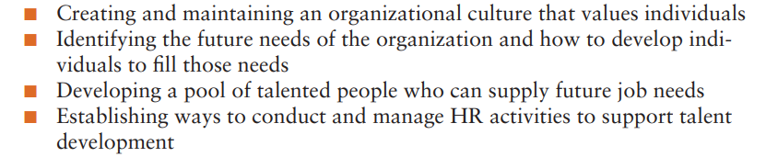
Chapter
Talent management
10
Talent management concerned with enhancing the attraction, development, and retention of key human resources
Talent management must be linked to strategic organizational plans.
Key areas that are important in talent management as part of strategic HR planning are:

Slide 6
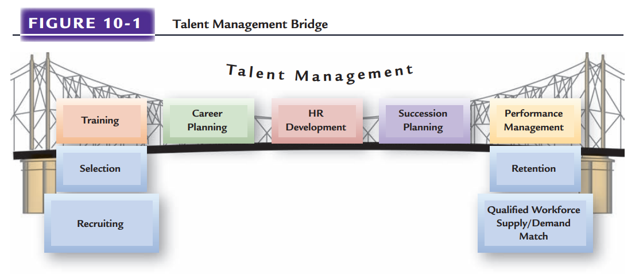
Nature of Talent Management
Talent management can be seen as a bridge. As illustrated in Figure 10-1, talent management activities provide the means to ensure that individuals who have been recruited and selected are retained as well-performing human resources.
Figure 10-1

Slide 7
Chapter
Talent Management Information Systems
10
A vital part of talent management is the implementation and use of electronic, Web-based, computer software.
Vendors have developed software for various parts of talent management, such as tracking training, providing succession planning replacement charts, or online performance appraisal systems. But these systems must be integrated, rather than run as separate programs.

Slide 8










Scope of Talent Management
Chapter
10
Targeting Jobs
Targeting Individuals
Strategic Focus Areas
From Potential to Skills
Focus on critical roles were vacancies impact operations/strategy
Shift from "high-potential" labels to skills-based assessment
Use skills-based role architecture rather than job titles alone
Address visibility bias (remote workers overlooked)
Identify future capability needs, not just current vacancies
Overcome similarity bias (managers nominating similar people)
Skills-Based Approach
Traditional
Skills-Based
Job titles
Competency profiles
Map roles to required competencies & proficiency levels
Manager nominations
Data-driven assessment
Create agile role architectures that evolve with business needs
Subjective potential
Measured readiness

Slide 9
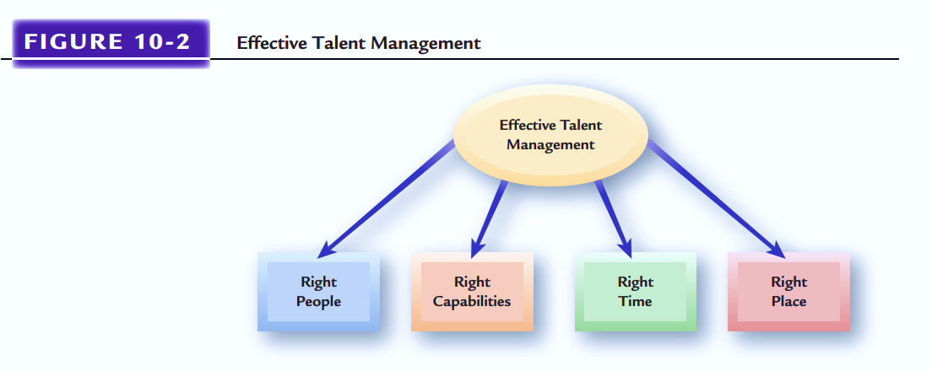
Effective Talent Management
Chapter
10
Regardless of the focus, effective talent management must be linked to HR planning. This means having the right number of human resources, with the right capabilities, at the right times, and in the right places, both short term and longer term, as Figure 10-2 indicates.
Figure 10-2

Slide 10







Careers and Career Planning
Chapter
10
Career Series : of work-related positions a person occupies throughout life.
Changing Nature of Careers:
  The old model of a career in which a person worked his or her way up the ladder in one organization is becoming rarer.
  Changing jobs and companies every year or two is becoming more common.
Protean Careers
Hybrid Work Impact
Self-directed career paths driven by personal values rather than organizational needs
Most employees Favor flexible arrangements
Boundaryless Careers
Work-Life Integration
Career progression across organizational
boundaries and industries
Shift from balance (competing demands) to integration (harmonious blend), focusing on employee wellbeing and mental health support.
Gig Economy & Platform Work
Freelancing, contract work,
and project-based engagements
Global Evolution
Career Cushioning
• Virtual assignments
• Cross-cultural career development
• Repatriation planning with remote options
Preparing for uncertainty by maintaining
networks and skills

Slide 11

Chapter
Organization-Centered Career Planning
10
Organization-centered career planning Career planning that focuses on identifying career paths that provide for the logical progression of people between jobs in an organization.
Career paths: Represent employees’ movements through opportunities over time.

Slide 12

Chapter
Individual-Centered Career Planning
10
Individual-centered career planning Career planning that focuses on an individual’s responsibility for a career rather than on organizational needs.
Individual Career Planning Components
Self-assessment
Feedback on reality
Setting of career goals

Slide 13
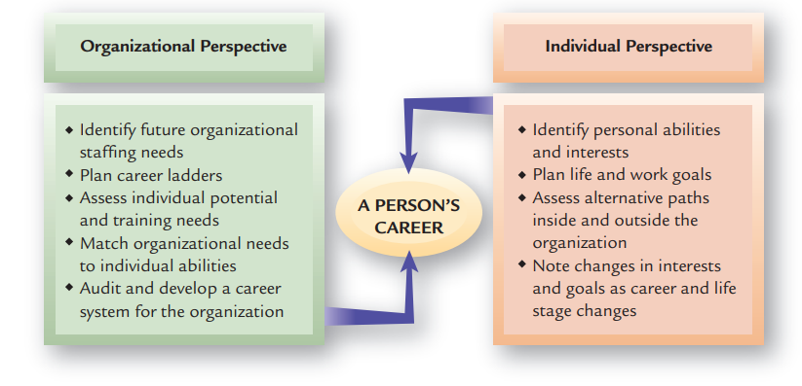
Chapter
10
Organizational V.s Individual Career Planning
Figure 10-3

Slide 14
Chapter
Individual-Centered Career Planning (Cont.)
10
Individual Career Choices
Four general individual characteristics affect how people make career choices:
Interests: People tend to pursue careers that they believe match their interests.
Self-image: A career is an extension of a person’s self-image.
Personality: An employee’s personality includes her or his personal orientation (for example, inclination to be realistic, enterprising, or artistic)
Social backgrounds: Socioeconomic status and the educational levels and occupations of a person’s parents are included in that person’s social background.

Slide 15
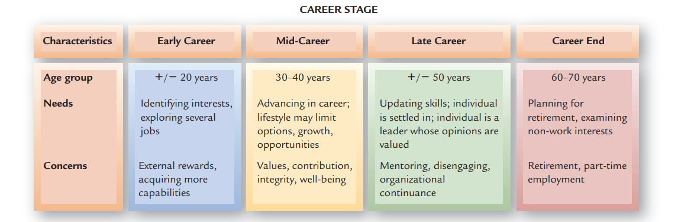
Career Progression Considerations
Chapter
10
General Career Periods
Figure 10-4

Slide 16











Chapter
Career Progression Considerations(Cont.)
10
Reskilling/Upskilling
Lateral Moves
Programs to develop new capabilities for future roles
Expand skills across departments, not just consolation
Career Plateaus
When opportunities to move up decrease, employees may face career plateaus where advancement stalls.
Project-Based Work
Reverse Mentoring
Digital Solutions
Short-term assignments to build new competencies
Learning from junior colleagues on new technologies
AI-powered career pathing tools suggesting alternative routes
Overcoming Plateaus
Internal gig platforms for project variety and skill development
Personalized learning recommendations based on skills gaps
Career
Plateau
Traditional
Advancement
Skills-Based
Progression
Stagnation Point

Slide 17
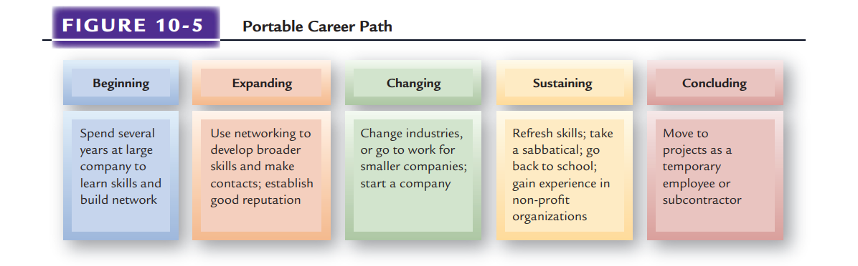
Chapter
10
Portable Career Path
Figure 10-5

Slide 18

Chapter
Career Transitions and HR
10
Three career transitions are of special interests to HR: organizational entry and socialization, transfers and promotions, and job loss.
Starting as a new employee can be overwhelming. “Entry shock” is especially difficult for younger new hires who find the work world very different from school.

Slide 19
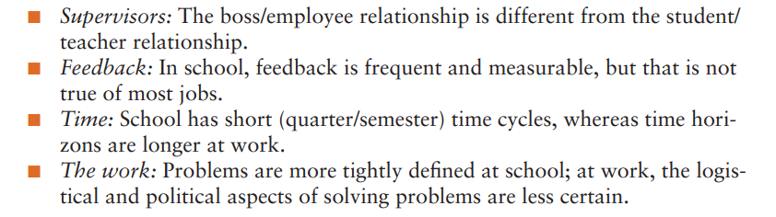
Chapter
Career Transitions and HR (Cont.)
10
Entry shock includes the following concerns:

Slide 20



Chapter
Special Individual Career Issues
10
Technical and Professional Workers
Global Career Concerns
Women and Careers
Dual-Career Couples

Slide 21

Chapter
Technical and Professional Workers
10
Technical and professional workers, such as engineers, scientists, physical therapists, and IT systems experts, present a special challenge for organizations.
Many of these individuals want to stay in their technical areas rather than enter management; yet advancement in many organizations requires a move into management.
An attempt to solve this problem, a dual-career ladder, is a system that allows a person to advance up either a management or a technical/professional ladder.

Slide 22

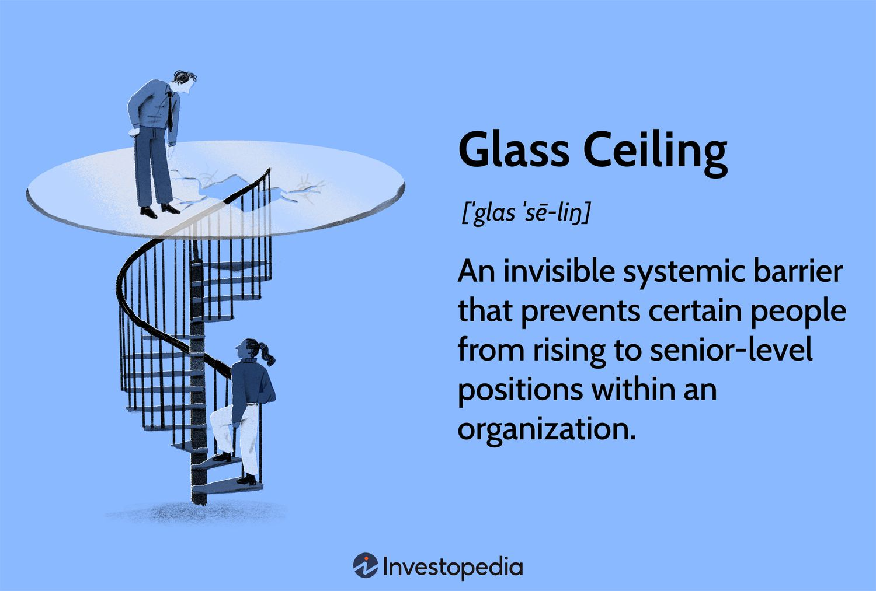
Chapter
Women and Careers
10
Work, Family, and Careers
The interaction and conflicts among home, family, and a career affect the average woman differently than they do men.
Glass Ceiling
This issue describes the situation in which women fail to progress into top and senior management positions.

Slide 23

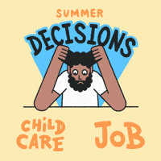
Chapter
Dual-Career Couples
10
Family-Career Issues For dual-career couples with children, family issues may conflict with career progression. Thus, one partner’s flexibility may depend on what is “best” for the family.
Relocation of Dual-Career Couples Traditionally, employees accepted transfers as part of upward mobility in organizations. However, for some dual career couples, the mobility required because of one partner’s transfer often interferes with the other’s career.

Slide 24
Global Career Concerns
Many global employees experience anxiety about their continued career progression.
Firms some time address this issue by Repatriation Planning, which is training, and reassignment of global employees to their home countries.
Global Development Issues Global managers are more expensive than home-country managers, and more problematic as well. Most global firms have learned that it is often a mistake to staff foreign operations with only personnel from headquarters, and they quickly hire nationals to work in a country.

Slide 25
Chapter
DEVELOPING HUMAN RESOURCES
10
Development Efforts to improve employees’ abilities to handle a variety of assignments and to cultivate employees’ capabilities beyond those required by the current job.
Developing Specific Capabilities/Competencies
  Lifelong Learning: Learning and development are closely linked. For many professionals, lifelong learning may mean meeting continuing education requirements to retain certificates.
  Re-Development:Whether due to a desire for career change or because the employer needs different capabilities, people may shift jobs in mid-life or midcareer

Slide 26
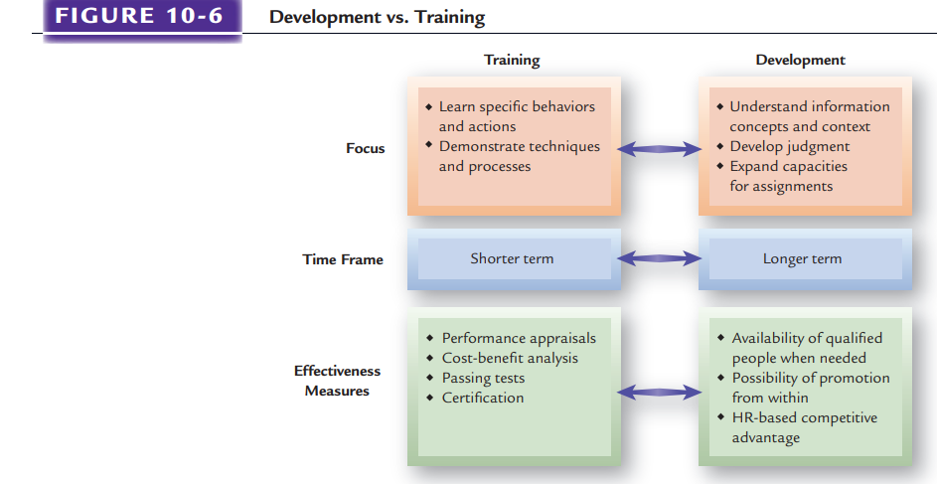
Chapter
10
Figure 10-6

Slide 27
Chapter
Development Needs Analyses
10
Methods that organizations use to assess development needs include assessment centers, psychological testing, and performance appraisals.
Assessment centers Collections of instruments and exercises designed to diagnose individuals’ development needs.
Psychological Testing have been used for several years to determine employees’ development potential and needs. Intelligence tests, verbal and mathematical reasoning tests, and personality tests are often given.
Performance Appraisals Well-done performance appraisals can be a source of development information. Performance data on productivity, employee relations, job knowledge, and other relevant dimensions can be gathered in such assessments.

Slide 28
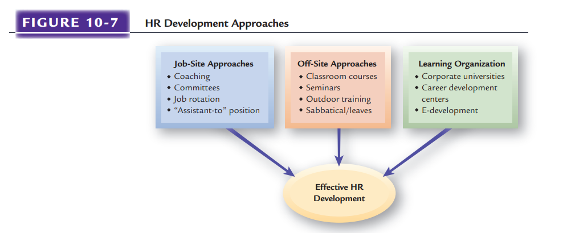
HR Development Approaches
Chapter
10
Figure 10-7

Slide 29
Chapter
HR DEVELOPMENT APPROACHES
10
Job-Site Development Approaches
Coaching :Training and feedback given to employees by immediate supervisors.
Committee assignments :Assigning promising employees to important committees may broaden their experiences and help them understand the personalities, issues, and processes governing the organization.
Job rotation: Process of shifting a person from job to job.
“Assistant-To” Positions Some firms create “assistant-to” positions, which are staff positions immediately under a manager. Through such jobs, trainees can work with outstanding managers they might not otherwise have met.

Slide 30
Chapter
HR Development Approaches (Cont.)
10
Off-Site Development Approaches
Classroom Courses and Seminars
Outdoor Development Experiences
Sabbaticals and Leaves of Absence
Most people are familiar with classroom training, which gives it the advantage of being widely accepted.
Some organizations send executives and managers off to or deals in the wilderness, called outdoor training or outdoor development.
Time off the job to develop oneself

Slide 31
HR Development Approaches (Cont.)
Chapter
Learning Organization Development Efforts
10
As talent management becomes more important, employers may attempt to become learning organizations.
These organizations encourage development efforts through shared information, culture, and leadership that stresses the importance of individual learning.
Developing such individuals requires an “organizational learning capacity” based on solving problems and learning new ways not previously used.

Slide 32
Chapter
Learning Organization Development Efforts(Cont.)
10
Corporate Universities and Career Development Centers
E-Development
The rapid growth in technology has led to more use of e-development. On-line development can take many forms, such as video conferencing, live chat rooms, document sharing, video and audio streaming, and Web-based courses.
Large organizations may use corporate universities to develop managers or other employees

Slide 33
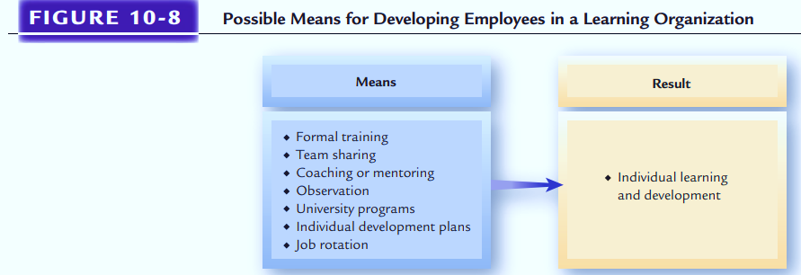
Learning Organization Development Efforts(Cont.)
Possible Means for Developing Employees in a Learning Organizations
Figure 10-8

Slide 34
Management Development
MANAGEMENT DEVELOPMENT
Supervisor Development
Leadership Development
Management Modeling
Management Coaching
Management Mentoring
Executive Education
Figure 10-9

Slide 35
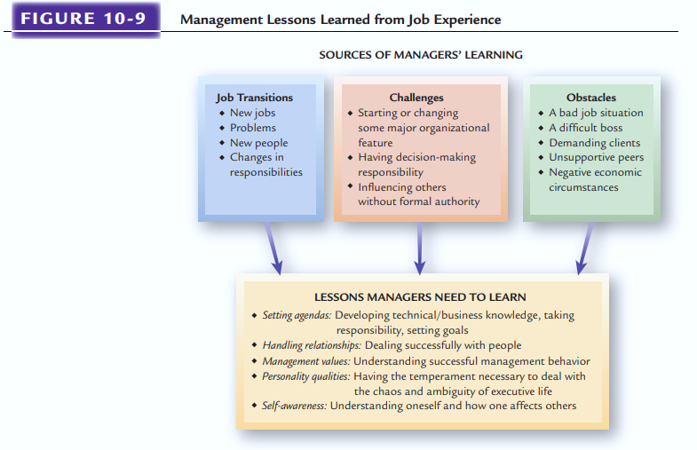
Management Lessons Learned from Job Experience
Figure 10-10

Slide 36
Chapter
Problems with Management Development Efforts
10
Many of the management development problems in firms have resulted from inadequate HR planning and a lack of coordination of HR development efforts.
Common problems include the following:
    Failing to conduct adequate needs analysis
    Trying out fad programs or training methods
    Substituting training instead of selecting qualified individuals

Slide 37
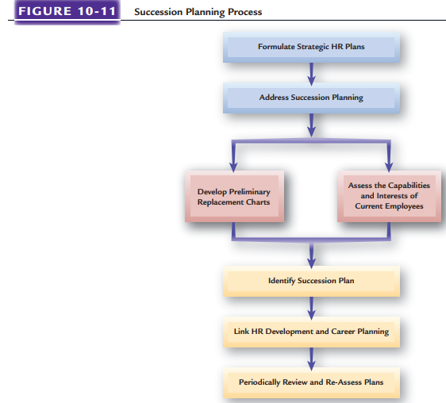
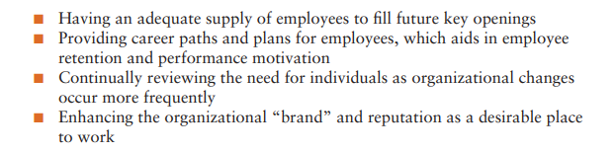
Chapter
Succession Planning
10
Succession planning Process of identifying a long-term plan for the orderly replacement of key employees.
Values of Succession Planning
Figure 10-11

Slide 38
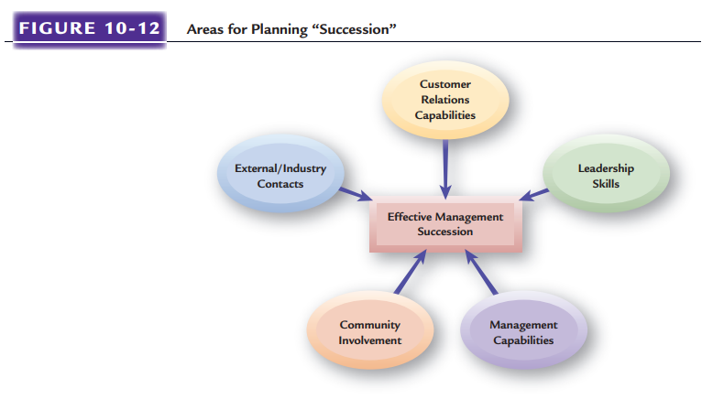
Chapter
Succession Planning (Cont.)
10
Common Succession Planning Mistakes:
Focusing only on CEO and top management succession is one of the most common mistakes made. Other mistakes include:
Starting too late, when openings are occurring
Not linking well to strategic plans
Allowing the CEO to direct the planning and make all succession decisions
Looking only internally for succession candidates
Figure 10-12

Slide 39
Chapter
SUMMARY
10
The Importance of Talent Management
Nature & Scope of Talent Management
Careers and Career Planning
Special Individual Career Issues
Developing Human Resources
HR Development Approaches
Succession Planning

Slide 40
References
Mathis, R. L., & Jackson, J. H. (2011). Human resource management (13th ed.). South-Western Cengage Learning.
Catalyst. (2025). Inclusion works: 2025 trends. https://www.catalyst.org/en-us/insights/2025/10-inclusive-workplace-trends
Chartered Institute of Personnel and Development. (2024). Resourcing and talent planning report 2024. CIPD. https://www.cipd.org/globalassets/media/knowledge/knowledge-hub/reports/2024-pdfs/8662-resource-and-talent-planning-2024-report-web.pdf
Deloitte. (2026). Global human capital trends. Deloitte Insights. https://www.deloitte.com/us/en/insights/topics/talent/human-capital-trends.html
Gallup. (2025). Future of the office has arrived: It's hybrid. Gallup, Inc. https://www.gallup.com/401384/indicator-hybrid-work.aspx
Insight222. (2025). People analytics trends 2025/26: Navigating AI and people analytics from ambition to action. Insight222. https://go.insight222.com/insight222-people-analytics-trends-report-2025/26
McKinsey & Company. (2024). Women in the workplace 2024. McKinsey & Company. https://wiw-report.s3.us-east-1.amazonaws.com/Women_in_the_Workplace_2025.pdf
Society for Human Resource Management. (2024). 2024 talent trends: Artificial intelligence in HR. SHRM. https://www.shrm.org/topics-tools/research/2024-talent-trends-report
SkillsDB. (2024). Skills-based succession planning: Move from gut feel to data. SkillsDB. https://skillsdb.com/blog/skills-based-succession-planning
Stanford University. (2025). Survey of working arrangements and attitudes. WFH Research. https://wfhresearch.com/
World Economic Forum. (2025). The future of jobs report 2025. World Economic Forum. https://www.weforum.org/reports/the-future-of-jobs-report-2025

Slide 41


Thank You

