Slide 1
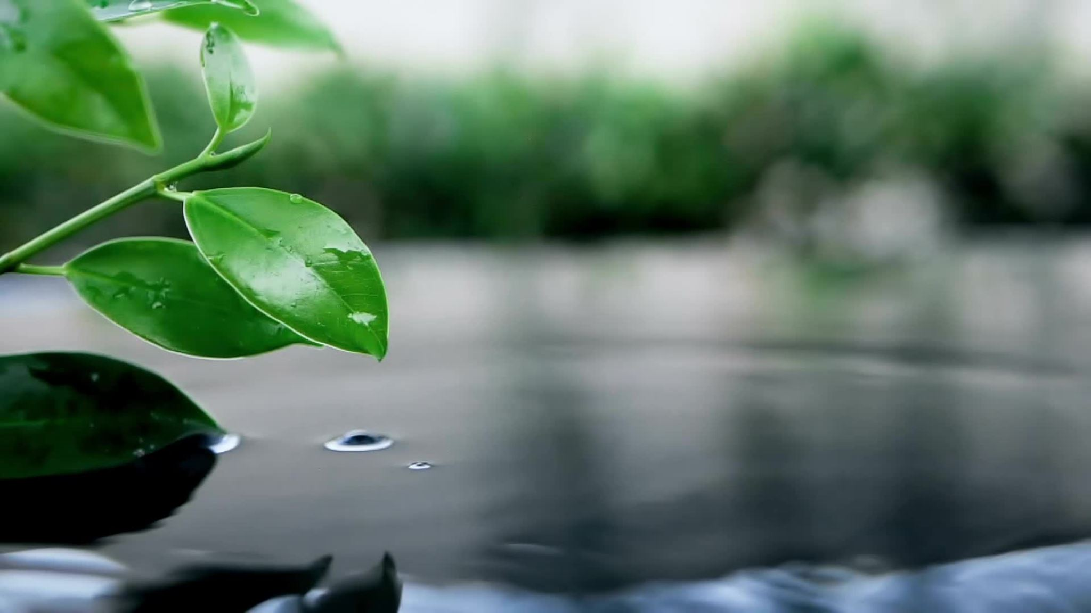
Significance of water If we talk about our personal lives, water is the foundation of our existence. The human body needs water for the day to day survival. We may be able to survive without any food for a whole week but without water, we won’t even survive for 3 days. Moreover, our body itself comprises of 70% water. This, in turn, helps our body to function normally. Thus, the lack of sufficient water or consumption of contaminated water can cause serious health problems for humans. Therefore, the amount and quality of water which we consume is essential for our physical health plus fitness.

Slide 2


