Slide 1
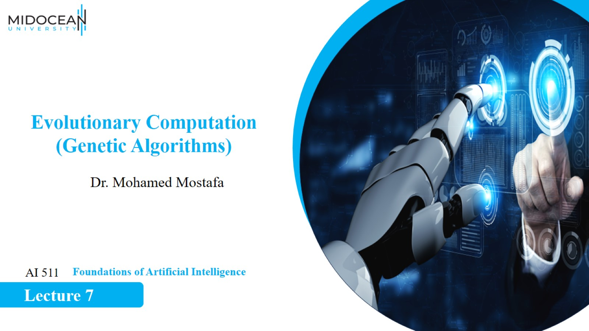

Slide 2
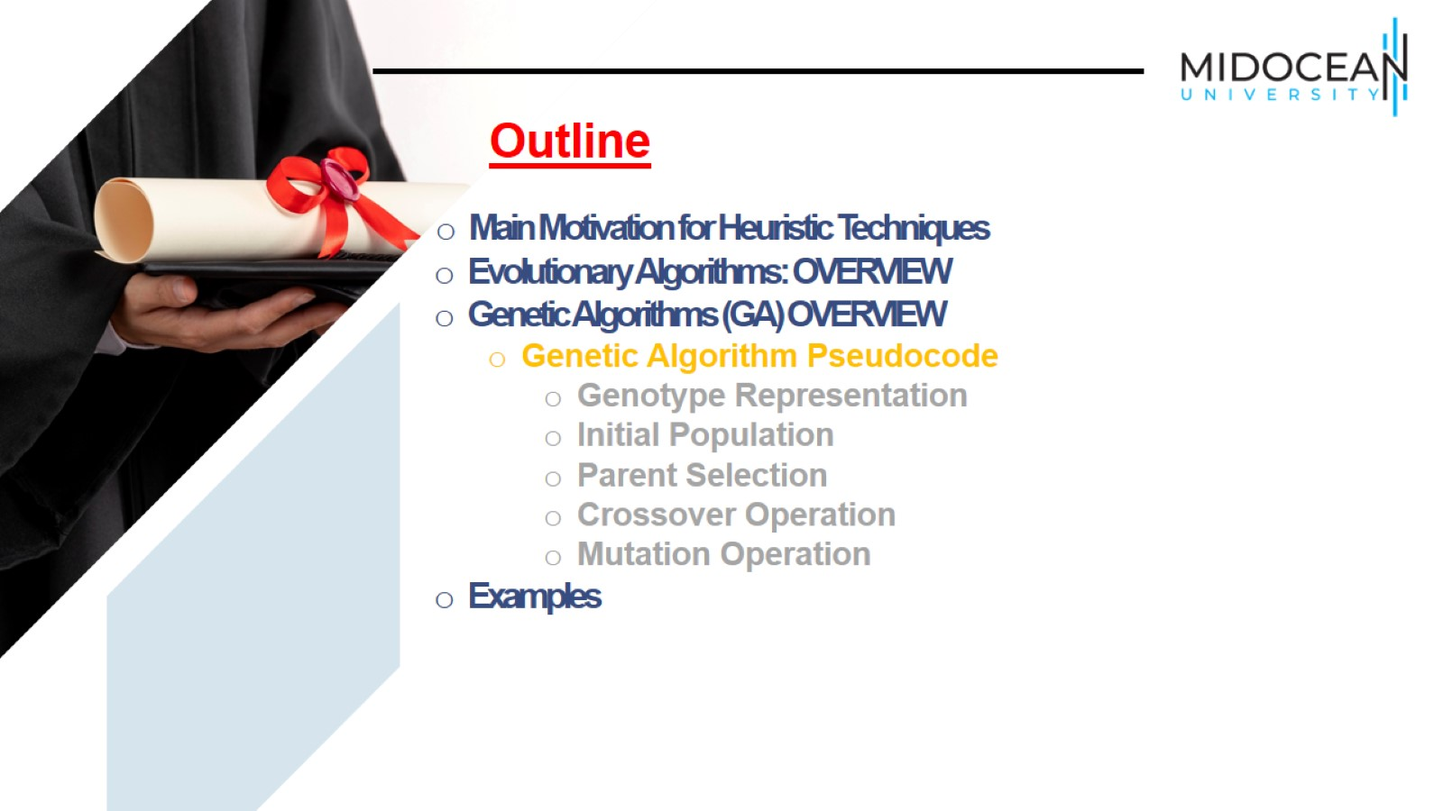

Slide 3
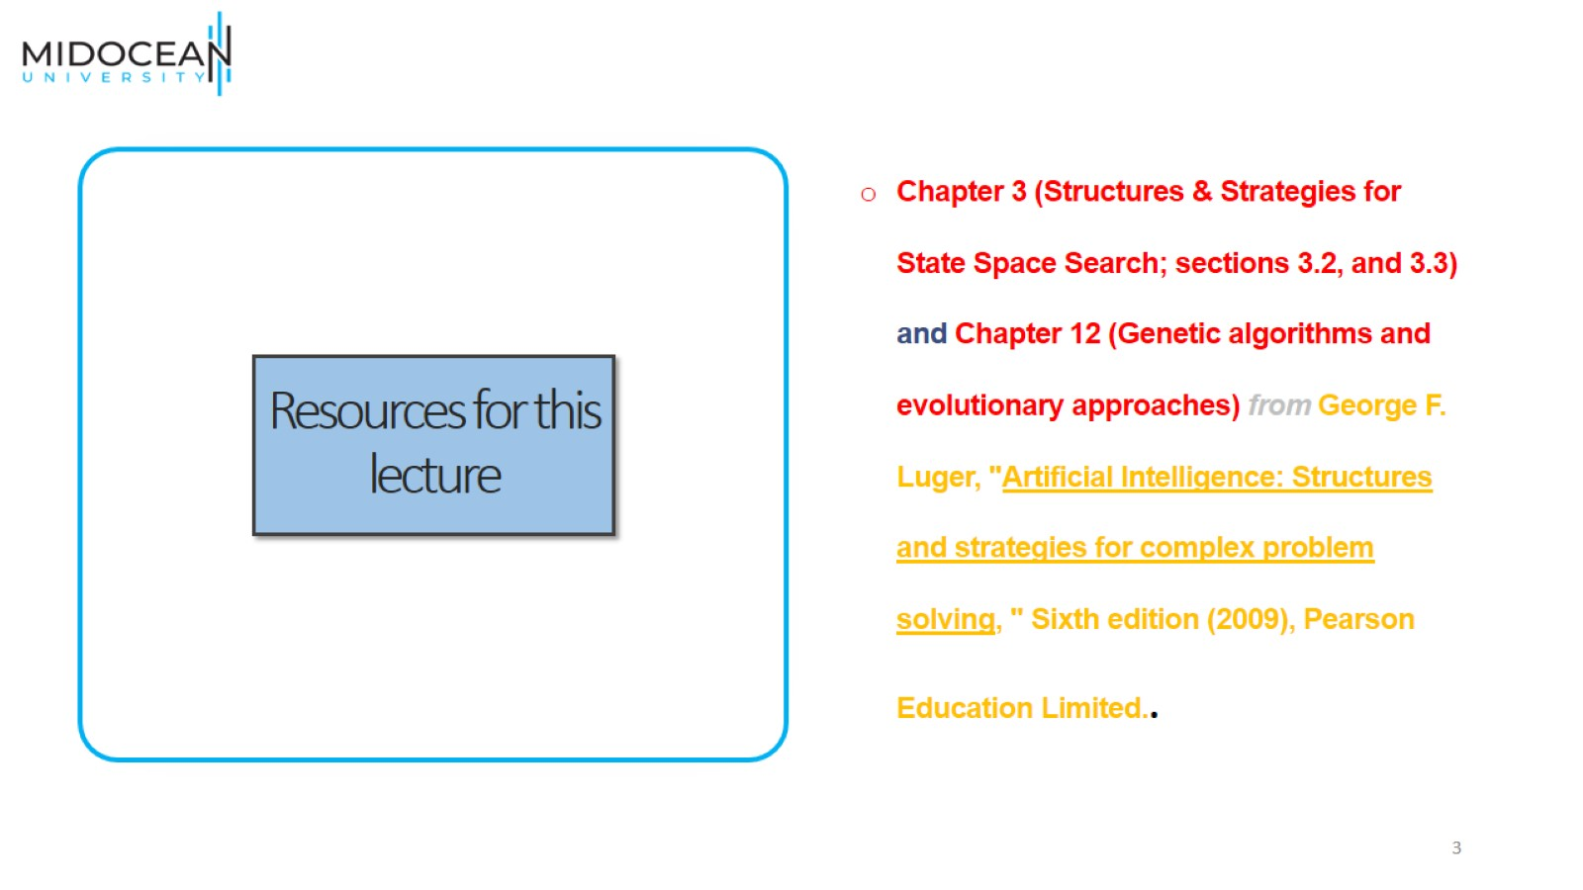
Resources for this lecture

Slide 4
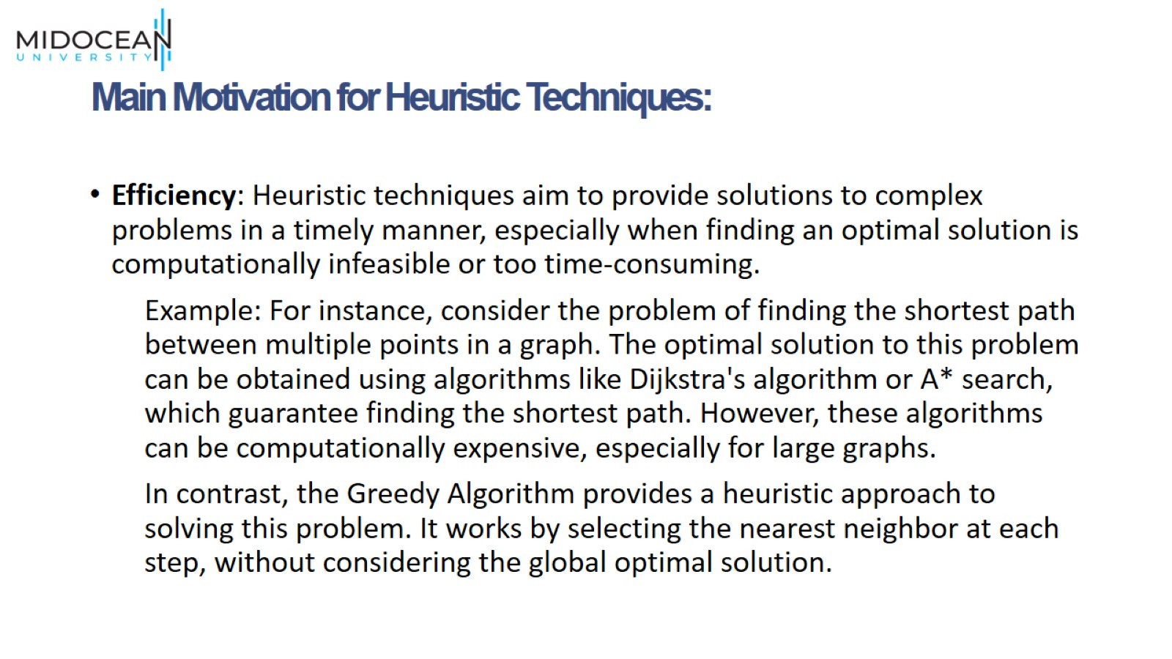
Main Motivation for Heuristic Techniques:

Slide 5
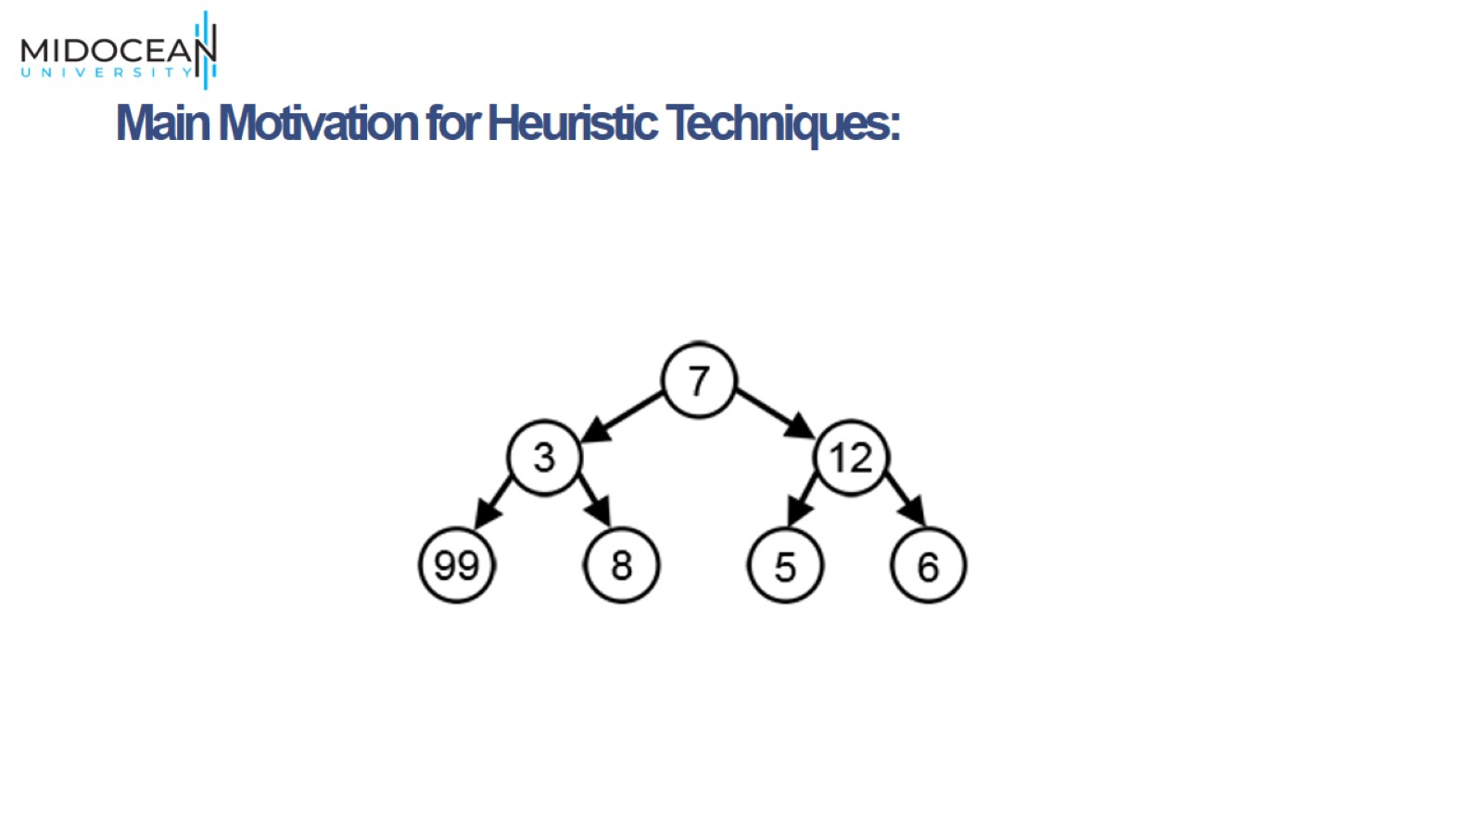
Main Motivation for Heuristic Techniques:

Slide 6
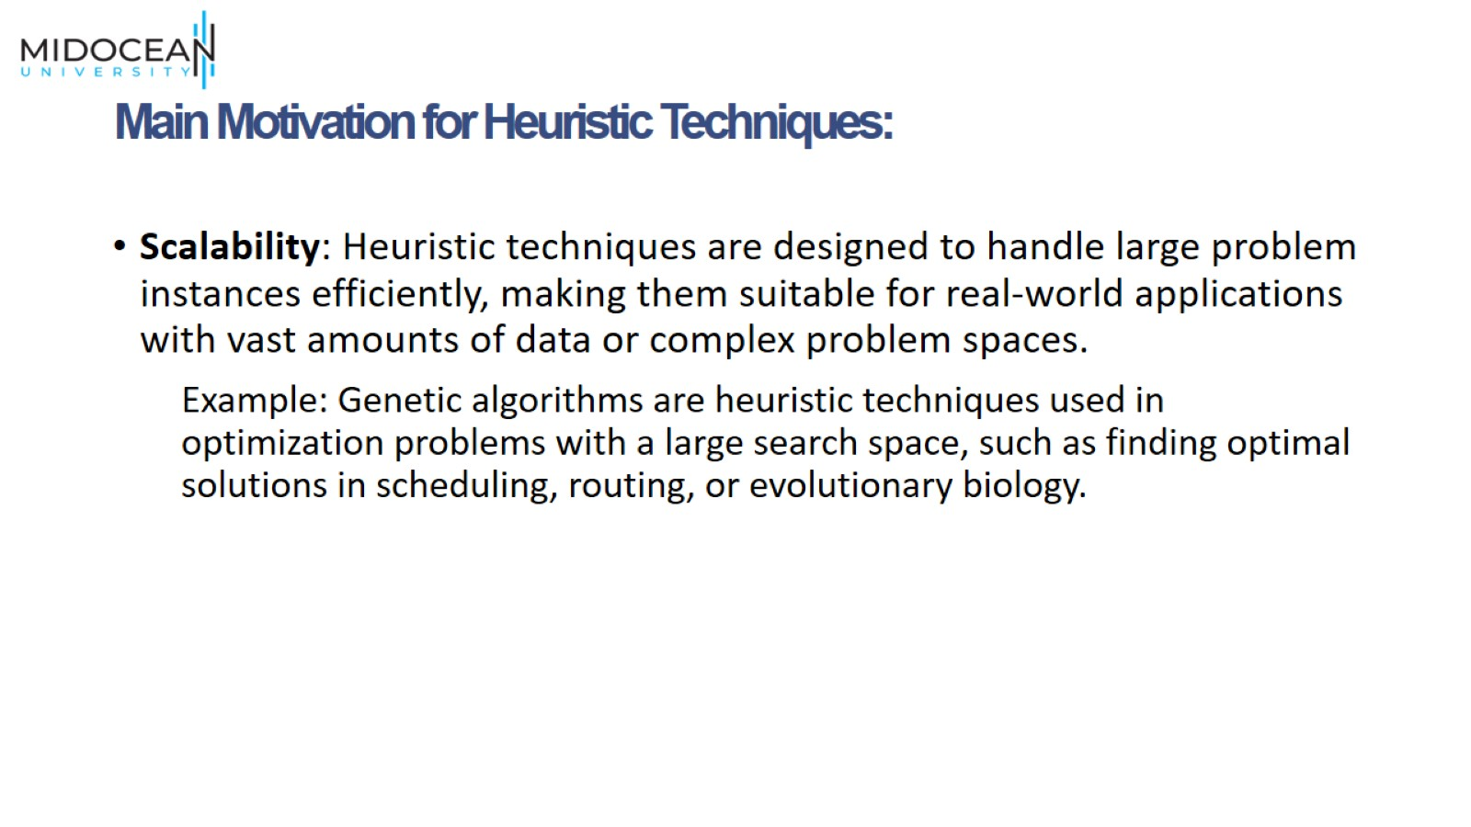
Main Motivation for Heuristic Techniques:

Slide 7
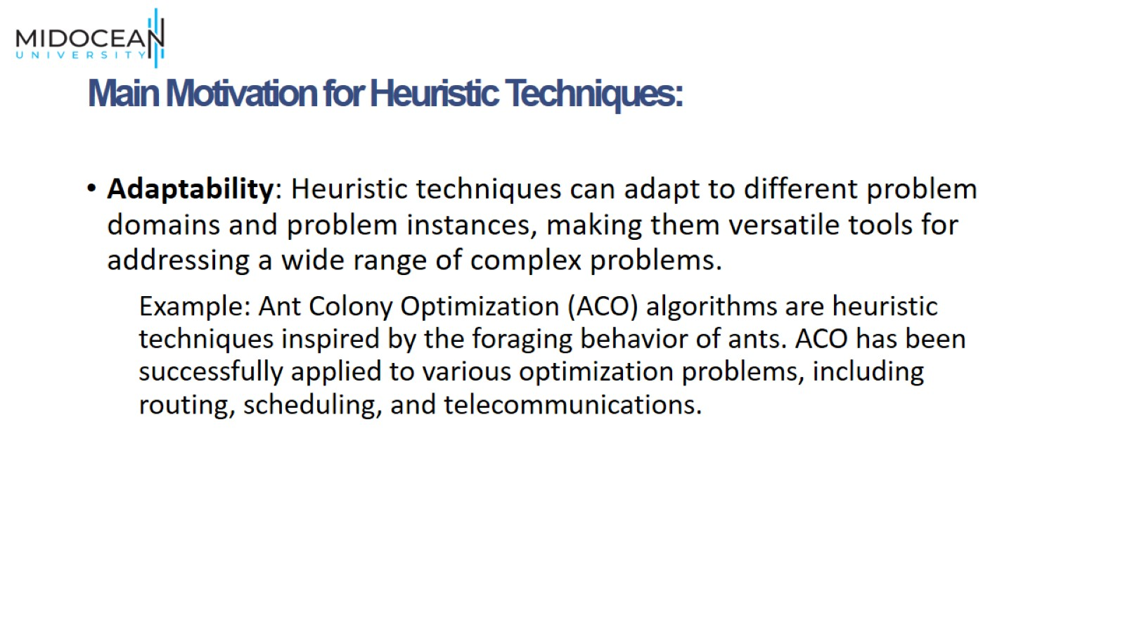
Main Motivation for Heuristic Techniques:

Slide 8
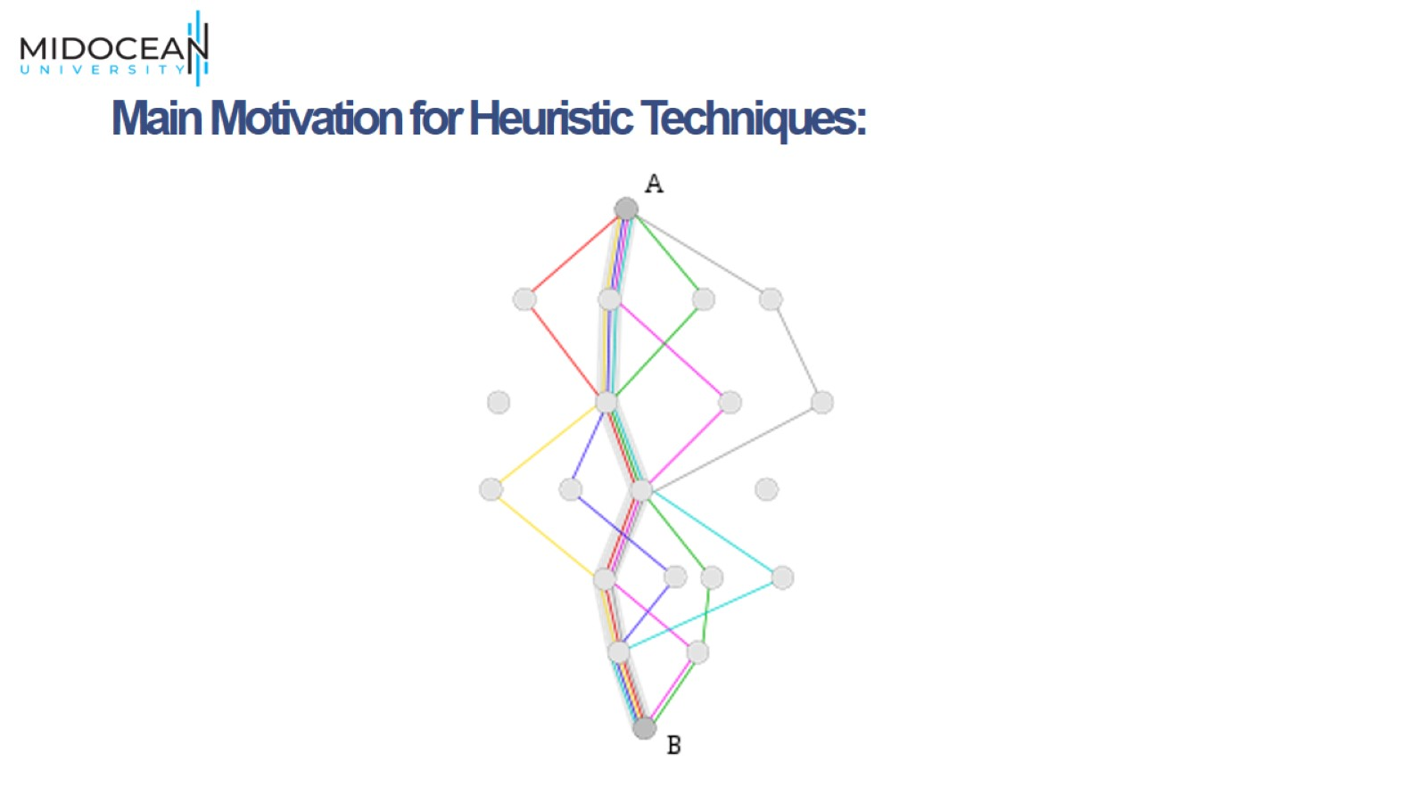
Main Motivation for Heuristic Techniques:

Slide 9
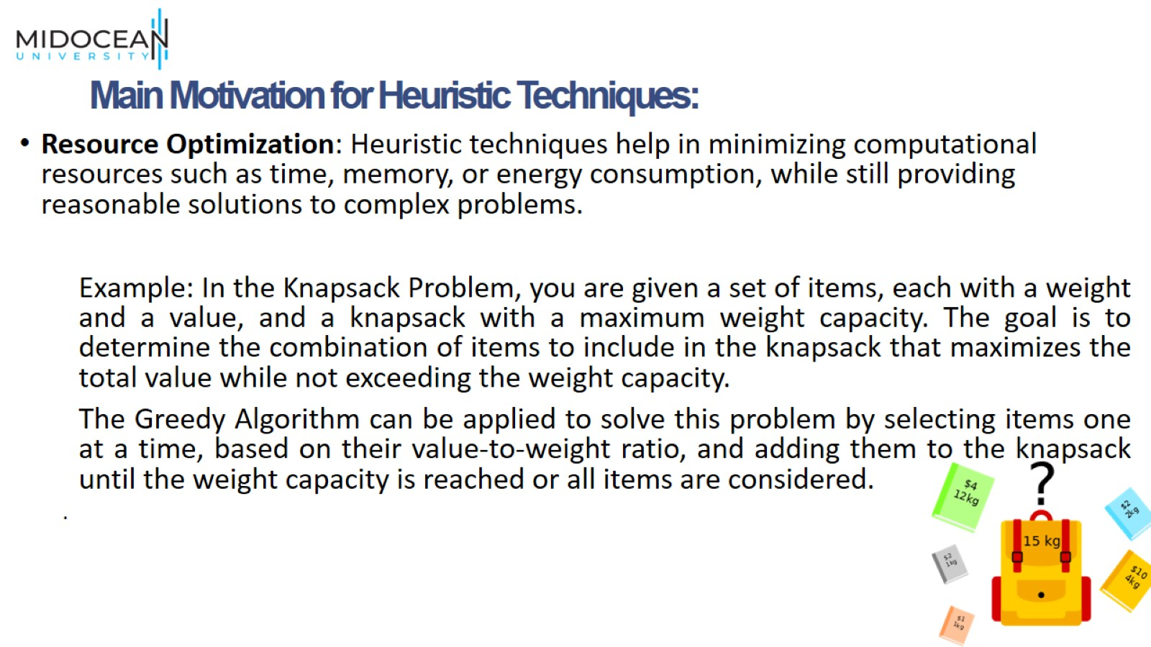
Main Motivation for Heuristic Techniques:

Slide 10
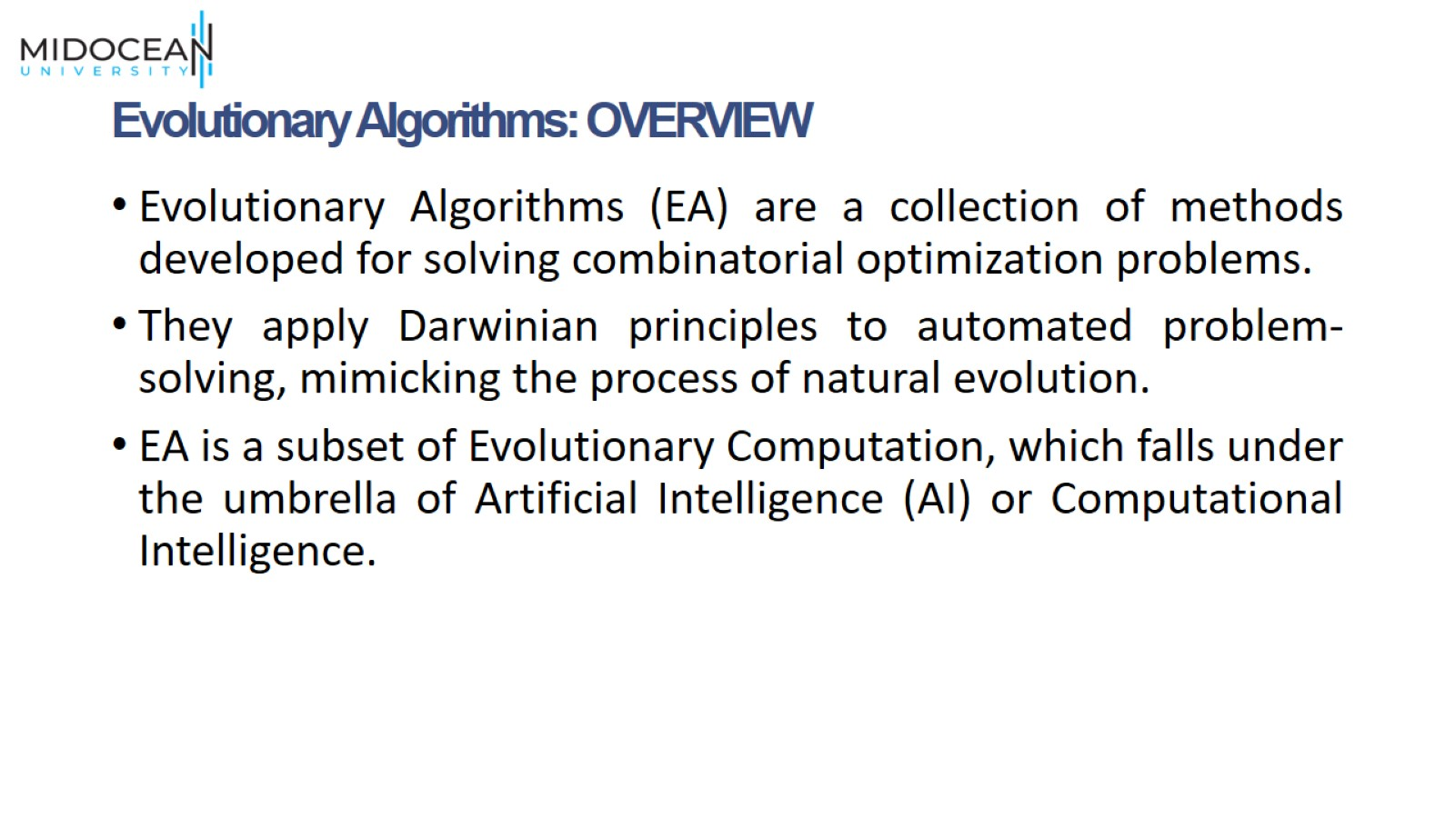
Evolutionary Algorithms: OVERVIEW

Slide 11
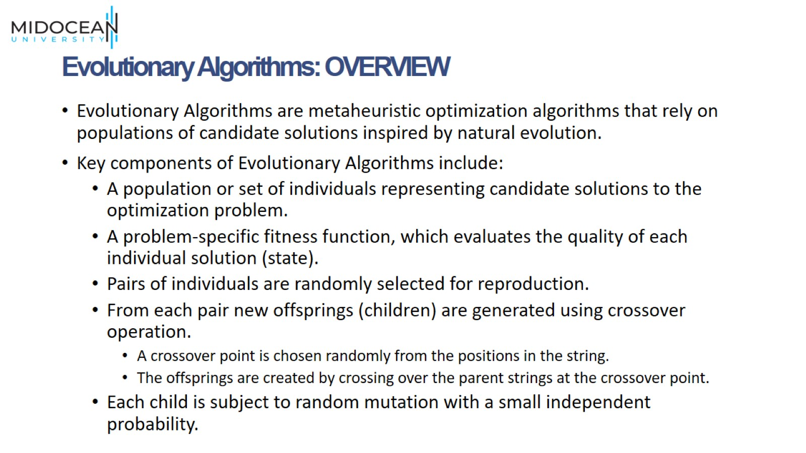
Evolutionary Algorithms: OVERVIEW

Slide 12
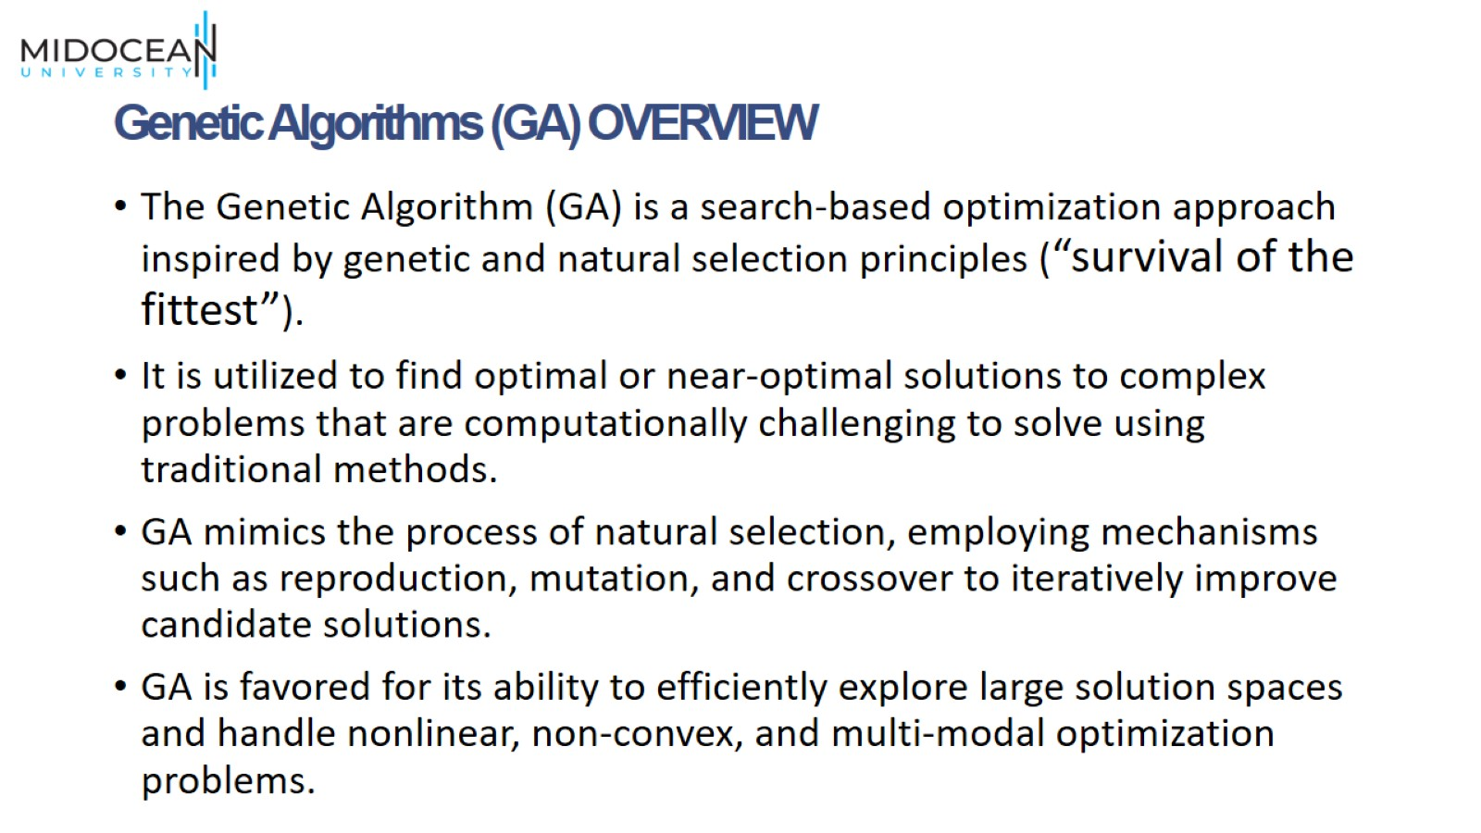
Genetic Algorithms (GA) OVERVIEW

Slide 13
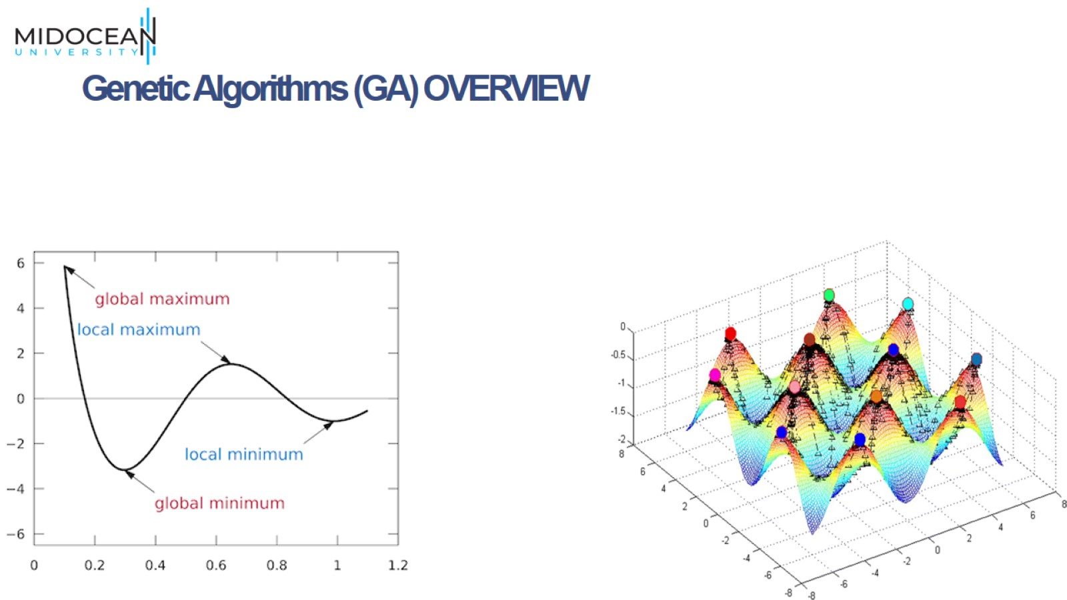
Genetic Algorithms (GA) OVERVIEW

Slide 14
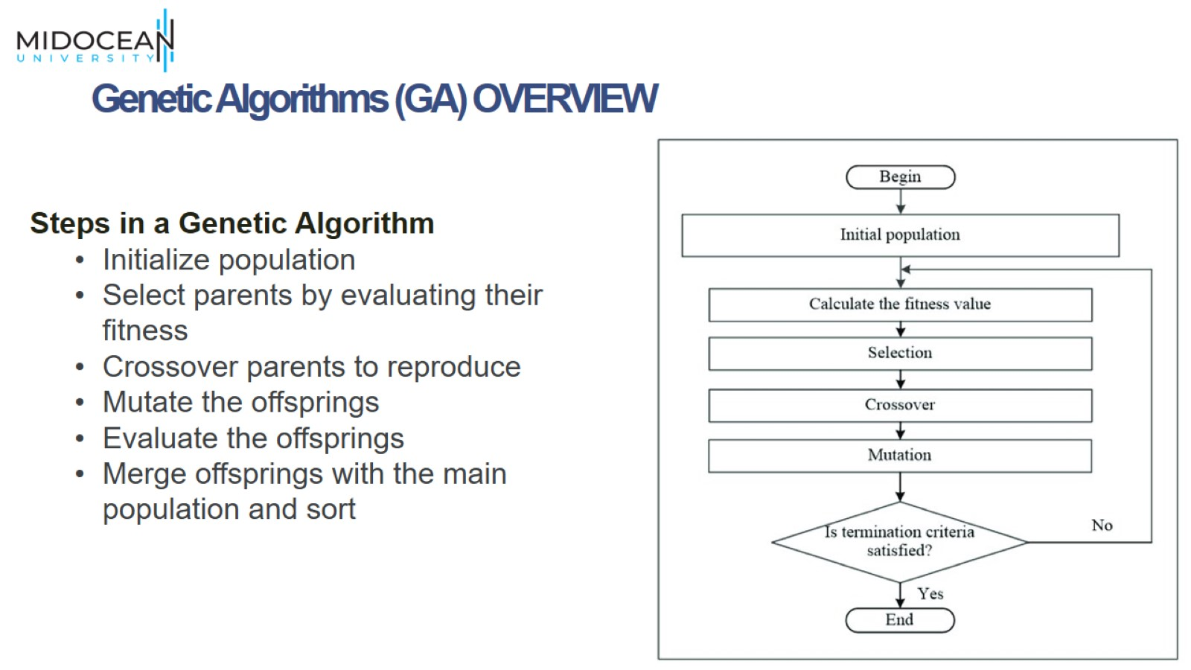
Genetic Algorithms (GA) OVERVIEW

Slide 15
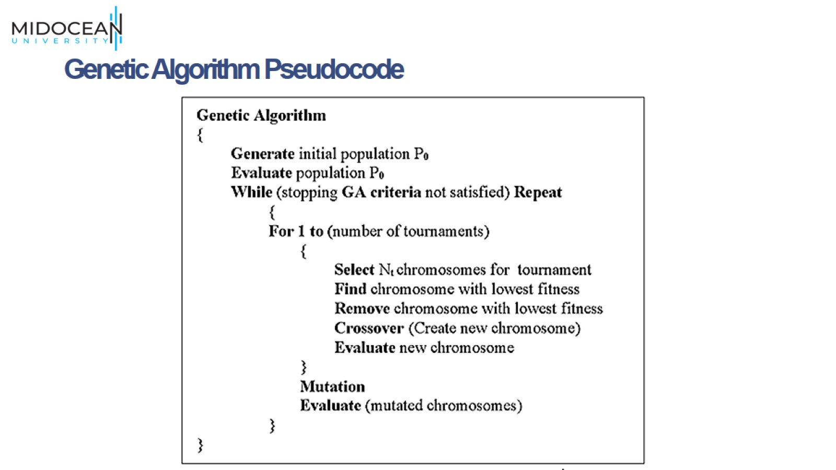
Genetic Algorithm Pseudocode

Slide 16
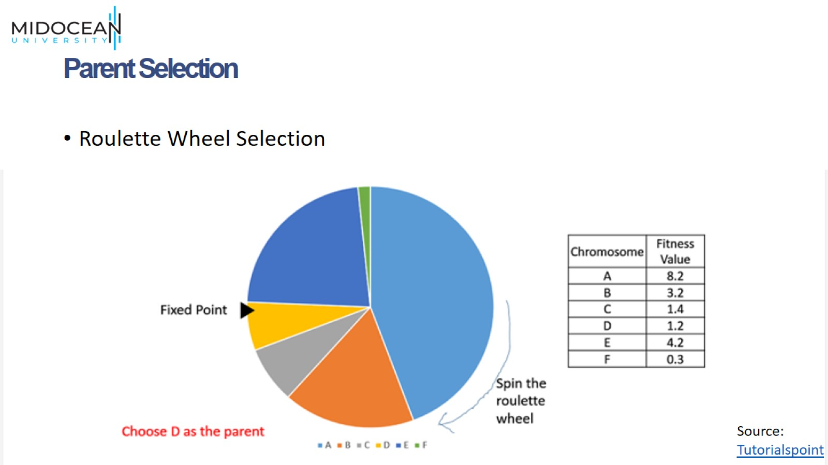
Parent Selection

Slide 17
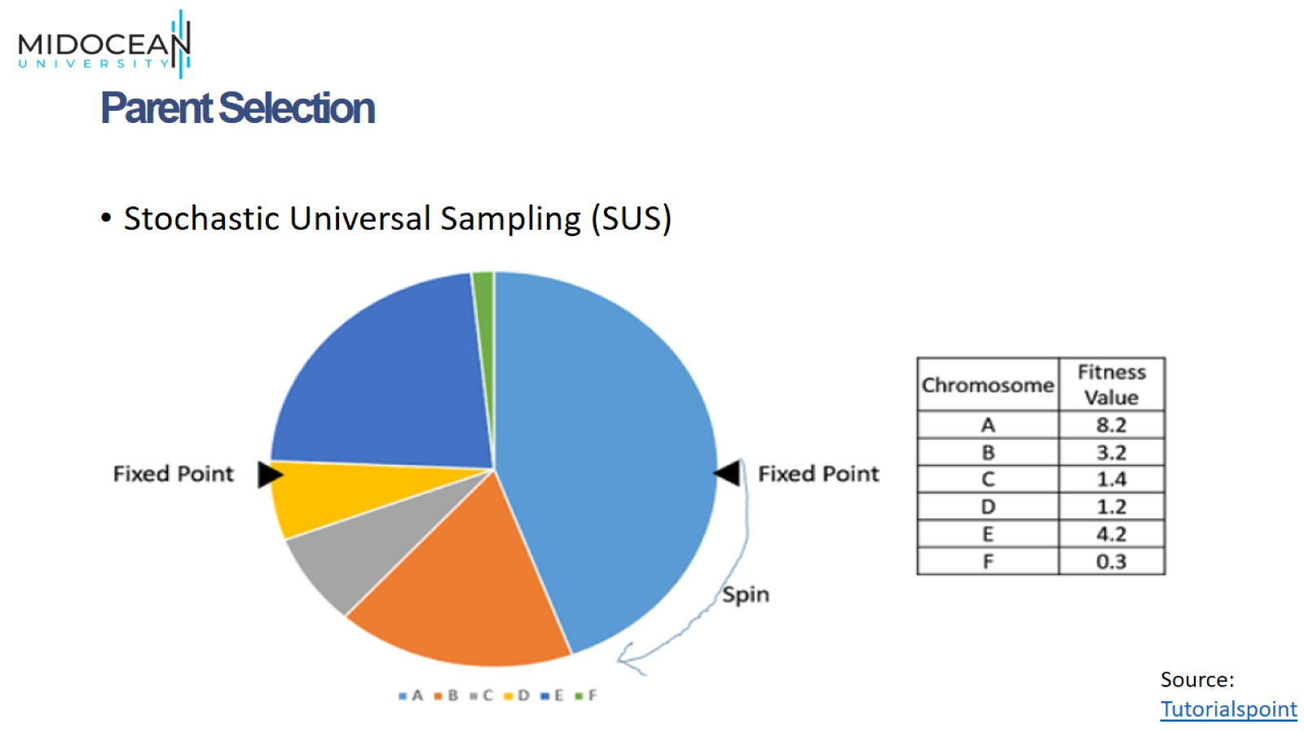
Parent Selection

Slide 18
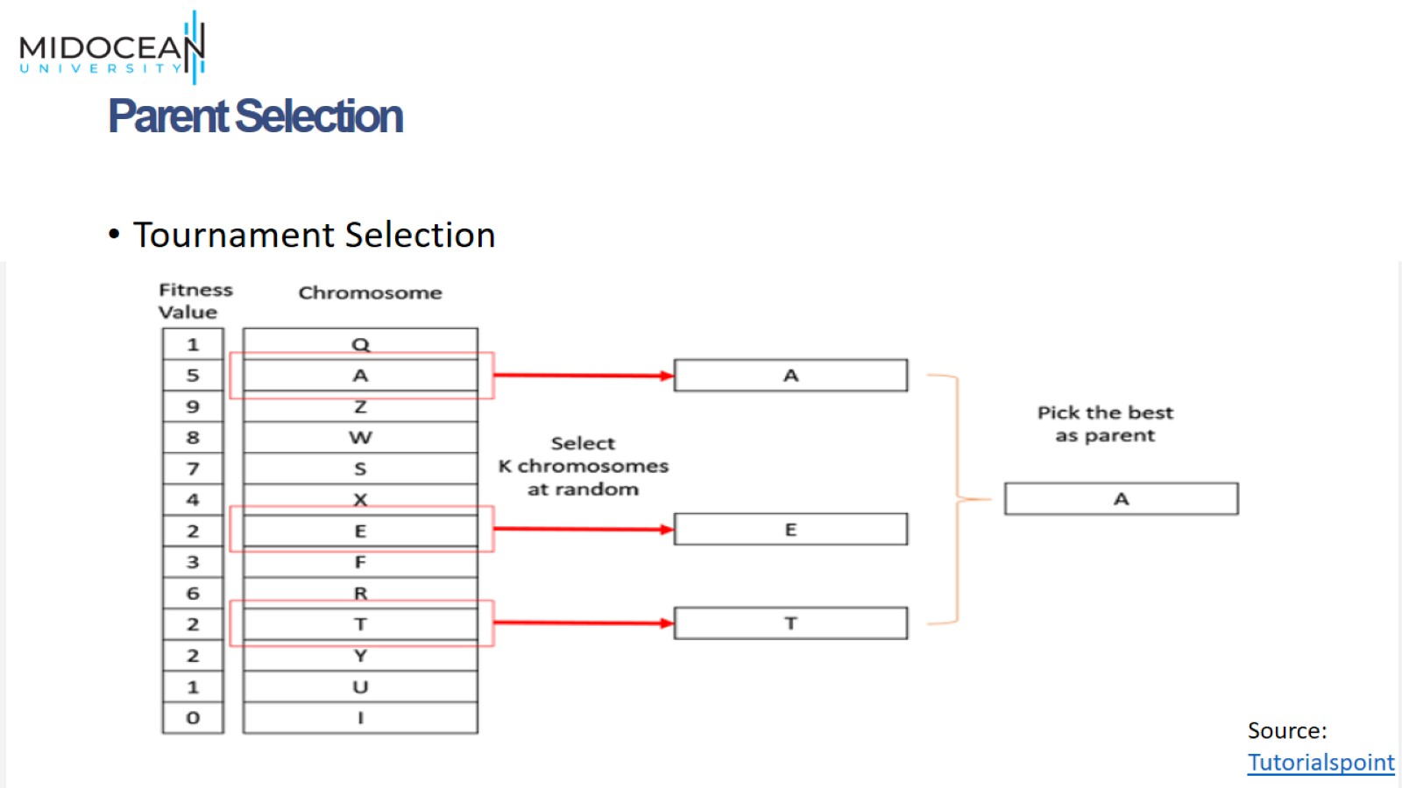
Parent Selection

Slide 19
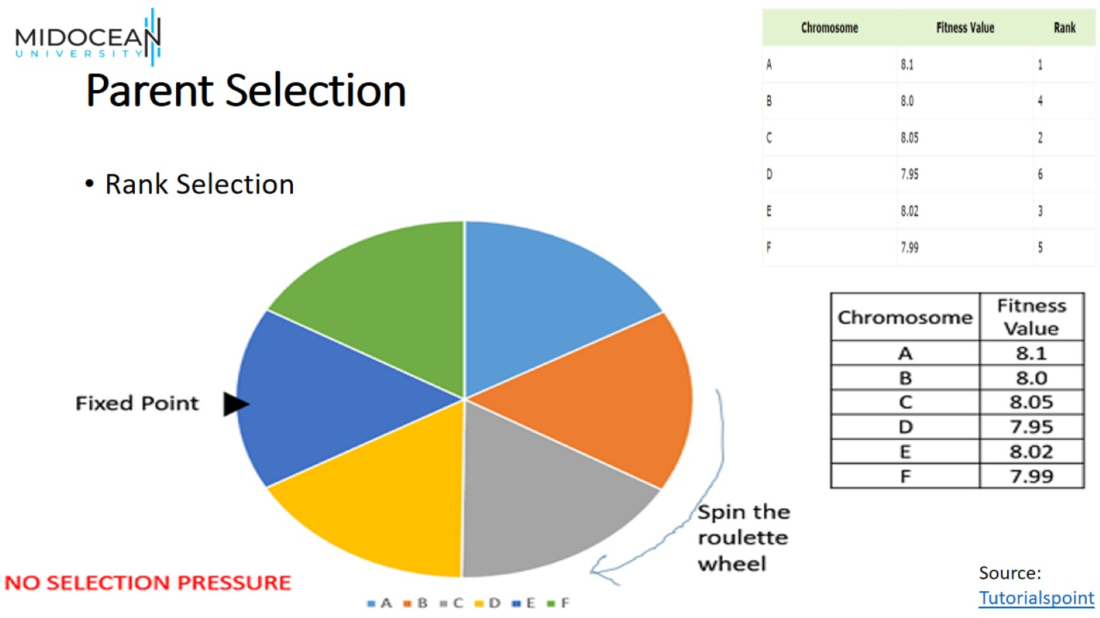
Parent Selection

Slide 20
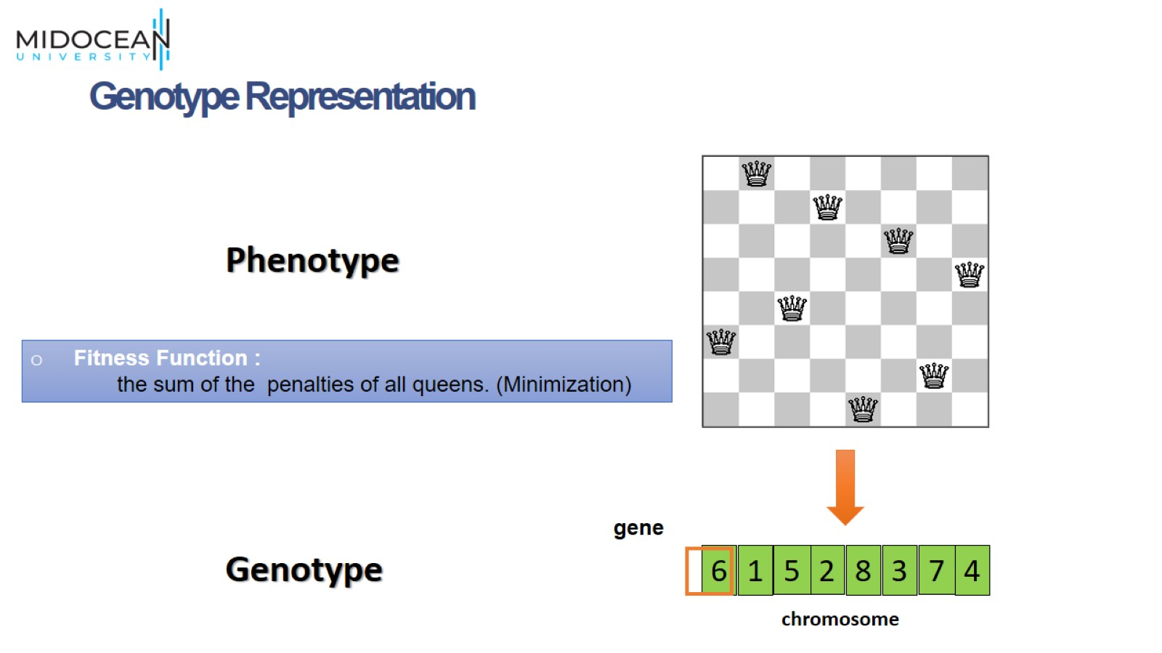
Genotype Representation

Slide 21
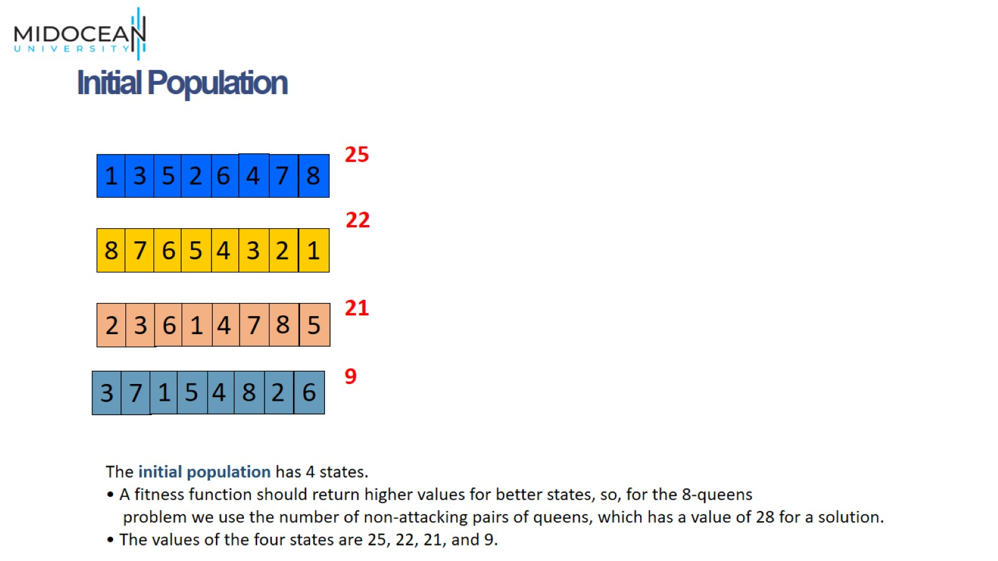
Initial Population

Slide 22
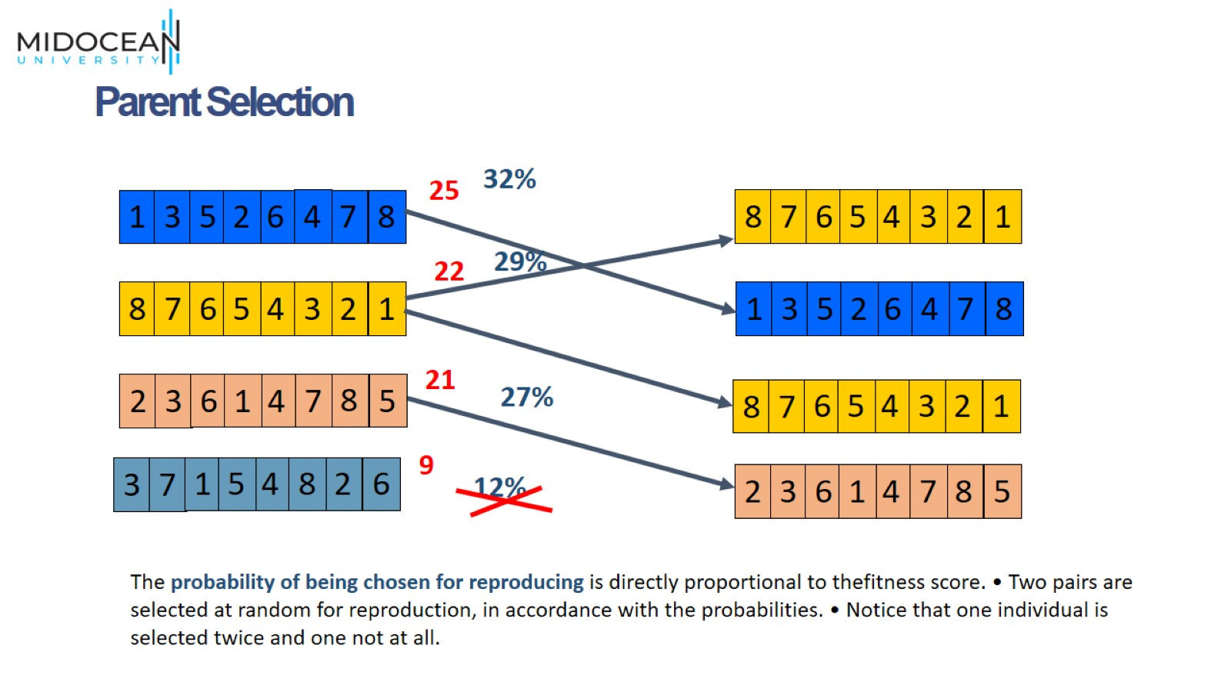
Parent Selection

Slide 23
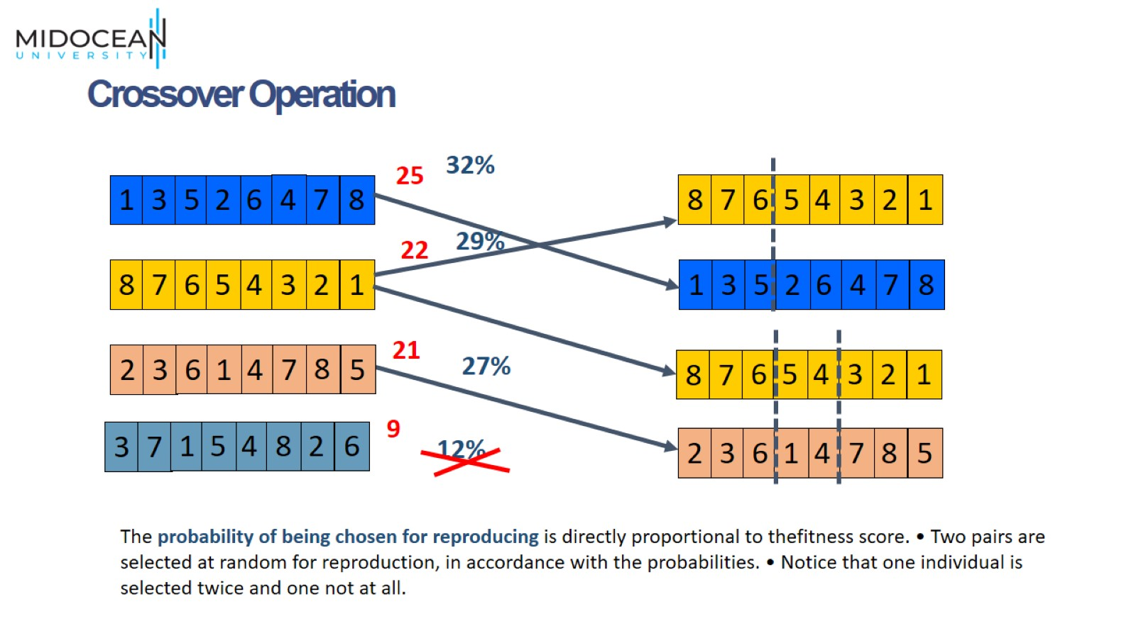
Crossover Operation

Slide 24
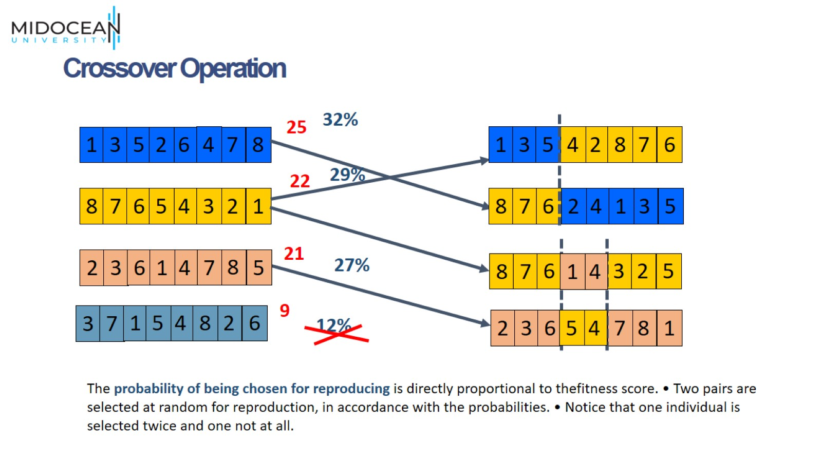
Crossover Operation

Slide 25
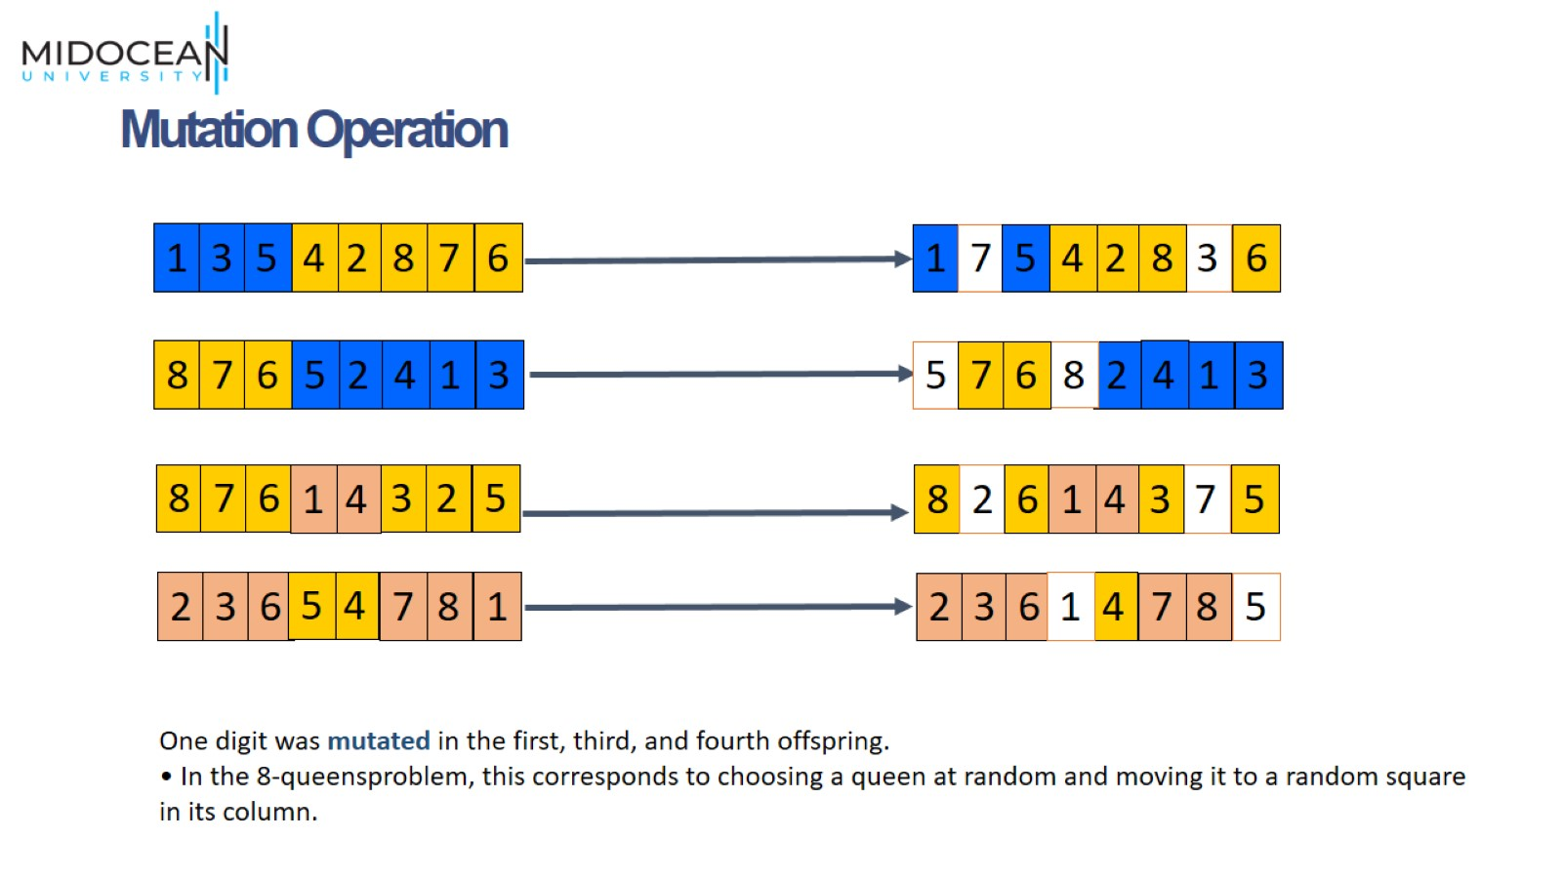
Mutation Operation

Slide 26
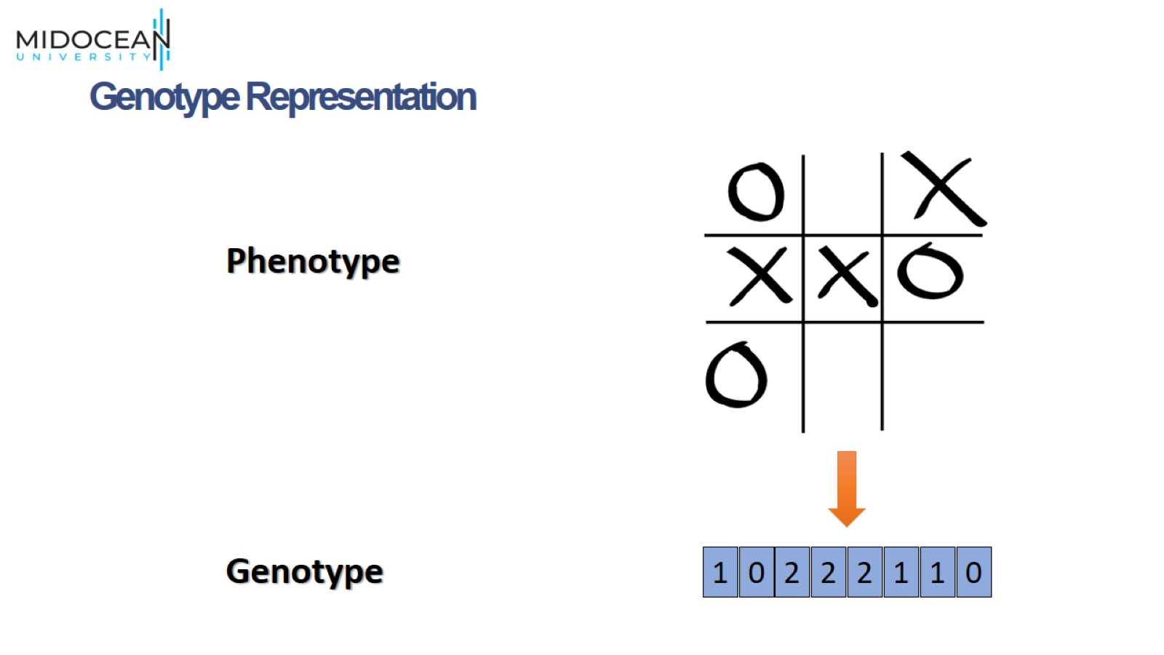
Genotype Representation

Slide 27
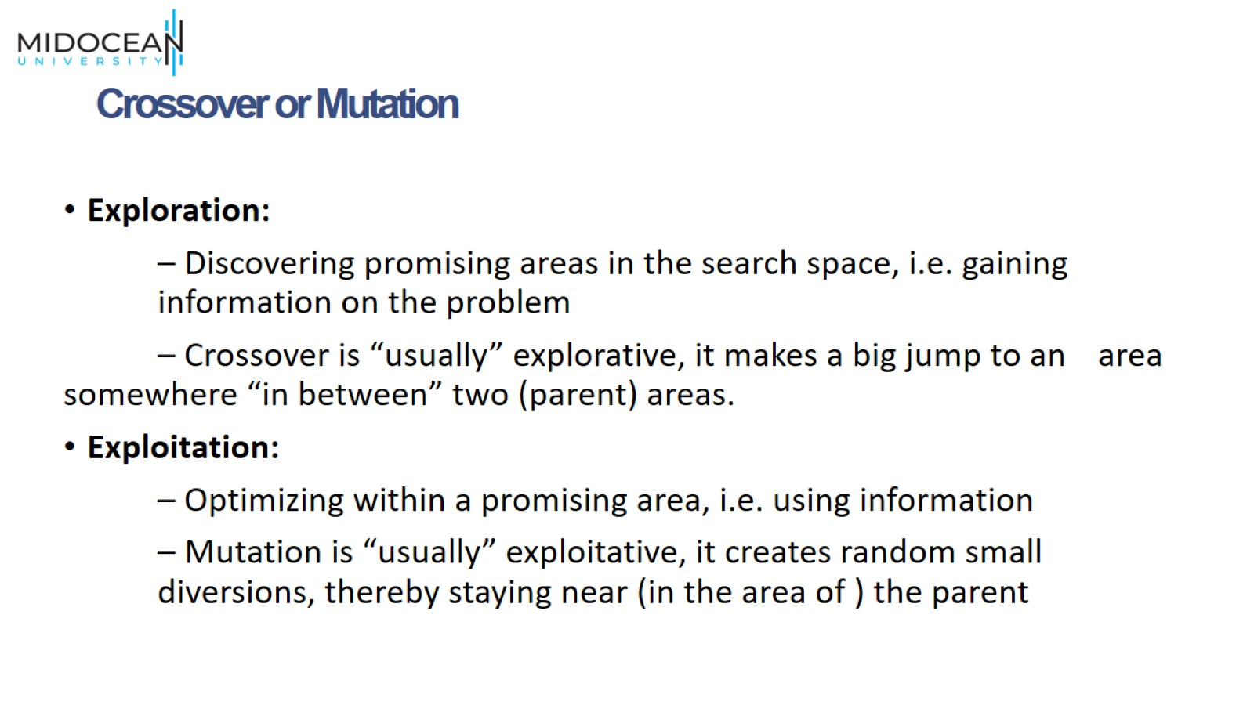
Crossover or Mutation

Slide 28
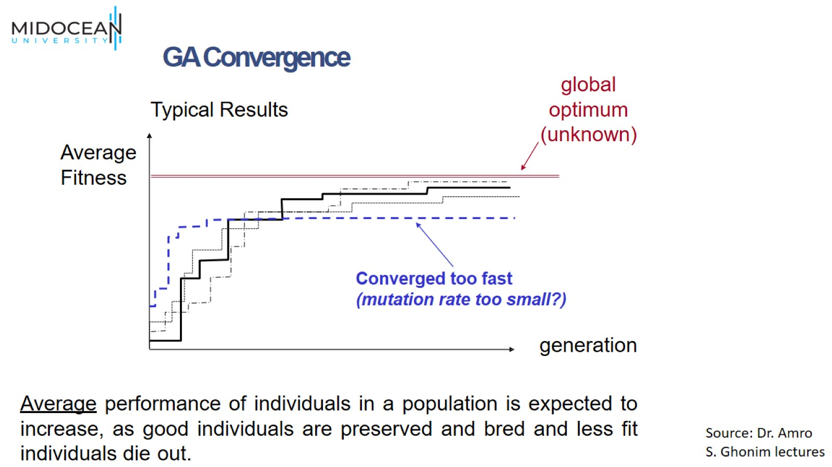

Slide 29
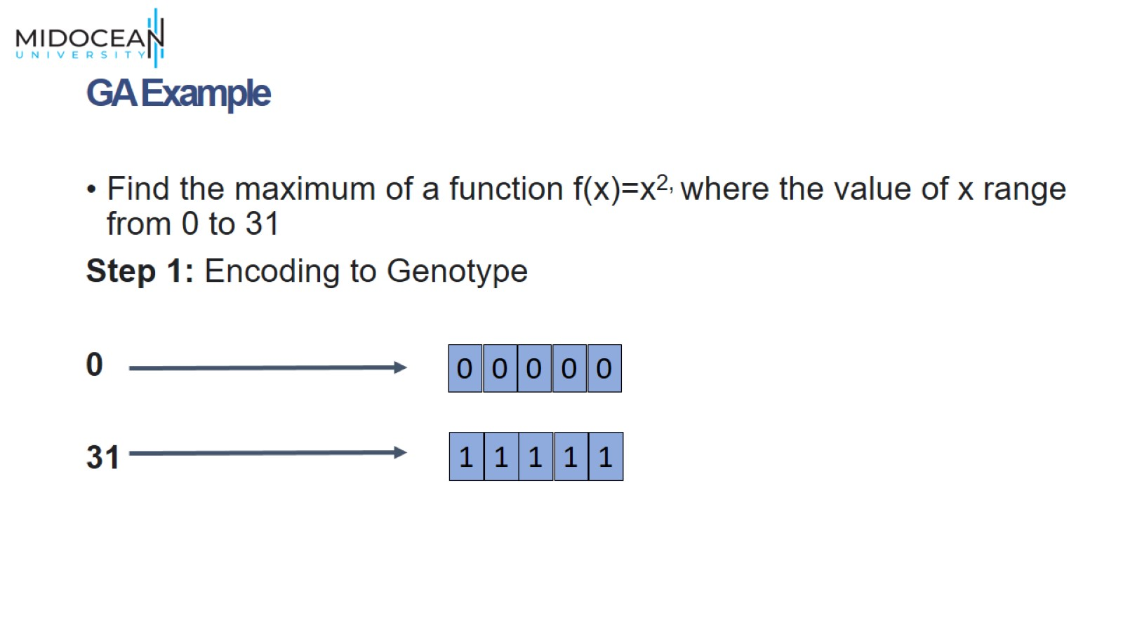
GA Example

Slide 30
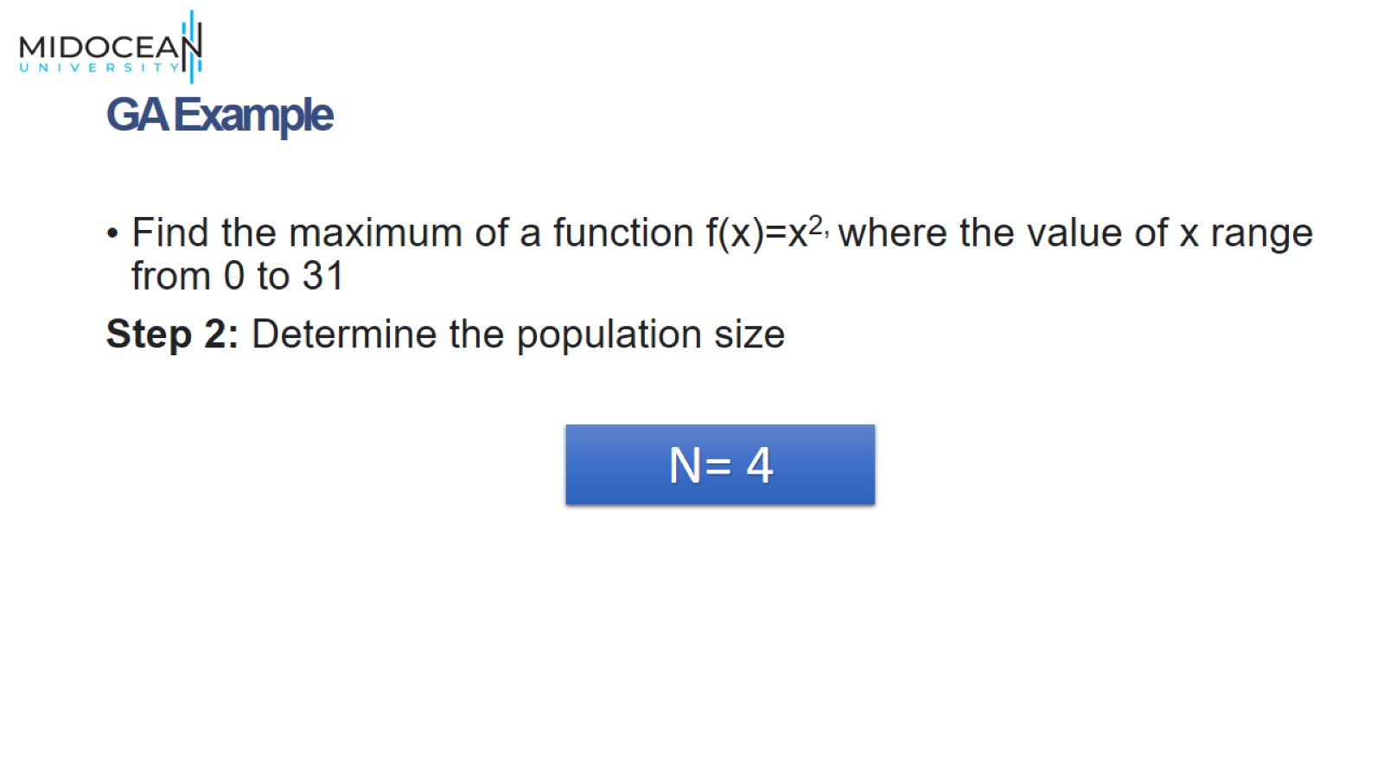
GA Example

Slide 31
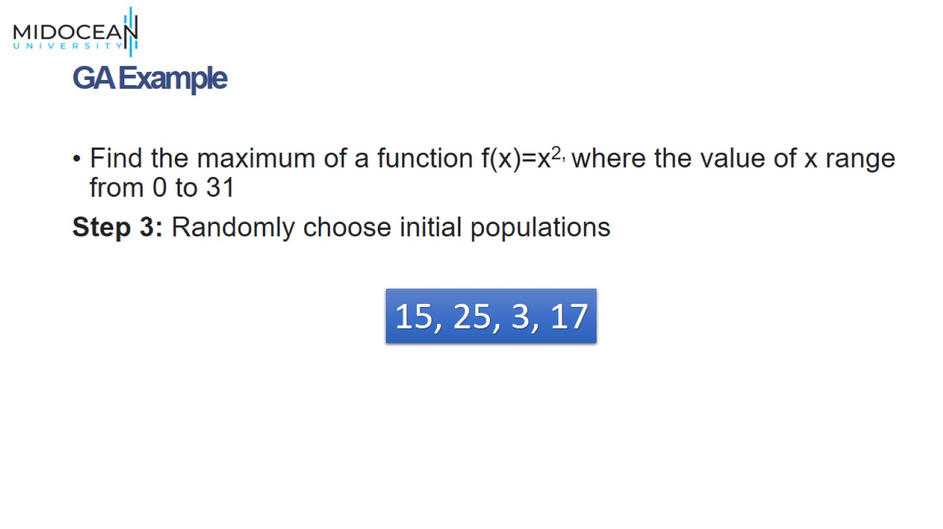
GA Example

Slide 32
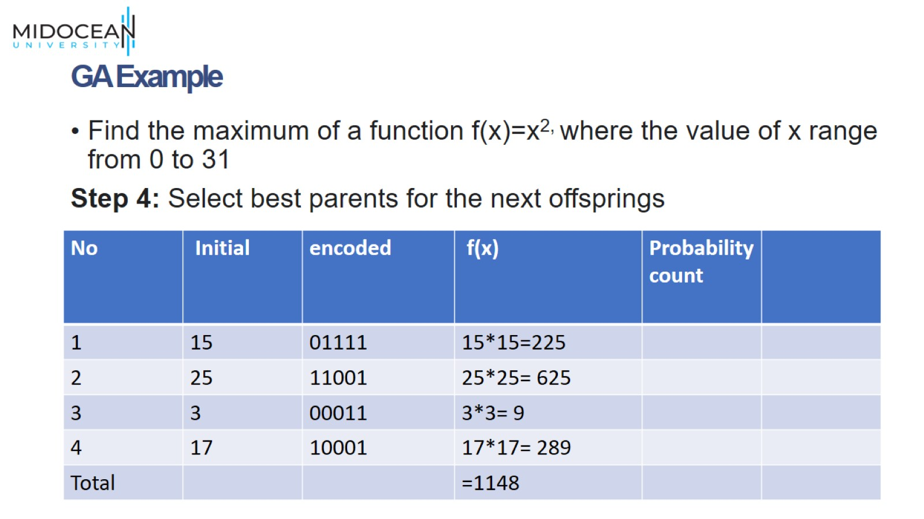
GA Example

Slide 33
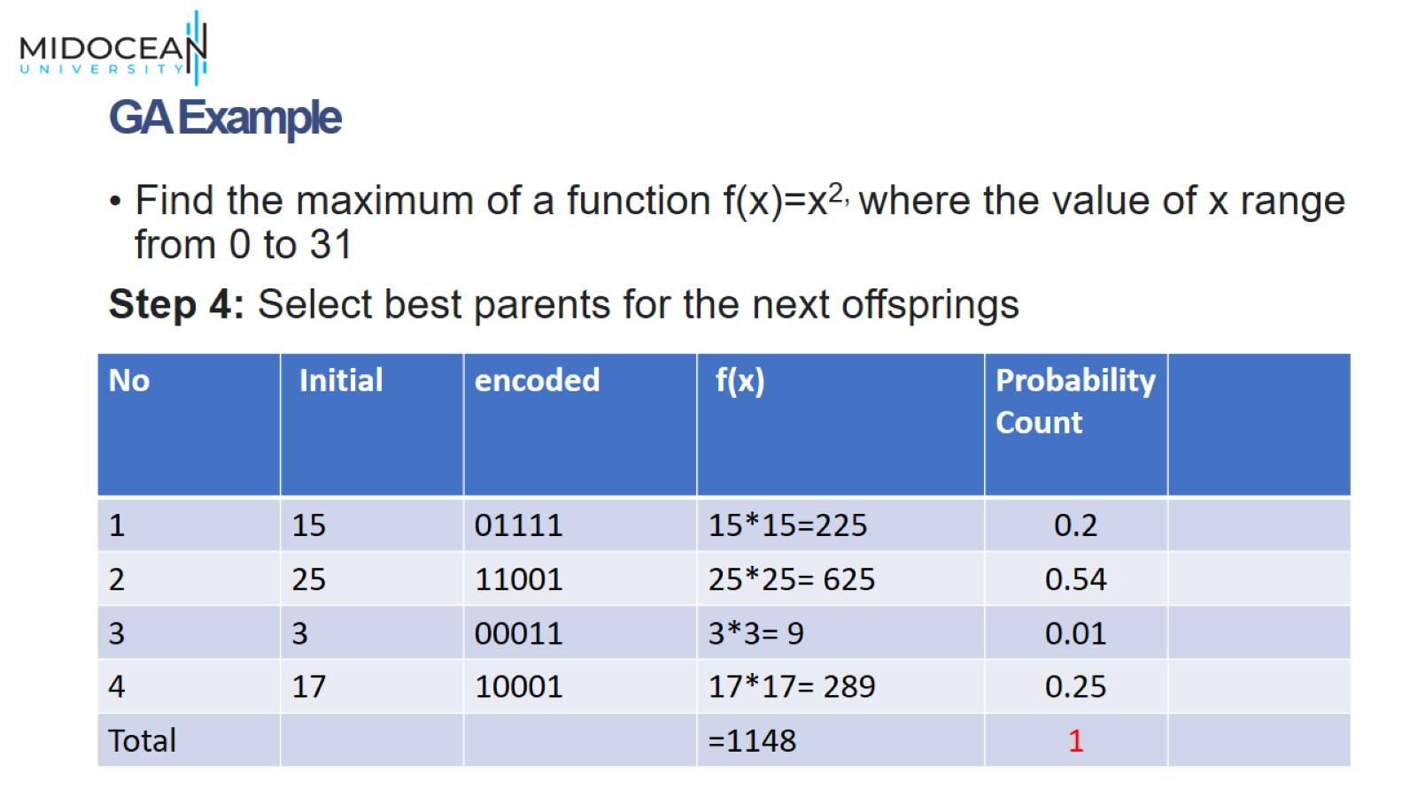
GA Example

Slide 34
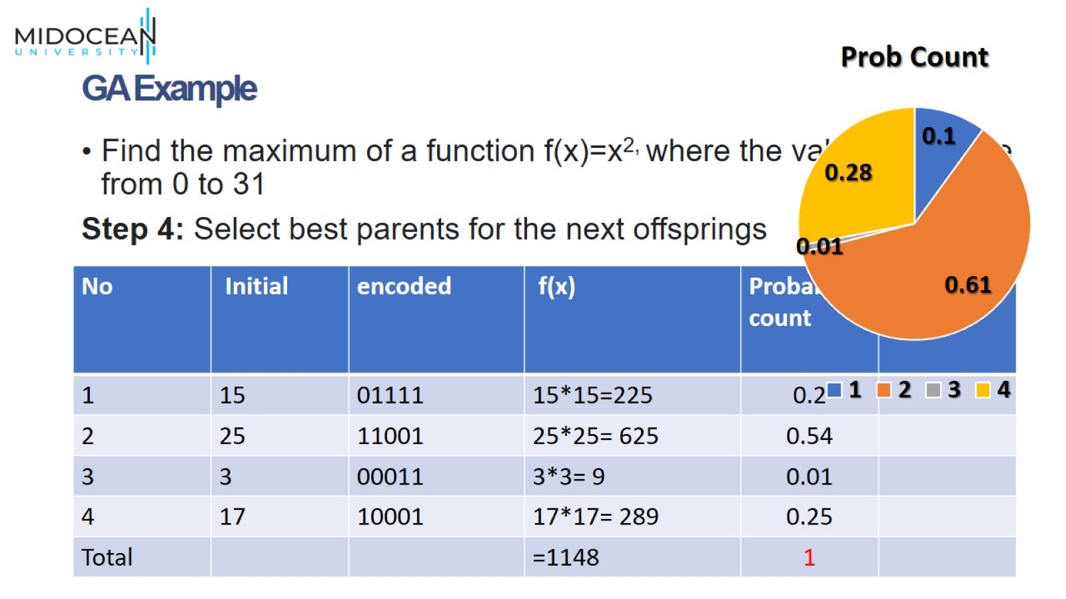
GA Example

Slide 35
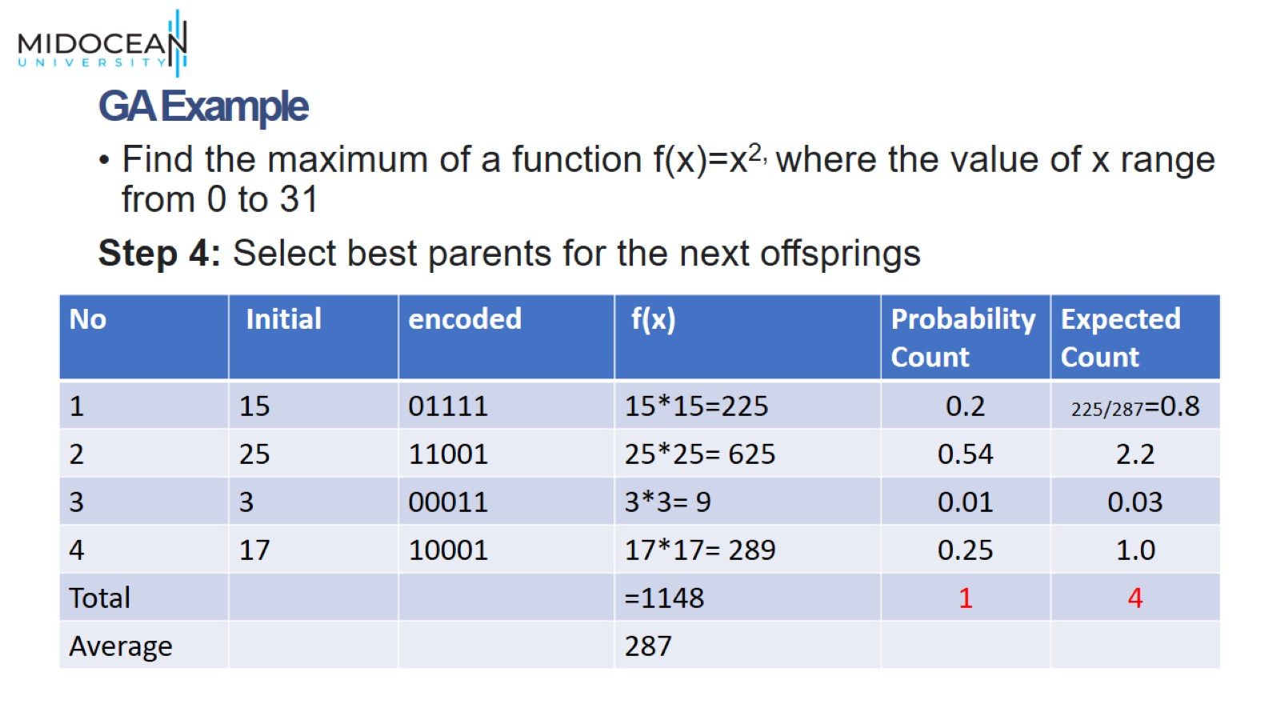
GA Example

Slide 36
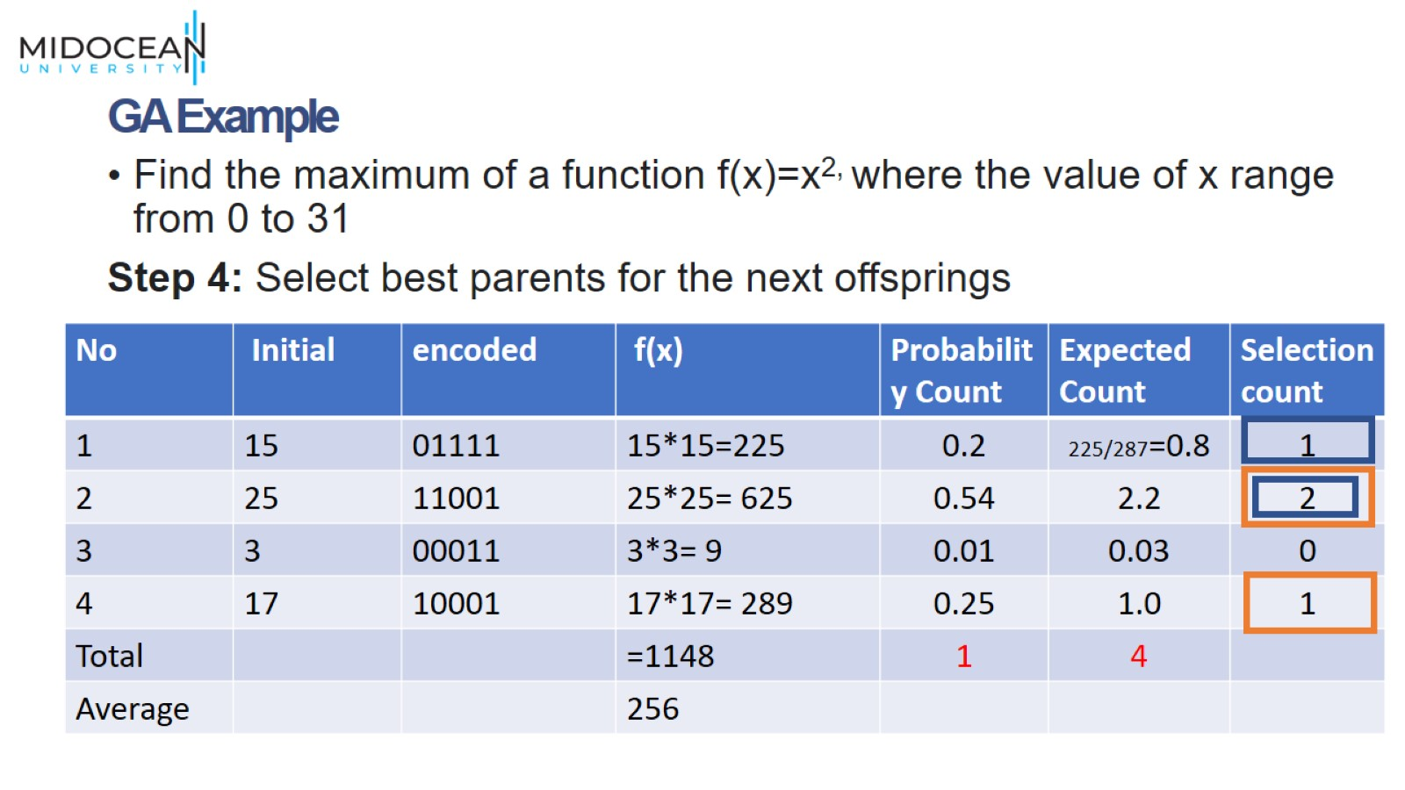
GA Example

Slide 37
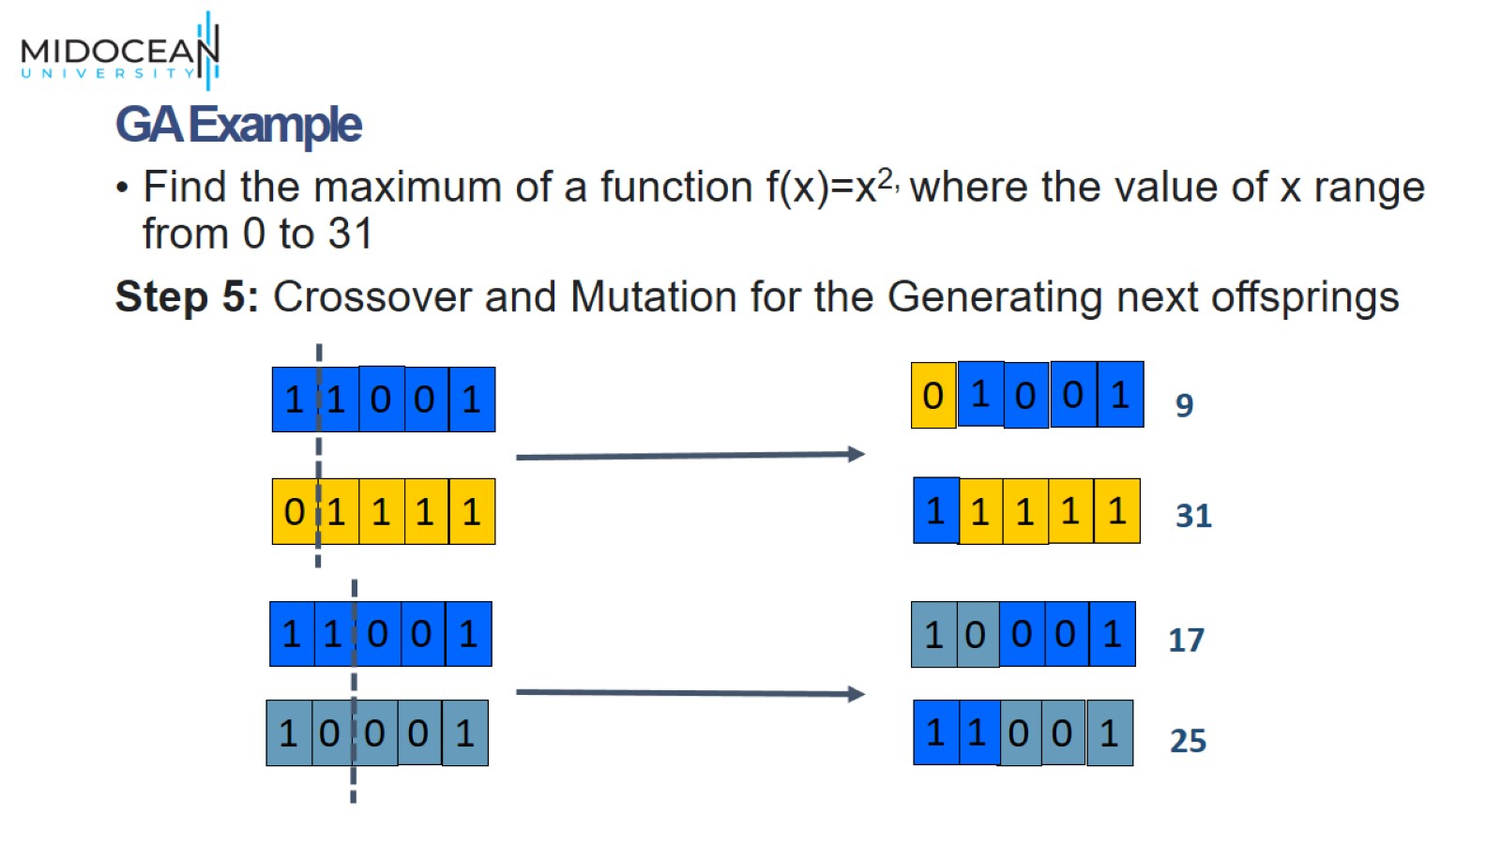
GA Example

Slide 38
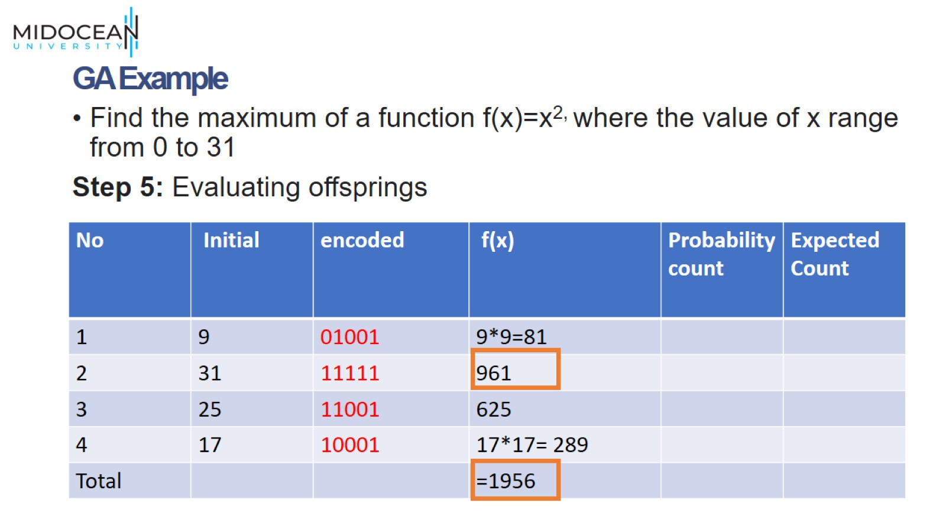
GA Example

Slide 39
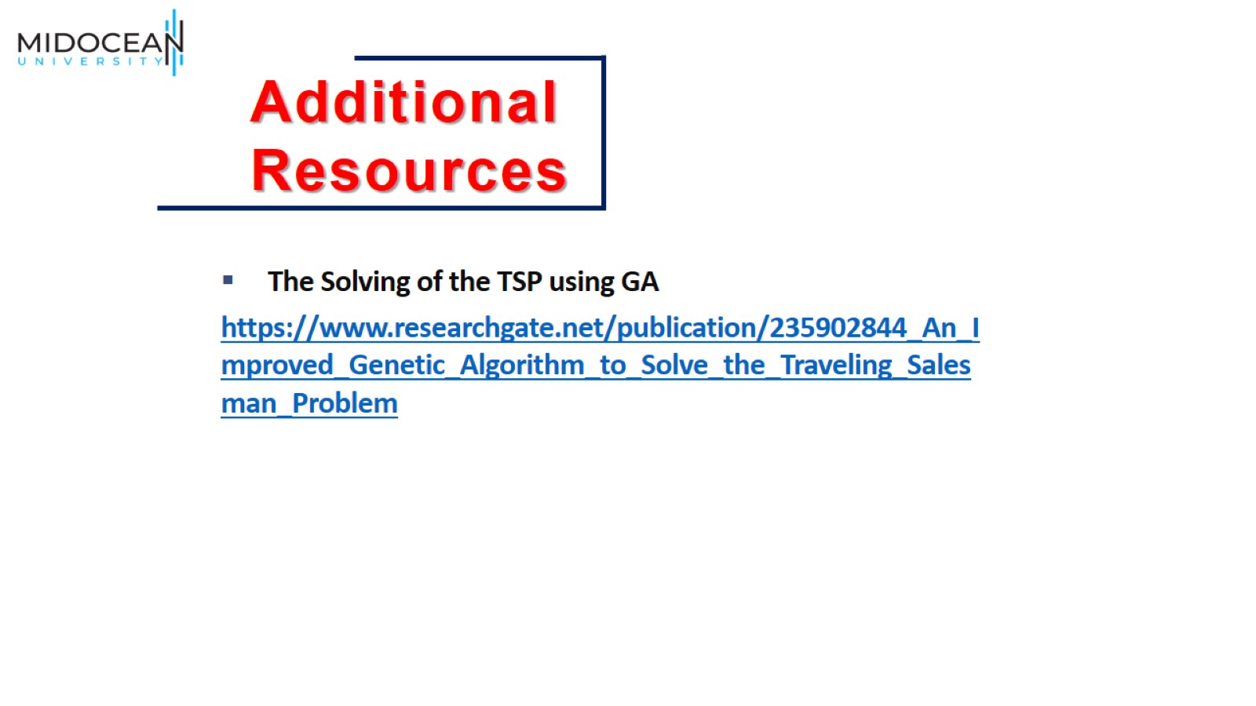

Slide 40


