Slide 1




Managing People
and Organizations
Lecture 6
MGM603
Prepared by
Dr. Usama Al-Fendi

Slide 2

Lecture 6
Motivating Behavior
Characterize the nature of motivation, including its importance and basic historical perspectives.
Identify and describe the need-based perspectives on motivation.
Identify and describe the major process-based perspectives on motivation.
Describe learning-based perspectives on motivation.
Outcomes of the chapter:

Slide 3
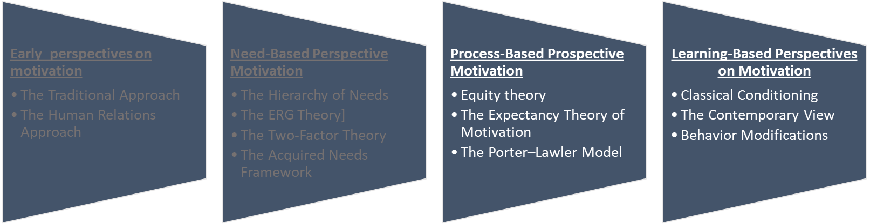
Lecture 6
Motivating Behavior
Chapter Sequence:

Slide 4
Lecture 6
Motivating Behavior
2- Process-Based Perspectives on Motivation
Process-Based Perspectives on Motivation | Process-based perspectives focus on how people behave in their efforts to satisfy their needs. In contrast to needs-based theories, process-based theories see motivation as a rational process: individuals perceive their environment, analyze it, develop reactions and feelings, and respond in certain ways. Rather than attempting to identify specific motivational stimuli, such as pay or recognition, process perspectives focus on why people choose certain behavioral options to satisfy their needs (regardless of the needs themselves) and how they evaluate their satisfaction after they have attained these goals. Two main process-based theories are Equity theory and Expectancy theory.

Slide 5
Lecture 6
Motivating Behavior
2- Process-Based Perspectives on Motivation
1- The Equity Theory of Motivation
Equity theory | Equity theory: Focuses on people’s desire to be treated with what they perceive as equity and to avoid perceived inequity The equity theory of motivation is based on the relatively simple premise that people in organizations want to be treated fairly The theory defines equity as the belief that we are being treated fairly in relation to others and inequity as the belief that we are being treated unfairly compared with others.

Slide 6
Lecture 6
Motivating Behavior
2- Process-Based Perspectives on Motivation
1- The Equity Theory of Motivation
Forming Equity Perceptions | People in organizations form perceptions of the equity of their treatment through a four-step process: First, they evaluate how they are being treated by the firm. Second, they form a perception of how a “comparison-other” is being treated. The comparison-other might be a person in the same workgroup, someone in another part of the organization, or even a composite of several people scattered throughout the organization

Slide 7
Lecture 6
Motivating Behavior
2- Process-Based Perspectives on Motivation
1- The Equity Theory of Motivation
Forming Equity Perceptions | People in organizations form perceptions of the equity of their treatment through a four-step process: Third, they compare their own circumstances with those of the comparison-other and then use this comparison as the basis for forming an impression of either equity or inequity. Fourth, depending on the strength of this feeling, the person may choose to pursue one or more of the alternatives

Slide 8
Lecture 6
Motivating Behavior
2- Process-Based Perspectives on Motivation
1- The Equity Theory of Motivation
Forming Equity Perceptions | Equity theory describes the equity comparison process in terms of an input-to-outcome ratio. Inputs are an individual’s contributions to the organization—such factors as education, experience, effort, and loyalty. Outcomes are what the person receives in return—pay, recognition, social relationships, intrinsic rewards, and similar things. The equity comparison thus takes the following form:

Slide 9

Lecture 6
Motivating Behavior
2- Process-Based Perspectives on Motivation
1- The Equity Theory of Motivation

Slide 10
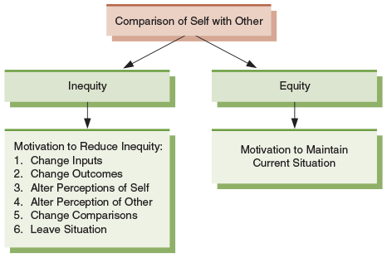
Lecture 6
Motivating Behavior
2- Process-Based Perspectives on Motivation
1- The Equity Theory of Motivation
Responses to Perceptions of Equity and Inequity
People form equity perceptions by comparing their situation with that of someone else’s. If they perceive equity, they are motivated to maintain the current situation. If they perceive inequity, they are motivated to use one or more of the strategies shown here to reduce the inequity. ALTER

Slide 11

Lecture 6
Motivating Behavior
2- Process-Based Perspectives on Motivation
1- The Equity Theory of Motivation
A key element of equity theory is that people in organizations compare their situations with that of other people. Take these two people, for instance. Each one has an education and experience, and contributes his time, talent, and effort to the company. In return, each gets pay, benefits, others rewards, and various forms of recognition. But if the man standing feels that the man sitting and reviewing his email is being treated better than he is, then he may decide to reduce his contributions to the organization or look for a new job somewhere else.

Slide 12
Lecture 6
Motivating Behavior
2- Process-Based Perspectives on Motivation
2- The Expectancy Theory of Motivation
The Basic Expectancy Model | The Expectancy Theory of Motivation: Suggests that people are motivated by how much they want something and the likelihood they perceive of getting it Expectancy theory is a more encompassing model of motivation than equity theory (expectancy theory is also known as VIE theory, for valence–instrumentality–expectancy). Over the years since its original formulation, the theory’s scope and complexity have continued to grow.

Slide 13
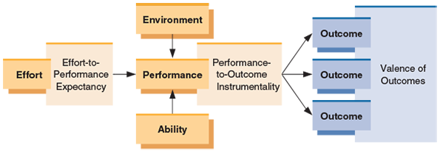
Lecture 6
Motivating Behavior
2- Process-Based Perspectives on Motivation
2- The Expectancy Theory of Motivation

Slide 14
Lecture 6
Motivating Behavior
2- Process-Based Perspectives on Motivation
2- The Expectancy Theory of Motivation
The Expectancy Theory of Motivation
The expectancy theory is the most complex model of employee motivation in organizations. As shown here, the key components of expectancy theory are effort-to-performance expectancy, performance-to-outcome instrumentality, and outcomes, each of which has an associated valence. These components interact with effort, the environment, and the ability to determine an individual’s performance.

Slide 15
Lecture 6
Motivating Behavior
2- Process-Based Perspectives on Motivation
2- The Expectancy Theory of Motivation
1- Effort-to-Performance Expectancy | Effort-to-performance expectancy is a person’s perception of the probability that effort will lead to successful performance. If we believe our effort will lead to higher performance, this expectancy is very strong, perhaps approaching a probability of 1.0 or 100%, where 1.0 equals absolute certainty that the outcome will occur.

Slide 16
Lecture 6
Motivating Behavior
2- Process-Based Perspectives on Motivation
2- The Expectancy Theory of Motivation
1- Effort-to-Performance Expectancy | If we believe our performance will be the same no matter how much effort we make, our expectancy is very low—perhaps as low as 0, meaning that there is no probability that the outcome will occur. Ex. Alex Morgan, a star soccer player who believes that when she puts maximum effort, she has a great chance of scoring higher than any opponent, clearly sees a link between her effort and performance.

Slide 17
Lecture 6
Motivating Behavior
2- Process-Based Perspectives on Motivation
2- The Expectancy Theory of Motivation
2- Performance-to-Outcome Expectancy | Performance-to-Outcome Expectancy the individual’s perception of the probability that performance will lead to certain outcomes. If a person thinks a high performer is certain to get a pay raise, this expectancy is close to 1.0. At the other extreme, a person who believes raises are entirely independent of performance has an expectancy close to 0. Finally, if a person thinks performance has some bearing on the prospects for a pay raise, his or her expectancy is somewhere between 1.0 and 0.

Slide 18
Lecture 6
Motivating Behavior
2- Process-Based Perspectives on Motivation
2- The Expectancy Theory of Motivation
2- Performance-to-Outcome Expectancy | Ex Green Bay Packers quarterback Aaron Rodgers may believe that if he plays aggressively all the time (performance), he has a great chance of leading his team to the playoffs. Playing aggressively may win him individual honors like the Most Valuable Player award, but he may also experience more physical trauma and throw more interceptions.

Slide 19
Lecture 6
Motivating Behavior
2- Process-Based Perspectives on Motivation
2- The Expectancy Theory of Motivation
3- Outcomes and Valences | An outcome is anything that might potentially result from performance. High-level performance conceivably might produce such outcomes as a pay raise, a promotion, recognition from the boss, stress, fatigue, or less time to rest, among others.. The valence of an outcome is the relative attractiveness or unattractiveness—the value—of that outcome to the person. Pay raises, promotions, and recognition might all have positive valences, whereas, stress, and less time to rest might all have negative valences.

Slide 20
Lecture 6
Motivating Behavior
2- Process-Based Perspectives on Motivation
2- The Expectancy Theory of Motivation
The basic expectancy framework suggests that three conditions must be met before motivated behavior occurs:
First, the effort-to-performance expectancy must be well above zero. That is, the worker must reasonably expect that exerting effort will produce high levels of performance.
Second, the performance-to-outcome expectancies must be well above zero. In other words, the person must believe that performance will realistically result in valued outcomes.
Third, the sum of all the valences must be well above zero as long as the positives outweigh the negatives.

Slide 21
Lecture 6
Motivating Behavior
2- Process-Based Perspectives on Motivation
2- The Expectancy Theory of Motivation
For example, stress and fatigue may have moderately negative valences, but if pay, promotion, and recognition have very high positive valences, the overall valence of the set of outcomes associated with performance will still be positive.

Slide 22
Lecture 6
Motivating Behavior
2- Process-Based Perspectives on Motivation
2- The Expectancy Theory of Motivation
2- The Porter–Lawler Model | The Porter–Lawler model appears in next Figure. Some of its features are quite different from the original version of expectancy theory. For example, the extended model includes abilities, traits, and role perceptions. At the beginning of the motivational cycle, effort is a function of the value of the potential reward for the employee (its valence) and the perceived effort-reward probability (an expectancy). Effort then combines with abilities, traits, and role perceptions to determine actual performance.

Slide 23
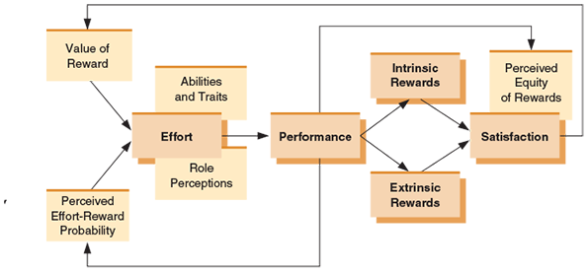
Lecture 6
Motivating Behavior
2- Process-Based Perspectives on Motivation
2- The Expectancy Theory of Motivation

Slide 24
Lecture 6
Motivating Behavior
2- Process-Based Perspectives on Motivation
2- The Expectancy Theory of Motivation
The Porter-Lawler Model
The Porter and Lawler expectancy model provides interesting insights into the relationships between satisfaction and performance. As illustrated here, this model predicts that satisfaction is determined by the perceived equity of intrinsic and extrinsic rewards for performance. That is, rather than satisfaction causing performance, which many people might predict, this model argues that it is actually performance that eventually leads to satisfaction.

Slide 25
Lecture 6
Motivating Behavior
3- Learning-Based Perspectives on Motivation
Learning is a relatively permanent change in behavior or behavioral potential that results from direct or indirect experience.
For example, we can learn to use a new software application program by practicing and experimenting with its various functions and options.
How Learning Occurs: Experts originally thought that learning occurred most often through a process called classical conditioning. However, it is more often based on cognitive processes.

Slide 26
Lecture 6
Motivating Behavior
3- Learning-Based Perspectives on Motivation
1- The Traditional View: Classical Conditioning
Classical conditioning is a simple form of learning in which a conditioned response is linked with an unconditional stimulus.
Classical conditioning (also known as Pavlovian or respondent conditioning) is learning through association and was discovered by Pavlov, a Russian physiologist. In simple terms, two stimuli are linked together to produce a new learned response in a person or animal.

Slide 27
Lecture 6
Motivating Behavior
3- Learning-Based Perspectives on Motivation
1- The Traditional View: Classical Conditioning
For example,
Ex.1 suppose an employee receives very bad news one day from his boss. It’s possible that the employee could come to associate, say, the color of the boss’s suit that day with bad news. Thus, the next time the boss wears that same suit to the office, the employee may experience dread and foreboding
Ex2. The most famous example of classical conditioning was Pavlov's experiment with dogs, who salivated in response to a bell tone. Pavlov showed that when a bell was sounded each time the dog was fed, the dog learned to associate the sound with the presentation of the food.

Slide 28
Lecture 6
Motivating Behavior
3- Learning-Based Perspectives on Motivation
2- The Contemporary View: Learning as a Cognitive Process
Contemporary learning theory generally views learning as a cognitive process; that is, it assumes that people are conscious, active participants in how they learn
1. First, the cognitive view suggests that people draw on their experiences and use past learning as a basis for their present behavior. These experiences represent knowledge, or cognitions.
For example, an employee faced with a choice of job assignments will use previous experiences in deciding which one to accept.
2. Second, people make choices about their behavior. The employee recognizes that he or she has two alternatives and chooses one.

Slide 29
Lecture 6
Motivating Behavior
3- Learning-Based Perspectives on Motivation
2- The Contemporary View: Learning as a Cognitive Process
3. Third, people recognize the consequences of their choices. Thus, when the employee finds the job assignment rewarding and fulfilling, he or she will recognize that the choice was a good one and will understand why.
4. Finally, people evaluate those consequences and add them to prior learning, which affects future choices.

Slide 30
Lecture 6
Motivating Behavior
3- Learning-Based Perspectives on Motivation
2- The Contemporary View: Social Learning
Social Learning When people observe the behaviors of others, recognize the consequences, and alter their own behavior as a result
Ex. A person can learn to do a new job by observing others or by watching videos.
Or an employee may learn to avoid being late by seeing the boss chew out fellow workers.
Social learning theory, then, suggests that individual behavior is determined by a person’s cognitions and social environment. More specifically, people are presumed to learn behaviors and attitudes at least partly in response to what others expect of them.

Slide 31

Lecture 6
Motivating Behavior
3- Learning-Based Perspectives on Motivation
2- The Contemporary View: Social Learning
Social learning occurs when people observe the behaviors of others, recognize the consequences, and alter their won behavior as a result. This individual is getting a reward and promotion. His co-workers may now be motivated to perform their jobs in the same way as him.

Slide 32
Lecture 6
Motivating Behavior
3- Learning-Based Perspectives on Motivation
Behavior Modification
Learning theory alone has important implications for managers, but organizational behavior modification has even more practical applications.
Behavior modification is the application of reinforcement theory to influence the behaviors of people in organizational settings.
One aspect of behavior modification is the use of various kinds of reinforcement when employees are observed behaving in desired or undesired ways.
Next figure summarizes these kinds of reinforcement.

Slide 33
Lecture 6
Motivating Behavior
3- Learning-Based Perspectives on Motivation
Behavior Modification
kinds of reinforcement
Individual behavior can be affected when stimulus is either presented or removed after a particular behavior. This is also dependent on whether the stimulus is positive or negative.
 | Nature of the Stimulus
 |  | Positive | Negative
Action | Present the Stimulus | Positive reinforcement; increases the behavior | Punishment; decreases the behavior
 | Remove the Stimulus | Extinction; decreases the behavior | Negative reinforcement; increases the behavior

Slide 34
Lecture 6
Motivating Behavior
3- Learning-Based Perspectives on Motivation
Behavior Modification
Positive reinforcement involves the use of rewards to increase the likelihood that a desired behavior—high performance, for instance—will be repeated.
For example, Positive reinforcement when a manufacturing employee wears uncomfortable but important safety gear, the manager can give the employee praise to increase the likelihood that the employee will wear the safety equipment in the future.
Positive reinforcement has been used at a Sears Department Store in Pennsylvania. A manager was having a difficult time getting his staff to prompt customers to apply for credit cards. He offered employees a bonus on their paycheck for every credit card application that was processed. In addition, every ninety days, the employee with the most submitted applications would be recognized at work and receive a gift card. As a result, the Sears store became the number one store for credit card applications in the

Slide 35
Lecture 6
Motivating Behavior
3- Learning-Based Perspectives on Motivation
Behavior Modification
Negative reinforcement is based on the removal of current or future unpleasant consequences to increase the likelihood that someone will repeat a behavior. In other words, avoidance or removal of something undesirable can be motivating.
For example, suppose a piece of hazardous manufacturing equipment is set so that when it is turned on, the machine operator hears a continuous loud buzzer. After the machine operator runs a series of safety checks, the buzzer stops. Because the machine operator wants the buzzer to stop, he or she is motivated to engage in safe work behaviors (running the safety checks).
If an employee has a long or unpleasant commute, allowing him or her to work from home one or two days a week if her performance stays high can also be rewarding and motivate good performance.

Slide 36
Lecture 6
Motivating Behavior
3- Learning-Based Perspectives on Motivation
Behavior Modification
Extinction refers to a procedure used in Applied Behavioral Analysis (ABA) in which reinforcement that is provided for problem behavior (often unintentionally) is discontinued in order to decrease or eliminate occurrences of these types of negative (or problem) behaviors.
For example, : Dannie tries to get mom's attention by dropping her toy on the floor. Her mom smiles at Dannie, picks up the toy and hands it back to her. This series of actions reinforces Dannie's negative behavior because she is getting the attention that she is seeking. As a result, she will continue to engage in this type of behavior in order to receive the positive reinforcement that her mom provides. To address this problem, Dannie’s mom should ignore Dannie when she drops the toy; if she consistently ignores this problem behavior, it is highly likely that Dannie will reduce engaging in this behavior as her actions no longer produce the effect that she is seeking.

Slide 37
Lecture 6
Motivating Behavior
3- Learning-Based Perspectives on Motivation
Behavior Modification
punishment the goal of punishment is removing a factor to make an undesired behavior less likely to happen.
For example, : Mary’s tv time was cut by 20 minutes because she did not listen to her Mom.
Jack was grounded for talking back.

Slide 38
Lecture 6
Motivating Behavior
3- Learning-Based Perspectives on Motivation
Behavior Modification reinforcement schedules
A partial reinforcement schedule is one in which the desired behavior is reinforced only part of the time.
There are four types of partial reinforcement schedules
Fixed-ratio: Desired behavior is reinforced after a specified number of correct responses—for example, receiving pay bonuses for every ten error-free pieces made per hour.
Fixed-interval: Desired behavior is reinforced after a certain amount of time has passed—for example, receiving weekly paychecks.

Slide 39
Lecture 6
Motivating Behavior
3- Learning-Based Perspectives on Motivation
Behavior Modification reinforcement schedules
Variable-ratio: Desired behavior is reinforced after an unpredictable number of behaviors—for example, a supervisor praises a call center representative after the third call, then the seventh call after that, and then the fourth call after that.
Variable-interval: Desired behavior is reinforced after an unpredictable amount of time has elapsed—for example, not knowing when a regional supervisor will visit your location for an inspection.

Slide 40
Lecture 6
Motivating Behavior
3- Learning-Based Perspectives on Motivation
Behavior Modification reinforcement schedules
To motivate the right behavior, an expert in behavior modification would identify the desired behaviors and then carefully reinforce them. This process involves five steps:
Define the problem—what is it that could be improved?
Identify and define the specific behavior(s) you wish to change.

Slide 41
Lecture 6
Motivating Behavior
3- Learning-Based Perspectives on Motivation
Behavior Modification reinforcement schedules
Record and track the occurrence of the target behavior.
Analyze the current negative consequences of the undesired behavior and arrange for more positive consequences to follow the desired behavior.
Evaluate whether the behavior has improved, and by how much.

Slide 42
Lecture 6
Motivating Behavior
Different motivation concepts and theories can be applied to various managerial challenges to enhance employee motivation.
Managerial Challenges | Motivation Theories
 | Self-Efficacy | McClelland’s Needs Theory | Herzberg’s Two-Factor Theory | Expectancy Theory | Equity Theory | Reinforcement
Firm has a low-cost business strategy but needs to motivate employees | x | x | x | x | x | x
An employee feels he cannot meet his performance goals | x |  |  | x
An employee feels underpaid relative to her coworkers |  |  | x |  | x
An employee engages in inappropriate behavior (bullying, ridiculing coworkers) |  |  |  |  |  | x
A talented employee is not feeling challenged at work |  | x | x | x
Because the work is repetitive, some employees find it boring and hard to stay motivated |  | x | x

Slide 43
Lecture 6
Motivating Behavior
Summary and Application
Motivation is the set of forces that cause people to behave as they do. Motivation starts with a need. People search for ways to satisfy their needs and then behave accordingly.
scientific management asserted that money is the primary human motivator in the workplace.
The human relations view suggested that social factors are primary motivators. Individual differences can play an important role in motivation.

Slide 44
Lecture 6
Motivating Behavior
Summary and Application
According to Abraham Maslow, human needs are arranged in a hierarchy of importance, from physiological to security to belongingness to esteem to, finally, self-actualization
The ERG theory is a refinement of Maslow’s original hierarchy that includes a frustration–regression component.
In Herzberg’s two-factor theory, satisfaction and dissatisfaction are two distinct dimensions instead of opposite ends of the same dimension.

Slide 45
Lecture 6
Motivating Behavior
Summary and Application
The equity theory of motivation assumes that people want to be treated fairly.
Expectancy theory, a somewhat more complicated model, follows from the assumption that people are motivated to work toward a goal if they want it and think that they have a reasonable chance of achieving it.
The Porter–Lawler version of expectancy theory provides useful insights into the relationship between satisfaction and performance.

Slide 46
Lecture 6
Motivating Behavior
Summary and Application
Learning also plays a role in employee motivation. Various kinds of reinforcement provided according to different schedules can increase or decrease motivated behavior.
People are affected by social learning processes. Organizational behavior modification is a strategy for using learning and reinforcement principles to enhance employee motivation and performance.

Slide 47


Thank You

