Slide 1

Project Time Management
Prepared by Dr. Nael Zabel
Lecture 3
PMG 212
Project Management Maturity

Slide 2

Lecture 3
Agenda
The Results of Uncontrolled Obstacles
Project Management: 1985–2009
Lifecycle Phase for Project Management Maturity
Project Vs Product
Maturity and Excellence
Success Factors
The Many Faces of Failure
Components of Failure

Slide 3
Lecture 3
Agenda
The Results of Uncontrolled Obstacles
Project Management: 1985–2009
Lifecycle Phase for Project Management Maturity
Project Vs Product
Maturity and Excellence
Success Factors
The Many Faces of Failure
Components of Failure

Slide 4
Lecture 3
The Results of Uncontrolled Obstacles
New products introduced into the marketplace too late
Temptation اغراء to make hasty متعجلdecisions that prove to be costly.
Management insisting on earlier and greater return on investment
Greater difficulty in establishing on-target objectives in real time
Problems in relating cost to technical performance and scheduling during the execution of the project

Slide 5
Lecture 3
The Results of Uncontrolled Obstacles
Decreased profits
Increased manpower needs
Cost overruns, schedule delays, and penalty payments occurring earlier and earlier
An inability to cope with new technology
R&D results too late to benefit existing product lines

Slide 6
Lecture 3
Agenda
The Results of Uncontrolled Obstacles
Project Management: 1985–2009
Lifecycle Phase for Project Management Maturity
Project Vs Product
Maturity and Excellence
Success Factors
The Many Faces of Failure
Components of Failure

Slide 7
Lecture 3
Project Management: 1985–2009
About markets, production methods, costs and scientific potentials are related to investment decisions.
All of these factors have combined to produce a king-size managerial headache.
There are just too many crucial decisions to have them all processed and resolved through regular line hierarchy at the top of the organization.

Slide 8
Lecture 3
Project Management: 1985–2009
Providing the project manager with integrative responsibility resulted in:
● Total accountability assumed by a single person
● Project rather than functional dedication
● A requirement for coordination across functional interfaces
● Proper utilization of integrated planning and control

Slide 9
Lecture 3
Project Management: 1985–2009
By the 1990s, companies had begun to realize that implementing project management was a necessity, not a choice.
The question was not how to implement project management, but how fast could it be done?

Slide 10
Lecture 3
Agenda
The Results of Uncontrolled Obstacles
Project Management: 1985–2009
Lifecycle Phase for Project Management Maturity
Project Vs Product
Maturity and Excellence
Success Factors
The Many Faces of Failure
Components of Failure

Slide 11
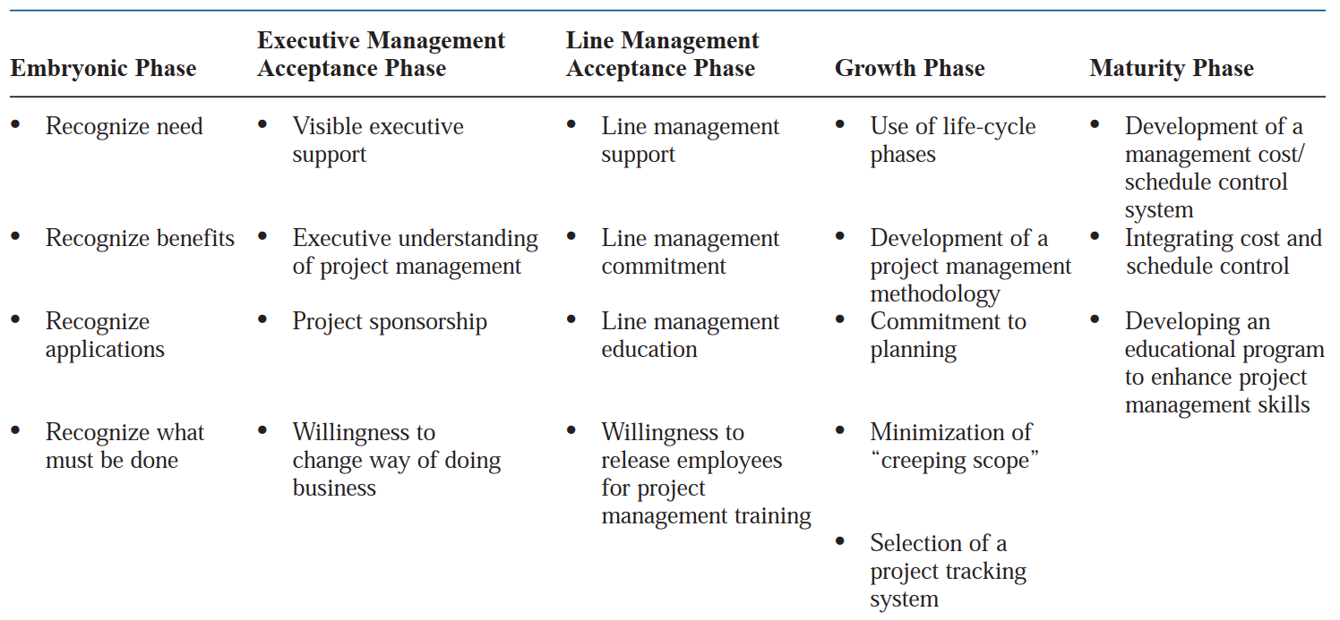
Lecture 3
Lifecycle Phase for Project Management Maturity

Slide 12
Lecture 3
The Six Driving Forces that lead recognize the need for Project
Management
Capital projects
Customer expectations
Competitiveness
Executive understanding
New project development
Efficiency and effectiveness

Slide 13
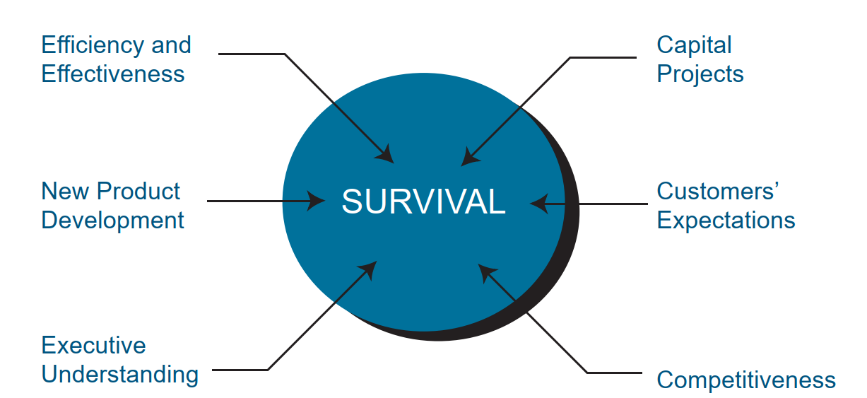
Lecture 3
The components of survival

Slide 14
Lecture 3
Agenda
The Results of Uncontrolled Obstacles
Project Management: 1985–2009
Lifecycle Phase for Project Management Maturity
The Speed of Maturity
Project Vs Product
Maturity and Excellence
Success Factors
The Many Faces of Failure
Components of Failure

Slide 15
Lecture 3
Project Vs Product
● Project scope defines the work that must be accomplished to produce a deliverable with specified features or functions. The deliverable can be a product, service, or other result.
● Product scope defines the features or functions that characterize the deliverable

Slide 16
Lecture 3
Agenda
The Results of Uncontrolled Obstacles
Project Management: 1985–2009
Lifecycle Phase for Project Management Maturity
Project Vs Product
Maturity and Excellence
Success Factors
The Many Faces of Failure
Components of Failure

Slide 17
Lecture 3
Maturity and Excellence
● Maturity in project management is the implementation of a standard methodology and accompanying processes such that there exists a high likelihood of repeated successes.
● Organizations excellent in project management are those that create the environment in which there exists a continuous stream of successfully managed projects and where success is measured by what is in the best interest of both the company and the project (i.e.,customer).

Slide 18
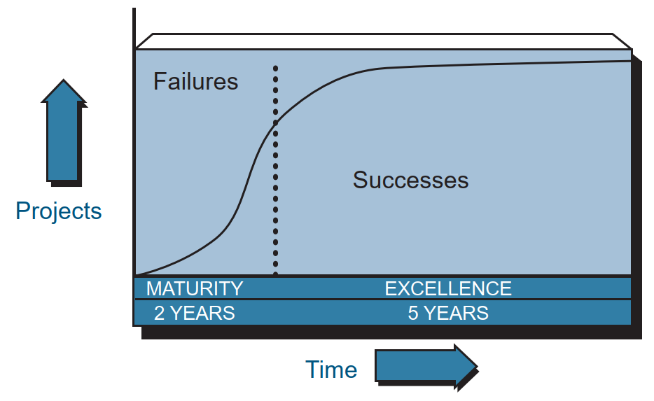
Lecture 3
The Growth of Excellence.

Slide 19
Lecture 3
Agenda
The Results of Uncontrolled Obstacles
Project Management: 1985–2009
Lifecycle Phase for Project Management Maturity
Project Vs Product
Maturity and Excellence
Success Factors
The Many Faces of Failure
Components of Failure

Slide 20
Lecture 3
Primary Success Factors
• Within time
• Within cost
• Within quality limits
• Accepted by the customer

Slide 21
Lecture 3
Secondary Success Factors
• Follow-on work from this customer
• Using the customer’s name as a reference on your literature
• Commercialization تسويقof a product
• With minimum or mutually agreed upon scope changes
• Without disturbing the main flow of work

Slide 22
Lecture 3
Secondary Success Factors
• Without changing the corporate culture
• Without violating safety requirements
• Providing efficiency and effectiveness of operations
• Satisfying OSHA/EPA requirements

Slide 23
Lecture 3
Secondary Success Factors
• Maintaining ethical conduct
• Providing a strategic alignment
• Maintaining a corporate reputation
• Maintaining regulatory agency relations

Slide 24
Lecture 3
Agenda
The Results of Uncontrolled Obstacles
Project Management: 1985–2009
Lifecycle Phase for Project Management Maturity
Project Vs Product
Maturity and Excellence
Success Factors
The Many Faces of Failure
Components of Failure

Slide 25
Lecture 3
The Many Faces of Failure
With unmeetable expectations, failure is virtually assured since we have defined failure as unmet expectations.
مع التوقعات التي لا يمكن تلبيتها ، يكون الفشل مضمونا تقريبا لأننا عرفنا الفشل على أنه توقعات غير ملباة.

Slide 26
Lecture 3
THE MANY FACES OF FAILURE
This is called a planning failure and is the difference between what was planned and what was, in fact, achieved.
وهذا ما يسمى فشل التخطيط وهو الفرق بين ما تم التخطيط له وما تم تحقيقه في الواقع.
Perceived failure is the net sum of actual failure and planning failure.
الفشل المتصور هو المجموع الصافي للفشل الفعلي وفشل التخطيط.

Slide 27
Lecture 3
THE MANY FACES OF FAILURE
● Ineffective planning
● Ineffective scheduling
● Ineffective estimating
● Ineffective cost control
● Project objectives being “moving targets”

Slide 28
Lecture 3
Agenda
The Results of Uncontrolled Obstacles
Project Management: 1985–2009
Lifecycle Phase for Project Management Maturity
Project Vs Product
Maturity and Excellence
Success Factors
The Many Faces of Failure
Components of Failure

Slide 29
Lecture 3
Components of Failure (pessimistic planning).
Project management has planned a level of accomplishment (C) lower than what is achievable given project circumstances and resources (D).
This is a classic under planning situation.
Actual accomplishment (B), however, was less than planned.

Slide 30
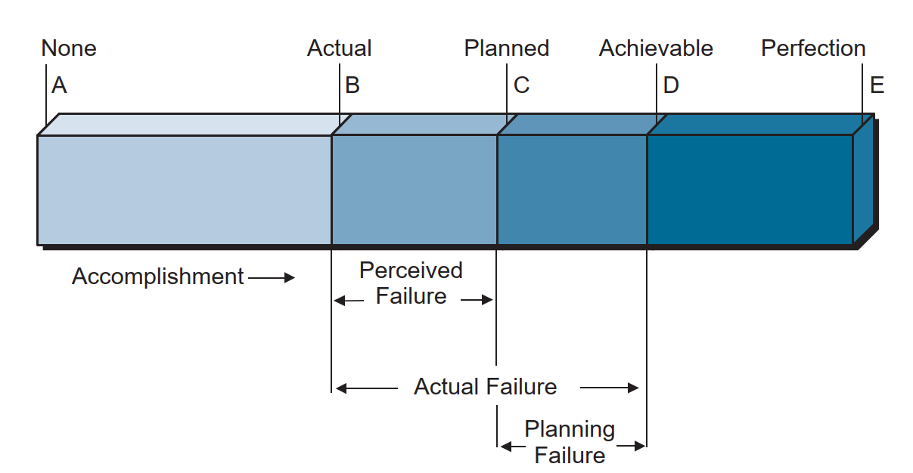
Lecture 3
Components of failure (pessimistic planning).
0
60
80
100
120

Slide 31
Lecture 3
Components of failure (optimistic planning).
Here, we have planned to accomplish more than is achievable. Planning failure is again assured even if no actual failure occurs. In both of these situations (overplanning and under planning), the actual failure is the same, but the perceived failure can vary considerably.

Slide 32
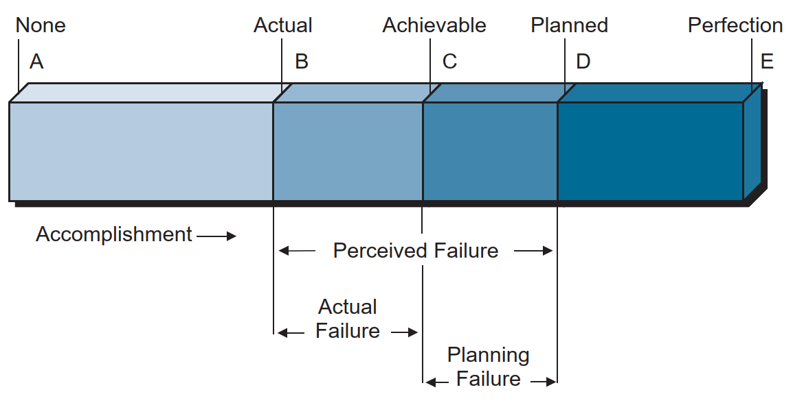
Lecture 3
Components of failure (optimistic planning).
0
60
80
100
120

Slide 33
Lecture 3
The Many Faces of Failure
Today, most project management practitioners focus on the planning failure term.
If this term can be compressed or even eliminated, then the magnitude of the actual failure, should it occur, would be diminished. A good project management methodology helps to reduce this term.
We now believe that the existence of this term is largely due to the project manager’s inability to perform effective risk management.

Slide 34
Lecture 3
Thank You

