Slide 1


Prepared by Dr. Aya Mohamed
ENT 614
Product Roadmap
Lecture 10

Slide 2

In the previous lecture
New Product Development (Part Two)
Topics covered :
What Is a Product Development Process?
Product Definition
Prototyping
Initial Design
Validation & Testing
Commercialization

Slide 3
In this lecture
Product roadmap
What Is a Product Roadmap?
Why Use a Product Roadmap?
What Are the Parts of a Product Roadmap?
How to Create a Product Roadmap?
What Are the Different Types of Product Roadmaps?
What Are the Best Practices for Great Roadmaps?
What Is the Now-Next-Later Approach in Product Roadmap?
Product Roadmap vs. Technology Roadmap

Slide 4
What is a Product roadmap?
A product roadmap is a high-level visual summary that maps out the vision of your product offering over time.
Moreover, it is a shared source of truth that outlines the vision, direction, priorities, and progress
a product roadmap is the significant efforts and necessities required to meet your overall business objectives. It is the timeline for implementing features and requirements. As product teams have shifted gears to the remote work environment, the need for roadmaps has grown exponentially to ensure that proper team alignment is achieved.

Slide 5
Product roadmap
What Are Product Roadmap Milestones?
Product managers must decode a ‘milestone’ for your product and the organization. Milestones refer to goals or dates achieved by your product team.
Some examples of a milestone are conferences, releases, and so on.
What Is Product Roadmap Voting?

Slide 6
Why to use the product roadmap?
The most considerable benefit of building a product roadmap is forcing conversations about where you will invest your time and resources and why.
Connecting your product strategy to implementation drives alignment. It keeps everyone focused on the work that helps you achieve your vision more efficiently.
The beauty of a product roadmap lies in its visual aspect. It allows you to communicate the product’s direction to internal teams and external stakeholders.
Everything you do as a product manager, impacts other groups in the organization. That is why the best product roadmaps include cross-functional teams and factors during initial creation

Slide 7
Product roadmap
Imagine that:
With a cross-functional roadmap in place, marketing will create more impactful campaigns.
Sales can set better customer expectations.
IT can improve the overall technical infrastructure.
Therefore, you should constantly update good product roadmaps. They are a way to keep everyone informed about the product’s goals and encourage collaboration between key stakeholders and various teams

Slide 8
What To Include in the Product Roadmap?
The requirements
Understanding your customer’s requests is essential to include in your product roadmap. Having a conversation with your sales and customer support teams helps you understand these needs and build on them.
Vision
A vision is something you desire the product to achieve. Setting this vision at the very beginning of the product roadmap is critical. You can always go ahead and change it as and when necessary. But putting it right in the beginning will help you answer your product questions.

Slide 9
What To Include in the Product Roadmap?
Strategy
Strategy includes how the product you are about to build will help grow the business and meet the vision. Informing this strategy to the teams and the stakeholders (internal and external) can go a long way. After this, it is a smooth transition to build a product roadmap around this strategy and follow it to reach the end goal.
Plan
Product planning is a must when building a product roadmap. This way, you know how to meet the vision. Setting timelines is helpful but leave some space for flexibility.

Slide 10
What To Include in the Product Roadmap?
Tracking the progress with markers
Timelines can be complicated to follow. Hence, dividing them using the markers helps you and your team measure the progress effectively.
Measuring using the metrics
Inform the team of what metrics you will use to measure the performances. And make sure that everyone is on the same page with the metrics

Slide 11
New Product Development Process
Step 4. Marketing Strategy Development
What are the Parts of a Product Roadmap?
Timeline
Any good roadmap needs to have some timetable.
It does not mean these dates serve as a deadline for the features. Instead, it is a way to rank the relative importance of the features.
Some standard timeline methods include:
Now, Next, Later: This release schedule is applicable when you have features not tied to a specific release.
June, July, August: This release schedule is practical when features are released every month.
Q1, Q2, Q3: This release schedule is helpful when you are planning long-term goals for your organization.
Release 1, Release 2, Release 3: This release schedule is valid when the time between releases varies

Slide 12
What are the Parts of a Product Roadmap?
Features
Features are the smaller parts of a product you are thinking of releasing in a specific period.
Features can be both high-level or detailed.
A good plan is to create a high-level feature and specify what sub-features you will need to add to make it work

Slide 13
What are the Parts of a Product Roadmap?
Goals
These are why you are implementing various features in your product.
Goals help stakeholders understand the purpose behind the decisions that you are making. That keeps the entire organization aligned.
Examples include Increasing user retention, increasing sales, or improving communication.

Slide 14
How To Create a Product Roadmap?
Define The Why
Review and Manage Ideas
Define Requirements
Once we’ve figured out the “why” and the “what,” next up is the “how.
Prioritize Your Product’s Strategic Themes And Organize Into Releases
Be Flexible
Tailor Your Roadmaps as per Your Audience

Slide 15

Remember that
You must remember that the roadmap is a strategic document.
The strategic objectives shared with your executives will be distinct from those you share with the marketing and development team.
If executive stakeholders look at your roadmap and ask, “Show us what you’re planning.” They don’t care about the nuances of your every feature. They want a broad timeline of what’s going to increase market share.
On the other hand, meeting with your developers will focus on the nuances of the features and how you want them to build them. You also discuss the expected time frame, the day-to-day tasks required, and the prioritization.

Slide 16

What Are the Different Types of
Product Roadmaps?
Delivery-focused Roadmaps
These are roadmaps with very detailed timelines and are best for engineering and User Experience (UX) teams. They help understand the specifics of a feature they are trying to implement.
They excel in communication status of development, communication goals of a feature, and understanding dependencies that various features may have.
An excellent example of a delivery-focused roadmap is the kanban roadmap.
This roadmap brings various initiatives together to find the progress and what you should complete.
This roadmap is handy for engineering, UX, and product teams as it allows them to plan without having hard deadlines

Slide 17

What Are the Different Types of
Product Roadmaps?
Customer-focused Roadmaps
Customer-focused product roadmaps help focus on the features that customers want.
This roadmap is also handy for customer-facing teams like marketing and sales. It allows them to share what is coming next for your product with users.
A popular example of a customer-focused roadmap is the releases roadmap. This roadmap shares when customers can expect certain features that they want in the product.
It is useful when planning milestones and determining the future of the product

Slide 18

What Are the Different Types of
Product Roadmaps?
Company Leadership Roadmaps
These roadmaps help give executives and stakeholders a high-level view and understanding of the product.
They show the direction of the product and how you are using time and other resources.
The summaries provided by these roadmaps are critical in keeping important stakeholders aligned with your product vision.
An example of a company leadership roadmap is the timeline roadmap. A timeline roadmap helps communicate your product strategy and the product’s plans for a specific time.

Slide 19

What Are the Best Practices for
Great Roadmaps?
You will never complete your product roadmap.
It’s constantly changing and shifting, so you need to ensure its editing and navigation consistency.
Detail is important, but only include those that are necessary.
Keep the roadmap focused on the immediate short-term, but always watch how this relates to your overall vision. Don’t lose sight of your NorthStar.
Ensure every stakeholder has access to the roadmap and regularly checks it.
Align your team and prioritize features consistently to ensure everyone is on the same page.

Slide 20
Product roadmap
What Is the Now-Next-Later Approach in Product Roadmap?
The now-next-later roadmap is an approach also referred to as the NNL product roadmap. Here, you divide the roadmap into three categories.
These are what the team is working on currently, what is on the product roadmap next, and what work you will undertake afterward.

Slide 21
Product Roadmap vs. Technology Roadmap
Who Is It Built For?
The technology roadmap is made for internal purposes. The engineers and the operations team build it to outline the plan to deliver specific features.
On the other hand, you build the product roadmap for external purposes. Using this roadmap, product managers inform the target audience that they’re creating this product to solve their problems.
It is mandatory for the PMs to use the best product management software available in the market to create roadmaps, build teams effectively and collect the customers’ needs

Slide 22
Product Roadmap vs. Technology Roadmap
Who Is It Built For?
What Is the Focus?
The focus in the technology roadmap is on how the technology will grow to accommodate the needs of the product roadmap.
The product roadmap focuses on what features to build and how to solve customer needs and benefit them.

Slide 23
Product Roadmap vs. Technology Roadmap
Who Is It Built For?
What Is the Focus?
Deliverables
In the technology roadmap, everything is specific. You set the deadlines because the other teams are dependent on the technology you build.
A technology product roadmap example: The sales and marketing team will start their work only after the feature building side is complete.
Product roadmaps are not rigid in timelines, and they are flexible in approach. But that does not mean there is no set deadline.
Product managers use these roadmaps to let the audience know that they will deliver certain features in some time.

Slide 24
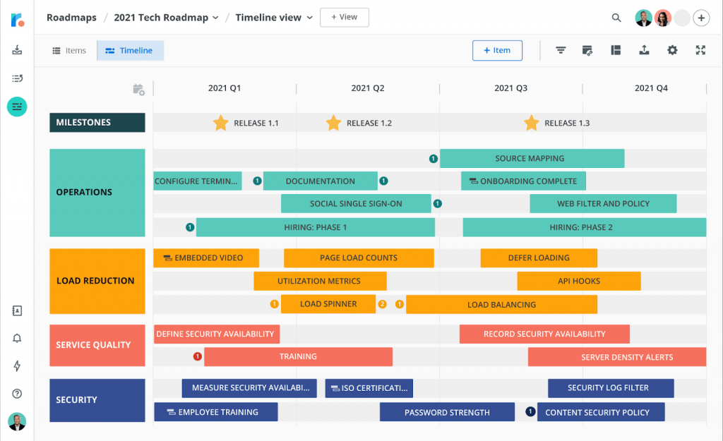
Product Roadmap example

Slide 25


Business Model Canvas
Business Model:
Describes the rationale of how an organization creates, delivers, and captures value
“There is not a single Business Model . . . . There are a lot of opportunities and options, we just have to discover them all” Tim O’Reilly
Learn 9 Elements of Business Model Canvas
Understand “painting” the Canvas
Apply Business Model Canvas to Senior Design Project
Identify “starting points” for Venture Capital Funding
Initiate “hands-on” experience - Homework

Slide 26
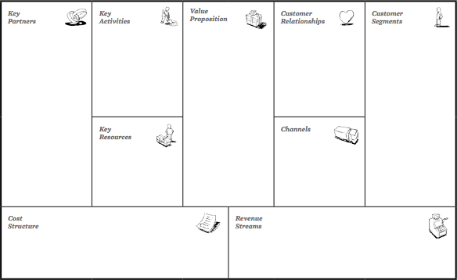
Business Model Canvas

Slide 27
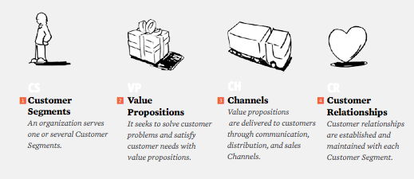
Business Model - 9 Building Blocks

Slide 28
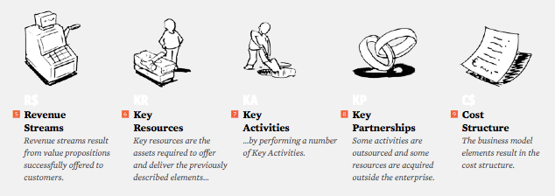
Business Model - 9 Building Blocks

Slide 29
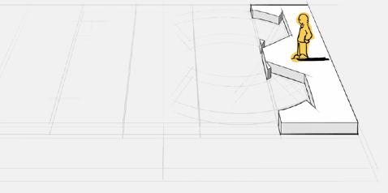
Customer Segmentation Building Block
Defines a group of people, or organizations, an enterprise aims to reach and serve
Customers are heart of Plan
Group Customers into distinct segments with common needs & behaviors
Separate segments if:
Need a distinct product
Utilize different Channels
Require special Relationships
Have different profitabilities
Pay for unique aspects

Slide 30
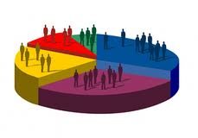
Types of Customer Segments
Mass Market
Don’t distinguish Segments
Niche Market
Specific Segments
Diversified
Serves unrelated Segments
Multi-Sided
Interdependent Segments
Segmented
Distinguish between segments with different needs

Slide 31
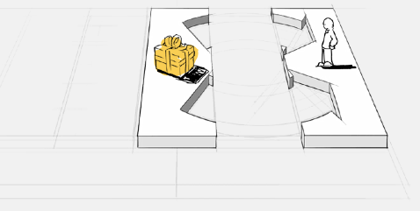
Value Proposition Building Block
Describes the bundle of products and services that create value for a specific Customer Segment
Reason why Customers buy from one company over another
Solves a Customer Problem, or satisfies a set of Needs

Slide 32



Value Proposition Elements
Design
Difficult to measure, but important in Fashion & Consumer Electronics
Performance
Common way to create value
PC sector relied on powerful machines, but has limits
Customization
Tailoring products & services to specific Customers
Enables customized products & economy of scale

Slide 33
More Value Proposition Elements
“Getting the Job Done”
Create value by helping Customer get jobs done
Brand / Status
Customers value use and display of a brand
Risk Reduction
Customers value risk reduction
Accessibility
Provide offering to Customers who lack access
Price
Low-price has implications for rest of Business Model
Cost Reduction
Important way to create value

Slide 34
Ex: Lego Factory Value Proposition & Segments
LEGO Factory expands scope of off-the-shelf kit by giving fans tools to build, showcase, and sell their own custom designed kits
Thousands of customer-designed kits complement standard blocks. LEGO Factory connects customers who create customized designs with other customers, thus becoming a customer match maker

Slide 35
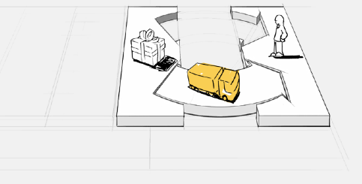
Channels Building Block
Describes how a company communicates with & reaches its Customers to deliver a Value Proposition
Customer Interface: Communication, Distribution, & Sales
Customer touch points, & important in their experience
Channels provide:
Product awareness
Allow Customers to purchase
Provide post-purchase support

Slide 36
Channel Types and Phases
Channels have 5 distinct phases. Each Channel can cover some or all of these phases
Awareness | Evaluation | Purchase | Delivery | After Sales
Raise awareness about company & offerings | Assist Customers evaluate Value Proposition | Allow Customers to purchase products & services | Deliver Value Proposition to Customers | Provide post-purchase support

Slide 37
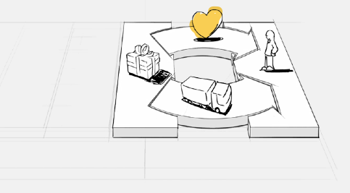
Customer Relationship Building Block
Describes the types of relationship a company establishes with specific Customer Segments
Must clarify desired relationship with each Customer Segment
Relationship Motivations:
Acquisition
Retention
Boost Sales (upselling)

Slide 38
Customer Relationship Categories
Personal Assistance
Direct access for help
Dedicated Personal Assistance
Customer specific Representative
Intimate relationship
Self-Service
No direct Customer relationship
Provides self-help
Communities
User community aides connections between members
Automated Services
Sophisticated form of self-service
Co-Creation
Beyond traditional relationship to co-create value.

Slide 39
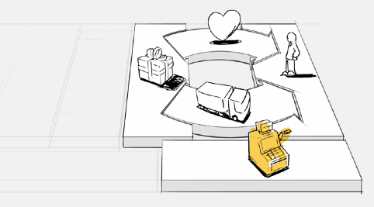
Revenue Streams Building Block
Represents cash a company generates from each Customer Segment (Revenue - Cost = Earnings)
“Arteries” of the Business
Must ask....”What is each Customer Segment willing to pay?”
Each Stream has different pricing: List, bargaining, market dependent, volume dependent, etc
Types of Revenue Streams: Transaction & Recurring

Slide 40
Ways to Generate Revenue Streams
Asset Sale
Physical product sale
Usage Fee
Service use fee
Licensing
Grant to use IP
Common in media industry
Brokerage Fees
Intermediation services performed on behalf of two or more parties
Subscription Fee
Sell continuous access to service
Lending / Renting / Leasing
Temporary grant of right to use asset for fixed time

Slide 41
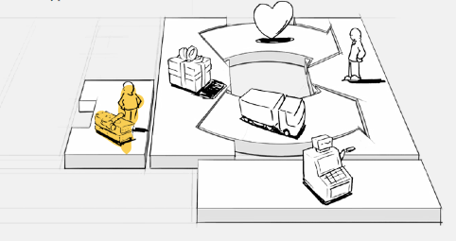
Key Resources Building Block
Describes most important assets required to make business model work
Enables production reach markets, & earn revenue
Required resources are dependent on selected Business Model
Resources may be physical, financial, intellectual, or human
Resources may be owned, leased or acquired

Slide 42
Ex: LEGO Relationships, Channels, Resources, & Revenue
Community of customers who are interested in niche content & want more than off-the-shelf kits
Web presence
Agile Mfg.
Supply Chain
User Groups
Web, Retail Stores, and User Groups
Small revenues from Customer designed kits. Valuable addition to traditional high-volume kits.

Slide 43
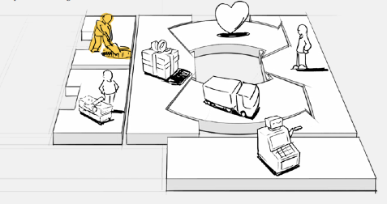
Key Activities Building Block
Describes most important things a company must do to make its Business Model work
Required to create and offer a Value Proposition, reach markets, maintain Customer Relationships, and earn Revenue

Slide 44
Key Activities Catalog
Production
Design, mfg., & deliver product in quantity or superior quality
Dominates mfg. Business Models
Problem Solving
Develop new solutions
Dominates knowledge management Business Models
Platform / Network
Networks, matchmaking, software and brands can serve as platforms

Slide 45
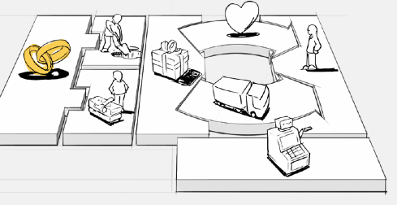
Key Partnerships Building Block
Describes network of suppliers and partners that make the Business Model work
Types of partnerships:
Strategic alliances between non-competitors
Strategic alliance between competitors
Joint Ventures to develop new business
Buyer-Supplier to assure reliable supply

Slide 46
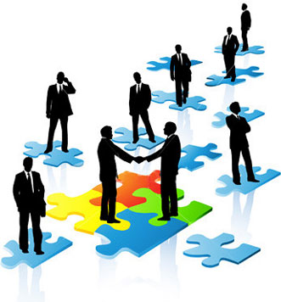
Partnership Motivations
Optimization & Economy of Scale
Most basic form of partnership
Often results in outsourcing
Reduction of Risk & Uncertainty
Competitors form strategic alliance in one area while competing in another
Acquisition of Particular Resources & Activities
Extend capabilities by relying on others to furnish part of the required resources / activities

Slide 47
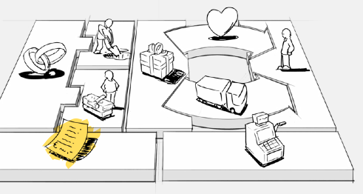
Cost Structure Building Block
Describes all costs incurred to operate a Business Model
Create & deliver value, maintain Customer relationships, & generate revenue all incur cost
Easily calculated after defining: Key Resources, Key Activities, & Key Partnerships

Slide 48
Cost vs. Value Driven Models
Cost Driven:
Low Cost Value Proposition, automation, & outsourcing
Fixed Cost
Same cost regardless of volume
Variable Cost
Cost vary in proportion with volume
Scale Economy
Cost / unit drops as volume increases
Scope Economy
Same mktg & dist. support many products
Value Driven:
Focused on value creation, not cost. Premium Value Propositions and personalized service

Slide 49
Ex: LEGO Factory Key Activities, Partners, & Cost Structure
Provide & manage platform & logistics for producing, packaging & delivery of custom-made sets
Customers who build new designs & post them on-line thereby generating content & value
Utilizes production & logistics already incurred by traditional retail block model

Slide 50
Final LEGO Factory Business Model Canvas
Provide & manage platform & logistics for producing, packaging & delivery of custom made sets.
Community of customers who are interested in niche content & want more than off-the-shelf kits.
Thousands of customer designed kits complement standard blocks. LEGO Factory connects customers who create customized designs with other customers, thus becoming a customer match maker
LEGO Factory expands scope of off-the-shelf kit by giving fans tools to build, showcase and sell their own customers designed kits.
Customers who build new designs & post them on-line thereby generating content & value.
WEb presence, Agile Mfg., Supply Chain, User Groups
Web, Retail Stores, and User Groups
Utilizes production & logistics already in place by traditional retail block model
Small revenues from Customer designed kits. Valuable addition to traditional high-volume kits.

Slide 51
According to McKinsey, AI integration enables teams to focus on higher-value strategic work instead of routine tasks
Top AI Tools in Product Development
ChatGPT → Ideation, research, product specs
GitHub Copilot → Code generation & development
Midjourney → Concept & visual design
Figma AI → UI/UX prototyping
Notion AI → Documentation & workflows
(2025+):
Data-driven, iterative, and partially autonomous
ion
AI Revolution in Product Analysis & Development
From Traditional Product Development → AI-Augmented Lifecycle
Traditional Model:
Linear stages (Discovery → Design → Development → Testing → Launch)
Human-driven decisions
Time-intensive iterations
AI-Augmented Model (2025+):
Data-driven, iterative, and partially autonomous
Continuous feedback loops
Human + AI co-creation

Slide 52
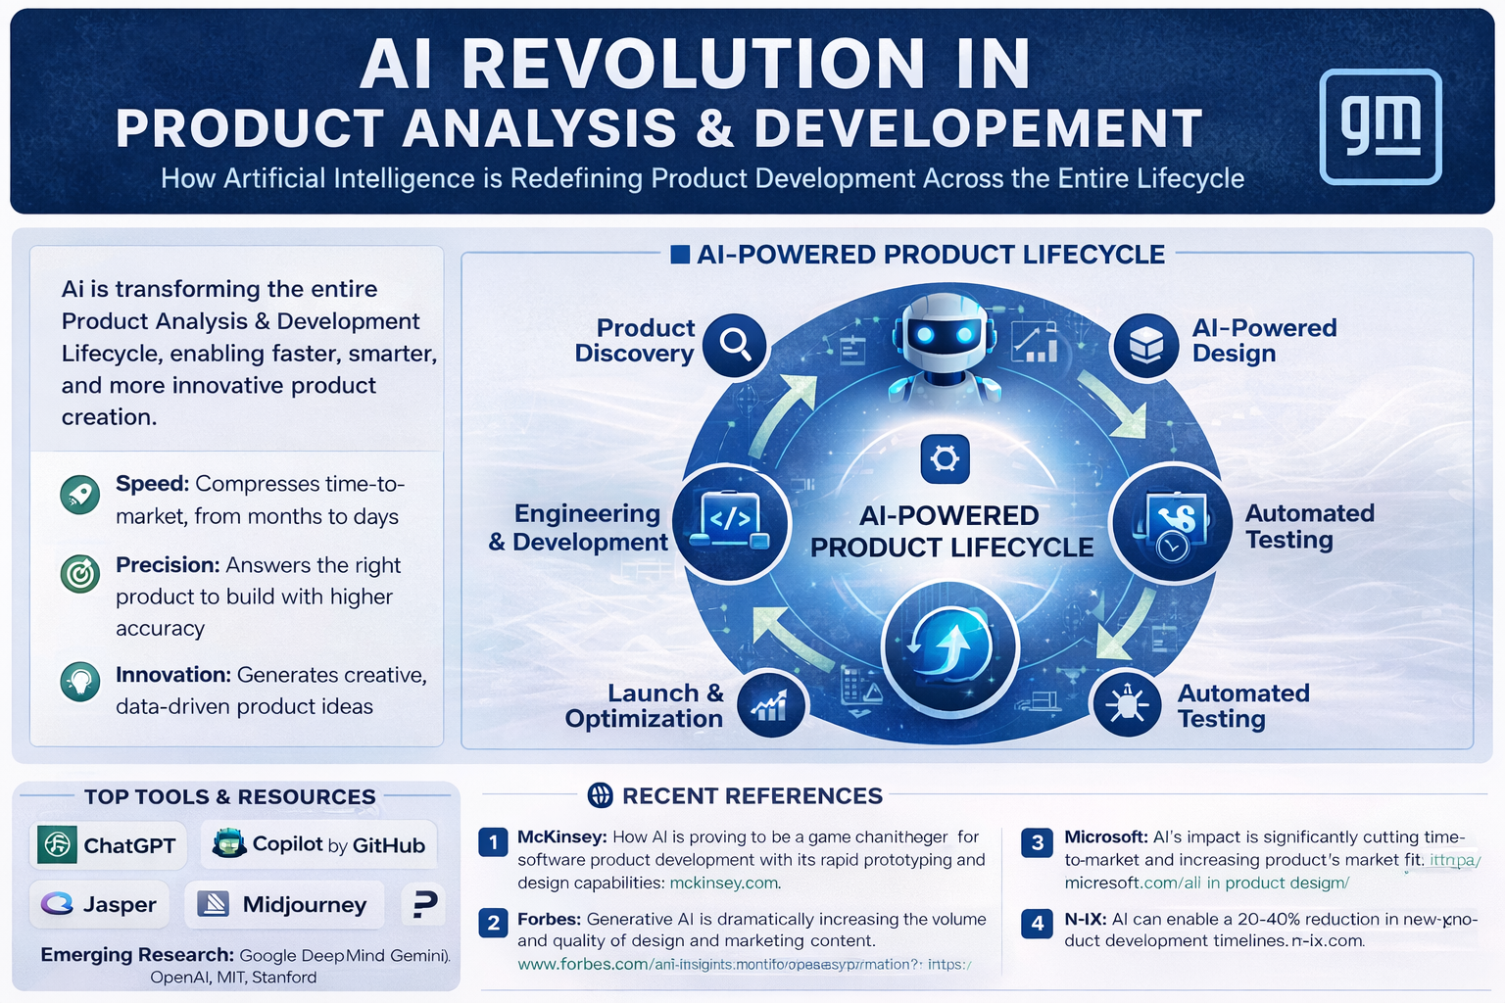
According to McKinsey, AI integration enables teams to focus on higher-value strategic work instead of routine tasks
Top AI Tools in Product Development
ChatGPT → Ideation, research, product specs
GitHub Copilot → Code generation & development
Midjourney → Concept & visual design
Figma AI → UI/UX prototyping
Notion AI → Documentation & workflows
(2025+):
Data-driven, iterative, and partially autonomous
ion
AI Revolution in Product Analysis & Development
From Traditional Product Development → AI-Augmented Lifecycle
Traditional Model:
Linear stages (Discovery → Design → Development → Testing → Launch)
Human-driven decisions
Time-intensive iterations
AI-Augmented Model (2025+):
Data-driven, iterative, and partially autonomous
Continuous feedback loops
Human + AI co-creation

Slide 53
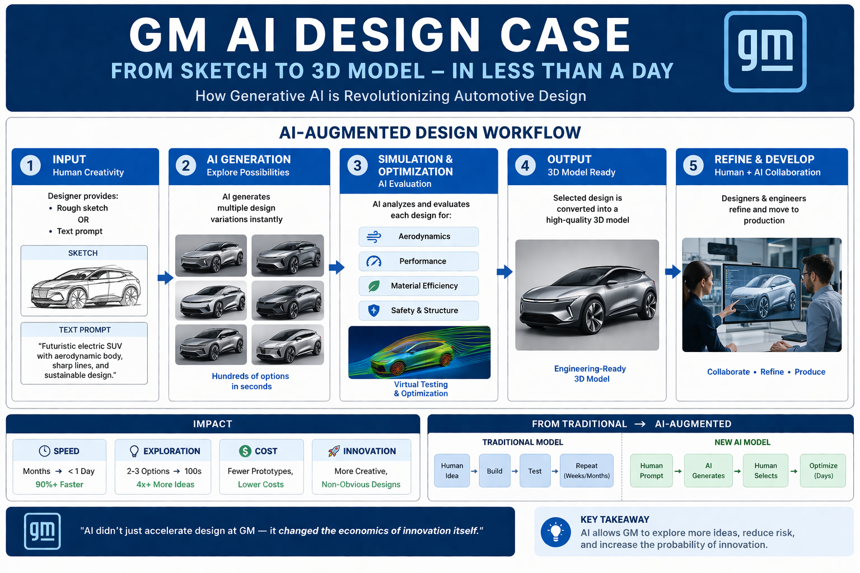


Slide 54
Conclusion
Product roadmap
A roadmap is a savior, and building a product roadmap will make the process more disciplined.
This lecture has shown what a product roadmap is and has given steps to build it.
You can use product roadmaps even if you are a product manager or a team member.
This product roadmap will save time and give you a sure shot at success.
Innovative Business Models make the most money

Slide 55
Product roadmap
What Is a Product Roadmap?
Why Use a Product Roadmap?
What Are the Parts of a Product Roadmap?
How to Create a Product Roadmap?
What Are the Different Types of Product Roadmaps?
What Are the Best Practices for Great Roadmaps?
What Is the Now-Next-Later Approach in Product Roadmap?
Product Roadmap vs. Technology Roadmap
Business model Canvas

Slide 56


Thank You

