Slide 1

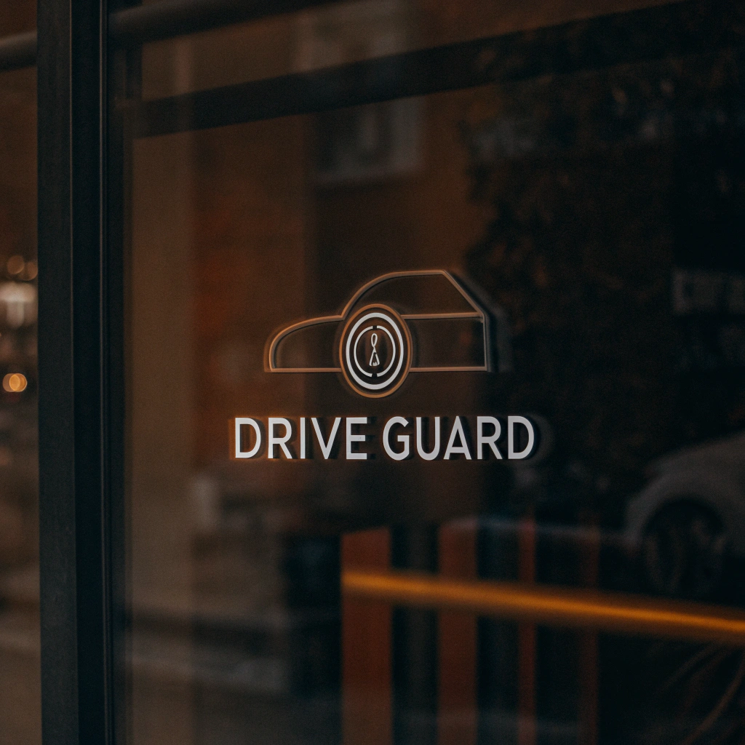

Drive Guard: AI-Powered Driver Monitoring System For Drowsiness Detection and Road Safety
Raghad AbdulAlem Hassan Muammar
Supervised by: Dr. Yasser Abdelhamid
Midocean University-AI Master’s Thesis Presentation

Slide 2
Table of contents
01
02
03
04
05
06
Abstract
Background
System Architecture
Datasets
Objectives
Related Works
07
Results& Expectations

Slide 3

01
Abstract
Driver drowsiness and syncope are major causes of road accidents.
Drive Guard is an intelligent AI-based driver monitoring system.
Uses high-definition cameras to monitor facial expressions and eye movement.
Detects signs of drowsiness and fainting, triggers acoustic alerts or emergency responses.
Aims to improve road safety and reduce accident rates caused by fatigue.

Slide 4
Background
02
•Road accidents due to driver fatigue and medical issues are a global concern.
•Existing systems are limited to eye closure detection.
•Drive Guard introduces advanced real-time analysis including fainting detection.
•Combines facial recognition, body language, and machine learning.

Slide 5
System Architecture
03
•Input: Live camera feed
•Processing: AI model detects drowsiness/fainting
•Output:
•Acoustic alarm
•Emergency SOS signal with GPS
•Real-time feedback

Slide 6
Datasets
04
Dataset Name | Link | Biomarker | Size | Limitations
Driver Drowsiness Dataset | https://www.kaggle.com/datasets/ismailnasri20/driver-drowsiness-dataset-ddd/data | Facial landmarks, eye movement, blink rate | 2.76 GB 5000+ Records | limited to certain drowsiness conditions.
Drowsy Detection Dataset | https://www.kaggle.com/datasets/yasharjebraeily/drowsy-detection-dataset | Eye, mouth features, videos. | 13.43 MB 8000+ records | focus on specific driver scenarios.
Drivers-drowsy | https://www.kaggle.com/datasets/khanh14ph/driver-drowsy | Eye movement, facial landmarks, video data. | 3.02 GB 10,000 records | focused on specific age group, video processing required.

Slide 7
Datasets
04
Dataset Name | Link | Biomarker | Size | Limitations
Drowsiness dataset | https://www.kaggle.com/datasets/dheerajperumandla/drowsiness-dataset | Eye blink, heart rate, facial landmark | 175.84 MB 5000+ Records | Imbalanced data, some missing entries.
Frame Level Driver Drowsiness Detection (FL3D) | https://www.kaggle.com/datasets/matjazmuc/frame-level-driver-drowsiness-detection-fl3d | facial features, frame level video data | 645.01 MB 5000+ Records | Requires high quality video data.
Drowsiness Detection Dataset | https://www.kaggle.com/datasets/prasadvpatil/mrl-dataset | Video, facial cues, physiological signals | 22.85 MB 5000+ Records | limited data on environmental factors.

Slide 8
Objectives
05
Real-time detection of driver drowsiness and syncope.
Distinguish between drowsiness and unconsciousness.
Trigger alarms and emergency alerts when needed.
Ensure robustness across different environments and driving conditions.

Slide 9
06
Related Works
Sigari et al. (2013)
Methodology:
Built a real-time fuzzy expert system using facial features (eye closure, head pose) from video sequences.
Strengths:
• Does not rely on explicit eye detection
• Customizable and adaptive for different drivers
Weaknesses:
• Performance may vary with facial visibility
• Requires calibration for each user
Results:
Achieved accuracy of 90.8% using video from 27 drivers.

Slide 10
06
Related Works
Saini et al. (2014)
Methodology:
Reviewed multiple detection techniques: vehicle-based, behavioral-based (e.G., Yawning, blinking), and physiological-based [EEG-ECG]
Strengths:
• Comprehensive survey of available approaches
• Highlights limitations of traditional systems
Weaknesses:
• No implementation or experimental validation
• Lacks real-time system testing
Results:
Only conceptual — no specific accuracy metrics.

Slide 11
06
Related Works
Lobo et al. (2020)
Methodology:
Analyzed real-world data from two driver monitoring systems (DMS) using oculomotor parameters monitoring (OPM) to link driver behavior with distraction/drowsiness alerts.
Strengths:
• Uses real-world large-scale driving data
• Highlights effect of trip length, speed, and rest breaks
Weaknesses:
• No direct detection model — observational study only
• Results limited by the data logging quality
Results:
Found strong statistical correlation; model accuracy ~93%.

Slide 12
06
Related Works
Dipu et al. (2021)
Methodology:
Used convolutional neural networks (CNN), specifically mobile net with single shot multibox detector (SSD) for detecting eye states (open/closed) in real-time video.
Strengths:
• High accuracy in detecting drowsiness
• Low computational requirements — works on devices like raspberry pi
Weaknesses:
• Limited to eye state detection — doesn’t capture full facial behavior
• May underperform in poor lighting
Results:
Achieved accuracy over 90%, with fast processing and low hardware cost.

Slide 13
06
Related Works
Sheykhivand et al. (2022)
Methodology:
Developed a deep CNN–ISTM hybrid model using EEG signals from simulated driving.
Strengths:
• High robustness against environmental noise
• Accurate classification of fatigue using brain activity
Weaknesses:
• Requires specialized EEG equipment
• Limited scalability to real driving environments
Results:
Achieved 99.23% accuracy in detecting fatigue states.

Slide 14
06
Related Works
Ardabili et al. (2024)
Methodology:
Used generative adversarial networks (GAN) and graph convolutional networks (GCN) to analyze EEG signals for fatigue detection.
Strengths:
• Handles complex EEG patterns
• Goes beyond binary classification (multi-class fatigue levels)
Weaknesses:
• Computationally intensive
• Relies on precise sensor data
Results:
Reported accuracy ranged between 91.7% to 99.4%.

Slide 15
Results& Expectations
98%
5>
|
07
High accuracy in detecting drowsiness and syncope ~98%.
Quick emergency alerts (<5 seconds).
Operates well in different environments (day/night).

Slide 16
Thank You

