Slide 1



Benefits Management
Prepared by Dr. Sami Alzahrani
Lecture 5
PMG 665
Program and Portfolio Management

Slide 2


Introduction
Chapter
05
Introduction
Programs are considered to be finished after all deliverables are completed and formally accepted, and all formal closure procedures are performed. However, it is becoming clear to many organizations that the quality of the program and its associated project deliverables and the quality of the execution in terms of budget and schedule compliance and customer satisfaction is not by far any guarantee of project success. While project success is measured by “product and project quality, timeliness, budget compliance, and degree of customer satisfaction. However, the success of a program is measured by “the degree to which the program satisfies the needs and benefits for which it was undertaken”.

Slide 3
Introduction
Chapter
05
Introduction
Many programs and projects lack the clear definition of what exactly is a benefit, how to measure its value and, most importantly, how to assure its sustainment within the performing organization. The purpose of this chapter is to clarify some aspects of the benefits management, establishing a relationship between the benefits life cycle and the program life cycle.

Slide 4
Benefits categories
Chapter
05
Benefits Management
In order to facilitate and support its identification and further analysis, benefits can be classified into key categories. Some benefits are easily determined and quantified, for example, increases in revenues or cost reductions. There are some benefits, though, that are more difficult to define because their contribution to business results are not direct and easily measured. Williams & Parr (2004) defined three main categories of benefits:

Slide 5
Benefits categories
Chapter
05
Benefits Categories
• Direct or Tangible Benefits
• Financial Benefits: Benefits that can be measured into currency quantities, such as increases in revenue and cost reductions.
• Non-financial Benefits: Benefits that are measurable, but not in currency or financial terms, such as client retention and lower staff turnover.
• Indirect or Intangible Benefits
• Benefits that are not easily quantified and measured, such as customer satisfaction, corporate image, and access to new markets.

Slide 6
Benefits management life cycle
Chapter
05
Benefits Management life cycle
In order to provide a predictable and coordinated manner to manage the expected program benefits and to assure compliance with governance standards, it is useful to establish a set of “processes and measures for tracking and assessing benefits throughout the program life cycle”. The delivery of benefits that in some level provide new capabilities or that improve existing ones is one of the main critical success factors of an investment, whether it is carried out as a project or as a program.

Slide 7
Benefits management life cycle
Chapter
05
Benefits Management life cycle
The identification, qualification and further quantitative analysis of the desired business benefits—aligned to the business strategy—should precede and direct the decisions to proceed with the program efforts along the program life cycle and also establish the baseline for measuring the program progress and success.

Slide 8
Benefits management life cycle
Chapter
05
Benefits Management life cycle
There are four phases for the benefits management life cycle, running in parallel with the program life cycle. It is important to emphasize that at the very beginning of the benefits management life cycle there should be a link to the company’s strategy plan in a way that it provides a clear identification of the desired business benefits and in order to allow the prioritization of the program initiative within the context of the enterprise portfolio. Determining how the proposed benefits are aligned to the business strategy and also how relevant those benefits are in the enterprise environment is an important tool to clarify the justification for investing in the program.

Slide 9
Benefits management life cycle
Chapter
05
Benefits Management life cycle
The benefits management life cycle proposed by the Project Management Institute (PMI®) flows in a manner that the level of information and maturity regarding the benefits management process increases along with the development of the program life cycle, from the very early defining and planning stages throughout the benefits realization, transition to operations and final program closure. The next sections will provide some clarification on the four stages of the benefits management life cycle.

Slide 10
Benefits Identification
Chapter
05
Benefits Identification
At the early stages of the program life cycle, most of the efforts are directed to the identification and qualification of the expected business benefits. The program business case or the program mandate should clarify the external and internal forces that drive the organization to the need for a change, which may lead to a program being created. During the identification of the expected benefits, it is important to establish a “clear definition and agreement among stakeholders on the factors contributing to these identified benefits”. Some factors are critical for appropriate benefits identification at this stage of the benefits management life cycle:

Slide 11
Benefits Identification
Chapter
05
Benefits Identification
• Understanding the business strategy
• Mapping each of the expected benefits into the strategic plan and goals
• Quantifying the benefits (estimates)
• Determining the core expected benefits
• Comparing the current state to the expected post-program scenario
• Comparing the current state to the projected scenario in case the program is not implemented, if appropriate
• Determining the premises for estimating the benefits

Slide 12
Benefits Identification
Chapter
05
Benefits Identification
The benefits identification phase should strongly take into account the organization’s strategic plan in order to establish a clear alignment with the company’s long-term objectives. Ideally, each of the expected benefits should be mapped into the company’s strategic plan. At this stage, there is probably not much data supporting the quantitative analysis for the benefits, so it is most likely that order-of-magnitude estimates are being used. Figure 6.1 below presents an example of a benefit identification and strategic mapping for a CO2 emissions reduction program.

Slide 13
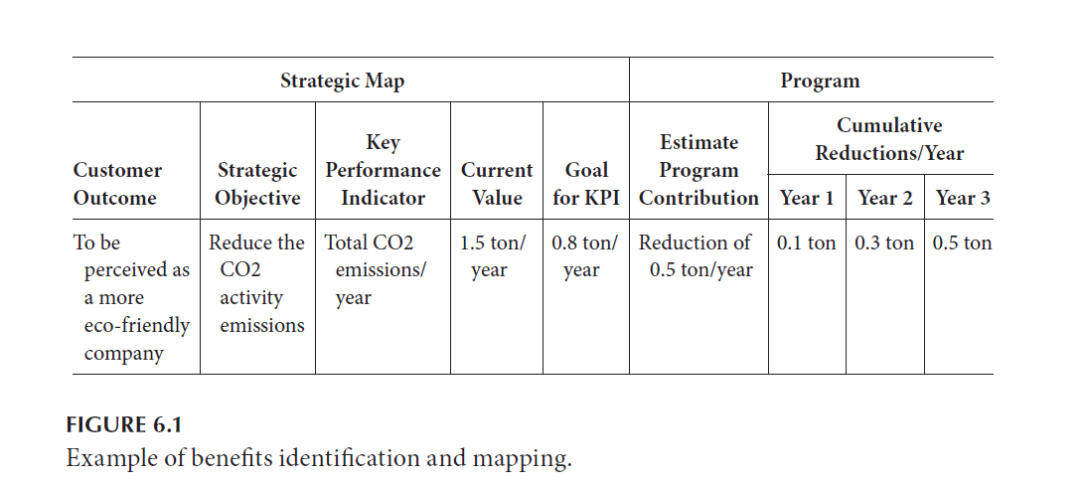
Benefits Identification
Chapter
05
Benefits Identification

Slide 14
Benefits Identification
Chapter
05
Benefits Identification
Figure 6.2 below is a graphical representation of the comparison between the program’s contribution to the corporate Key Performance Indicators (KPI) and a projection of the expected scenario if the program is not undertaken.

Slide 15
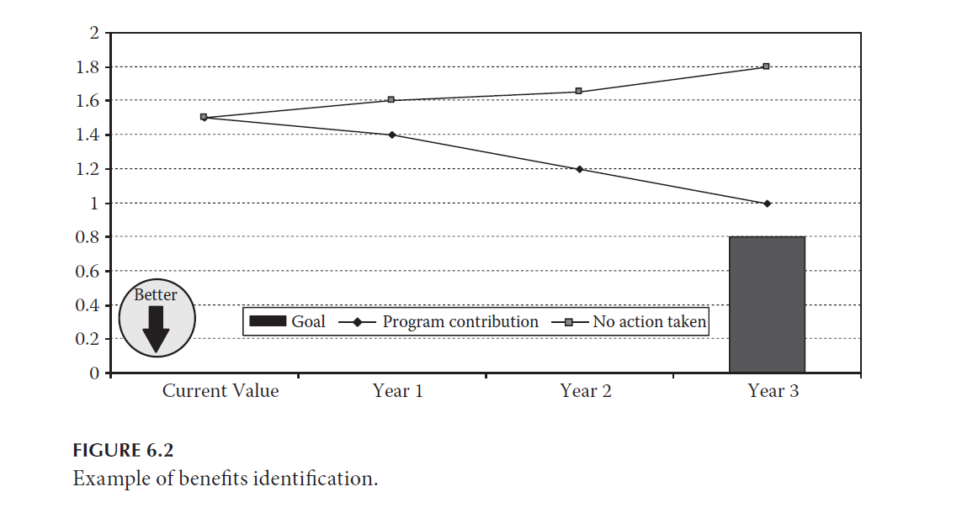
Benefits Identification
Chapter
05
Benefits Identification

Slide 16
Benefits Analysis and Planning
Chapter
05
Benefits Analysis and Planning
After the expected program benefits are identified and agreed upon, the ground work for defining the tactical means by which the benefits are to be achieved takes place. The analysis of the program’s expected benefits should result in a supportive basis for planning the benefits realization, providing information that will support further planning decisions.

Slide 17
Benefits Analysis and Planning
Chapter
05
Benefits Analysis and Planning
The benefits planning process is iterative and should be revisited at pre-defined check points, such as program phase-gate reviews; at points where there are scope changes; or when risks occur. Some relevant information to take into account during the benefits planning process includes:

Slide 18
Benefits Analysis and Planning
Chapter
05
Benefits Analysis and Planning
• The prioritization of the expected program benefits and the estimated contribution from each component in achieving the program benefits. This information will support the planning decisions regarding the priorization of the program components and the definition of the program scope
• The benefits metrics and quantitative analysis that will support the monitoring of the benefits realization
• The benefits measurement and completion criteria
• The roadmap for delivering the expected benefits

Slide 19
Benefits Analysis and Planning
Chapter
05
Benefits Analysis and Planning
There are four main activities for the benefits analysis and planning phase:
• Derive and prioritize the program’s components—to identify each component’s contribution to the expected program benefits and prioritize them accordingly
• Derive benefits metrics—in order to allow its further measurements during the program’s execution and after its transition to ongoing operations

Slide 20
Benefits Analysis and Planning
Chapter
05
Benefits Analysis and Planning
• Establish a benefits realization plan and methods to monitor it—to support program execution and the benefits realization tracking and reporting with an emphasis on resources needed, benefits interdependencies, realization premises, and constraints
• Map benefits into the program plan—to establish a correlation between the program’s expected benefits and those of its constituent components.

Slide 21
Prioritizing Program Components
Chapter
05
Prioritizing Program Components
In order to derive and prioritize the program components, it is necessary to determine the contribution from each component to the overall expected program benefits. A Component × Benefits correlation matrix is proposed below in Figure 6.3. below

Slide 22
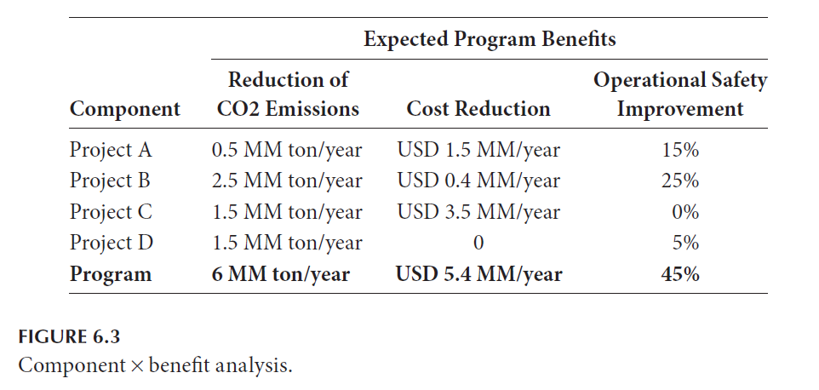
Prioritizing Program Components
Chapter
05
Prioritizing Program Components

Slide 23
Performing Benefits and Risk Analysis
Chapter
05
Performing Benefits & Risk Analysis
Another important factor to be taken into consideration during the benefits analysis and planning phase is the benefits versus risk analysis, which is performed in order to assess the risks affecting the delivery of the program’s benefits. One approach that is often overlooked is to establish a correlation between the program risks and the program benefits, in addition to mapping the risks to the program components. A correlation matrix that allows mapping and assessing the impact of identified program risks into each expected benefit is proposed in Figure 6.9 as follows:

Slide 24
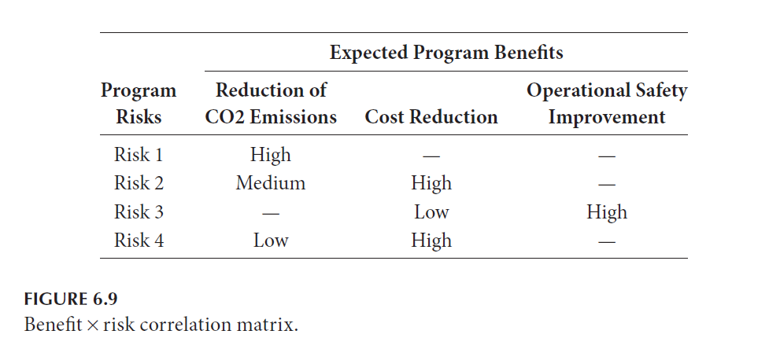
Performing Benefits and Risk Analysis
Chapter
05
Performing Benefits & Risk Analysis

Slide 25
Performing Benefits/Cost Analysis
Chapter
05
Performing Benefits & Cost Analysis
Whether a benefit is measurable in monetary terms or not, an assessment of the benefits versus the cost of each of the program’s components is useful in order to help the program manager prioritize the components in the program and also in order to establish a parameter for performance measurements in the later program life cycle phases.
The most easy and traditional way to measure the benefit versus cost ratio is to simply divide the component cost (or the overall program cost) by the expected benefit, as illustrated below in Figure 6.10.

Slide 26
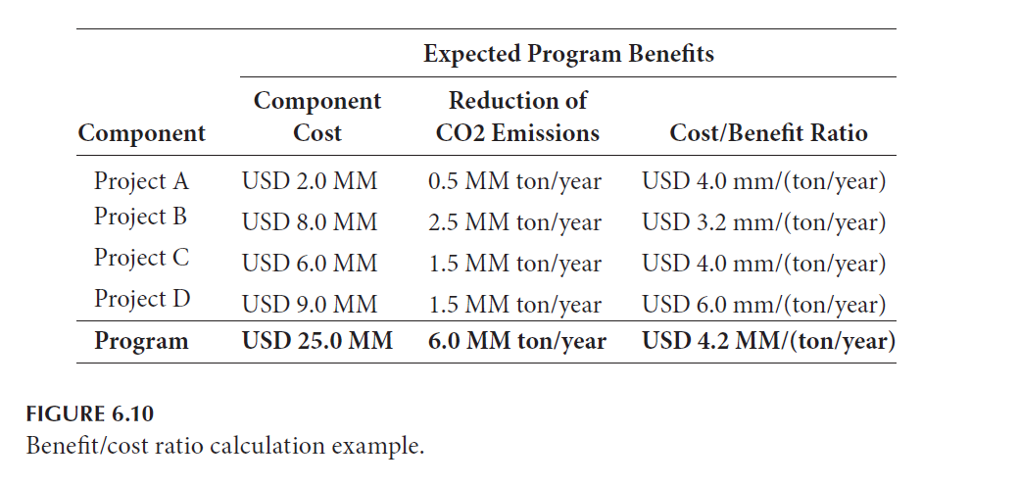
Performing Benefits/Cost Analysis
Chapter
05
Performing Benefits & Cost Analysis

Slide 27
Benefits Realization Monitoring Plan
Chapter
05
Benefits Realization Monitoring Plan
In order to establish a framework for agreement on the benefits realization measurement criteria, the program manager should establish a plan for benefits measurement after the program implementation. The plan should refer to any pre-existing KPIs for future reference, if one already exists, and clearly determine who is responsible for the benefits measurements and communication.

Slide 28
Benefits Realization Monitoring Plan
Chapter
05
Benefits Realization Monitoring Plan
Some benefits might be difficult and expensive to measure, so any resources needed to conduct the benefits measurements should be determined, such as human resources, new equipment, or facilities. The plan should be formally registered as a deliverable at the program level and communicated and agreed upon by the main stakeholders.
For each benefit, the plan should determine the criteria and requirements for measuring the benefits realized and should contain information such as the following:

Slide 29
Benefits Realization Monitoring Plan
Chapter
05
Benefits Realization Monitoring Plan
• Benefit identification
• Measurement units: In order to allow a clear understanding of the measurements and to allow the further comparisons to the current KPI values, such as monetary units, meters, tons, etc.
• Date (or event) to start the benefit measurements: It is important to determine when the measurements are going to start, whether at a pre-determined date, or after a specific program event, such as a new equipment ramp-up period or a regulatory demand.

Slide 30
Benefits Realization Monitoring Plan
Chapter
05
Benefits Realization Monitoring Plan
• Frequency of measurements (monthly, quarterly, etc.)
• Measurement criteria and methods
• Resources needed for measurements: Any resources needed in order to perform the measurements should be estimated and planned.

Slide 31
Benefits Realization Monitoring Plan
Chapter
05
Benefits Realization Monitoring Plan
• KPI previous value (if one exists): Any KPI affected by the program implementation and related to the benefit being measured should be tracked before the program implementation for future comparisons.
• Expected KPI value: The new value expected for the KPI after the delivery of the benefit.
• Communication methods: How the benefits measurements are going to be communicated to the stakeholders—a monthly report, a meeting, etc.
• Measurement responsibility

Slide 32
Monitoring Components
Chapter
05
Monitoring Components
Monitoring the execution of the program components provides program managers with the necessary information to forecast the future realization of the expected program benefits. Special attention should be devoted to program changes that could affect the benefits realization or viability. Also, deviations on components schedules or budgets might cause delays in realizing benefits, which might even cause the program to be canceled.

Slide 33
Maintaining a Benefits Register
Chapter
05
Maintaining Benefits Register
Data collection regarding benefits realization should be performed periodically, in order to provide the program sponsor and stakeholders with the actual benefits realized versus the planned benefits. For those programs whose benefits are delivered before the formal program work is completed, the measurements for benefit realization should be performed in conjunction with the program periodic health checks and program performance measurements.

Slide 34
Benefits Reporting
Chapter
05
Benefits Reporting
Program benefits may be realized before the program work is completed. In order to keep the sponsor and stakeholders’ expectations about the program benefits within a realistic range, program managers should periodically assess and report the actual realized program benefits. Among other factors, benefits reporting should take into account the following:

Slide 35
Benefits Reporting
Chapter
05
Benefits Reporting
• Program Business Case
• Benefits Realization Plan
• Benefits Roadmap
• Actual Benefits to Date
• Program Stakeholder Analysis
• Program Communications Management Plan
• Communications Strategy
• Program Communications Log
• Program Master Schedule

Slide 36
Benefits Transition
Chapter
05
Benefits Transition
The final step in the life cycle is to formally transition the benefits to the program’s customers, end users, or a product or support group within the organization. At this time, the program has closed, and its benefits have been realized successfully according to its stakeholders, the governance board, and the program sponsor.

Slide 37
Benefits Transition
Chapter
05
Benefits Transition
The program’s transition plan has been executed, and stakeholders who now are responsible for sustaining the benefits have been active participants in the transition process.

Slide 38
Chapter
05
Reference
Reference
Program Management: A Life Cycle Approach
by Ginger Levin, PMP, PgMP
Chapter 6

