Slide 1

RHSA (Admin 1) Red Hat Enterprise Linux 8 Essentials
Prepared by Eng. Taghreed Elsayed
Lecture 9
Using Virtualized system

Slide 2

Chapter
15
Using Virtualized system
Getting started with virtualization
To start using virtualization in RHEL 8, follow the steps below. The default method for this is using the command-line interface (CLI).
Enable the virtualization module and install the virtualization packages - Enabling virtualization.
Create a virtual machine (VM):
For CLI, Creating virtual machines using the command-line interface.
For GUI, Creating virtual machines and installing guest operating systems using the web console.

Slide 3
Chapter
15
Using Virtualized system
Start the VM:
For CLI, Starting a virtual machine using the command-line interface.
For GUI, Starting virtual machines using the web console.
Connect to the VM:
For CLI, Connecting to a virtual machine using SSH or Opening a virtual machine graphical console using Virt Viewer.

Slide 4
Chapter
15
Using Virtualized system
1. Creating virtual machines using the command-line interface
To create a virtual machine (VM) on your RHEL 8 host using the virt-install utility, follow the instructions below.
Prerequisites
Virtualization is enabled on your host system.
You have sufficient a amount of system resources to allocate to your VMs, such as disk space, RAM, or CPUs. The recommended values may vary significantly depending on the intended tasks and workload of the VMs.
An operating system (OS) installation source is available locally or on a network. This can be one of the following:
  An ISO image of an installation medium
  A disk image of an existing VM installation

Slide 5
Chapter
15
Using Virtualized system
Procedure
To create a VM and start its OS installation, use the virt-install command, along with the following mandatory arguments:
The name of the new machine (--name)
The amount of allocated memory (--memory)
The number of allocated virtual CPUs (--vcpus)
The type and size of the allocated storage (--disk)
The type and location of the OS installation source (--cdrom or --location)
Based on the chosen installation method, the necessary options and values can vary. See below for examples:

Slide 6

Chapter
15
Using Virtualized system
The following creates a VM named demo-guest1 that installs the Windows 10 OS from an ISO image locally stored in the /home/username/Downloads/Win10install.iso file.
This VM is also allocated with 2048 MiB of RAM and 2 vCPUs, and an 80 GiB qcow2 virtual disk is automatically configured for the VM.

Slide 7

Chapter
15
Using Virtualized system
The following creates a VM named demo-guest2 that uses the /home/username/Downloads/rhel8.iso image to run a RHEL 8 OS from a live CD.
No disk space is assigned to this VM, so changes made during the session will not be preserved. In addition, the VM is allocated with 4096 MiB of RAM and 4 vCPUs.

Slide 8

Chapter
15
Using Virtualized system
The following creates a RHEL 8 VM named demo-guest3 that connects to an existing disk image, /home/username/backup/disk.qcow2. This is similar to physically moving a hard drive between machines,
so the OS and data available to demo-guest3 are determined by how the image was handled previously. In addition, this VM is allocated with 2048 MiB of RAM and 2 vCPUs.

Slide 9

Chapter
15
Using Virtualized system
Troubleshooting
If virt-install fails with a cannot find default network error:
  Ensure that the libvirt-daemon-config-network package is installed:

Slide 10

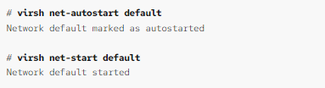
Chapter
15
Using Virtualized system
b.Verify that the libvirt default network is active and configured to start automatically:
c.If it is not, activate the default network and set it to auto-start:

Slide 11
Chapter
15
Using Virtualized system
1. Creating virtual machines
To create a virtual machine (VM) on the host machine to which the web console is connected, follow the instructions below.
Prerequisites
Virtualization is enabled on your host system.
The web console VM plug-in is installed on your system.
You have sufficient a amount of system resources to allocate to your VMs, such as disk space, RAM, or CPUs. The recommended values may vary significantly depending on the intended tasks and workload of the VMs.

Slide 12
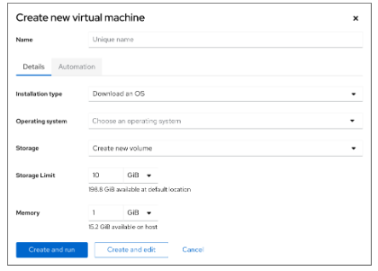
Chapter
15
Using Virtualized system
Procedure
In the Virtual Machines interface of the web console, click Create VM.
The Create new virtual machine dialog appears.

Slide 13
Chapter
15
Using Virtualized system
2.Enter the basic configuration of the VM you want to create.
Name - The name of the VM.
Installation type - The installation can use a local installation medium, a URL, a PXE network boot, a cloud base image, or download an OS from a limited set of operating systems.
Operating system - The VM’s operating system. Note that Red Hat provides support only for a limited set of guest operating systems.
Storage - The type of storage with which to configure the VM.
Storage Limit - The amount of storage space with which to configure the VM.
Memory - The amount of memory with which to configure the VM.

Slide 14
Chapter
15
Using Virtualized system
3.Create the VM:
If you want the VM to automatically install the operating system, click Create and run.
If you want to edit the VM before the operating system is installed, click Create and edit.

Slide 15
Chapter
15
Using Virtualized system
Creating virtual machines by importing disk images
To create a virtual machine (VM) by importing a disk image of an existing VM installation, follow the instructions below.
Prerequisites
The web console VM plug-in is installed on your system.
You have sufficient a amount of system resources to allocate to your VMs, such as disk space, RAM, or CPUs. The recommended values can vary significantly depending on the intended tasks and workload of the VMs.
Make sure you have a disk image of an existing VM installation

Slide 16
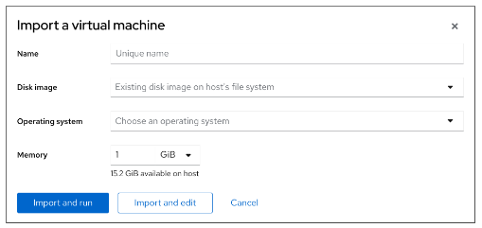
Chapter
15
Using Virtualized system
Procedure
In the Virtual Machines interface of the web console, click Import VM.
The Import a virtual machine dialog appears.

Slide 17
Chapter
15
Using Virtualized system
Enter the basic configuration of the VM you want to create.
Name - The name of the VM.
Disk image - The path to the existing disk image of a VM on the host system.
Operating system - The VM’s operating system. Note that Red Hat provides support only for a limited set of guest operating systems.
Memory - The amount of memory with which to configure the VM.
Import the VM:
If you want the VM to automatically install the operating system, click Import and run.
If you want to edit the VM before the operating system is installed, click Import and edit.

Slide 18
Chapter
15
Using Virtualized system
3. Installing guest operating systems using the web console
The first time a virtual machine (VM) loads, you must install an operating system on the VM.
Prerequisites
The web console VM plug-in is installed on your system.
A VM on which to install an operating system must be available.

Slide 19
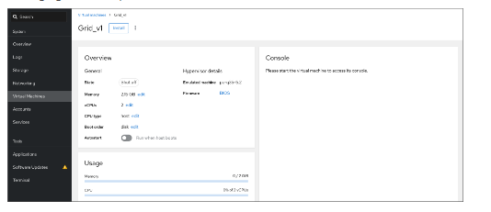
Chapter
15
Using Virtualized system
Procedure
In the Virtual Machines interface, click the VM on which you want to install a guest OS.
A new page opens with basic information about the selected VM and controls for managing various aspects of the VM.

Slide 20
Chapter
15
Using Virtualized system
Optional: Change the firmware.
Click the firmware.
In the Change Firmware window, select the desired firmware.
Click save
The installation routine of the operating system runs in the VM console.

Slide 21
Chapter
15
Using Virtualized system

Slide 22
Chapter
15
Using Virtualized system

Slide 23
Chapter
15
Using Virtualized system

Slide 24
Chapter
15
Using Virtualized system

Slide 25
Chapter
15
Using Virtualized system

Slide 26
Chapter
15
Using Virtualized system

