Slide 1



Network
Programming
in Python
Prepared by Dr. Hamada I. AbdulWakel
Lecture 2

Slide 2



Basics of Network
Programming – Part I
Lecture 2
Prepared by
Dr. Hamada I. AbdulWakel
www.midocean.ae

Slide 3
Lecture
RECAP: LECTURE 1
02
Network definition, importance, components, and types.
Network programming levels.
The virtual environments.
www.midocean.ae

Slide 4
Lecture
LECTURE MAIN POINTS
02
Service Oriented Architecture (SOA).
Application Program Interface (API).
Wire Protocol Formats.
API modules in Python.
www.midocean.ae

Slide 5
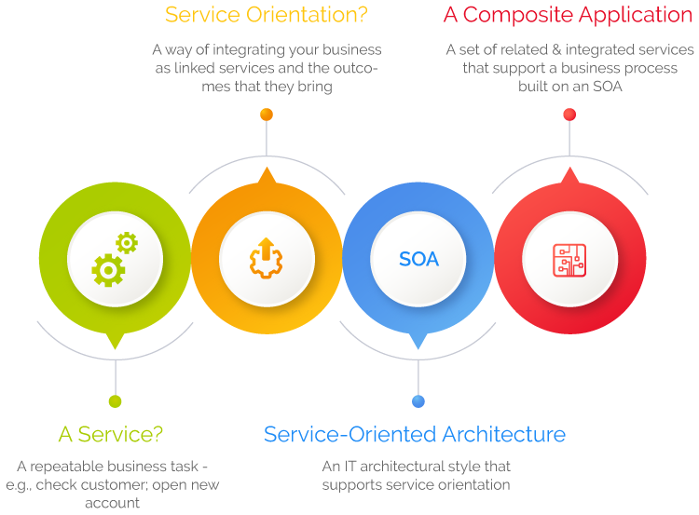
SERVICE-ORIENTED ARCHITECTURE (SOA)
Lecture
02
www.midocean.ae

Slide 6
SERVICE-ORIENTED ARCHITECTURE (SOA)
Lecture
02
Cont'd
SOA is a method of software development that uses software components called services to create business applications.
Each service provides a business capability, and services can also communicate with each other across platforms and languages.
Developers use SOA to reuse services in different systems or combine several independent services to perform complex tasks.
www.midocean.ae

Slide 7
Lecture
02
COMPONENTS OF SOA
Services: the basic building blocks of SOA.
  They can be private — available only to internal users of an organization
  Or public — accessible over the internet to all.
Heterogeneous application which developed using different platform cannot communicate with each other because they did not know the language of each other.
Web services are language independent and platform independent. Web services are mainly used for cross communication between heterogeneous technologies.
www.midocean.ae

Slide 8
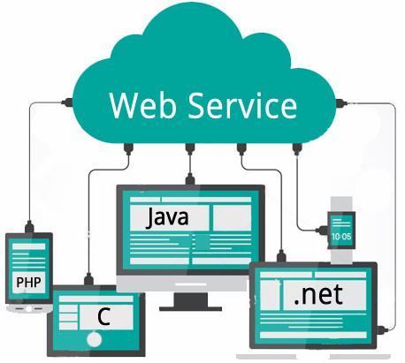
Lecture
02
COMPONENTS OF SOA
Cont'd
www.midocean.ae

Slide 9
Lecture
02
COMPONENTS OF SOA
Cont'd
Service provider: creates, maintains, and provides one or more services that others can use.
Service consumer: requests the service provider to run a specific service. It can be an entire system, application, or other service.
The service contract: defines the nature of the service and its associated terms and conditions, such as the prerequisites for using the service, service cost, and quality of service provided.
www.midocean.ae

Slide 10
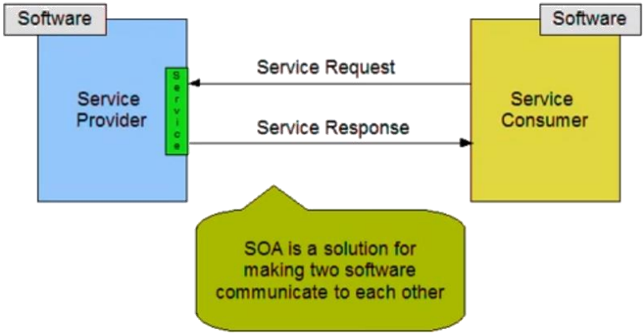
Lecture
02
COMPONENTS OF SOA
Cont'd
www.midocean.ae

Slide 11
Lecture
02
COMPONENTS OF SOA
Cont'd
Service's prerequisites are the rules that determine how the data transmission over a network.
These rules are called communication protocols.
  Simple Object Access Protocol (SOAP).
  RESTful HTTP.
  Java Message Service (JMS).
www.midocean.ae

Slide 12
APPLICATION PROGRAMMING
INTERFACE (API)
Lecture
02
API could be a software system interface that enables two applications to act with one another with no user intervention.
  APIs offer a secure and standardized means for applications to communicate.
It defines:
  URL style to make requests.
  The required data for the service.
  The data formats that will be received.
All web services are APIs, but not all APIs are web services (e.g., when Photoshop needs to save as the image).
www.midocean.ae

Slide 13
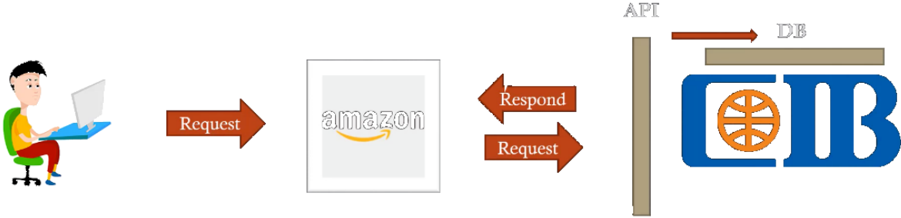
Lecture
02
SOA SERVICE EXAMPLE
Retrieving a credit card statement online.
Reservation in a hotel.
Car renting.
www.midocean.ae

Slide 14
Lecture
02
WIRE PROTOCOL
A protocol is a set of rules that all parties follow, so that we can predict each other's behavior.
Whenever you transmit information over a network, that information is transformed from a binary representation into another representation that was designed for network use.
The form that it takes for network transmission is called its wire representation.
www.midocean.ae

Slide 15
Lecture
02
WIRE PROTOCOL
Cont'd
We need to unify the format between programs so that program can expect this format and thus extract the information from it easily.
A wire protocol refers to a way of getting data from point to point.
There are two common wire representations:
  eXtensible Markup Language (XML) format.
  JavaScript Object Notation (JSON) format.
www.midocean.ae

Slide 16
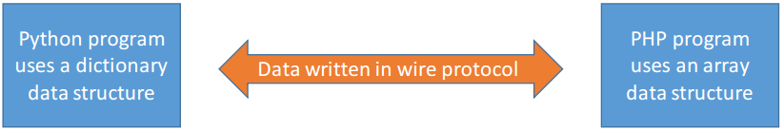
Lecture
02
WIRE PROTOCOL
Cont'd
www.midocean.ae

Slide 17
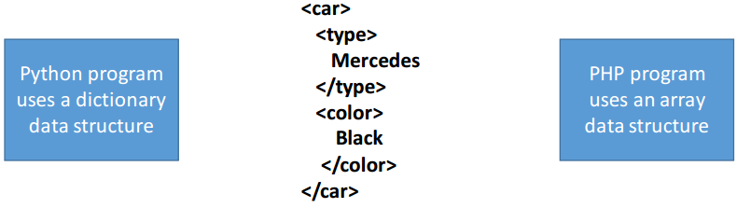
Lecture
02
XML WIRE PROTOCOL
www.midocean.ae

Slide 18
Lecture
02
XML WIRE PROTOCOL
Cont'd
XML is a markup language much like HTML and was designed to store and transport data.
With XML, the author must define both the tags and the document structure, where XML tags are not predefined like HTML tags.
XML provides a software- and hardware-independent way of storing, transporting, and sharing data.
www.midocean.ae

Slide 19
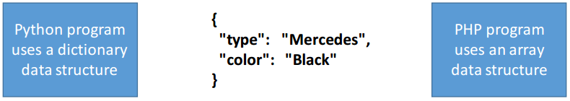
Lecture
02
JSON WIRE PROTOCOL
www.midocean.ae

Slide 20
Lecture
02
JSON WIRE PROTOCOL
Cont'd
JSON is a lightweight data-interchange format.
It is commonly used for transmitting data in web applications
Each property has two parts: a name and a value, separated by a colon.
XML is hard to read and leaves much to be desired in terms of coding. JSON was created to resolve these issues.
www.midocean.ae

Slide 21
Lecture
02
JSON IN PYTHON
Python has a built-in package/module called json, which can be used to work with JSON data.
The json.loads() method is used to parse a JSON string and the result is a Python dictionary.
The json.dumps() method is used to convert a Python dictionary to a JSON string.
www.midocean.ae

Slide 22
Lecture
02
JSON IN PYTHON
Cont'd
Code:
import json
data = '''
{ "Name": "Midocean university",
"Location": "United Arab Emirates",
"Contacts":
{ "email": "contact@midocean.ae",
"tel": "+966-505281134"}
}'''
www.midocean.ae

Slide 23
Lecture
02
JSON IN PYTHON
Cont'd
Code:
import json
…..
universityinfo = json.loads(data)
print("Name:", universityinfo["name"])
print("Email:", universityinfo["Contact"]["email"])
universityinfo = json.dumps(data)
print(universityinfo)
www.midocean.ae

Slide 24
WEB PAGE ACCESSING AND READING
Lecture
02
Web pages are full of original, high-quality content that could be used for different reasons.
URL parts:
  Protocol part, such as https.
  Host name part, such as en.wikipedia.org.
  Port number part, getting from the protocol.
  Path part, such as wiki/URL.
  Querystring, such as key and life.
  Fragment, such as #History.
www.midocean.ae

Slide 25
Lecture
02
URLLIB MODULE
Urllib is a Python package that allows you to access and interact with web pages using their URL’s (Uniform Resource Locator).
This facility of urllib provides the flexibility to run GET, POST, and PUT methods and mock the JSON data in the Python code.
Urllib module is not a built-in module, you need to install it manually.
pip install urllib3
www.midocean.ae

Slide 26
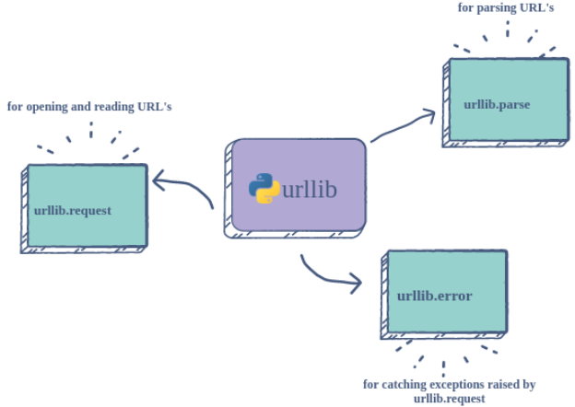
Lecture
02
URLLIB MODULE COMPONENTS
www.midocean.ae

Slide 27
Lecture
02
URLLIB MODULE COMPONENTS
Cont'd
Urllib.request
  Used for opening and reading web pages. The main method if urlopen() to open the specified URL.
Urllib.parse
  Used for parsing the parts of the URLs.
Urllib.error
  Used for catching exceptions encountered when opening URLs and other errors.
www.midocean.ae

Slide 28
Lecture
02
URLLIB DESCRIPTION
Code:
import urllib
from urllib import request
help(urllib)
print(dir(request))
resp = request.urlopen('https://www.wikipedia.org')
print(type(resp))
print(dir(resp))
www.midocean.ae

Slide 29
Lecture
02
URLLIB DESCRIPTION
Cont'd
Code:
…....
print(resp.code)
print(resp.length)
data = resp.read()
print(type(data)) #page as bytes
html = data.decode()
print(type(html)) #page as string
print(html) #page as html code
www.midocean.ae

Slide 30
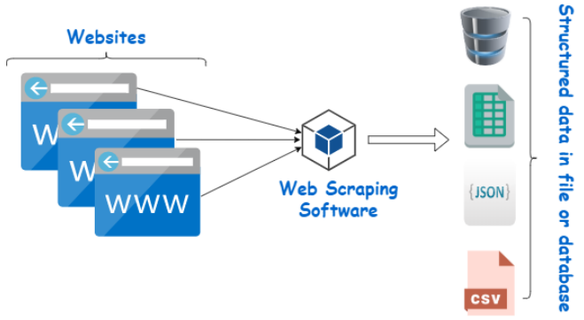
Lecture
02
WEB SCRAPING
www.midocean.ae

Slide 31
Lecture
02
WEB SCRAPING
Cont'd
A web scraping software will automatically crawl and extract data from multiple pages of websites based on your requirement.
  Usually, the web pages are described as unstructured data.
Web Scraping is an automatic way to retrieve unstructured data from a website and store them in a structured format.
  By automating this process, these software can extract huge amounts of data in a very short time.
www.midocean.ae

Slide 32
Lecture
02
WEB SCRAPING
Cont'd
A web scraper works as following:
  Step 1: Making an HTTP request to a server.
  Step 2: Extracting and parsing (or breaking down) the website’s code.
  Step 3: Saving the relevant data locally
www.midocean.ae

Slide 33
Lecture
02
WEB SCRAPING EXAMPLE
Code:
from urllib.request import urlopen
page = urlopen('http://data.pr4e.org/romeo.txt')
word_count = dict()
for line in page:
words = line.decode().split()
for word in words:
word_count[word] = word_count.get(word, 0) + 1
print(word_count)
www.midocean.ae

Slide 34
Lecture
02
REQUESTS MODULE
The de facto standard for making HTTP requests in Python.
One of the most common HTTP methods is GET. The GET method indicates that you’re trying to get or retrieve data from a specified resource.
It abstracts the complexities (in code writing and HTTP requests handling) of making requests behind a beautiful, simple API.
To install the requests module.
pip install requests
www.midocean.ae

Slide 35
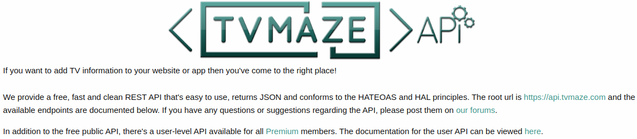
Lecture
02
COMPLETE API EXAMPLE
Using TVmaze.com API.
www.midocean.ae

Slide 36
Lecture
02
COMPLETE API EXAMPLE
Cont'd
Code:
import requests, json, pprint
url = "https://api.tvmaze.com/singlesearch/shows"
params = {"q":"the flash"}
response = requests.get(url, params)
if response.status_code == 200:
print(response.text) #without json style
data = json.loads(response.text)
print(data) #json, but without good formating
pprint.pprint(data)
www.midocean.ae

Slide 37
Lecture
02
COMPLETE API EXAMPLE
Cont'd
Code:
if response.status_code == 200:
data = json.loads(response.text)
name = data['name']
premiered = data['premiered']
summary = data['summary']
print(f"{name} premiered on {premiered}.")
print(summary)
else:
print(f"Error: {response.status_code}")
www.midocean.ae

Slide 38
Lecture
02
QUESTIONS FOR ONLINE DISCUSSION
Write a program to get the current weather for your location using https://openweathermap.org/ website.
www.midocean.ae

Slide 39


Thank You

