Slide 1











PROJECT FEASIBILITY STUDY
PMG201
Prepared by
Dr. Nagwan Alqershi
Lecture No. 2

Slide 2

Demand Estimation.
Benefit Estimation.
Cost Estimation.
Economic Feasibility Evaluation.
Financial Feasibility Analysis.

Slide 3

Demand Estimation
Consumer Interviews.
Market Experiments.
Regression Analysis.

Slide 4

Demand Estimation:
Estimating the future demand for products, either existing or new is a significant aspect of demand analysis. A manager needs to have information about the likely future demand of its product to enable the firm to produce the required quantities of a product at the right time and arrange well in advance for the various inputs (like labor, raw material, .) as well as to pursue optimal pricing strategies. machines etc

Slide 5

Demand estimation and forecasting means predicting future demand for the product under given conditions and helping the manager in making decisions with regard to production, sales, investment, expansion, employment of manpower etc., both in the short run as well as in the long run.

Slide 6

1- Consumer Interviews :
To obtain information concerning the demand function for a particular product, firms frequently interview consumers and administer questionnaires concerning their buying habits, motives, and intentions.

Slide 7

1- Consumer Interviews :
Firms may also run focus groups in an attempt to discern consumers’ tastes. Despite the limitations of consumer interviews and questionnaires, many managers believe that such surveys can reveal a great deal about how their firms can serve the market better.

Slide 8

2- Market Experiments : Amethod of estimating the demand curve for a particular commodity is to carry out direct market experiments. The idea is to vary the price of the product while attempting to keep other market conditions fairly stable (or to take changes in other market conditions into accountnother).
www.midocean.ae

Slide 9

2- Market Experiments :
Before carrying out a market experiment, weigh the costs against the benefits. Direct experimentation can be expensive or risky because customers may be lost and profits cut by the experiment.

Slide 10
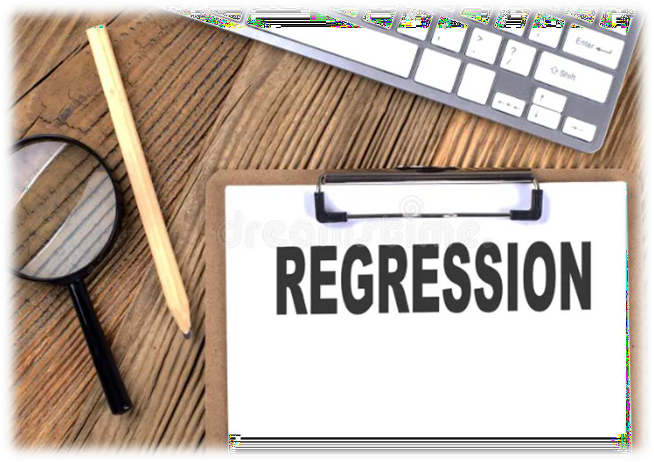
3- Regression Analysis: Although consumer interviews and direct market experiments are important sources of information concerning demand functions, they are not used as often as regression analysis.

Slide 11
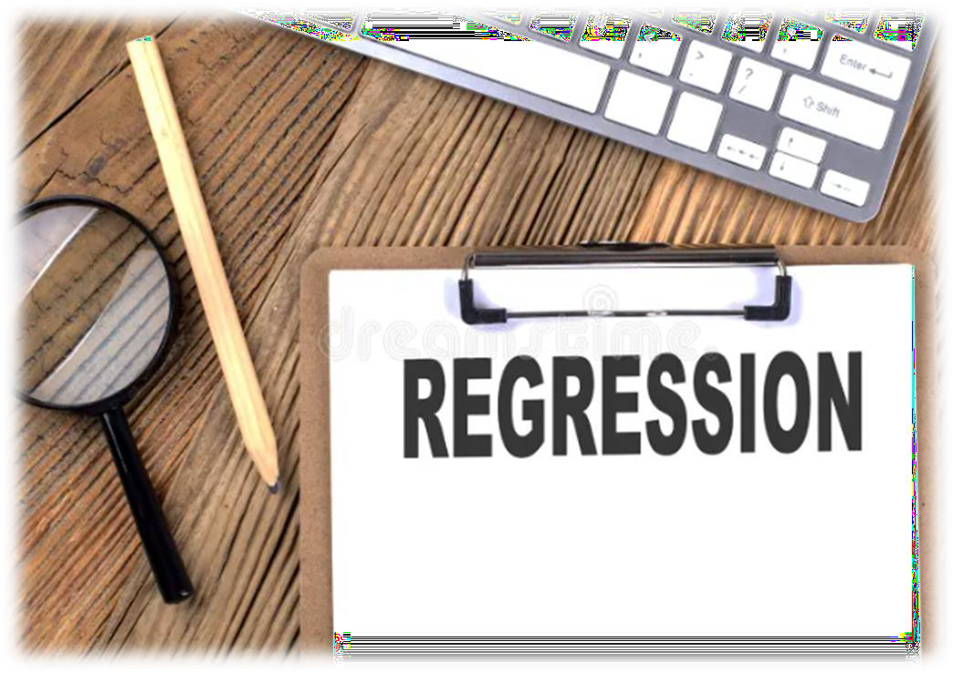
3- Regression Analysis: Regression analysis describes the way in which one variable is related to another.
Regression analysis derives an equation that can be used to estimate the unknown value of one variable based on the known value of the other variable.

Slide 12
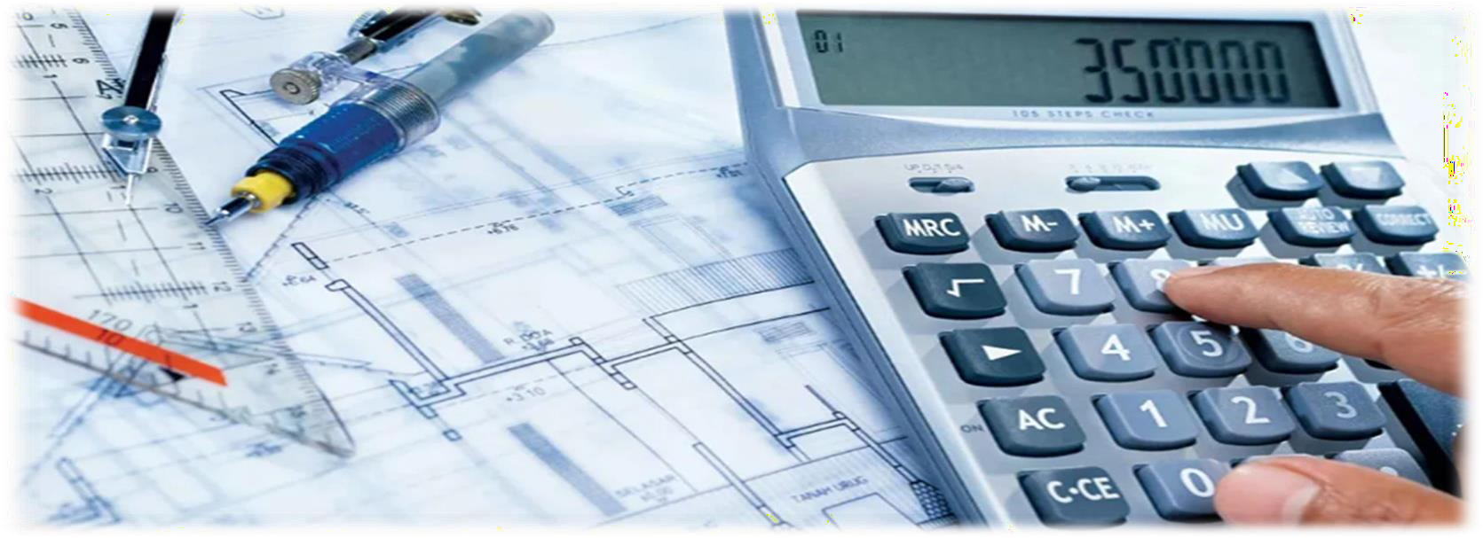
Benefit estimation

Slide 13

Benefit estimation starts with the
identification of benefit items.
Benefit estimation
Benefit items vary greatly according to the characteristics and contents of projects, and they need to be subdivided according to project plans submitted by the competent ministry. Once they are identified, opportunity cost or value per unit is calculated by item to estimate benefits.

Slide 14

Benefit estimation
Investment projects of transportation facilities generate direct benefits for transportation and indirect social benefits.
It is not easy to classify the benefits of water resources projects as direct or indirect or as tangible or intangible and to suggest calculation methods for each project.
The benefits of industrial complexes can be derived from the revenue of additional added value or industrial production that will occur as a result of their formation.

Slide 15

3- Cost Estimation
Cost estimation also differs depending on the nature and specifics of projects. Project costs can be largely divided into construction costs, land acquisition costs, Operating and Maintenance costs (O&M costs), etc.
Construction costs refer to the entirety of project costs minus lot purchase costs and additional facility costs ^{ءاشر} فيلاكت اهنم احورطم ةيفاضإلا قفارملا فيلاكتو, and, land acquisition costs are the costs of buying lots in the project area and compensation costs ف·_{ي} ضرأ عطق ^{ءاشر} ضيوعتلا فيلاكتو ^{عوشمر} لا ةقطنم. O&M costs include not only initial investment costs but also ordinary operating costs that even consider life cycle costs to maintain the functions of fixed assets like land, buildings, and facilities.

Slide 16
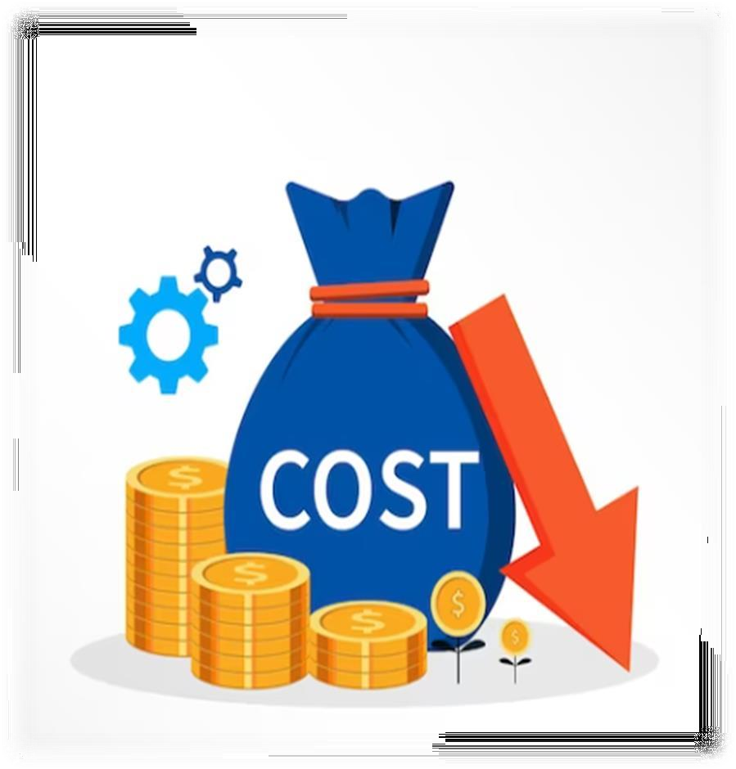
The following reviews and suggests cost estimation methods for transportation, water resources, and other projects:
Transportation Projects: Cost analysis should be done differently for different transportation projects to build expressways, roads, bridges, railroads, ports, and airports.
Water Resources Projects: Cost estimation for water resources projects should be divided for dam construction, river conservation work, etc.
Other Projects: The costs are to be estimated
based on the size and characteristics of facilities.

Slide 17

Calculation Standards for Land
Acquisition Costs,
Land acquisition costs in preliminary feasibility studies are purchase costs of and compensation.
Purchase costs of land are those to buy lots required for public interest projects targeted by preliminary feasibility studies.
Compensation for obstructions refers
to money paid to remove
things like buildings, structures,

Slide 18
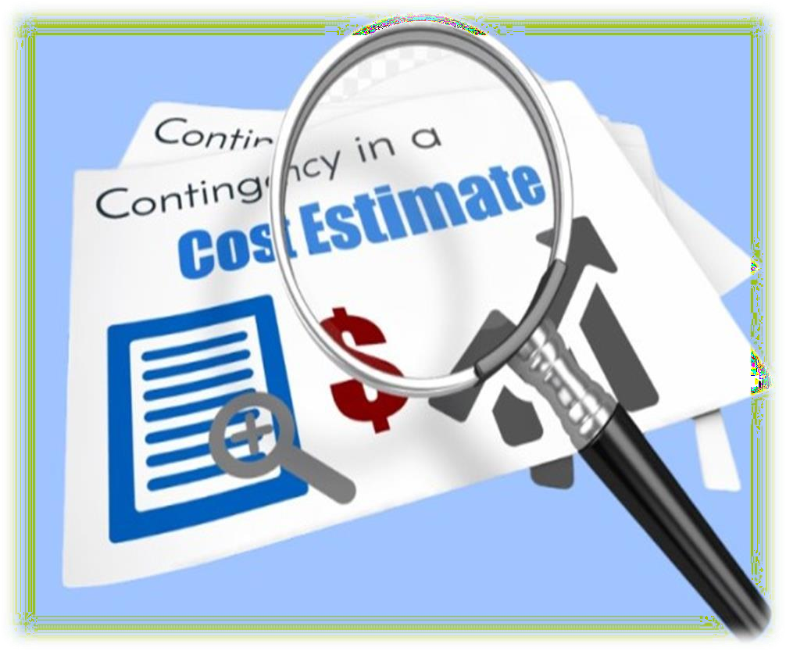
- To review the feasibility of investment projects, contingency reserves must be included as a cost item.
-The process of pushing ahead with a project inevitably entails numerous unexpected events and contingency reserves should be set aside against them.
Calculation Standards for Contingency Reserves
-Contingency reserves are to be set at 10% of the total project
costs including VAT.

Slide 19
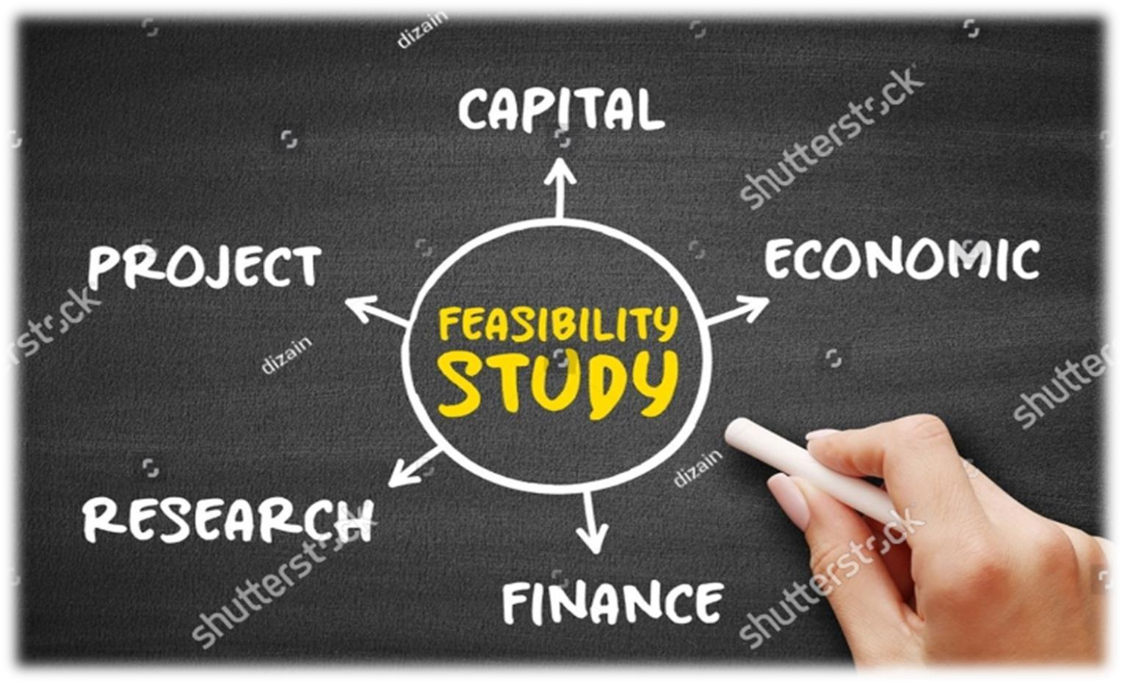
Economic Feasibility Evaluation

Slide 20

Economic Feasibility Evaluation
Economic Feasibility is evaluated using the benefit and cost numbers from the above estimation of demand, benefits, and costs.
Evaluation of economic feasibility basically depends on cost-benefit analysis.

Slide 21

1. Analysis Methods
A Benefit-Cost Ratio (BCR) is first calculated to evaluate economic feasibility. A BCR is the ratio of benefits to costs where both benefits and costs are expressed as discounted present values. In other words, costs and benefits to occur in the future are converted into present values, and the present value of benefits is
divided by those costs.

Slide 22

2. Social Discount Rate
One of the most important parameters used in the economic feasibility evaluation of government-financed projects is the social discount rate. Discounted benefit and cost values are determined by the social discount rate, and as a result, the BCR. Determination of the social discount rate is an absolute determinant of economic feasibility.

Slide 23

4. Base Day of Analysis, Period of Analysis, Etc.
In economic feasibility evaluation, all the benefits and costs should be discounted at the same point of time. As benefits and costs occur at different points of time, they should be reconciled as the values of the same point of time using a discount rate.
This makes them comparable.

Slide 24
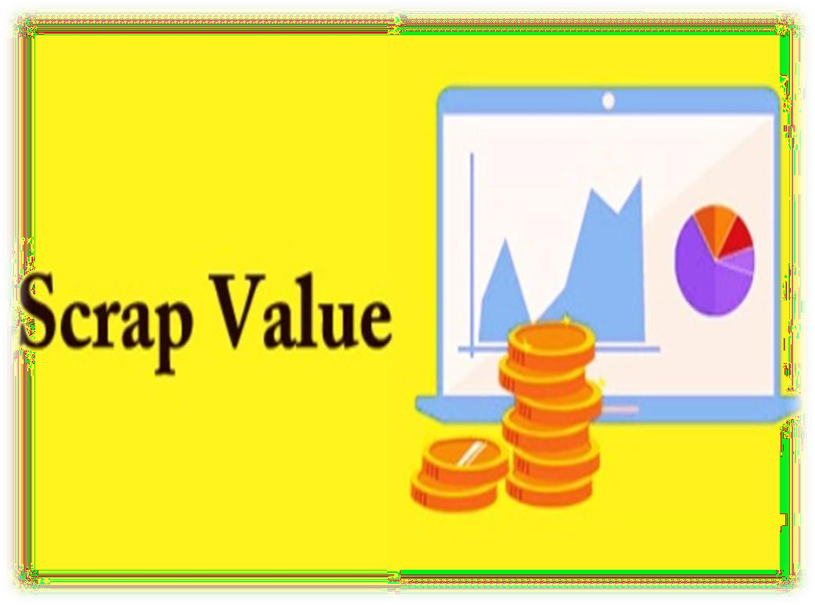
5. Processing of Salvage
Value:
Salvage value is closely related to the duration of the concerned facility and the analysis period of economic feasibility.
The formula for calculating the salvage value is as follows: Salvage Value = Purchase Price – (Annual Depreciation × Number of Years).

Slide 25
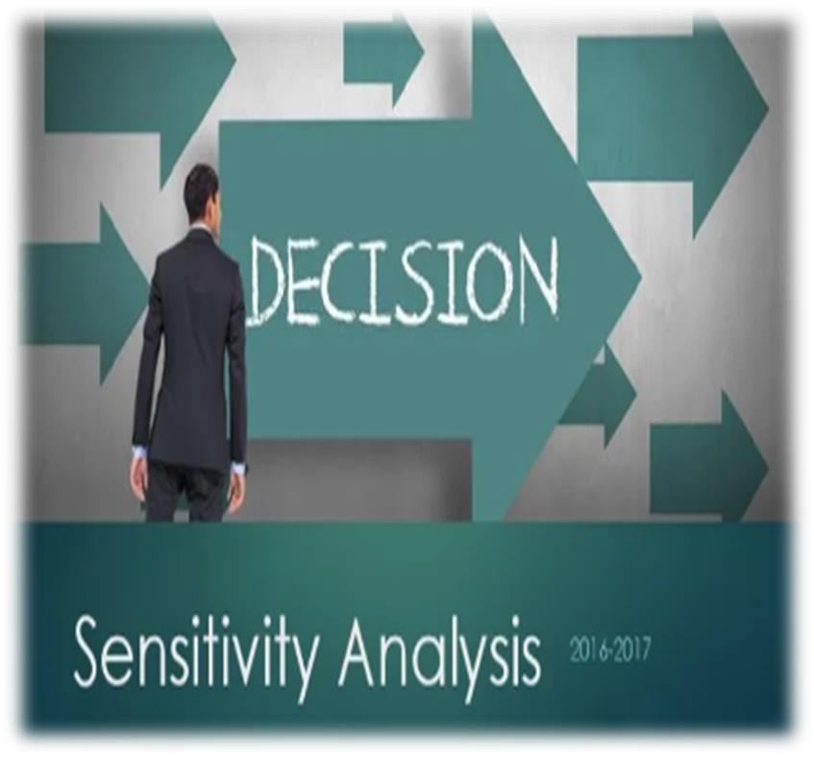
6. Sensitivity Analysis Sensitivity analysis determines how different values of an independent variable affect a particular dependent variable under a given set of assumptions.
It studies how various sources of uncertainty contribute to the forecast’s overall uncertainty by posing ‘what if’ questions.
Sensitivity analysis is used within specific boundaries that depend on one or more input variables.

Slide 26
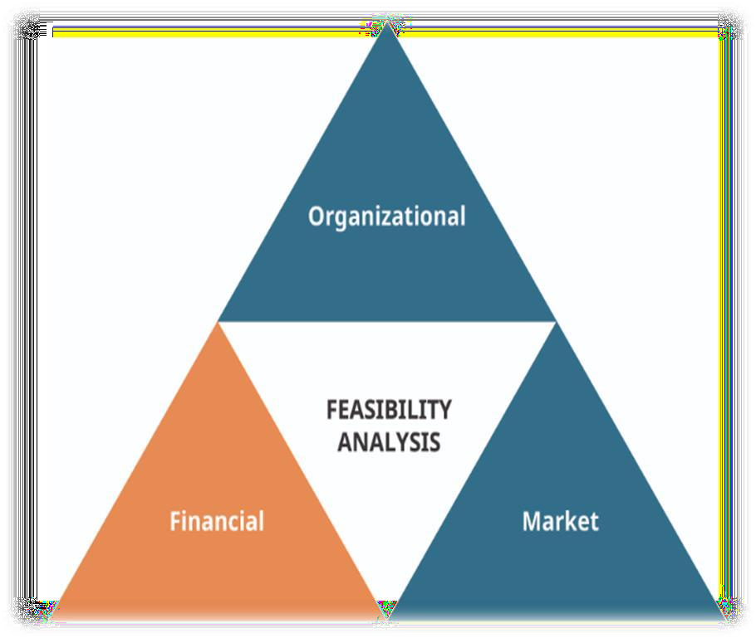
5- Financial Feasibility Analysis
Financial Feasibility Analysis
Comparison between Economic Feasibility Analysis and Financial Feasibility Analysis.
Analysis Methods.

Slide 27
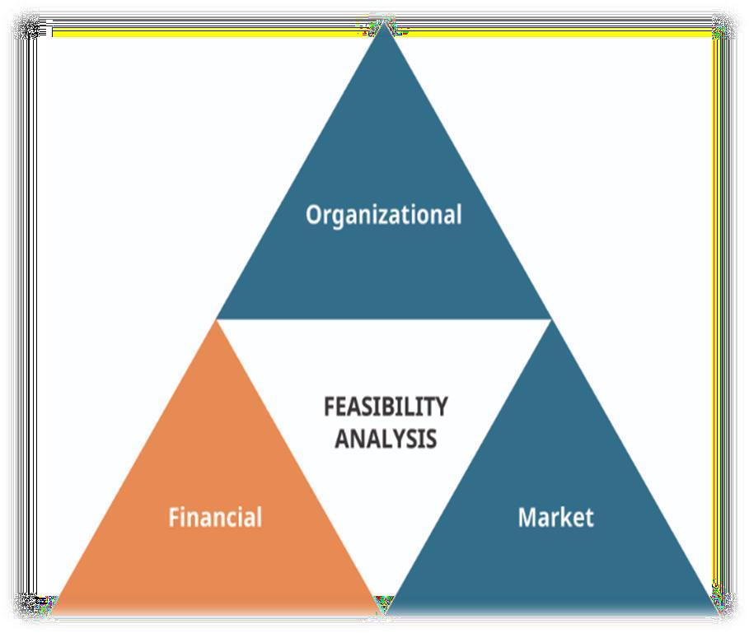
Financial Feasibility Analysis
A financial feasibility study is a comprehensive analysis and evaluation of the financial aspects of a proposed project, investment, or business venture. The primary purpose of such a study is to assess whether the project or venture is financially viable and if it makes economic sense to proceed with it.

Slide 28
Financial Feasibility
Analysis
Projects that are not profitable enough to be pursued by a private party can be pursued as PPP projects with some level of government financial support if they are more suitable to be pursued by such party in terms of creativity and efficiency. In this case, financial feasibility analysis needs to be conducted to ascertain an appropriate amount of government financial support.

Slide 29
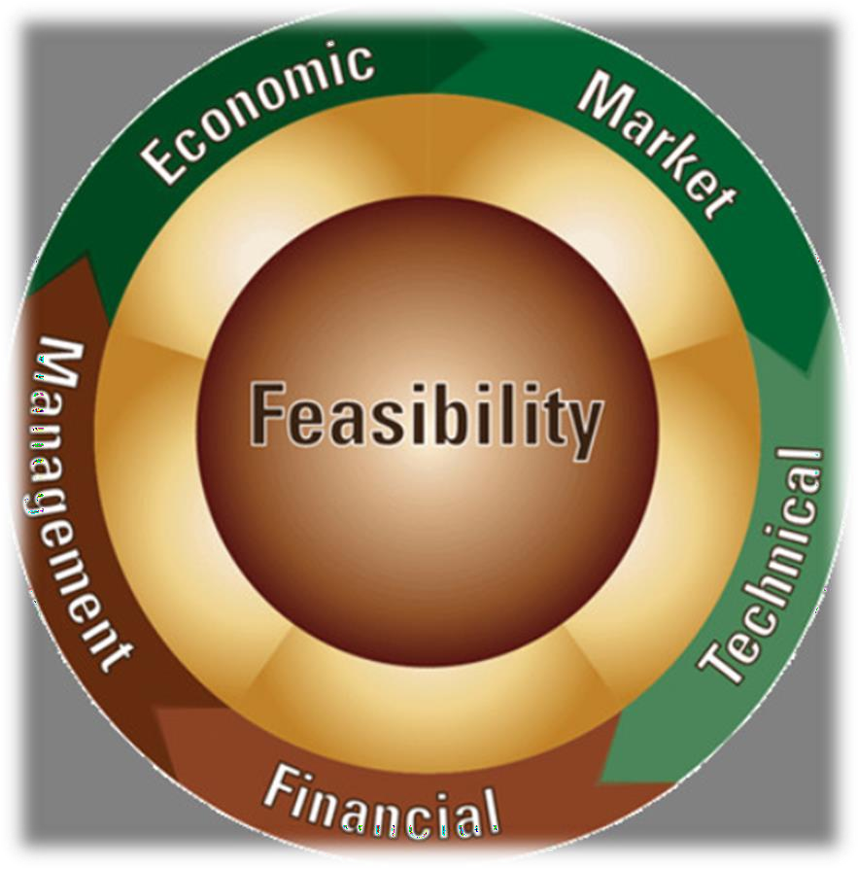
Comparison between Economic Feasibility Analysis and Financial Feasibility Analysis
Economic feasibility analysis is to measure public projects’ costs and benefits from the perspective of the entire nation (society) and accordingly to calculate their economic profitability and to determine their feasibility.
In comparison, financial feasibility analysis estimates actual monetary costs and cash flows from the perspective of individual parties responsible for projects, not the entire society, and accordingly calculates financial profitability to ascertain projects’ feasibility.

Slide 30
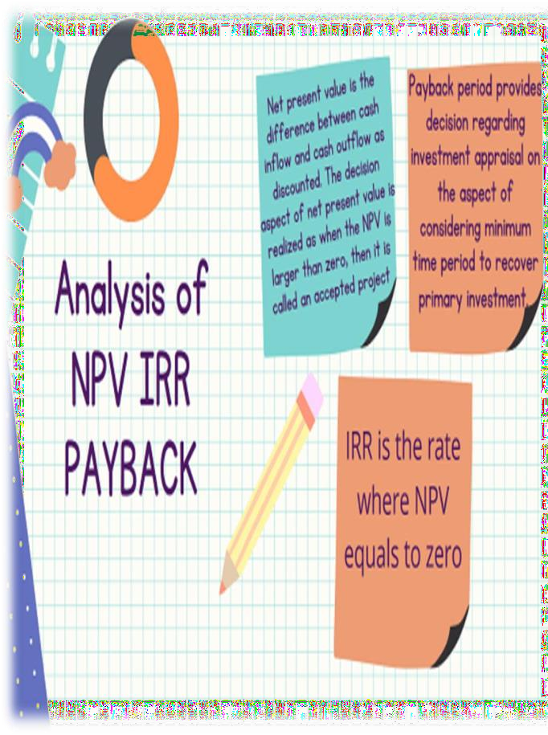
Types of financial feasibility analysis
A few of the more popular choices when creating a financial feasibility analysis are:
Cost Estimates,
Return On Investment,
Payback Period, And
Net Present value.
www.midocean.ae

Slide 31

Cost estimates: Cost estimates are a way for project managers to forecast the costs and resources needed to carry out the planned project.. The cost estimates are generally completed before the market and financial feasibility study is completed, and you may need to revisit those documents for reference. ROI, or return on investment, is an approximate measure used to determine the probability of getting a positive return from an investment.
This measure is a ratio comparing gains or losses to the investment’s cost.

Slide 32


www.midocean.ae

