Slide 1


Database Management System
IT 261
Bachelor of Information Technology
Prepared by Dr. Khaled Eskaf
Lecture 3

Slide 2

Week | Topic | Objective | MySQL Practical Activities
1 | Introduction to Database Concepts | Understand basic database concepts. | Install MySQL, explore the interface, create a basic database.
2 | Relational Data Model | Learn about the relational data model. | Create relational tables in MySQL.
3 | Relational Integrity Rules | Understand relational integrity constraints. | Implement primary and foreign key constraints in MySQL.
4 | Relational Algebra and Basic SQL | Explore relational algebra and basic SQL commands. | Use basic SQL queries in MySQL.
5 | Advanced SQL Queries | Delve into complex SQL operations. | Execute advanced SQL commands in MySQL.
6 | Introduction to Database Normalization | Begin learning database normalization principles. | Apply the first normal form (1NF) in MySQL.
7 | Advanced Database Normalization | Explore advanced normalization techniques. | Normalize a database in MySQL to 2NF and 3NF.
8 | Data Modeling and ER Diagrams | Understand data modeling and ER diagrams. | Create an ER diagram and implement it in MySQL.
9 | Database Design for Real-World Apps | Apply database design to real-world scenarios. | Develop a database schema based on a real-world example.
10 | Project and Review | Apply all learned concepts in a comprehensive project. | Complete a project in MySQL incorporating all learned skills.
www.midocean.ae

Slide 3

www.midocean.ae

Slide 4

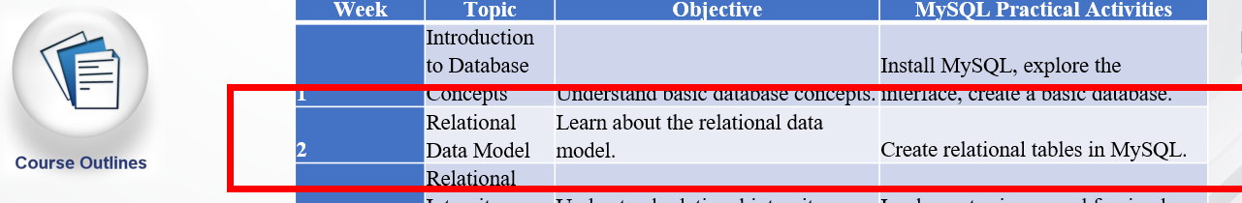
The Entity-Relationship Model
www.midocean.ae

Slide 5
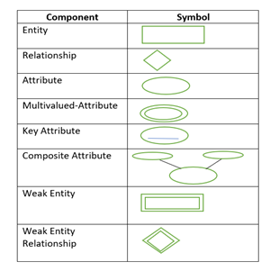
Components of ER Diagram
You base an ER Diagram on three basic concepts:
Entities
Attributes
  Key Attribute
  Composite Attribute
  Multivalued Attribute
  Derived Attribute
Relationships
  One-to-One Relationships
  One-to-Many Relationships
  Many-to-One Relationships
  Many-to-Many Relationships
www.midocean.ae

Slide 6
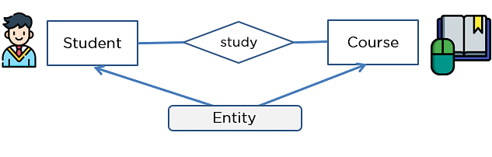
Entities
An entity can be either a living or non-living component.
It showcases an entity as a rectangle in an ER diagram.
For example, in a student study course, both the student and the course are entities.
www.midocean.ae

Slide 7
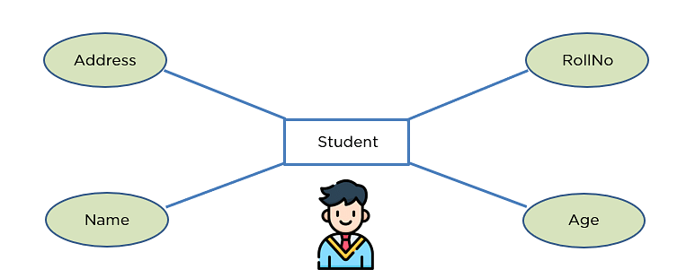
Attribute
An attribute exhibits the properties of an entity.
You can illustrate an attribute with an oval shape in an ER diagram.
www.midocean.ae

Slide 8
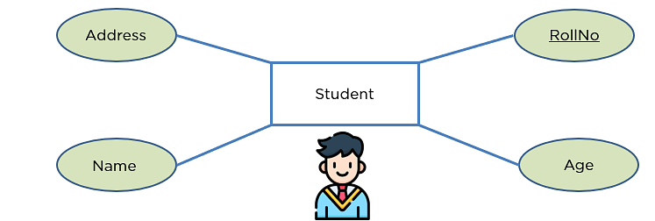
Key Attribute
Key attribute uniquely identifies an entity from an entity set.
It underlines the text of a key attribute.
For example: For a student entity, the roll number can uniquely identify a student from a set of students.
www.midocean.ae

Slide 9
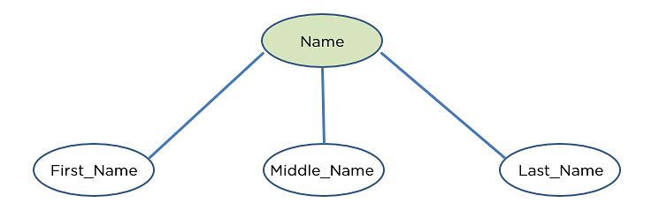
Composite Attribute
An attribute that is composed of several other attributes is known as a composite attribute.
An oval showcases the composite attribute, and the composite attribute oval is further connected with other ovals.
www.midocean.ae

Slide 10
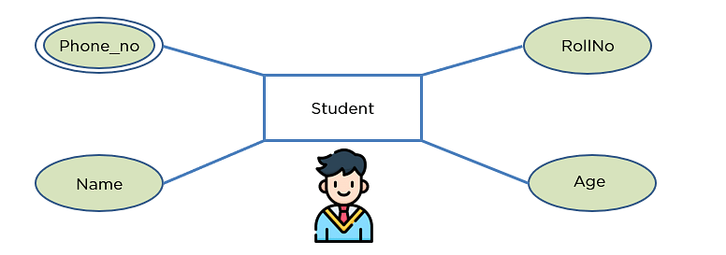
Multivalued Attribute
Some attributes can possess over one value, those attributes are called multivalued attributes.
The double oval shape is used to represent a multivalued attribute.
www.midocean.ae

Slide 11
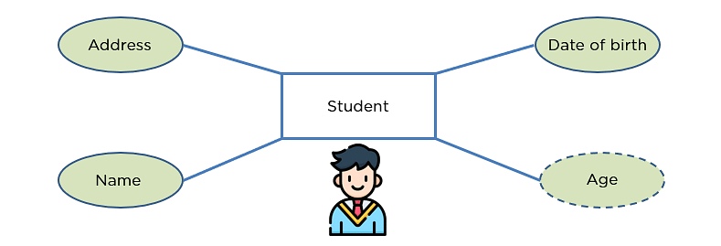
Derived Attribute
An attribute that can be derived from other attributes of the entity is known as a derived attribute.
In the ER diagram, the dashed oval represents the derived attribute.
www.midocean.ae

Slide 12
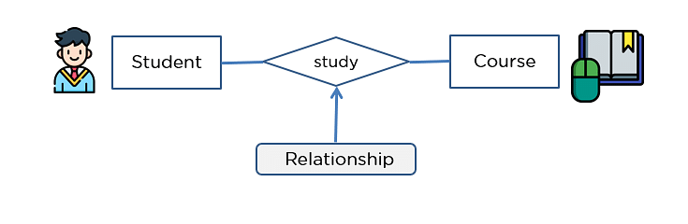
Relationship
The diamond shape showcases a relationship in the ER diagram.
It depicts the relationship between two entities.
In the example below, both the student and the course are entities, and study is the relationship between them.
www.midocean.ae

Slide 13

One-to-One Relationship
When a single element of an entity is associated with a single element of another entity, it is called a one-to-one relationship.
For example, a student has only one identification card and an identification card is given to one person.
www.midocean.ae

Slide 14

One-to-Many Relationship
When a single element of an entity is associated with more than one element of another entity, it is called a one-to-many relationship
For example, a customer can place many orders, but an order cannot be placed by many customers.
www.midocean.ae

Slide 15

Many-to-One Relationship
When more than one element of an entity is related to a single element of another entity, then it is called a many-to-one relationship.
For example, students have to opt for a single course, but a course can have many students.
www.midocean.ae

Slide 16

Many-to-Many Relationship
When more than one element of an entity is associated with more than one element of another entity, this is called a many-to-many relationship.
For example, you can assign an employee to many projects and a project can have many employees.
www.midocean.ae

Slide 17
How to Create an ER Diagram
Before you design a relational database, it makes sense to create an ER diagram. You may have software that is equipped to handle this process. If not, Put pen (or pencil) to paper, or find a software program that can handle the charting requirements.
To create an ER diagram by hand:
Create a rectangular box for each entity or concept relevant to your model.
Draw lines to connect related entities to model the relationships. Label the relationships using verbs inside diamond shapes.
Identify the relevant attributes for each entity, beginning with the most important attributes, and enter them in ovals in the diagram. Later, you can make the attribute lists more detailed.
www.midocean.ae

Slide 18

Creating an Entity-Relationship (ER) Diagram for a simple bank system involving customers and their bank accounts can be a great way to understand how ER diagrams work.
www.midocean.ae

Slide 19

ER Diagram for Bank Database:
In an ER diagram for a Banking System, we will have to keep in my mind the following points while making the diagram:
There are going to be a number of entities, namely customers, banks, bank accounts, and transactions.
The various entities in our diagram will have many different attributes like the Customer has First Name and Last Name.
There are going to be varying relationships between the various entities like the Bank account, and the Customer will have a relationship called owned by, where we show that the account is being held by the Customer.
www.midocean.ae

Slide 20
Let's start with making our ER diagram:
Deciding Entities
We first decide the entities that we are going to have in our diagram :
Bank
Bank Account
Transaction
Customer
www.midocean.ae

Slide 21
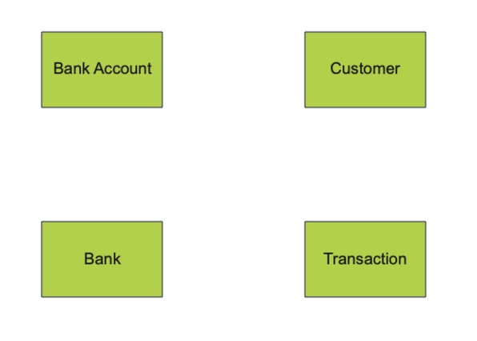
Bank
Bank Account
Transaction
Customer
www.midocean.ae

Slide 22
Deciding Attributes :
We then decide what attributes are associated with these entities:
Bank: Name, City
Bank Account: Balance, Account holder, Bank
Customer: First Name, Last Name, Phone Number
Transaction: Deposit Account, Withdrawal Account, Timestamp, Currency, Amount
www.midocean.ae

Slide 23
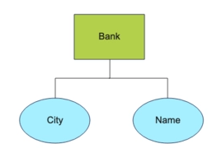
Bank: Name, City
www.midocean.ae

Slide 24
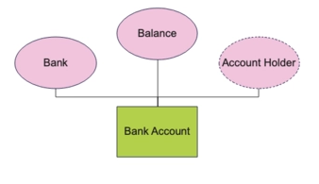
Bank Account: Balance, Account holder, Bank
www.midocean.ae

Slide 25
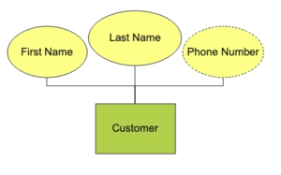
Customer: First Name, Last Name, Phone Number
www.midocean.ae

Slide 26
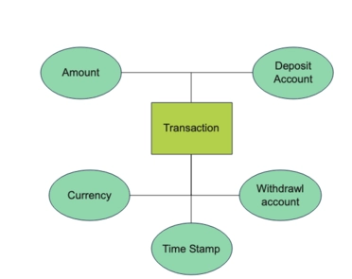
Transaction: Deposit Account, Withdrawal Account, Timestamp, Currency, Amount
www.midocean.ae

Slide 27
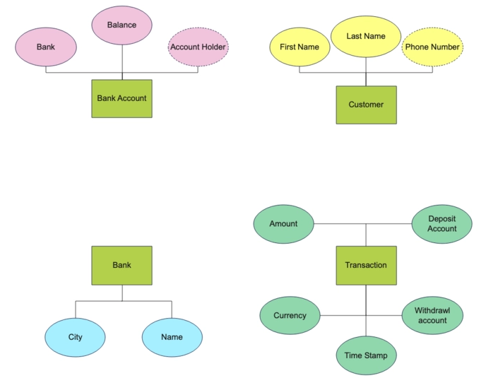
Bank: Name, City
Bank Account: Balance, Account holder, Bank
Customer: First Name, Last Name, Phone Number
Transaction: Deposit Account, Withdrawal Account, Timestamp, Currency, Amount
www.midocean.ae

Slide 28
Deciding Relationships :
We then decide the relationships between the various entities:
A Bank Account is owned by a Customer.
A Bank has a Bank Account.
A Transaction is linked to the Bank Account.
The relationship between Bank Account and Customer is many to one because a Customer can have many Bank Accounts.
The relationship between Bank and Bank Account is one too many as a Bank has many bank accounts.
The Transaction to bank account relationship is many to one because multiple transitions can be linked to one bank account.
www.midocean.ae

Slide 29
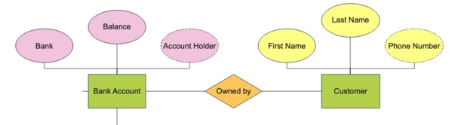
A Bank Account is owned by a Customer.
www.midocean.ae

Slide 30
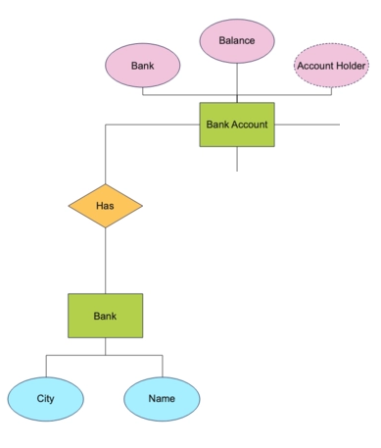
A Bank has a Bank Account.
www.midocean.ae

Slide 31
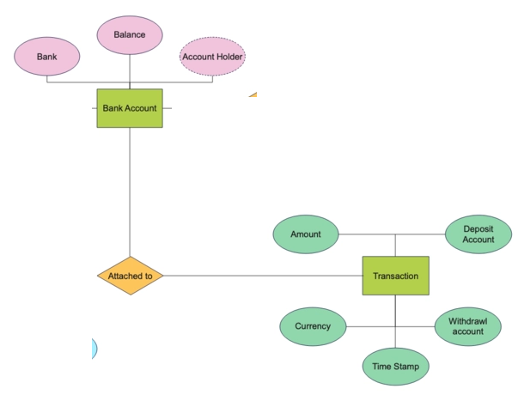
A Transaction is linked to the Bank Account
www.midocean.ae

Slide 32
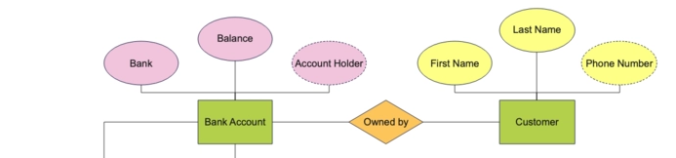
The relationship between Bank Account and Customer is many to one because a Customer can have many Bank Accounts.
www.midocean.ae

Slide 33


The relationship between Bank and Bank Account is one too many as a Bank has many bank accounts.
www.midocean.ae

Slide 34
The Transaction to bank account relationship is many to one because multiple transitions can be linked to one bank account.
www.midocean.ae

Slide 35
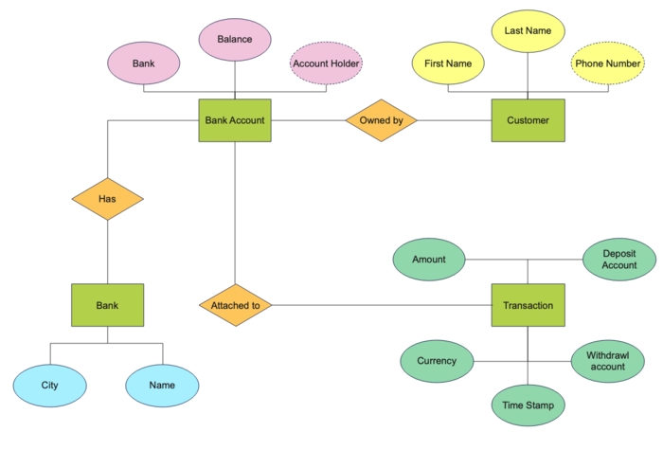
www.midocean.ae

Slide 36
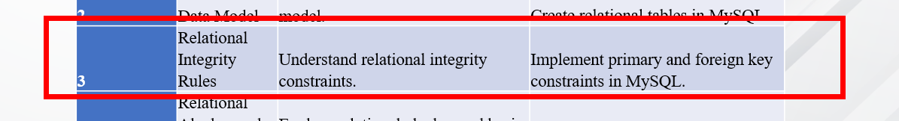
Chapter
Week 3 Outlines
03
www.midocean.ae

Slide 37
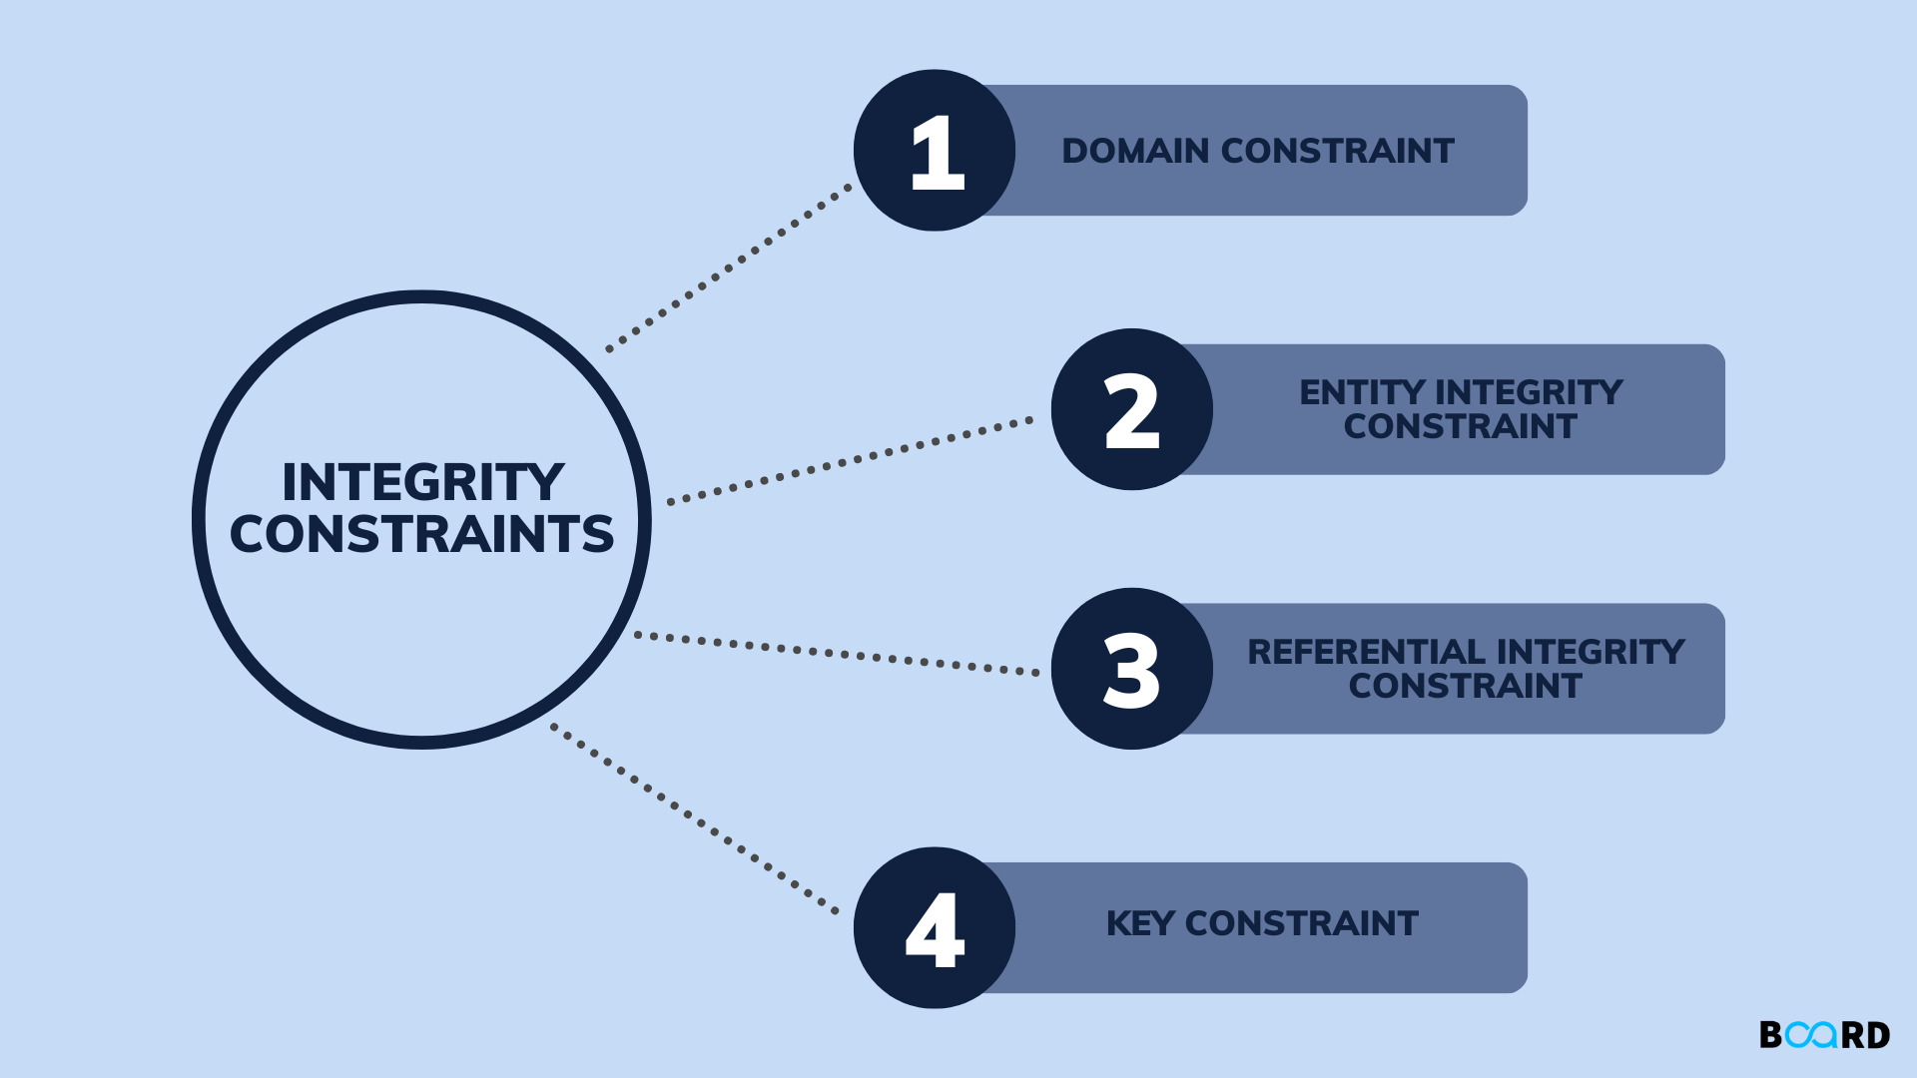
Chapter
Relational integrity rules
03
www.midocean.ae

Slide 38
Chapter
03
Relational integrity rules are fundamental in relational database design, ensuring data remains accurate and consistent. They include primary keys to uniquely identify records, foreign keys to maintain referential integrity (ensuring relationships between tables are preserved), and unique constraints to prevent duplicate entries. These rules help in maintaining the reliability of data relationships across the database, crucial for beginners to understand as they form the backbone of database structure and integrity.
www.midocean.ae
Notes:
تعتبر قواعد التكامل العلائقي أساسية في تصميم قواعد البيانات العلائقية، مما يضمن بقاء البيانات دقيقة ومتسقة. وهي تتضمن مفاتيح أساسية لتعريف السجلات بشكل فريد، ومفاتيح خارجية للحفاظ على التكامل المرجعي (ضمان الحفاظ على العلاقات بين الجداول)، وقيود فريدة لمنع الإدخالات المكررة. تساعد هذه القواعد في الحفاظ على موثوقية علاقات البيانات عبر قاعدة البيانات، وهو أمر ضروري للمبتدئين لفهمه لأنها تشكل العمود الفقري لبنية قاعدة البيانات وسلامتها.

Slide 39
Chapter
03
Relational integrity rules include:
Primary Keys: Uniquely identify each record in a table.
Foreign Keys: Establish and enforce relationships between tables.
Unique Constraints: Prevent duplicate entries in specific columns.
Check Constraints: Ensure that column values meet a specified condition.
Not Null Constraints: Ensure that a column cannot have a null value.
These rules ensure data accuracy and consistency within relational databases.
www.midocean.ae
Notes:
المفاتيح الأساسية: لتحديد كل سجل بشكل فريد في جدول.
المفاتيح الخارجية: لإنشاء وفرض العلاقات بين الجداول.
القيود الفريدة: لمنع الإدخالات المكررة في أعمدة محددة.
القيود المحددة: لضمان أن تلبي قيم الأعمدة شرطًا محددًا.
القيود غير الفارغة: لضمان عدم ترك عمود بدون قيمة.
تضمن هذه القواعد دقة واتساق البيانات داخل قواعد البيانات العلاقية

Slide 40
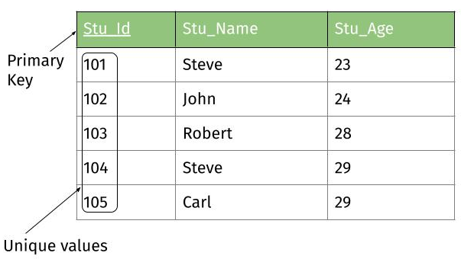
Chapter
03
Primary Keys
Table named Students, where each student has a unique student ID, a name, and an age. The primary key for this table would be the student ID because it uniquely identifies each record. Here's a basic example:
Table: Students
  Columns: StudentID (Primary Key), Name, Age
  Rows:
    Stu_Id: 1, Stu_Name: ali ahmed, Stu_Age:20
    Stu_Id : 2, Stu_Name: hassan ahmed, Stu_Age:21
www.midocean.ae

Slide 41
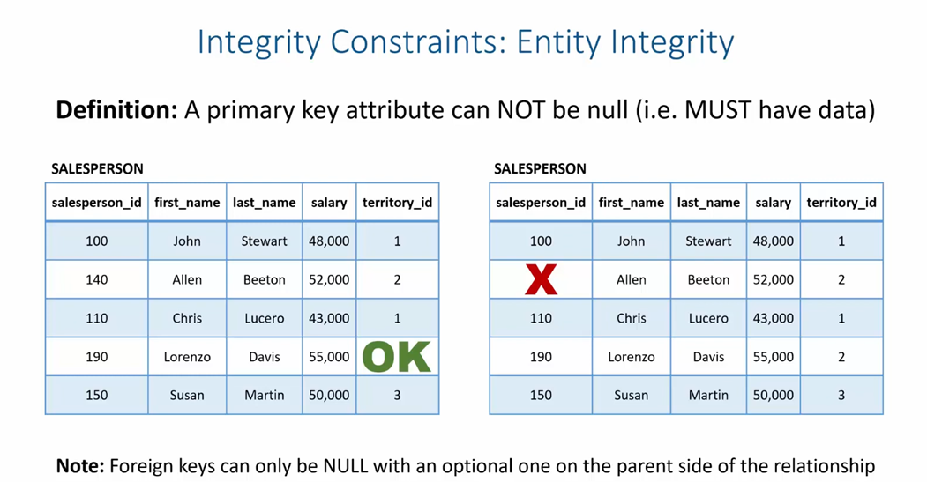
Chapter
03
www.midocean.ae

Slide 42
Chapter
Foreign Keys
03
Foreign keys establish a relationship between two tables in a database, ensuring referential integrity. For example, consider two tables: Students and Courses. Each student enrolls in a course, creating a relationship between students and courses.
Students Table:
  Columns: StudentID (Primary Key), StudentName
Courses Table:
  Columns: CourseID (Primary Key), CourseName, StudentID (Foreign Key)
The StudentID in the Courses table is a foreign key that references the StudentID in the Students table. This setup ensures that each course entry is associated with a valid student, maintaining the integrity of the database.
www.midocean.ae
Notes:
التكامل المرجعي

Slide 43
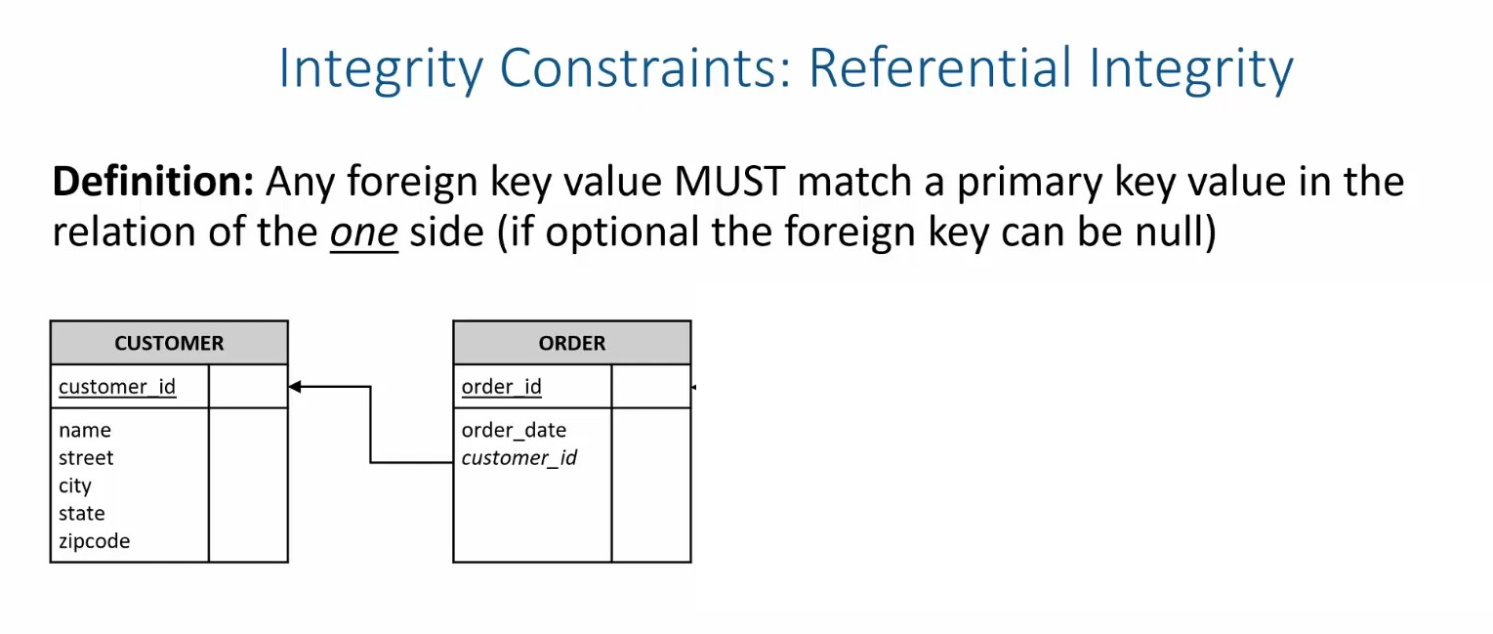
Chapter
03
www.midocean.ae

Slide 44
Chapter
Unique Constraint
03
Unique constraints ensure that all values in a column are different from each other, preventing duplicate entries in a database table. For instance, in a table named Students, a unique constraint on the email column guarantees that no two students can have the same email address. Here's a simplified example of how this might be applied:
Table Name: Students
Columns: StudentID, Name, Email
Unique Constraint: Applied to the Email column.
By setting a unique constraint on the Email column, the database ensures that every student has a distinct email address, thus maintaining the integrity and uniqueness of student contact information.
www.midocean.ae
Notes:
القيد الفريد

Slide 45
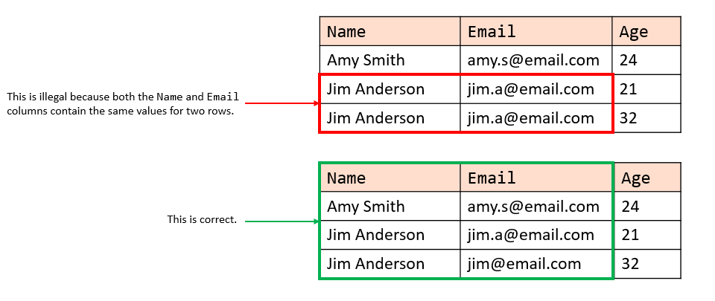
Chapter
03
www.midocean.ae

Slide 46
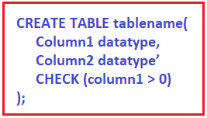
Chapter
03
Check Constraints
Check constraints in a database ensure that all values in a column meet a specific condition. For example, if you have a table named "Employees" and you want to make sure that the age of each employee is greater than 18, you would add a check constraint on the "Age" column.
Example Table: Employees
Columns: EmployeeID, Name, Age
www.midocean.ae

Slide 47
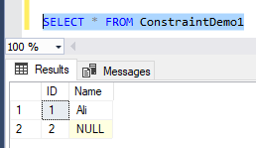
Chapter
03
Not Null Constraints
Not Null Constraints Example:
Imagine we have a table named Students, where each student must have a unique student_id and a name. To ensure every student record has a name, we apply a Not Null constraint on the name column.
Table Name: Students
Columns: student_id (INT), name (VARCHAR)
www.midocean.ae

Slide 48
Chapter
A domain constraint
03
A domain constraint specifies the permissible values for a given attribute in a database table. For example, consider a table named "Students" with an attribute "Grade". If the "Grade" attribute only accepts values from A to F, then the domain constraint for "Grade" would be set to only these letters. This ensures data integrity by restricting the grade values entered into the database to only those that are valid within the specified domain.
www.midocean.ae

Slide 49
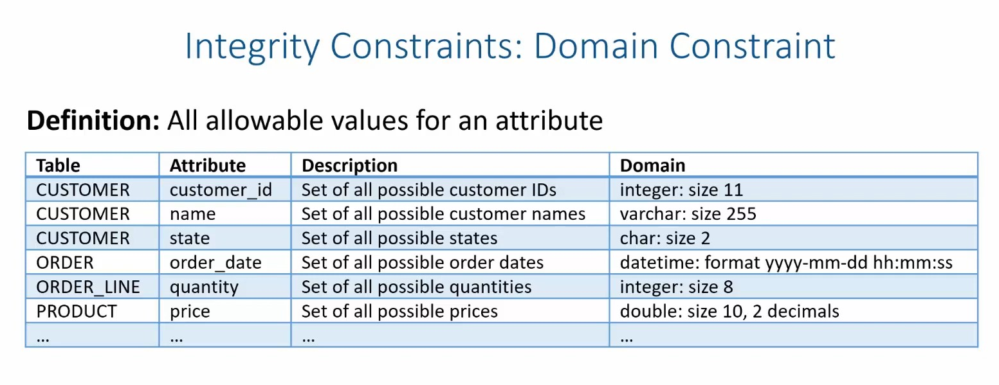
Chapter
03
www.midocean.ae

Slide 50

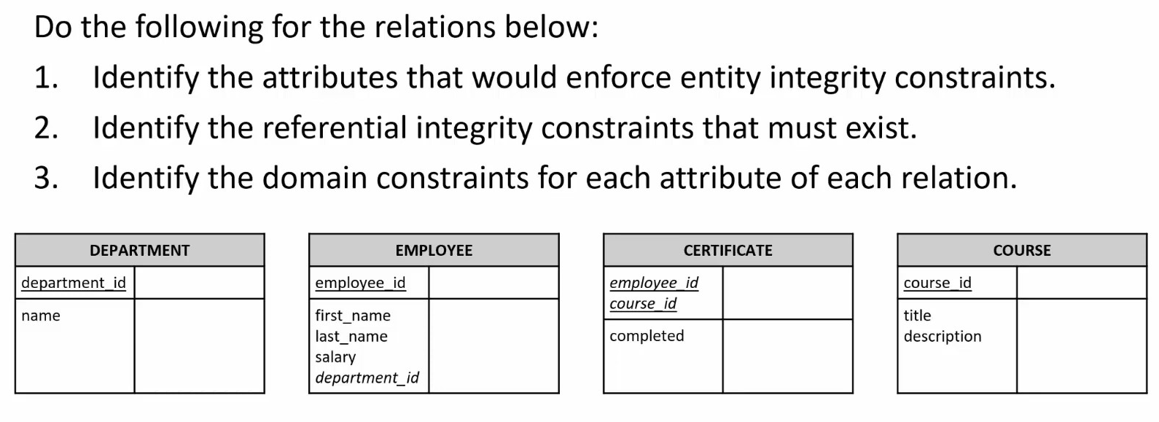
Chapter
03
www.midocean.ae

Slide 51
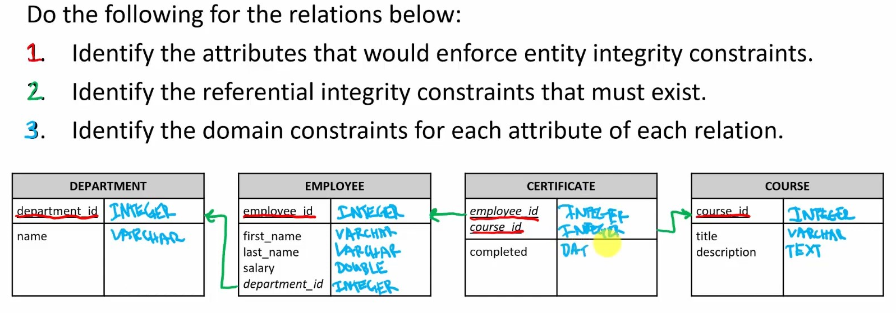
Chapter
03
www.midocean.ae

Slide 52

Chapter
03
www.midocean.ae

Slide 53
Chapter
03
To create a database in MySQL Workbench for students, courses, and teachers, follow these steps:
Open MySQL Workbench and connect to your MySQL server.
Create a New Schema: Click on the "+" icon next to "Schemas" to create a new database. Name it school_db and apply the changes.
Create Tables: Use the toolbar to create new tables for Students, Courses, and Teachers.
  For Students, add fields like student_id, name, email.
  For Courses, include course_id, course_name, teacher_id.
  For Teachers, fields might be teacher_id, name.
Define Primary Keys for each table (e.g., student_id, course_id, teacher_id) and set them to auto-increment.
Establish Relationships: Use foreign keys to link Courses to Teachers by teacher_id.
Insert Data: Use INSERT INTO statements to populate each table with sample data.
www.midocean.ae

Slide 54
Chapter
03
1.Create a Database (Schema):
CREATE DATABASE school_db; USE school_db;
Create a Table for Students:
CREATE TABLE Students ( student_id INT AUTO_INCREMENT, name VARCHAR(100), email VARCHAR(100), PRIMARY KEY(student_id) );
Create a Table for Courses:
CREATE TABLE Courses ( course_id INT AUTO_INCREMENT, course_name VARCHAR(100), teacher_id INT, PRIMARY KEY(course_id), FOREIGN KEY(teacher_id) REFERENCES Teachers(teacher_id) );
Create a Table for Teachers:
CREATE TABLE Teachers ( teacher_id INT AUTO_INCREMENT, name VARCHAR(100), PRIMARY KEY(teacher_id) );
www.midocean.ae

Slide 55



Thank You

