Slide 1



Project Cost
Management
Lecture 10
PMG 213
Prepared by
Dr. Hoda Metwally
www.midocean.ae

Slide 2
Project Cost
Management
Lecture 10
Lean Six Sigma
PMG 213
Prepared by
Dr. Hoda Metwally
www.midocean.ae

Slide 3

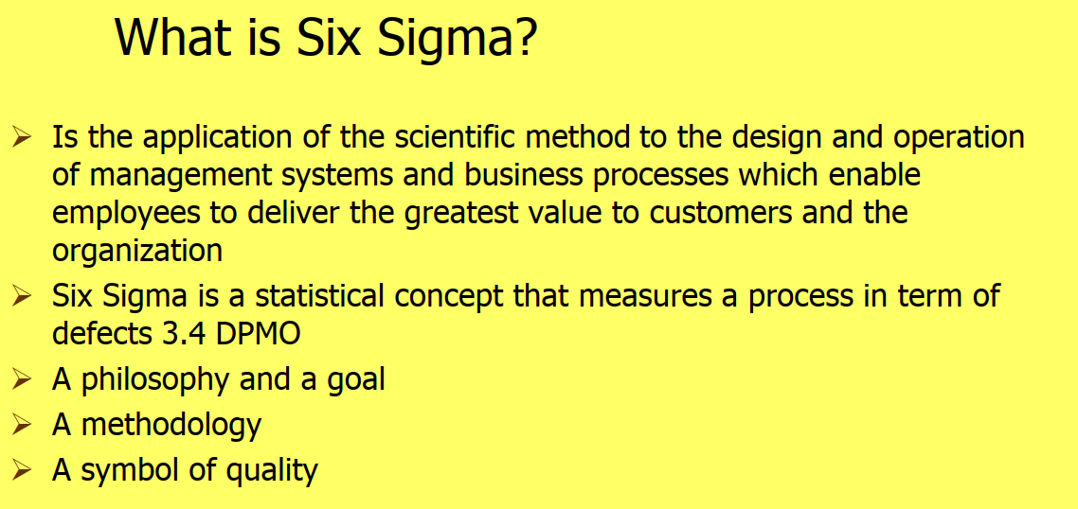
www.midocean.ae

Slide 4
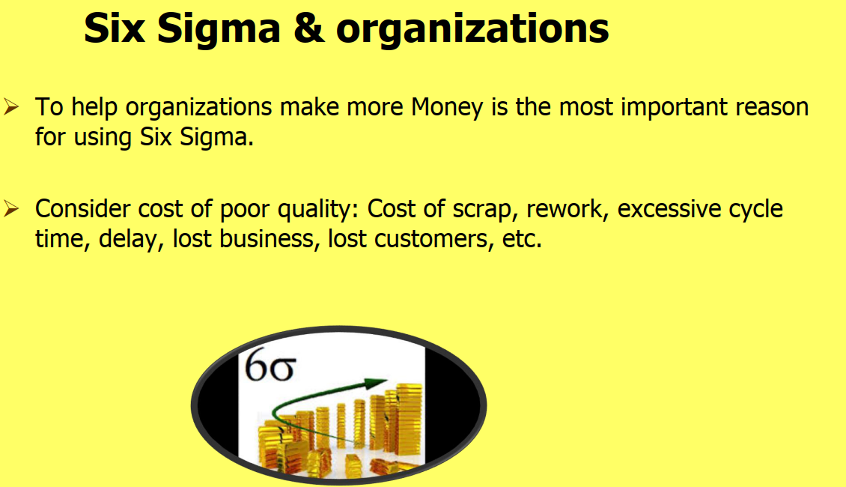
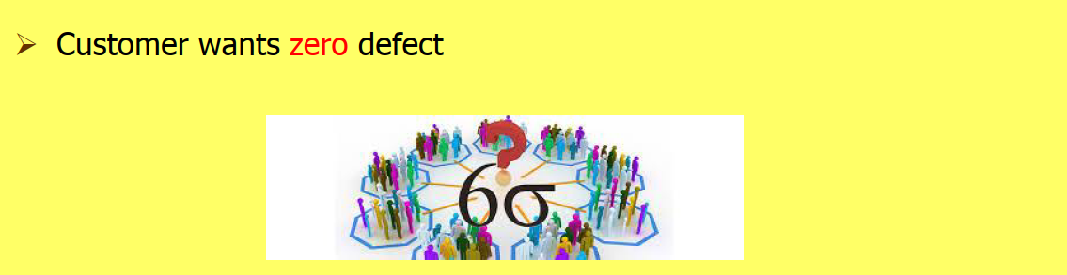
www.midocean.ae

Slide 5
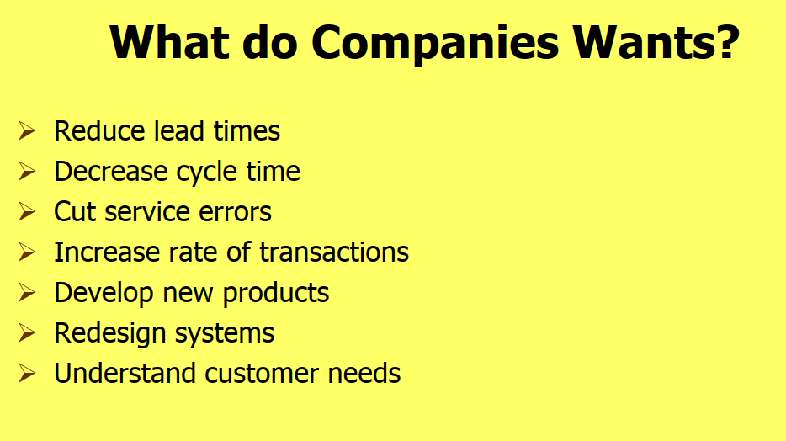
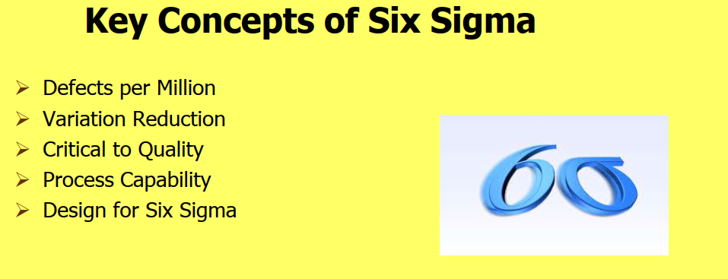
www.midocean.ae

Slide 6
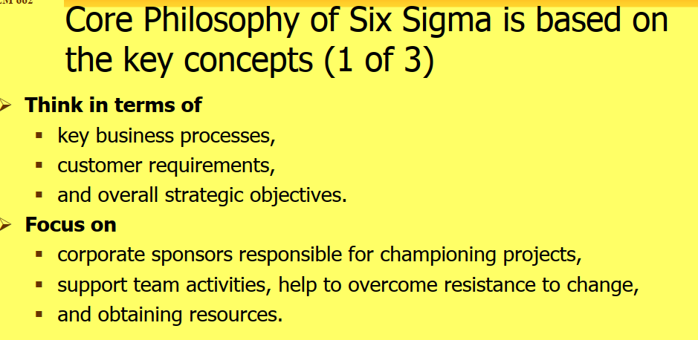
www.midocean.ae

Slide 7
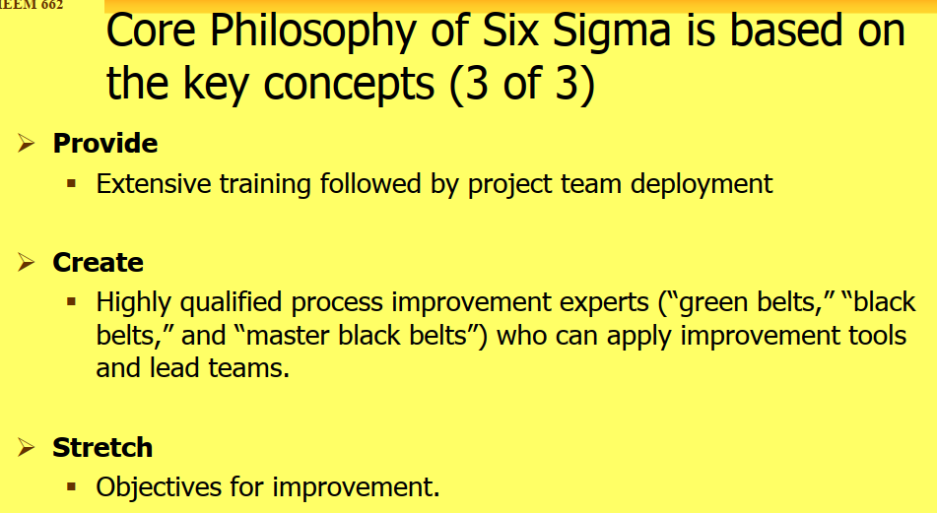
www.midocean.ae

Slide 8
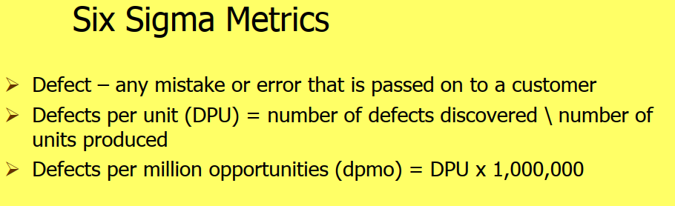
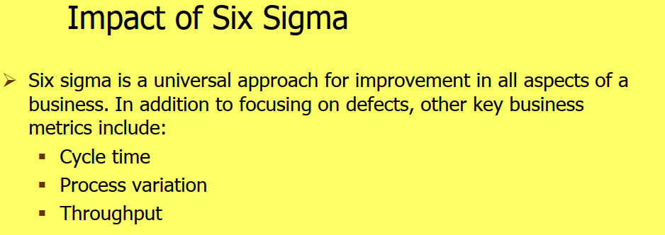
www.midocean.ae

Slide 9
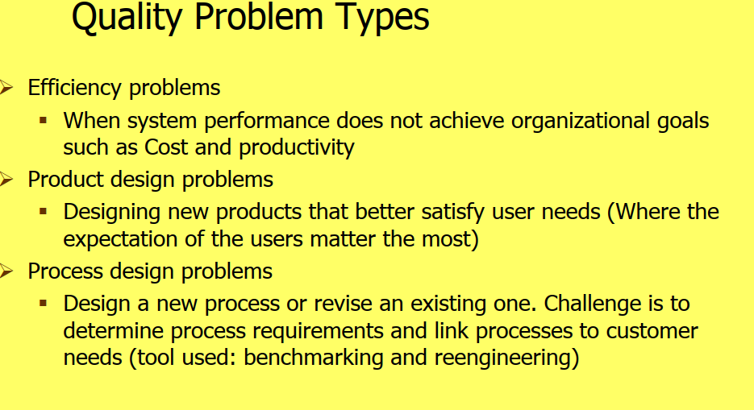
www.midocean.ae

Slide 10

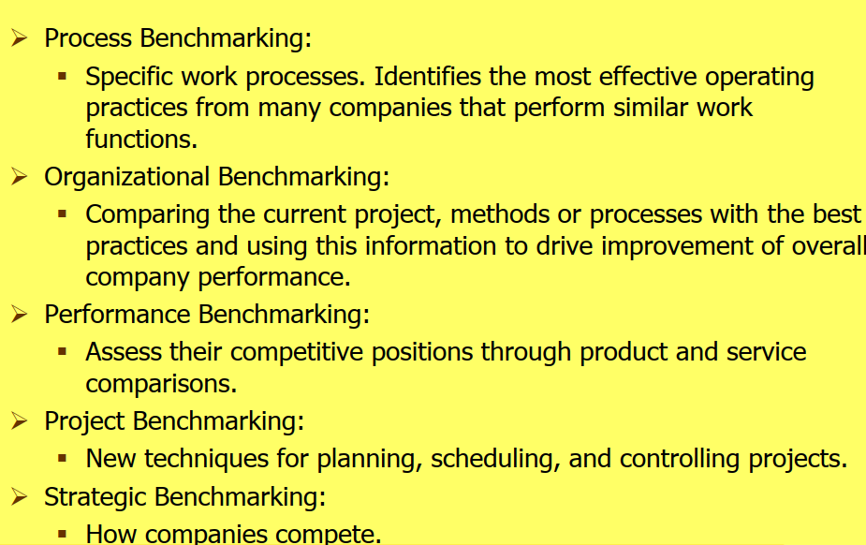
www.midocean.ae

Slide 11
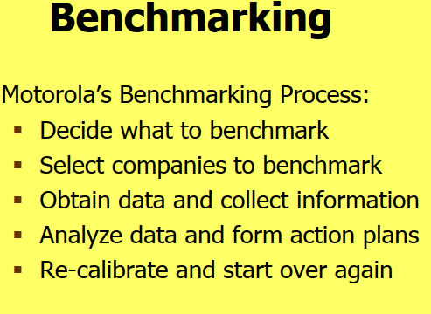
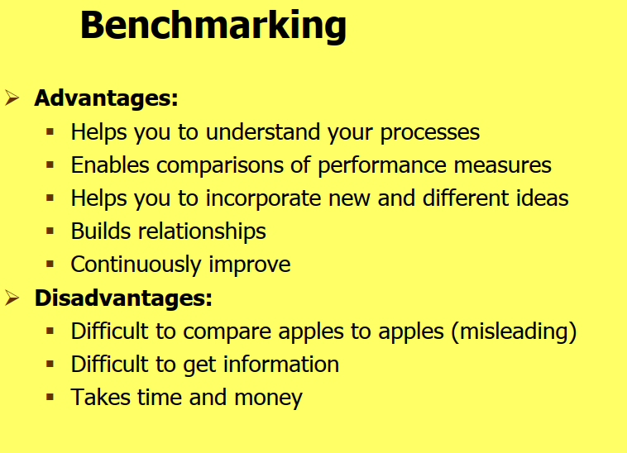
www.midocean.ae

Slide 12
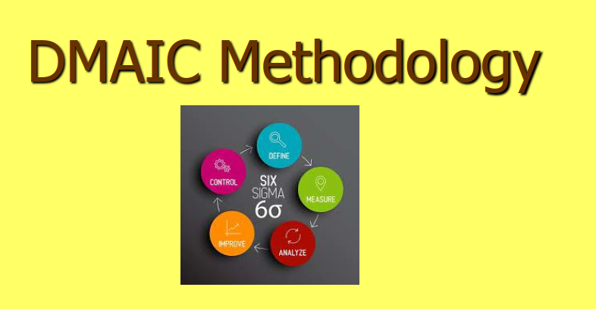
www.midocean.ae

Slide 13
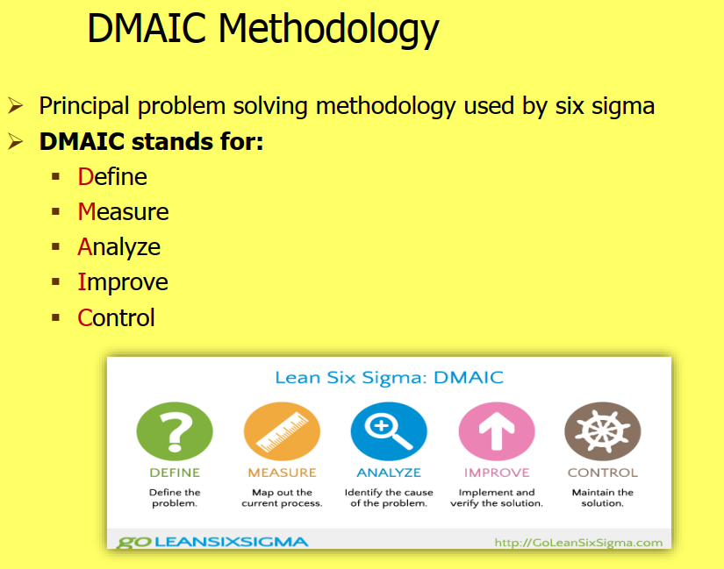
www.midocean.ae

Slide 14
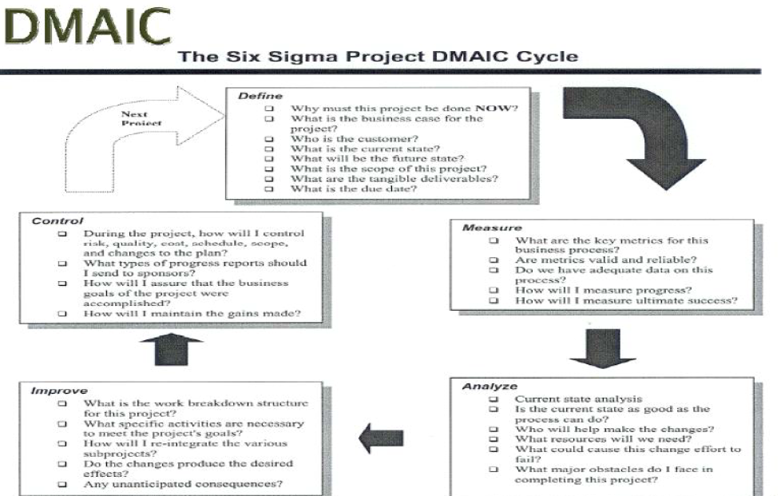
www.midocean.ae

Slide 15
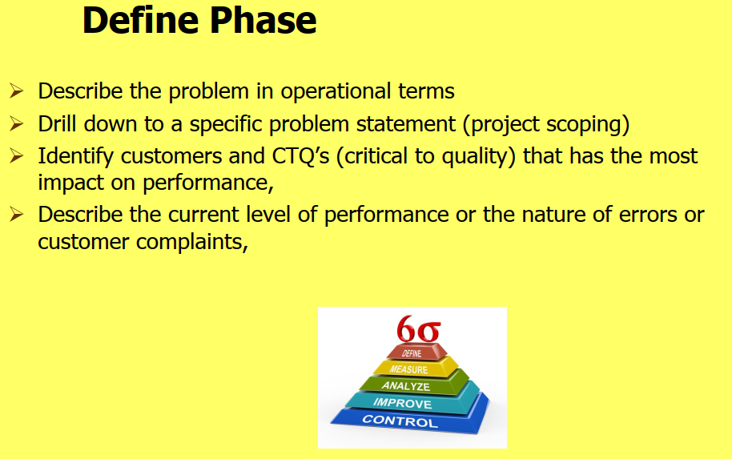
www.midocean.ae

Slide 16
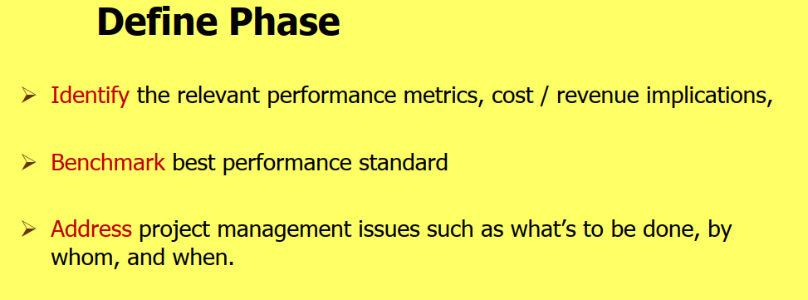
www.midocean.ae

Slide 17
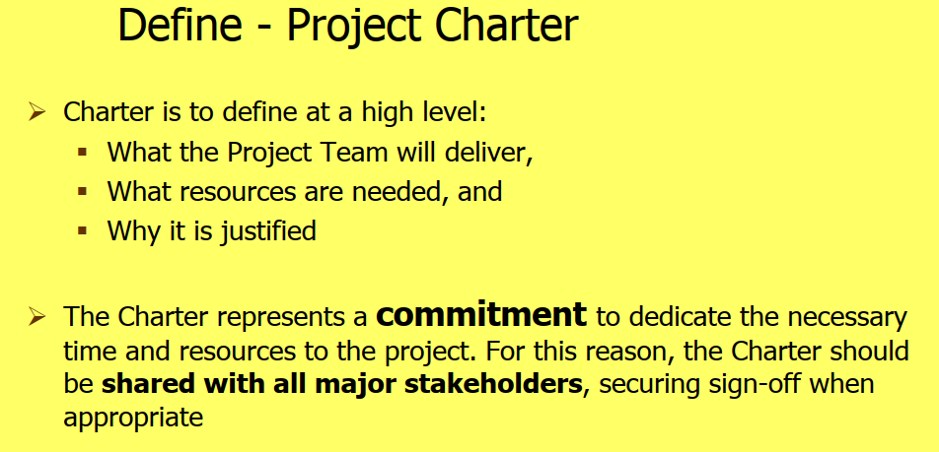
www.midocean.ae

Slide 18
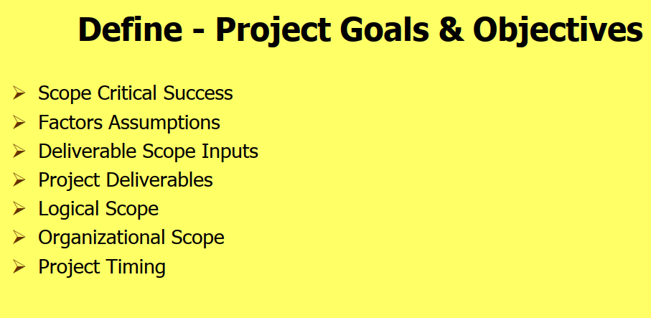
www.midocean.ae

Slide 19
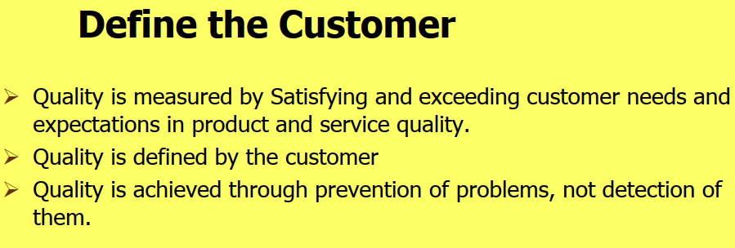
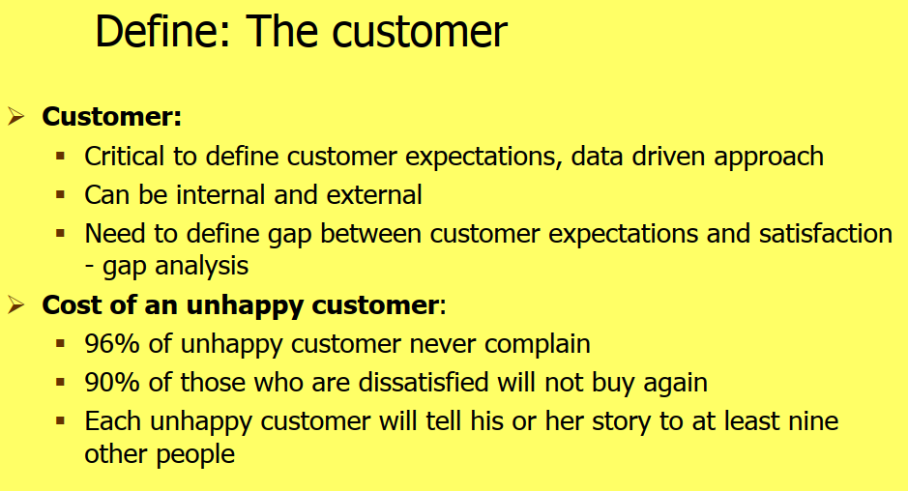
www.midocean.ae

Slide 20
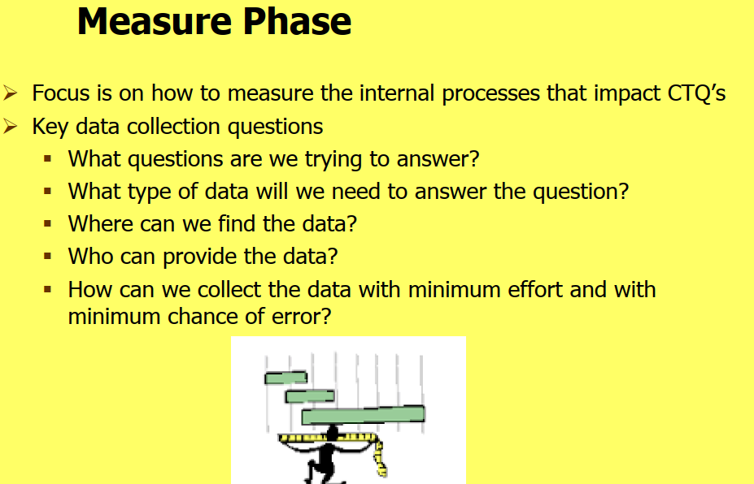
www.midocean.ae

Slide 21
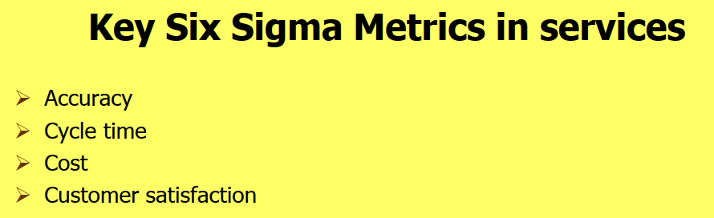
www.midocean.ae

Slide 22
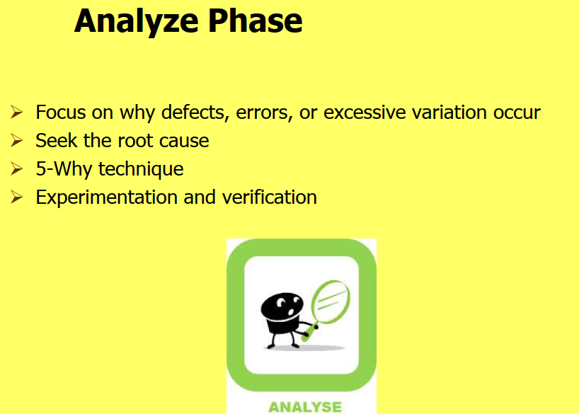
www.midocean.ae

Slide 23
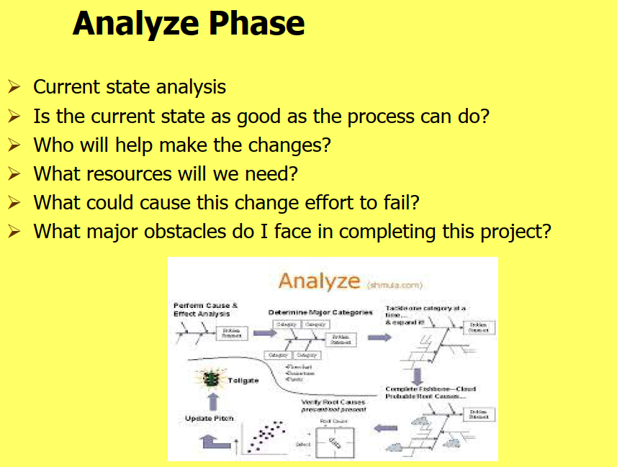
www.midocean.ae

Slide 24
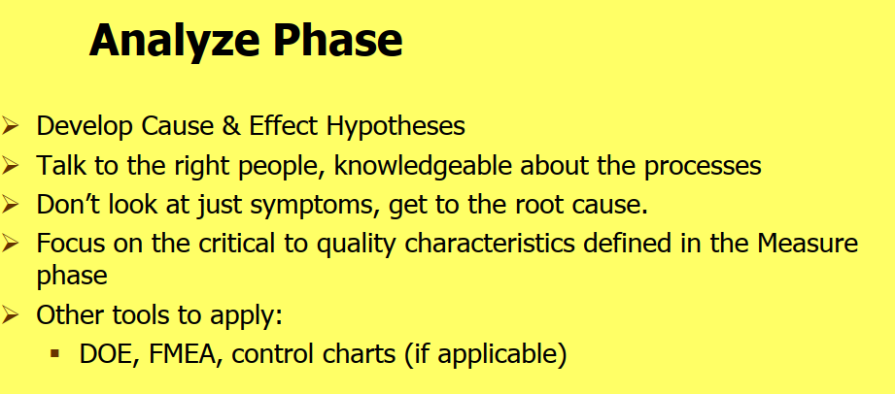
www.midocean.ae

Slide 25
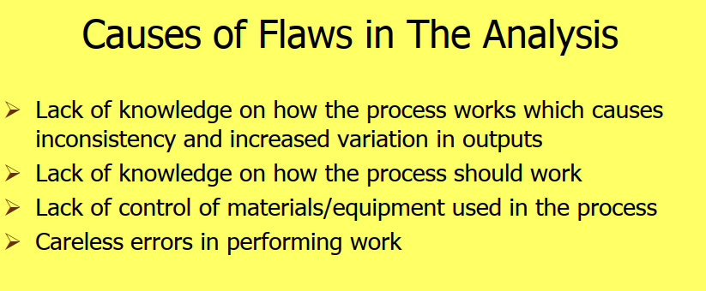
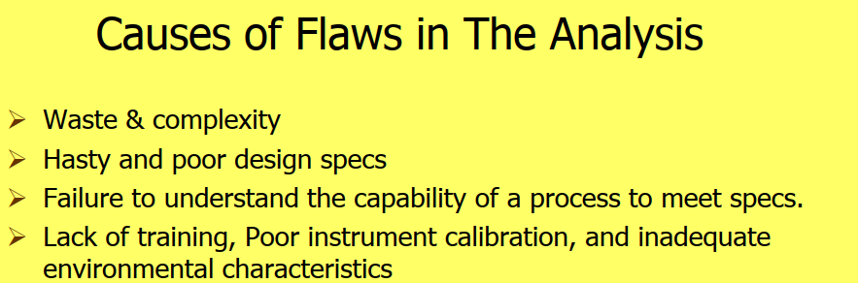
www.midocean.ae

Slide 26
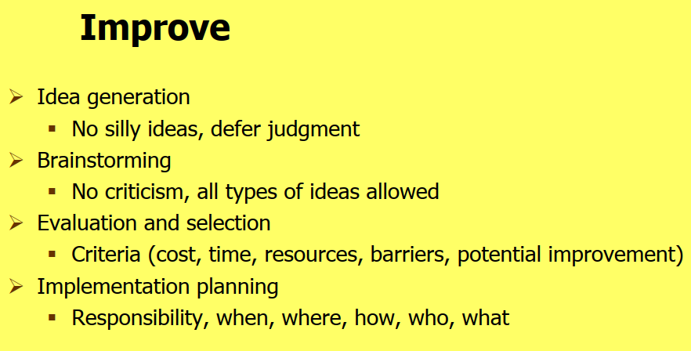
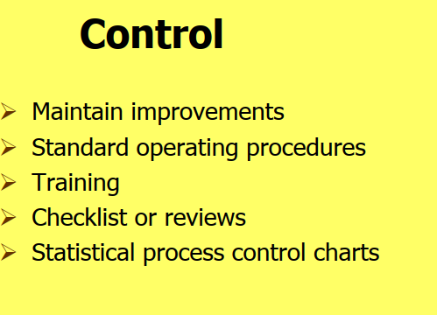
www.midocean.ae

Slide 27
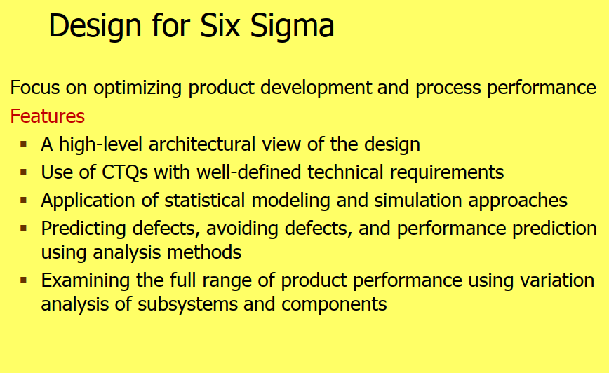
www.midocean.ae

Slide 28
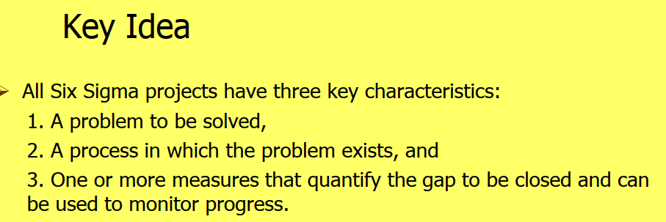
www.midocean.ae

Slide 29
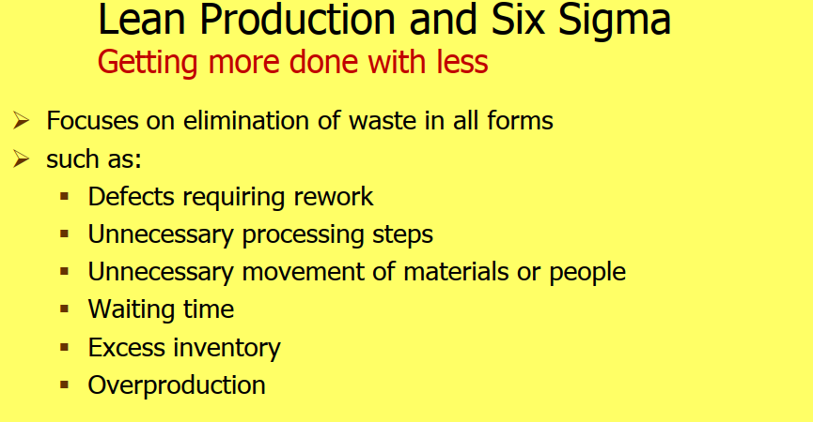
www.midocean.ae

Slide 30
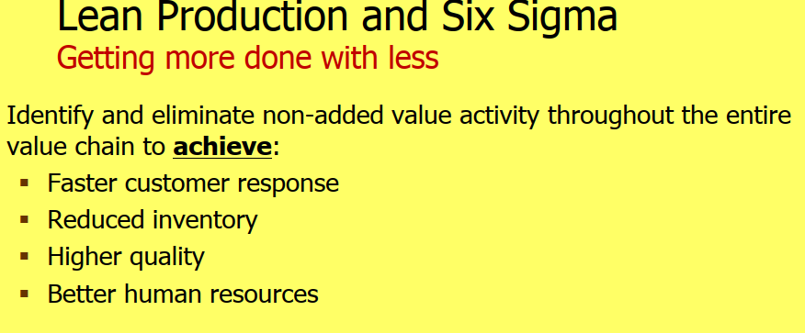
www.midocean.ae

Slide 31
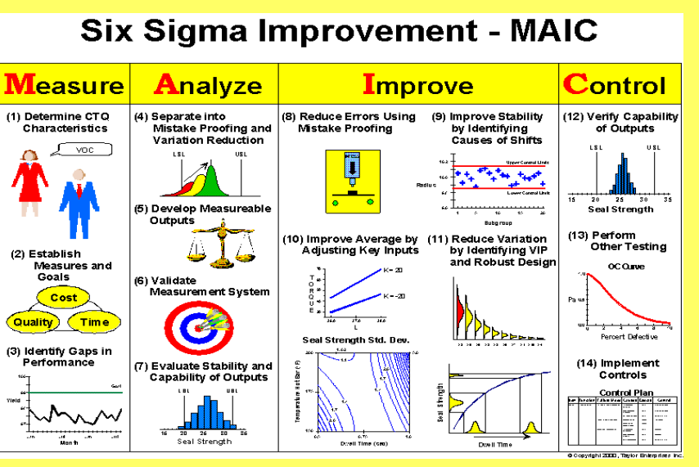
www.midocean.ae

Slide 32
Summary:
Six sigma is deﬁned as a business process that allows companies to improve their bottom line by designing and monitoring everyday business activities in ways that minimize waste and resources while increasing customer satisfaction .
Six sigma could also be described as an improvement program for reducing variation, which focuses on continuous improvements.
Improvement projects are driven in a wide range of areas and at different levels of
complexity, in order to reduce variation. The main purpose of reducing variation on a
product or a service is to satisfy customers. The goal of six sigma is that only 3.4 of
a million customers should be unsatisﬁed. The major components for a successful six sigma implementation are management involvement , organization, infrastructure, training and statistical tools. There are improvement methodologies in six sigma for already existing processes and for new processes.
www.midocean.ae

Slide 33
The methodology used to improve an existing process can be divided into ﬁve phases
Deﬁne:
Deﬁne which process or product that needs improvement. Deﬁne the most suitable team members to work with the improvement. Deﬁne the customers of the process, their needs and requirements, and create a map of the process that should be improved.
(2) Measure:
Identify the key factors that have the most inﬂuence on the process, and decide upon how to measure them.
www.midocean.ae

Slide 34
(3) Analyze:
Analyze the factors that need improvements.
(4) Improve:
Design and implement the most effective solution. Cost-beneﬁt analyses should be used to identify the best solution.
(5) Control:
Verify if the implementation was successful and ensure that the improvement sustains over time.
www.midocean.ae

Slide 35
Some similarities and differences between TQM, six sigma and lean
www.midocean.ae

Slide 36
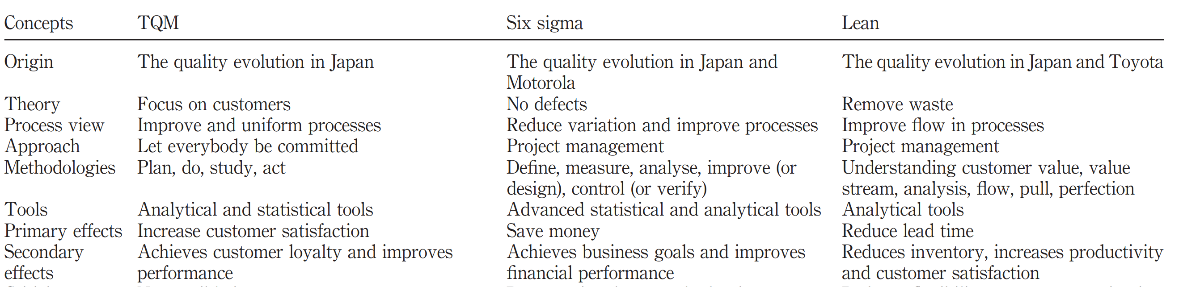
Some similarities and differences between TQM, six sigma and lean
www.midocean.ae

Slide 37
Lean Six Sigma Integration
Now we will show each applicable lean tool in six sigma project phase:
Define phase:
-Introduce lean, Value Stream Map, Financial analysis : identify waste & quantify it financially. Understand the Voice Of Customer & prepare for the Value Stream Map.
-Introduce process baseline performance including VSM metrics, inventory :lead times, cycle time.
-Value added & non value added activities & downtime.
-Identify the LSS suitable tools approach to the selected project; determine if the focus is on the product flow or variability.
www.midocean.ae

Slide 38
2-Measure:
-Measure the baseline performance of the current process using the lean metrics
-Present the data graphically.
-Map the current state value stream,
-Measure process capability (defects per million opportunities -& process sigma level )
-Identify waste & quantify it financially.(identify & quantify cost of variation & defects)
-Use value stream metrics which include inventory , lead times, cycle time value added & non value added activities & downtime.
-Use a cause & effect diagram to brainstorm potential variables or inputs that affect process output.
-Use a Kaizen event approach & identify any quick improvement actions that don't need further analysis (just do it items)
www.midocean.ae

Slide 39
3-Analyze:
-Implement the quick hits that don't require further analysis.
-Use graphical tools to investigate the reasons for variation
-Analyze current state VSM :
.Ex: Analyze unnecessary steps & ways to minimize waste within & between steps
analyze flow of products & information , lead times, cycle time, rework & downtime .
- Create a lean future VSM to implement the next phase.
4-Improve
- Optimize & standardize the process , eliminate unnecessary steps or at least minimize waste within it, develop standard operating procedures & best practices
-Build an improvement implementation action plan
www.midocean.ae

Slide 40
-Use a Kaizen event to implement improvements:
Ex: improve time & use 5s approach, use mistake-proofing techniques and use visual workplace approach.
5-Control
-Update sigma level.
-Design a control plan using the mistake –proofing approach; design and implement corrective actions , design an audit plan.
-Reconfirm the financial analysis by conducting cost benefit analysis
-Hand over responsibilities , train process owner on using the control plan and monitor continuously .
www.midocean.ae

Slide 41
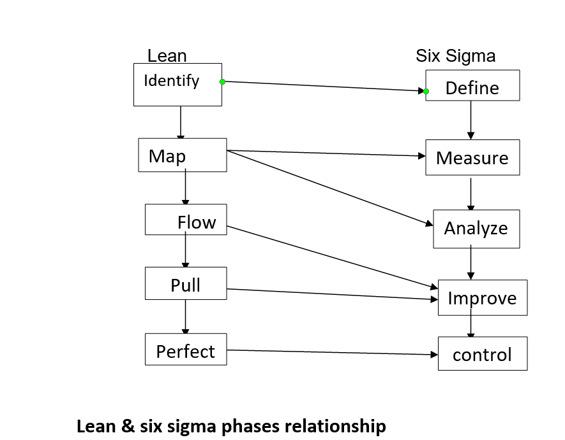
www.midocean.ae

Slide 42
Critical Success factors of LSS:
1-Management support & commitment .
2- Company Financial Capability.
3- Culture change by using facts to show need for using LSS.
4-Clear definition of strategy & goal of the project
5- Frequent information sharing, communication & assessment on Lean & Six Sigma results.
6-Using six sigma as the infrastructure for applying lean tools.
7- Staff involvement , rewards & recognition.
8- Effective training & program improvement efforts.
www.midocean.ae

Slide 43



Thank You

