Slide 1

Internet and Information Technology
ITC202
Lecture 0 - Overview.
Dr. Eng. Youssef Ntefeh

Slide 2
Course Overview
This course contains an introduction to information technology and computing systems.
The history and theory of information systems.
Practical application of technologies.
The student will be introduced to computer software, hardware, and networking technologies.
An introduction to the latest version of Microsoft Office.

Slide 3
Learning Outcomes
Using Technology Effectively.
Understanding the Computers Parts.
Application Software: Programs That Let You Work.
Introduction to Word, Excel, and PowerPoint.
Using the Internet and Web’s Resources.
Protecting Your Digital Data and Devices.

Slide 4
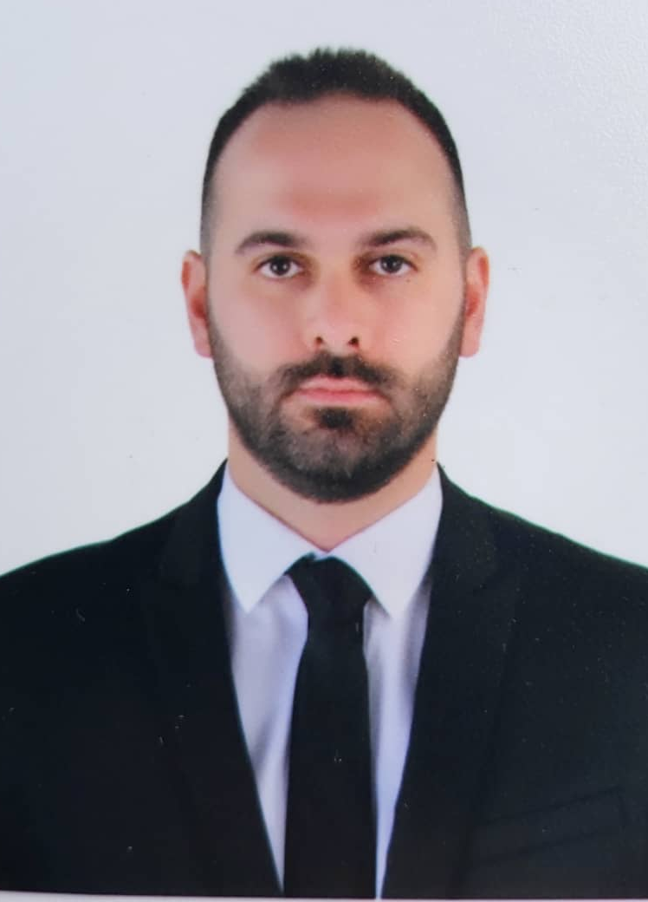
Course Staff
Dr. Eng. Youssef Ntefeh
E-mail: Youssef@esc.ac.ae

Slide 5


Slide 6
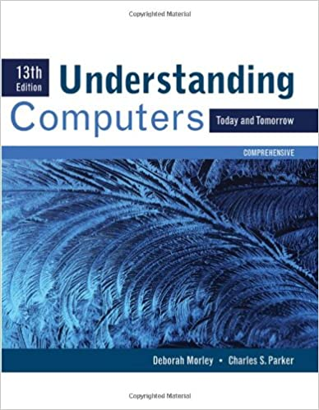
Reference

